Slide 1
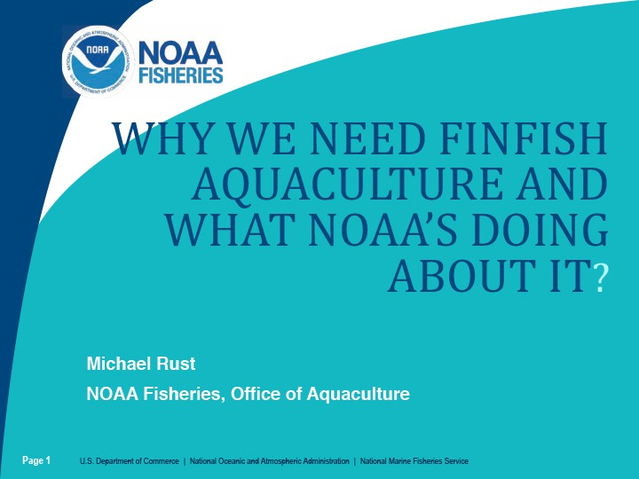
Why We Need Finfish Aquaculture and What NOAA’s Doing About it

Slide 2
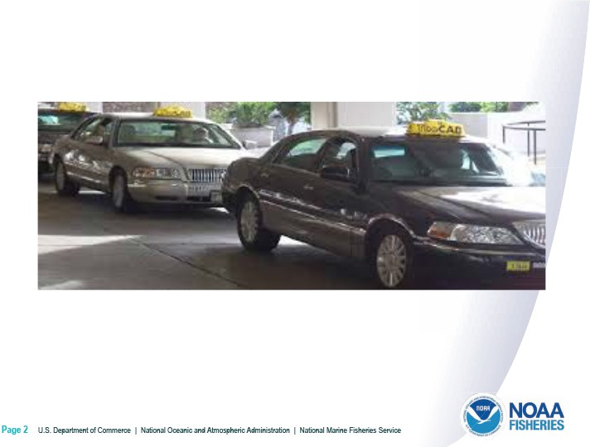
Taxis

Slide 3
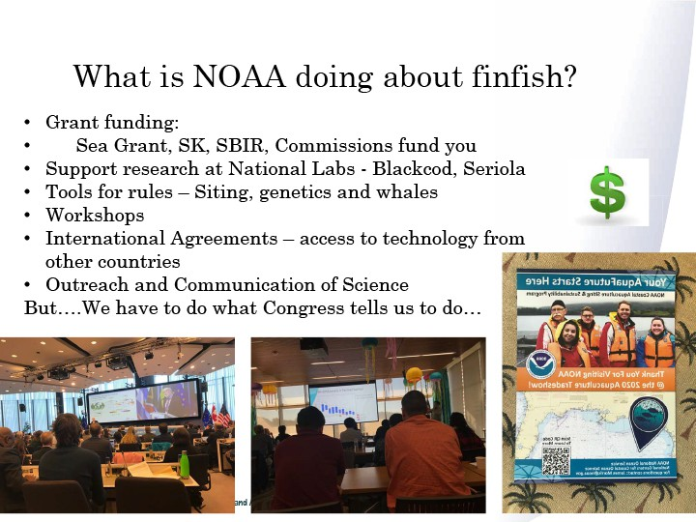
What is noaa doing about finfish?

Slide 4
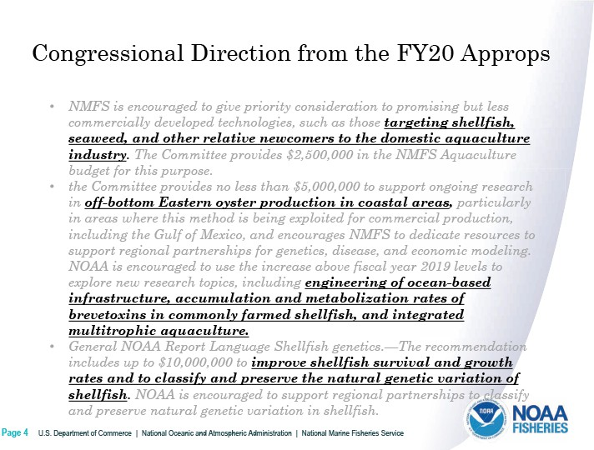
Congressional direction fro fy20 approps

Slide 5
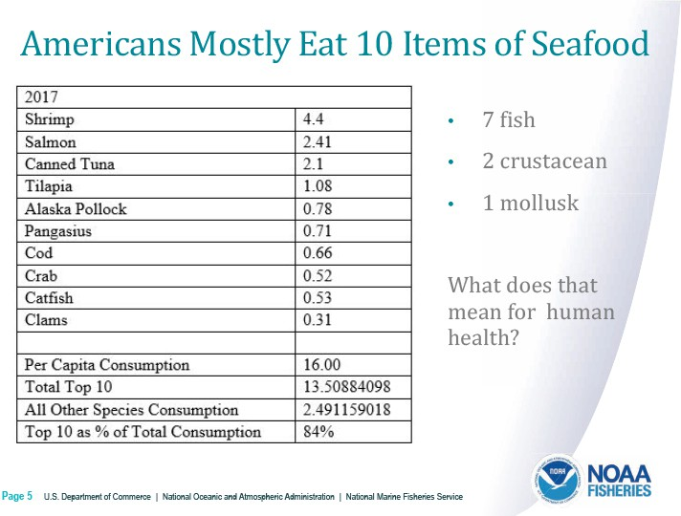
Americans mostly eat 10 items

Slide 6
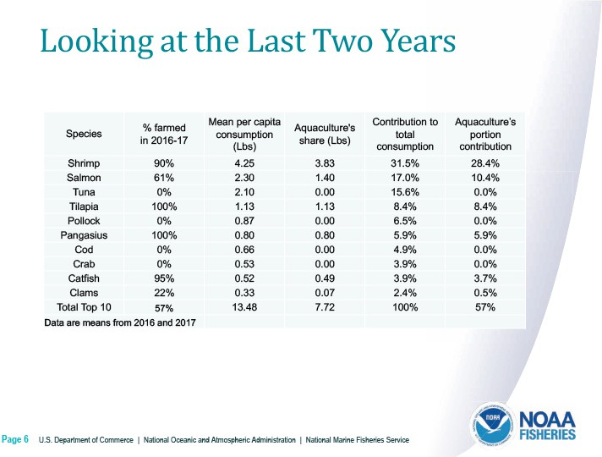
Looking last two years

Slide 7
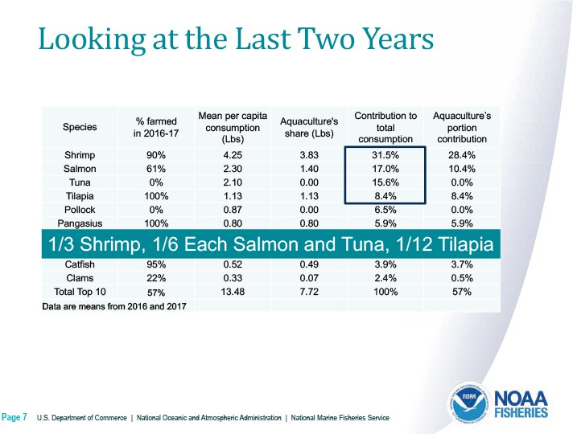
Looking last two years 2

Slide 8
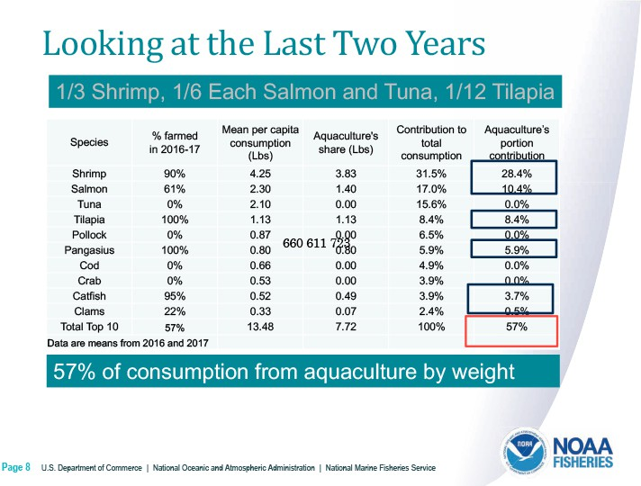
Looking 3

Slide 9
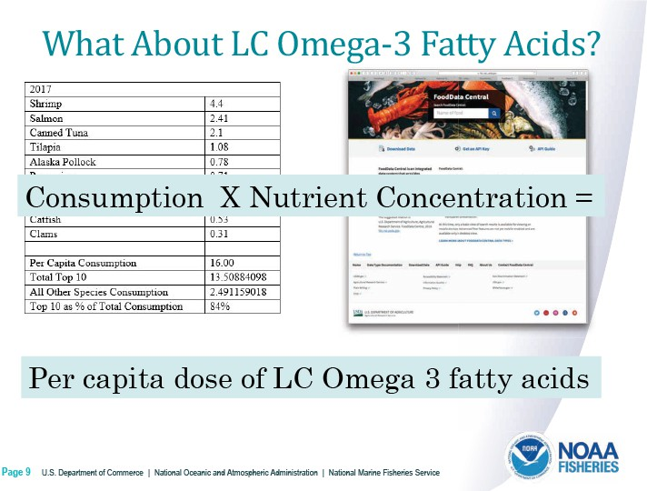
What about LC Omega 3

Slide 10
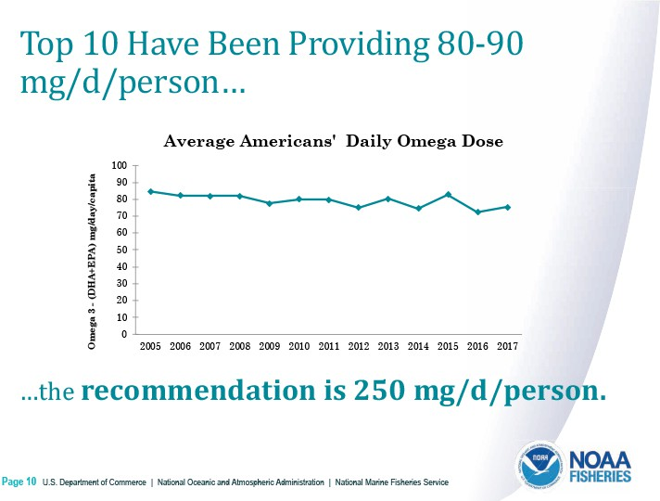
Top 10

Slide 11
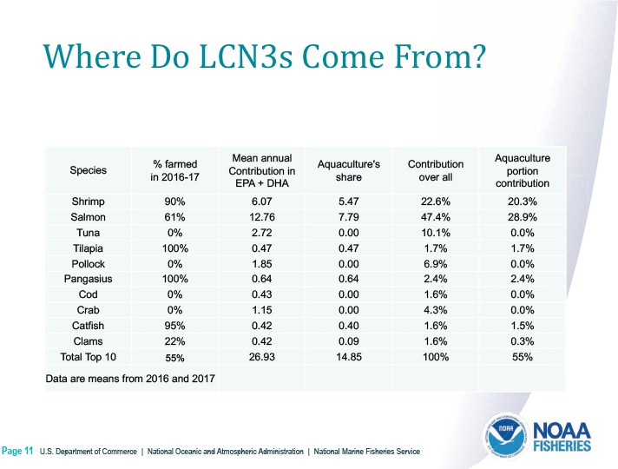
Where do LCN3s

Slide 12
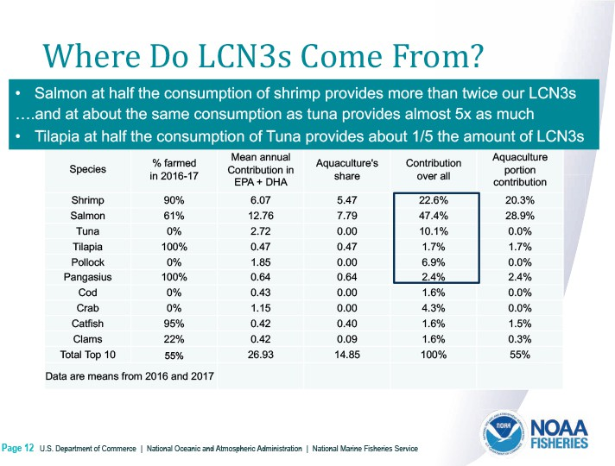
Where do LCN3s - 2

Slide 13
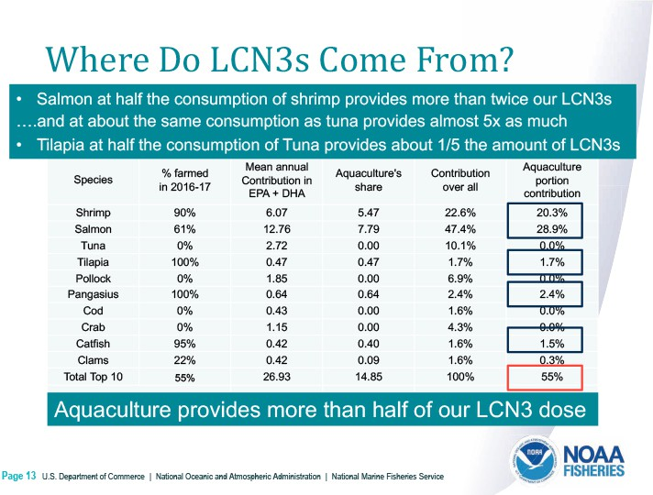
Where do LCN3s - 3

Slide 14
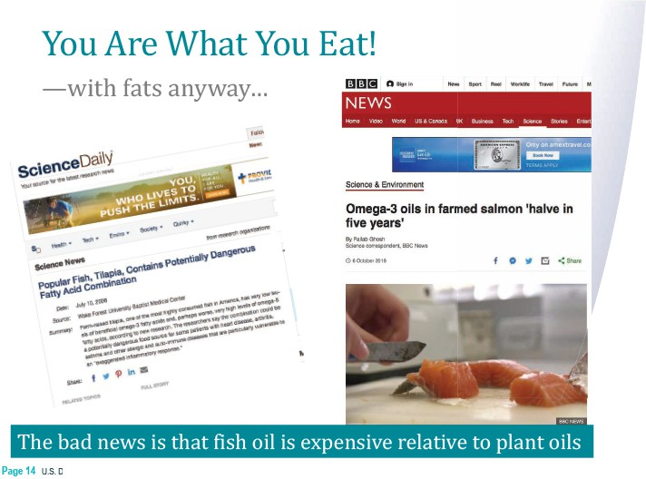
You are what you eat

Slide 15
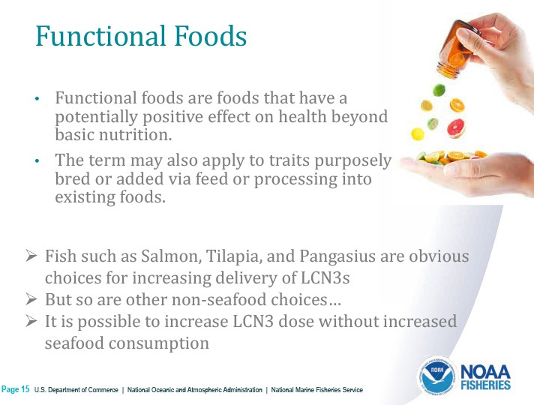
Functional foods

Slide 16
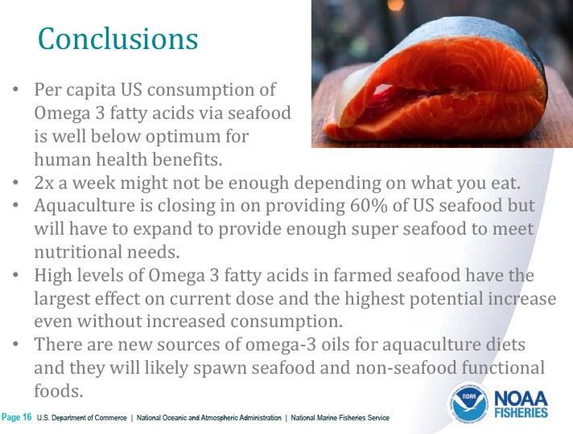
conclusions

Slide 17
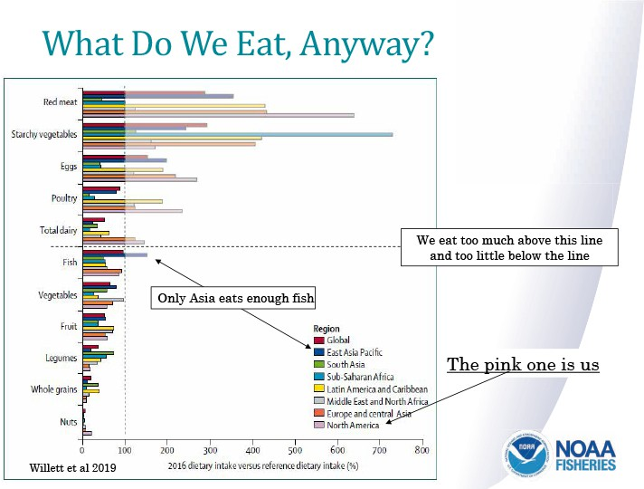
What do we eat

Slide 18
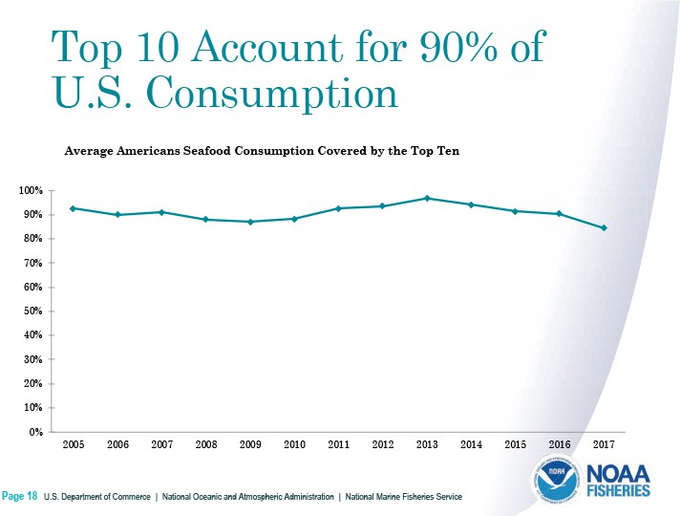
Top 10 account for 90%

Slide 19
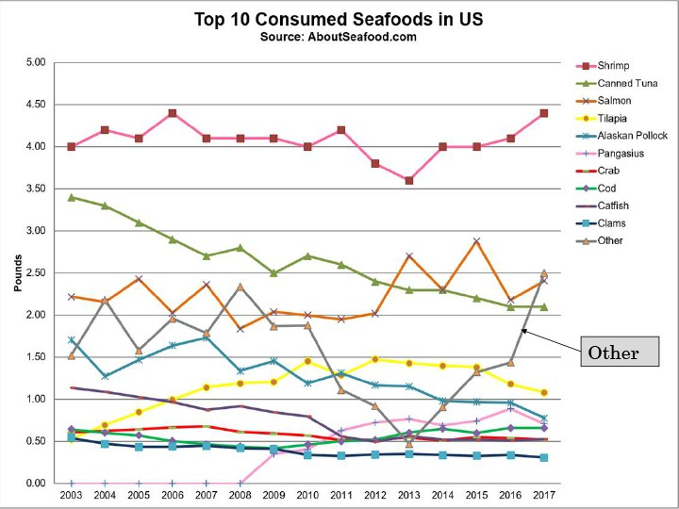
Top 10 consumed seafoods

Slide 20

You are what you eat – with fats anyway

