Slide 1
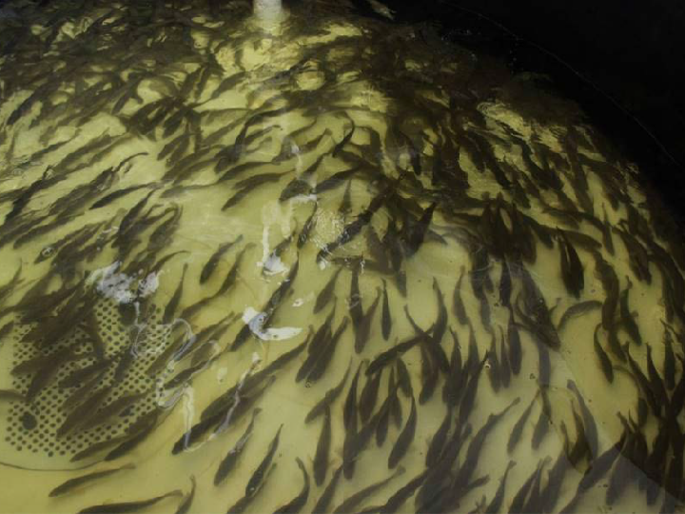
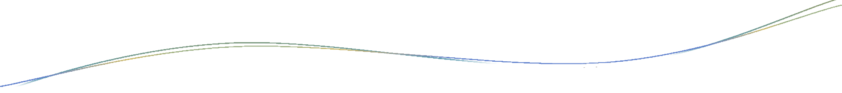


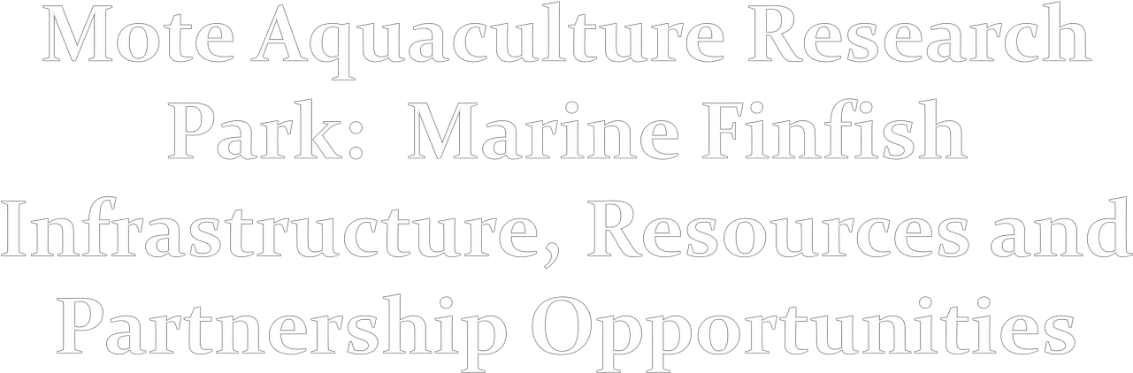
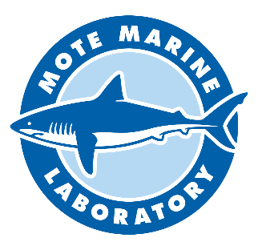
Mote Aquaculture Research
Kevan L. Main, Nicole R. Rhody, Matthew Resley, Michael J. Nystrom, Ron Hans & Ryan Schloesser
Mote Aquaculture Research Park Mote Marine Laboratory Sarasota, Florida, USA kmain@mote.org
,

Slide 2

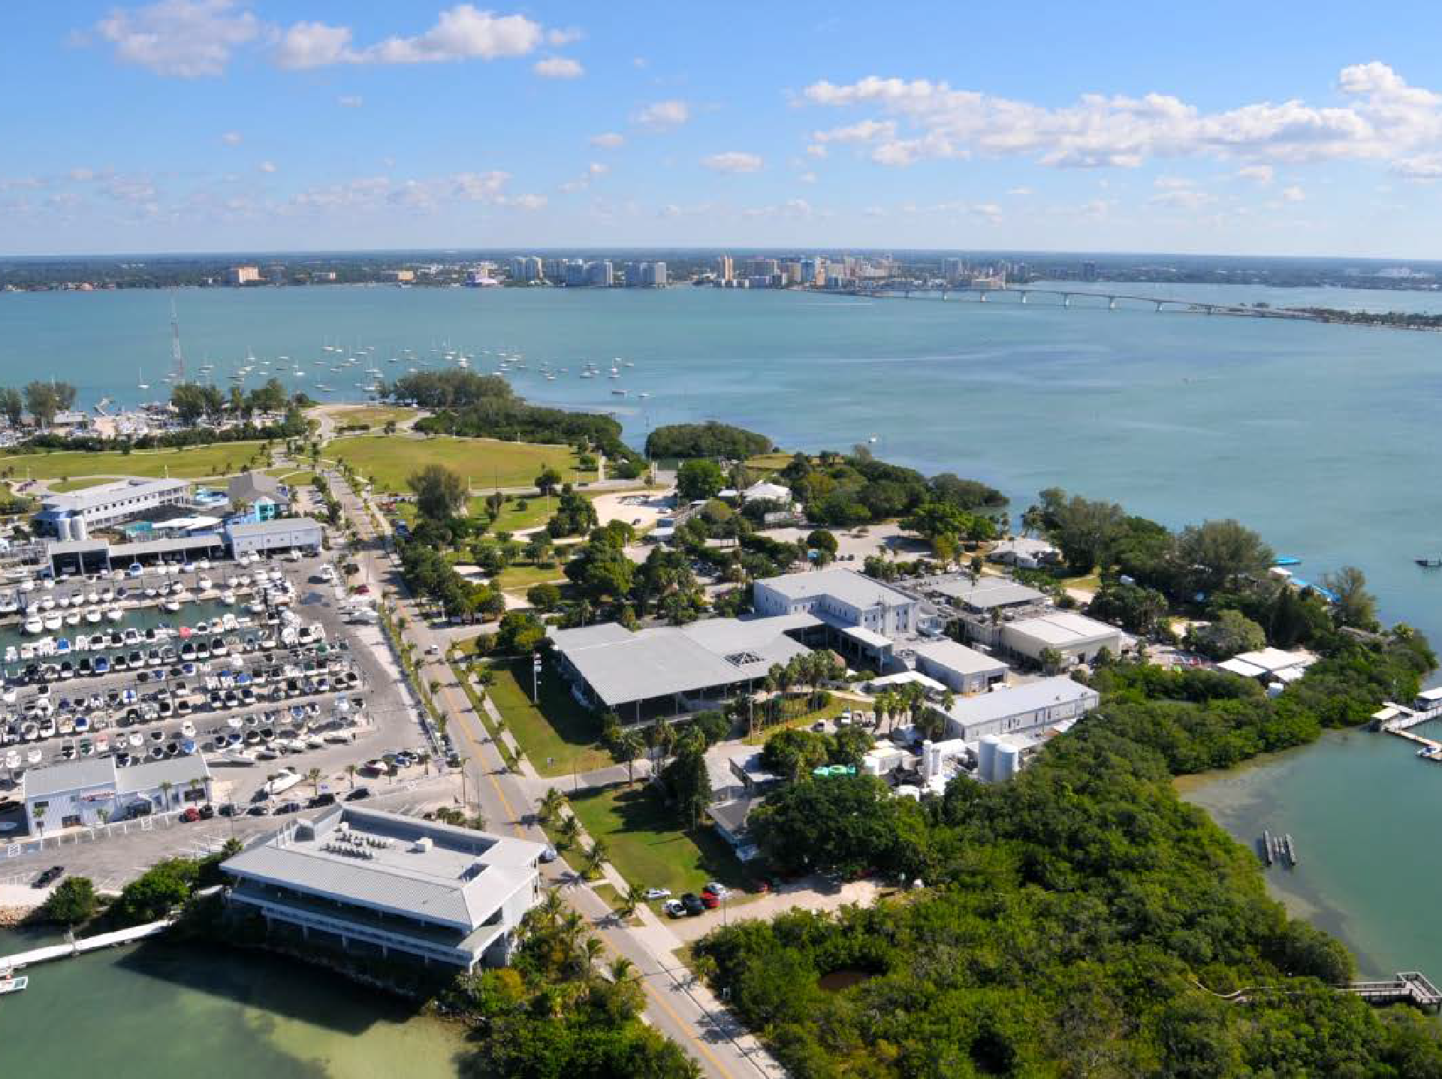
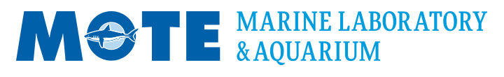
MOTE Marine Laboratory & Aquarium
Leading the Way in Global Marine Science and Education

Slide 3
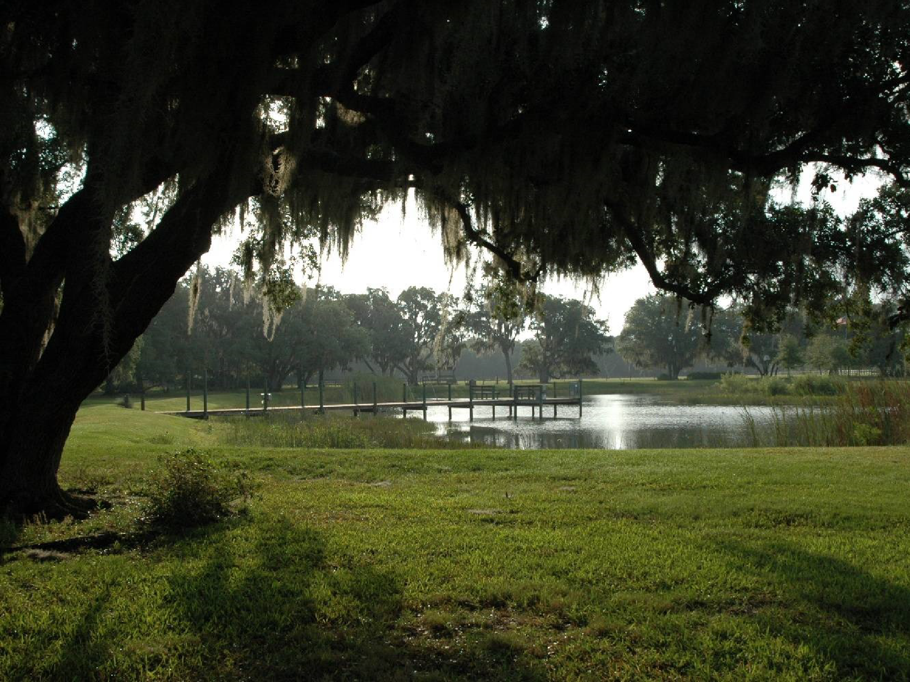
Mote Aquaculture Research Park Sustainable Land-based Fish Farming
Fish reproduction, larval rearing & on-growing technologies for stock enhancement and food production
Development of land-based recirculating aquaculture systems (RAS) & integrated aquaculture systems (IAS)

Slide 4
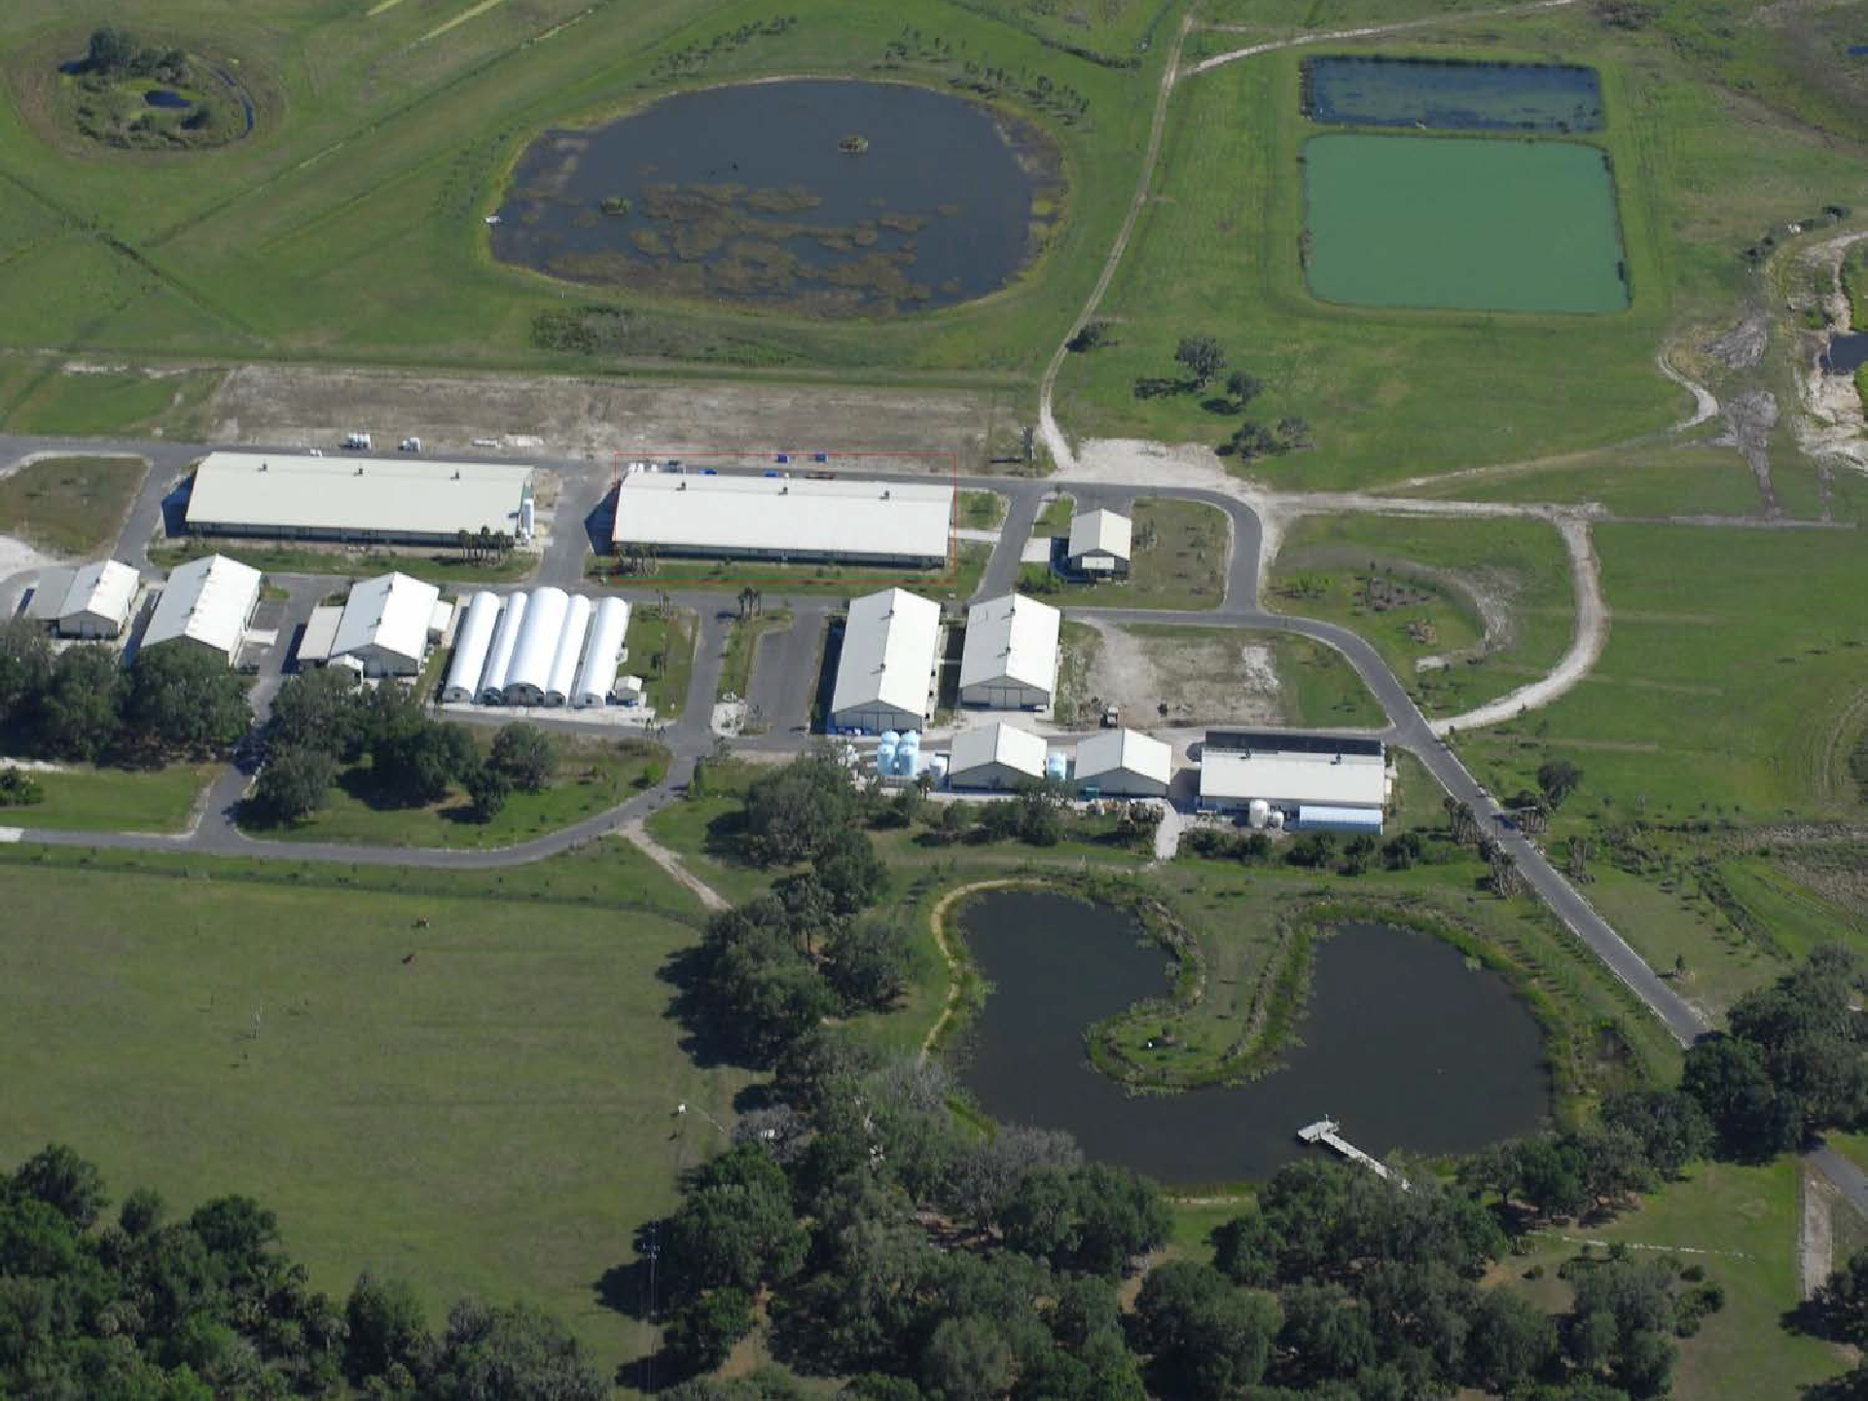
INFRASTRUCTURE:
Mote Aquaculture Research Park
Property: 100 hectares Covered Infrastructure: >125K sq ft
Zero-discharge Marine RAS
Fresh Wastewater Filtration
Red Tide Mesocosm Lab
Freshwater Fish Production
Coral Gene Bank
Maintenance & Shop
Larval Rearing & Live Feeds
Storage
Freshwater Fish
Marine Broodstock
Wetland Plants
Microbiome Lab
& Fingerling Hatchery
Marine Aquaponics
Marine Growout
Marine Wastewater Filtration
Stock Enhancement Research
Brackish Wastewater Filtration
Snook Pond

Slide 5

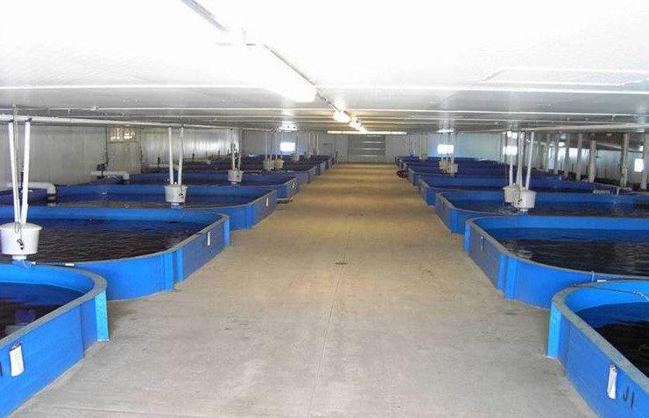
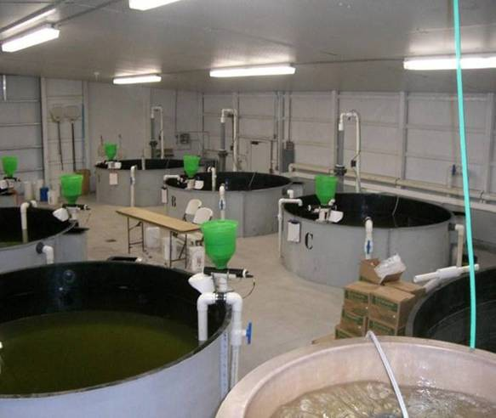
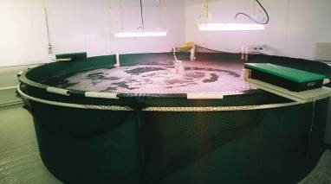
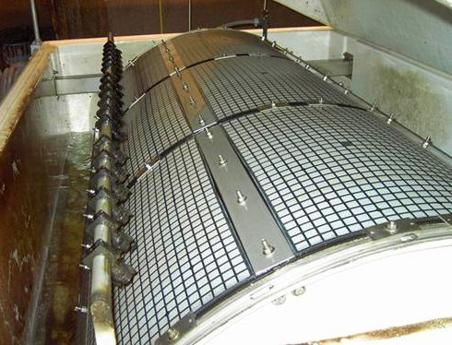
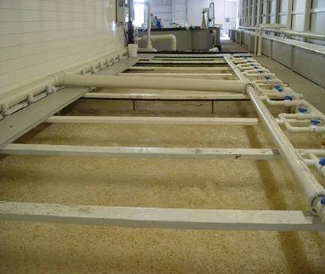
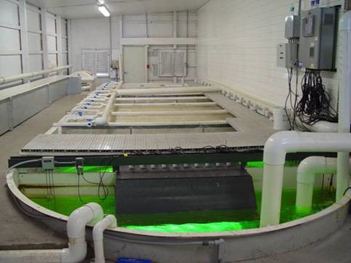
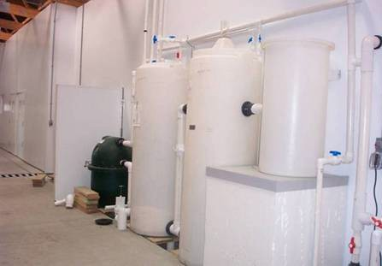
Commercial-Scale Indoor RAS for all production stages
Large-scale Freshwater Fish Growout
Marine Growout
Marine Broodstock

Slide 6
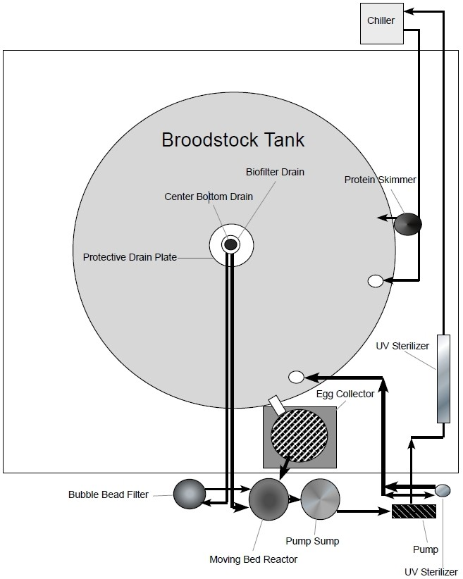
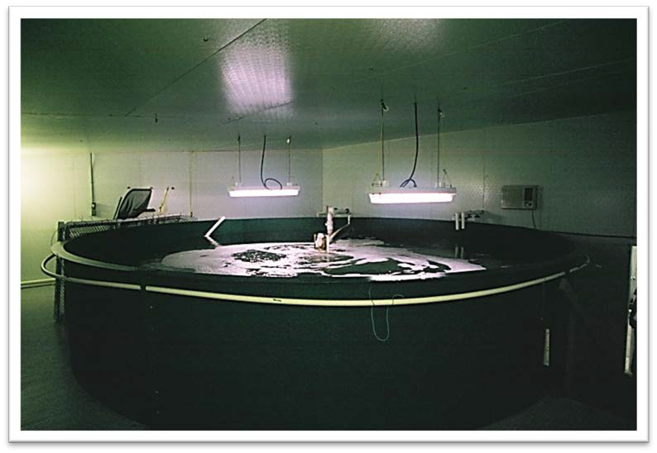
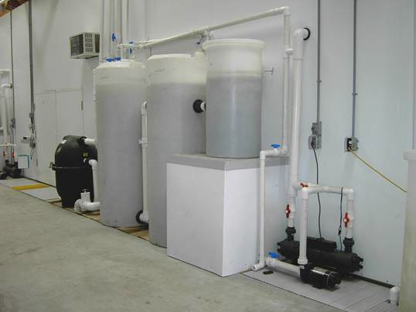
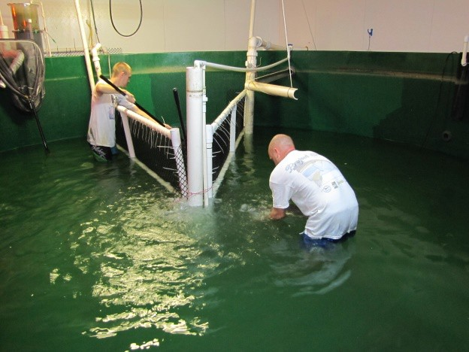
Broodstock (Group) Maturation & Spawning Tanks
7 independent systems: three 44.5 m³ tanks four 25-m³ tanks

Slide 7
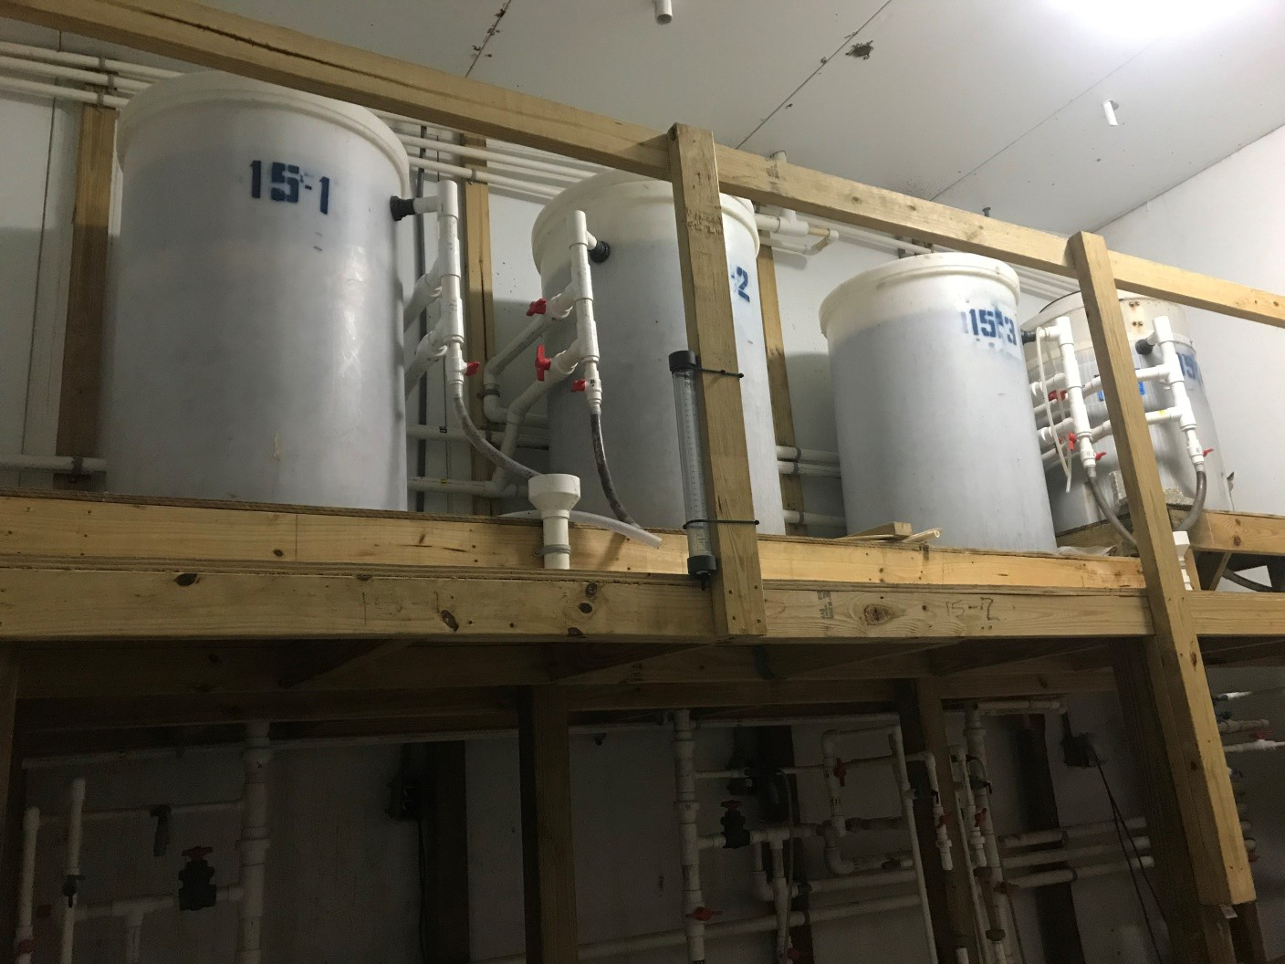
Denitrification

Slide 8
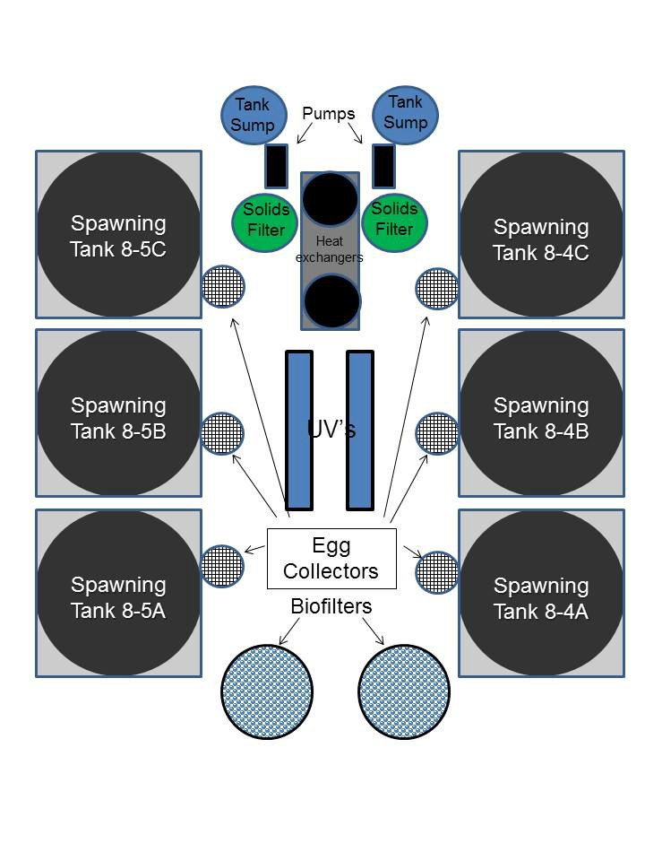
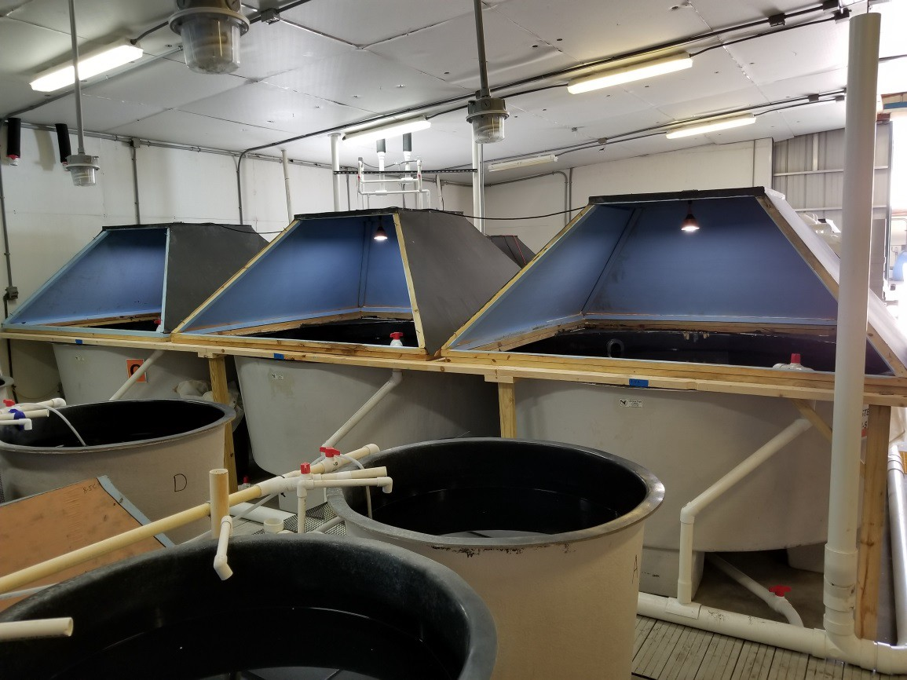
Individual Broodstock Spawning Tanks
2 independent systems: three 3.3 m³ tanks

Slide 9
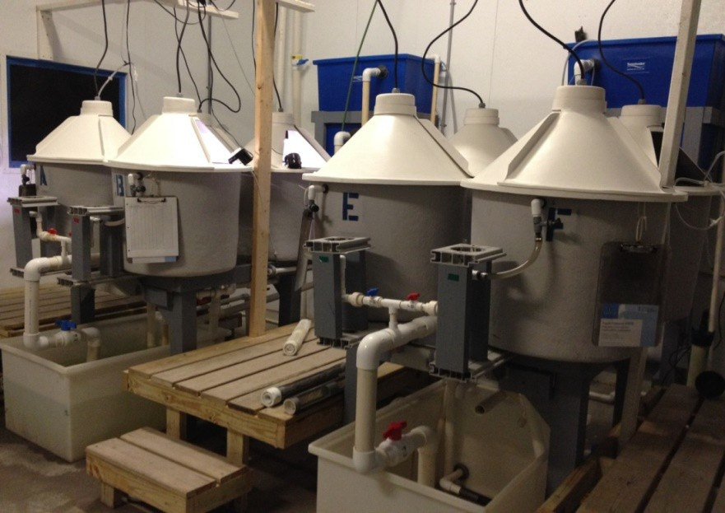
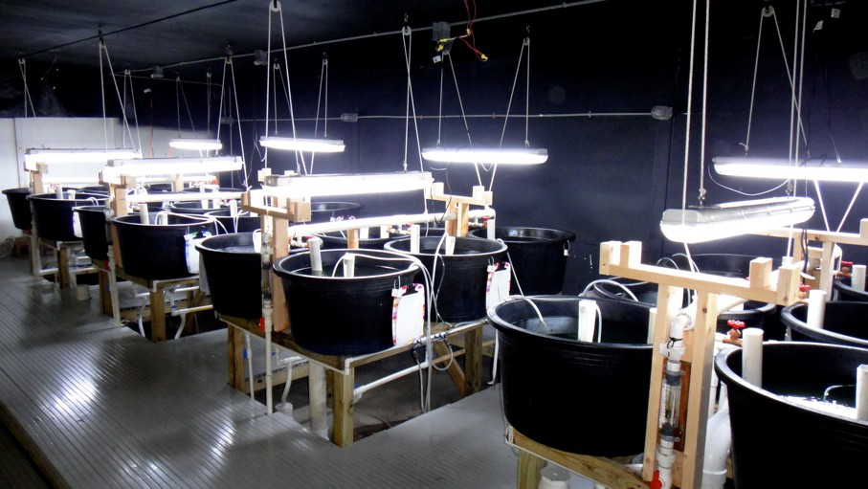
Larval experimental tanks
Three 4-tank (100 L) RAS systems
Four 6-tank (130 L) RAS systems

Slide 10
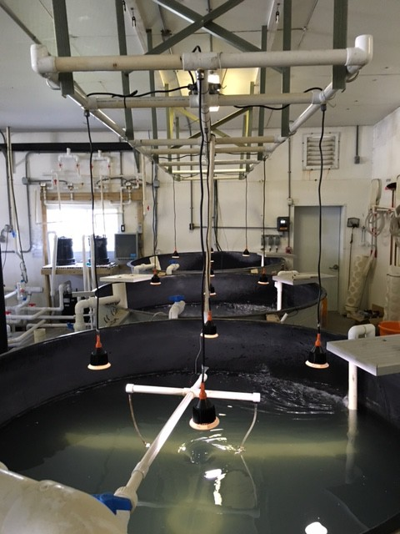
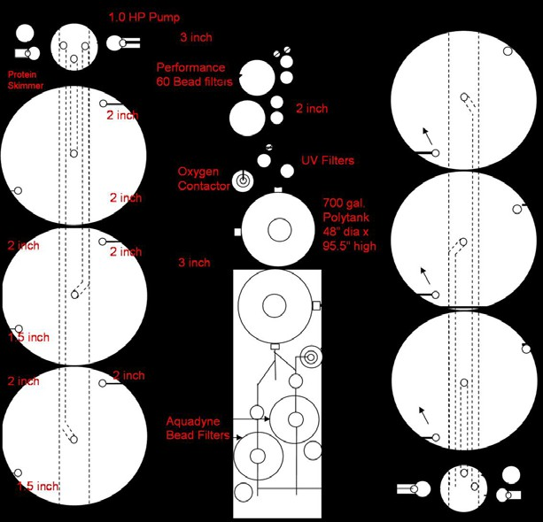
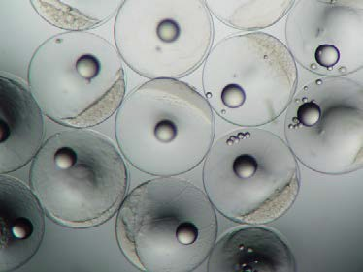
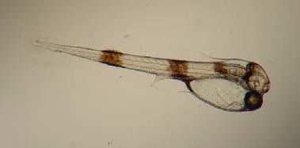
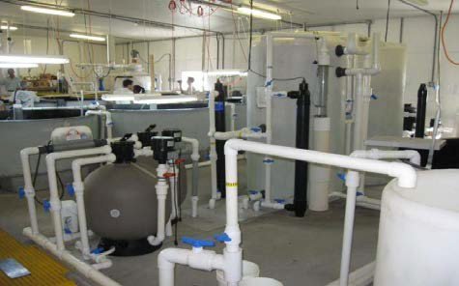
Larval Production Tanks
Two 3-tank (3.3 m³) tank systems

Slide 11
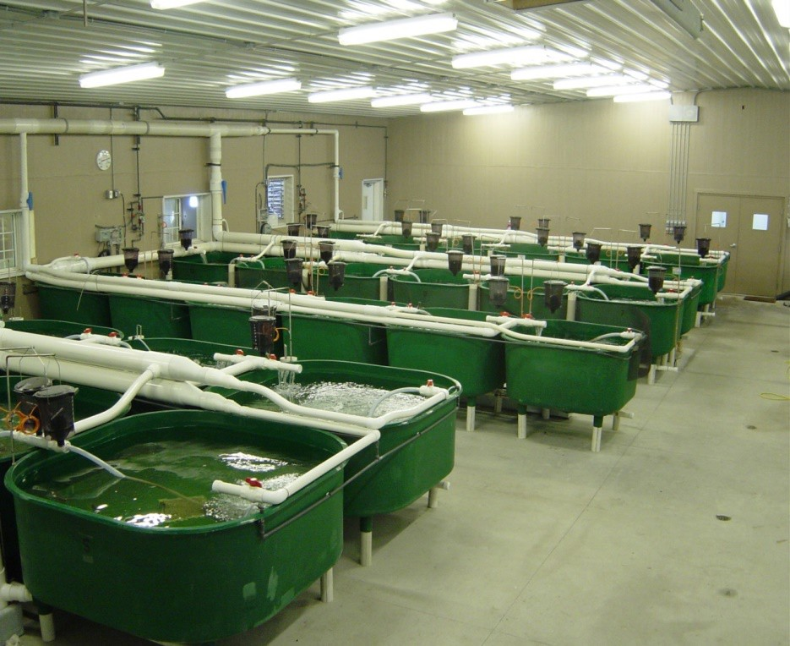
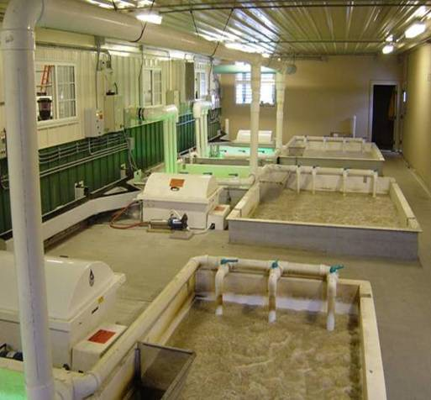
Fingerling Production/Experimental Tanks
3 Systems: 18 1-m³ tanks, 12 1-m³ tanks + 12 2-m³ tanks

Slide 12
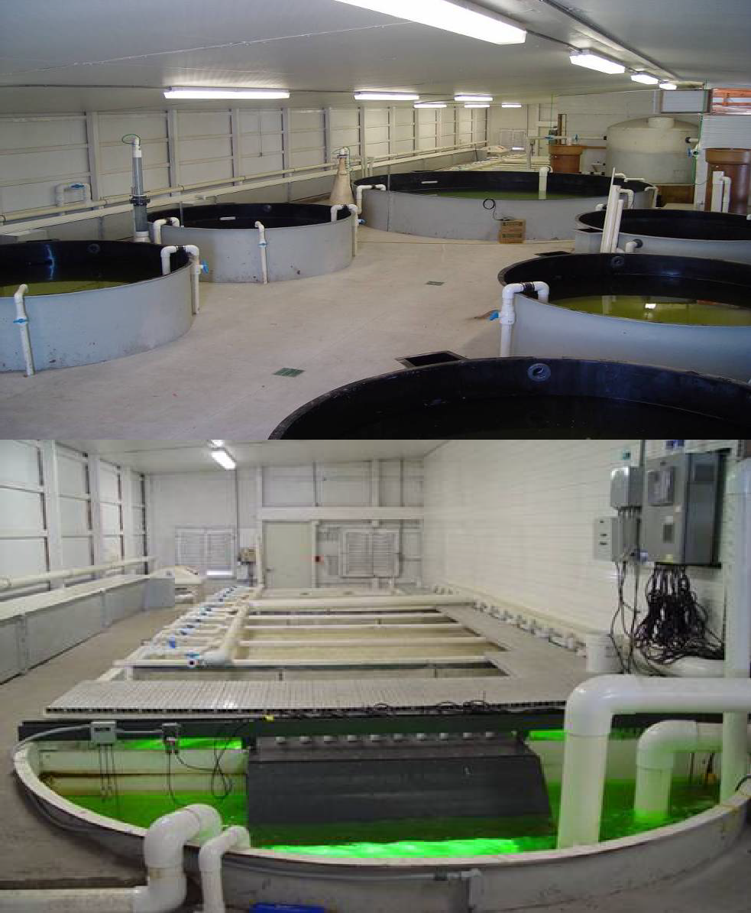
Growout Production/ Experimental Systems
Six 8.9 m³ tanks + One 35.7 m³ tank
Linked to a large-scale RAS Filtration System
-Solids - drum filter & foam fractionator
-Biofiltration - moving bed bioreactor
-CO₂ degassing
-Disinfection -UV
-Oxygen injection

Slide 13
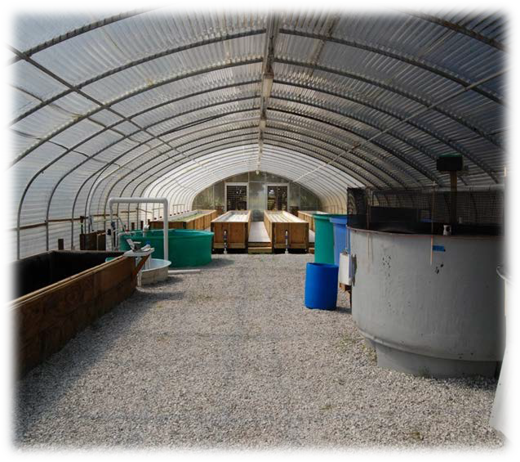
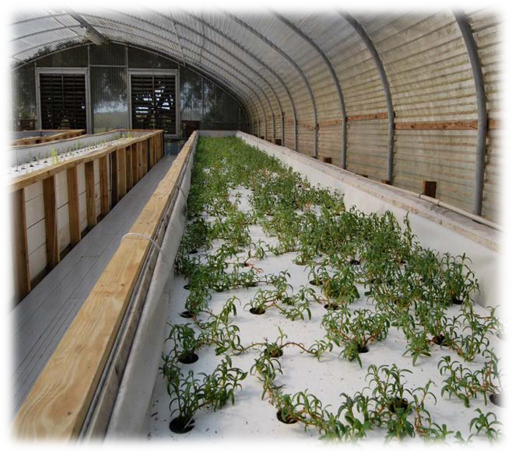
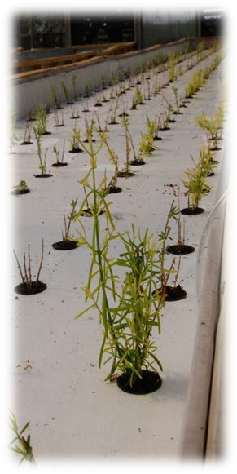
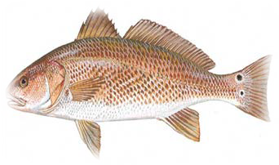
Integrated Aquaculture/Aquaponic RAS System
Sea purslane
Redfish
Saltwort

Slide 14
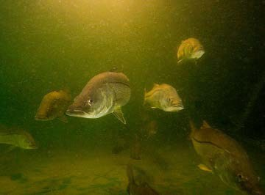
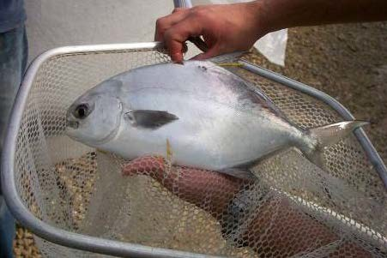
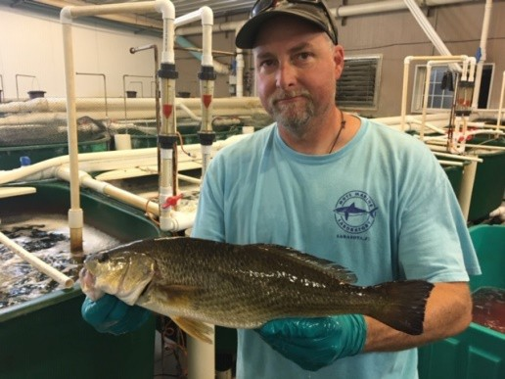
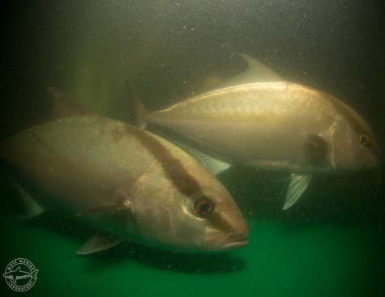
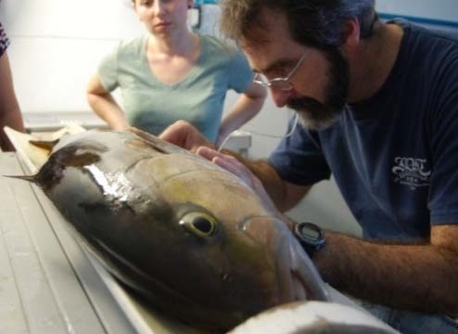
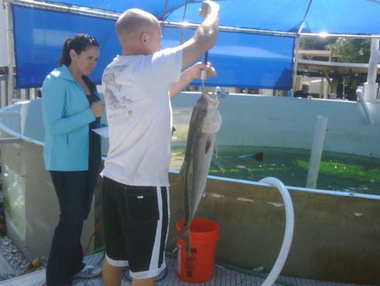
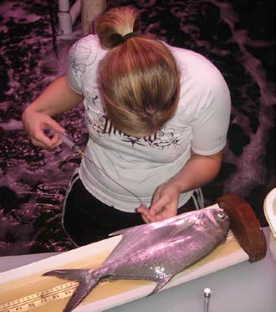
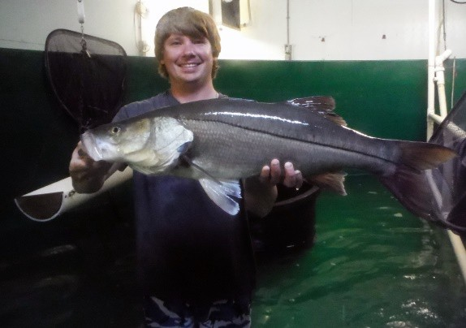
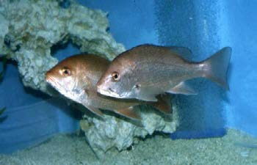
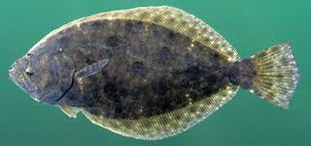
MARINE FINFISH RESOURCES

Slide 15
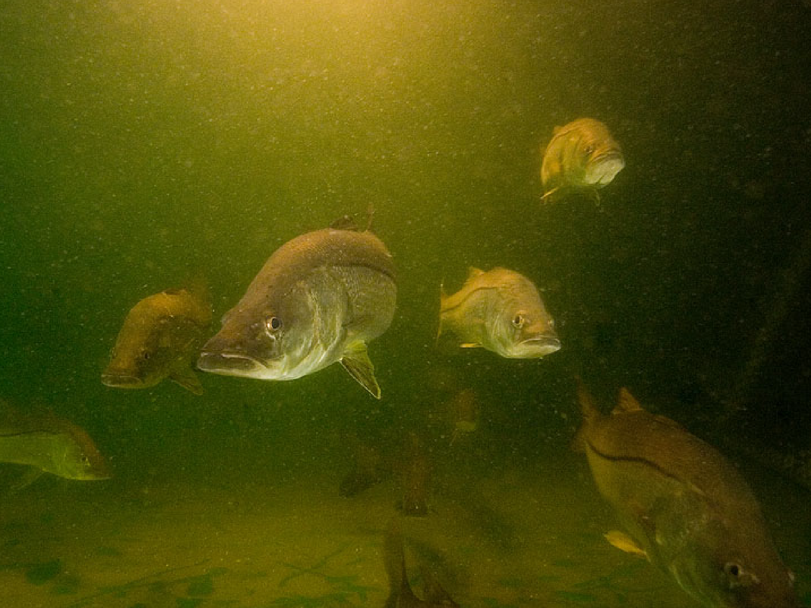
Maturation & Spawning
Maturation & Spawning Technology with Common Snook
Large-scale production of snook for marine stock enhancement

Slide 16
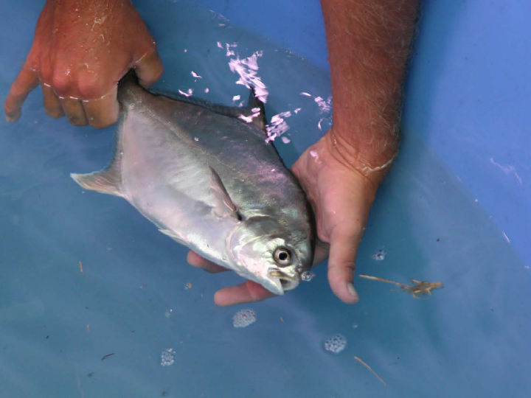

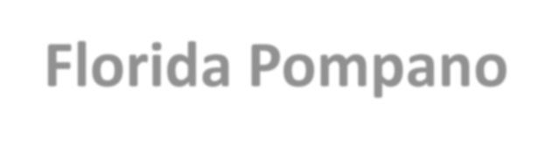

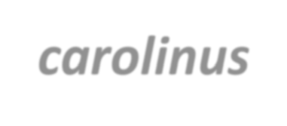
Maturation & Spawning Technology with Florida Pompano
Trachinotus carolinus
Expand Supply of Emerging Marine Finfish Fingerlings for Land-based Aquaculture

Slide 17


Red Drum (Redfish) Sciaenops ocellatus
Production of Marine Finfish Fingerlings for Land-based Aquaculture & Stock Enhancement

Slide 18


Maturation & Spawning Technology
Almaco Jack
Project Title: DEVELOPING TECHNOLOGIES TO EXPAND THE SUPPLY OF EMERGING MARINE FINFISH FINGERLINGS FOR OFFSHORE AQUACULTURE
Photo-thermal conditioning
➢ Initial and current conditions:13hr of light and 26-27ºC
➢ Little known about cycling them as they have been held in ambient systems before now
Nutrition
➢ Initial diet of shrimp, thread herring, and squid
➢ Feed changed to 70% thread herring and 30% squid to increase protein in diet based on other research
Hormone Therapies
➢ Not required as they are fully volitionally spawning
Maturation & Spawning Technology with Almaco Jack Seriola rivoliana
Expand Supply of Emerging Marine Finfish Fingerlings for Offshore Aquaculture

Slide 19
Industry, University, Government & Foundation Partnerships
Focus on addressing bottlenecks in aquaculture and system technologies/APPLIED RESEARCH & Supporting Industry Needs
Developing maturation & spawning technologies for new/emerging species
Improving larval rearing methods to increase production
Developing & Testing new diets for broodstock, larvae and growout applications
Developing commercial-scale growout technologies in zero- discharge RAS
Short-term production of live feeds, larvae & fingerlings to support industry & government needs

Slide 20
Industry, University, Government and Foundation Partnerships
Industry Partnerships:
Ocean ERA/Kampachi Farms; Aquaco Farms; Osprey Biotechnics; Aquatic Plants of Florida; Caribbean Sea Farms
Government Agency Partnerships:
Florida Fish & Wildlife Conservation Commission (>25 years); Gulf State Marine Fisheries Commission; Florida & National Sea Grant College Program; Florida Division of Agriculture & Consumer Services, Division of Aquaculture; NOAA Fisheries, Southwest Fisheries Science Center; USDA-AFRI
University Partnerships:
University of South Florida; University of Maryland Baltimore; University of Texas Marine Science Institute; Auburn University; University of Florida – IFAS; Florida Atlantic University, Harbor Branch Oceanographic Institution; University of South Mississippi, Gulf Coast Research Laboratory
Foundation Partnerships:
Good Food Institute; Mote Scientific Foundation

