Slide 1








Infrastructure, Research, Demonstration and Partnership Opportunities
Thad Cochran Marine Aquaculture Center
Infrastructure, Research, Demonstration and Partnership Opportunities
Kelly Lucas, Reg Blaylock, Angelos Apeitos and Brian Cuevas

Slide 2
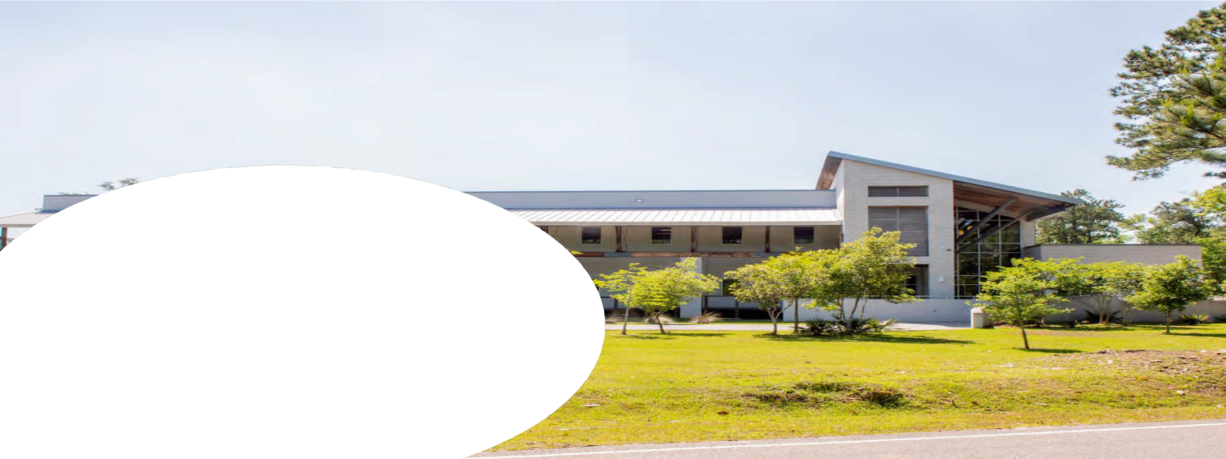
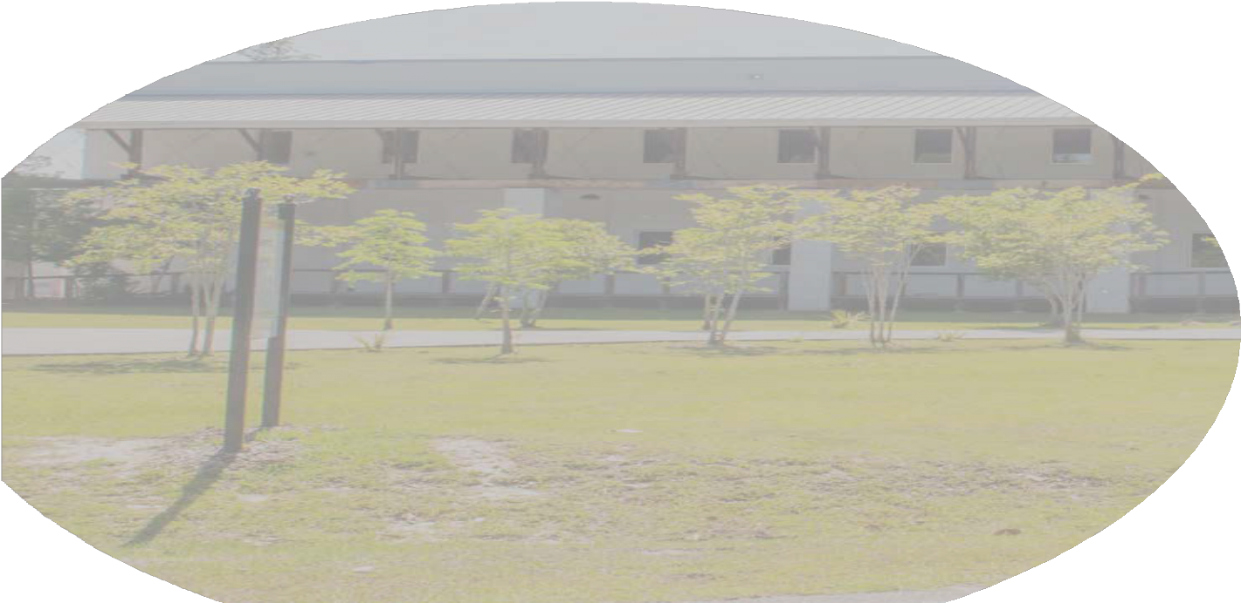
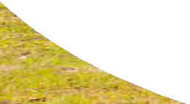
Overview
Overview
Location
Infrastructure
Research and Development
Species
Partnerships, Services and Agreements

Slide 3
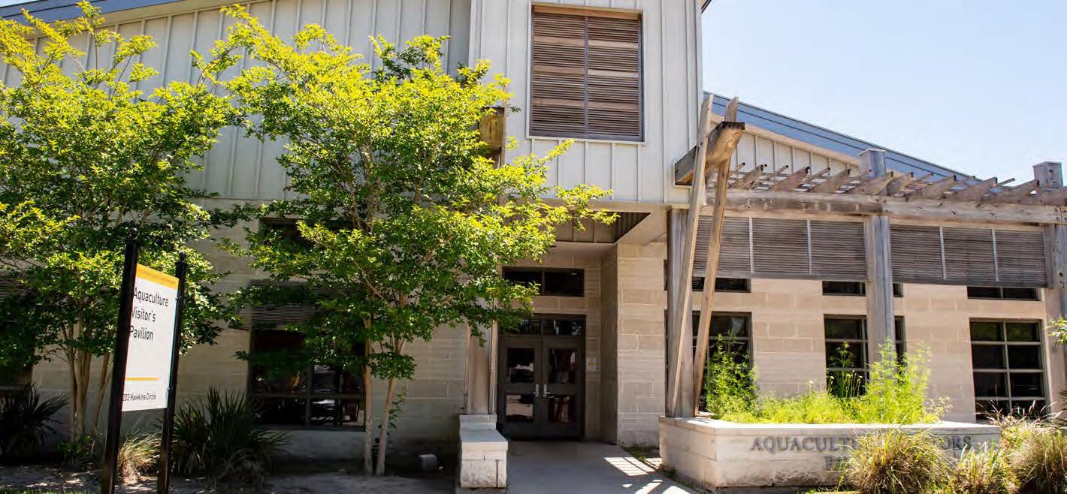
TCMAC
We work with industry, government and non-profit organizations to alleviate the bottlenecks that constrains the production of marine species.
TCMAC

Slide 4
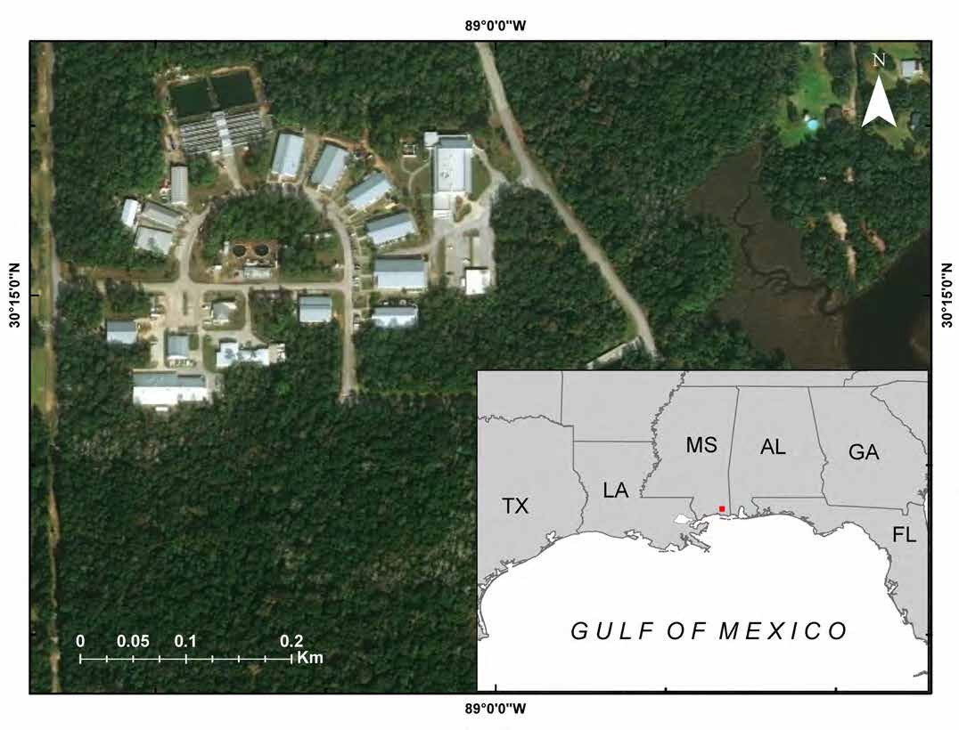
Located: Central Gulf of Mexico

Slide 5
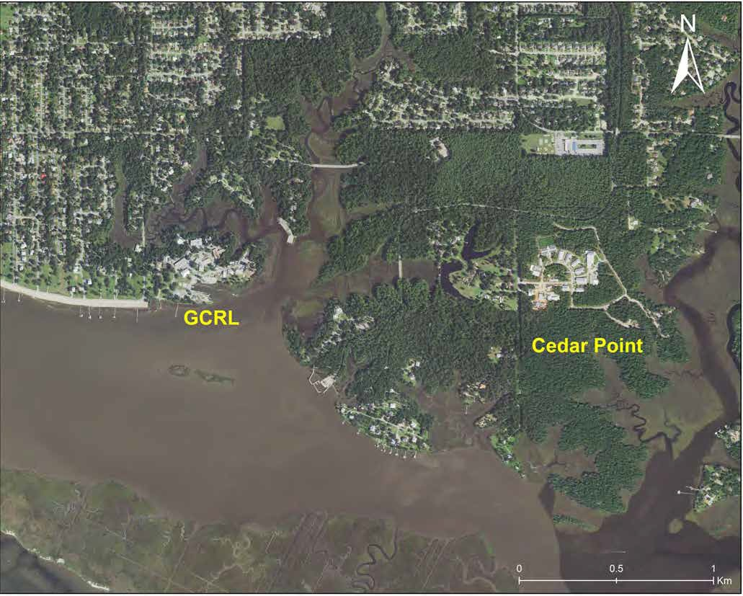
Ocean Springs Research Sites

Slide 6
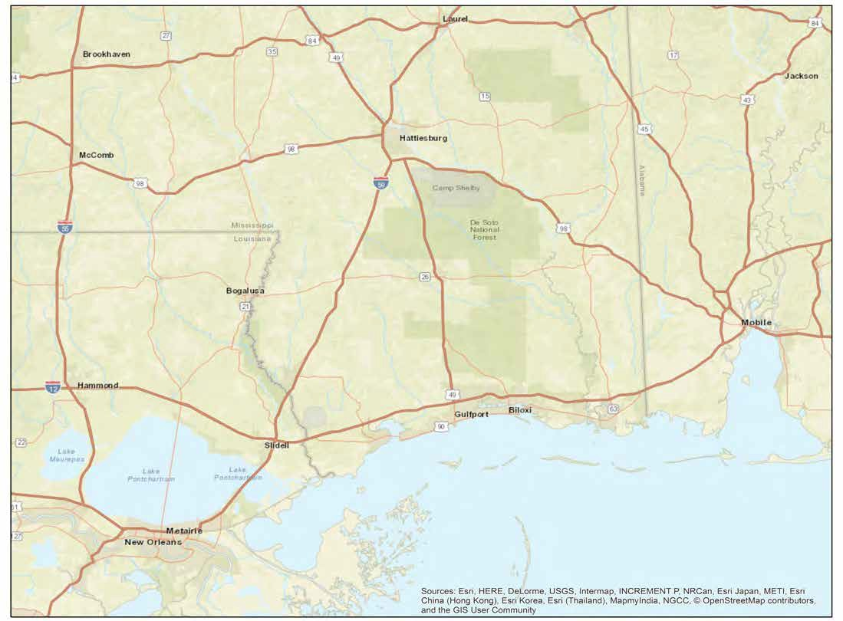

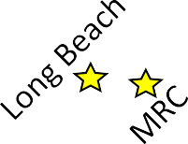

Distributed Facilities and Resources
USM Main Campus

Slide 7
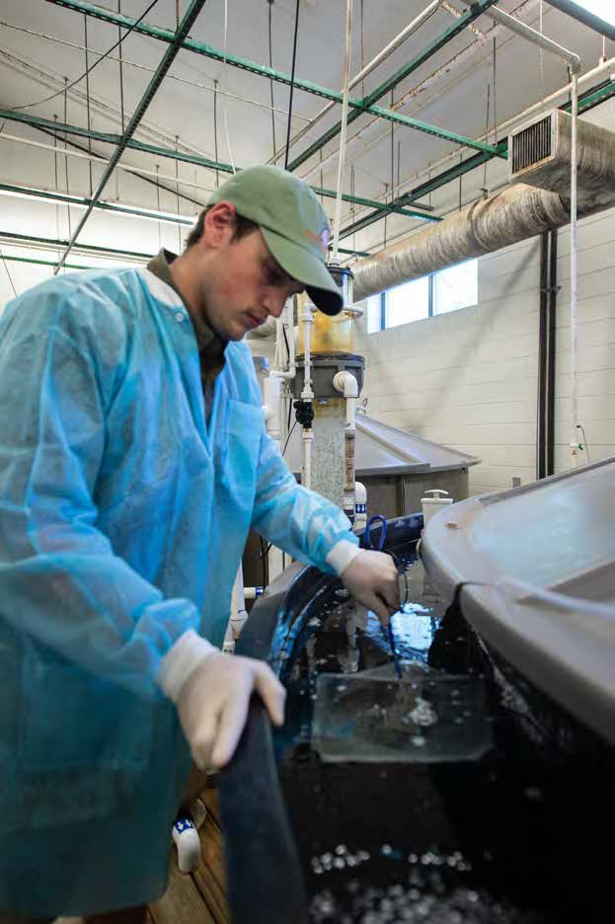
Facilities
13 Buildings
9,300 m²
4,600 m²
  culture space for animals and live feeds
930 m²
  Experimental space
    isolated and replicated disease, nutrition, and genetics/reproductive physiology research
contains isolated small-, medium-, and large-scale systems with single-pass climate control

Slide 8
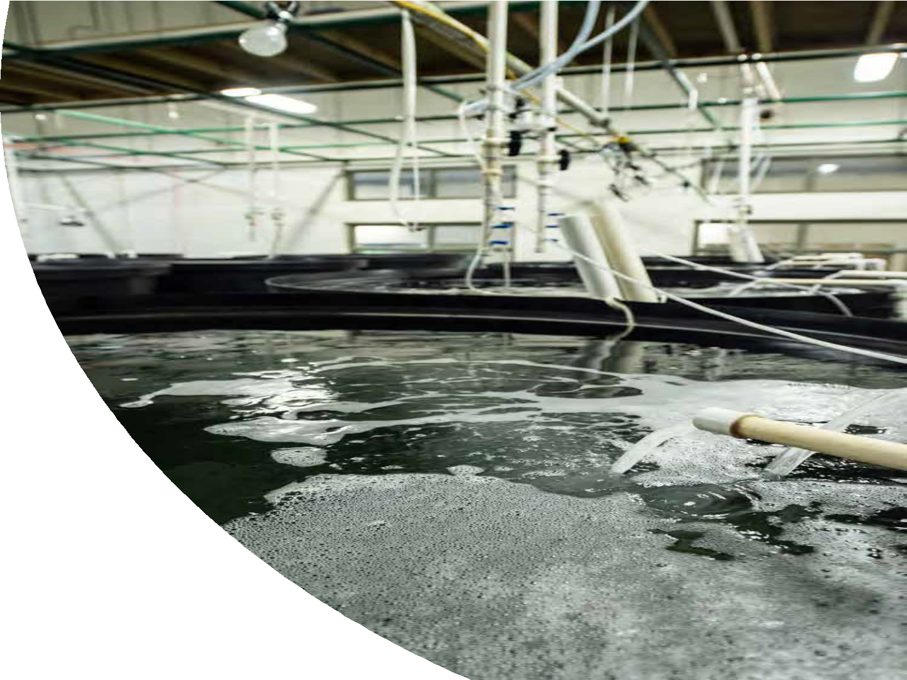
Systems
RAS technology
Artificial seawater or raw seawater
Filtration and water quality
  Propeller-washed bead filters
  Moving bed bioreactors
  Protein fractionators (with ozone)
  Heat pumps
  Oxygen cones (5,000-gal liquid Oxygen backup)
Biosecure
Climate controlled
Customizable tanks and systems
Generator backup
Gated/ Secure facility

Slide 9
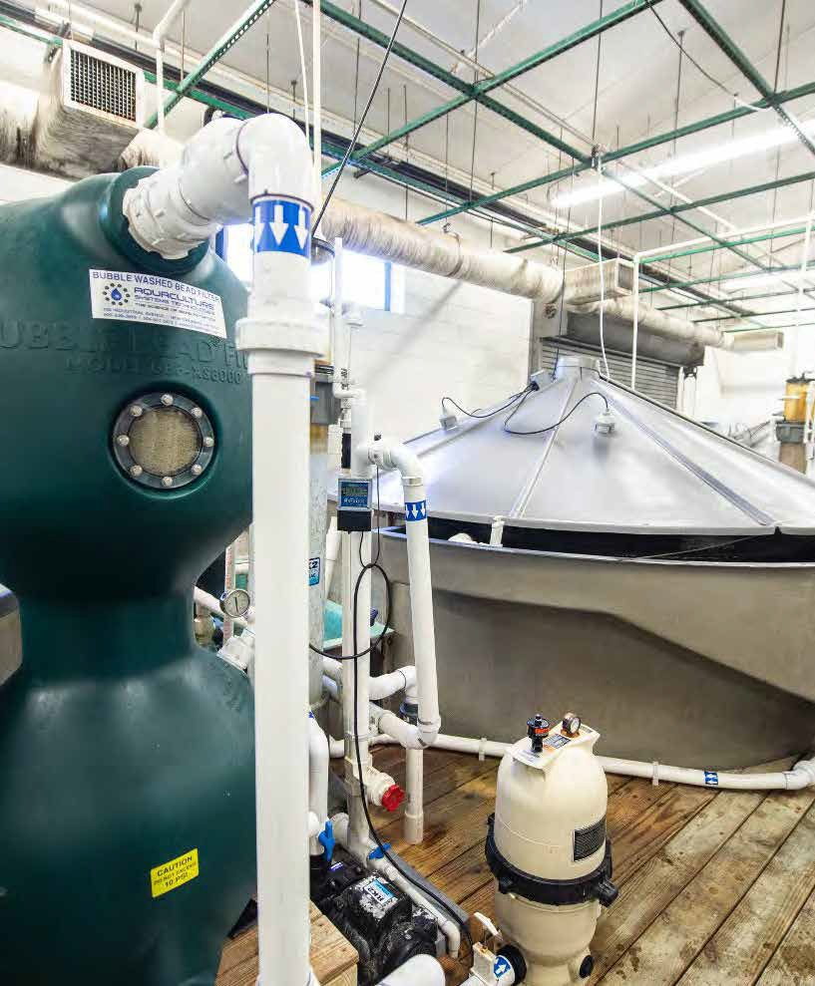
Finfish
Brood Systems
5 areas for brood holding and maturation
571,000 L tank space
  3 – 6 m diameter tanks
  Photo-thermal control
  Dedicated generator and oxygen backup
  Remote monitoring

Slide 10
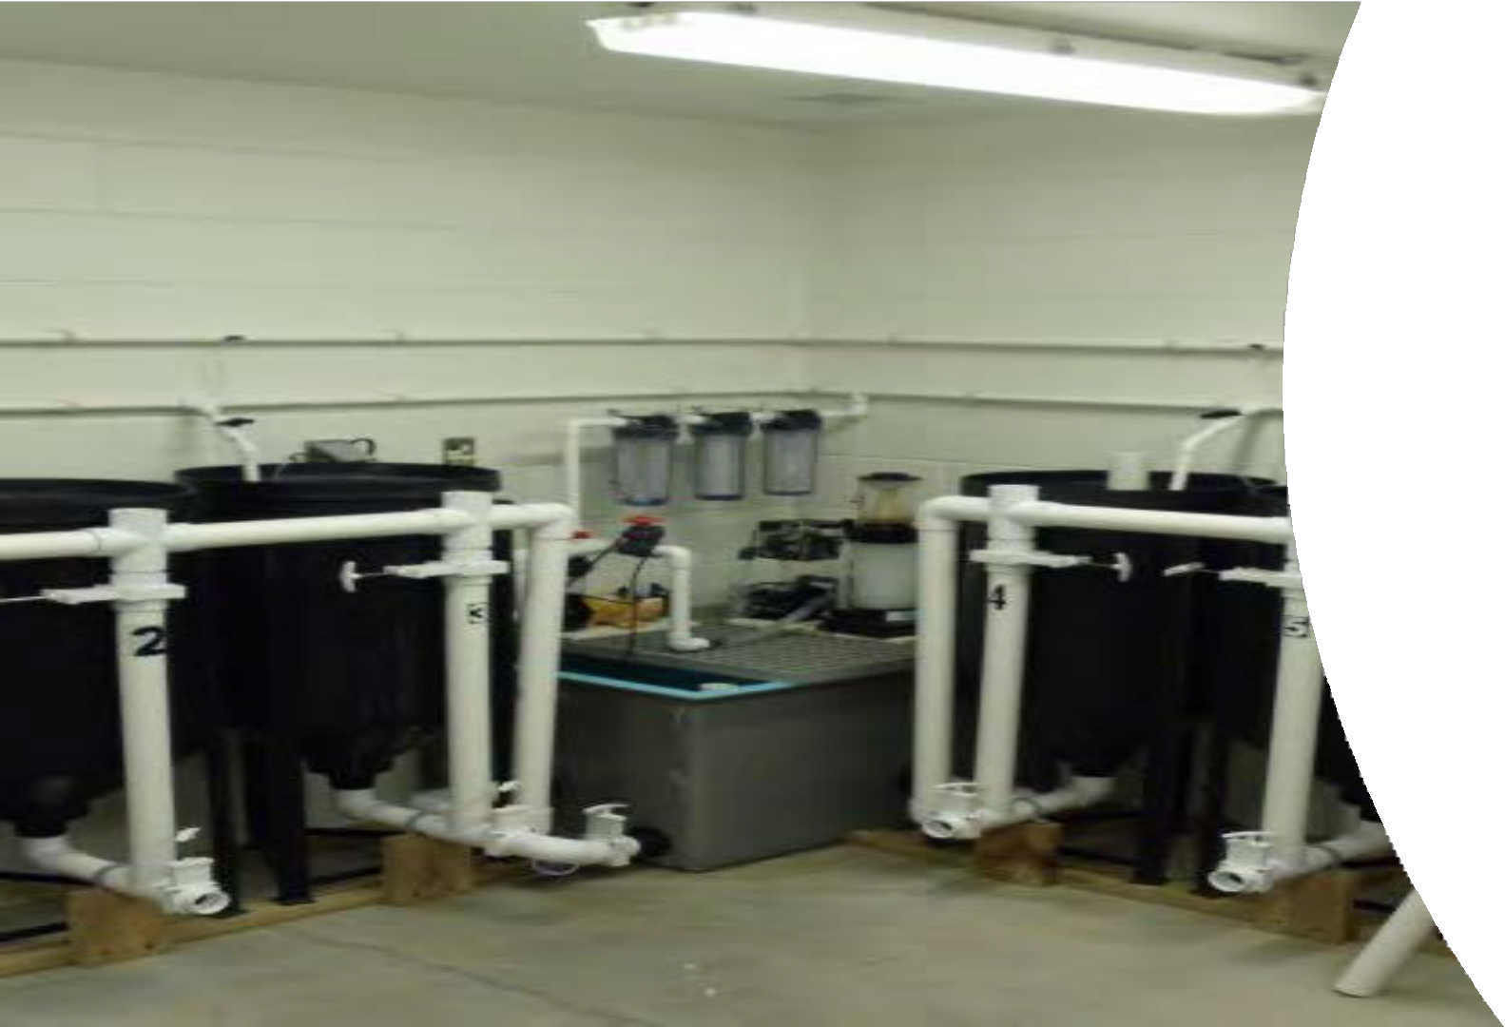

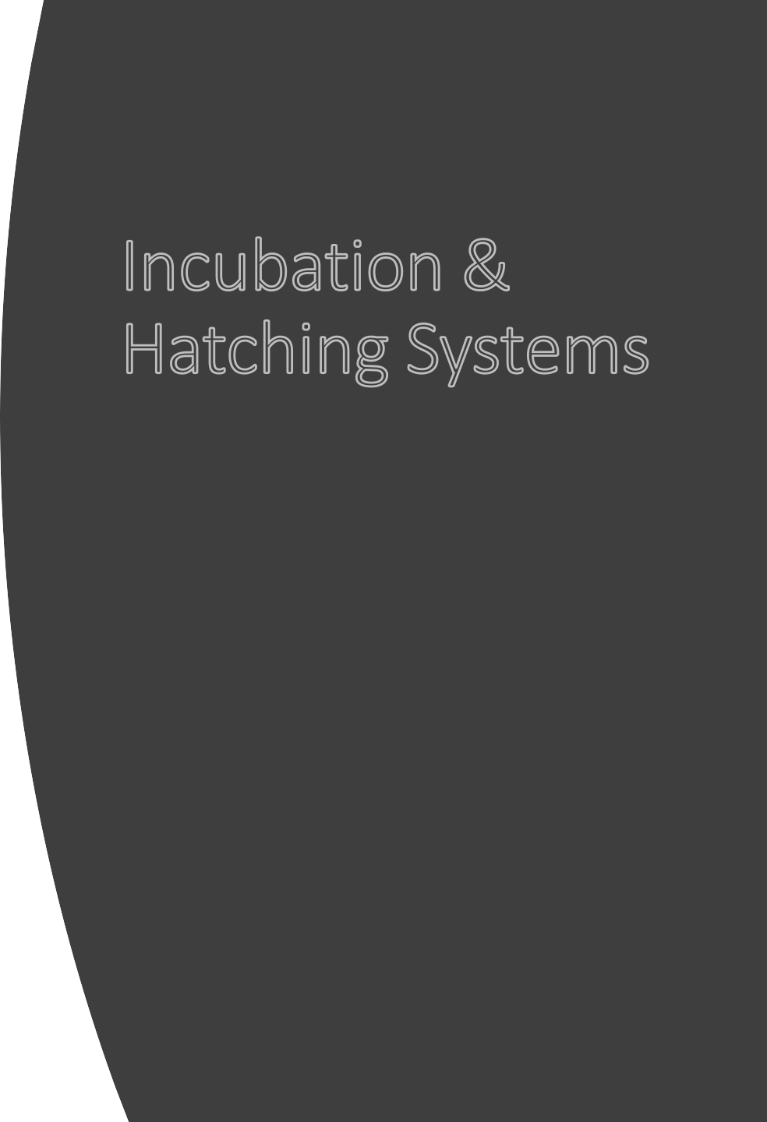
Incubation & Hatching Systems
3 systems for egg incubation and hatching
3,720 L tank volume
  RAS Systems
  Thermally controlled

Slide 11
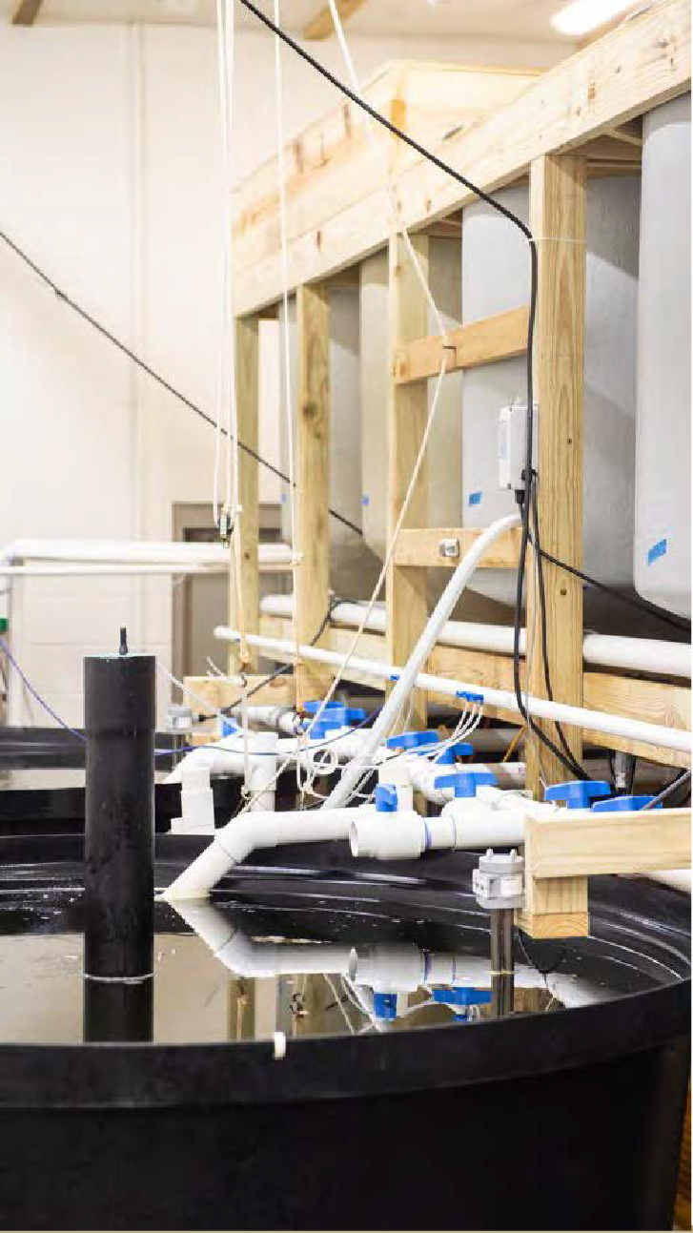


Live Feeds Systems
Copepods
  148,000 L of culture volume available
  20 million Nauoplii produced daily
Rotifers
  Static water systems
  100 to 200 L tanks
  2200 L culture volume available
  800 million to 1.2 billion rotifers produced daily
Artemia
  400 L static systems
  3200 L volume available
  800 million Instar 2 produced daily

Slide 12
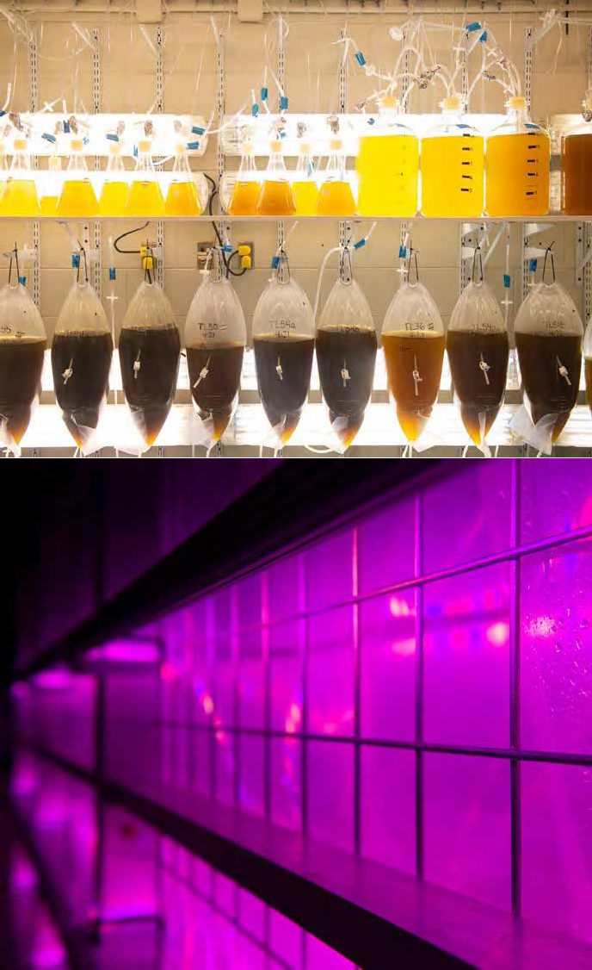
Algae
Algae
Systems
  Semi-continuously operated photobioreactors
    PureBiomass PBR
      1,375 L and 250 L
    Industrial Plankton
      1,000 L
  Hanging bag system
Production Capability
  Productivity: 0.20g L⁻¹ day⁻¹
    Current
      Yield 240 g day⁻¹
    Yr. 2021
      1,100 g day⁻¹
Species
  Chaetoceros calcitrans, Chaetoceros muelleri, Nannochloropsis oculate, Pavlova lutheri, Rhodomonas salina, Tetraselmis sp., Thalassiosira weissflogii, Tisochrysis lutea.

Slide 13
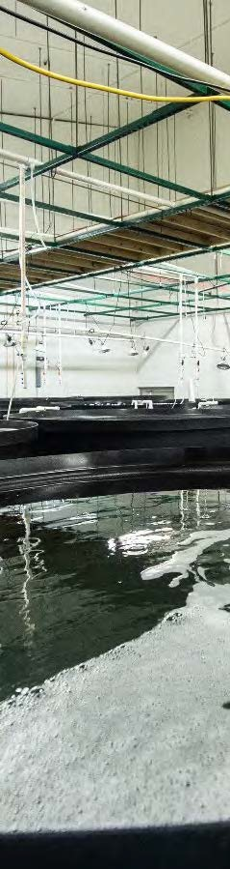
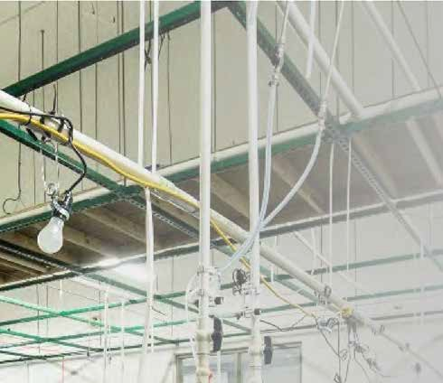
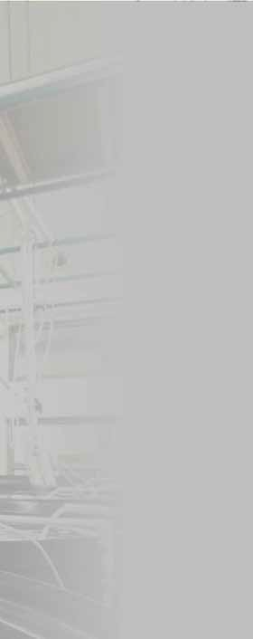





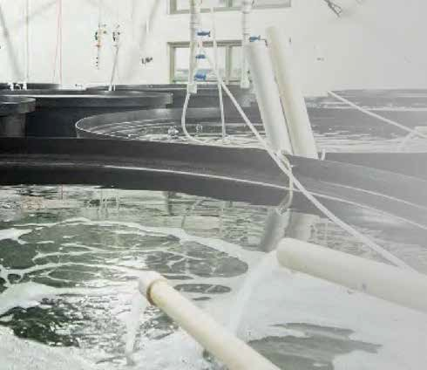

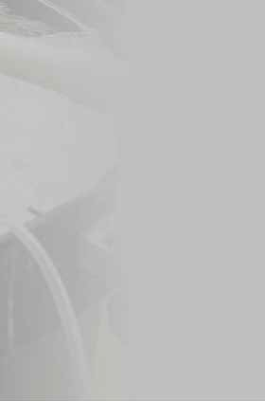
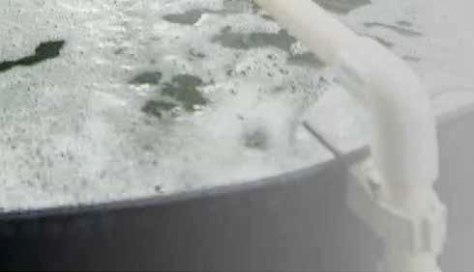
Larval Rearing
Systems
7 areas available for rearing larvae
120,000 L culture volume
RAS & static systems
  400 – 4000 L tanks
  FRP or HDPE
  Photo-thermal control

Slide 14

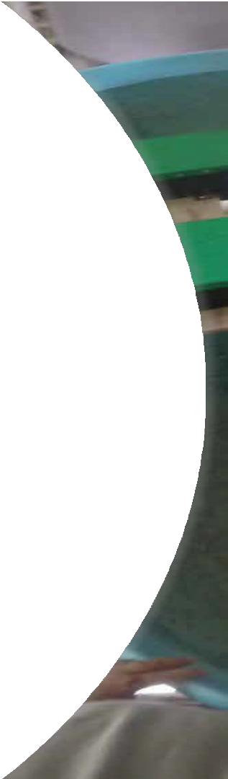
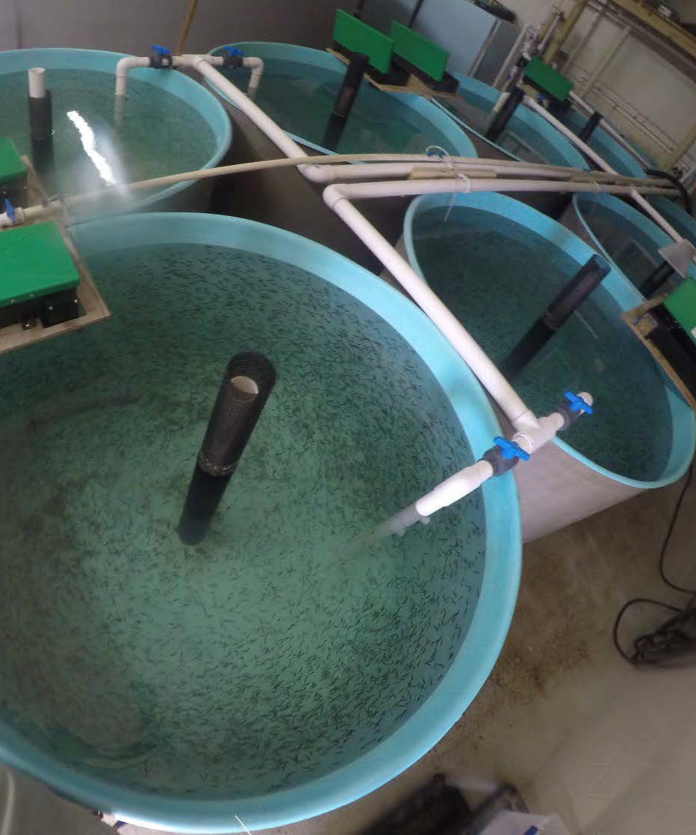





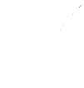
Nursery Systems
2-3 systems available
92,000 L culture volume
  1.5 to 5.5 m diameter tanks
  Thermal control
Operated at a 40 kg/m³, designed for higher loads

Slide 15
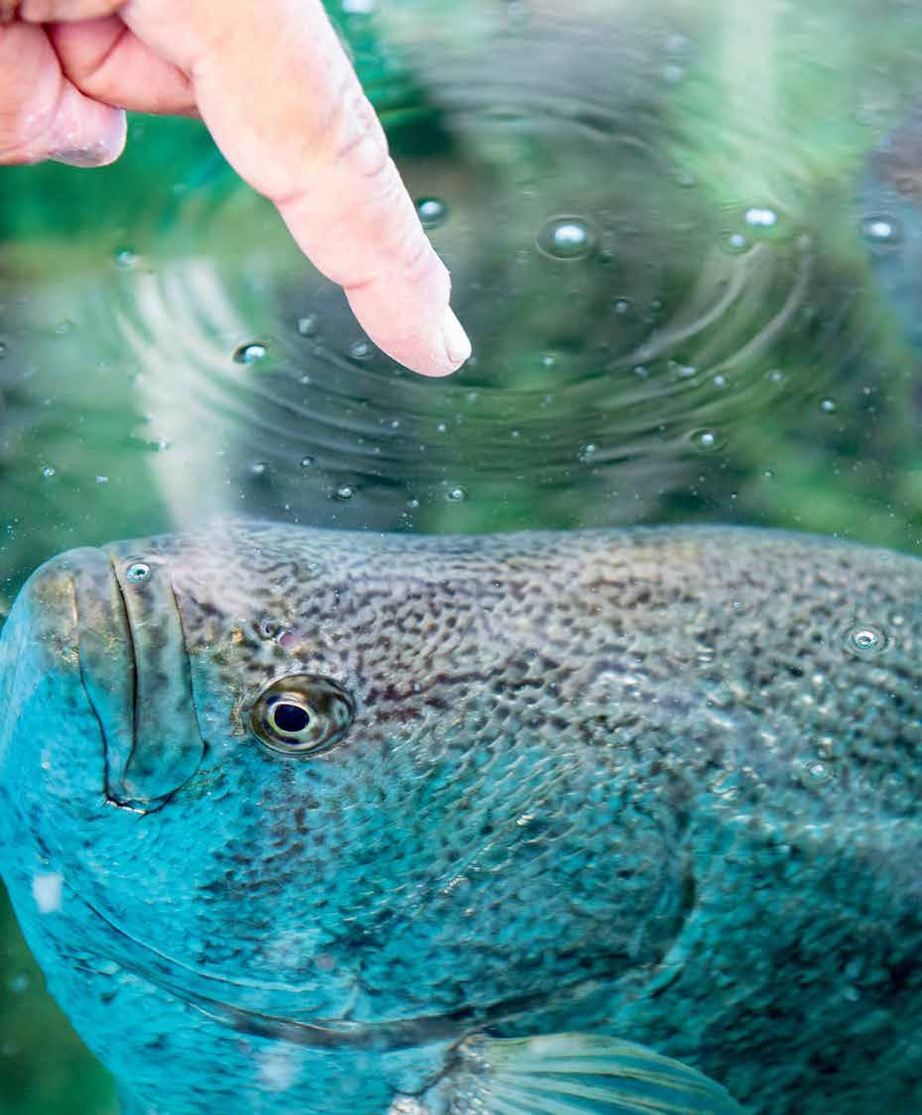
Growout Systems
8 systems available
1.1 million L available culture volume
  1.5 – 5.5m tanks
  Thermally controlled

Slide 16
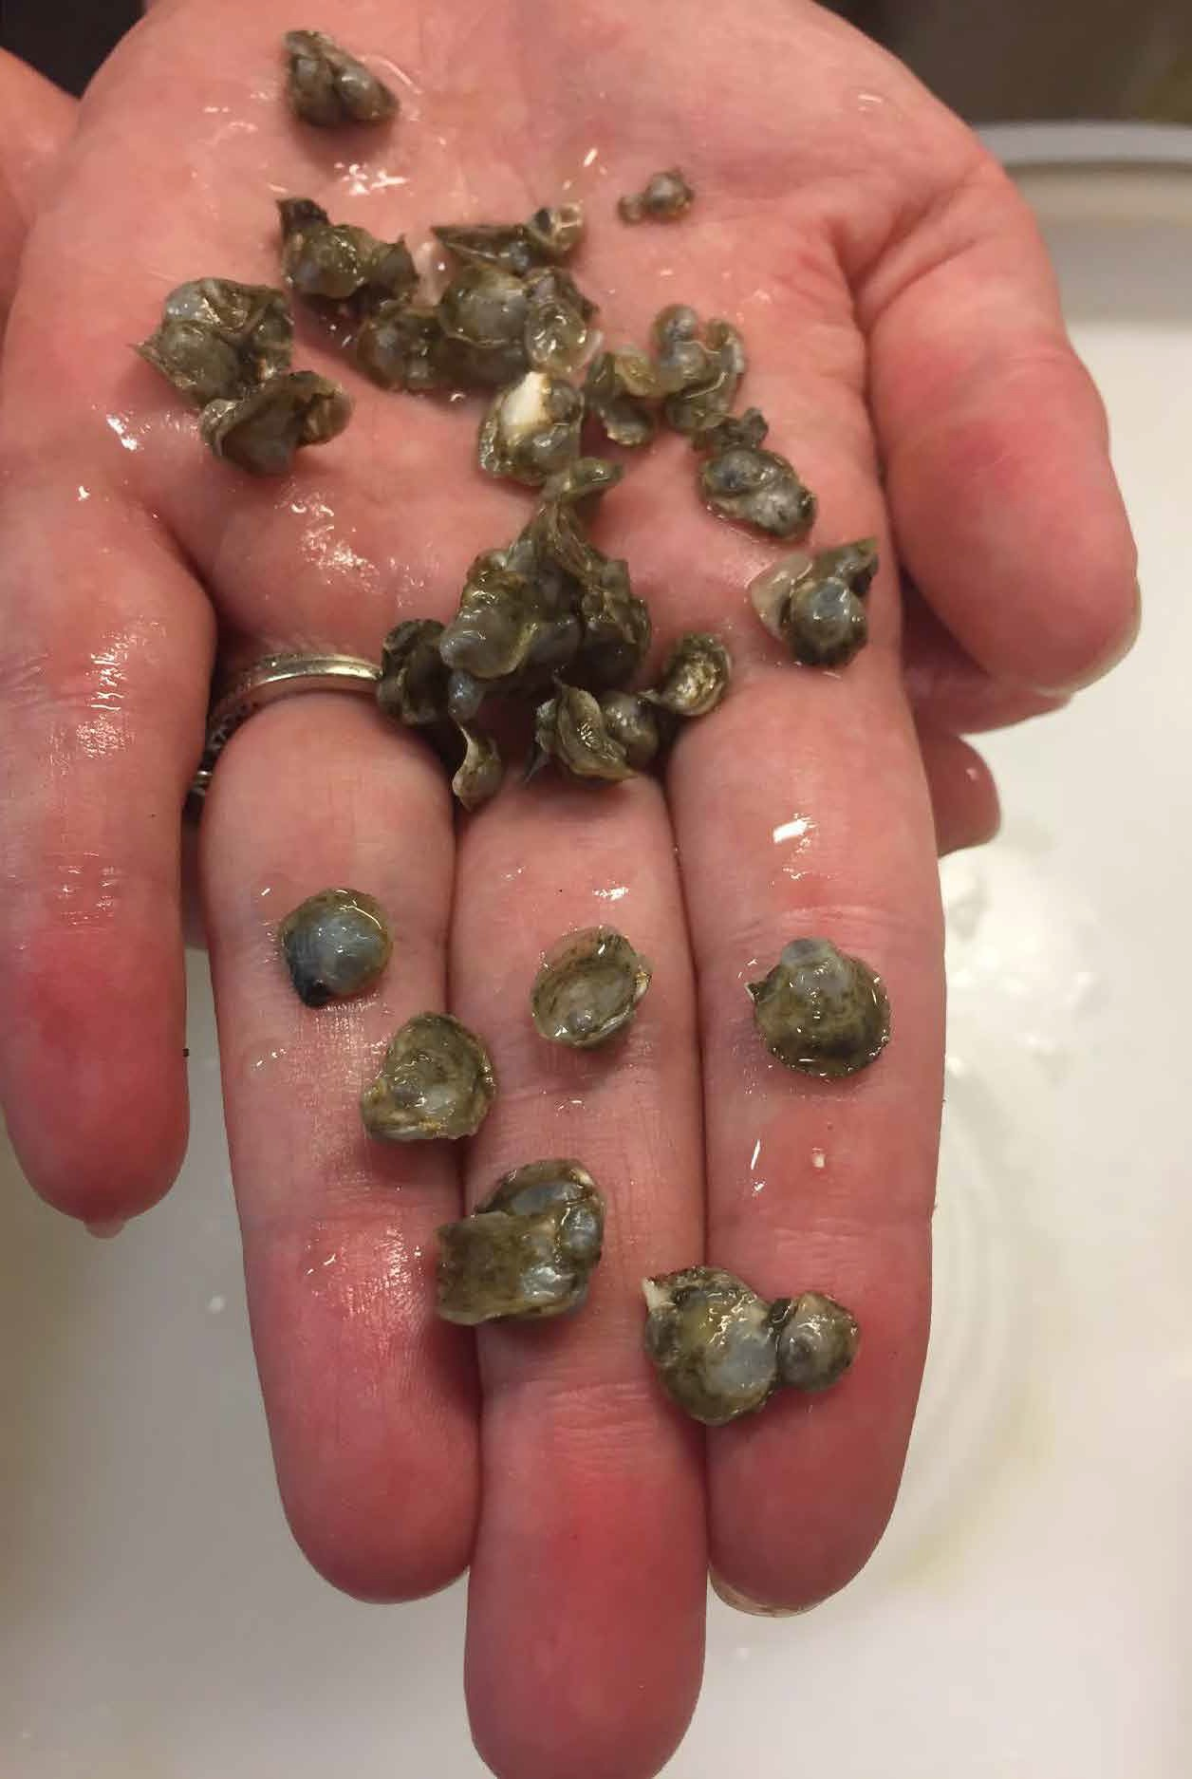
Oyster Hatchery
Artificial Seawater
Recirculating closed systems
Temperature control
Volume ASW
  Current: 87,000 L
  YR 2021: 450,000 L
Capacity
  Current: 300 Million larvae
  YR 2021: 5 Billion larvae

Slide 17

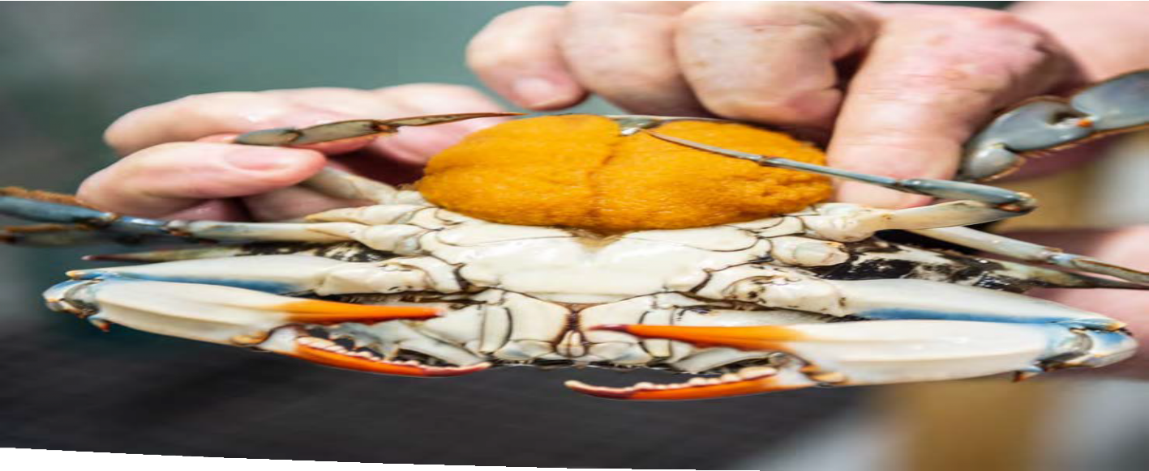

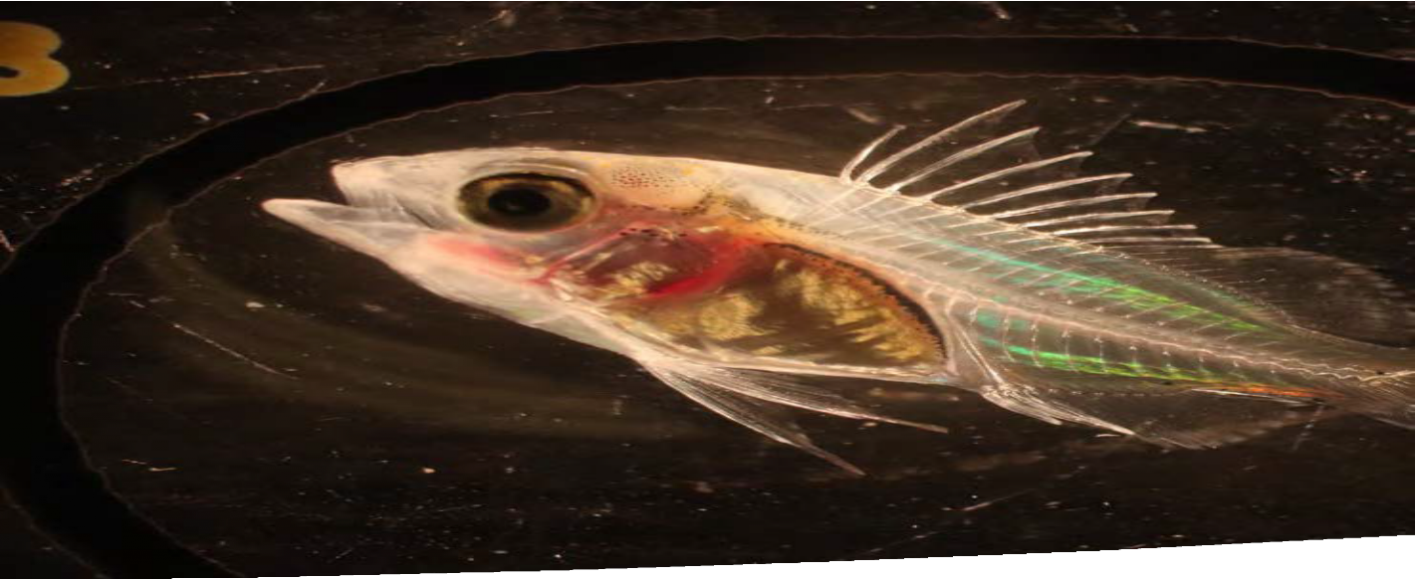
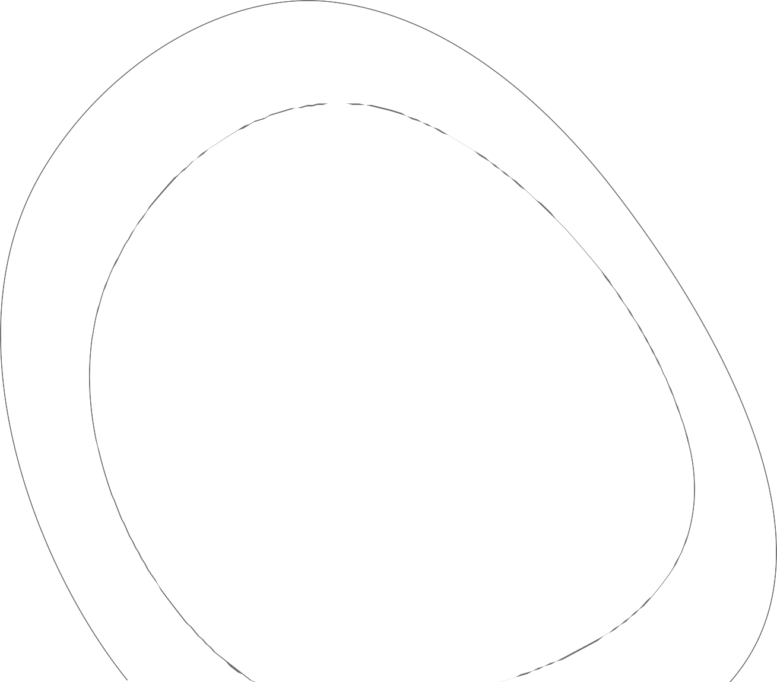






Research and Development
Aquatic Health
Genetics
Larviculture
Reproductive Physiology
Live Feeds
Recirculating Aquaculture Systems Design
Nearshore and Offshore Aquaculture
Research and Development

Slide 18

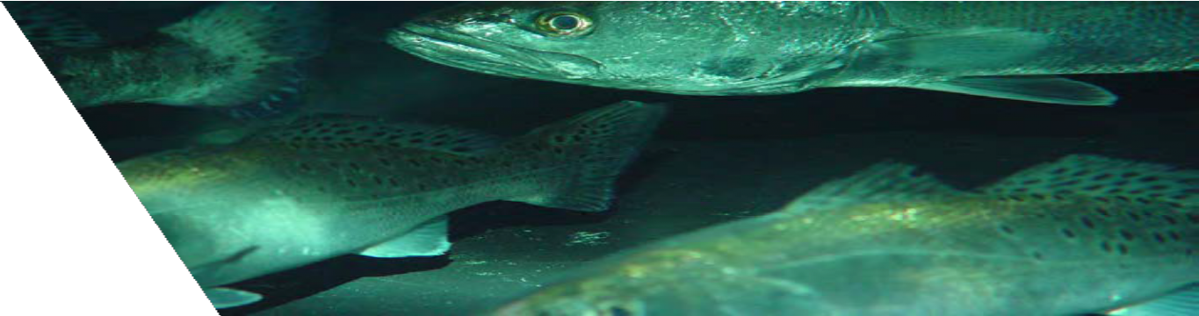
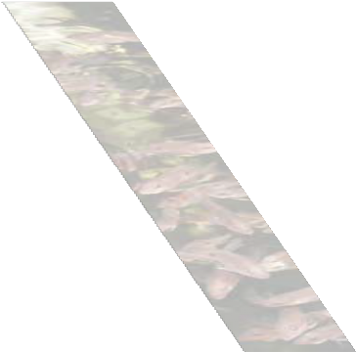
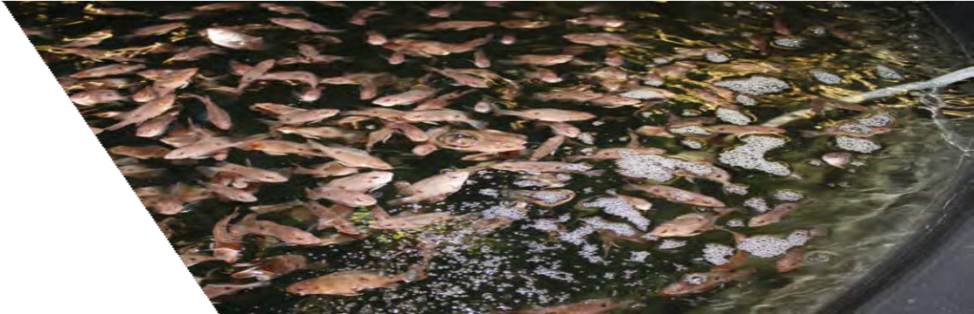
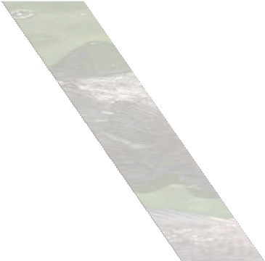
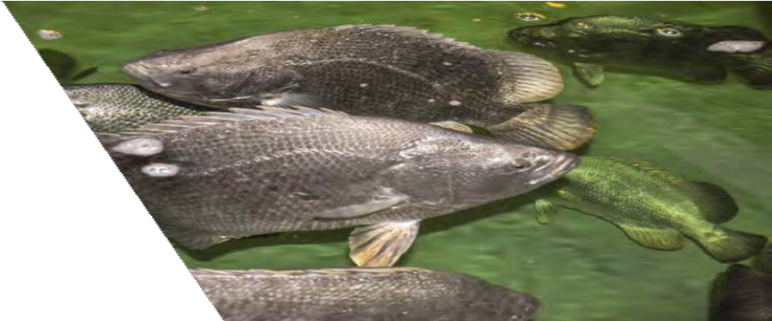
Species
Current
  Spotted sea trout (Cynoscion nebulosus)
  Tripletail (Lobotes surinamensis)
  Blue crab (Callinectes sapidus)
  Oyster (Crassostrea virginica)
Collecting in 2020
  Red drum (Sciaenops ocellatus)
  Gray snapper (Lutjanus griseus)
Previous
  Red snapper (Lutjanus campechanus)
  Atlantic croaker (Micropogonias undulates)
  Striped bass (Morone saxatilis)
  Cobia (Rachycentron canadum)
  Marine shrimp (Litopenaeus vannamei)
  Pompano (Trachinotus carolinus)

Slide 19




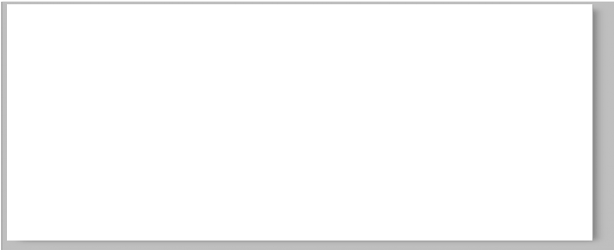
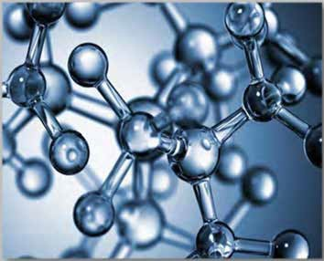


Foster aquaculture technology development and commercialization
Industry Partnership
Partnership Agreements
Licensing Agreements
Develop Strategic Partnerships
Confidentiality and Material Transfer Agreements
Services Agreement
Sponsored Research Research Subaward
Technology is transferred to Industry collaborator through Option, Licensing and Joint Partnership Agreement
Available Services:
Analytical and Biological Testing
Research and Development Lease Space
Sponsored Research
Technology License
Aquaculture Consulting

Slide 20







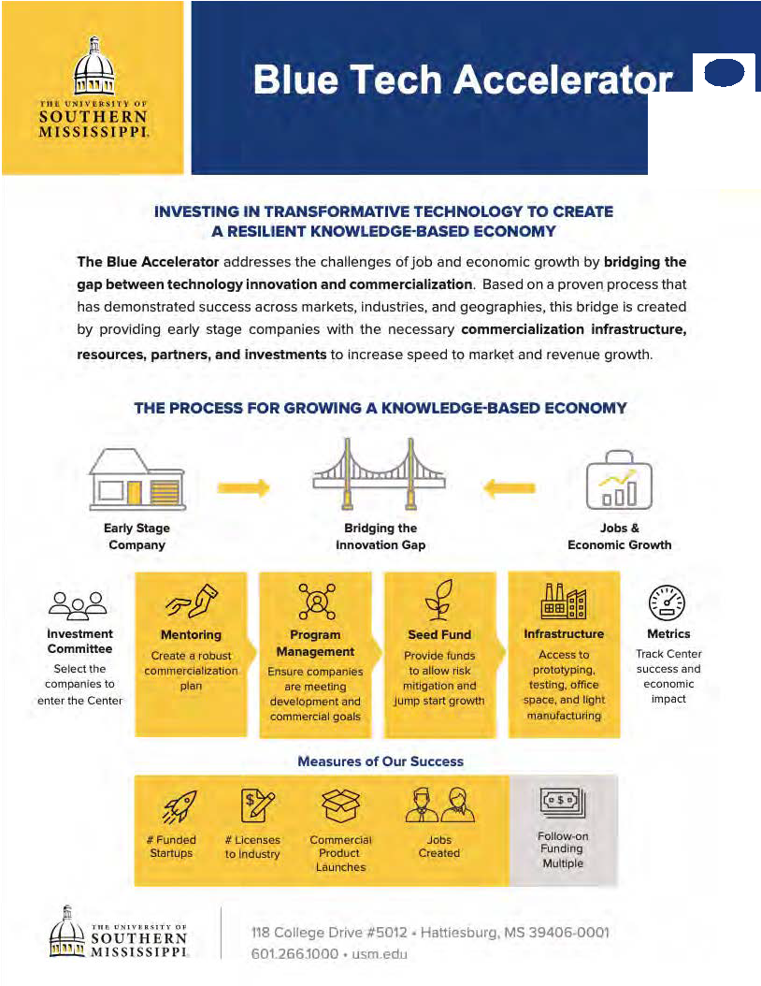



Bridging the innovation gap for early stage aquaculture companies to increase speed to market and revenue growth

Slide 21



Contact
Kelly Lucas, PhD. Director
Thad Cochran Marine Aquaculture Center
School of Ocean Science and Engineering
The University of Southern Mississippi
228-818-8028
Kelly.lucas@usm.edu

