Slide 1


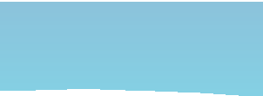




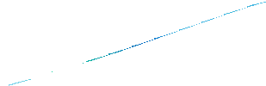








Marine Finfish Aquaculture Resources in Southern California
Mark Drawbridge
Aquaculture America 2020 Honolulu, Hawaii February 9-12th

Slide 2
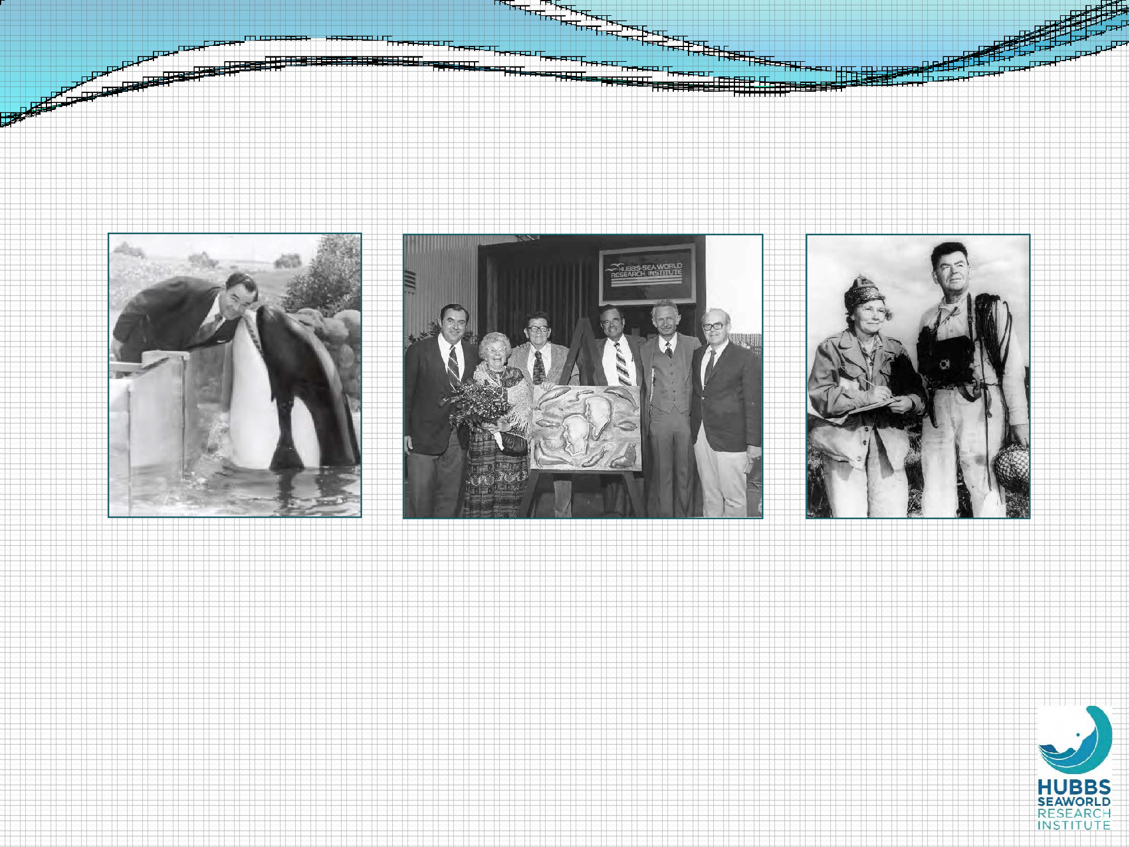
HSWRI Founded in 1963
Milton Shedd
Visionary Founder of SeaWorld
HSWRI Re-dedication Ceremony (1977)
World-renowned Marine Biologist Dr. Carl Hubbs and His Wife, Laura
Mission: “To return to the sea some measure of the benefits derived from it.”

Slide 3
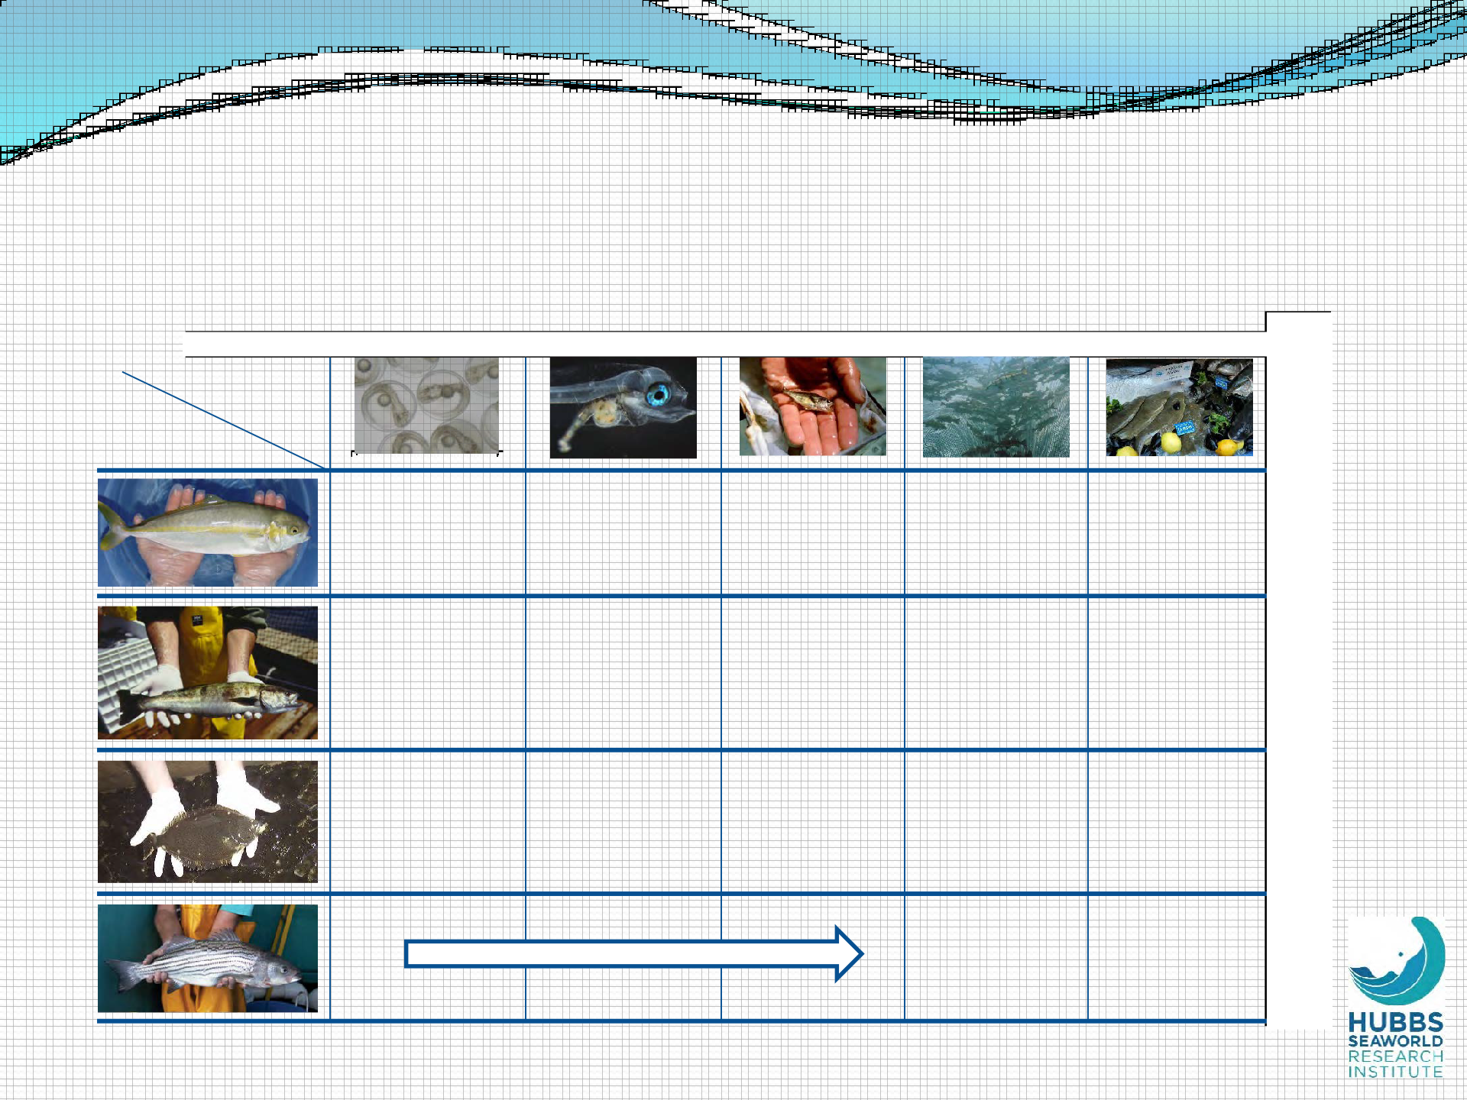
Finfish Aquaculture Experience at HSWRI – Species and Phases of Development
Spawning
Hatchery
Fingerling
Growout
Market testing
Phase
Species
CA yellowtail
X
X
X
X
X
White seabass
X
X
X
X
X
CA Halibut
X
X
X
X
X
Striped bass
X
X
Spawned and pond-reared by commercial growers

Slide 4
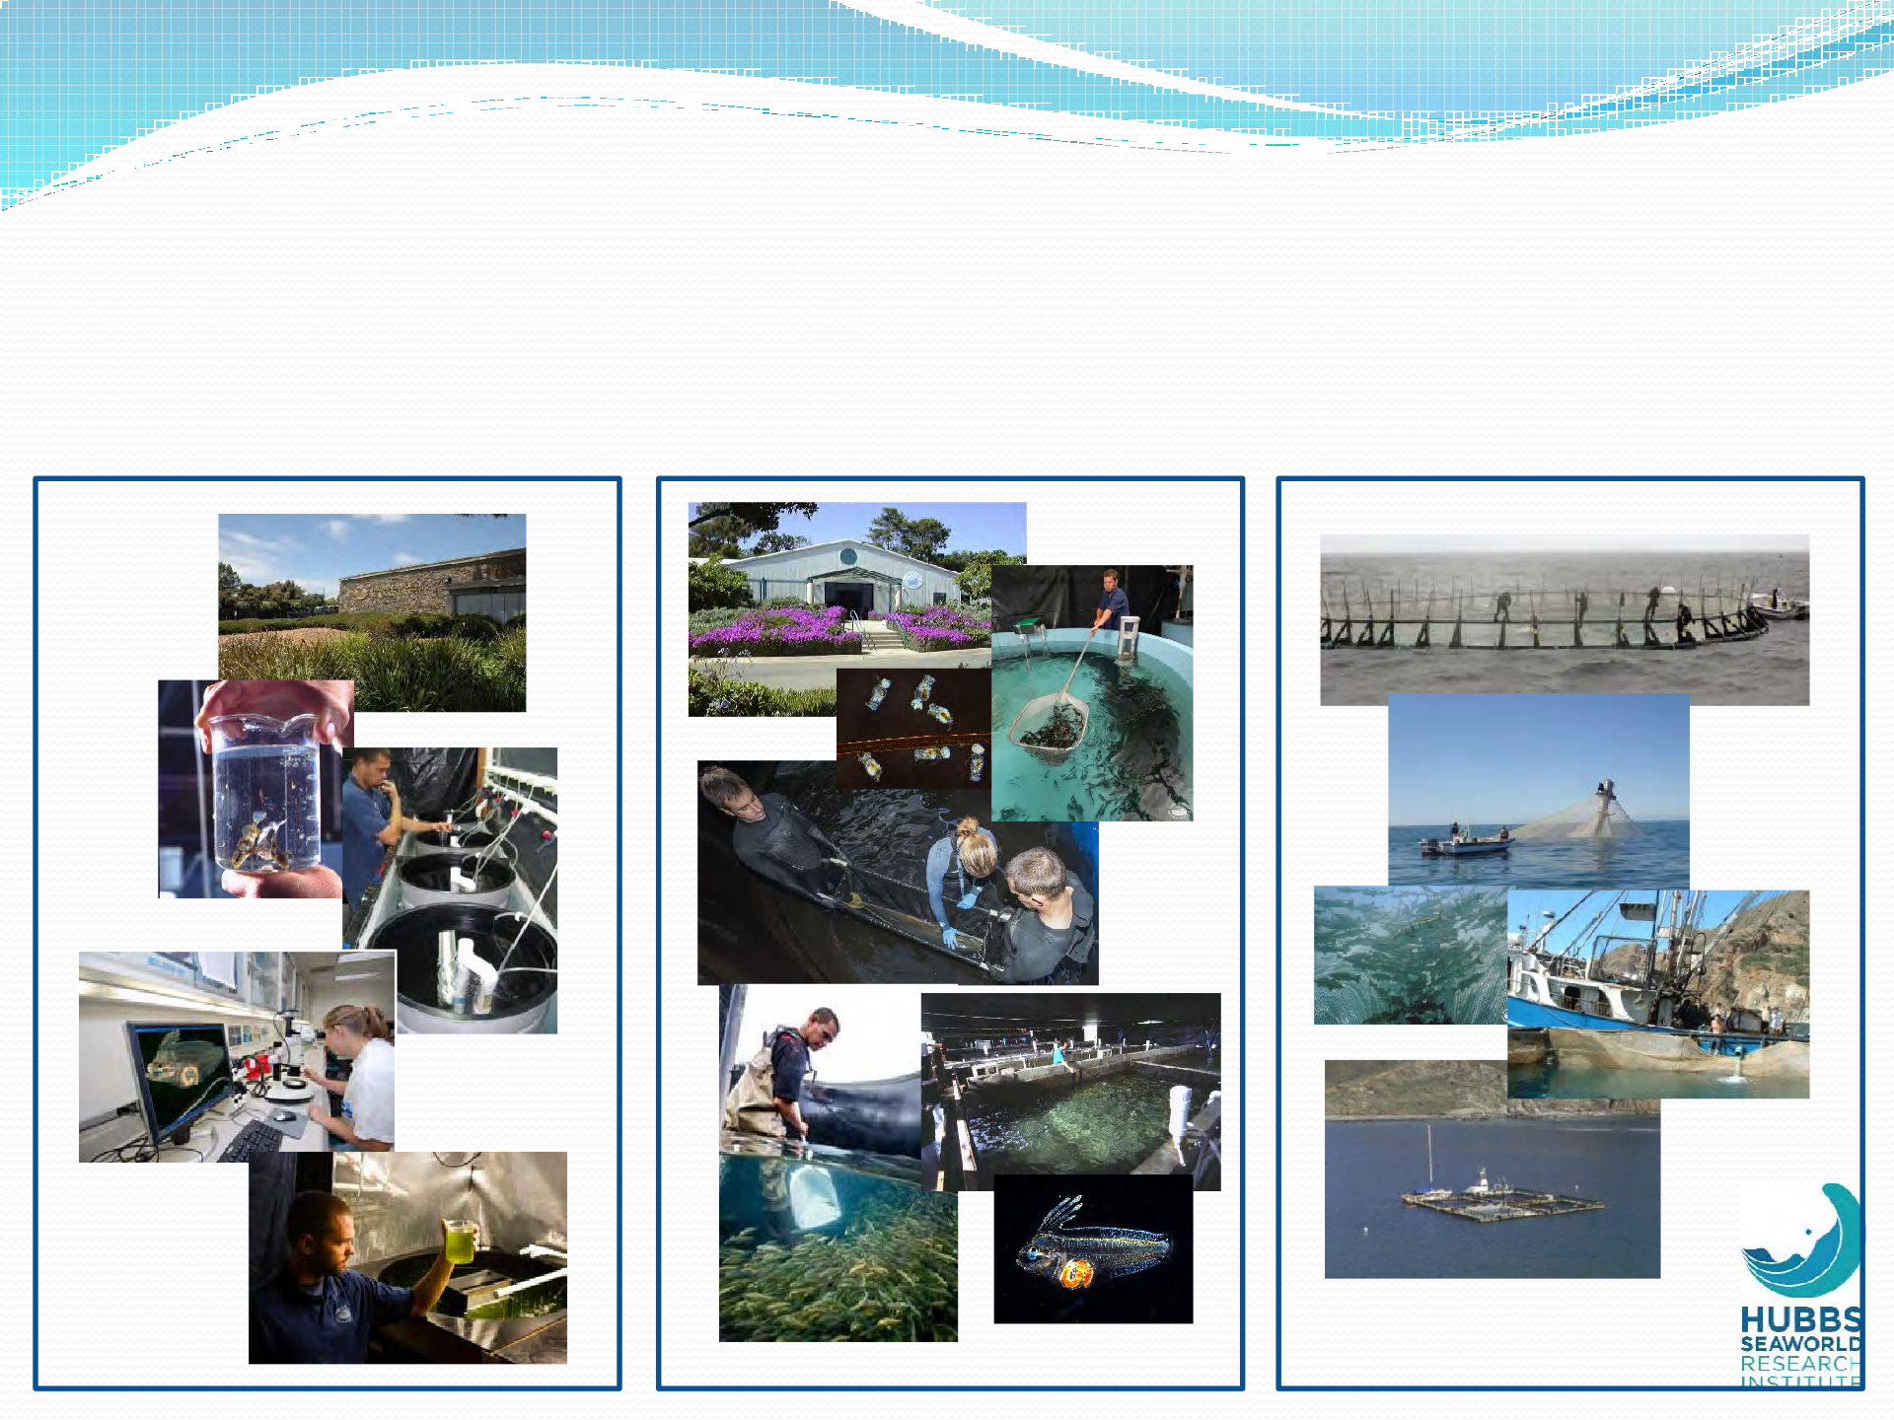
Finfish Aquaculture Experience at HSWRI - Technology
Small-scale R&D
Hatchery Production Ocean Growout

Slide 5
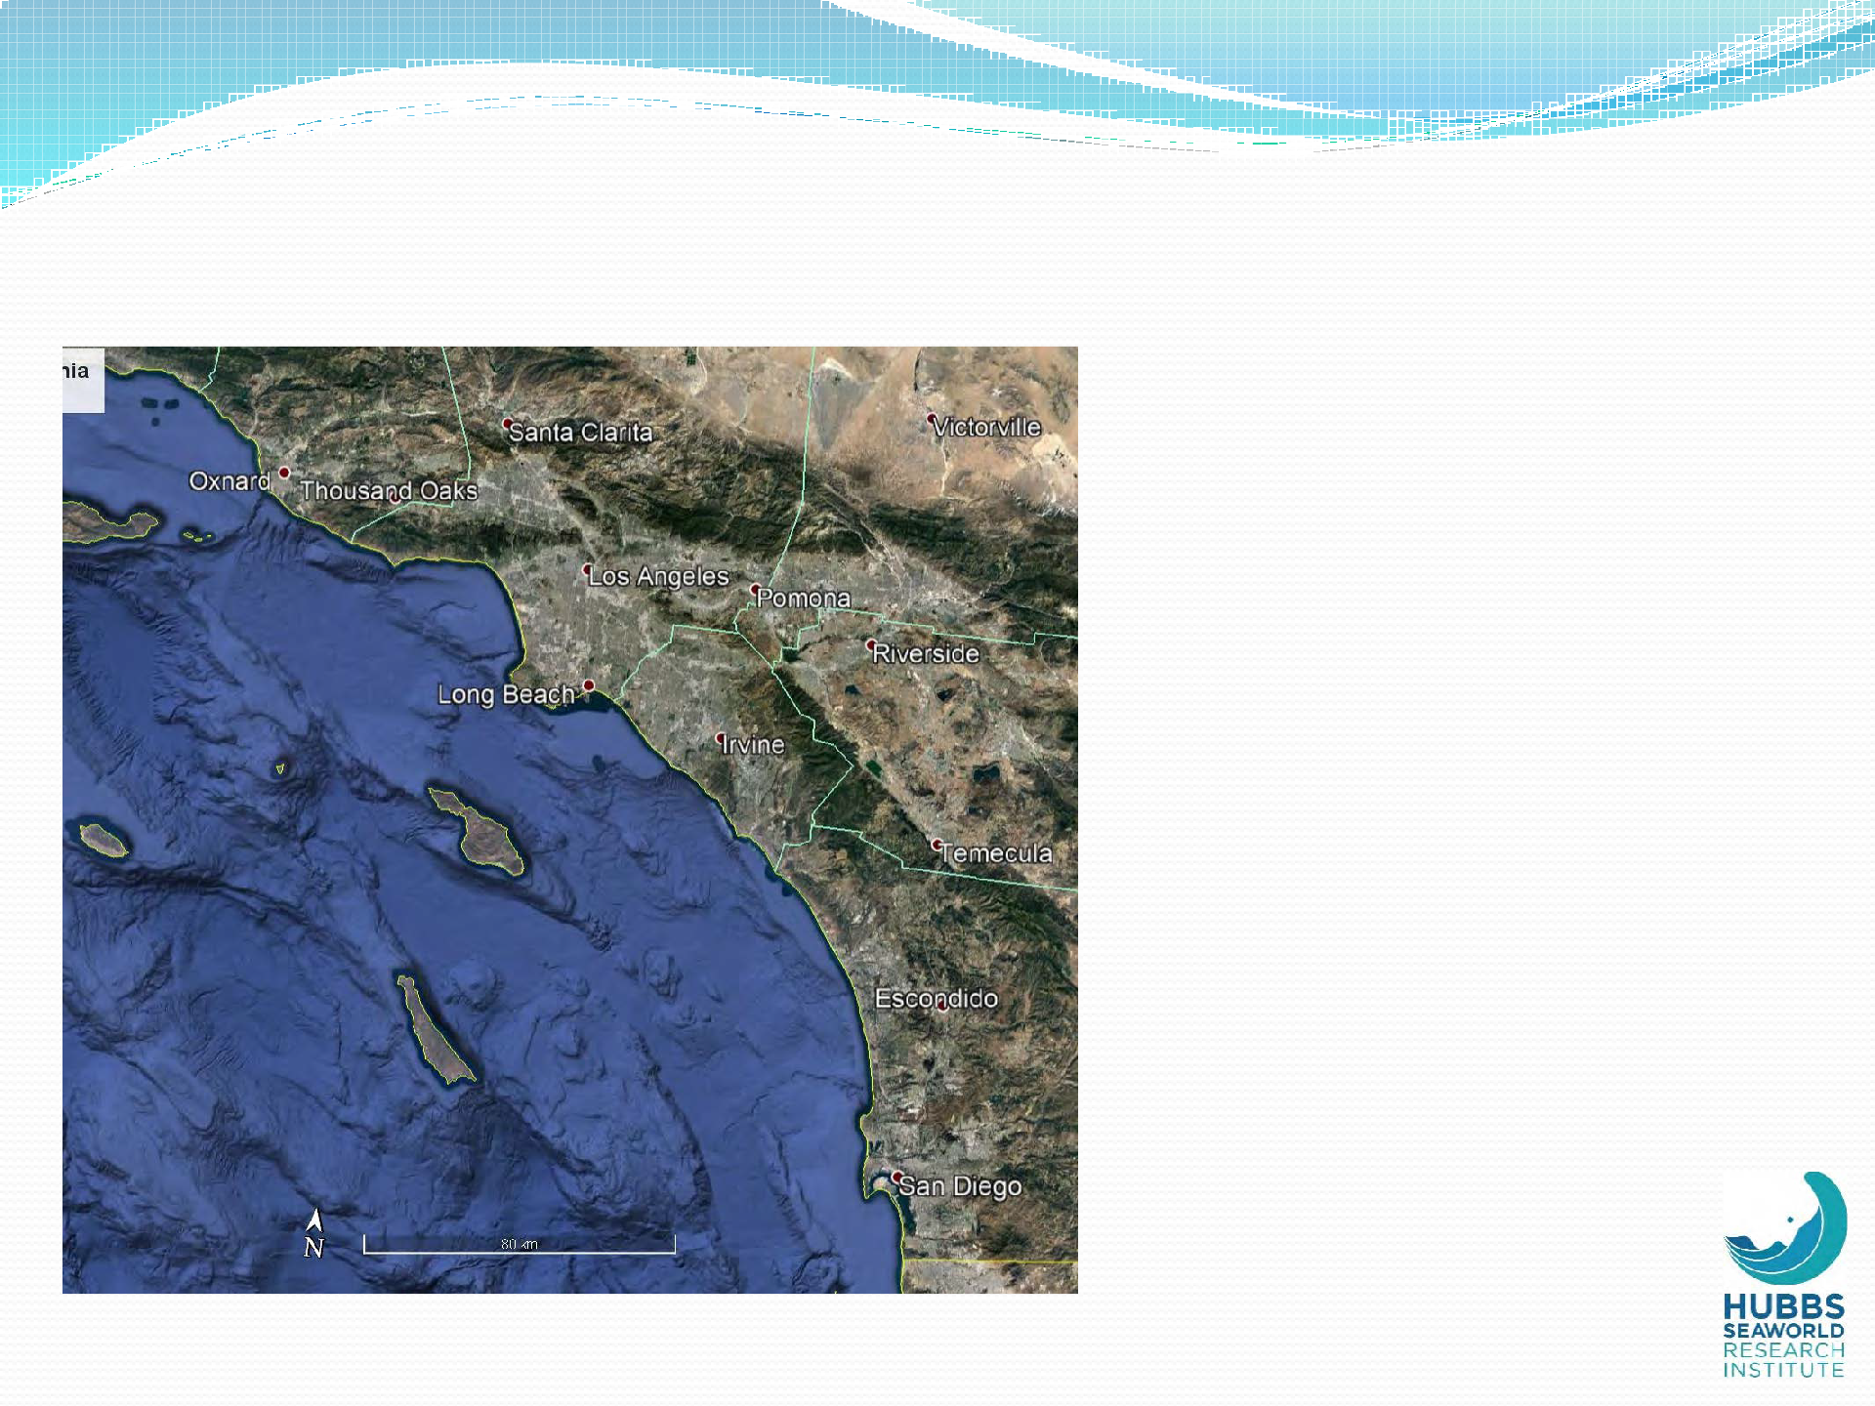
Southern California - General
 Mild climate and seas
 Excellent species
 Proximity to seafood markets
 Commercial fishing history/infrastructure
 Port interest
 Sportfishing industry
 University system
Heavy coastal use
Political/regulatory environment

Slide 6
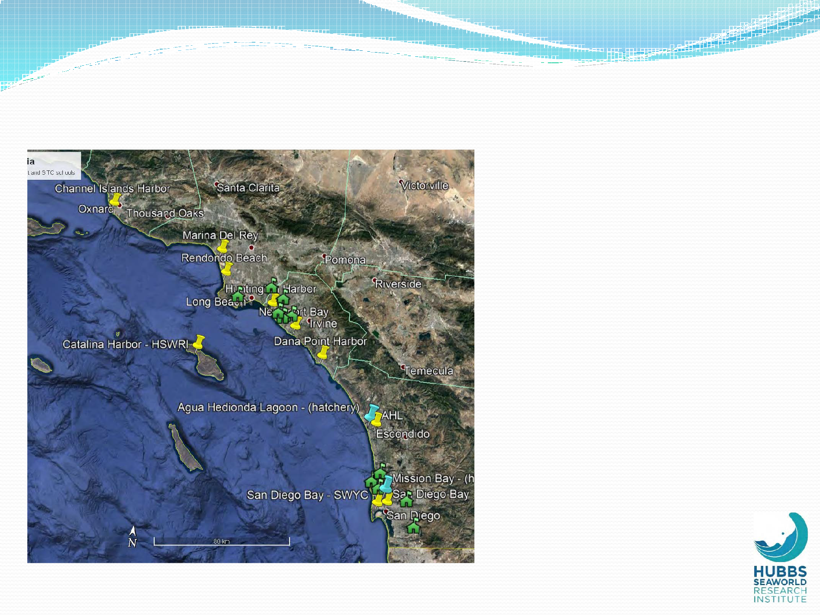
Southern California – Ed/Outreach
10 coastal growout facilities (volunteer)
11 Seabass in the Classroom (SITC) schools
2 research/production facilities

Slide 7
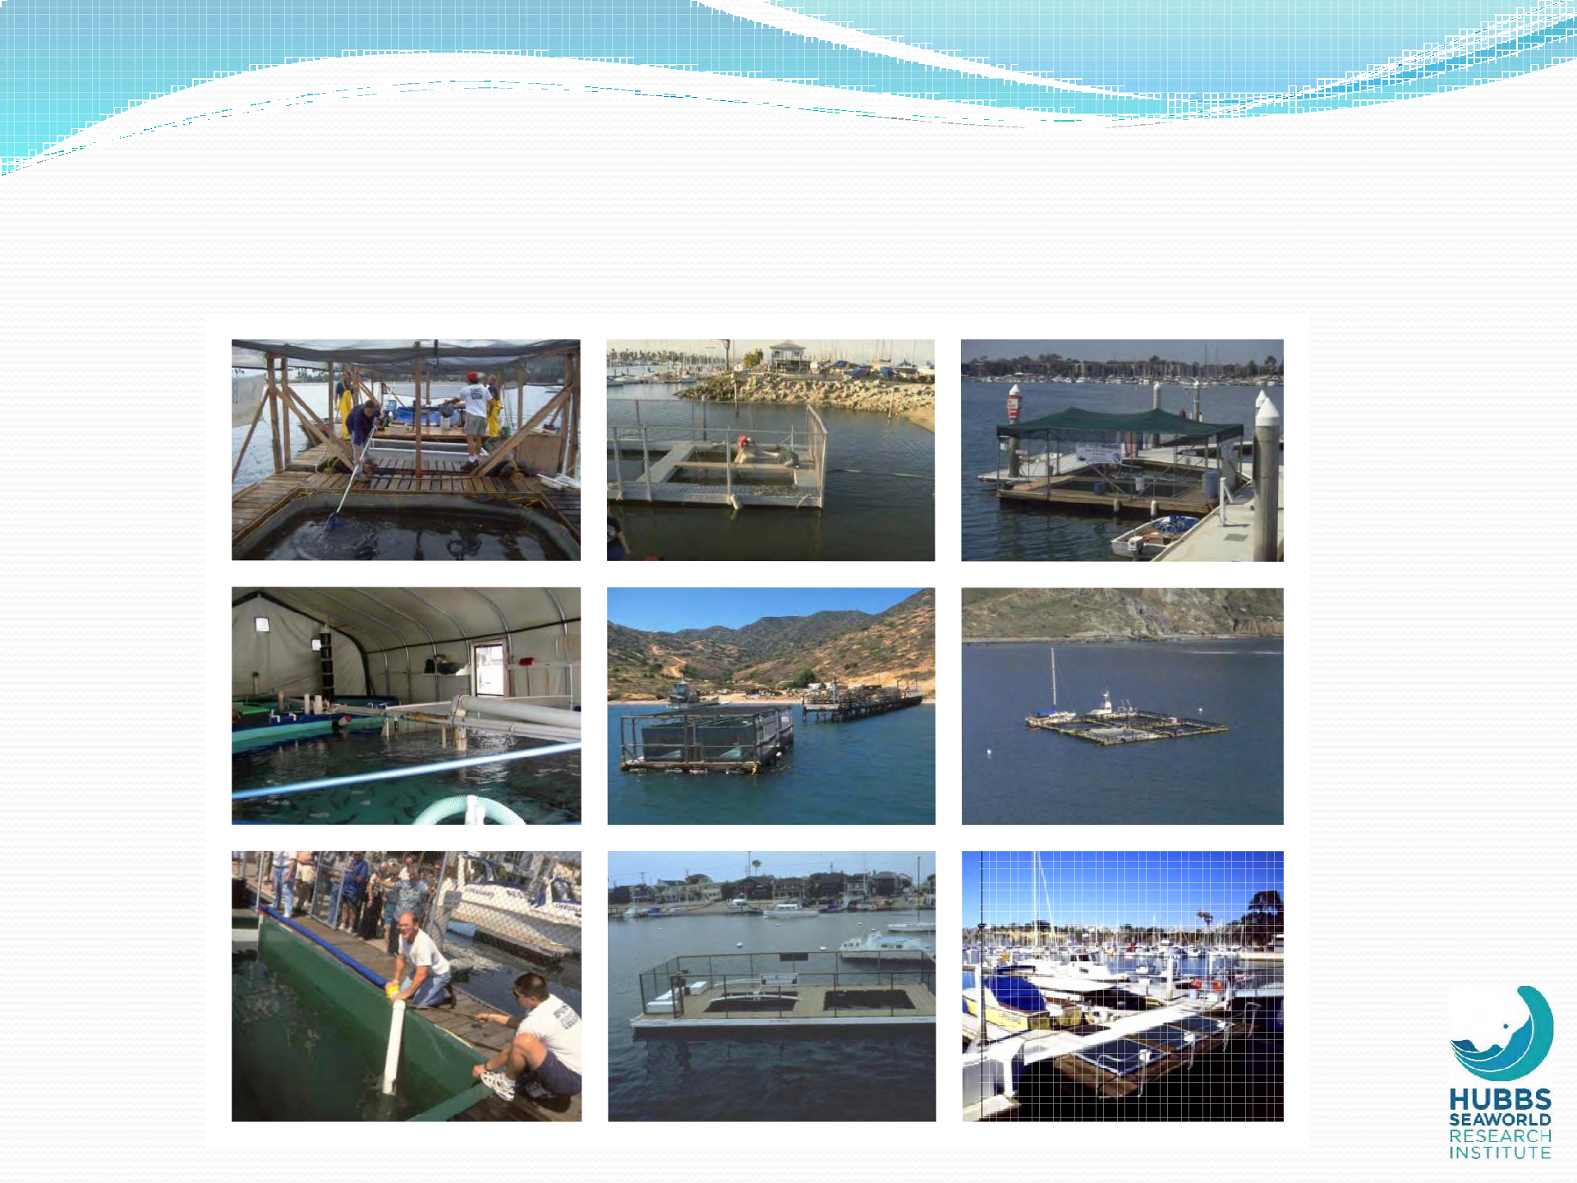
Examples of Growout Facilities
Santa Barbara (90m³)
Channel Islands Harbor (170m³)
Marina del Rey (35m³)
King Harbor (45m³)
Catalina Harbor – Inner (115m³)
Catalina Harbor – Outer (2240m³
Huntington Harbor (15m³)
Newport Bay (60m³)
Dana Point Harbor (27m³)

Slide 8
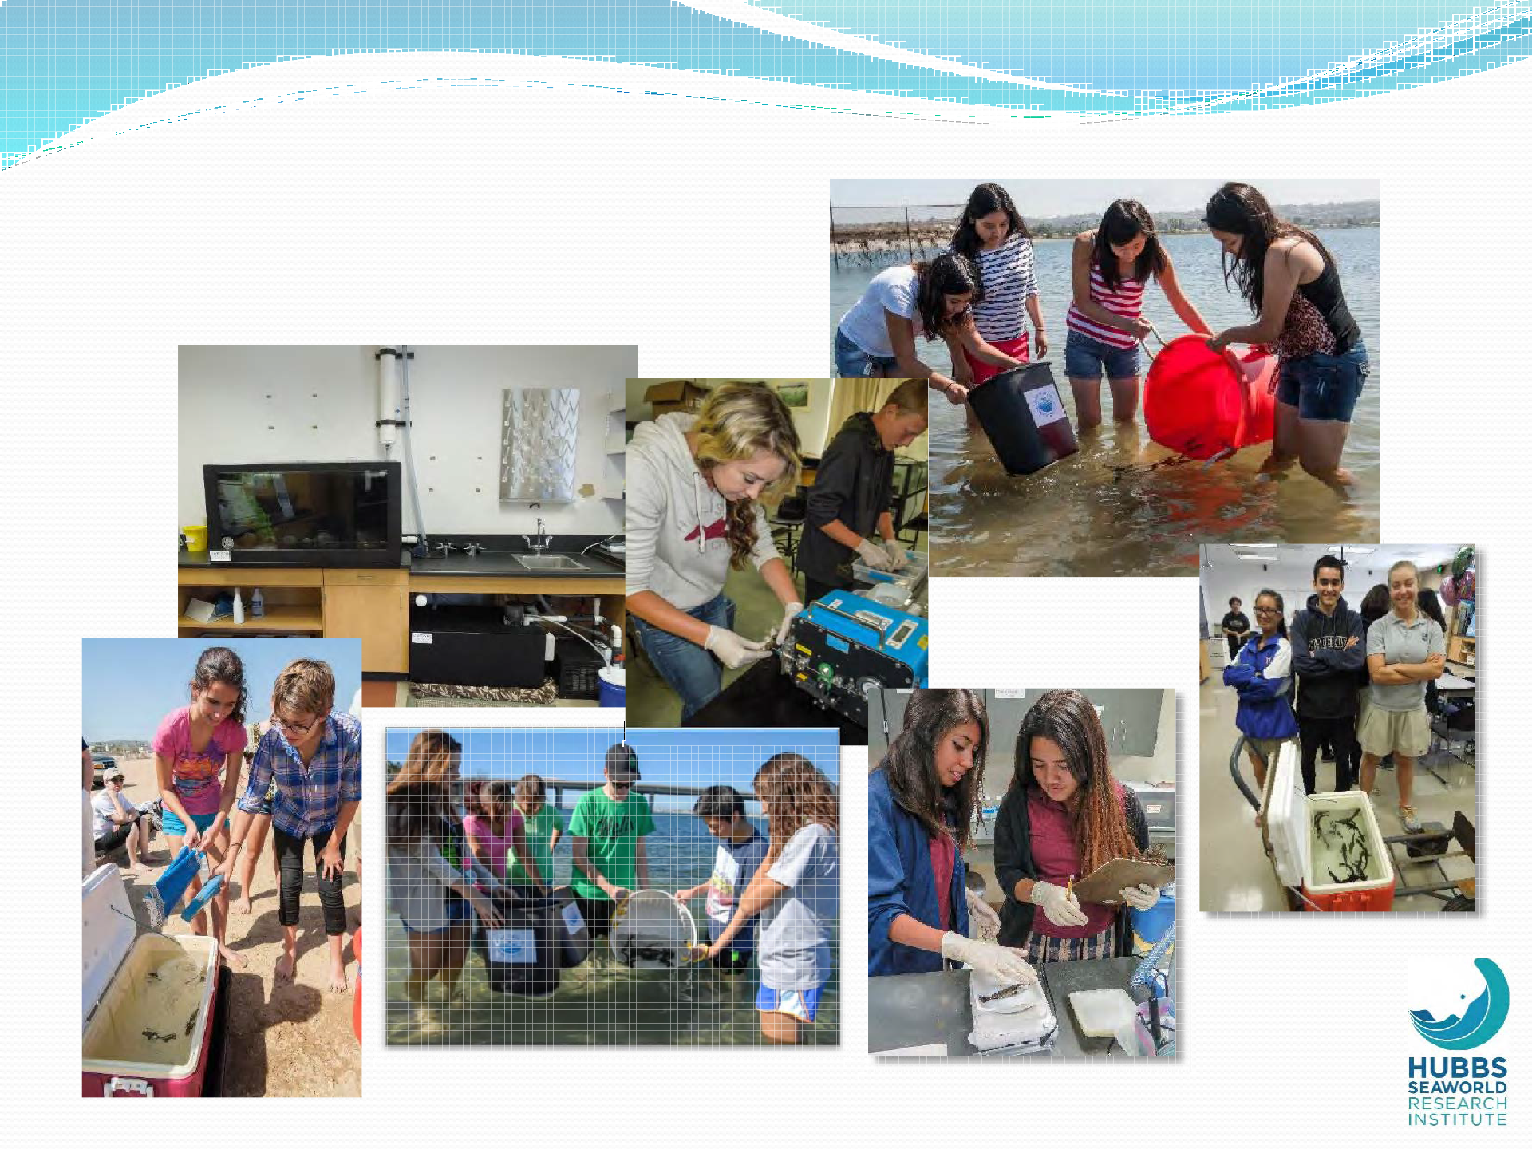
SITC in Action

Slide 9
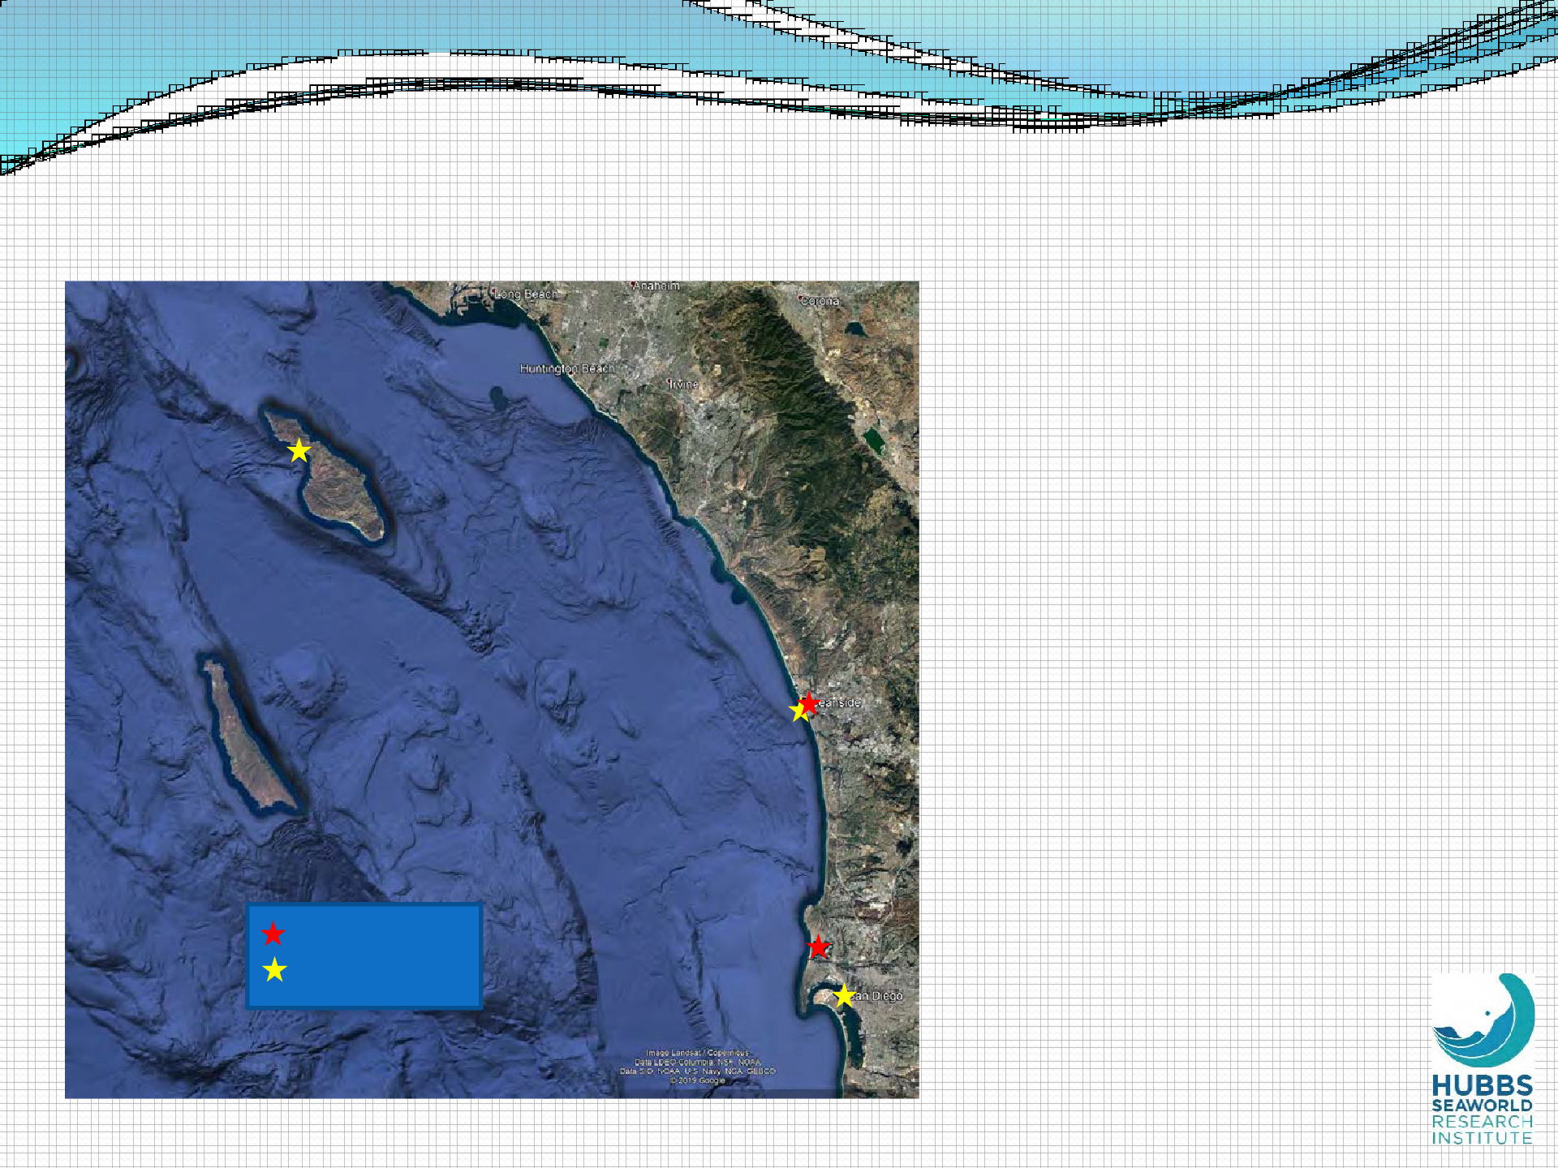
Southern California – HSWRI Facilities
Santa Catalina Island
Carlsbad
Hatchery Coastal Cage
San Diego

Slide 10
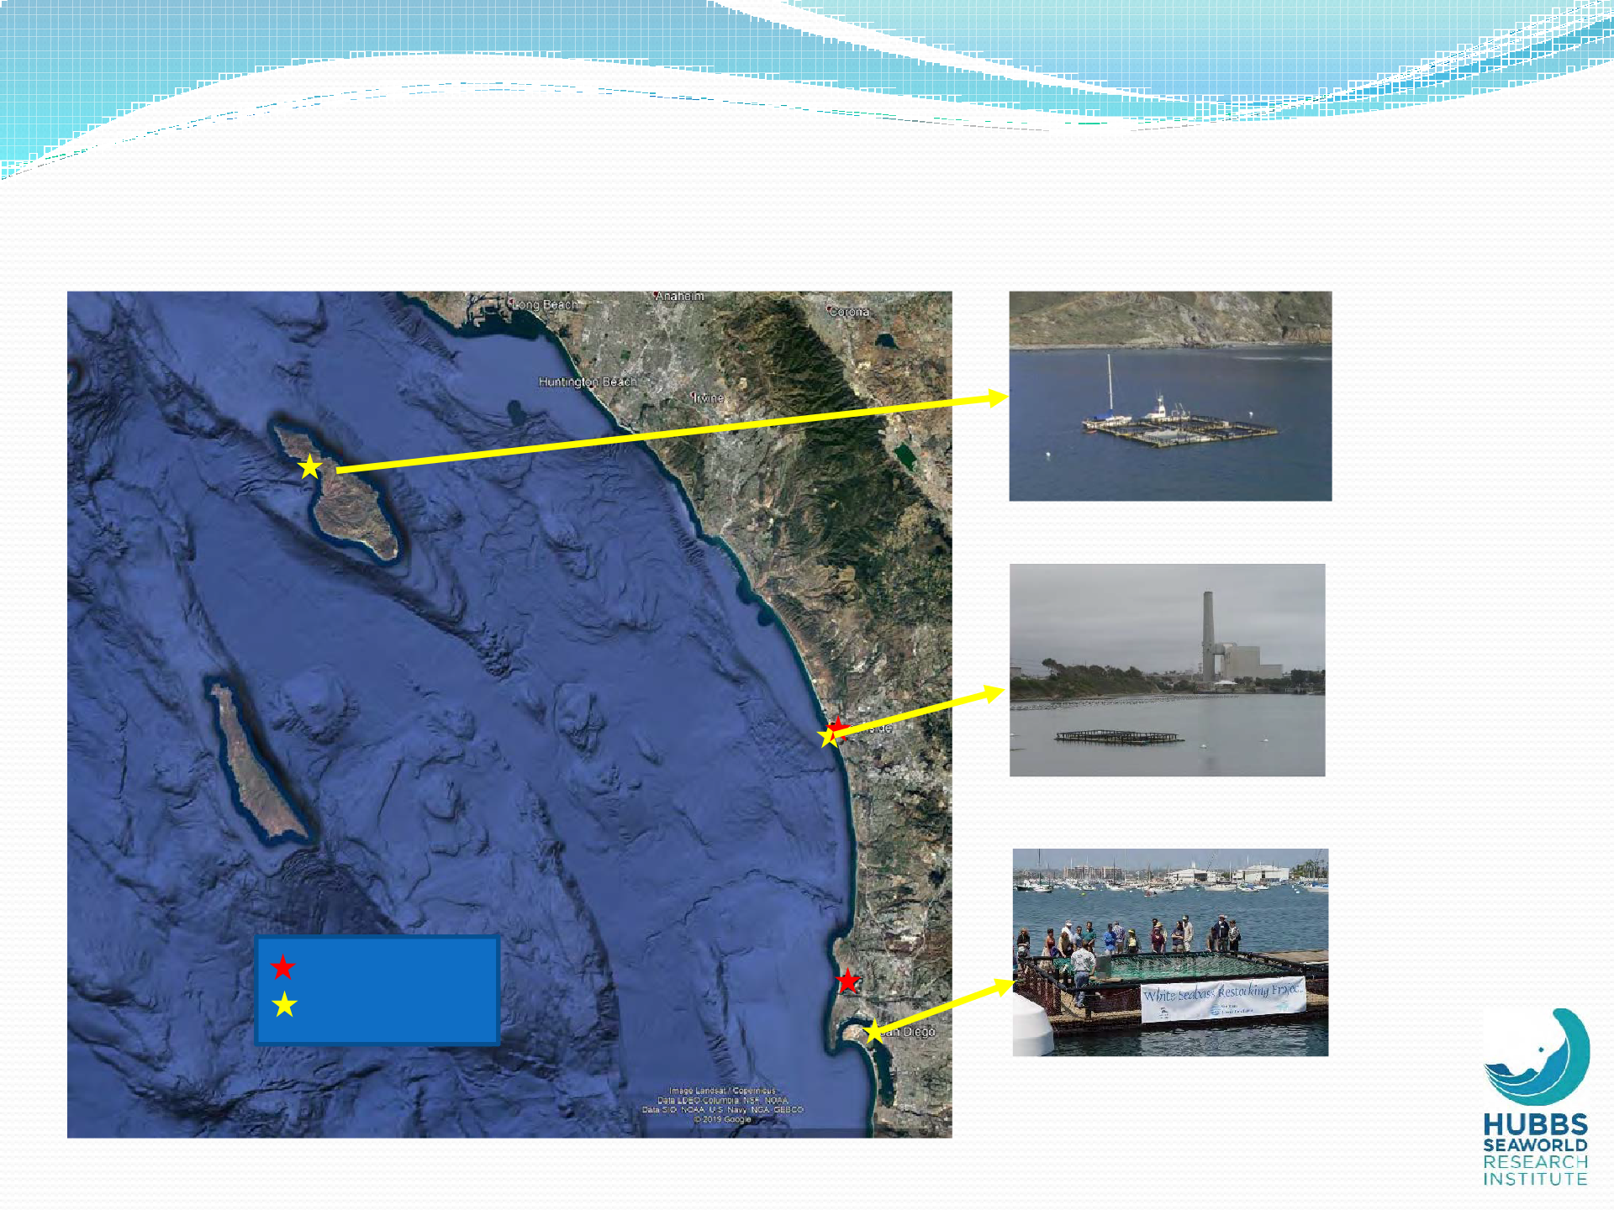
Southern California HSWRI Facilities
Santa Catalina Island
Catalina Island (1997)
Four cages of 500m³ each
Carlsbad
Agua Hedionda Lagoon (2003)
Two cages of 195m³ each
Hatchery Coastal Cage
San Diego
San Diego Bay (2003)
Two cages of 55 and 115m³ each

Slide 11
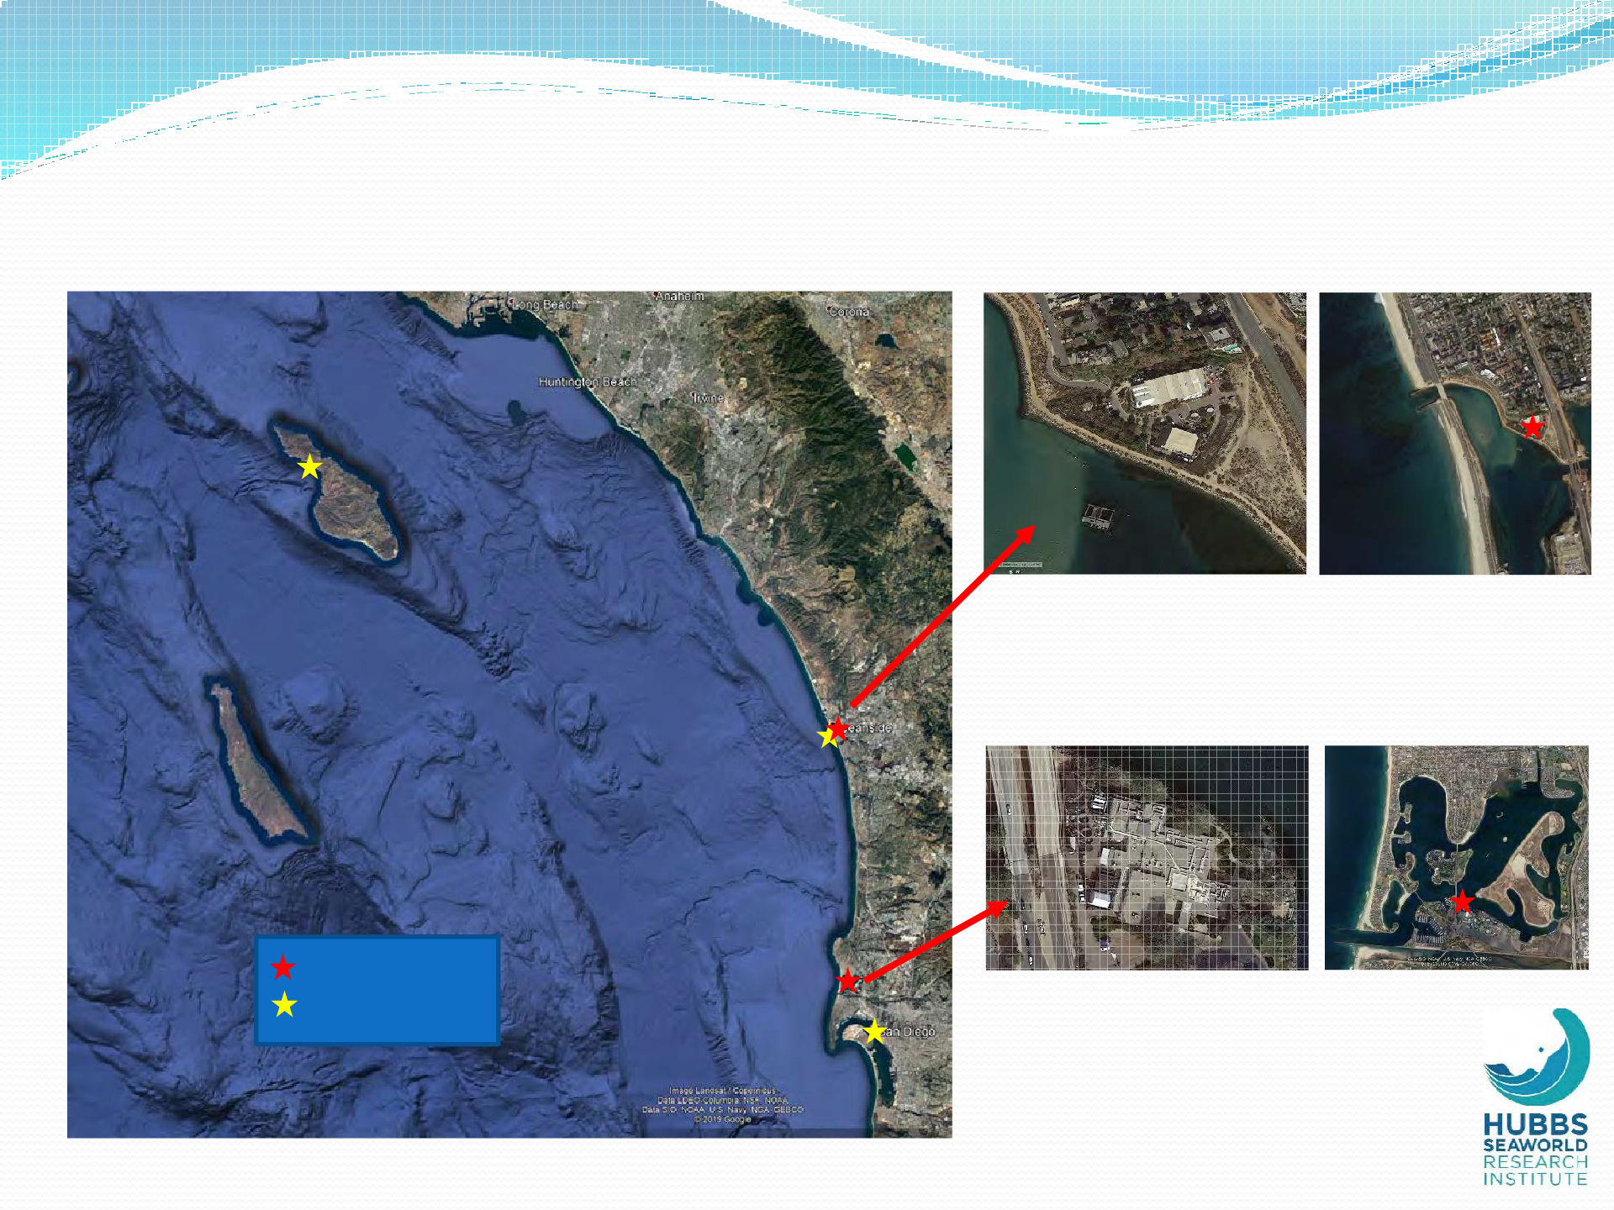
Southern California -- HSWRI Facilities
Santa Catalina Island
Marine fish hatchery (1995)
2,000 m² (22,000 ft²)
4,542 L/m (1,200 gpm) seawater system
100% dedicated
Carlsbad
Hatchery Coastal Cage
San Diego
Main offices/laboratory (1994)
2,800 m² (30,000 ft²)
1,324 L/m (350 gpm) seawater system
~30% dedicated

Slide 12
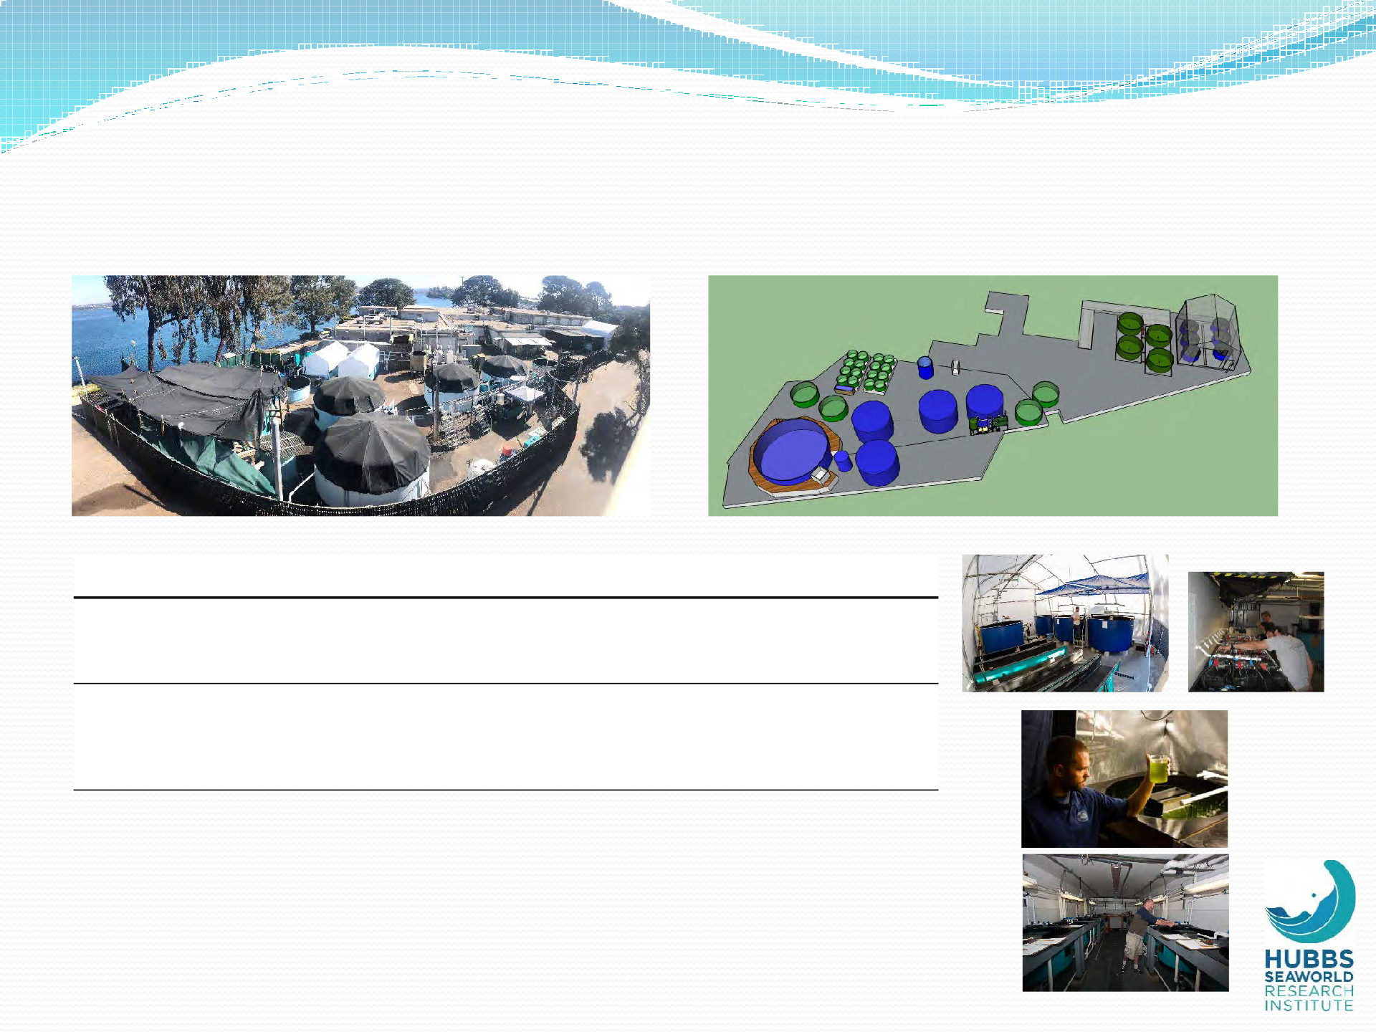
Mission Bay Laboratory
1
4
8
4
5
7
5
6
Tank Vol (L) | Number (#) | RAS? | Temperature Control? | Light Control? | Life Stage | ID
1,000 | 16 | X | X |  | Juvenile | 1
320 | 24 | X | X | X | Larvae-early juvenile | 2
320 | 15 | X | X | X | Larvae-early juvenile | 3
11,500 | 6 |  |  |  | Young brood or market size* | 4
32,000 | 4 | 1 | 1 |  | Broodstock (YT and Halibut) | 5
140,000 | 1 | 1 |  |  | Broodstock YT | 6
8,000 | 2 |  |  |  | Quarantine/misc | 7
5,400 | 4 |  | X | X | Larval rearing | 8
8
2
+ rotifer and Artemia daily feeding capacity of 1billion and 500 million, respectively
+ seasonal egg production for YT and halibut; 44 and 170 million in 2019
+ offices, cubicles, meeting rooms, auditorium
3

Slide 13
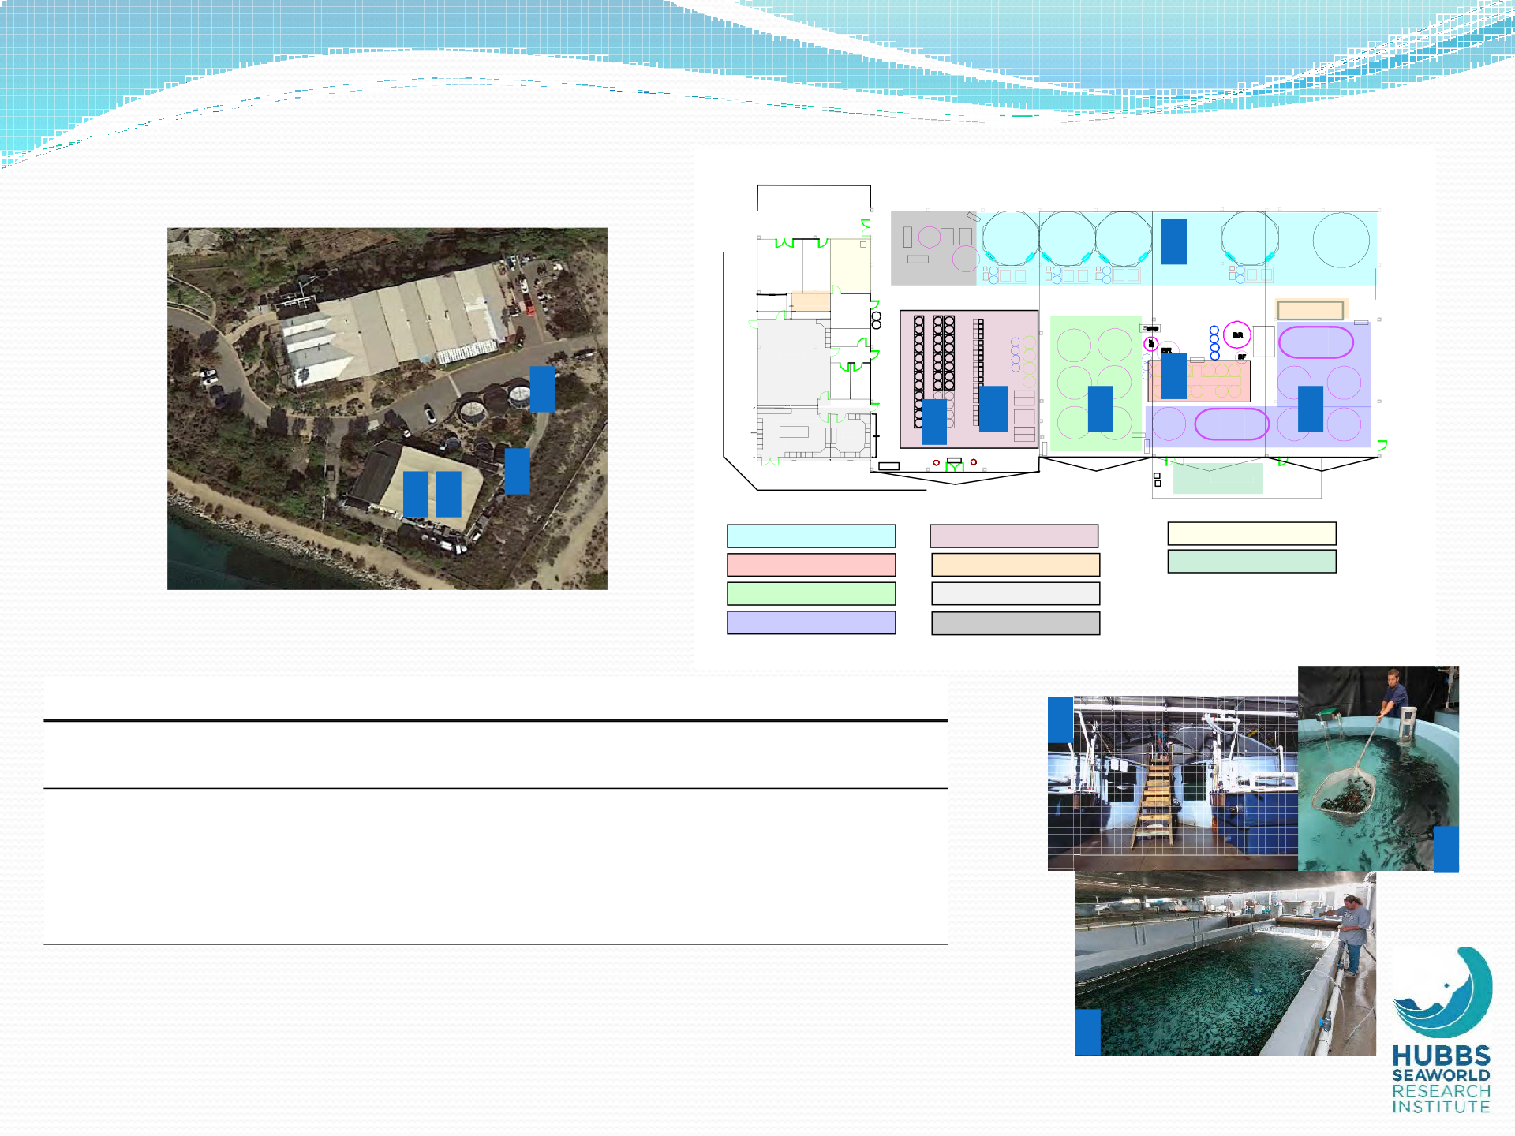
Carlsbad Hatchery
Filter Pad
B1 B2 B3
4
B4
B5
Store Naup Workshop Room Room
Rolll Up Door
Algae Bacti
Freezer Food Prep
Dry Lab
Dive Locker
J1
Sump
J2
6
8
Rest Room
5
Lunch Room
1
2
6
Offffiice
Offffiice
9
Taggiing Area
3 7
Broodstock
Egg Hatching (incubators) Nursery I (J1) Nursery II (J2)
Experimental
Food Storage Office and Laboratory
Live Feeds
Tagging Station
Industrial Machinery
Tank Vol (L) | Number (#) | RAS? | Temperature Control? | Light Control? | Life Stage | ID
320 | 36 | X | X | X | Larvae-early juvenile | 1
80 | 40 | X | X | X | Larvae-early juvenile | 2
1,000 | 12 |  |  |  | Juvenile | 3
44,000 | 5 | X | X | X | Broodstock White Seabass | 4
1,650 | 12 | X | X | X | Hatching/early larval | 5
8,000 | 14 | X | X | X | Early juvenile | 6
28,000 | 6 |  |  |  | Juvenile | 7
64,000 | 3 |  |  |  | Juvenile | 8
38,000 | 2 | X |  |  | Broodstock quarantine | 9
4
6
+ Artemia production capacity of 650 million per day
+ year-round WSB egg production; 330 million in 2019
7

Slide 14
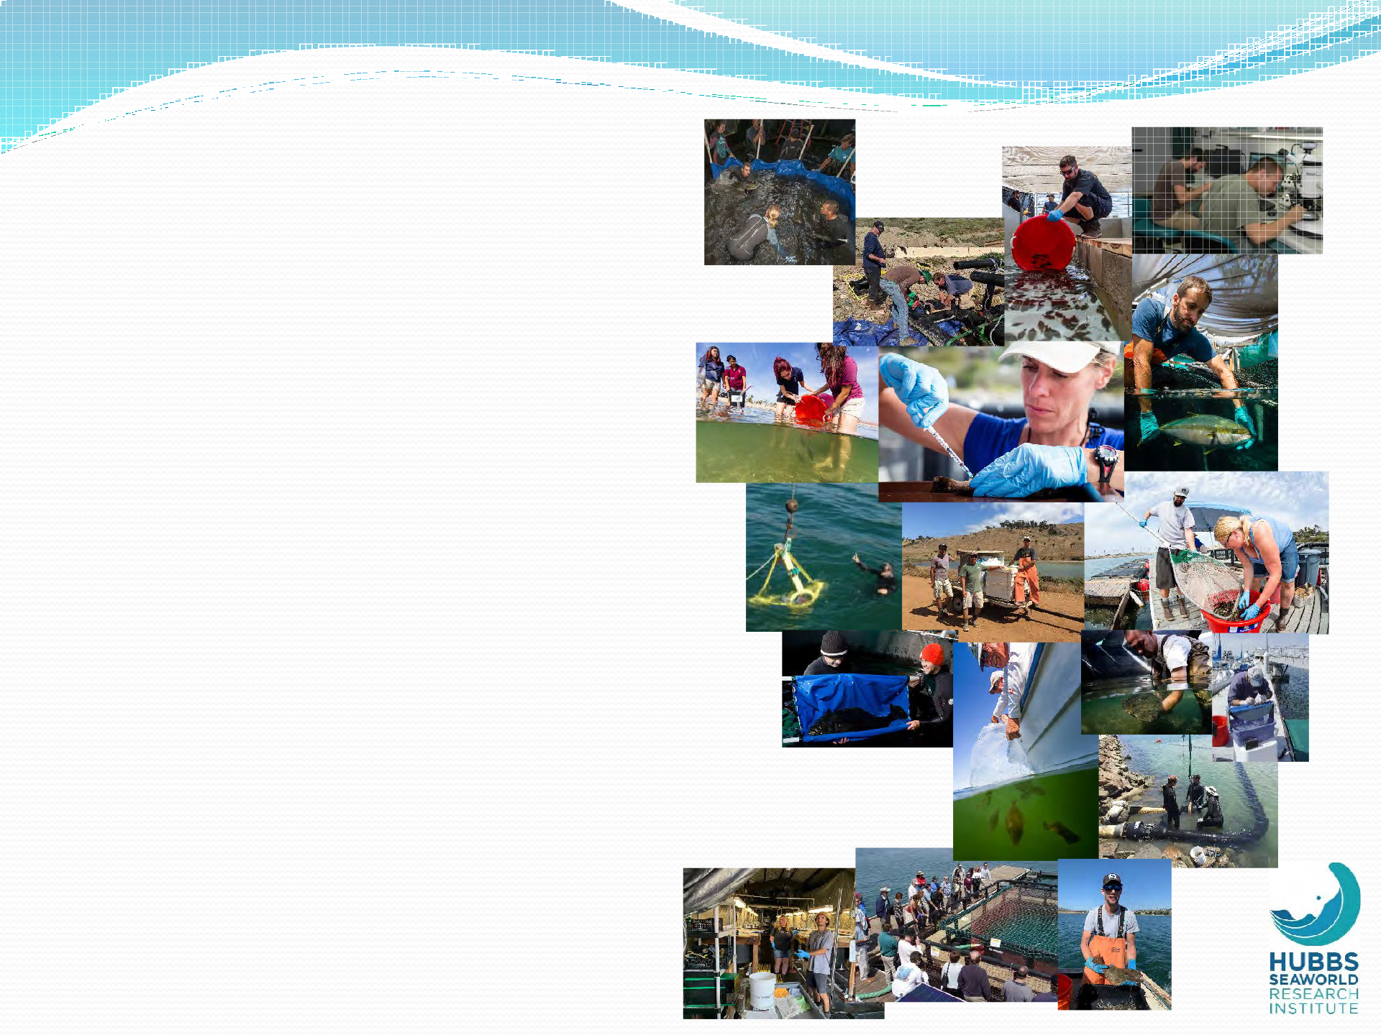
People
Overall (~20 production, research, support, education)
Current research focus/expertise
  Nutrition (all life stages)*
  Fish health
  Genetics*
  Physiology*
  Systems design/engineering/tech transfer
  Fisheries ecology/population biology
  IMTA*
Cage Operations (1.5 + many volunteers)
DSO + 2-3 certified divers
Education (Ed Coordinator, grad students and interns)
* Supported heavily by collaborators!

Slide 15
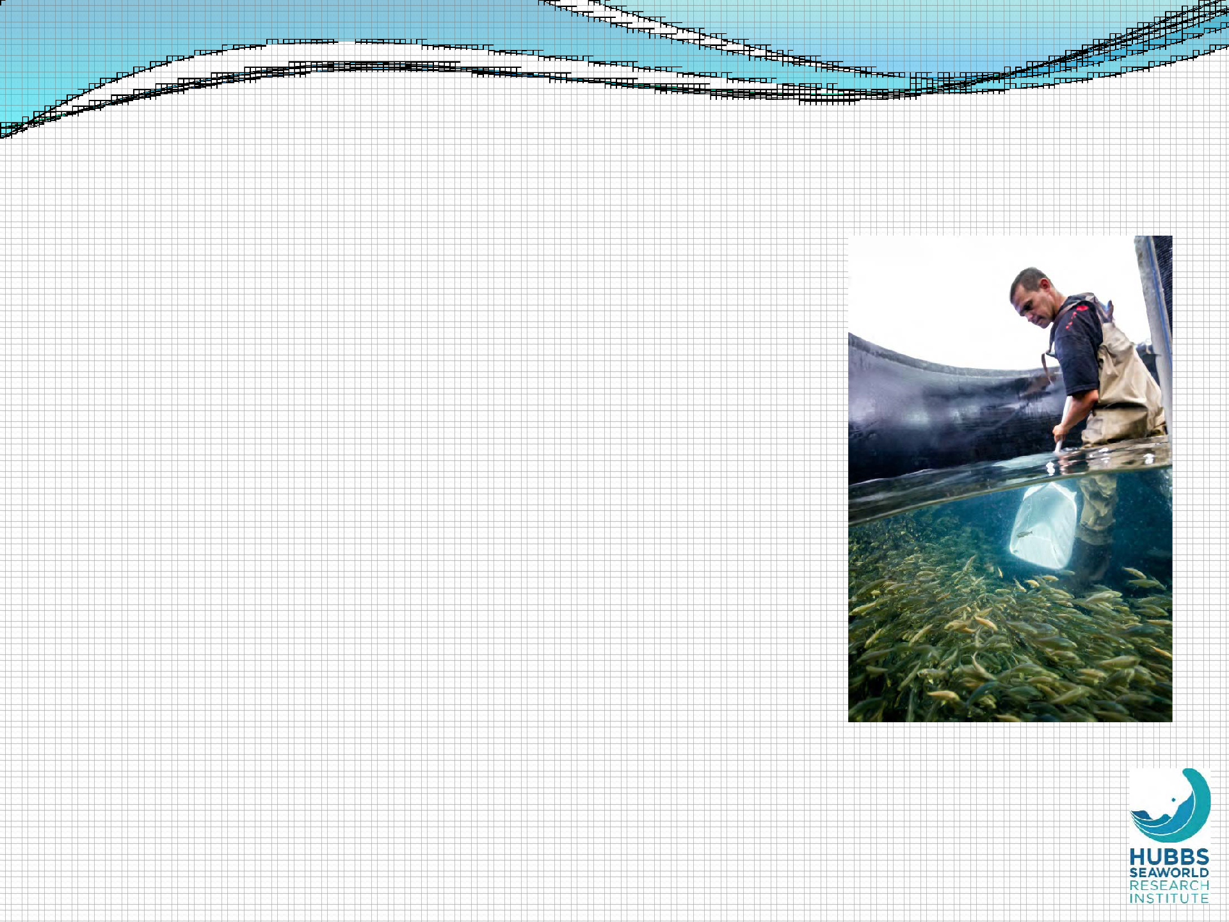
Summary
Good physical and biological environment
/ difficult political and regulatory
Extensive and long-term presence in SoCal – especially with seabass
Excellent (and unique) land-based facilities for research and production
Active and reliable spawning of three top candidate species
Dedicated and highly experienced staff who are:
  Practical and creative
  Results-oriented
  Collaborative

Slide 16
Thank You!

