Slide 1
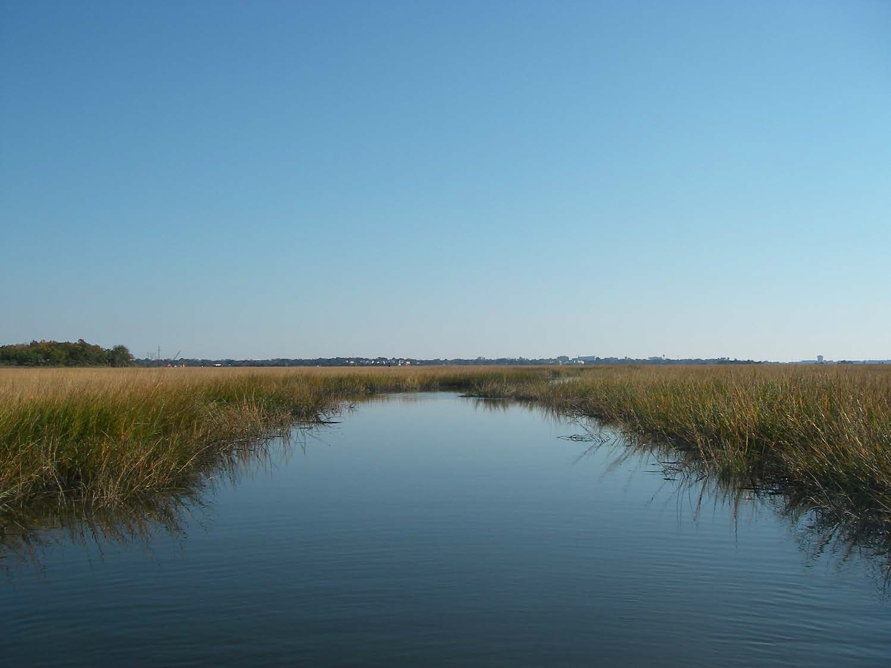
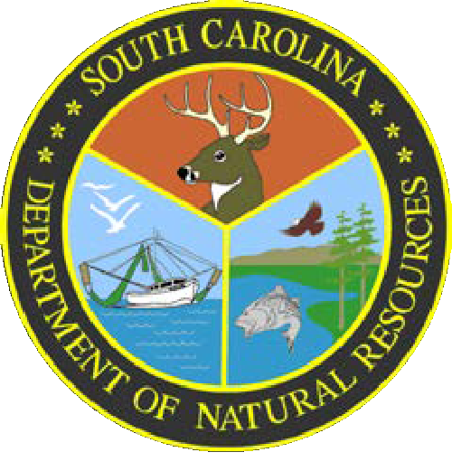
South Carolina Department of Natural Resources Marine Aquaculture Program
Fort Johnson Campus, Charleston SC
Marine Resources Research Institute
  Hollings Marine Laboratory
  Waddell Mariculture Center, Bluffton

Slide 2
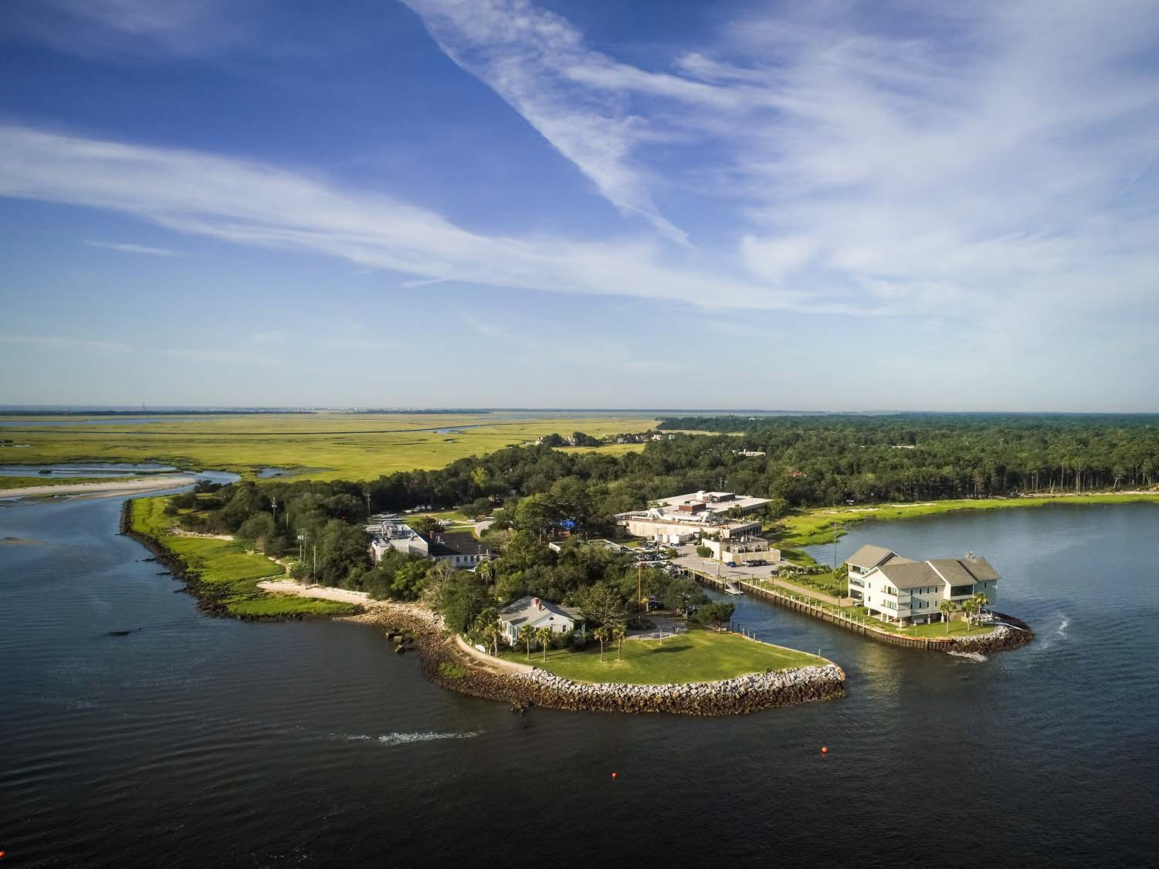
Fort Johnson Campus, Marine Resources Center

Slide 3
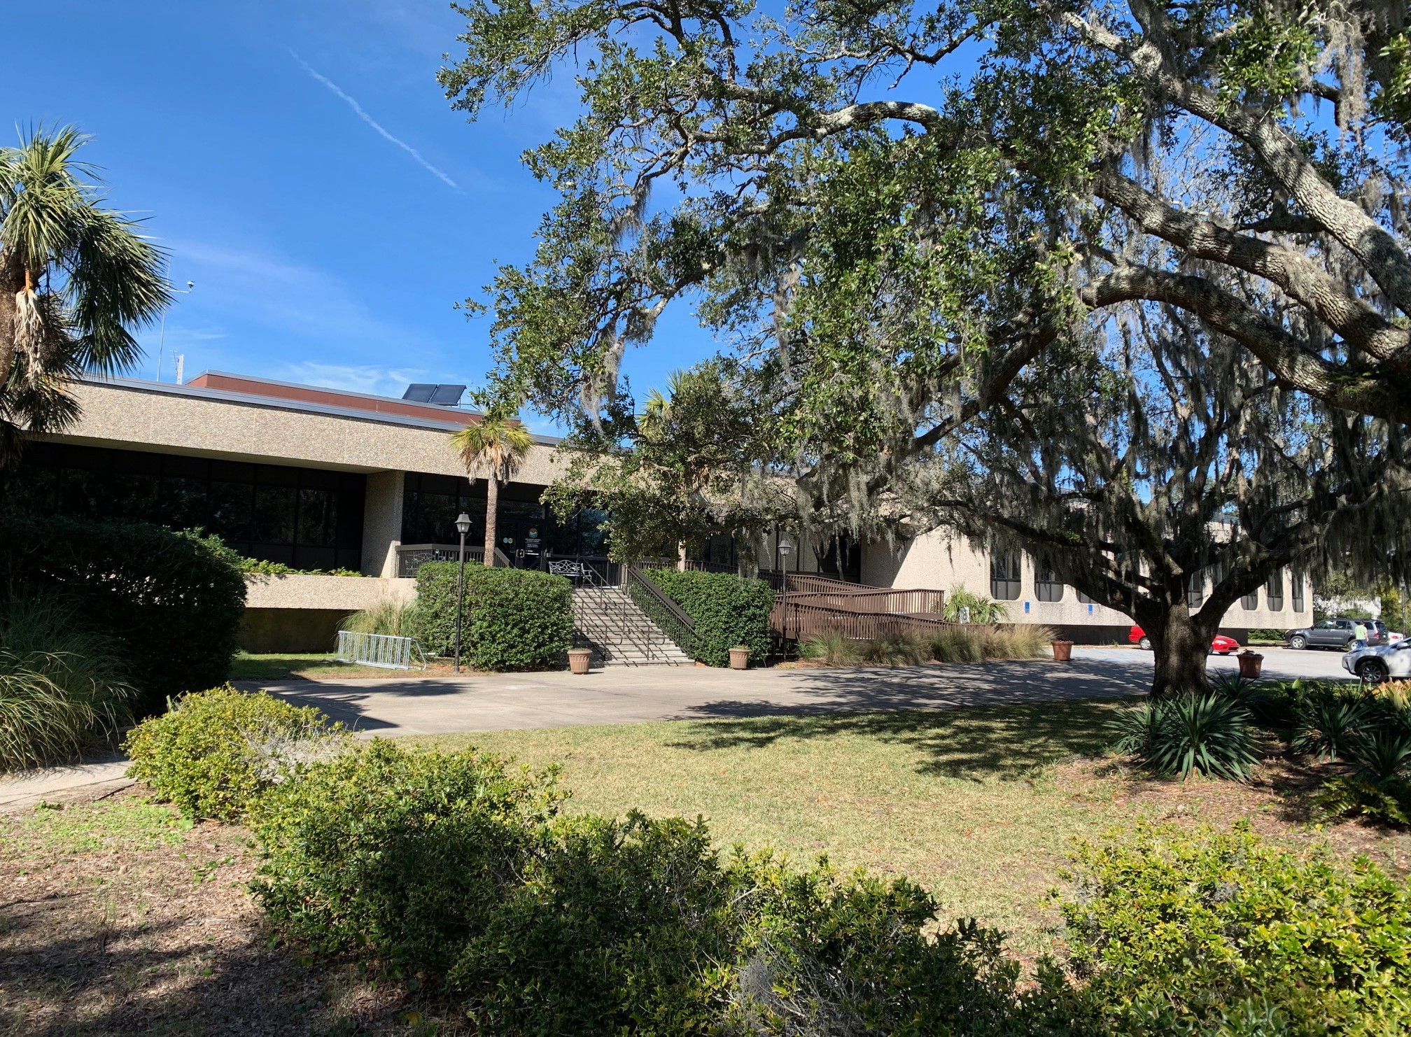
Marine Resources Research Institute (MRRI)

Slide 4
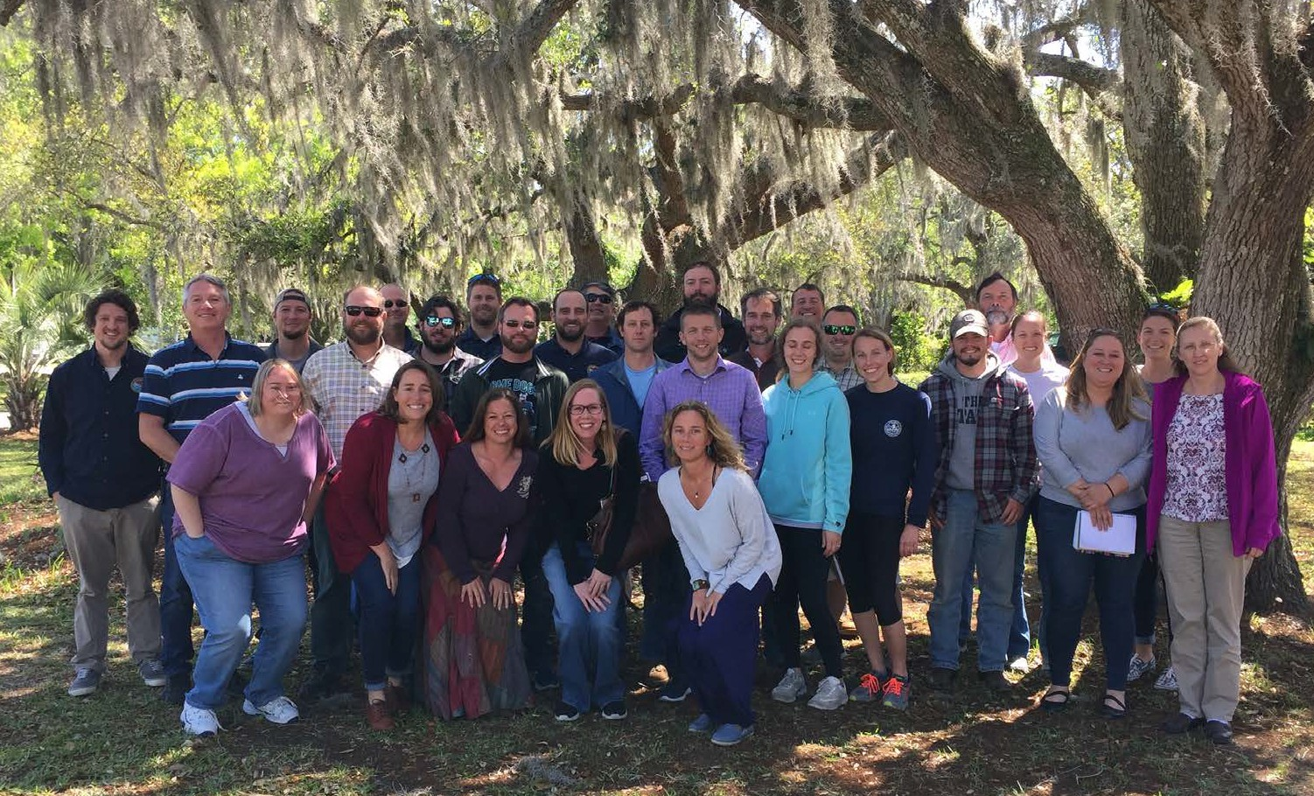
Aquaculture and Stock Enhancement Team

Slide 5
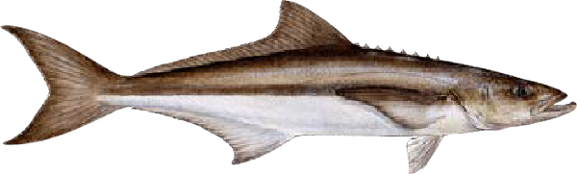
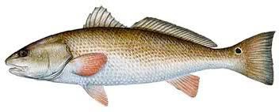
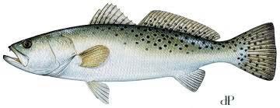
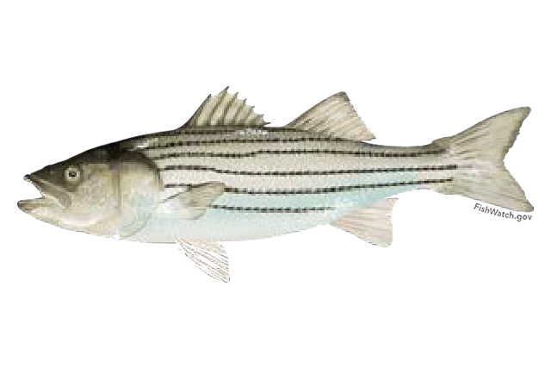
Aquaculture and Stock Enhancement
Stock enhancement of marine species
Environmental tolerance testing
Fish nutrition/feed development
“omics” for diet formulation and testing
Demonstration-scale testing of diets and treatments
Genetic tools for aquaculture
Application of Nanobubble technology
Effects of parasites on performance and flesh quality

Slide 6
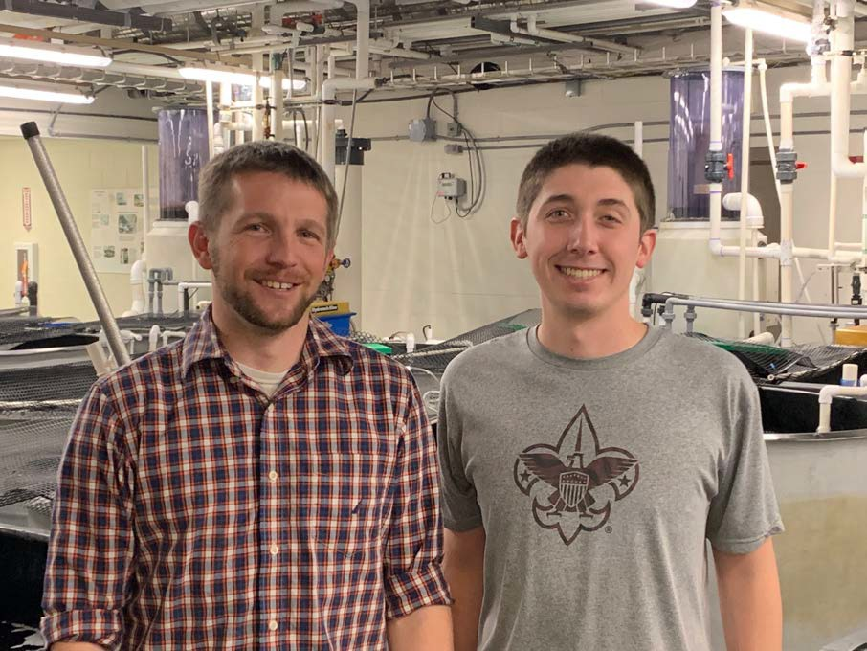
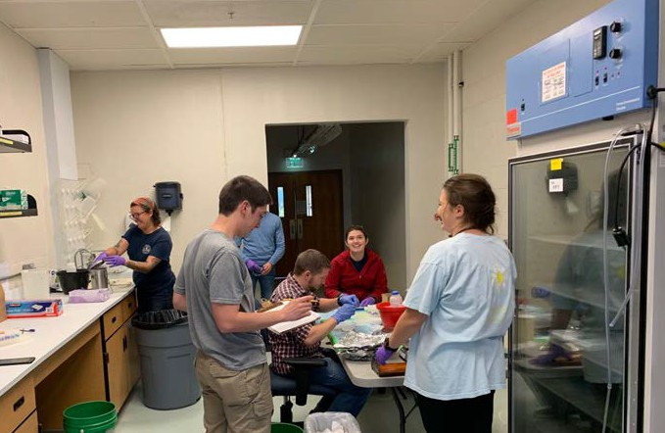
Dr. Aaron Watson and College of Charleston student David Klett
South Carolina Department of Natural Resources – Mariculture Section - Aquaculture Nutrition Research
Develop and evaluate fishmeal and fish oil replacement feeds and ingredients
Utilize traditional aquaculture production metrics as well as advanced metabolic techniques
Increased utilization of more sustainable and cost-effective
ingredients to replace fishmeal and fish oil
Evaluate enzyme additions in plant- based fish feeds to increase mineral
utilization
Indigestible phytase-bond phosphorus in plant-based feeds
Reduce effluent wastewater by adding phytase enzymes allow fish to
efficiently utilize phosphorus
Use of alternative feed ingredients
Brewers waste as feed additive

Slide 7
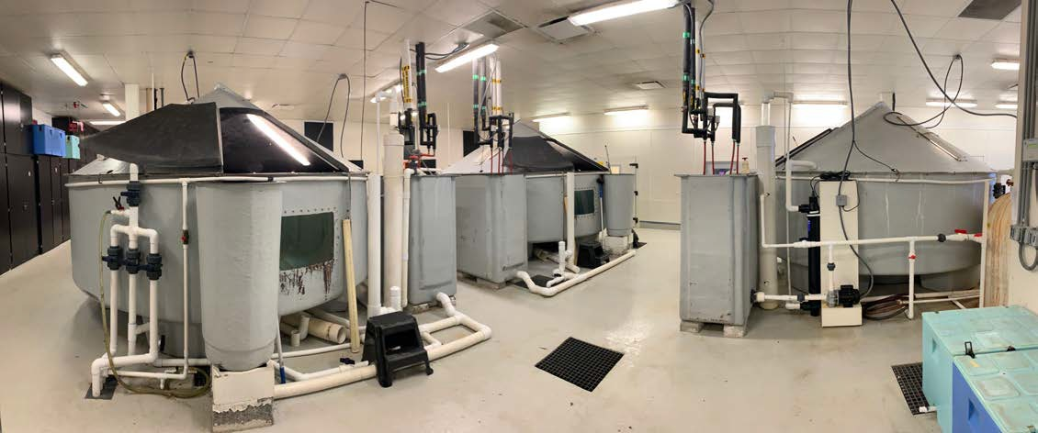
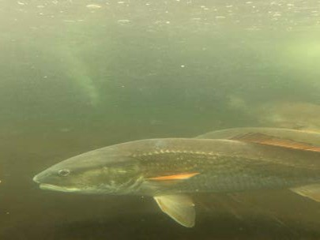
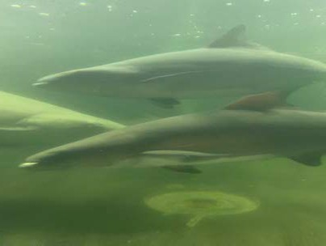
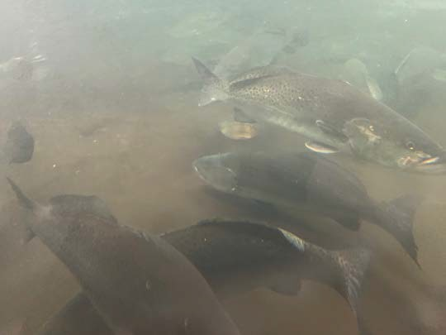
Broodstock Conditioning Culture at MRRI

Slide 8
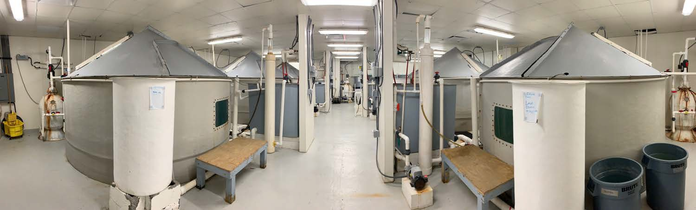
Broodstock Conditioning Culture

Slide 9
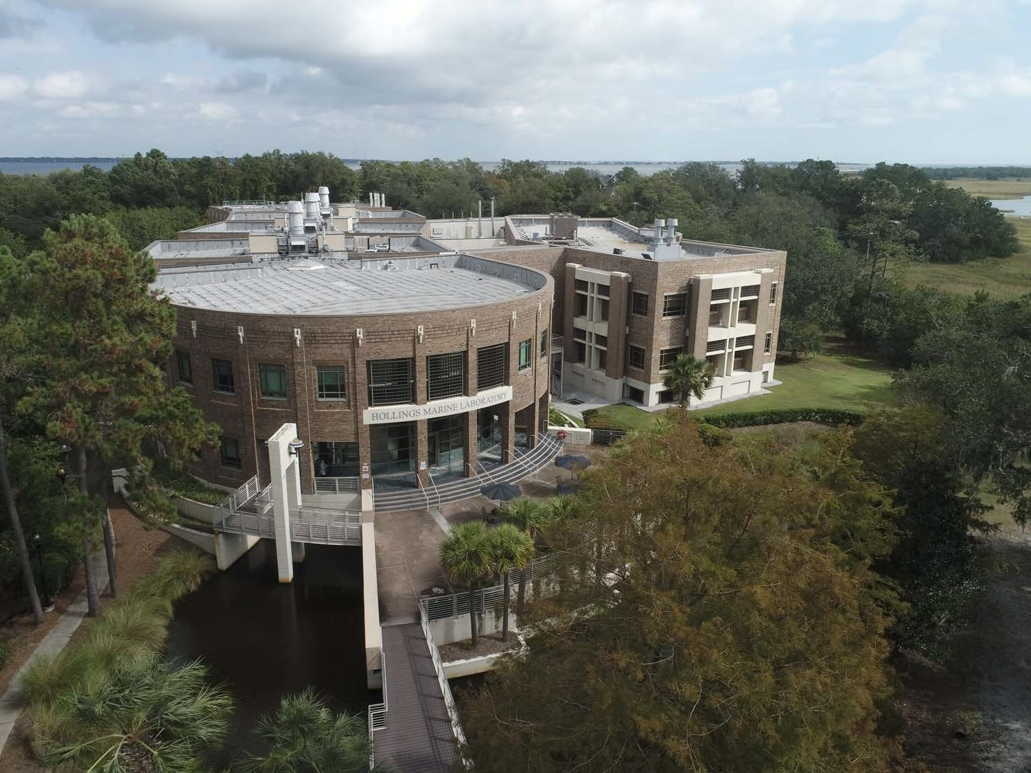
Hollings Marine Laboratory

Slide 10
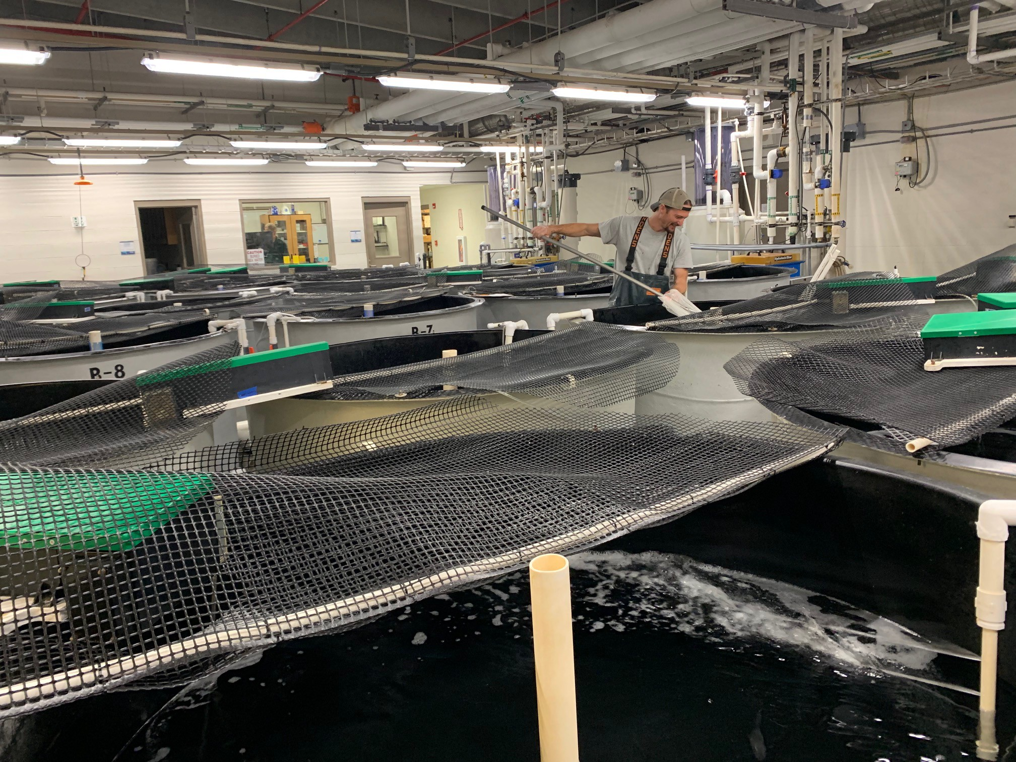
Fish facility

Slide 11
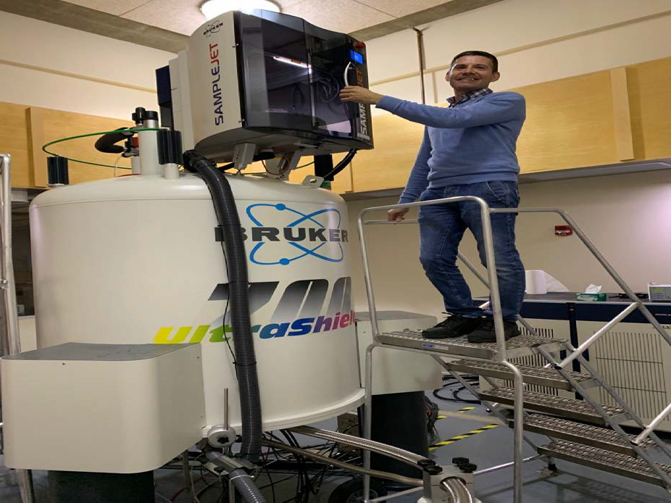
Dr. Fabio Casu
South Carolina Department of Natural Resources – Mariculture Section - Aquaculture Nutrition NMR based Metabolomics research
Increase understanding of nutritional requirements through metabolic profiling
  Apply NMR-based metabolite profiling
and LCMS Orbitrap lipid profiling to identify nutritional needs in a variety of feeds, species, and life stages
Develop “-Omics” tools for aquaculture research
  Development of biomarker discovery methods and novel metabolism and
physiology evaluation techniques
  Leverage cutting-edge technology to identify and develop more rapid techniques to diagnose nutritional deficiencies

Slide 12
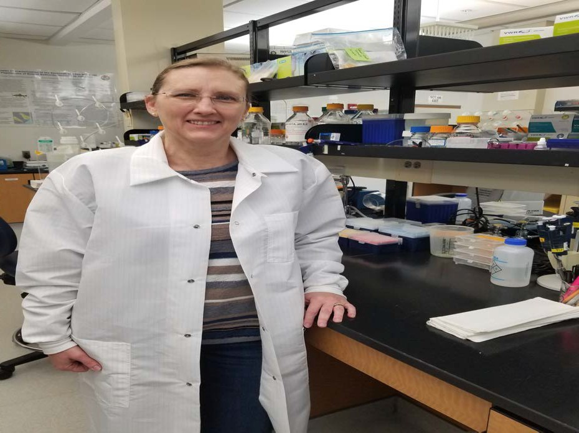
Dr. Tanya Darden
South Carolina Department of Natural Resources – Genetics Research
Using genetic tools to optimize hatchery production and sourcing broodstock
Using Genetics and IBM to determine risk of net pen escapement
Using Genetics and IBMs to optimize hatchery
production and determine stocking goals for stock enhancement
Genetic tools to track fish released into the wild
Genetic tools for forensic evaluation of
seafood products
eDNA research to locate broodstock, invasive species detection

Slide 13
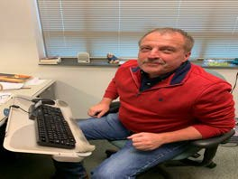
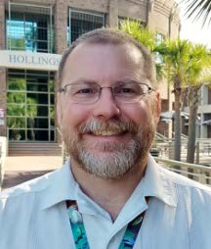
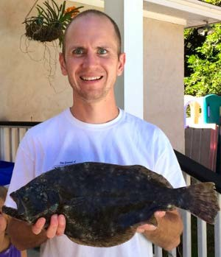
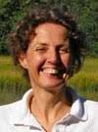
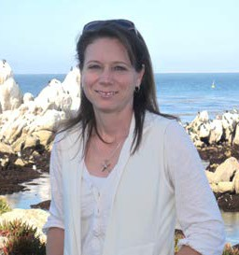
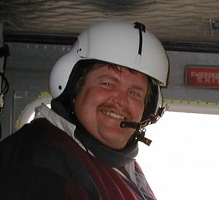
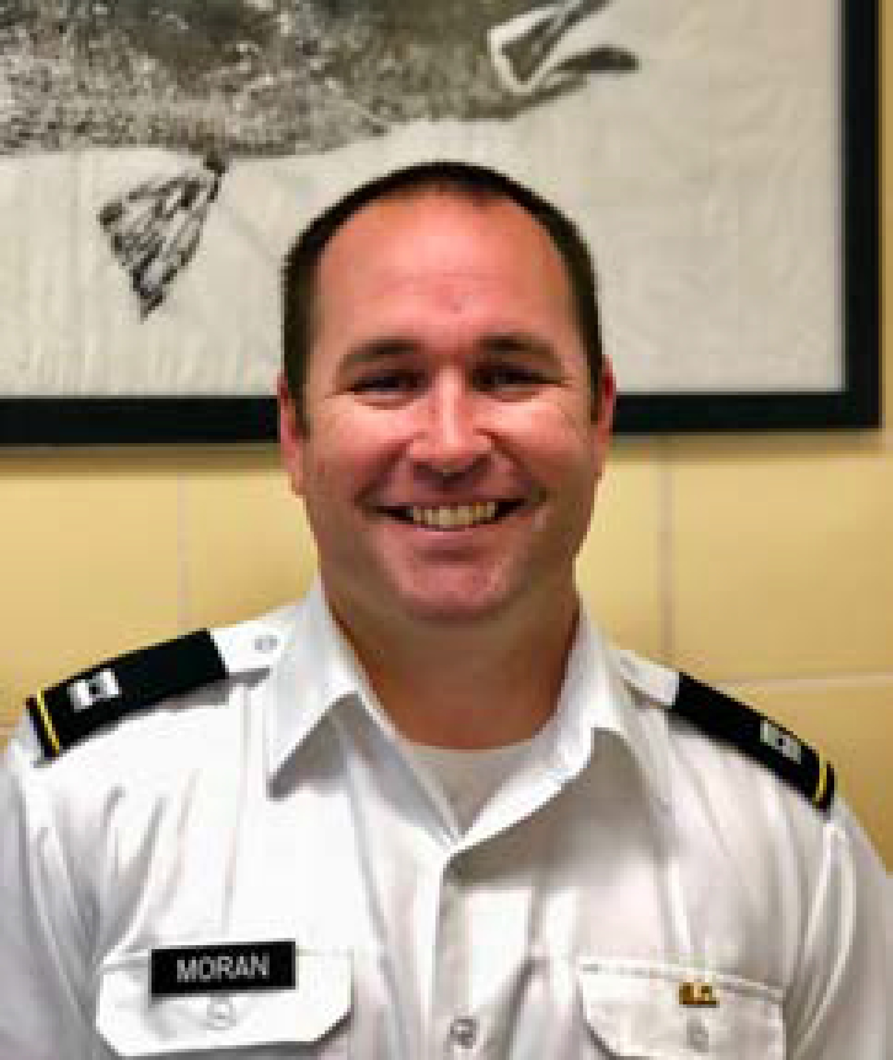
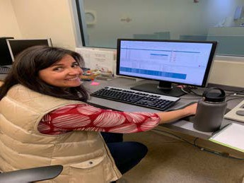
NIST/NOAA/College of Charleston/Citadel Military College
Dr. Mike Janech
Dr. Peter Moeller
Dr. Isaure De Buron
Dr. Eric McElroy
Dr. Peter Lee
Dr. Jody Beers
Dr. Clinton Moran
Dr. Tracey Schock

Slide 14
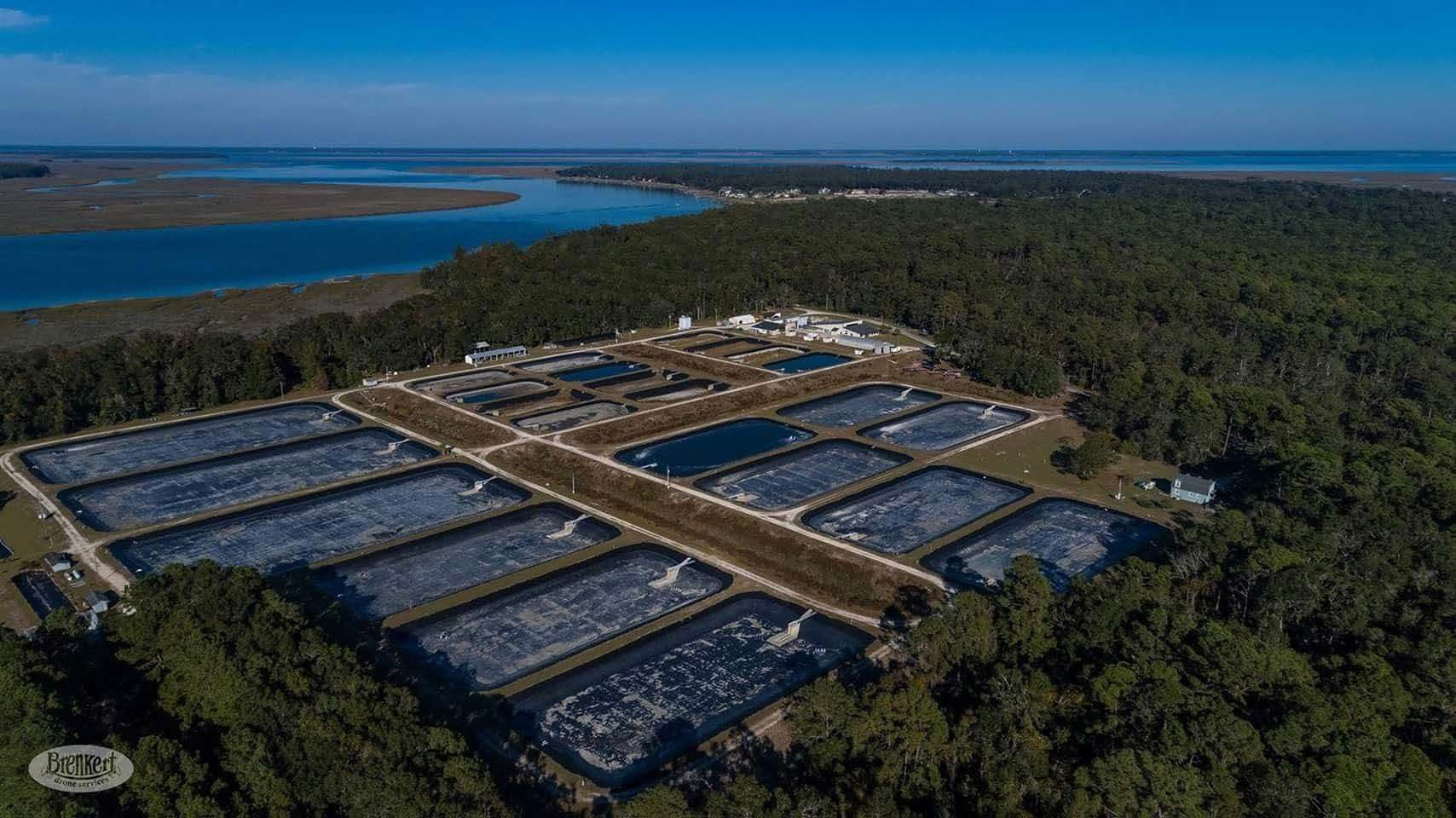
WMC Facilities and Research

Slide 15
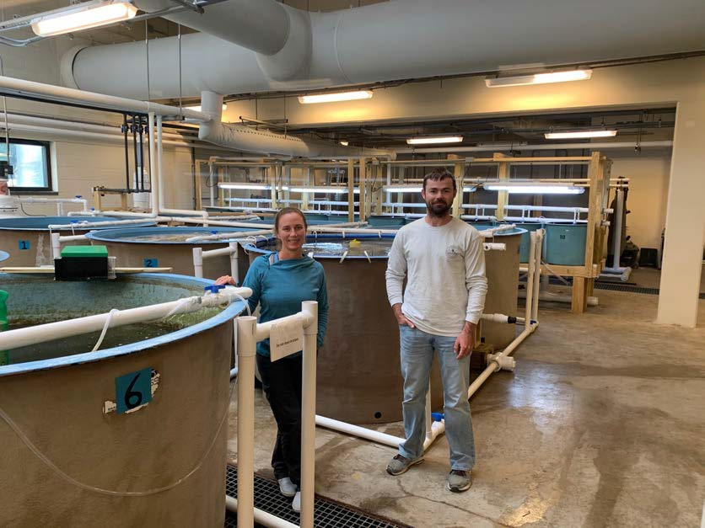
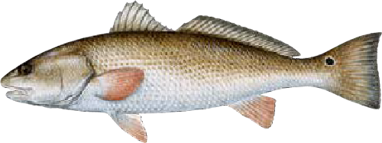
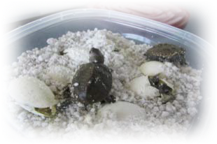
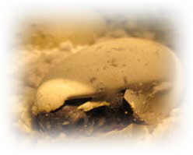
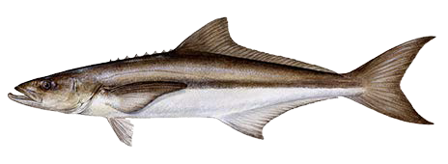
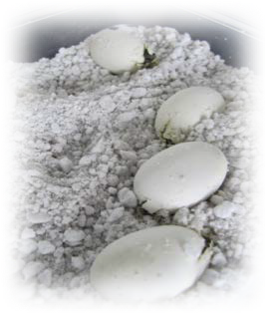
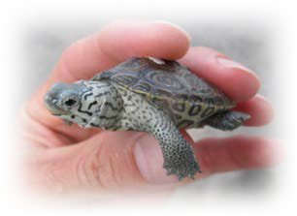
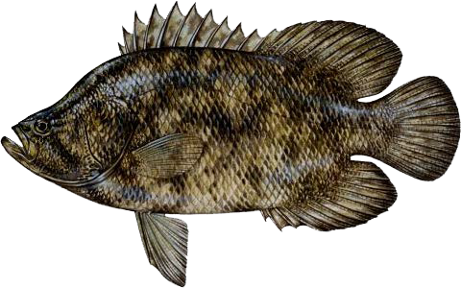
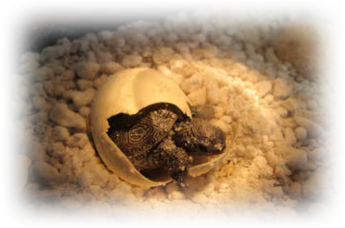
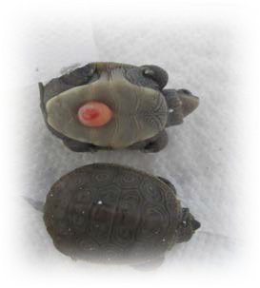
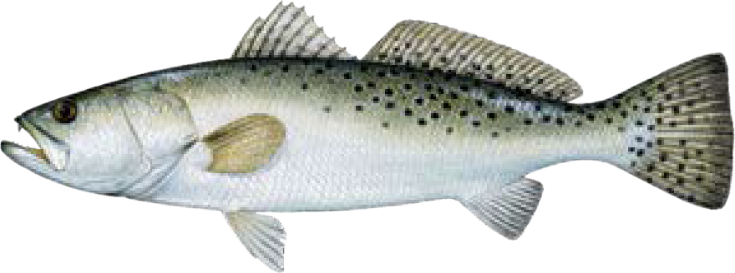
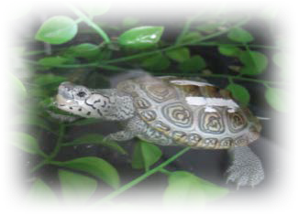
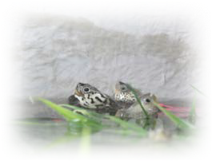
Erin Levesque and Dr. Jason Broach
South Carolina Department of Natural Resources – Mariculture Section – Waddell Mariculture Center
Stock Enhancement Research
Improve spawning and larval and juvenile grow-out techniques for red drum, spotted seatrout, and cobia
Evaluate aquaculture potential and ecology of other species of recreational, commercial,
and conservation interest to South Carolina
Education and outreach to the public
regarding marine resources and mariculture efforts in South Carolina

Slide 16
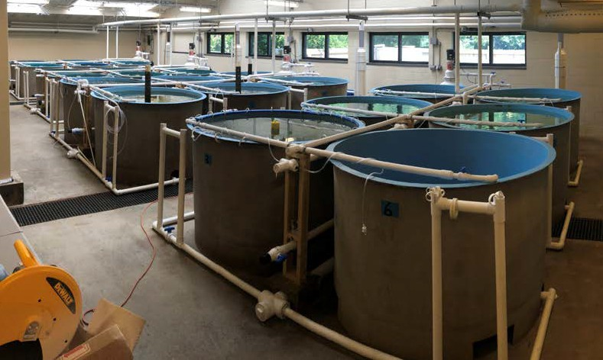
Intensive Aquaculture Research WMC
Growout systems
  4, 6-tank systems
    12, 1,250-L tanks
    12, 2,400-L tanks
  Plumbing also adaptable for
single, interconnected 24-tank
system that allows for increased
replication with reduced
background variation
Evaluation of stocking densities,
temperature effects, feed rates, diets, etc.
Plumbing adaptable to allow for
external egg collectors and
replicated spawning experiments for small-bodied fishes

Slide 17
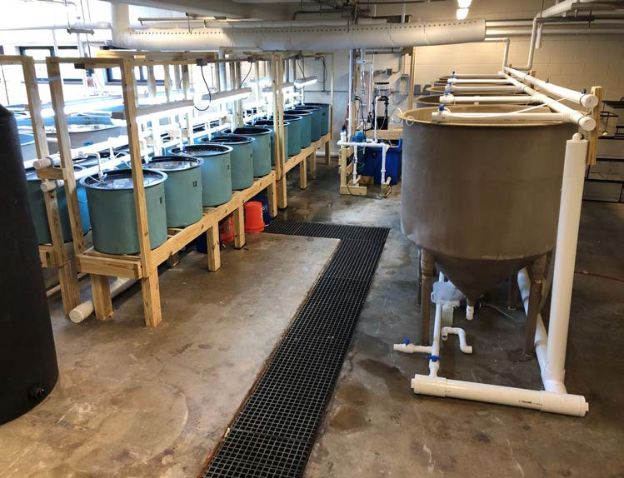
Intensive Aquaculture Research
Egg/Larval/Zooplankton
System
20, 155-L Tanks
5, 1,063-L Tanks
Egg incubation
Mass culture of fish larvae
Replicated evaluations of
environmental and nutrition effects on larvae
Plumbing allows for isolation
of individual tanks for
zooplankton culture (rotifers and Artemia)

Slide 18
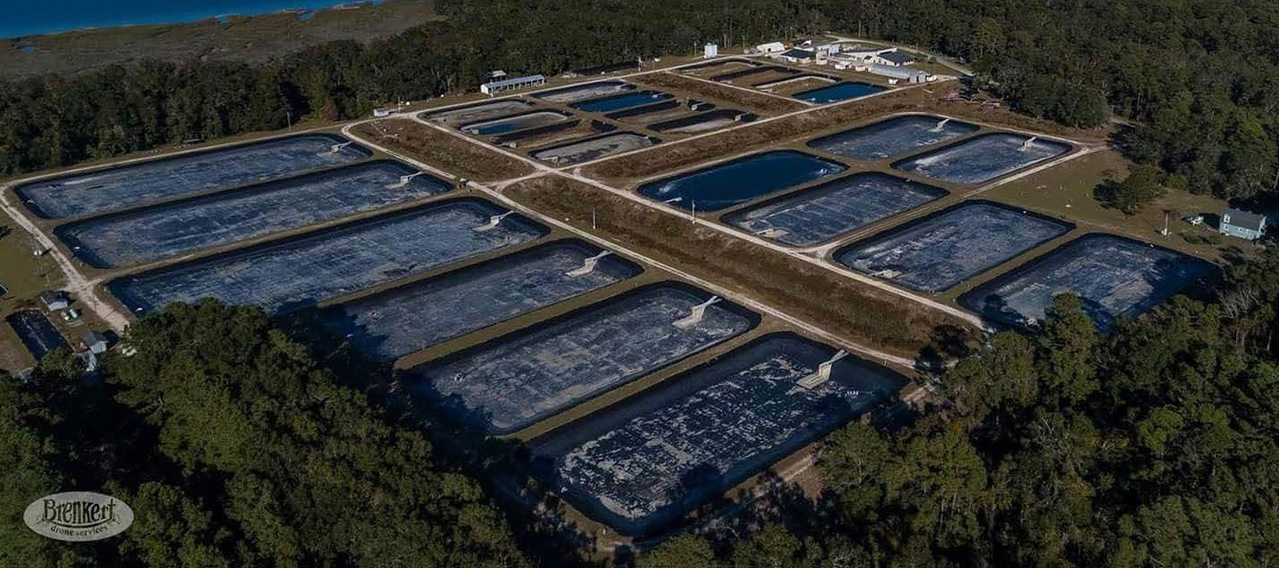
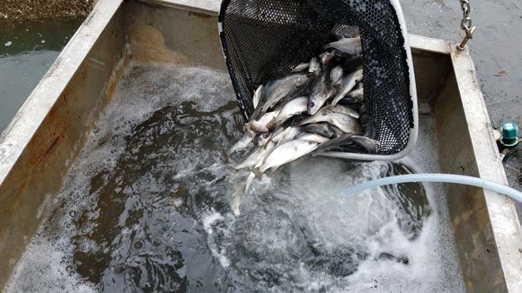
Extensive Culture
12, 0.25-acre ponds
9, 0.5-acre ponds
3, 1.25-acre ponds
Growout of juveniles and sub-adults
for stock enhancement and tagging
studies
Commercial, pilot-scale testing for
evaluating growout methods and
feasibility
Demonstration scale research

Slide 19
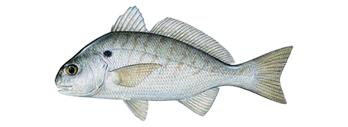
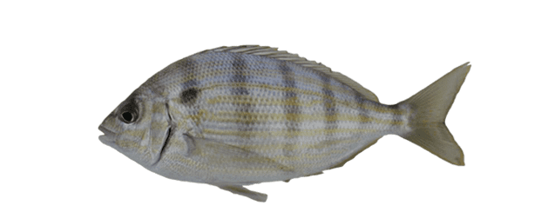
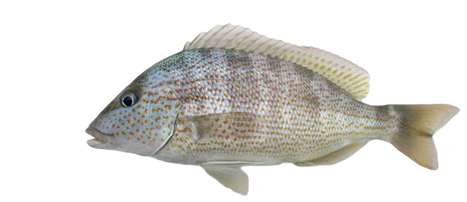
Future Research Projects Funded
Replacing Artemia Use in Larval Feeding Regimes of Three Marine Baitfish- Spot, Pinfish, and Pigfish
Evaluating Shellfish Ponds to Produce a Compatible Crop of Marine Fish, Tripletail Lobotes surinamensis

Slide 20
Opportunities
As a consequence of producing fish for stock enhancement there is often excess fish
Key southeast species available
Demonstration-scale facilities
Access to tools and techniques to help the aquaculture community
SBIR partnerships
Cooperative Extension projects
Training opportunities
Genetic sample processing
Consulting

Slide 21
Collaborations
(Contractual funding, SBIR, Joint competitive grants)
Key Partners
State/federal natural resource agencies (NC, GA, MD), Universities (CofC, Clemson, USC, UGA, VCU, WVU)
Zeigler - Red Drum Digestibility (novel ingredients) and Growth Trial
Zeigler - Reduction in Fishmeal/effluent waste for Red Drum
Ichthus Unlimited – Novel Tuna Diet NMR-based Metabolomics
Ichthus Unlimited (pending) – Red Drum Digestibility (novel ingredients)
Barron Algae-algae production as food/ animal feed additive
Nanopure Technology-Nanobubble ozonation
Hubbs Sea World Research Institute
Charleston Brewmasters
Swimming Rockfish and Shrimp Farm
Southland Fisheries
Hampton Roads Sanitation District

Slide 22
Challenges to Public-Private Partnerships
Use of public resources for private profit
Easier for us to partner with organizations rather than companies
Non-Disclosure Agreements/ Intellectual Property
Cost (Collaborative grant-based model works best)
Space (hasn’t been too much of a problem)
Risk
Competition
Time to manage the relationship
Safety
IACUC

Slide 23

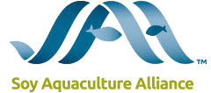




Acknowledgements
Saltwater Recreational Saltwater License Funds
Sportfish Restoration Funds
Soy Aquaculture Alliance
Waddell Mariculture Center Fund
State of South Carolina
Hollings Marine Laboratory
Grice Marine Laboratory
SCDNR Aquaculture Team

