Slide 1


Pompano Culture in Recirculating Aquaculture Systems
Funding Thanks to
Paul S. Wills

Slide 2
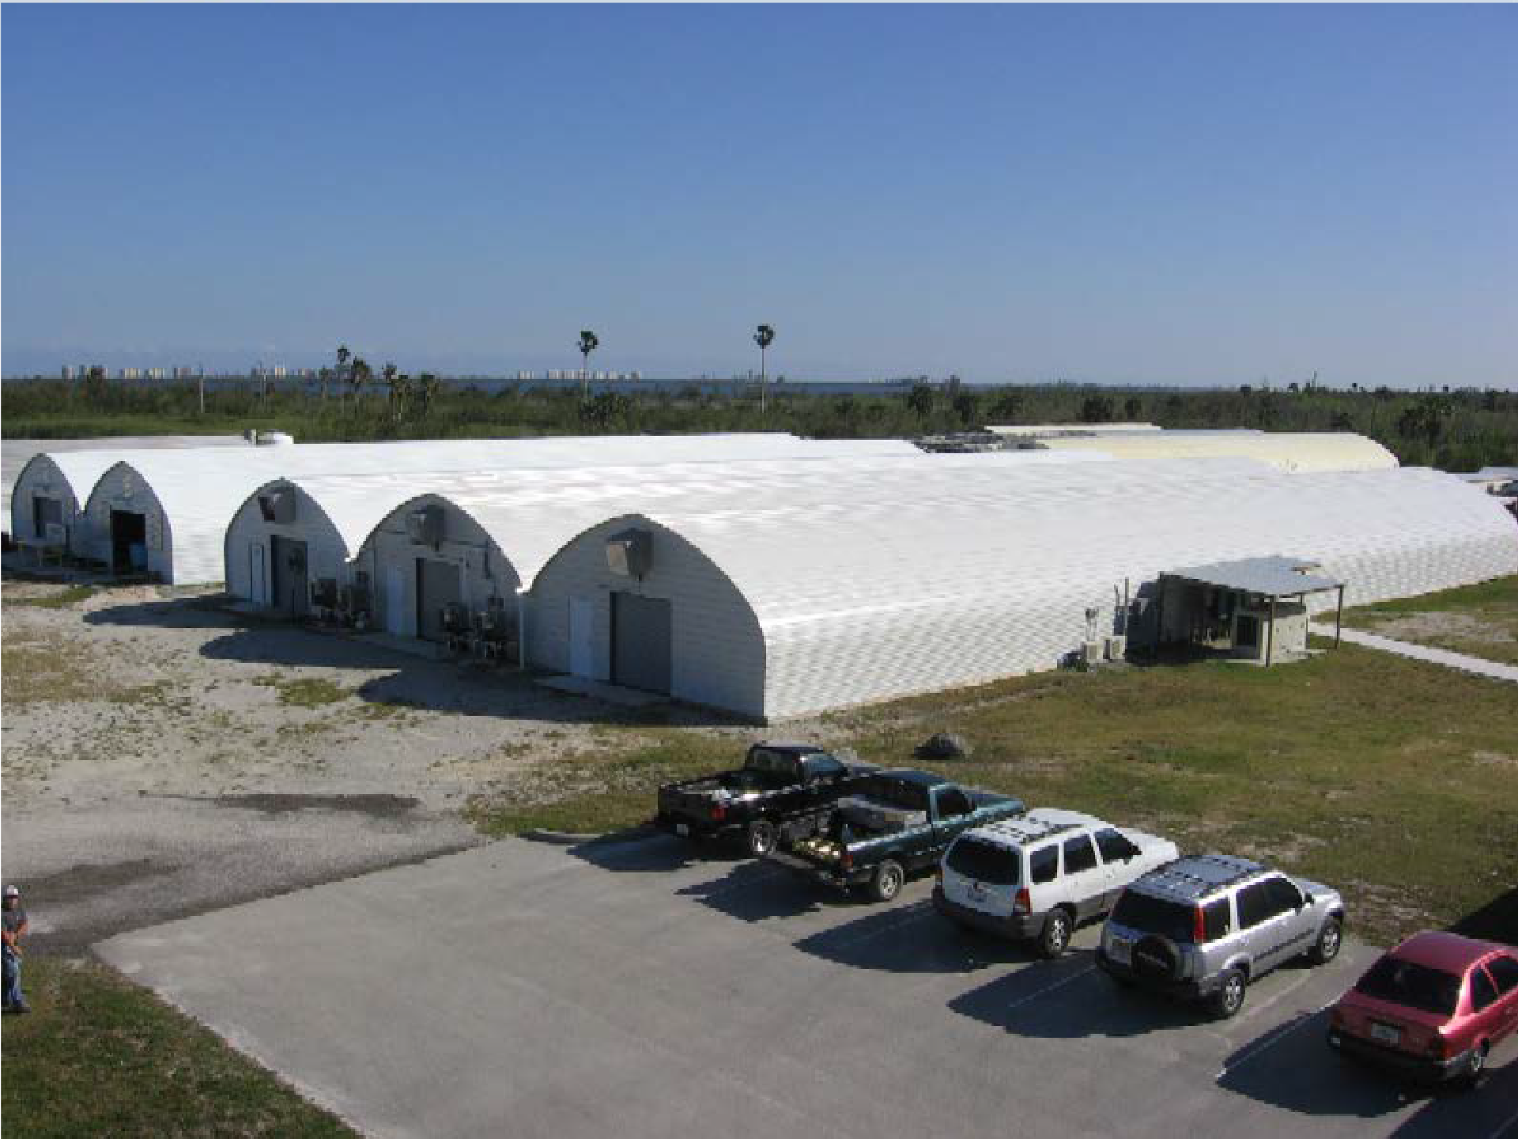
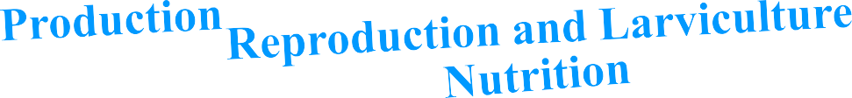



Inland
Recirculating Aquaculture Systems

Slide 3
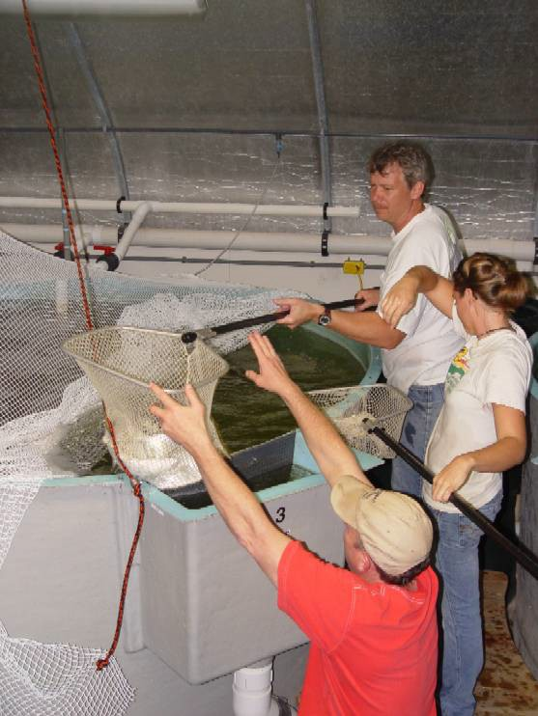
Recirculating Aquaculture Systems (RAS)
Year round growing season
Reduced water consumption
Reduced effluent discharge
Intensive production
Enhanced biosecurity
Increased food safety
Containment of escapees
Environmental Sustainability

Slide 4
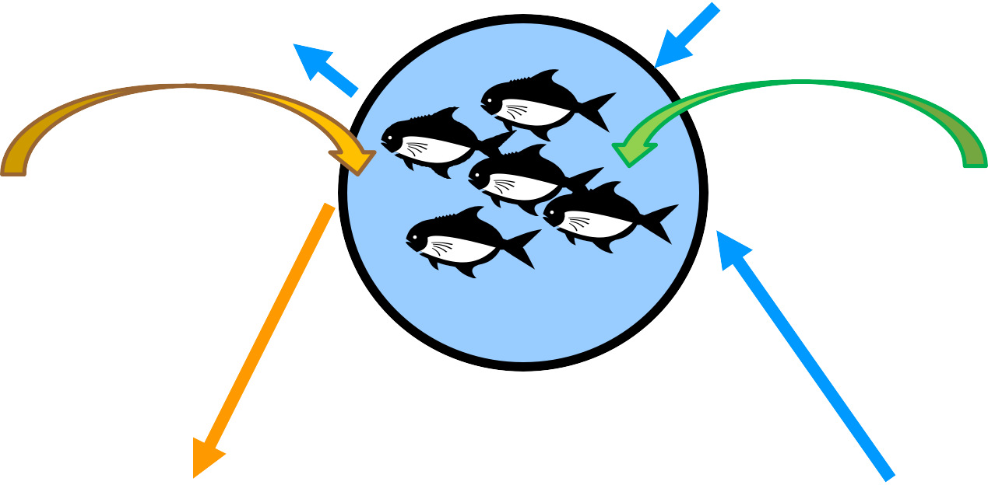
Basic RAS Design
Waste Water Makeup Water & Evaporation
Feed
Oxygen
Solid and Dissolved wastes
Nitrate
(very low toxicity)
Solids Filtration
Biofiltration
Ammonia
(Highly Toxic)
Concentrated Waste Sludge

Slide 5
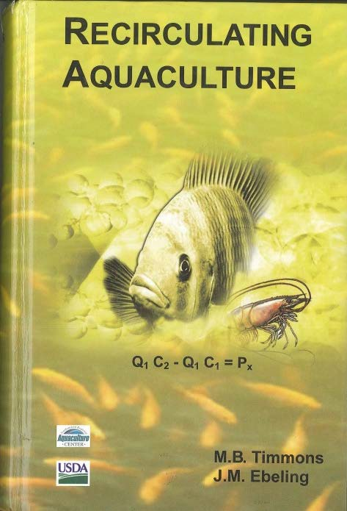
Advanced RAS design and Operation
HBOI-FAU ACTED Workshop:
“Recirculating Aquaculture Systems: Design, Engineering and Operation”
Instructors: Michael Timmons and Jim Ebeling Dates: October 17-19, 2013
Cost: $450
Information: See Jill Sunderland or, www.aquaculture-online.org or, www.fau.edu/hboi
or, call 772-242-2506

Slide 6
Basis of the Commercial System Design
Scaled up version of tested design developed jointly for USDA-ARS project and FL-FWCC marine hatchery program FMFEI
System Tested with:
  Red Drum up to ~90 Kg/m³
  Florida Pompano ~40 Kg/m³

Slide 7




LOW HEAD GROWOUT SYSTEM
2
3
4
1
7
5
6
1. Long flow pathway moving bed reactor with cross flow oxygenator, float valves, and propeller pump; 2. Incoming salt and freshwater lines with float valves and water meters; 3. UV sterilizer; 4. Torrus filters with 13ft³ of MB3 floating plastic media; 5. Ten-foot diameter tanks w/ center sump and sidebox drain; 6. Diverter box; and 7. 60 micron drum filter.

Slide 8
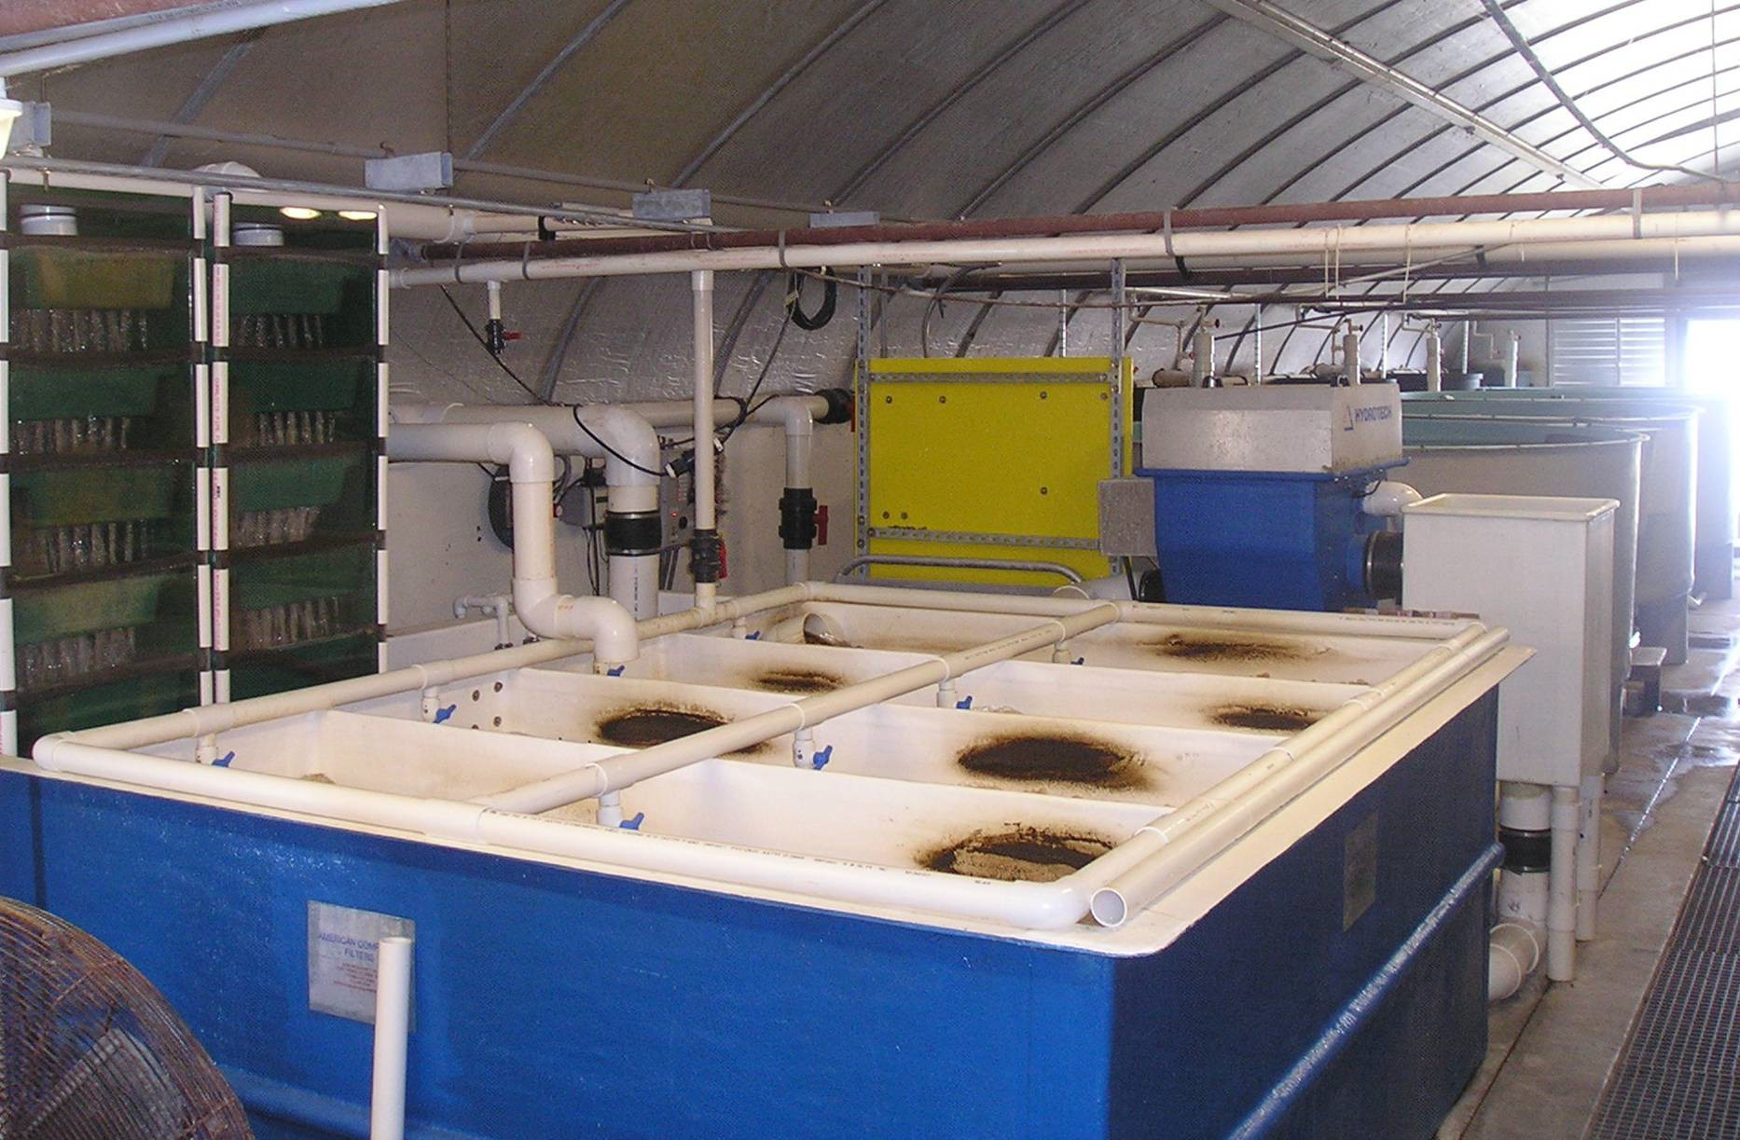

Slide 9
BIOFILTER VOLUMETRIC NITRIFICATION RATES
175.0
Long Flow Pathway Moving Bed Biofilter
150.0
125.0
100.0
75.0
50.0
25.0
0.0
g TAN/m³ media-day
0.00
0.20
0.40
0.60 0.80 1.00
Influent TAN (mg/L)
1.20
1.40
1.60

Slide 10
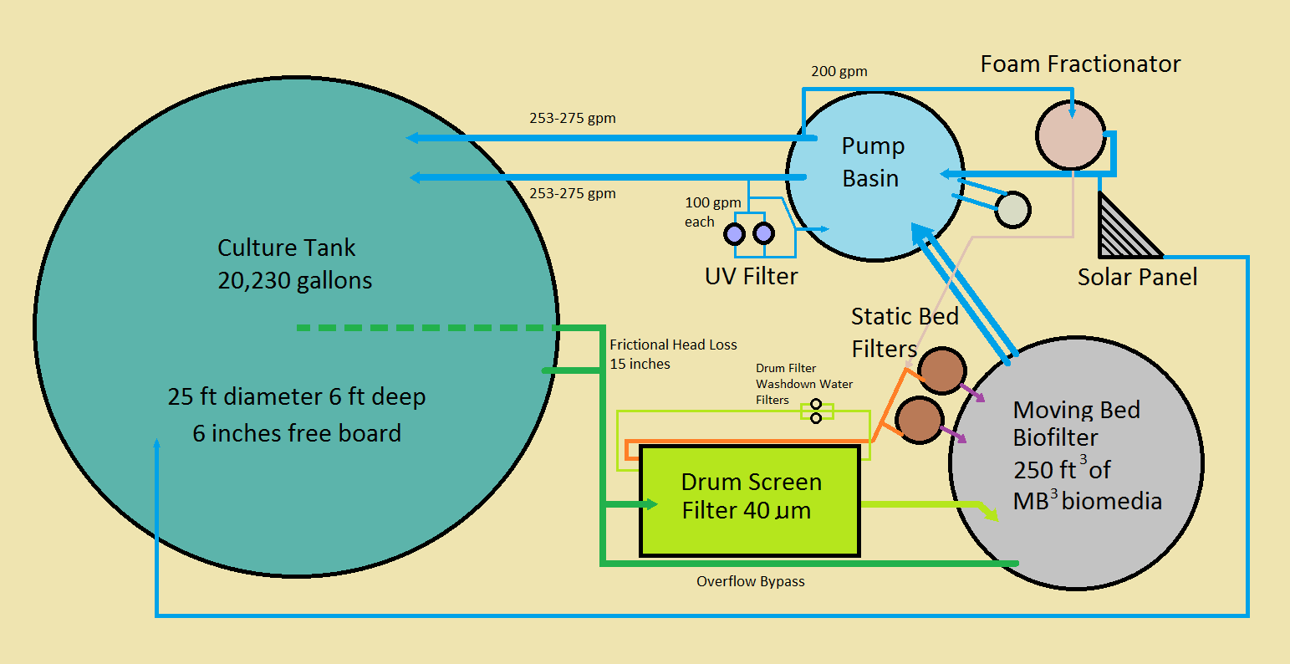
Commercial System Design
*
Not to scale
* Static Bed filters each contain 8 ft³ of MB³ biomedia

Slide 11
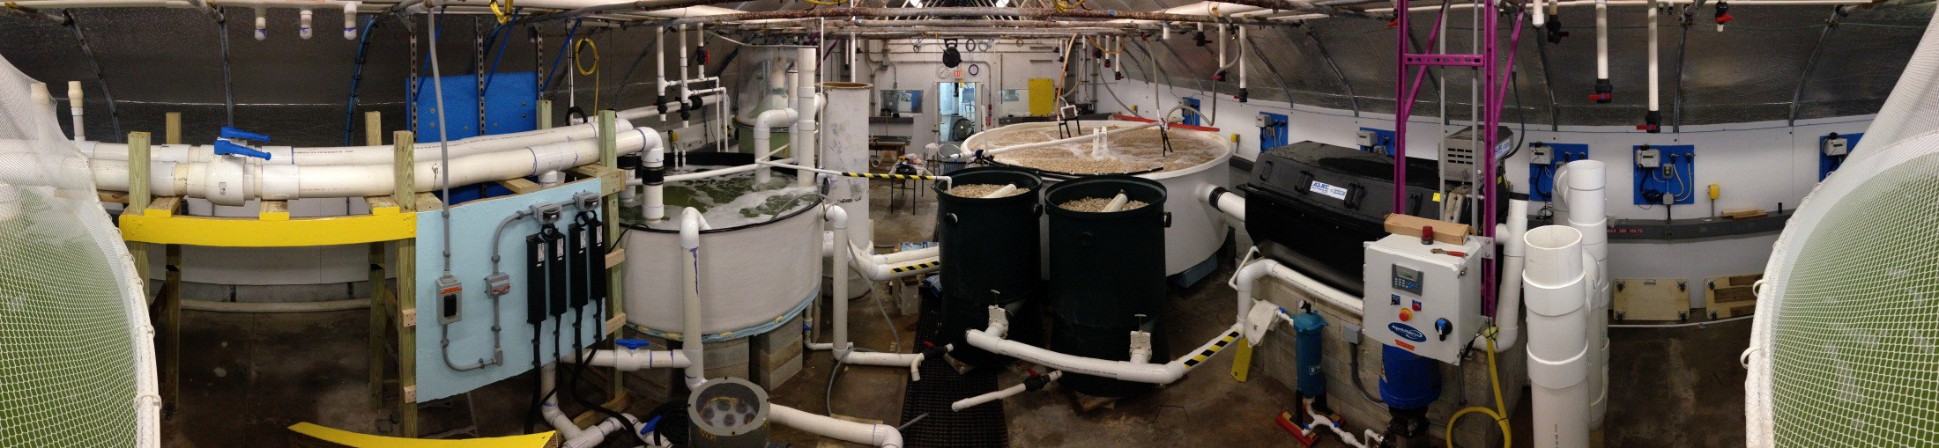
Panorama of Filtration System
Foam Fractionator
Return Water
Biofilter Drum Screen Filter
Main Pumps
Pumping BSatsaitnic Bed Filters Ultraviolet filters

Slide 12
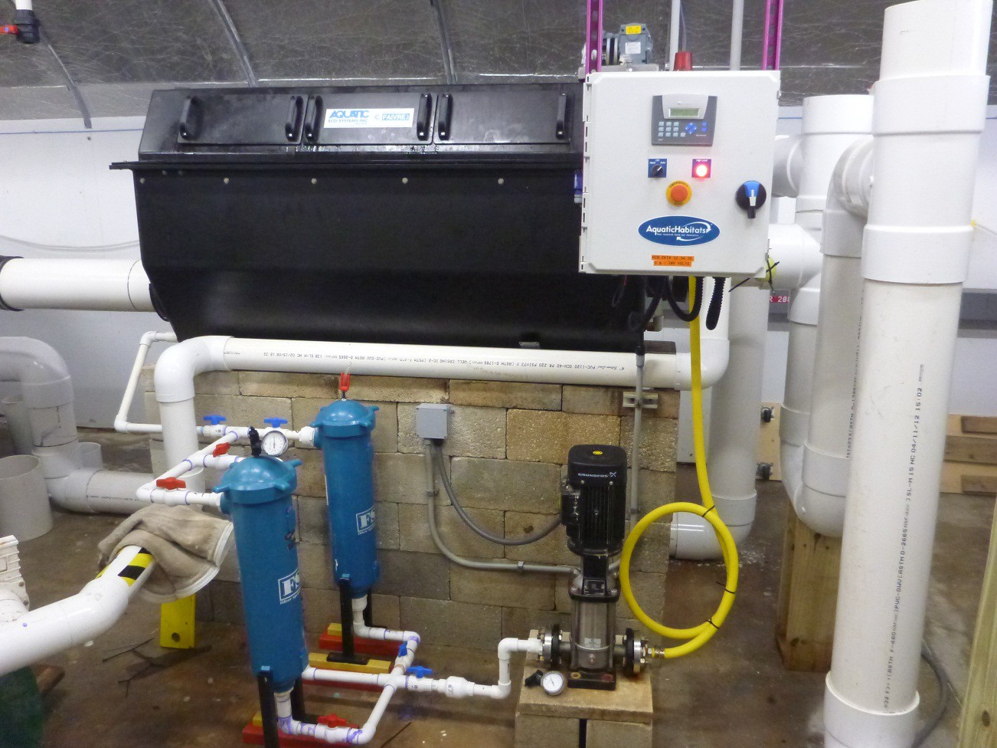
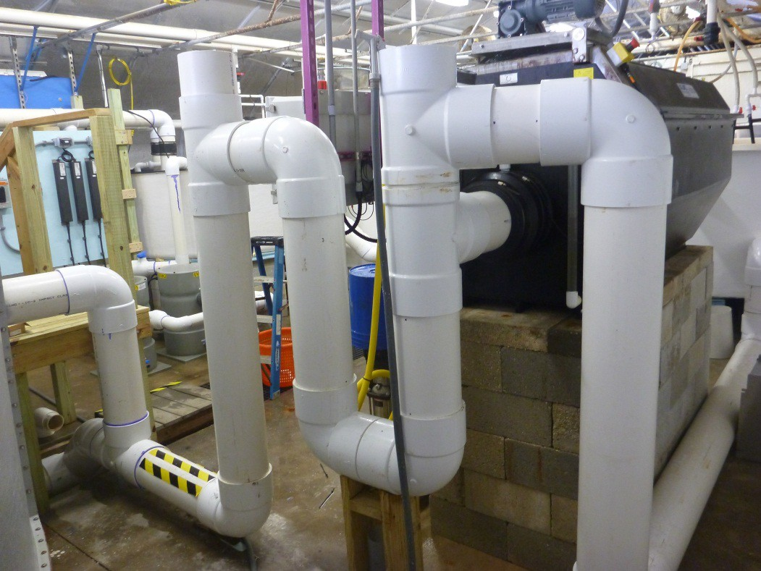
Drum Screen Filter

Slide 13
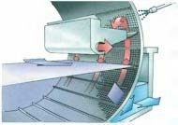
Microscreen Cleaning Process

Slide 14
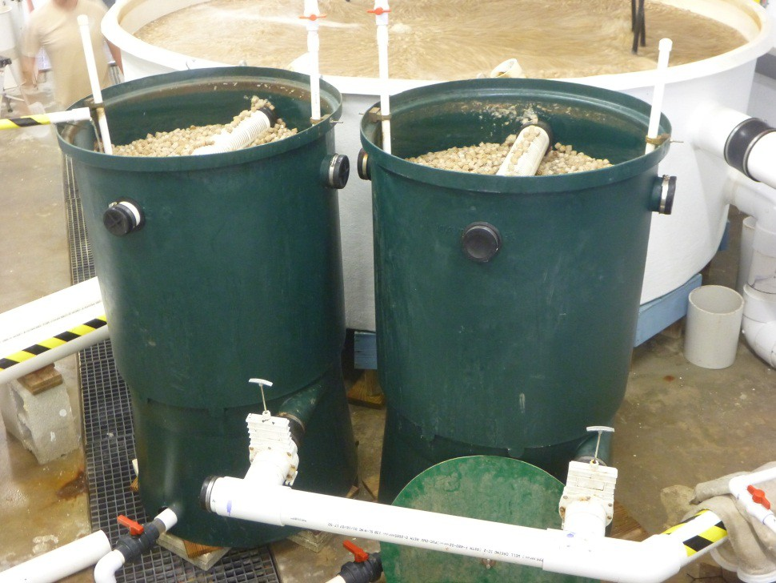
Waste Water Recapture
We used a Static Bed Filter to separate solids from Drum Screen Filter Waste stream
  Concentrates solids prior to discharge
  Recaptures significant component of water used for wash down of drum screen
  Each contains 8 Ft³ MB³ Media

Slide 15
Removal Efficiency (%)
50
45
40
35
30
25
20
15
10
5
0
43.2 + 12.0
Swirl separator Static bed Moving bed
Solids removal efficiency
RE = (TSS_{IN}-TSS_{OUT}) / TSS_{IN}
14.9 + 17.4
10.3 + 8.5
25.0
22.2 + 1.7
Swirl separator
^{20.0} Static bed
Moving bed
15.0
Removal Efficiency (%)
Solids removal efficiency (< 50 microns)
10.0
6.8 + 2.1
5.0
0.0
-5.0
-6.5 + 2.1
-10.0

Slide 16
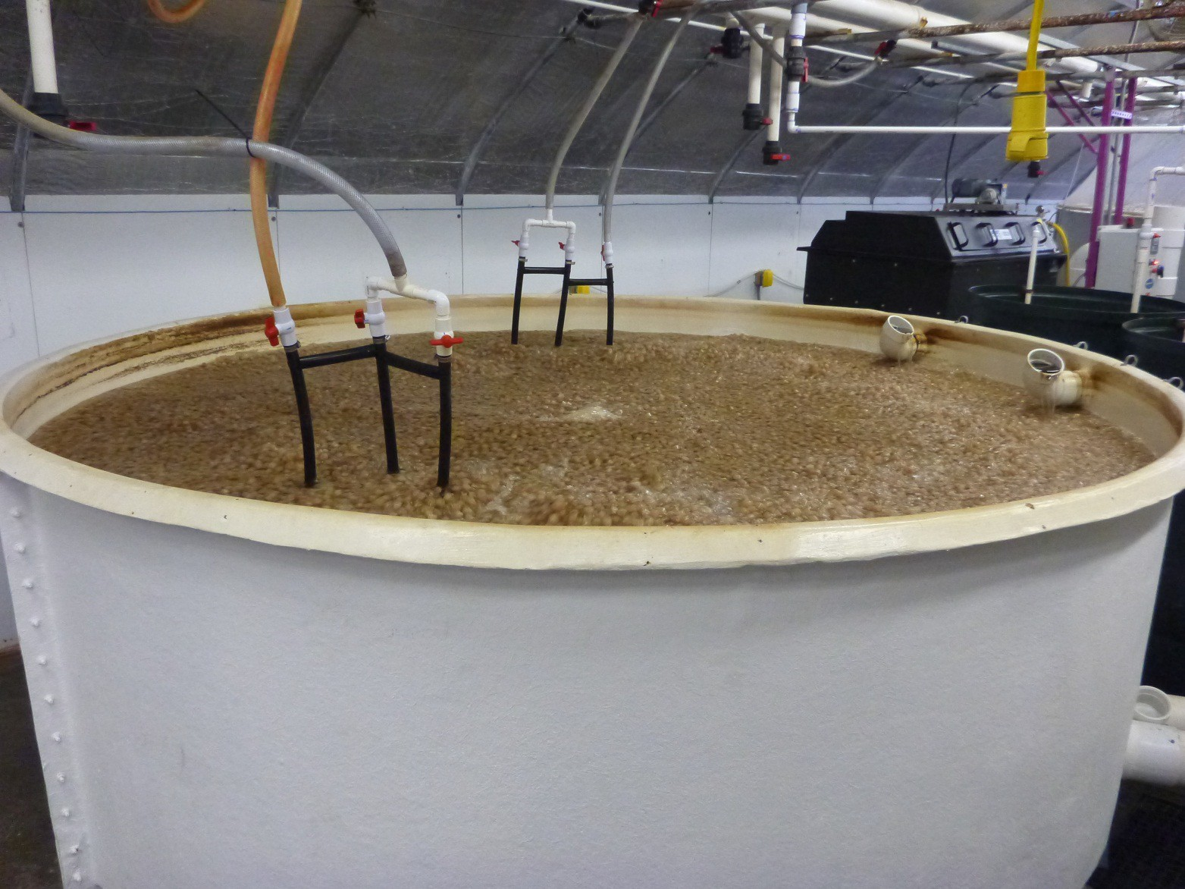
Moving Bed Biofilter (250 ft³ MB³ Biomedia)
Aeration Keeps Bed Fluidized

Slide 17
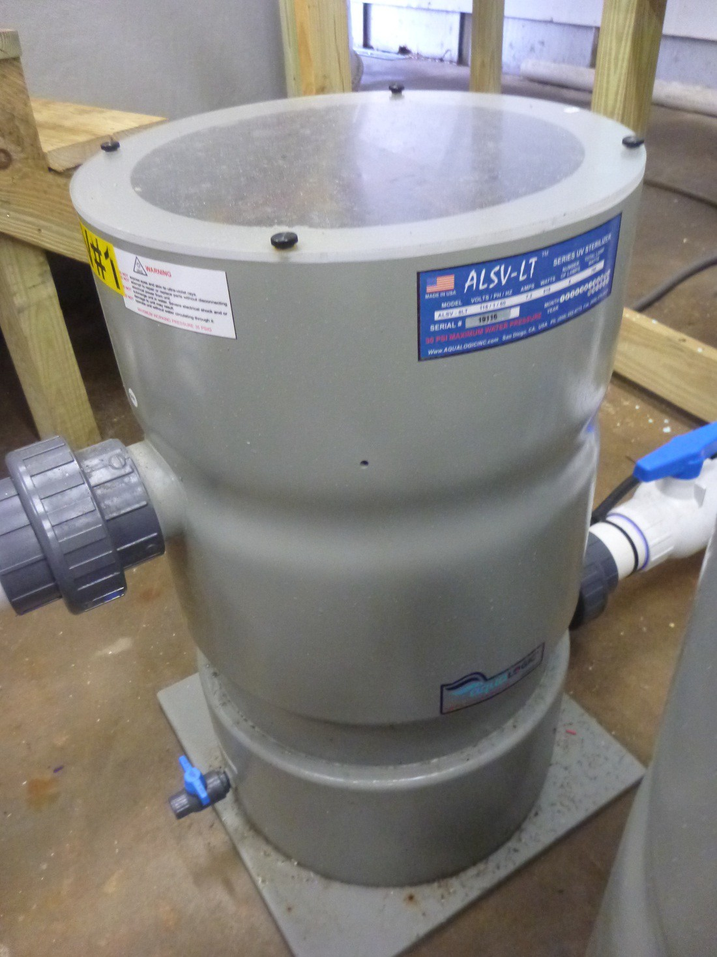
Minimum Dose Desired
30,000 uW sec/cm²
The two units delivering
~150,000 uW sec/cm²

Slide 18
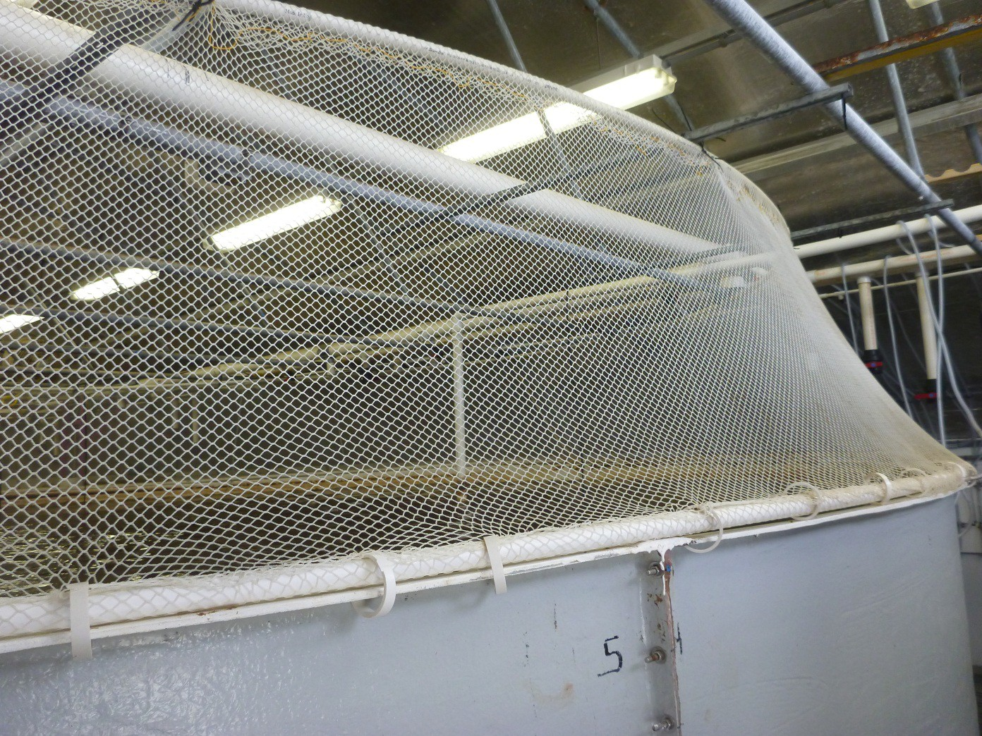
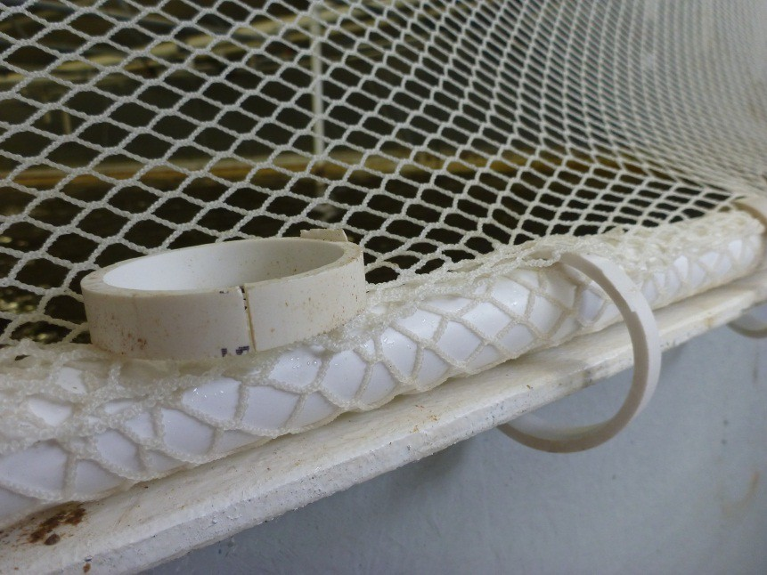
Tank Cover

Slide 19
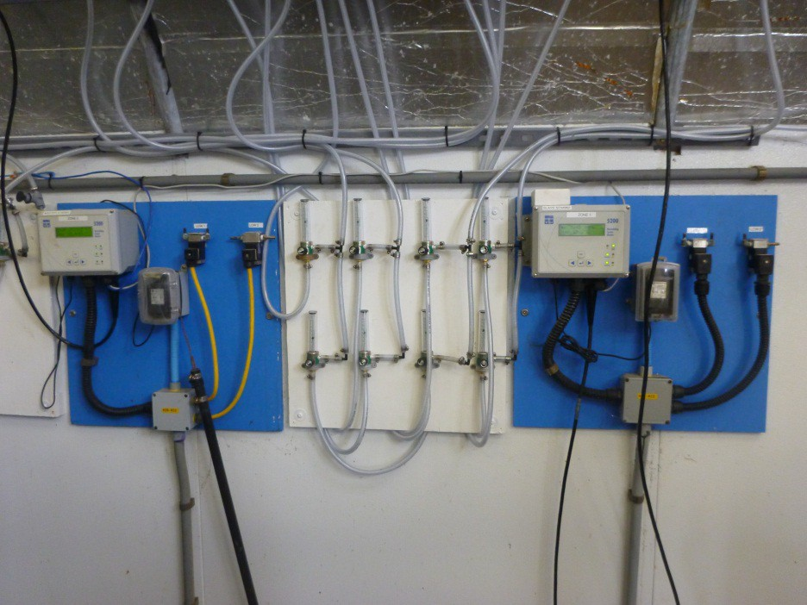
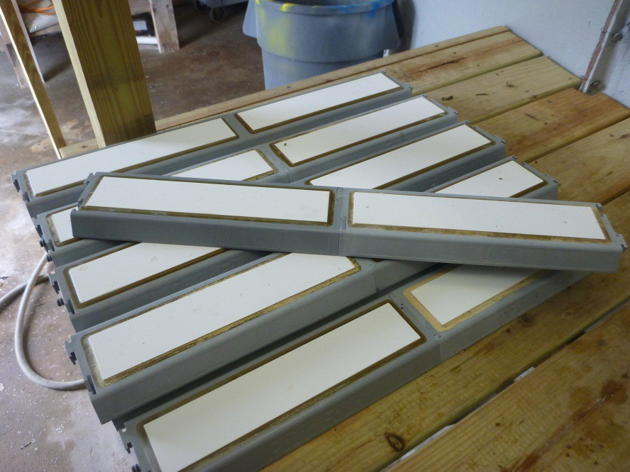
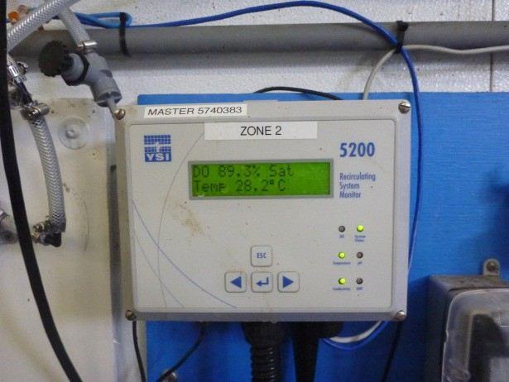
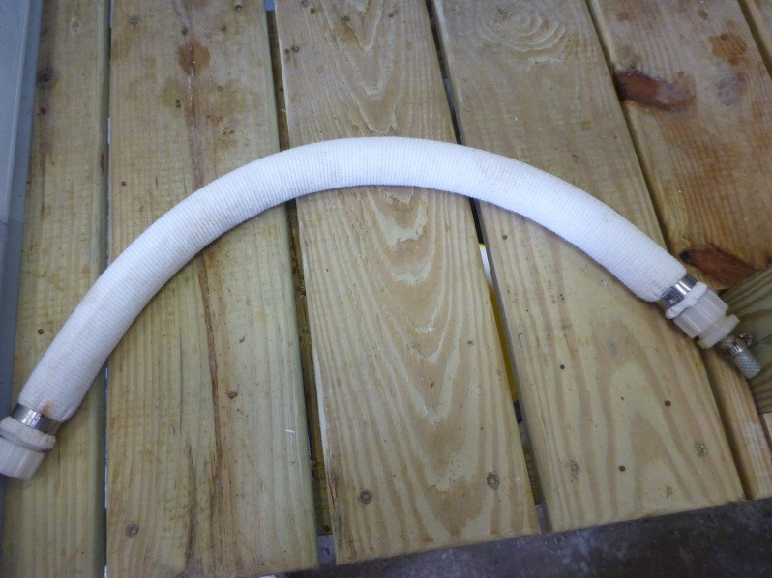
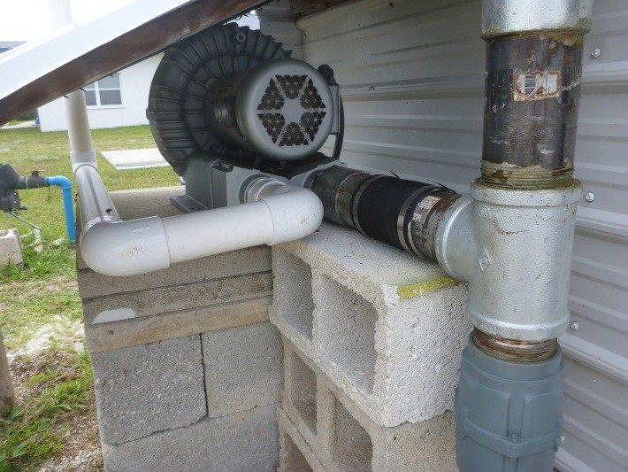
Aeration and Oxygenation

Slide 20
Aeration and Oxygenation
Oxygenation Zone 2
25 ft Diameter
O₂
Sensors
Aeration Zone
Oxygenation Zone 1

Slide 21
Backup Systems
Systems designed to combat “Murphys Law”
  “If anything can go wrong it will”
Therefore managers must:
  Anticipate
  Plan
  Train
  Respond
    (an automatic system that “cries wolf” can derail this necessary task)

Slide 22
Backup Systems
Generators
Automatic oxygen system

Slide 23
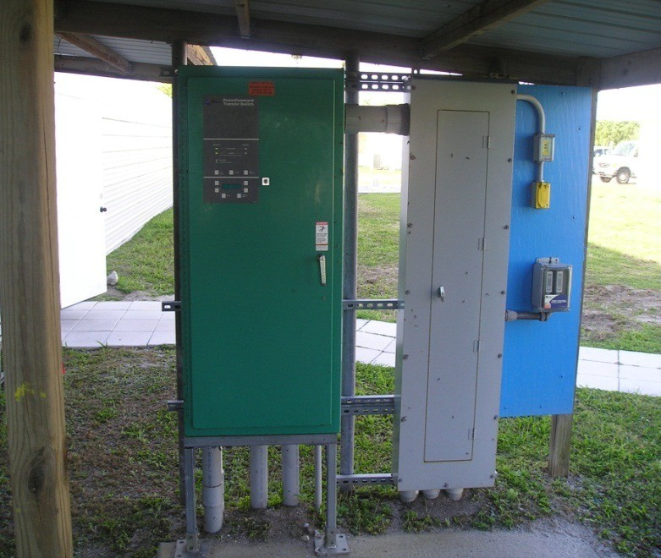
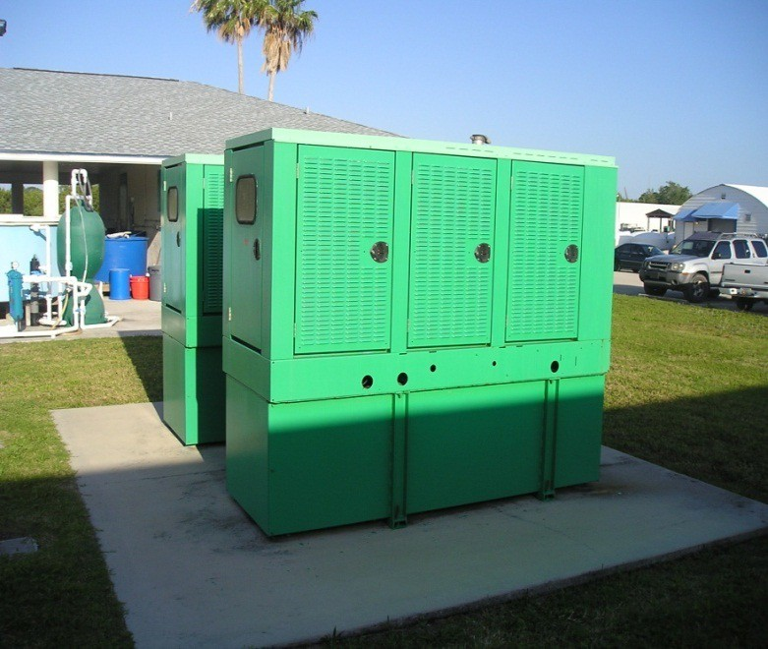
Generators
Must have disconnect switch and meet other local requirements

Slide 24
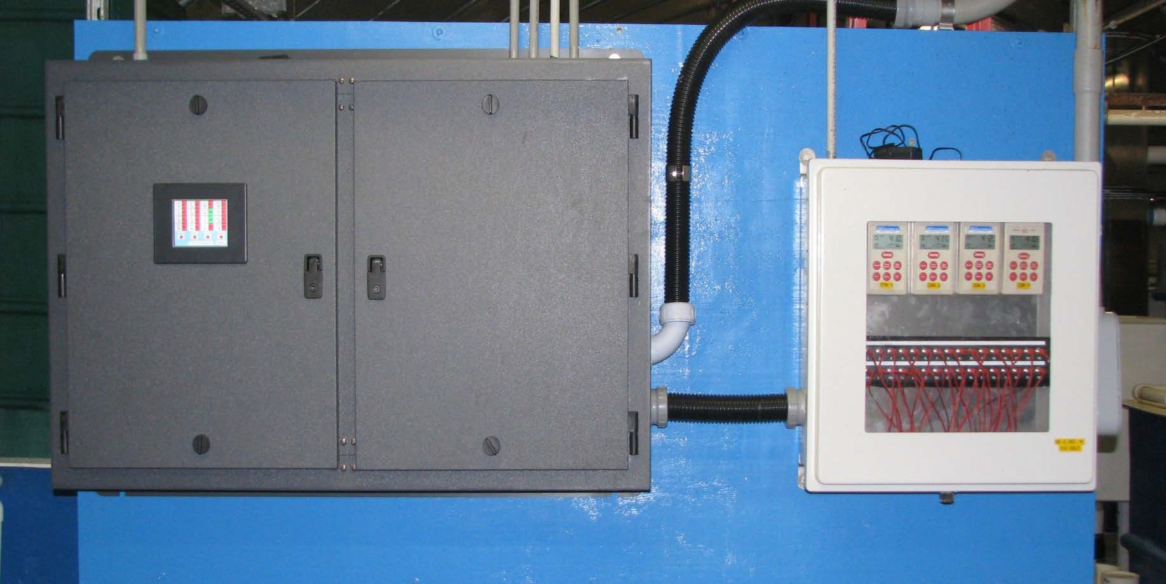
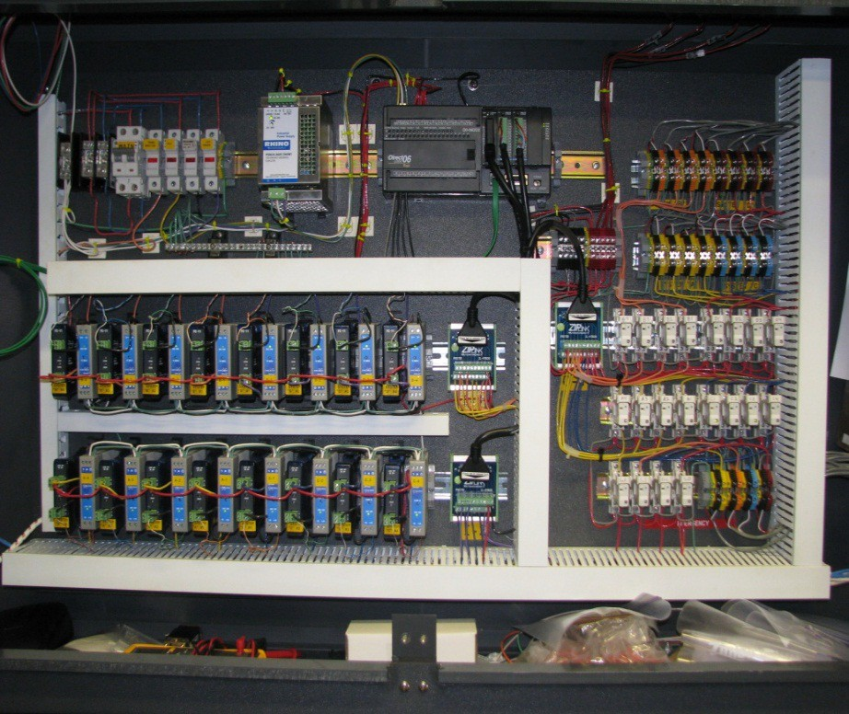

Slide 25
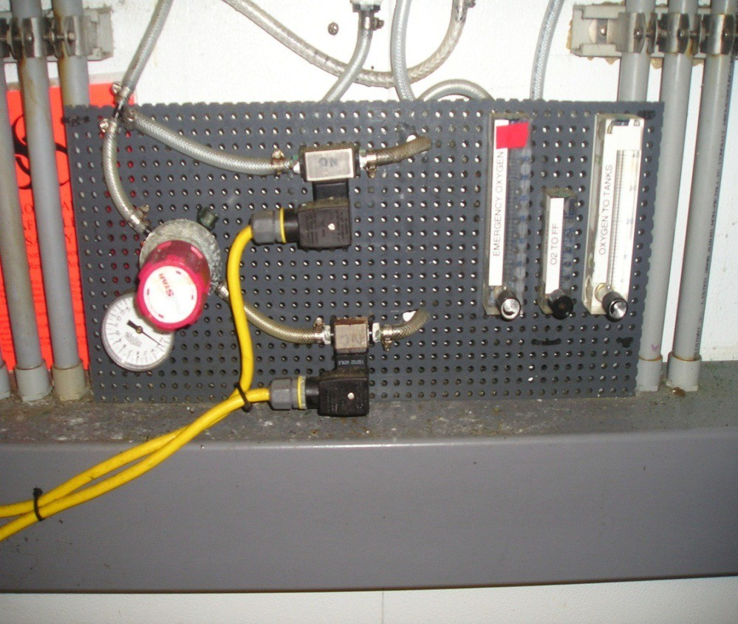
Automatic Oxygen System
Opens oxygen flow to tanks regardless of monitoring systems or other backup systems if the power turns off
Must use Normally Open Solenoid Valves for failsafe system
– Normally open ➔ closed when power applied

Slide 26
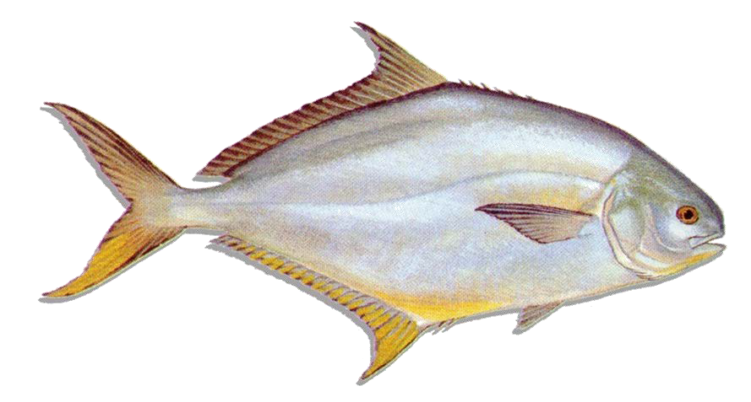
Broodstock Conditioning and Spawning System
USDA-ARS/HBOI-FAU Design

Slide 27


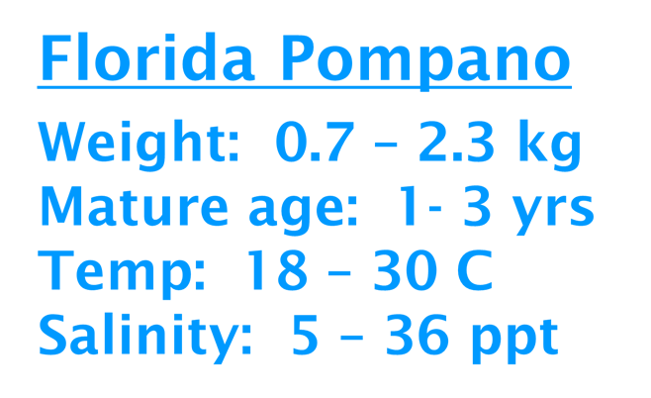

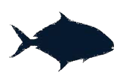



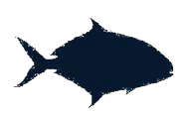

Broodstock Profile
Florida Pompano
Weight: 0.7 – 2.3 kg
Mature age: 1- 3 yrs
Temp: 18 – 30 C
Salinity: 5 – 36 ppt

Slide 28
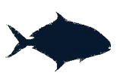

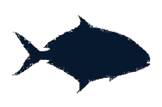
Water Quality Management Parameters
Parameter Temperature pH
Dissolved oxygen Alkalinity Ammonia
Nitrite
Total dissolved solids
Target Level 16 – 30 C
7.6 – 8.2
≥ 5 mg/L
≥ 200 mg/L
≤ 1 mg/L
≤ 2 mg/L
≤ 5 mg/L

Slide 29
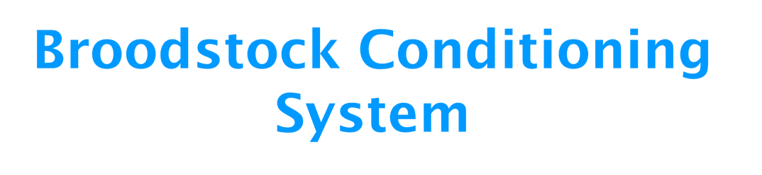







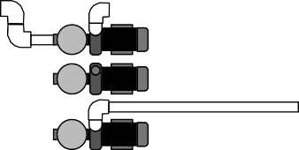
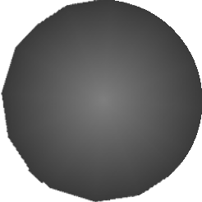
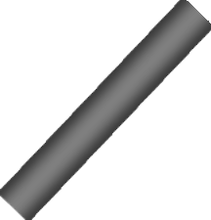
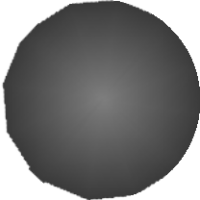







Broodstock Conditioning System
Culture Unit (5.7 m³)
Egg Collectors (0.3 m³)
Waste
Cartridge filters
Pump to chiller
Sump (2.3 m³)
Waste
UV
Waste
Beadfilter (0.1 m³)
Return from chiller

Slide 30
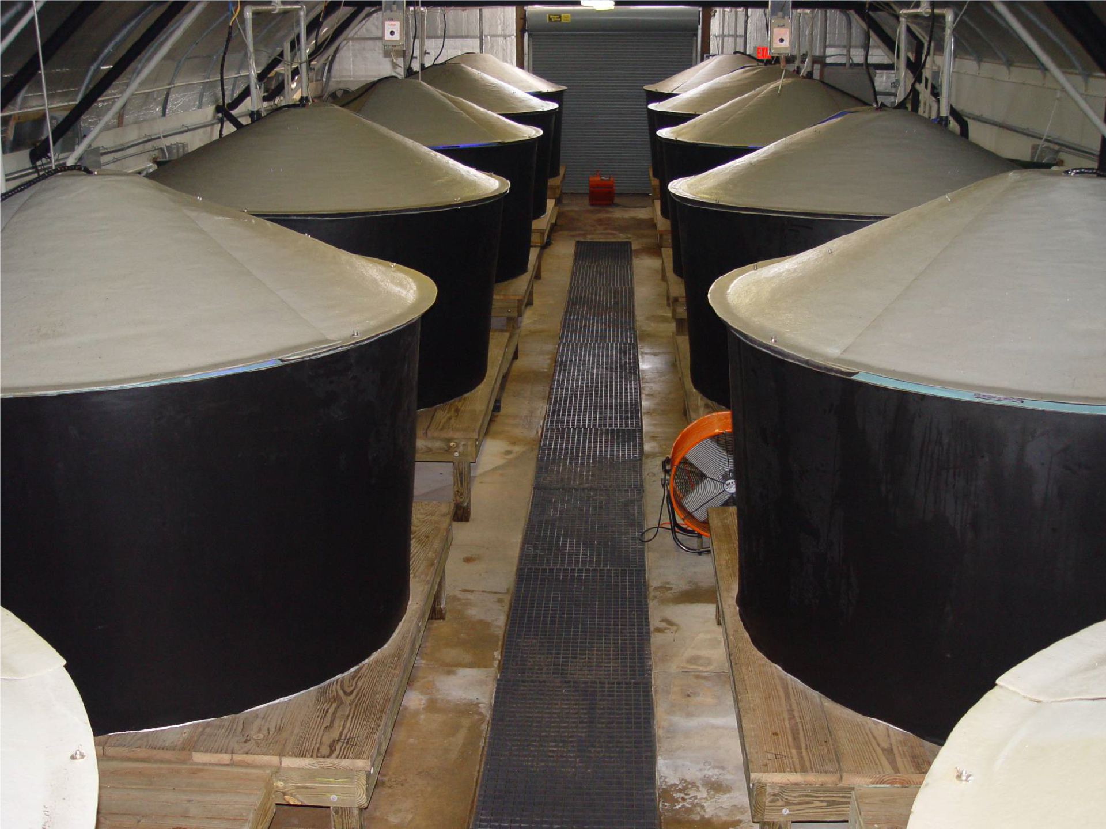

Slide 31
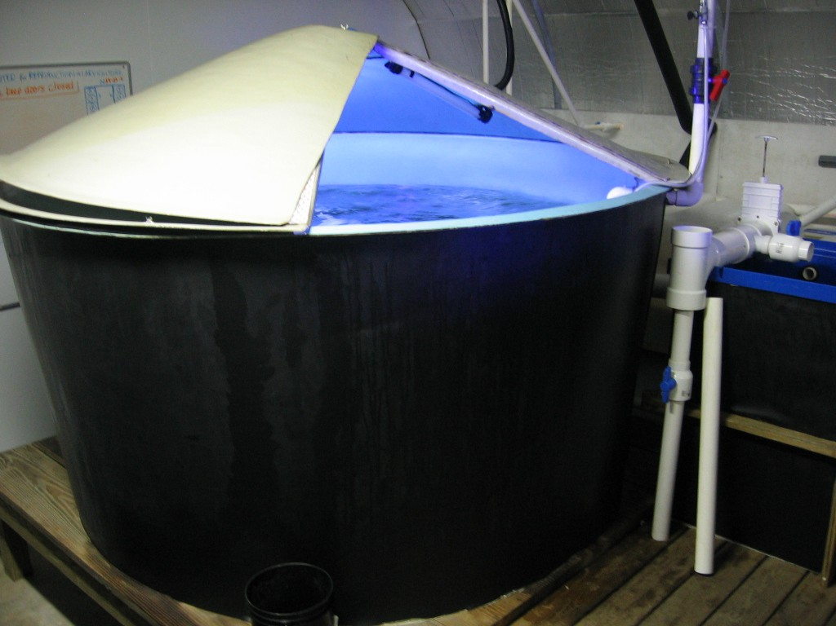
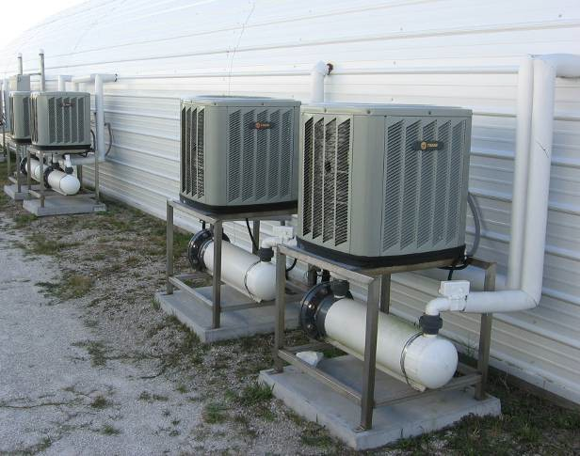
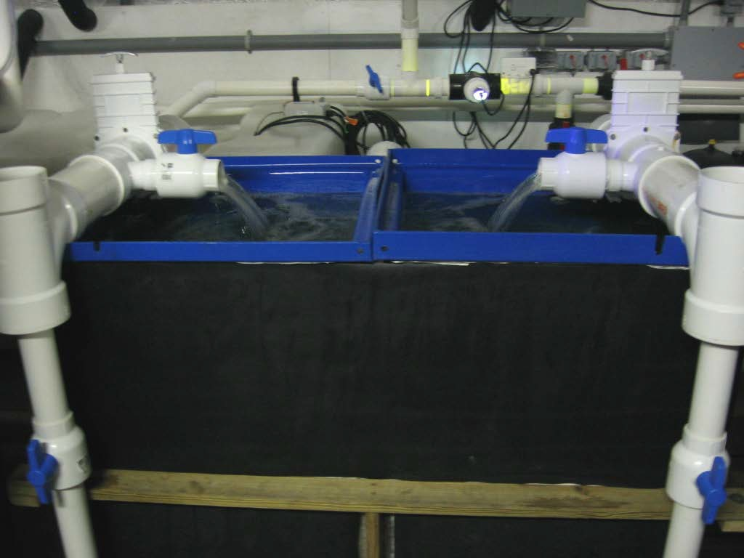
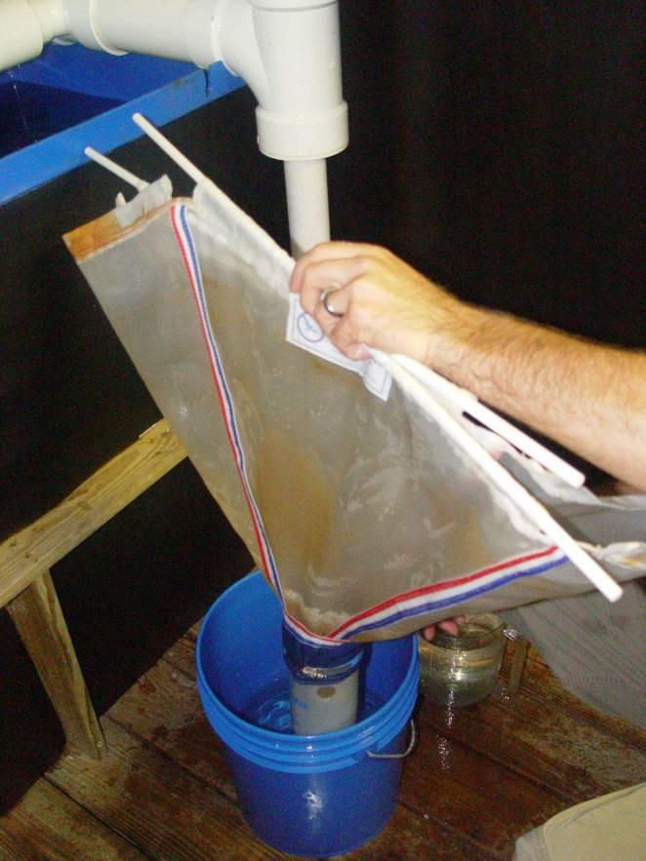
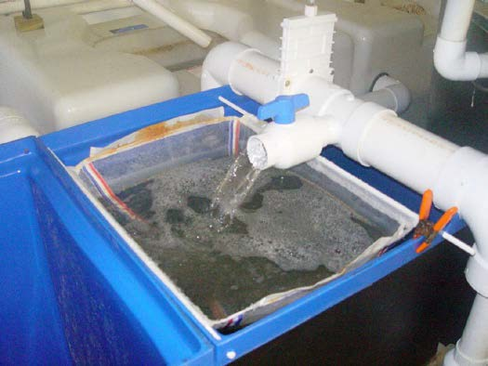

Slide 32
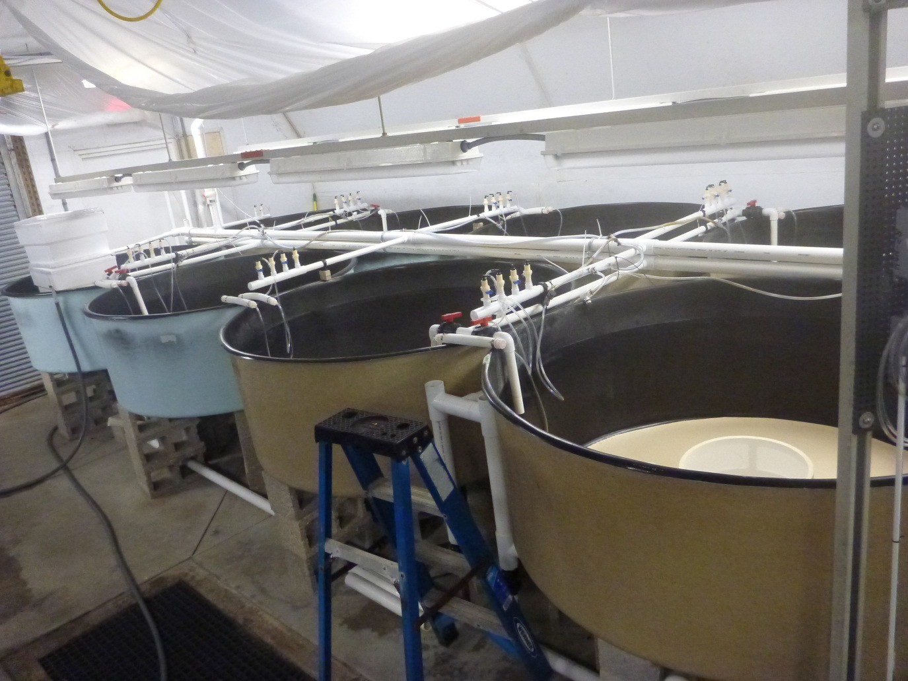
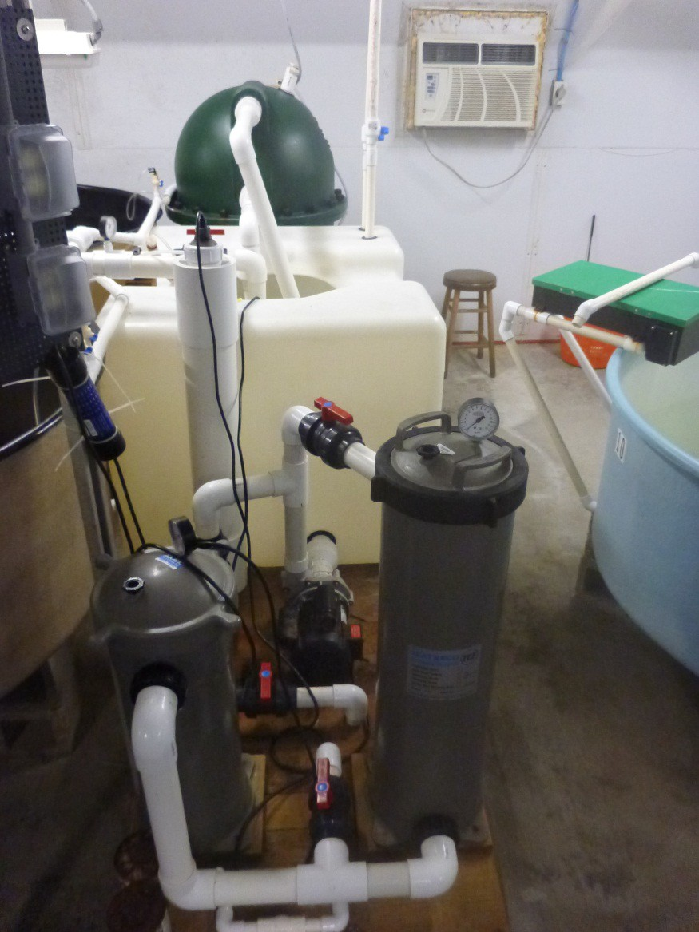
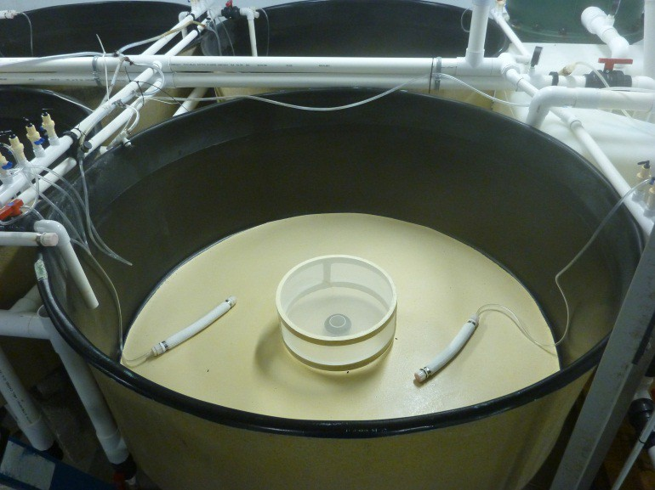
Larviculture System

Slide 33
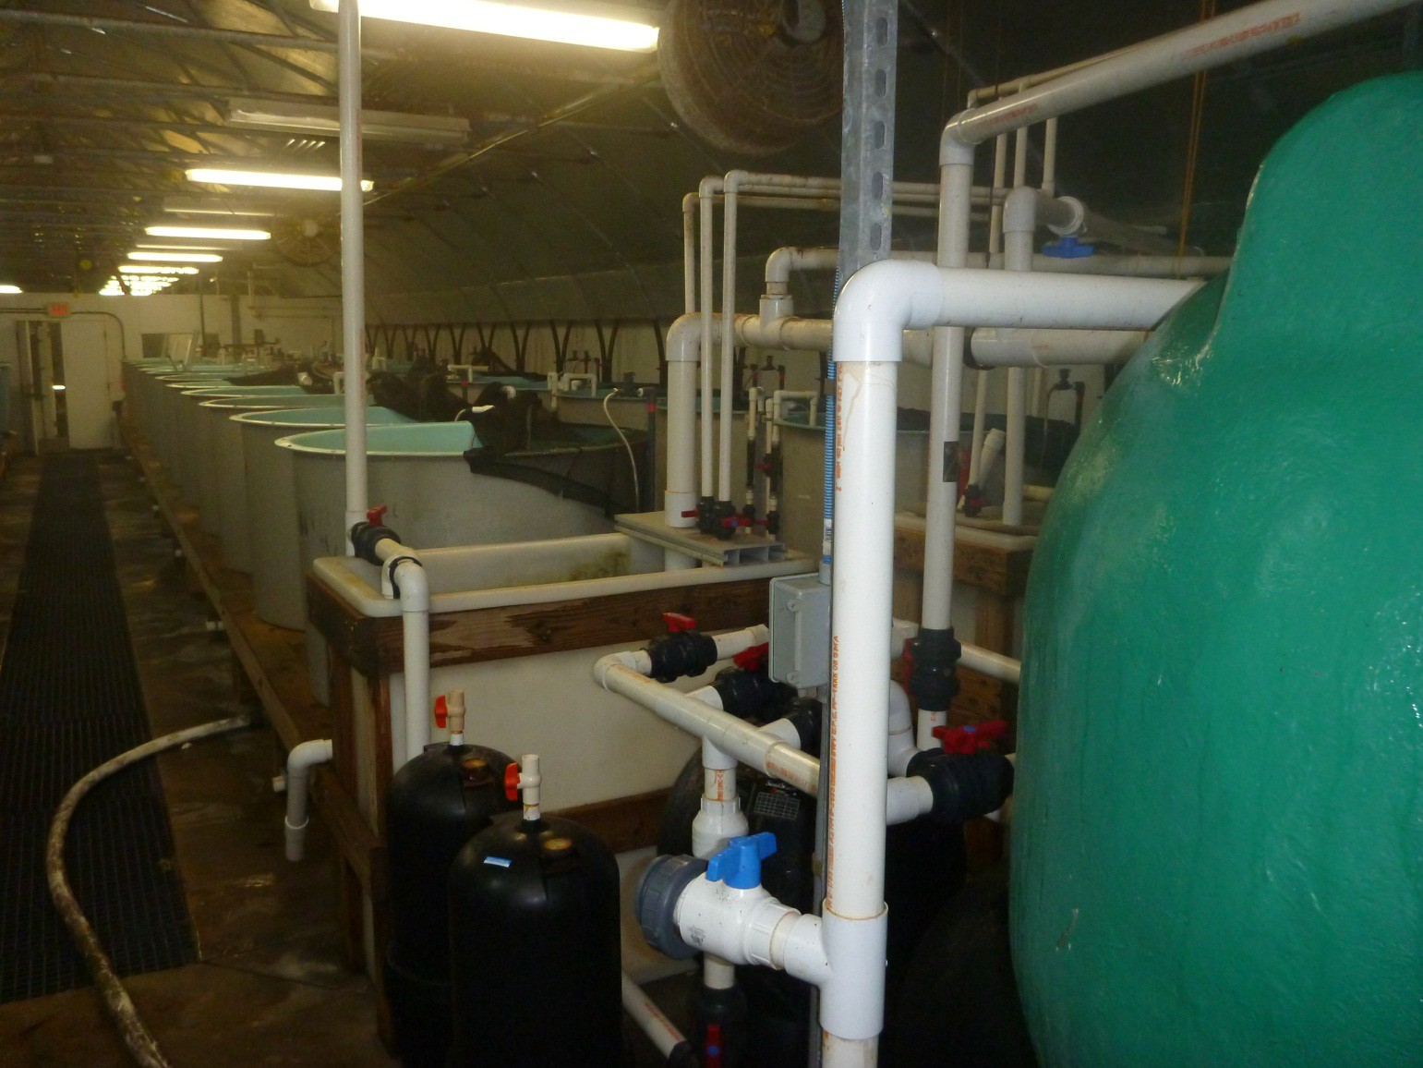
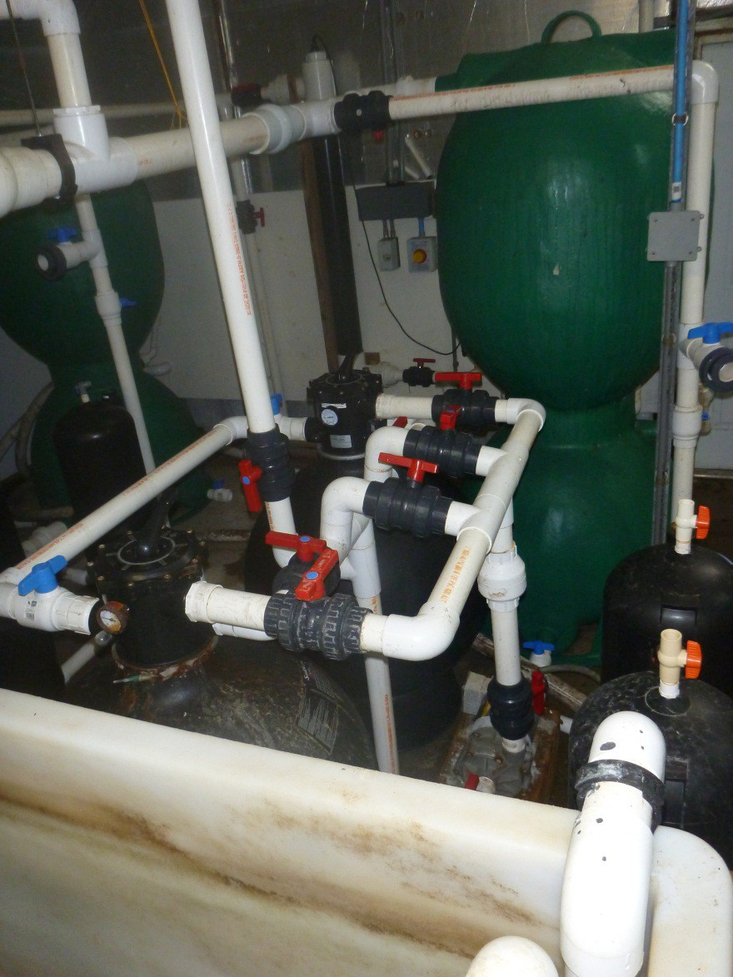
Nursery System

Slide 34
Limitations of RAS Technology
Waste products from the fish must be treated before discharge
– This is much easier than in other aquaculture systems such as open ocean net-pens
No one has ever achieved 100% recirculation due to water needed for removing waste products and lost to evaporation
WASTES !!!!!

Slide 35
WASTES!!! WHAT?! WASTE
!!!!!
What are they?
  Uneaten feed and other Solids
  Liquid Excretions
One Characteristic of these “Wastes” is that they contain quite a bit of nutrient
  (esp., Nitrogen, Phosphorus)
So, why not USE nutrients instead of discharging them?

Slide 36
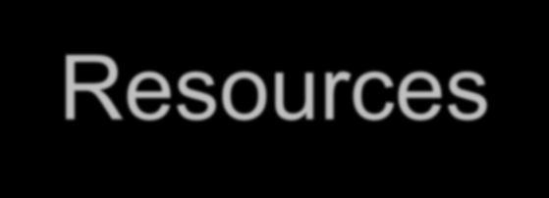
The Answer:
Integrated Multi-Trophic Aquaculture (IMTA)
Turn Wastes into Resources
The Next Generation in Recirculating System Design
IMTA = Integrated Multi-trophic Aquaculture Systems

Slide 37
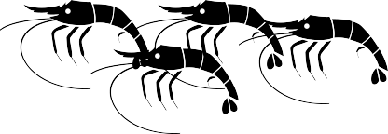


Prototype Land Based HBOI-IMTA Funded Through Aquaculture SLP
Prepared Feed
Assimilative Culture
Fed Culture
Filtration Systems
Extractive Culture Settleable Solids
Solids
Extractive Culture Suspended Solids
Fed Culture
Prepared Feed

