Slide 1
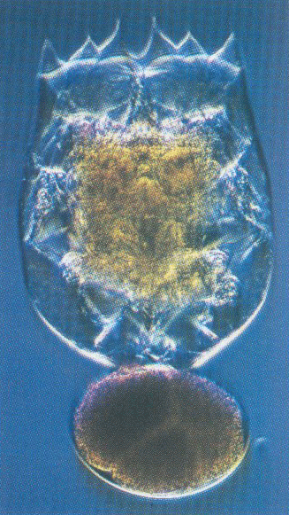

Live Feeds for Marine Fish Larvae
Aquaculture Center for Training, Education and Demonstration

Slide 2
Why live feeds?

Slide 3
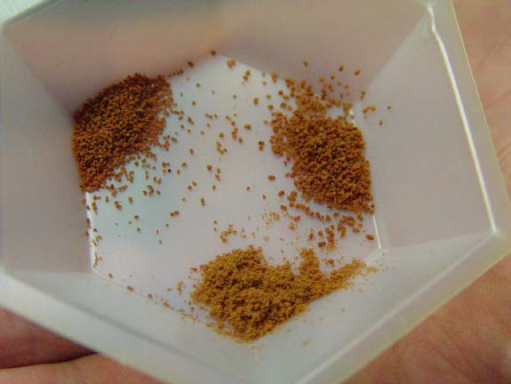
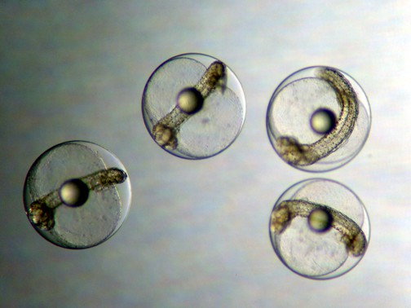
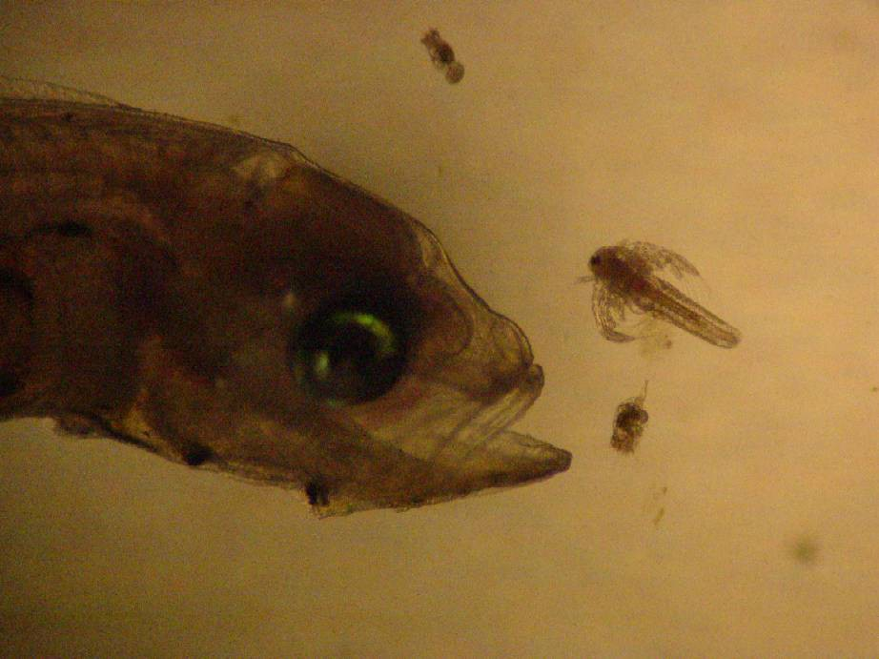
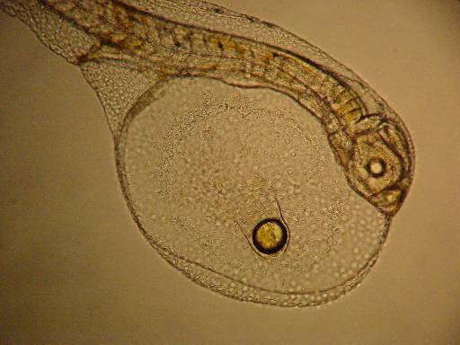

Slide 4
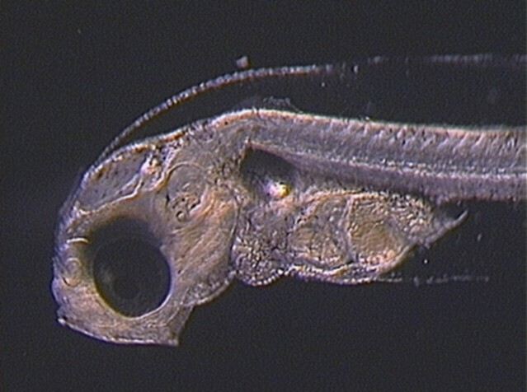

Slide 5
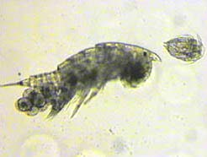
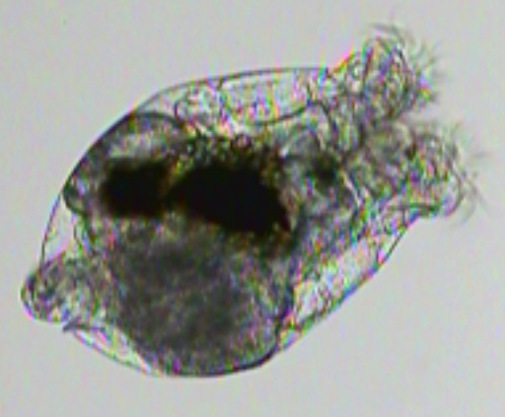
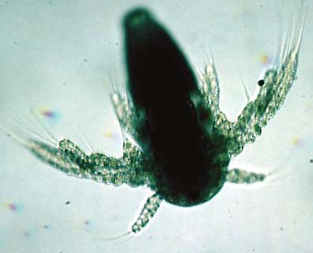
Important Criteria For Selecting Live Feeds
Is it the appropriate size for target species?
Is the nutritional quality adequate for good growth and survival of the target species?
Can it be produced cost effectively?

Slide 6
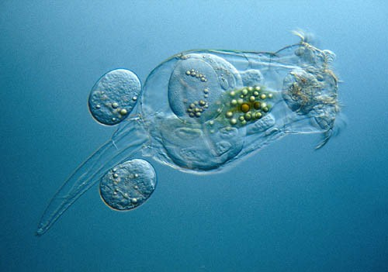
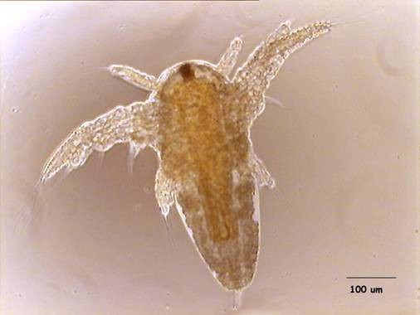
Live Feeds
The two live feeds most commonly used are:
Rotifers (Brachionus sp.) Artemia sp. (brine shrimp)
Other live feeds include: Molluscan trochophore larvae Ciliates
Copepods Wild plankton

Slide 7
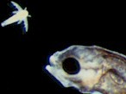
What makes good prey?
Size - prey size is dependent upon fish larvae mouth size. Typical initial prey size for most fish larvae is 50-120 microns in width.
Movement - slow moving prey are more easily captured by fish larvae.
Familiarity - fish larvae must learn to locate and capture prey. The more experience the larvae have with the prey, the higher the success rate.

Slide 8
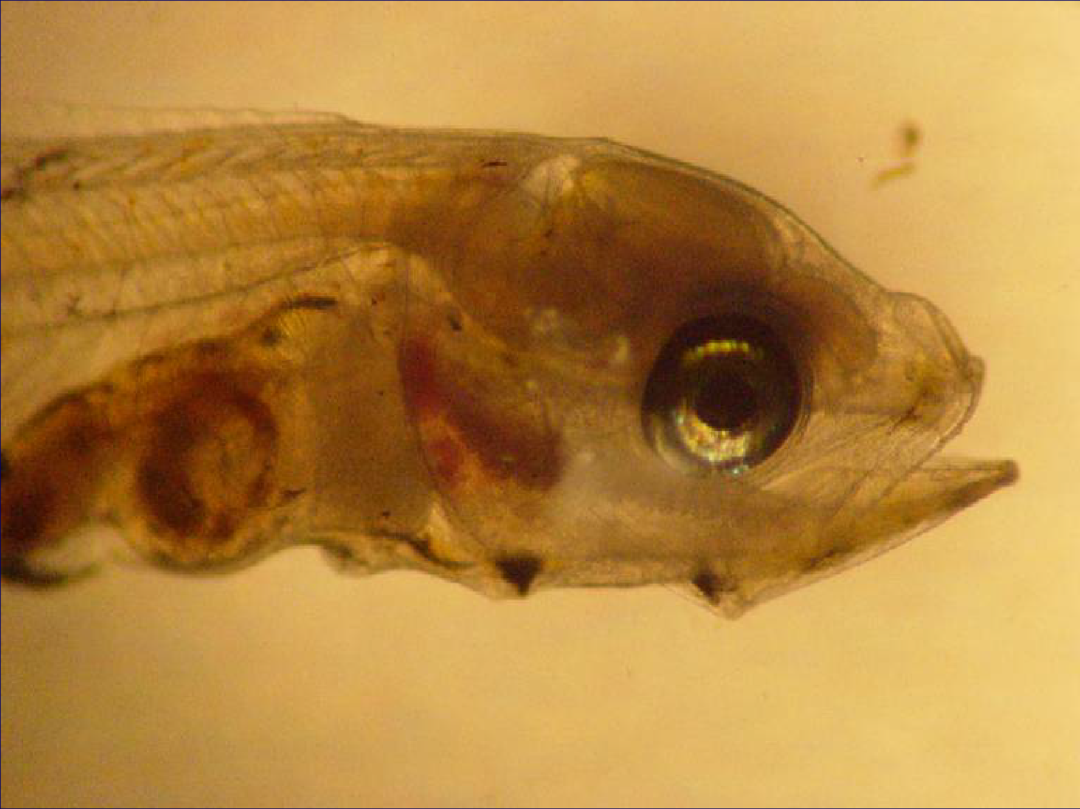

Slide 9
Larval Feeding Strategies
Larval fish consume more food per unit body weight (50 – 300%) than fish in grow-out operations (2 – 10%)
Target Densities 1 to 10 prey per ml
Average Feeding Rates 200 to 600 prey per day

Slide 10
Feeding Regime
microfeeds
Enriched Artemia Artemia nauplii
enriched rotifers
Green water
0
3 6 9
12
Age (d)
15
18
21
24

Slide 11
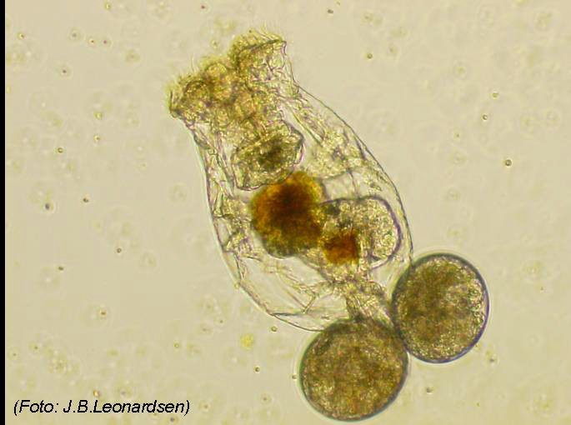
Rotifers

Slide 12
Why use rotifers as live food?
Excellent for larval fish and shellfish
–High nutritional quality
–Small body size
–Slow swimming rate
–High rate of reproduction
–Low rate of mortality

Slide 13
What is a Rotifer?
Microscopic protozoan
Saltwater and fresh water environments
Asexual and sexual reproduction
Phylum Rotifera “wheel-bearer”
(> 2000 species)

Slide 14
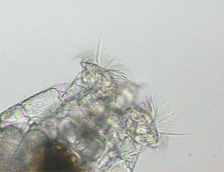
Rotifer Corona
Cilia

Slide 15
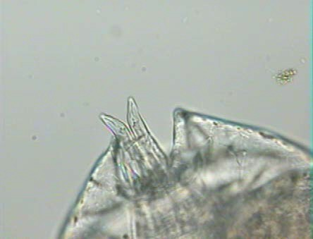
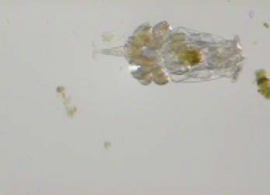
Planktonic rotifers swim continuously and rarely attach. The foot is used to attach when needed. At the base of the foot are the toes used to attach to the substrate.
Foot
Toes

Slide 16
Species & Strains
Marine Species Brachionus plicatilis Brachionus rotundiformis
Freshwater Brachionus rubens Brachionus calycflorus
Three Strains
L-type (large type, B. plicatilis)
  Body length = 200 - 360 µm
S-type (small type , B. rotundiformis)
  Body length = 150 - 220 µm
SS-type (special small, B. rotundiformis)
  Body length = 70 - 160 µm

Slide 17

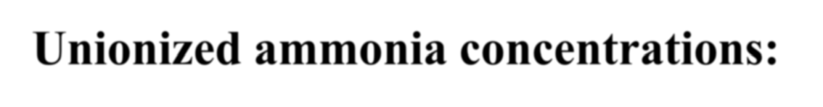

Optimal Conditions
Salinity below 35 ppt
Temperature range 27- 32ºC
15 hour photoperiod
Moderate to low aeration
pH range from 6.5 - 8.0
Unionized ammonia concentrations: not to exceed 1 mg/liter

Slide 18

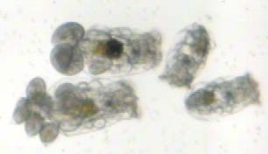
When the conditions are right
Female with eggs
Juvenile

Slide 19
Production Methods
Cultures can be started by inoculations with live rotifers or by using cysts (resting eggs)
Cysts have a shelf life of over one year
Rotifers can be produced using algae, yeast, specialized products, or a combination
Acceptable rotifer production ranges from 100 - 500 per ml
Super-intensive culture requires specialized labor, equipment and techniques

Slide 20
Culture Methods
Continuous
Lasts 20 to 30 days
Harvest 20 to 30% per day
Refill with sterilized water daily
Batch (Our Method)
Harvest all rotifers at 3 to 5 days
Discard water
Re-stock with new water and rotifers

Slide 21
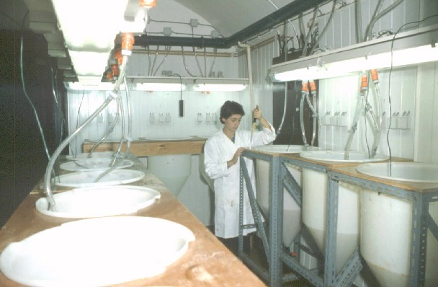
Intensive Production Methods
Requires:
–Continuous supply of algae
–De-foaming agents
–Filtration of water
–pH adjustments
–Oxygen gas
–Nylon filtration mats
Diligent & Constant Management!

Slide 22
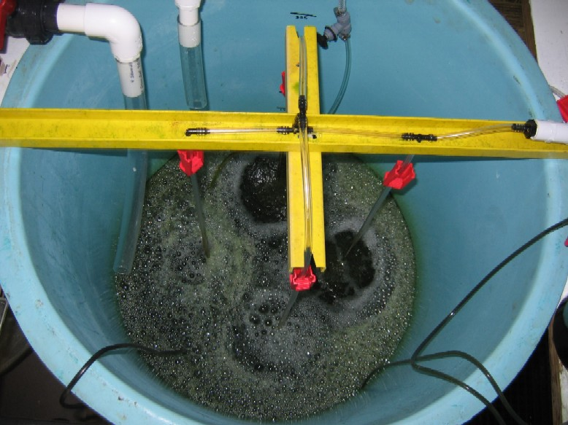
Inside Rotifer Tank

Slide 23
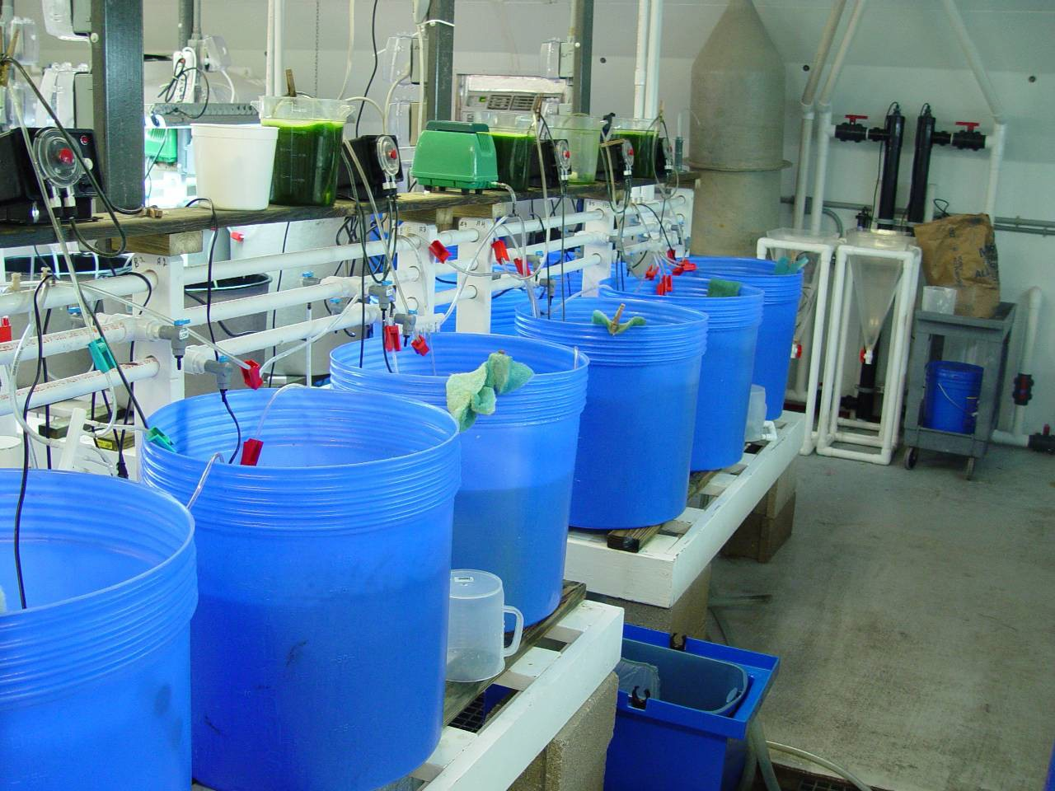

Slide 24
Culture Condition
Rotifer cultures are healthy if:
  Rotifers are swimming rapidly
  Females with eggs : female ratio of about 1.2 :1
  Little or no bacteria or ciliates present
Cloudy water is a good sign of imminent crash
Crashing cultures will have a bad odor

Slide 25
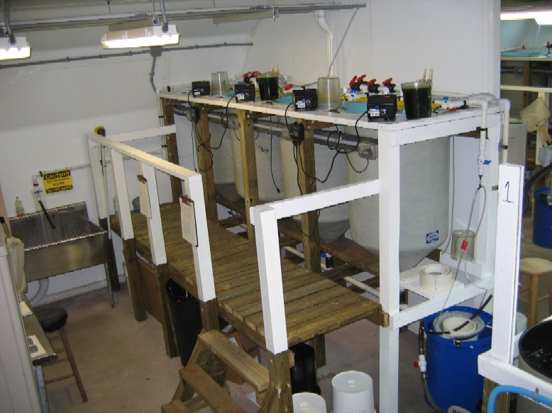

Slide 26
Our Rotifer Formula
Fill tank with seawater adjusted to 25
- 35 ppt
Add liquid chlorine (10%) & mix
Add sodium thiosulfate to neutralize chlorine and areate.
Add inoculating rotifers - a minimum of 150 to 250 per ml

Slide 27
Production Methods
Use light aeration
Keep light intensity to a minimum
Feed live algae/algae paste and rotifer diet daily
After 3 - 5 days rotifers will reach 500 to 750 per ml
Harvest and enrich for feeding and use to inoculate new tanks

Slide 28
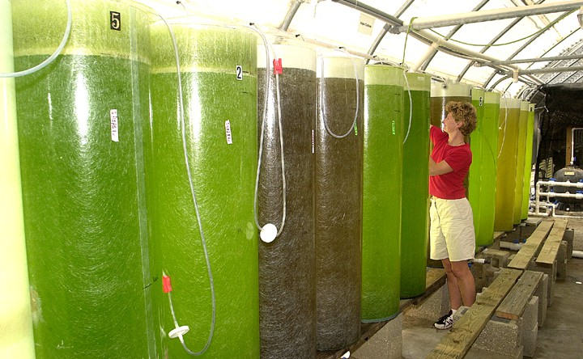
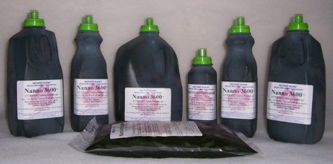
Feeding Algae
Nannochloropsis oculata & Isochrysis galbana
Live Algae
Instant Algae

Slide 29
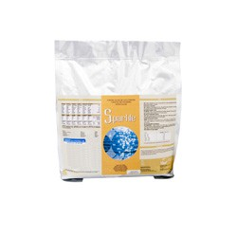
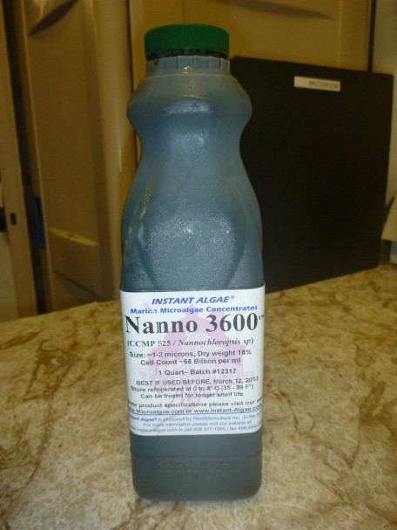
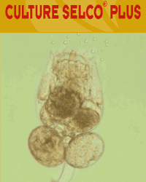
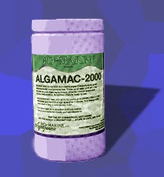
Rotifer Diets

Slide 30
Rotifer Enrichment
Bioencapsulation – feed rotifers nutrients essential for larval fish
Enrichment increases the Omega 3 fatty acids in the rotifers.
Common enrichment products:
  Algae - live, frozen, or dried
  Emulsion products - liquid or dry
    Selco (culture and DHA protein), Microfeast, Algamac, RotiRich

Slide 31
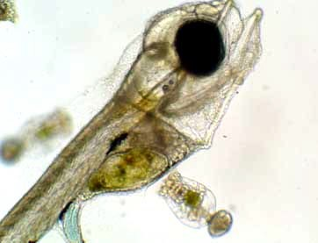


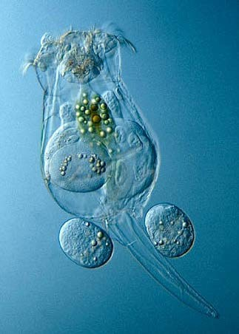

Enrichment
What??
Why??
Fatty Acids
Amino acids
Vitamins
Pigments
Probiotics

Slide 32
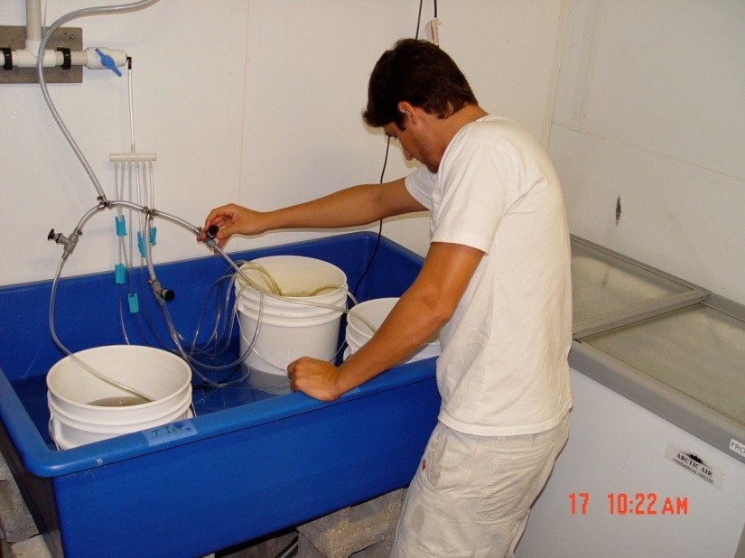
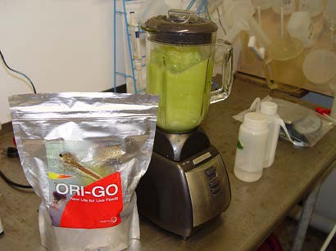
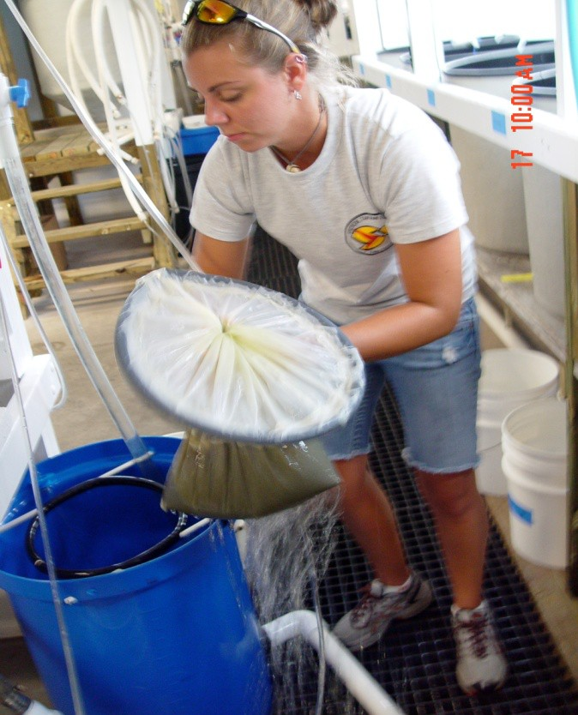

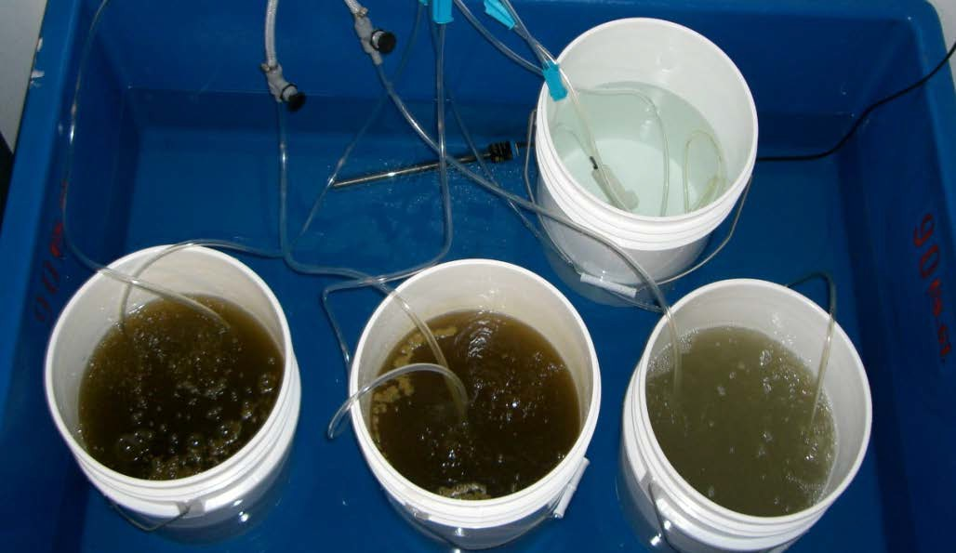
Water bath (28 ºC) for 3 h
Enrichments
20 million rotifers (10 am)
Harvesting

Slide 33
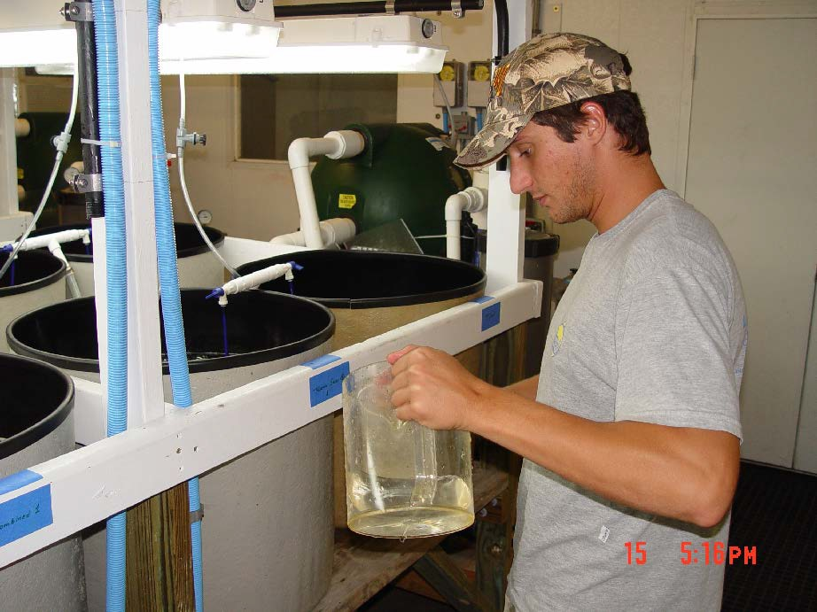
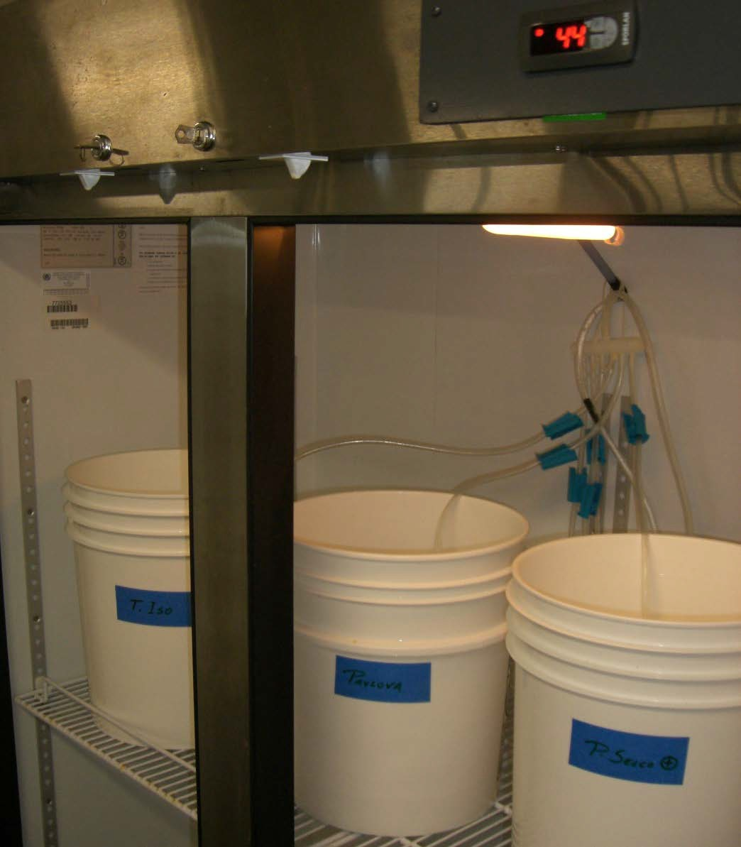
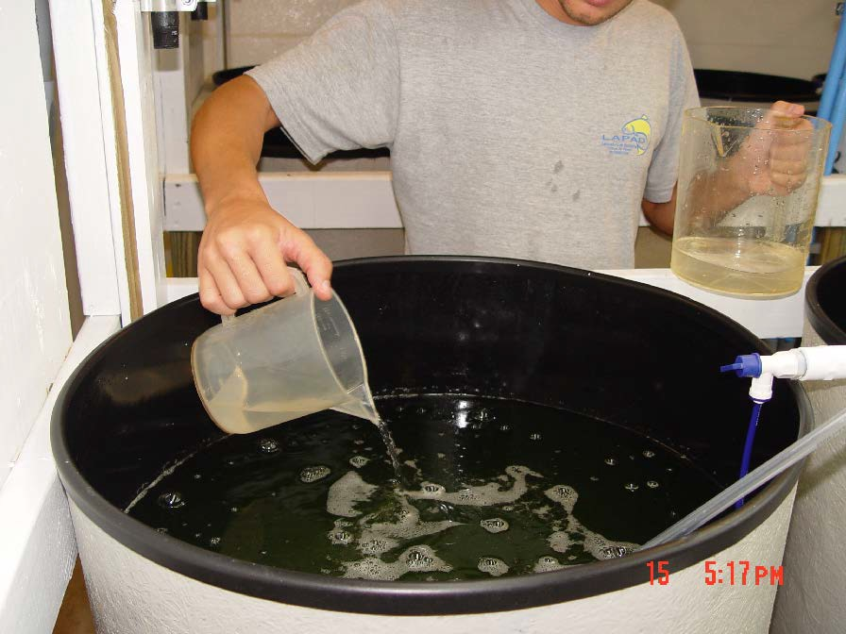
Cold storage (5-10 ºC)

Slide 34
Rotifer Schedule
8:30 AM
9:00 AM
9:30 AM
Feed larvae enriched rotifers Assess rotifer populations
Harvest tank, prepare enrichment containers, restart clean tank
Enrich rotifers(2-4 hour contact time) Refill algae containers, AM rotifer feeding Harvest, rinse, feed, and cold store rotifers Feed larvae enriched rotifers
Feed larvae enriched rotifers
10:00 AM
10:30 AM
1:00 PM
5:00 PM
9:00 PM

Slide 35
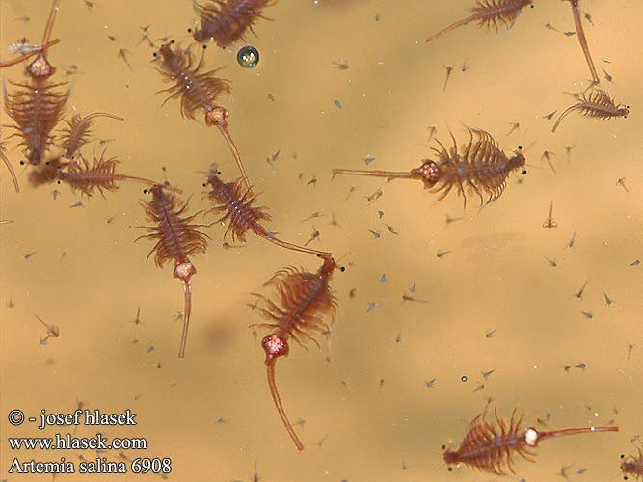
Artemia

Slide 36
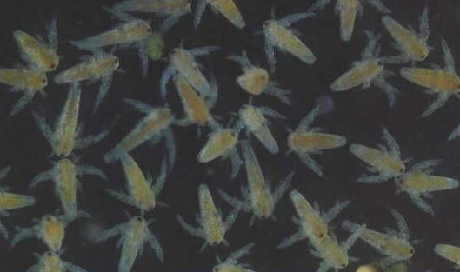
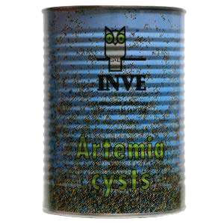
What is an Artemia?
Microscopic crustacean (brine shrimp)
Saltwater environments
Sold as cysts

Slide 37
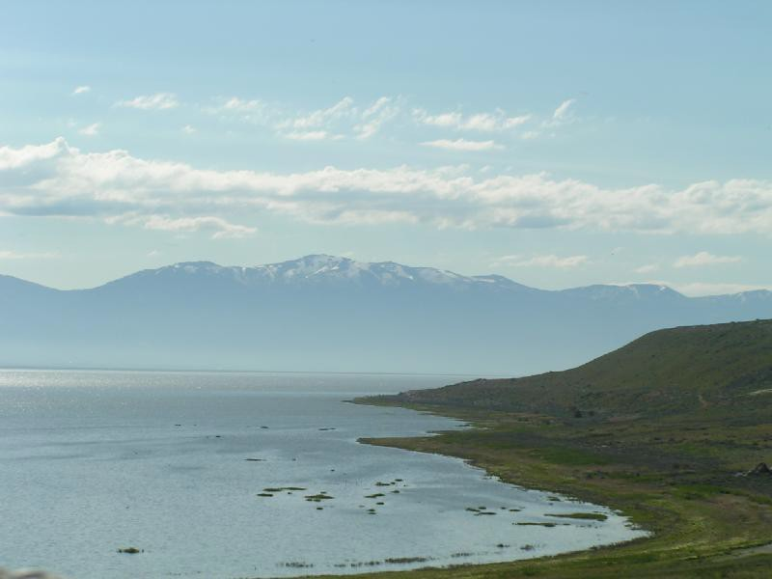
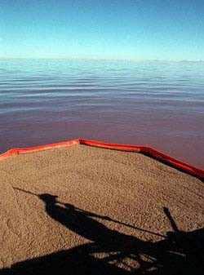
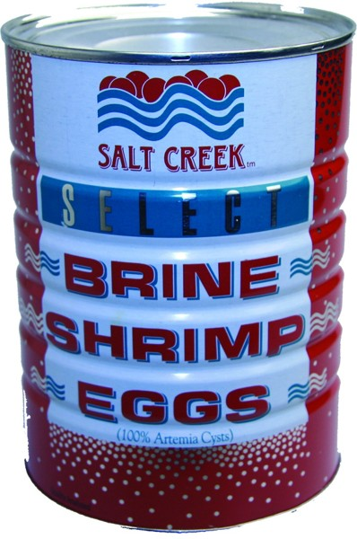
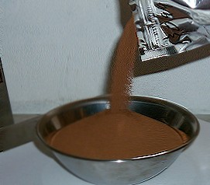

Slide 38
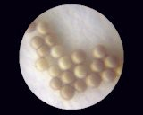
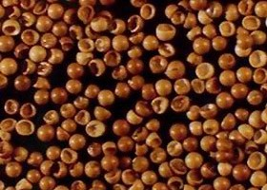
Decapsulation
Dehydrated cysts
Hydrated cysts
+ chemicals

Slide 39
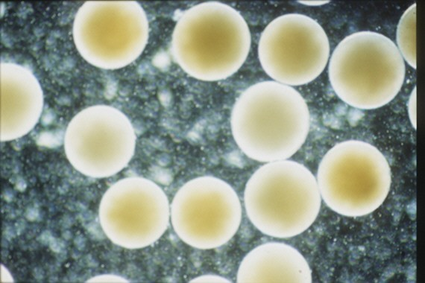
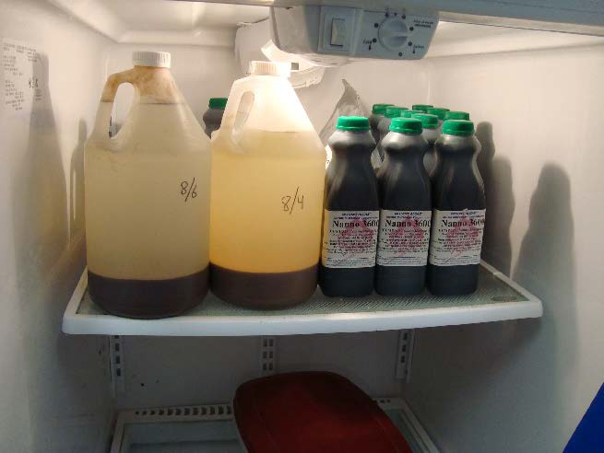
Decapsulated cysts

Slide 40
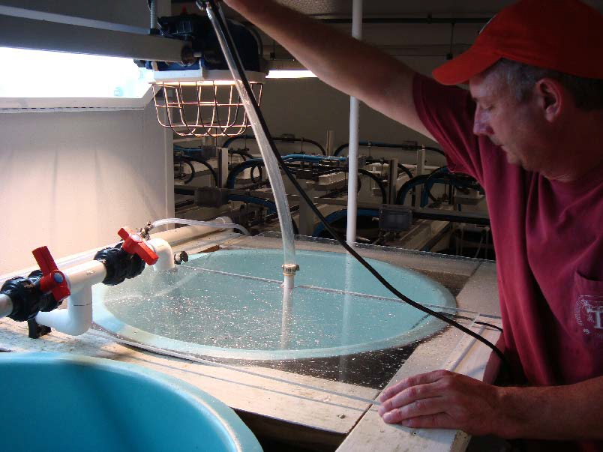

Incubation
Sterilized water
25-30 g/L salinity
28-30 C
Vigorous aeration

Slide 41


15-20 h = hatching
“Umbrellas”
First instar

Slide 42


Slide 43


Slide 44



Slide 45

Enrichment
Second instar

Slide 46




Slide 47

Sterilized water
25-30 g/L salinity
26-27 C
Moderate aeration
Enrichment contact 24 hrs.

Slide 48


Slide 49
Artemia Schedule
8:30 AM
9-11:00 AM
11:30 AM
1:00 PM
5:00 PM
9:00 PM
Feed larvae nauplii and/or enriched Artemia Harvest Artemia tanks
Cold store harvested nauplii, start enrichment tank Start next day enrichment, feed larvae
Feed larvae Feed larvae
Feedings should be spaced out during 24 period ~ 4-6 hrs.

Slide 50


