Slide 1
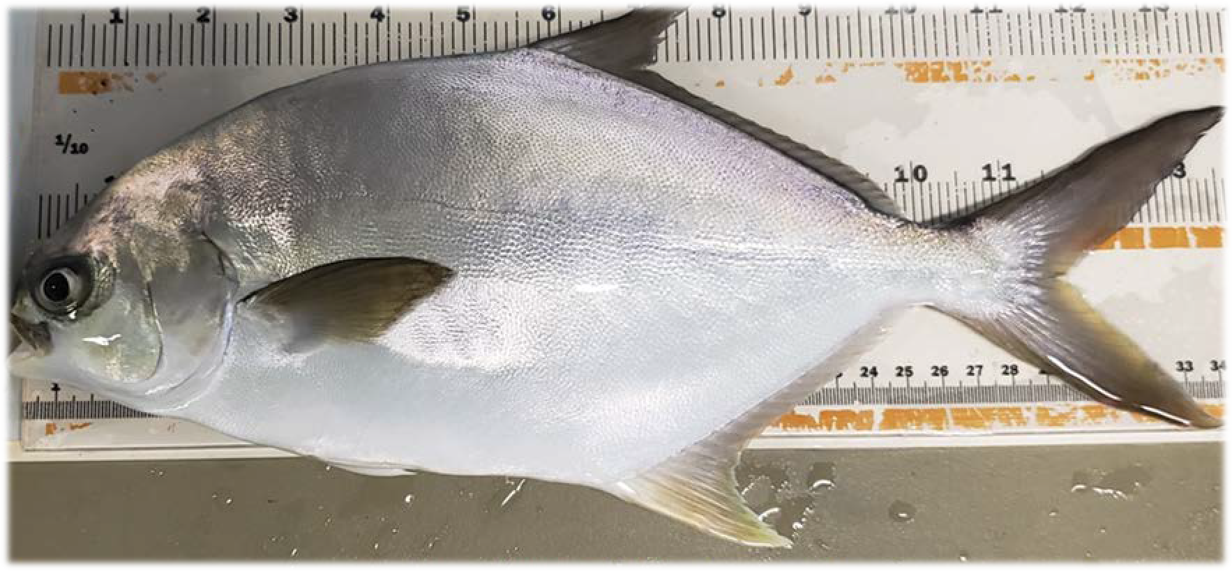





Summary of Project Experiment Results Florida Pompano Trachinotus carolinus

Slide 2
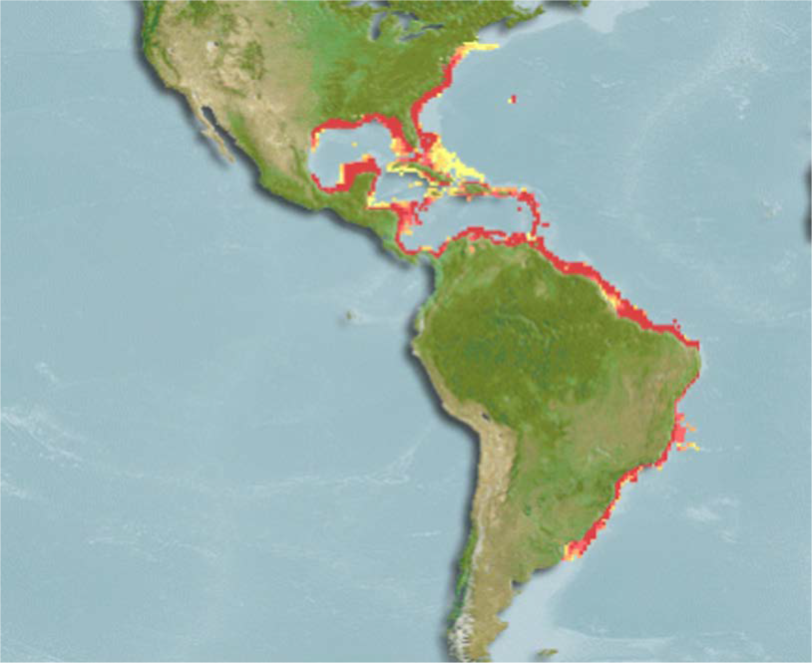
Wild Distribution (Florida Pompano)
•
•
•
•
•
•
www.aquamaps.org

Slide 3
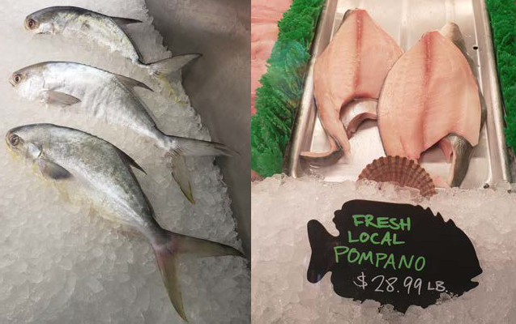







Commercial Value
Pelican Seafood Company (Fort Piece, FL) March 25, 2021
$63.92 per Kg
$28.99 per lb.

Slide 4


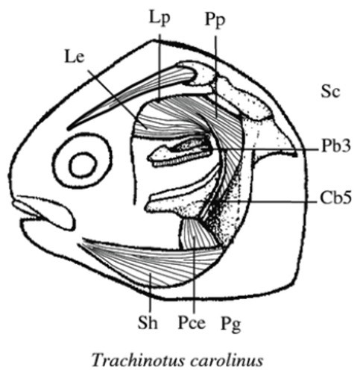






Jaw Morphology
(Grubich, 2003)

Slide 5



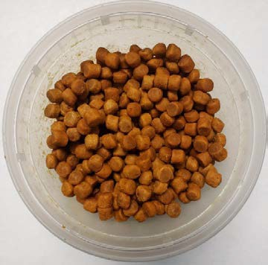



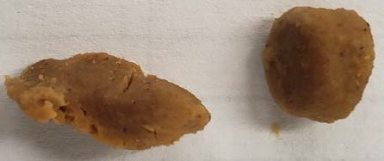
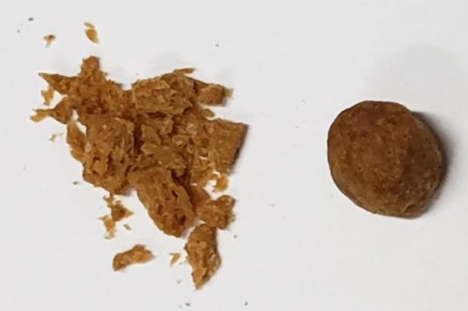

Non-perishable

Slide 6













Four Experiments

Slide 7







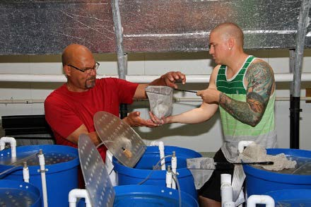
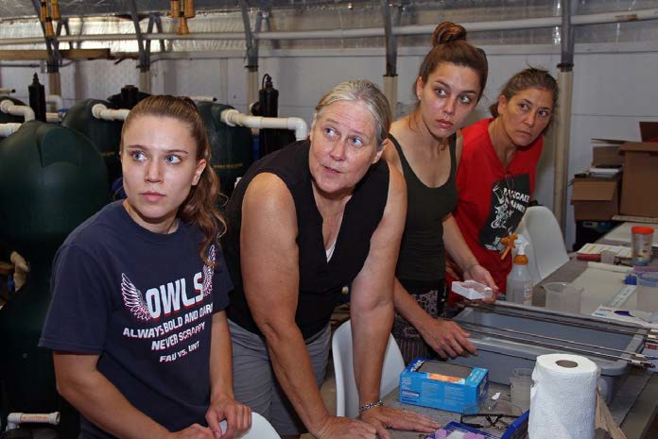
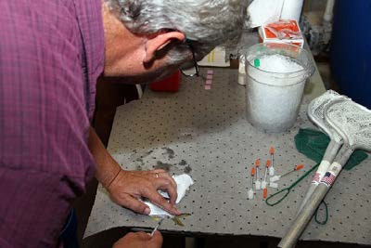
Experiment 1

Slide 8










Experiment 2

Slide 9







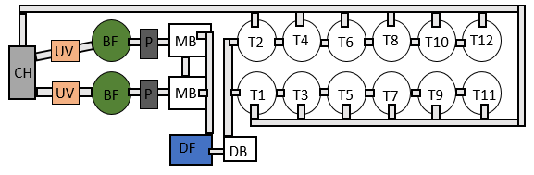
Experimental Design

Slide 10

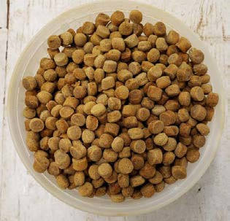
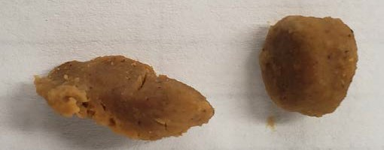







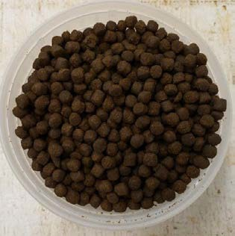




Treatments

Slide 11
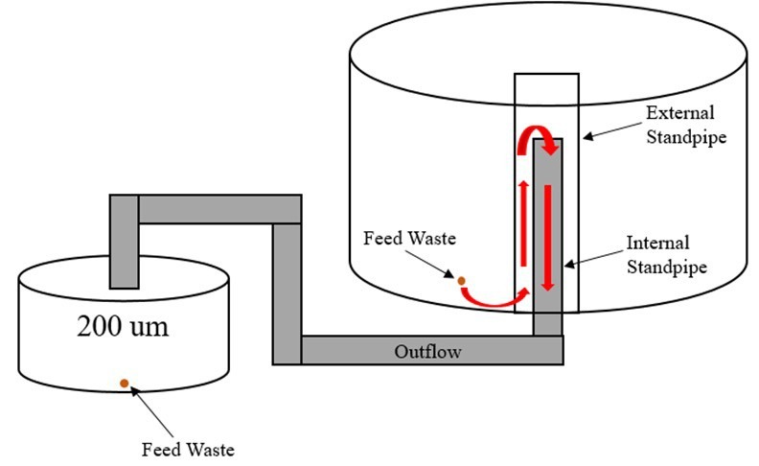
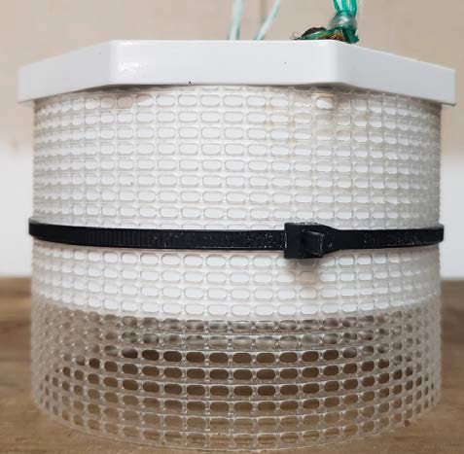

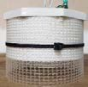
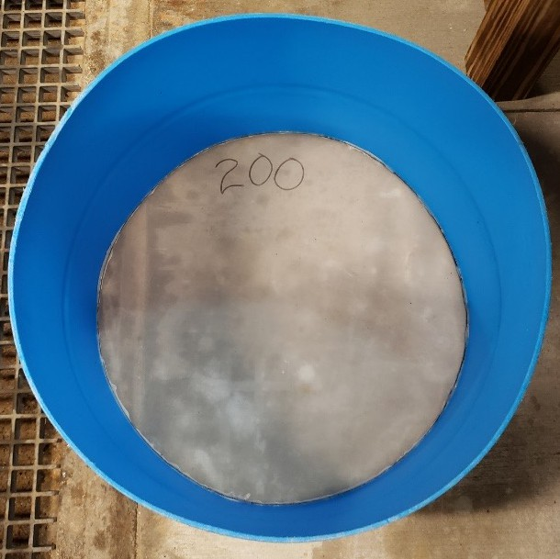





Sample Collection

Slide 12



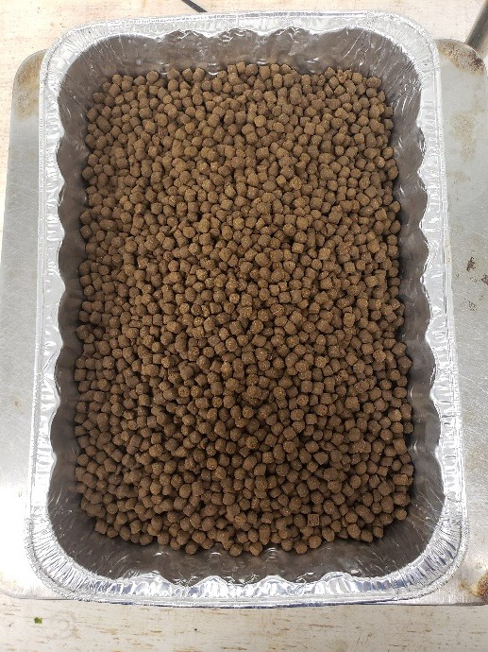
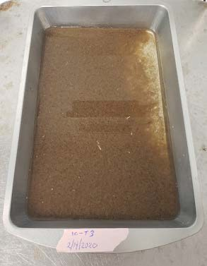
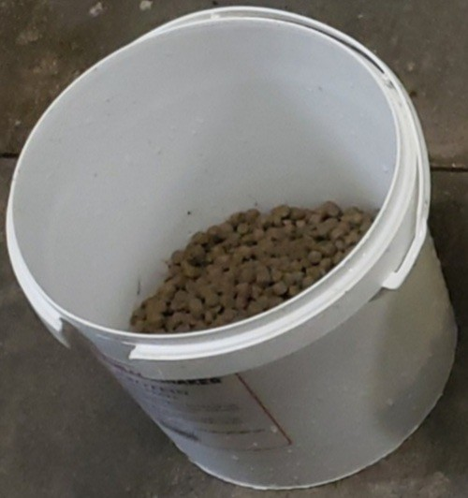
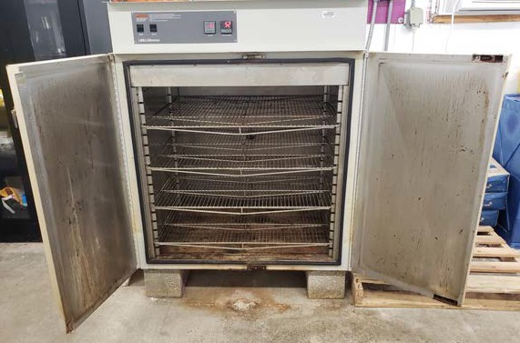
Drying Samples

Slide 13

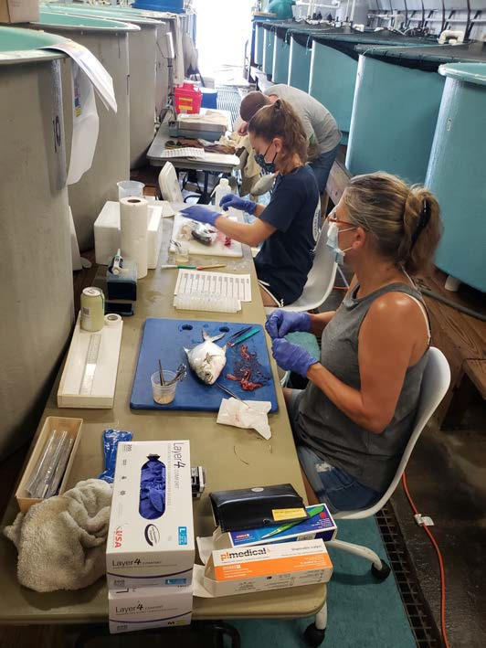


Fish Samples

Slide 14



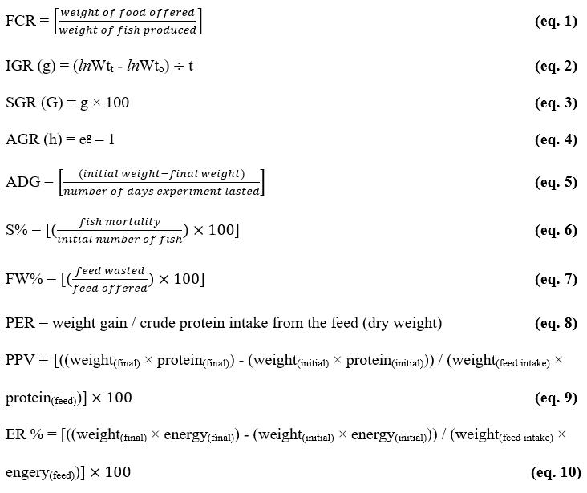
Analysis
Feed Conversion Ratio
Specific Growth Rate
Percent Survival

Slide 15
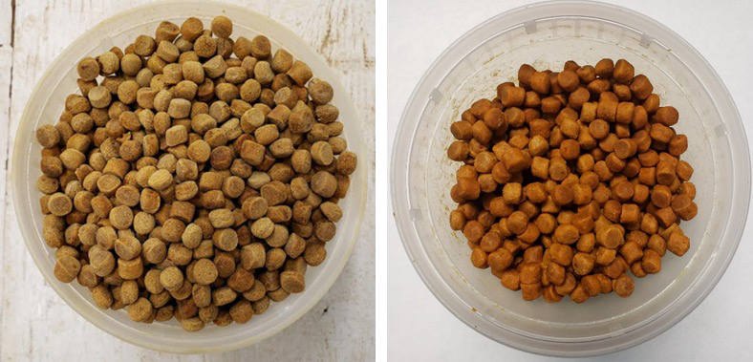
Experiment 2: Results

Slide 16
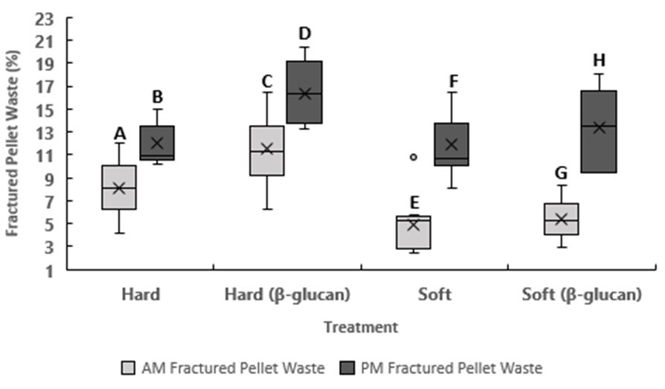
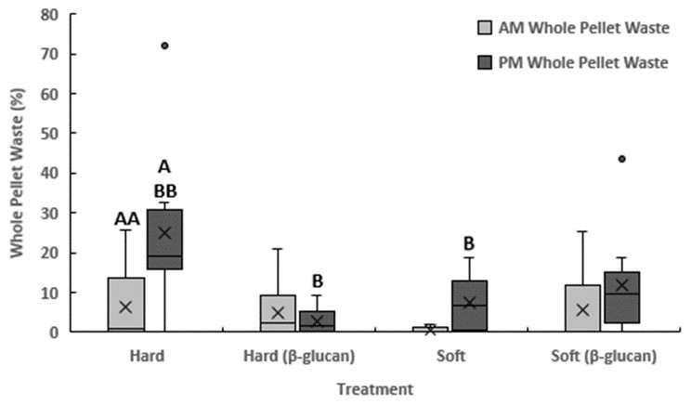


































Experiment 2 graphs

Slide 17
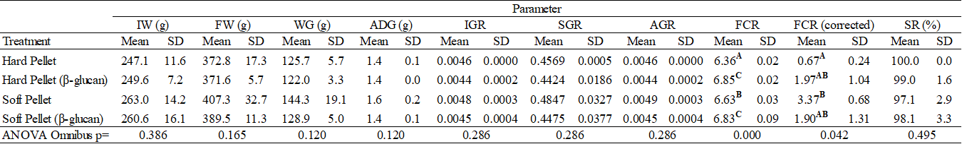
Fish Sample Results

Slide 18






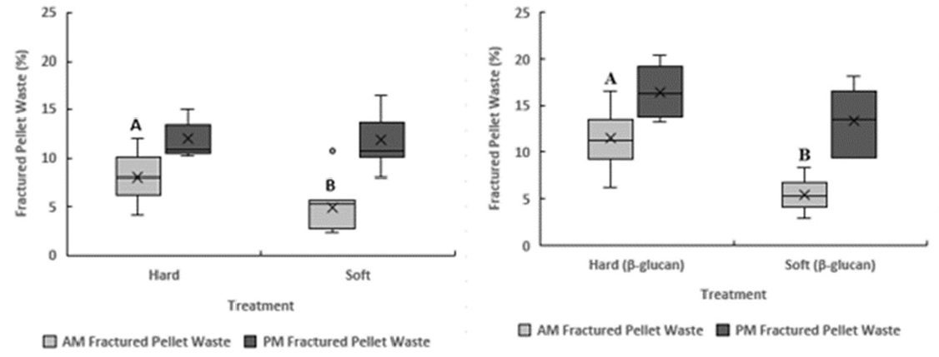

Experiment 2 - Discussion

Slide 19



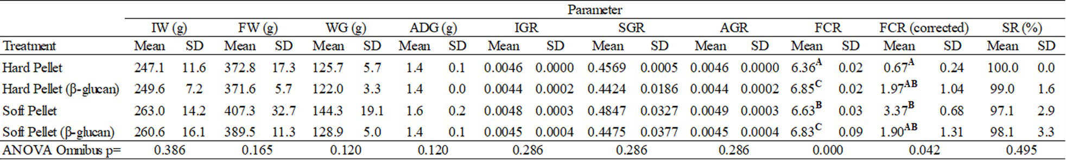
Experiment 2 – Discussion cont.

Slide 20








Experiment 3

Slide 21
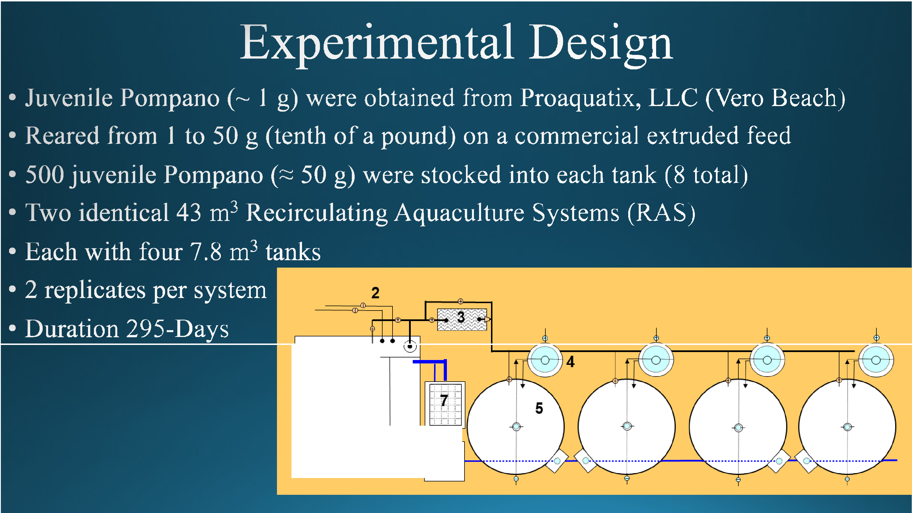
Experiment 3 - Design
1
���-�- ⁰6⁰

Slide 22

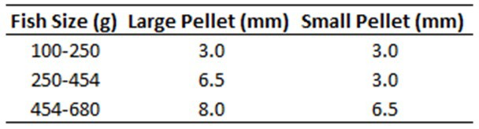












Experiment 3 - treatments

Slide 23

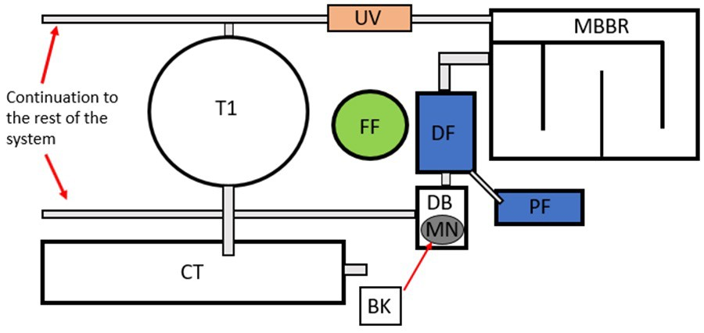
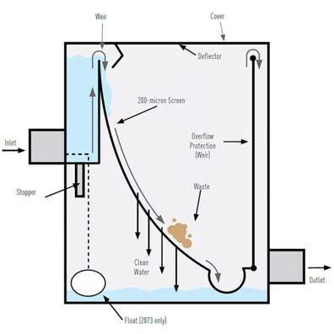









Experiment 3 – Sample Collection
Pentair Aquatic Eco-Systems

Slide 24

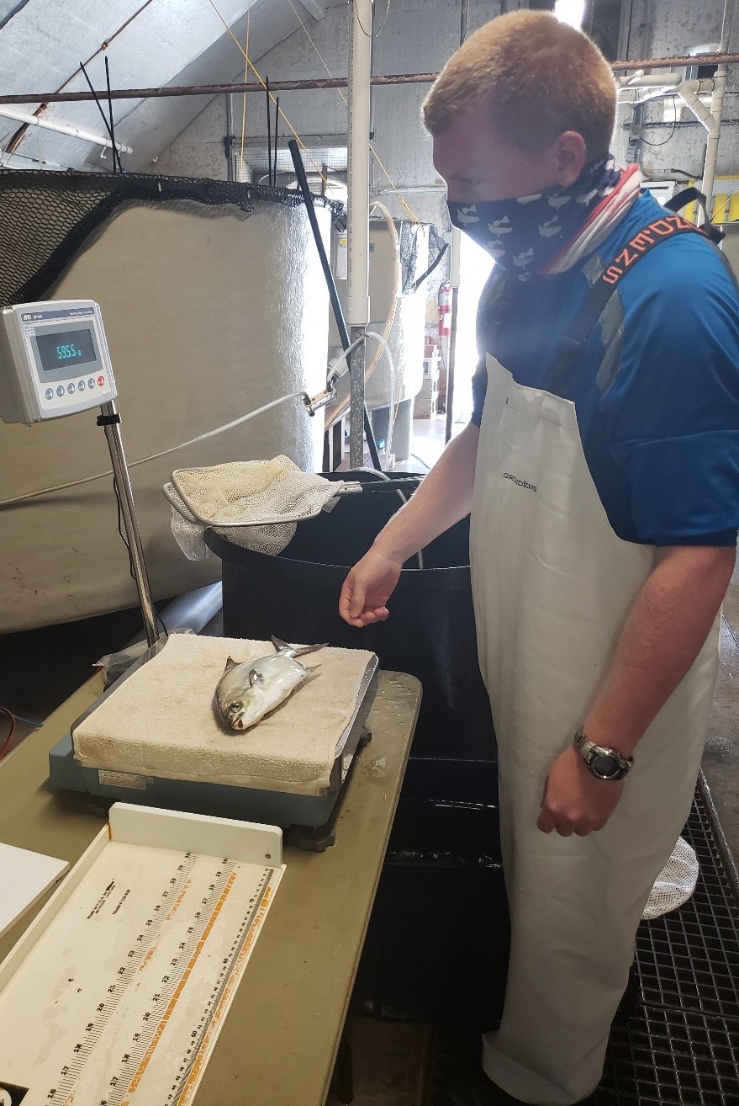

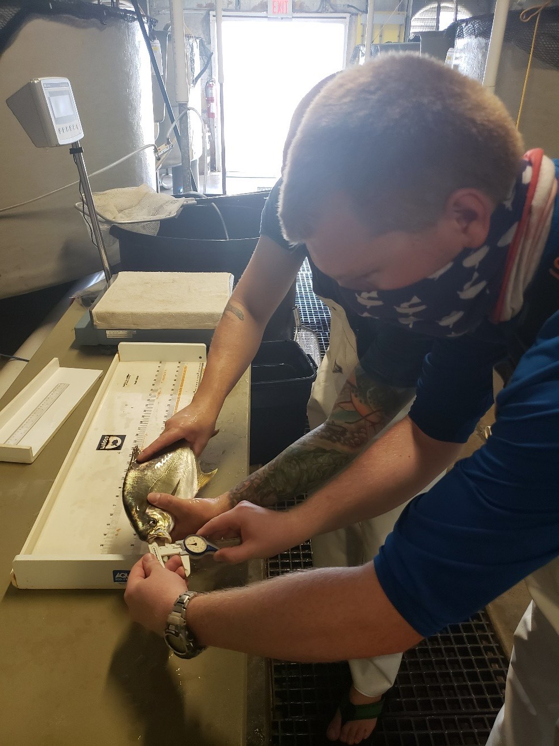










Experiment 3 – Fish samples

Slide 25


Exp. 3 - Analysis
Feed Conversion Ratio
Specific Growth Rate
Percent Survival

Slide 26
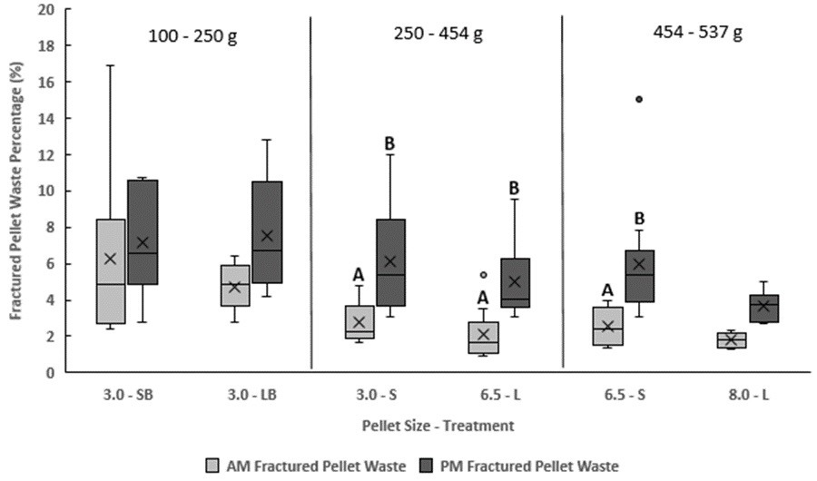















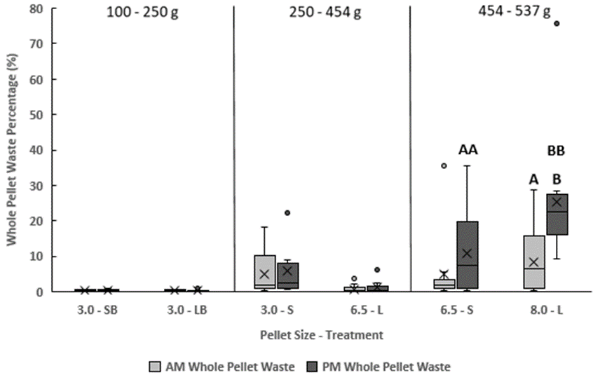




Exp. 3 - Results

Slide 27
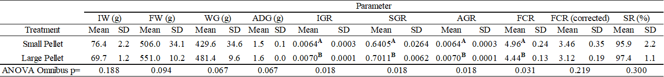
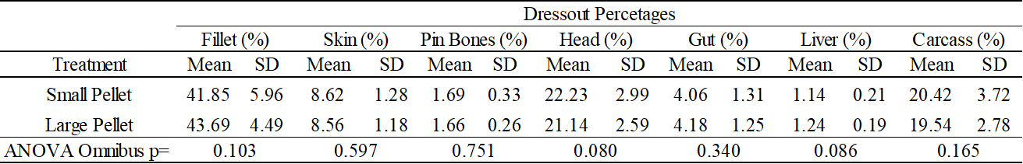
Florida Pompano Samples

Slide 28
Exp. 3 - Discussion
Experiment 3 - Discussion
Pellet size does not play a role in the amount of FPW
Again, there were differences between A.M. and P.M. FPW collections
A.M. FPW samples (first feeding) were taken after the ompano a gone a n1g twit no ee .
I18
100- 250g
250-454 g
454-537 g
-
P.M. FPW samples (last feeding) were taken when 2¹3 of •
16
•
the days feed ration had been offered
14
B
.,
12
B
In P.M. Pompano may not be as hungry and therefore
10
:$
B
engage in "sloppy" feeding.
8
■
6
X'
Note:
4
0
2
8 Effi
6.5-S
Riche (2009) showed that Pompano reared within a
0
3.0-SB
.. . ... t • It.
temperature of 28°C ± 1°C, had a gut passage rate of abou
3.0-UI
3.0-S 6.5-L
Pellet Size - Treatment
8.0-L
3 hours
Pompano were fed every three hours during the day with no feedings overnight, therefore the Pompano should have been ready to eat at every feeding.

Slide 29






Experiment 3 - Discussion
3.0% BW
3.0% BW
2.5% BW
These observations provide for more Accurate Feed Tables
 These will be in the Pompano Culture Manual

Slide 30




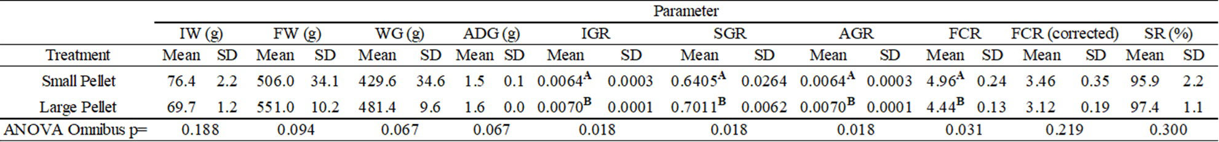
Exp. 3 – Discussion with chart

Slide 31







Experiment 4 - Synthesis

Slide 32


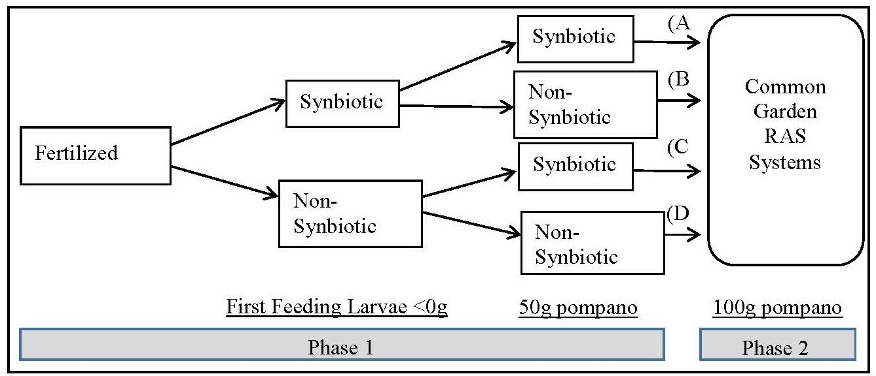
Exp. 4 - Design
Sub-Experiment 1
Sub-Experiment 2
Phase 2
Fertilized eggs

Slide 33















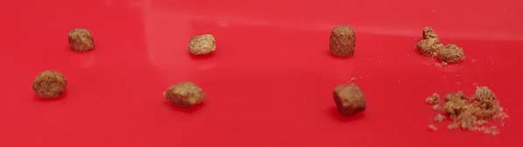
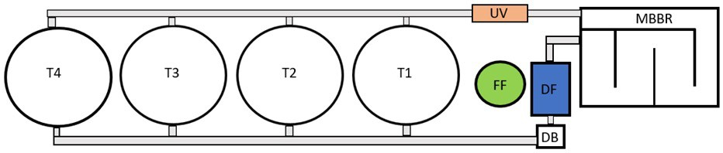
Experiment 4 - Design
SOFT
р
HARD
р

Slide 34
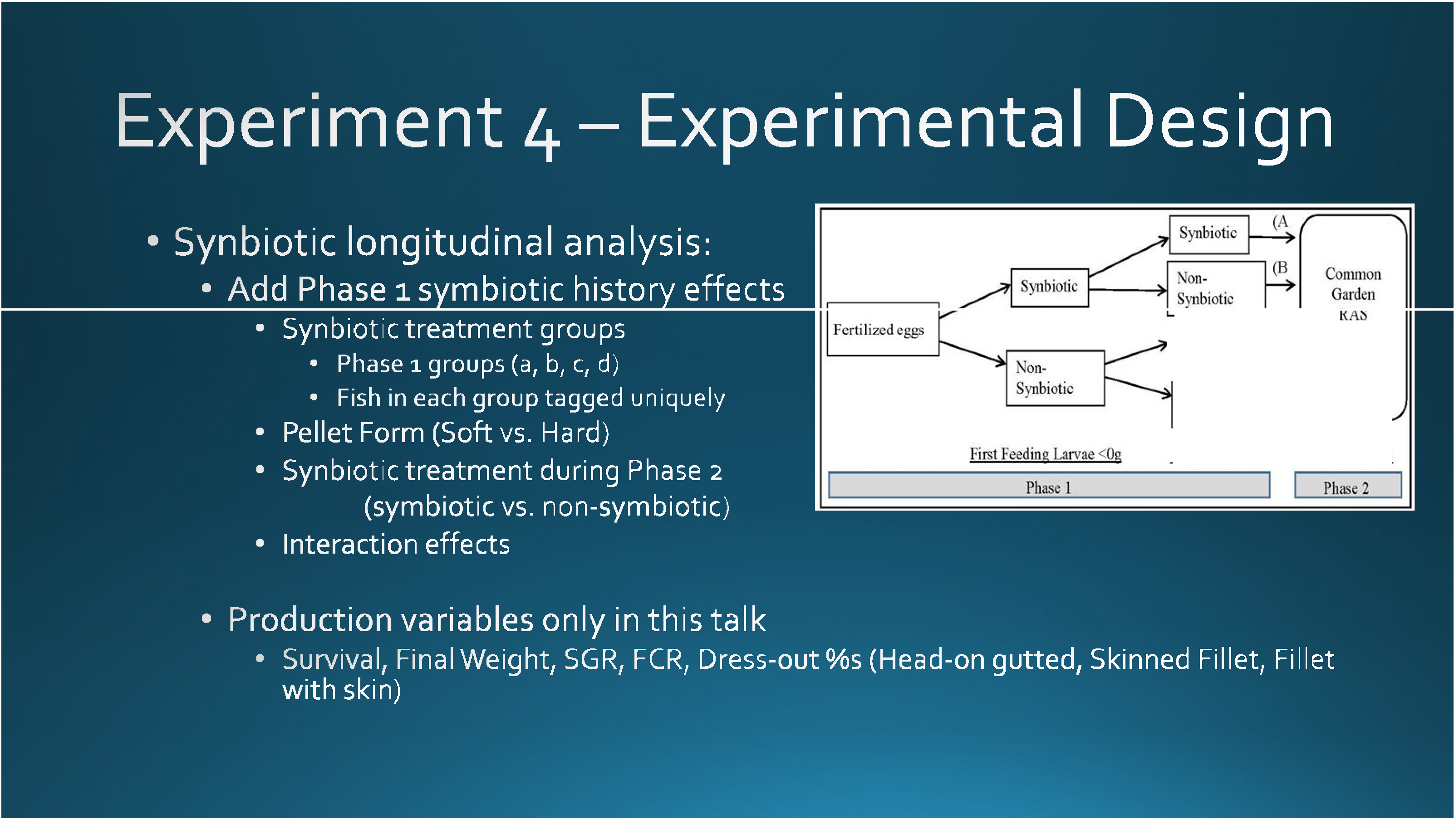
Experiment 4 – Experimental design
�
---�(D
Non-
Synbiotic
Systems
50gpompano
IOOg pompano

Slide 35



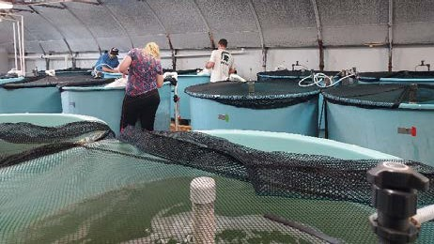
Exp. 4 – Results – Phase 1
Specific Growth Rate - g
FCR
0.08
0.07
0.06
0.05
0.04
0.03
0.02
0.01
0
1.4
1.2
1
0.8
0.6
0.4
0.2
0
Synbiotic
Non-Synbiotic
Final Weight (g)
Synbiotic
Non-Synbiotic
g
Survival %
FCR
80
70
60
50
40
30
20
10
0
100
80
60
40
20
Non-Synbiotic Final Weight
0
Synbiotic
Synbiotic
Non-Synbiotic
Survival

Slide 36



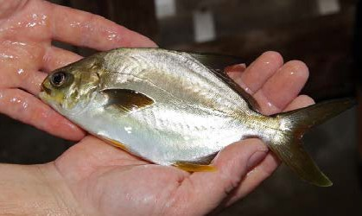
Exp. 4 – Results – phase 1 sub-exp 2
Specific Growth Rate - g
FCR
0.025
2.5
0.02
2
0.015
1.5
0.01
1
0.005
0.5
0
Syn-Syn Non-Non Syn-Non Non-Syn
g
0
Syn-Syn Non-Non Syn-Non Non-Syn
Final Weight (g)
Survival %
FCR
120
100
100
80
80
60
40
60
40
20
20
0
Syn-Syn Non-Non Syn-Non Non-Syn Final Weight
0
Syn-Syn
Non-Non
Syn-Non
Non-Syn
Survival

Slide 37




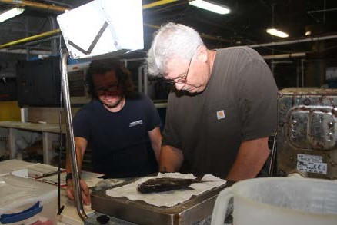
Exp. 4 – Results – Phase 2
Specific Growth Rate - g
FCR
0.007
0.006
0.005
0.004
0.003
0.002
0.001
0
7
6
5
4
3
2
1
0
Hard Syn Hard-Non Soft Syn Soft-Non
Hard Syn Hard-Non Soft Syn Soft-Non
g
Final Weight (g)
Survival %
FCR
600
120
500
100
400
80
300
60
200
40
100
0
20
0
Hard Syn Hard-Non Soft Syn Soft-Non Final Weight
Hard Syn Hard-Non Soft Syn Soft-Non
Survival

Slide 38






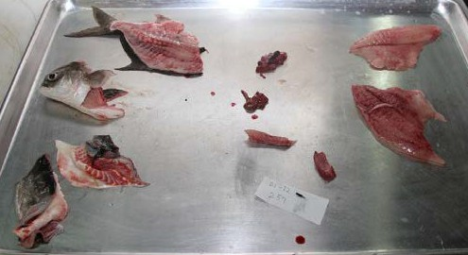
Exp 4 – Results – Phase 2 – Dress-out
Skinless Fillet %
Skin-on Fillet %
100
100
80
80
60
60
40
40
20
20
0
Hard Syn Hard-Non Soft Syn Soft-Non Skinless Fillet
0
Hard Syn Hard-Non Soft Syn Soft-Non Skin-on Fillet
Head-On-Gutted %
100
80
60
40
20
0
Hard Syn Hard-Non
HOG
Soft Syn
Soft-Non

Slide 39




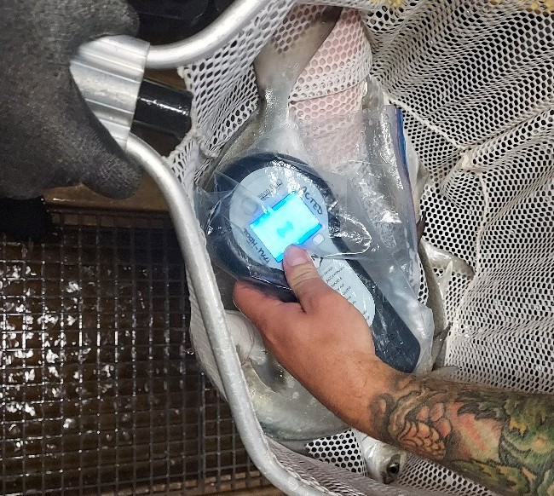

Exp 4 Results – Phase 2 – Longitudinal Analysis
Specific Growth Rate - g
% Weight Increase
0.007
0.006
0.005
0.004
0.003
0.002
0.001
0
a
300
b
250
200
150
100
50
Synbiotic Non-synbiotic g
Specific Growth Rate - g
0
A
B
C
D
Hard-Syn
Hard-No n So ft-Syn
Final Weight (g)
So ft-Non
0.007
600
0.006
500
0.005
400
0.004
300
0.003
0.002
200
0.001
100
0
A
B
C
D
0
Hard-Syn
Hard-Non
Soft-Syn
Soft-Non
A
B
C
D
Hard-Syn
Hard-No n
So ft-Syn
So ft-Non

Slide 40








Conclusions

Slide 41


















Acknowledgements
Funding
Dr. Laramore’s Lab:
Erica Albright
Caitlyn Courtemanche
Cari Sinacore
Florida Sea Grant Project: CDFA 11.417: Wills - Final Steps Toward Commercialization of Pompano Aquaculture NA18OAR4170345

Slide 42


Questions?

Slide 43
Blank slide – blue gradient

Slide 44











Trachinolini
T. goreensis
(Longfin Pompano)
T. ovatus
(Pompano)
T. goodei
(Great Pompano)
(Reed et al. 2002)
T. auratus
(Golden Pompano)
T. blochii
(Snubnose Pompano)
T. teraia
(Shortfin Pompano)
T. falcatus
(Permit)
T. rhodopus
(Gafftopsail Pompano)

Slide 45

Results – Phase 2 - Factorial
Specific Growth Rate - g
FCR
0.007
0.006
0.005
0.004
0.003
0.002
0.001
0
7
6
5
4
3
2
1
0
Hard Syn Hard-Non Soft Syn Soft-Non
Hard Syn Hard-Non Soft Syn Soft-Non
g
Final Weight (g)
Survival %
FCR
600
120
500
100
400
80
300
60
200
40
100
0
20
0
Hard Syn Hard-Non Soft Syn Soft-Non Final Weight
Hard Syn Hard-Non Soft Syn Soft-Non
Survival

Slide 46

Results Phase 2 – Factorial Experiment
Specific Growth Rate - g
FCR
0.007
0.006
0.005
0.004
0.003
0.002
0.001
0
a a
7
6
5
4
3
2
1
0
ab
b
Hard Syn
Hard-Non Soft Syn Soft-Non
Final Weight (g)
Hard Syn Hard-Non Soft Syn Soft-Non
g
Survival %
FCR
600
a ab
120
500
b
c
100
400
80
300
60
200
40
100
0
20
0
Hard Syn
Hard-Non Soft Syn Soft-Non Final Weight
Hard Syn Hard-Non Soft Syn Soft-Non
Survival

Slide 47
















Florida Pompano (Trachinotus carolinus)

Slide 48


Exp. 3 – Discussion with charts

