Slide 1
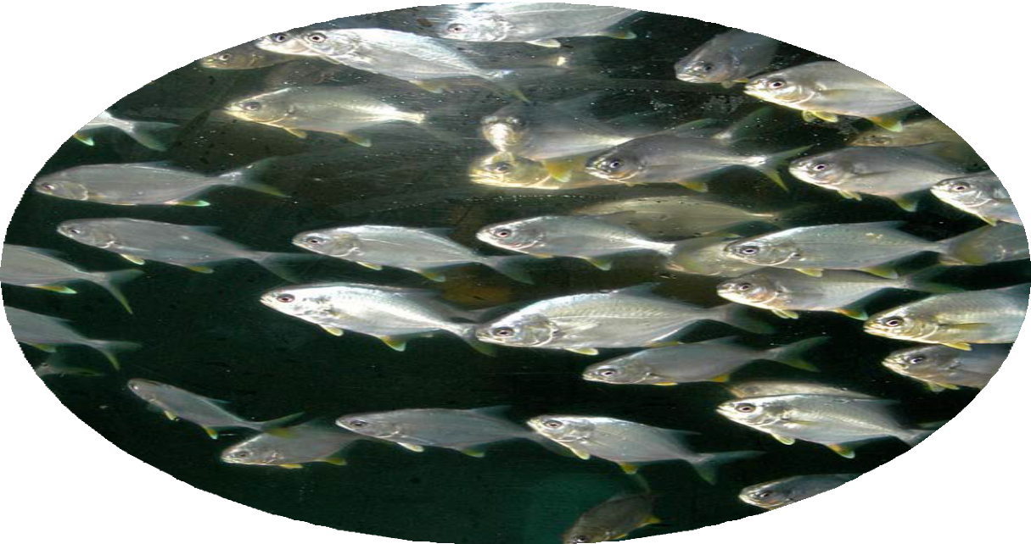

Seafood Marketing Considerations
Megan Davis, Ph.D., Research Professor
FAU Harbor Branch Oceanographic Institute
Commercialization Status of Florida Pompano
Aquaculture Industry Workshop January 19, 2023

Slide 2
Five Steps to Building an Aquaculture Business
Five Steps to Building an Aquaculture Business
Research and Training
Evaluations of Expectations
Planning:
Market, Production, Business
Testing: Demonstration-Scale
Commercial Production

Slide 3
Market Analysis
The analysis of the market can be difficult because selling your product is a long way off: 12 - 36 months.
Need to plan 3 - 5 years ahead of the sale of your product.
Need to know how the revenue will flow into the business.

Slide 4
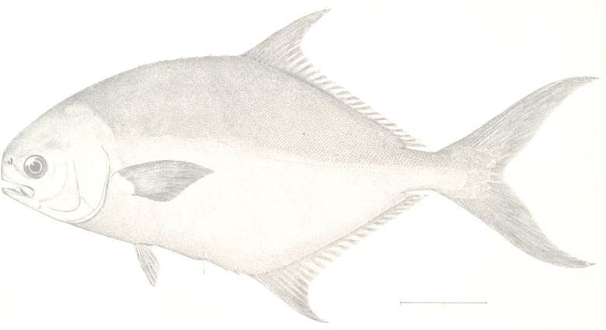
The Market Mix – the Four Ps
Product
Price
Place
Promotion

Slide 5
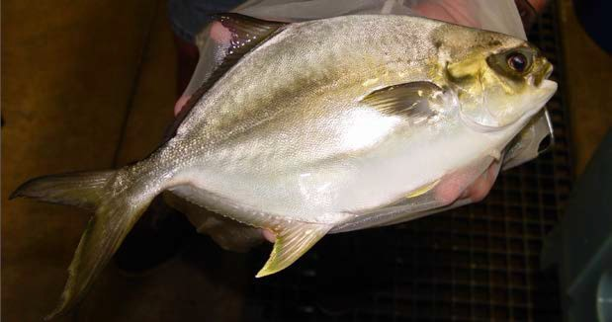
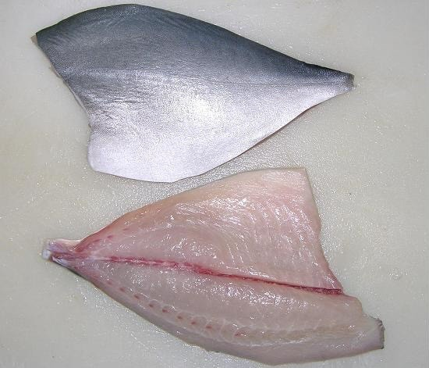
Product
Form
  whole on ice, fresh, frozen, gutted or fillet
Whole (1.0 – 2.0 lbs)
Fillets
(4-6 or 5-7 ounce)

Slide 6
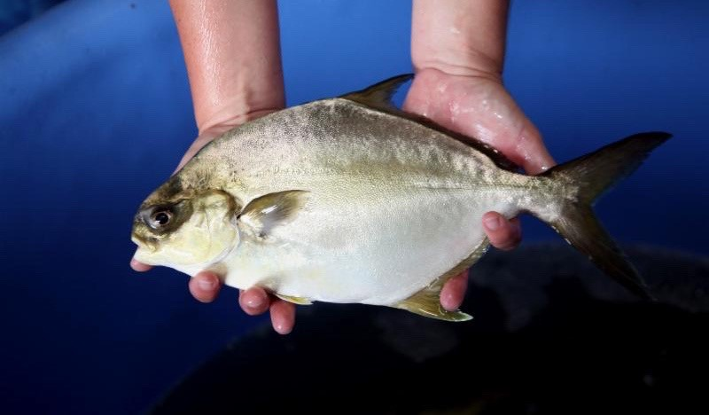
Product 2
Quantity
  estimate sales frequency and amount of product
  Growout is approximately 1-year
Packaging
  iced in heavy waxed box, vacuum-packed, IQF, labeled
Regulations
  processing permits, HACCP

Slide 7
HACCP and Quality Assurance Programs
In December 1995, the FDA issued seafood regulations based on Hazard Analysis and Critical Control Point
HACCP is a preventive system to ensure safer foods and is designed to identify hazards, establish controls, and monitor those controls
Other resources available: Cooperative Extension Service or Sea Grant Marine Advisory Service, seafood trade organizations, regional offices of the Food and Drug Administration or National Marine Fisheries Service

Slide 8
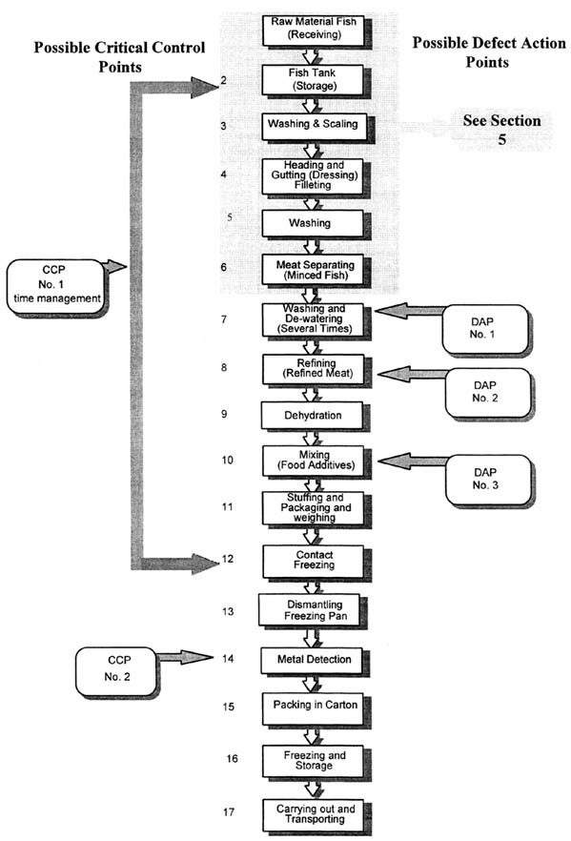
HACCP Flow Diagram
cover all of the steps in the process which the business performs
include receiving and storage steps for each of the ingredients, including non-fishery ingredients
be verified on-site for accuracy

Slide 9
Price
Farm gate price to the support the farm must meet or be below market price.
60-80% of seafood is sold through restaurants – e.g., deboned fillet of fish
Farm gate price/Yield = product value
  If $13.99 per pound whole fish*
  $13.99/0.56 yield = $24.98 per pound for deboned fillet

Slide 10
Prices
Product | Crab-e-Bills (Sebastian, Florida) | All Fresh Seafood (Online)
Whole Fish | $13.99 | $13.99
Fillets | $28.99 | $24.99
Dress out = 56-59%
January 2023 Prices

Slide 11
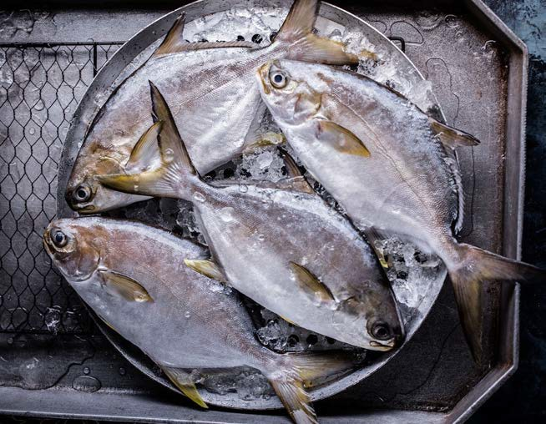
Price 2
Need to include processing, packaging and delivery
Intangible quality to price - value to buyer
New products in short supply may demand a higher price
Direct and niche marketing
Photo: Aquaco

Slide 12
There are two main factors that will determine the size of the business:
Determining the Size of the Business
Resource availability
» Land
» Capital Resources
» Labor
Market Size
» Direct market ®Smaller sales volume
» Commodity market®Larger sales volume

Slide 13
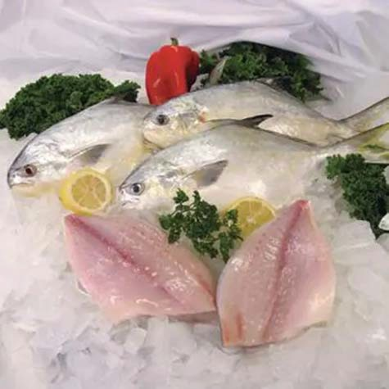
Direct Retail Sales
Sell directly to the customer
Achieve the greatest per unit profit
Good direction for small-scale producers
Photo: All Fresh Seafood

Slide 14
Direct Market Ideas
Local Customer Base
Roadside Market
Fish Fry Fund-raiser
Fairs and Festivals
Office Building Markets
Restaurants
Retail Stores
Value-added Market
Fee Fishing

Slide 15
Place
Location of the farm = survival
Buyers - processing plants
Transportation - trucking, airports, highways
Regulatory Services - inspectors
Storage - freezers
Need to deliver at the least cost to have a competitive edge

Slide 16

Promotion
How to introduce a new aquaculture species (Florida Pompano) into the marketplace at a local and national scale?
Who is the target audience?
  determine buyer and where they are located
How can the audience be reached?
  need to trigger action
What is the cost of each option?
  advertisement (business cards, magazine, social media)
» identify what you sell
» include the call to action
Photo: Aquaco

Slide 17
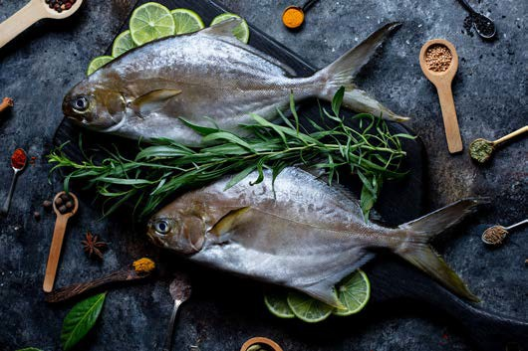
Advantages of Aquaculture Products
Harvest times - consistency
Fresh product or processed to market specifications
Size is uniform
Flavor is reliable
Personal touches
Meets the customer’s needs
Photo: Aquaco
Photo: All Fresh Seafood
17

Slide 18
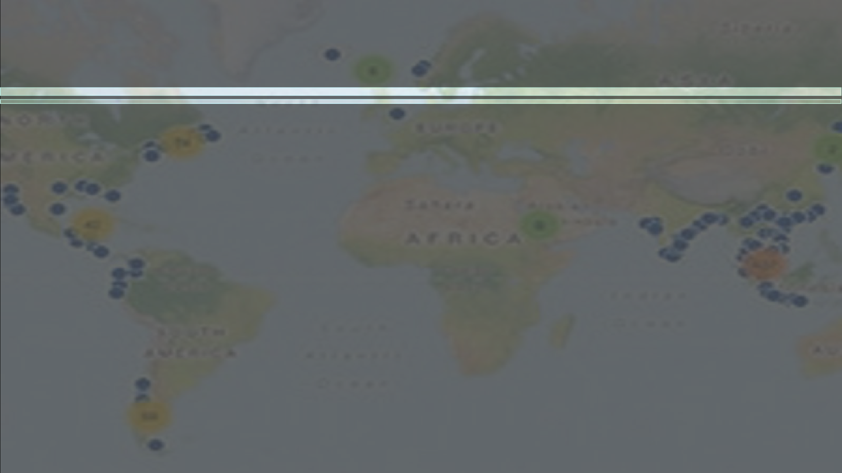





Wild and Farmed Products
Wild and Farmed Products
certifications ecolabels

Slide 19
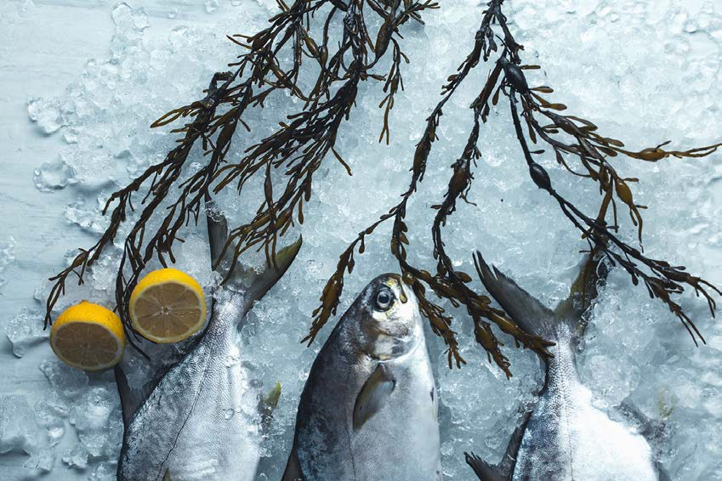
Know What is Important to the Consumer & Buyer
Health
Nutrition
Convenience
Variety
Source – Wild, Farmed
Value
Sustainability
Safety and Quality
Photo: Aquaco

Slide 20
Consumer and Buyer Behavior
FAU course (2019, 2020) – Professor Eileen Acello
Group projects –
  Pitch seafood as a healthy protein choice to be consumed 2x per week with the goal to increase seafood consumption in US
  What is the unmet consumer need and solutions to satisfy that need. Consumers:
» Gen Z (born 1997 - 2010)
» Gen Y (born between 1981- 1996)
» Gen X (born between 1965 - 1980)
» Baby Boomer (born between 1946-1964)

Slide 21
Findings: Consumer and Buyer Behavior
Category | Gen Z | Gen Y | Gen X | Boomers
Consume Seafood (%) | 87 | 89 | 96 | 94
Reason to Eat Seafood | Health Taste | Health Taste | Health Taste | Health Taste
Reason Not to Eat Seafood | Smell, taste, contaminants, unfamiliar, texture, allergies | Taste, price | Price, cooking know how, smell, taste | Price, taste, smell, allergies
Place of Consumption | Home Restaurant | Home Restaurant | Home preference b/c budget | Home Restaurant

Slide 22
SWOT: Consumer and Buyer Behavior
Categories | Summary (Gen Z, Y, X, Boomers)
Strengths | Healthy, Nutritious, Sustainable
Weaknesses | Price, Taste, Smell, Lack of Knowledge on How to Prepare
Opportunities | Easy Access to Recipes and How to Cook, Online Deliveries, Health
Threats | Other Proteins, Misinformation, Hesitant to Try, Contaminants

Slide 23
Principles of Advertising
FAU course (2020) – Professor Eileen Acello
Group projects – (by demographics)
  How to reach the consumer about seafood?
  How make the consumer feel comfortable to try seafood?
  How to build consumer confidence in buying and cooking seafood?
  How to educate the consumer?
» Seafood is healthy to eat
» Seafood is easy to cook at home
» Aquacultured seafood is safe and healthy to eat
» Consuming seafood 2x per week is recommended as part of a healthy diet

Slide 24
Principles of Advertising 2
 | Gen Z | Gen Y | Gen X | Boomers
Social Media | Instagram and Snapchat | Instagram and Facebook | Facebook and Friends | Facebook and In Store
Information Gathering | Through Videos, Online | Foodie Influencers | Online Reviews, TV Ads, Videos | Online and Print Ads
Place of Consumption | Variety | Need to feel comfortable cooking | Home | Home
Type of Seafood | Organic and Natural | Preference to Salmon but Eat Variety | Variety | Wild, Fresh
Overall – target the health benefits of eating seafood

Slide 25

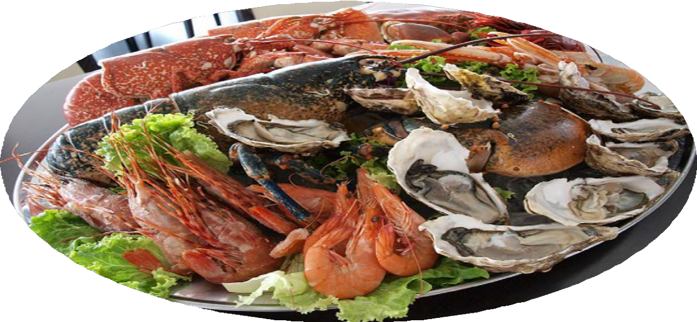
Simply Served Seafood
Simply Served Seafood
”Seafood is Superfood”

Slide 26
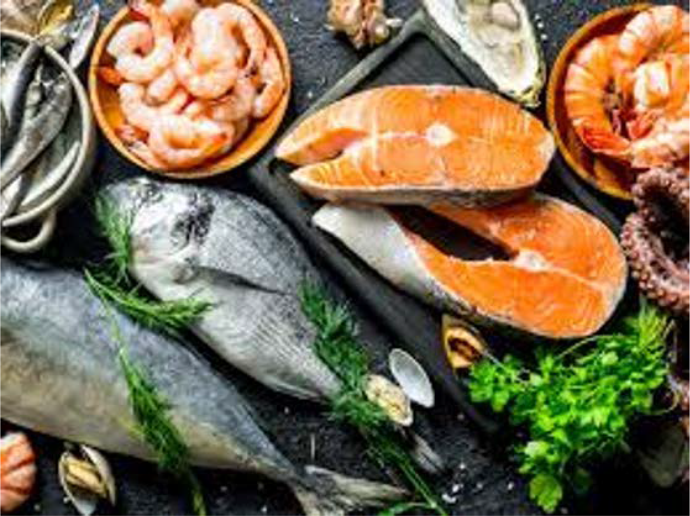
“I’m on a seafood diet, I eat everything I sea”
Aqua-Marketing Agency

Slide 27

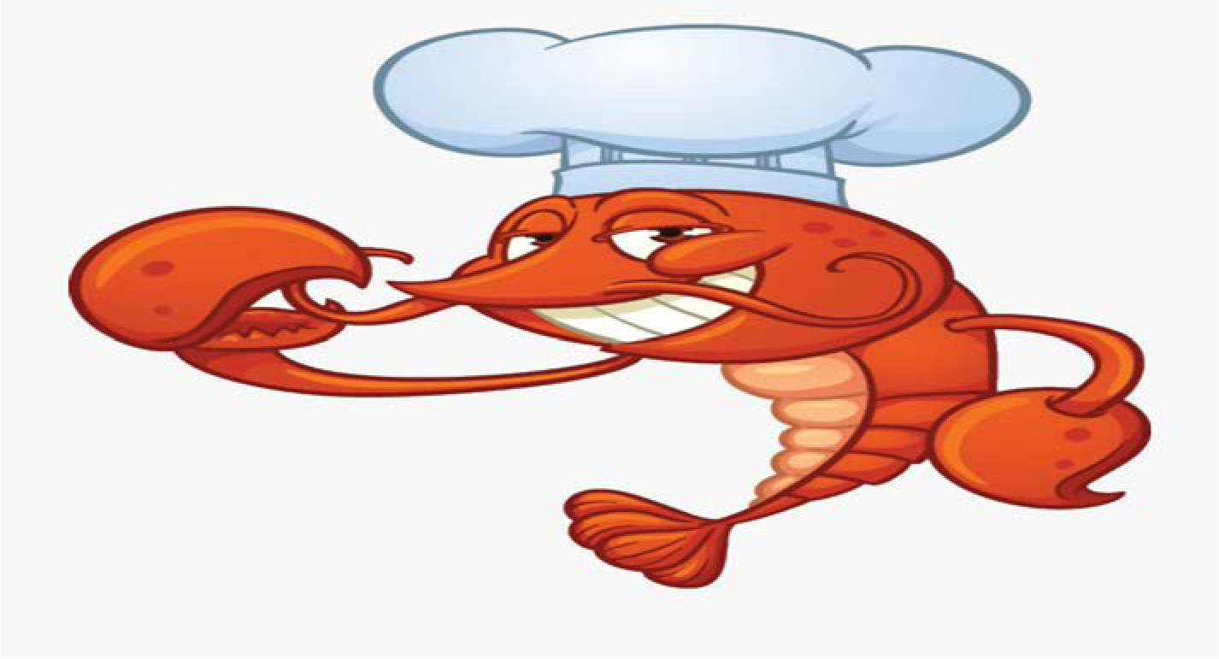
Agency
“From the sea into our hearts!”
Alex Fox, Dalton Haskin, Eric Naphor, Joe Burgese, Nelson Rengifo
(Generation X)

Slide 28
#seemyseafood
Present By: Mid Atlantic Food Group

Slide 29
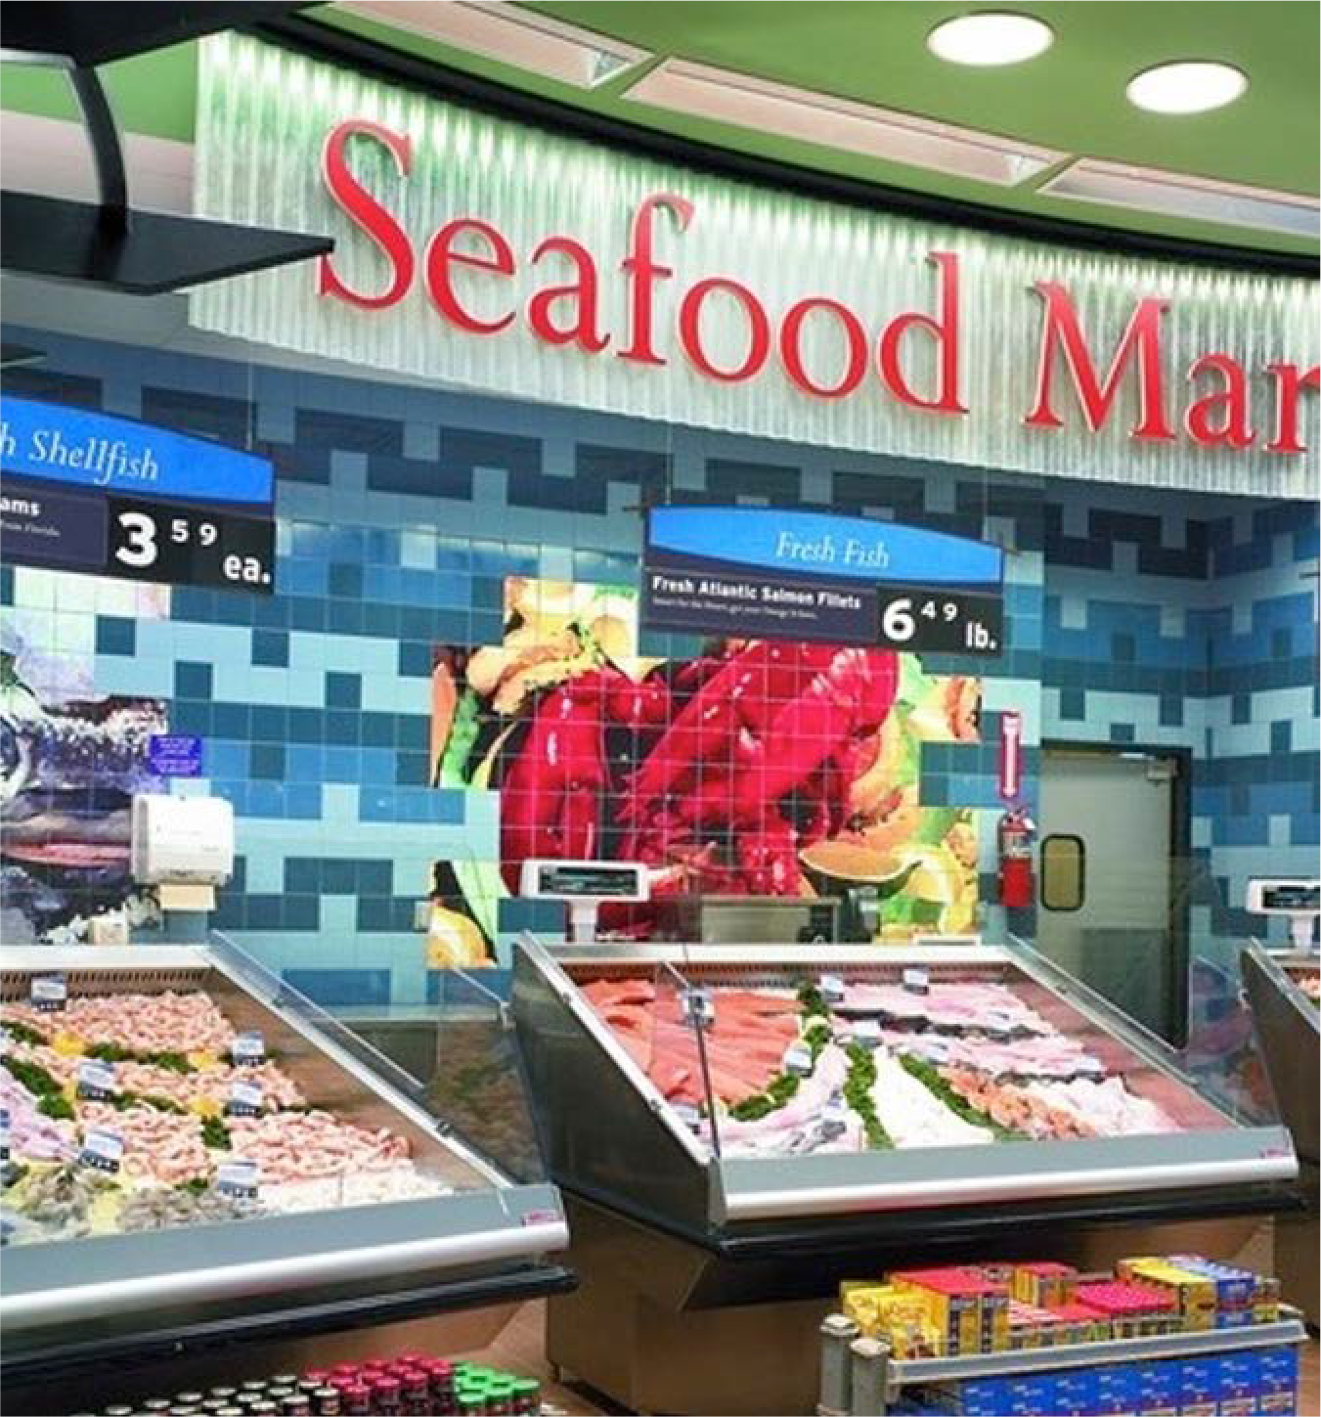
Resources:
Seafood Markets, restaurants, online sales
Seafood Nutrition Partnership https://www.seafoodnutrition.org/
Seafood Source https://www.seafoodsource.com/
NOAA Fisheries Fishwatch https://www.fishwatch.gov/
Shamshak et al. 2019. US Seafood consumption JWAS
USAS webinar Seafood in the Diet: Consumption Patterns at Retail and Food Service https://youtu.be/PhWnTZgpi44
David Love et al. 2020. Food Sources and Expenditures for Seafood in the United States. Nutritional Value of Seafood https://doi.org/10.3390/nu12061810
29

