Slide 1
The Impacts of Probiotics and Prebiotics in RAS Pompano Aquaculture
Susan Laramore

Slide 2
Fish Health
Stress and Disease
Disease can be reduced by good management
Diseases are often combated by
Alternatives
Chemicals and antibiotics, but….
Potential risks to consumers and the environment
Probiotics, prebiotics, immunostimulants
Effects Production and Profitability
But not eliminated

Slide 3
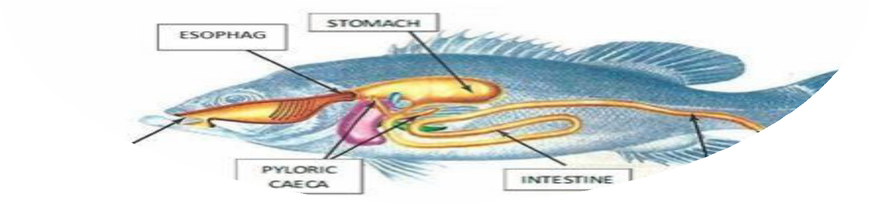
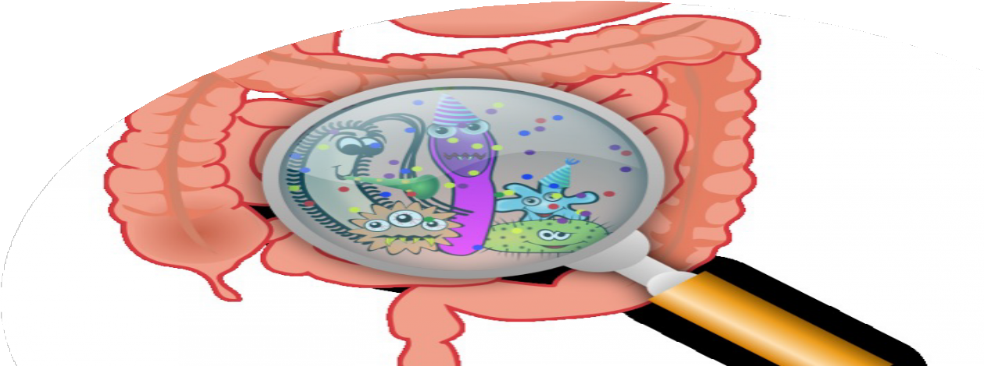
Fish Gastrointestinal Tract
Gut microbiome consists of trillions of microbes
Develops throughout a fishes lifetime
Impacted by bacteria from the water and feed
Balanced GIT – 85% good guys
Produce antimicrobial agents that promote an immune response

Slide 4
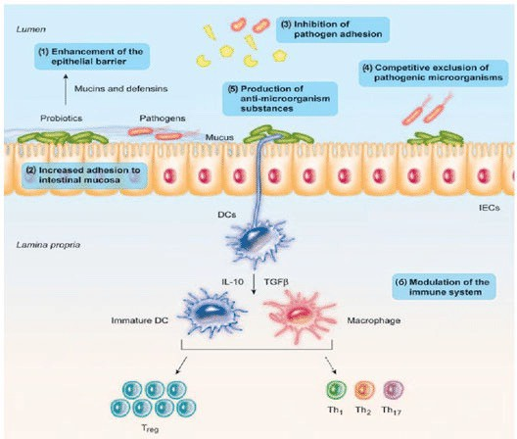
Probiotics, Prebiotics, Synbionts
Probiotics = live beneficial bacteria that improve
intestinal microbial balance
LABs and Bacillus sp.
Prebiotics = non-digestible feed ingredients that
selectively stimulate growth or activity of probiotics
fructooligosaccharides (FOS),
mannanooliogsaccharides, inulin and β-glucan
Synbionts = Probiotics + Prebiotics
Modulate the non-specific immune system
First line of defense

Slide 5
Why project was initiated
Unaware of investigations concerning the effect of
Why Project was Initiated
synbionts during the entire culture cycle of pompano or any other fish species (egg to harvest)
“Increase nutrient availability, health status, and survival of Florida Pompano utilizing synbiotic feed additives”
One of three project objectives

Slide 6
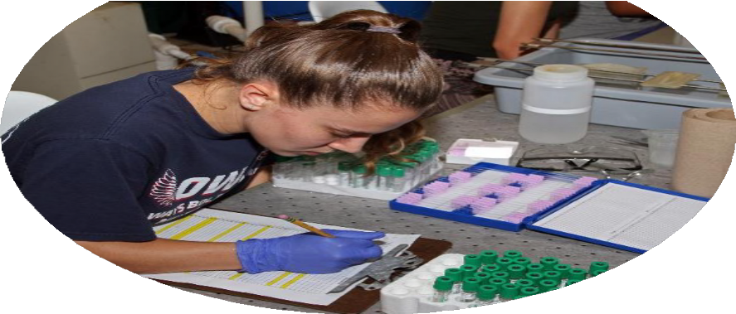
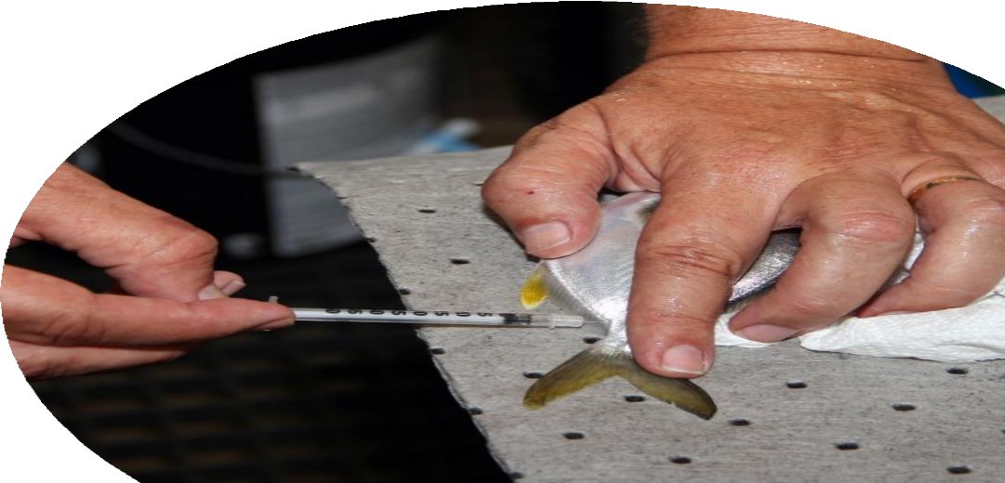
Hematological Indices
Red blood cells (RBCs, Erythrocytes)
White blood cells (WBCs, Leukocytes)
Total counts
Differential leukocyte counts
Lymphocytes, thrombocytes, heterophils, monocytes, eosinophils
Lymphocytes – produce B (antibodies) and T (killer cells)
Granulocytes – produce enzymes
eosinophils, heterophils
Phagocytes – heterophils, monocytes

Slide 7

Immune System Function
Engulfing, destroying, discharging
Phagocytosis
Macrophages, monocytes, heterophils
Immune System Function
 |  |  | Breaks down harmful oxygen molecules
Superoxide dismutase (SOD)
 |  |  | Speeds up chemical reactions
 |  |  | Anti-microbial activity
Lysozyme Activity
 |  |  | Gram positive bacteria

Slide 8
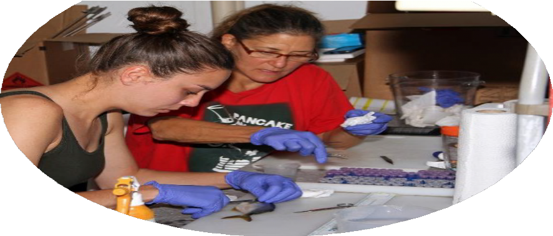
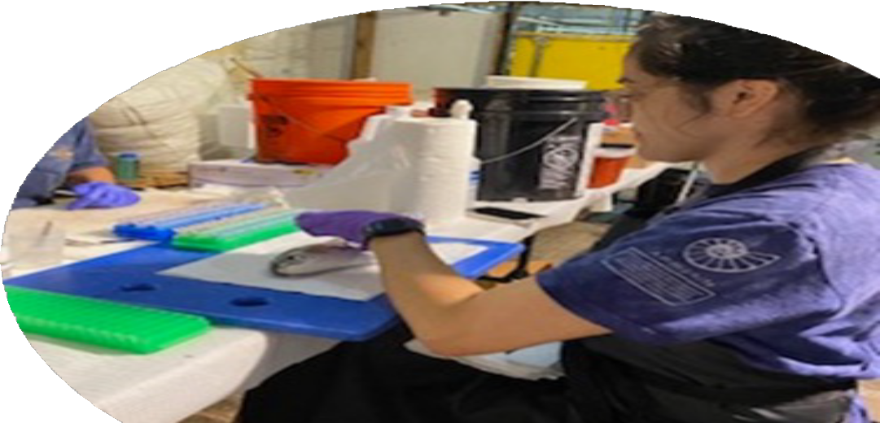
Digestive Enzymes
Amylase
converts starch into simple sugars
Lipase
breaks down fats
Protease
breaks proteins into peptides and amino acids
Alkaline Phosphatase
breaks down proteins, protects GIT from bacteria and aids in digestion
Proteins

Slide 9


Experiment 1 – Synbiont Screening
Ten treatments
Control, Probiotic, Probiotic + Prebiotic 1 (4 levels), Probiotic + Prebiotic 2 (4 levels)
Bacillus sp blend + Pedicoccus acidilactici (10⁶ CFU g⁻¹)
FOS or β-glucan (0.5, 1.0, 2.0 and 4.0 g kg⁻¹)
Three months
5 to 50 g larval pompano
8 - 16 Fish/Treatment

Slide 10
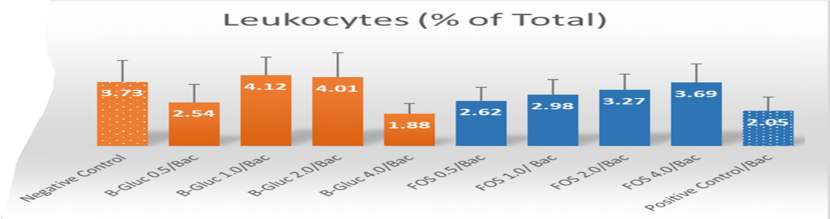
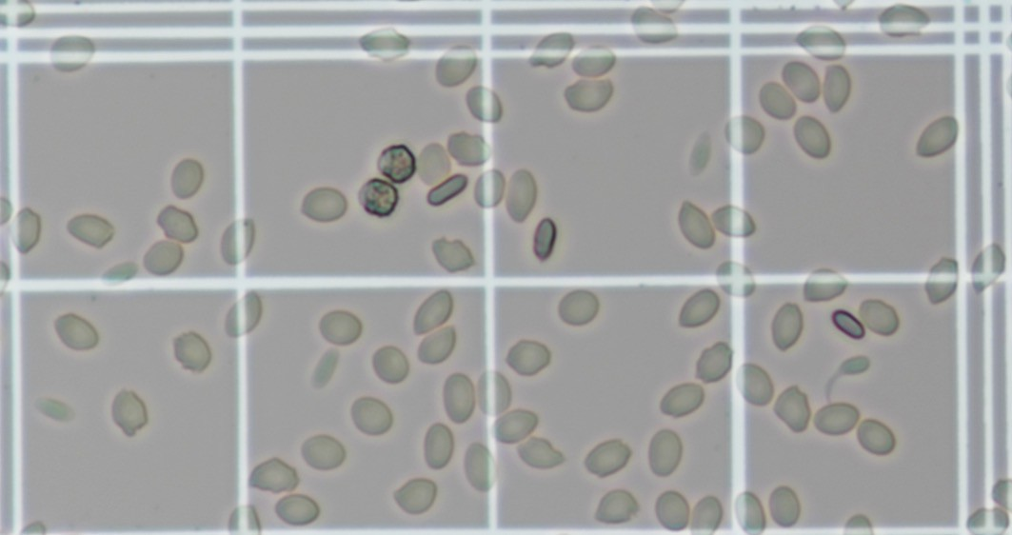
Hematological Indices 2
bc
c
bc
bc
c
ab
abc
abc
a
a
Proportion of RBC’s or WBC’s
(P<0.001)
Differential Leukocyte Counts
Lymphocytes (P=0.1733)
Thrombocytes (P=0.3341)
Monocytes (P=0.0142)
β-Glu 2.0, FOS 4.0
Granulocytes
Heterophils (P=0.0511)
β-Glu 1.0 & 2.0, FOS 4.0
Eosinophils (P=0.2912)

Slide 11
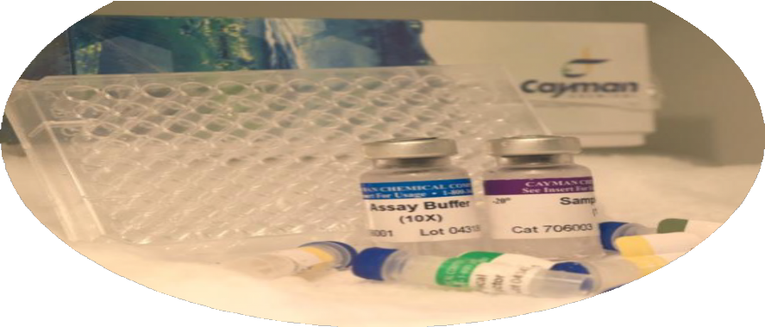
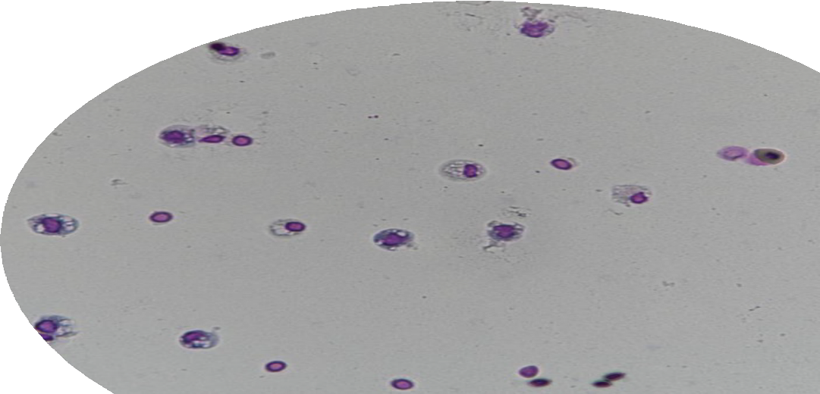

Immune Function
Phagocytosis
NS (P=0.857)
β-Gluc 1.0/Bac, FOS 2.0/Bac
SOD
NS (P=0.872)
β-Gluc 1.0/Bac, FOS 4.0/Bac
Lysozyme
NS (P=0.344)
β-Gluc 2.0/Bac, FOS 1.0/Bac

Slide 12
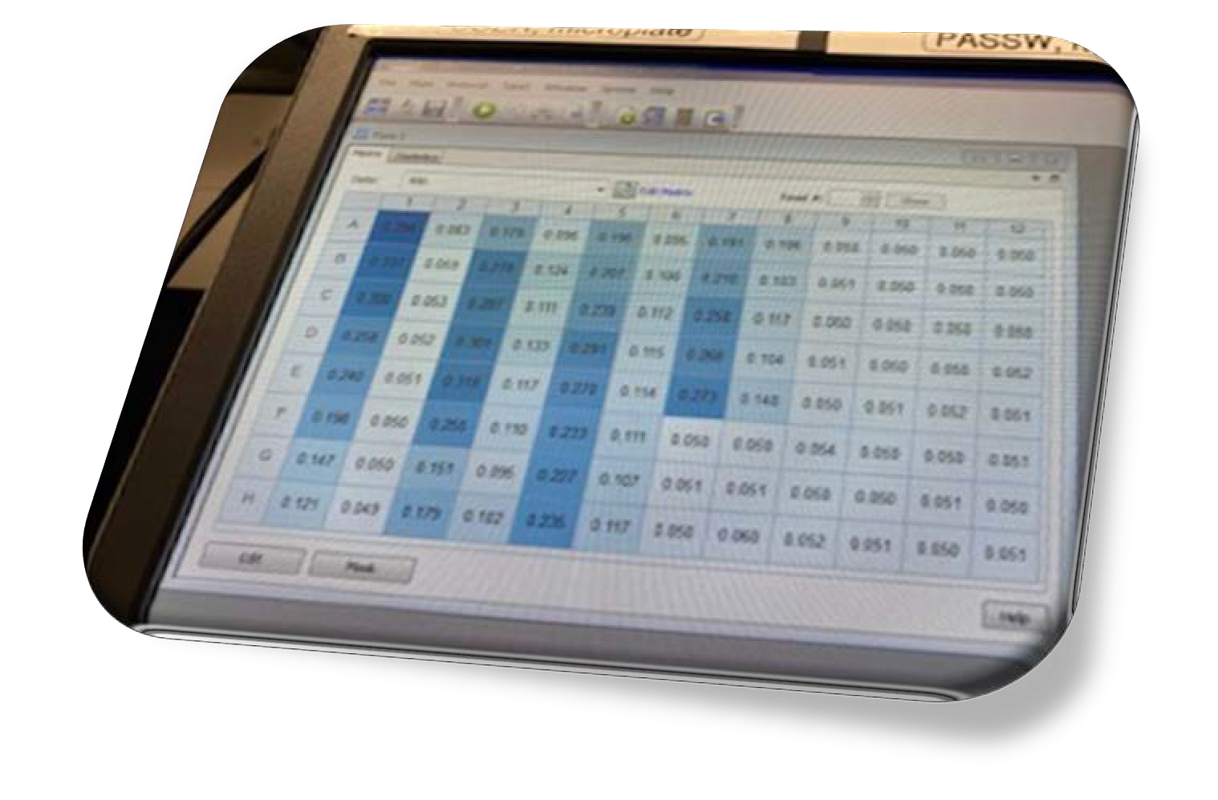
Digestive Enzymes 2
Protein
NS (P=0.69)
Alkaline Phosphatase
NS (Ppro=0.72, Ptiss=0.76)
Amylase
NS (Ppro=0.42, Ptiss=0.47)
Lipase
Sig (Ppro=0.011, Ptiss=0.013)
Highest in FOS 4.0/Bac
Protease
NS (Ppro=0.260, Ptiss=0.241)

Slide 13
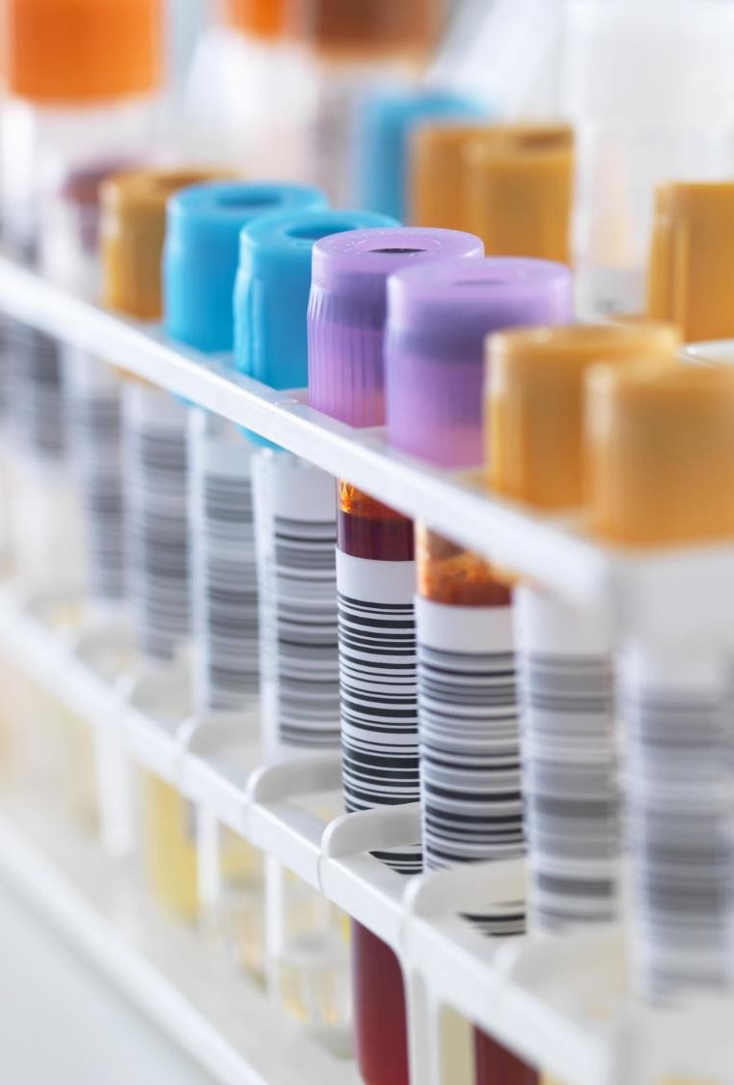
Take Away
No clear-cut winner
0.5% prebiotic addition didn’t perform well
4% prebiotic addition did not increase benefit in β-Gluc
Cost prohibitive for FOS
Best performance in…
β-Gluc 1.0 and 2.0/Bacillus sp + P. acidilactici
FOS 2.0 and 4.0/Bacillus sp + P. acidilactici

Slide 14
Experiment 2 – Pellet Type + Synbiont
Four treatments
Hard pellet + Synbiont Soft pellet + Synbiont
Pedicoccus acidilactici (10⁶ CFU g⁻¹)
β-glucan (1.0 g kg⁻¹)
Three months
250 g pompano
12 Fish/Treatment

Slide 15
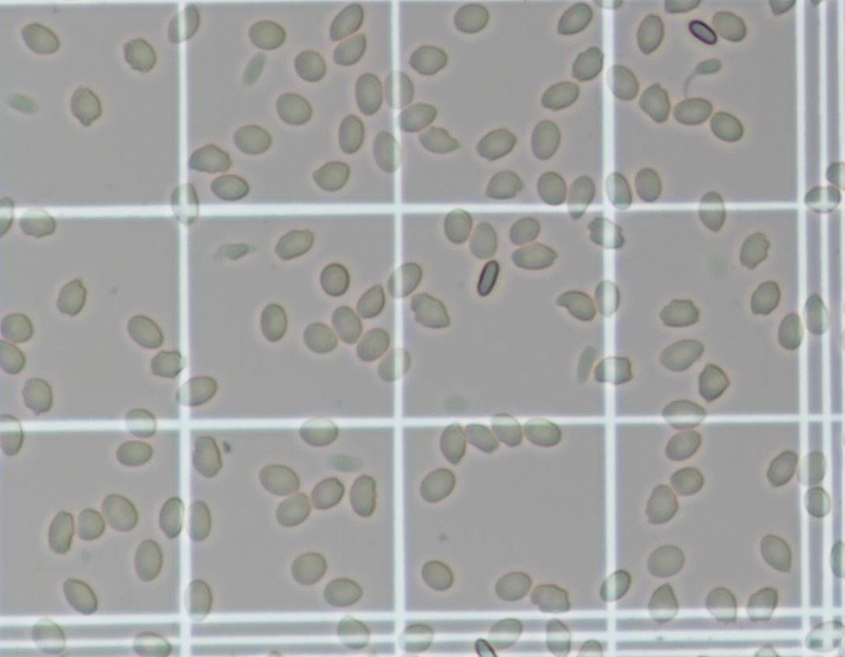

Hematological Indices 3
Proportion of RBC’s or WBC’s
NS (P=0.277)
Differential Leukocyte Counts
Thrombocytes (P=0.378)
Lymphocytes (P=0.056)
Hard vs Hard β-glucan (P=0.0188)
Monocytes (P=0.806)
Granulocytes
Heterophils (P=0.549)
Eosinophils (P=0.749)

Slide 16
Immune Function 2
OBJ 2 Phagocytosis Activity
Macrophage Engulfing (% Positive)
Treatment | Mean | SD
Hard Pellet | 20 | 6.3
Hard Pellet (β-glucan) | 29.8 | 12.6
Soft Pellet | 36.2 | 8.9
Soft Pellet (β-glucan) | 36.7 | 9.4
ANOVA Omnibus p = | 0.023*
A Priori Orthogonal Contrast
Macrophage Engulfing (% Positive)
Hard vs Soft | 0.0076*
Hard vs Hard β-glucan | 0.0998
Soft vs Soft β-glucan | 0.9471
No β-glucan vs -glucan | 0.2195
Phagocytosis
Sig (P=0.023)
SOD
NS (P=0.743)
Lysozyme
NS (P=0.590)

Slide 17
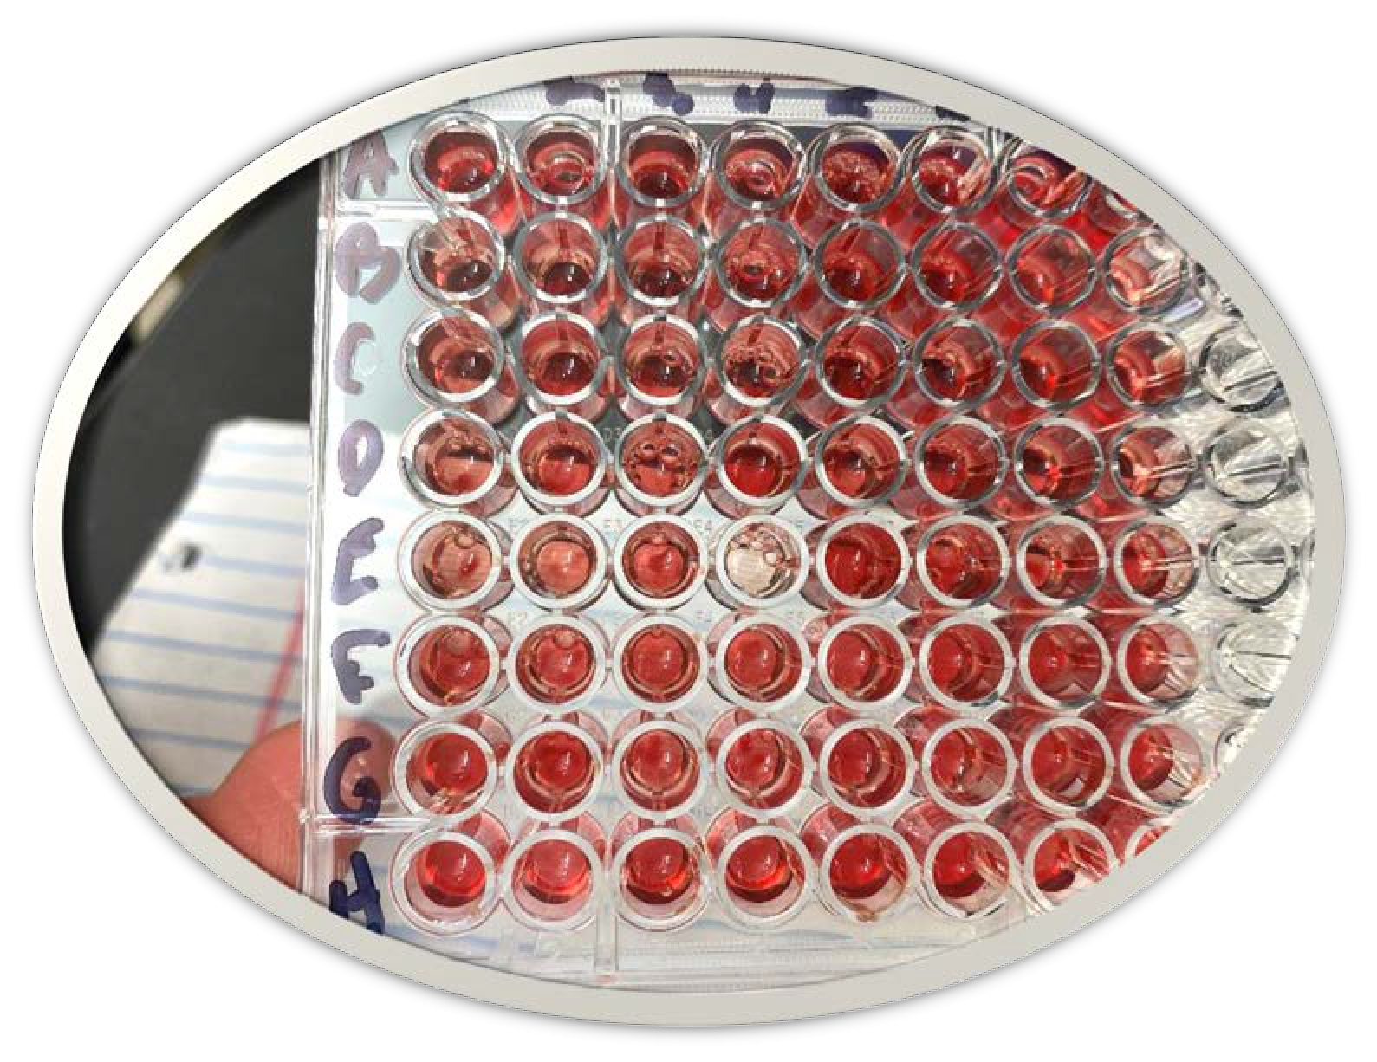

Digestive Enzymes 3
Protein (mg/L)
NS (P=0.199)
Alkaline Phosphatase (U/mg)
NS (Ppro=0.862)
Amylase (U/mg)
Sig (Ppro=0.030)
Hard vs Soft (P=0.005)
Lipase (U/mg)
NS (Ppro=0.308)
Protease (mg/L)
NS (Ppro=0.259)

Slide 18
More Questions Than Answers!
The synbiontic provided no apparent health benefits
Differences were only seen between pellet type
Was the sample size too small to detect differences?
Did we choose the right levels and synbiont combination?
Was addition at 250 g too late in life cycle for any benefit?
Were the fish too healthy to detect any benefit?

Slide 19

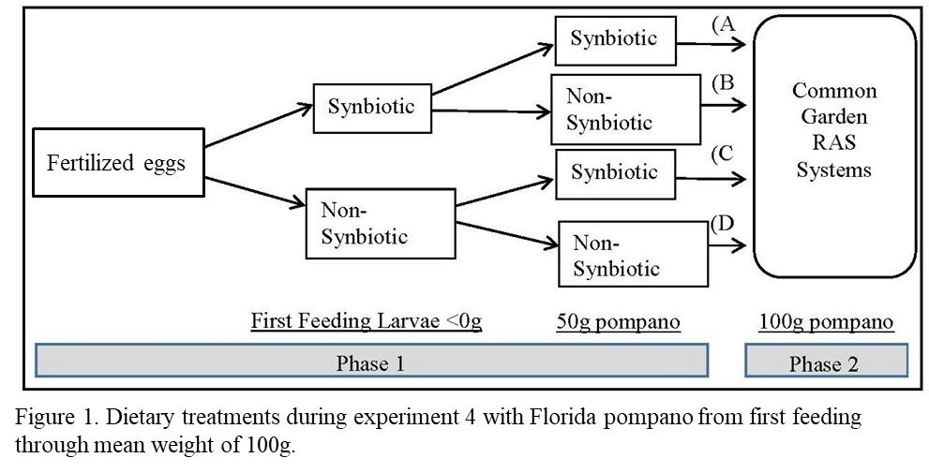
Experiment 4 – Early
Synbiont Application
Phase 1
Phase 2
Phase 3
1 month
2 Treat
16 fish/Trt
1 month
4 Treat
8 fish/Trt
8 months
• + Pellet type
16 Treat
8 fish/Trt
Stats for 4:
Hard, Soft, Non, Syn
24 fish/Trt

Slide 20

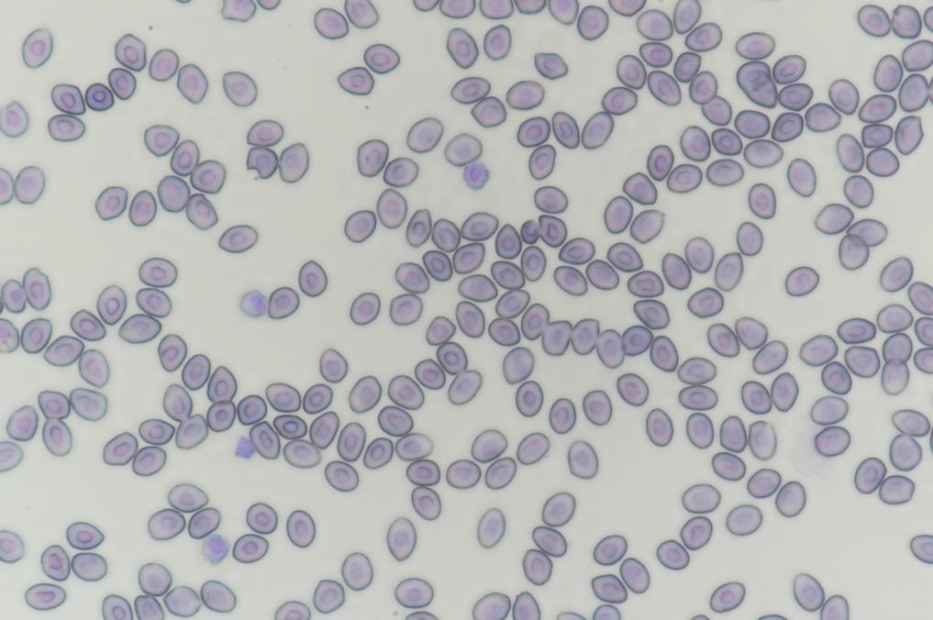

Hematological Indices 1
Only significant differences were seen in Phase 1:
Proportion of RBC’s or WBC’s
RBCs in Non Synbiont (P=0.019)
Differential Leukocyte Counts
Heterophils (P=0.0167)
Non Synbiont
Thrombocytes (P=0.058)
Synbiont

Slide 21
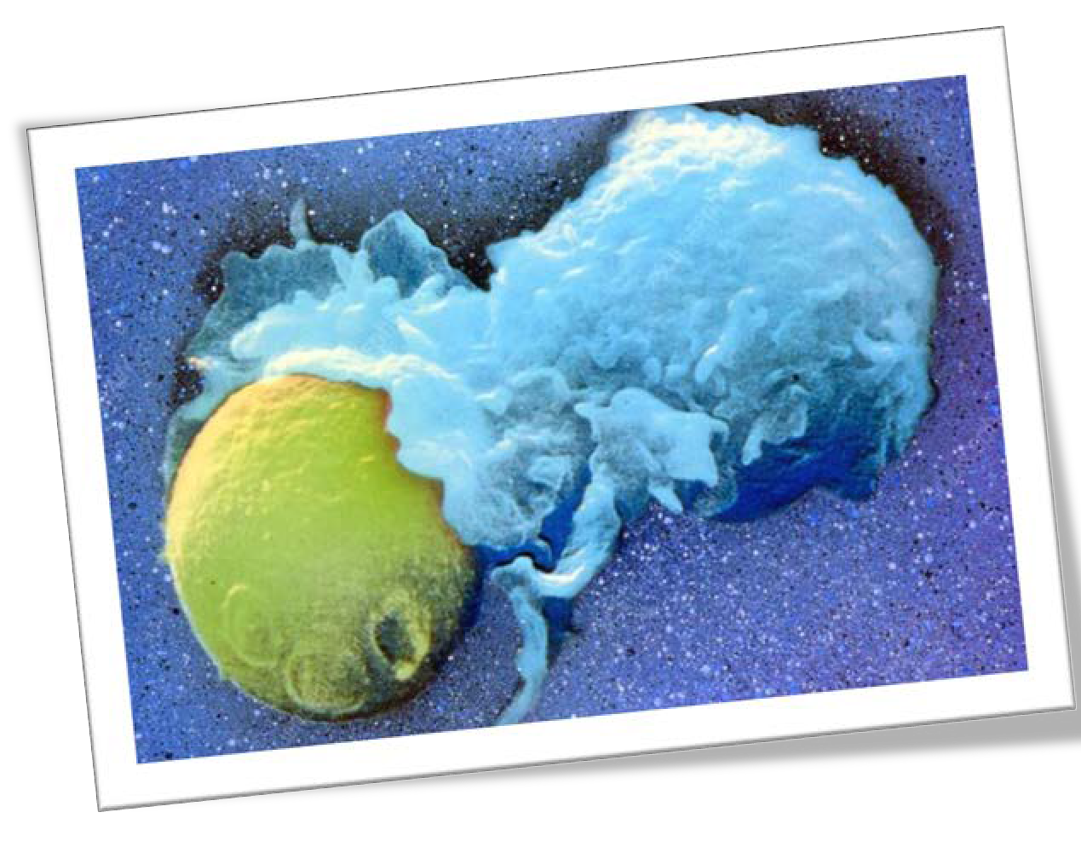
Immune Function 3
Phagocytosis (Phase 3 only)
Sig (P=<0.001)
Non Synbiont
Synbiont*pellet interaction; Soft
SOD
Sig Phase 3 (P=0.033)
Pellet type (P=0.0226), Syn (P=0.0659)
Soft Non vs Hard Syn
Lysozyme
NS all phases (P=0.940, 0.344, 0.086)

Slide 22
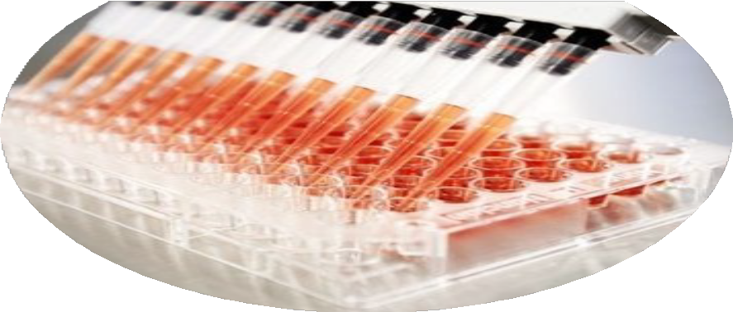
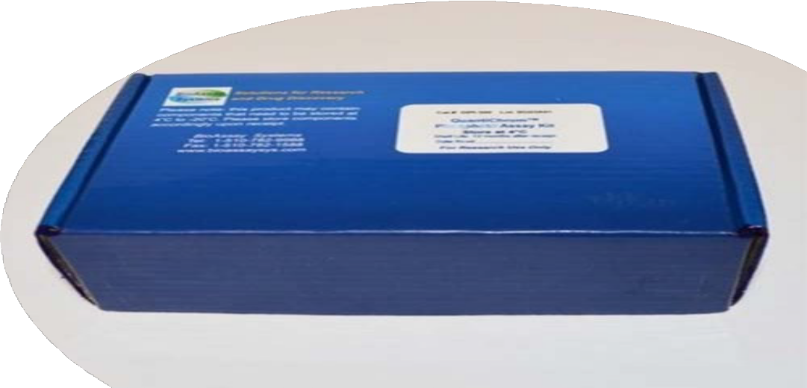
Digestive Enzymes 4
Phase 1 – NS
Phase 2 – NS
Phase 3 - Sig
Alkaline Phosphatase (P=0.005 – 0.05)
Pellet*synbiont interaction (P=0.002-0.004)
Hard non = Soft syn > Soft non, Hard syn
Amylase (P=0.0339 – 0.05)
Pellet*synbiont interaction (P=0.004-0.007)
Hard syn = Soft non > Hard non, Soft syn

Slide 23
More to Tease out!
Phase 1 - early response (larvae – 50 g) to synbionts
Hematological only
Syn = deceased RBCs, decreased heterophils, increased platelets
Phase 2 – addition or removal of synbionts (50 – 100 g)
No difference was seen in tested health parameters
Phase 3 – Pellet type + addition or removal of synbionts
(100 g to harvest)
No Hematological responses
Immune function responses
Phagocytosis, SOD
Digestive enzyme responses
Alkaline phosphatase, Amylase
*Still to compare phase 3
– Tease out Hard pellets only
- Affects of the phase 2 “swap”

Slide 24
Are Synbiotics beneficial
Are Synbiotics beneficial in RAS Pompano Culture?
Inconclusive
Impacts of Stress, Disease Challenge should be evaluated
Right combinations, optimal levels
Statistical power analysis
Usefulness of Health Indices
Early life stages - Hematological Assays
RBCs vs WBCs, heterophils, lymphocytes, thrombocytes
Later life stages – Immune system Function, Digestive Enzymes
Immune = phagocytosis, SOD
Digestive = lipase, alkaline phosphatase, amylase

Slide 25
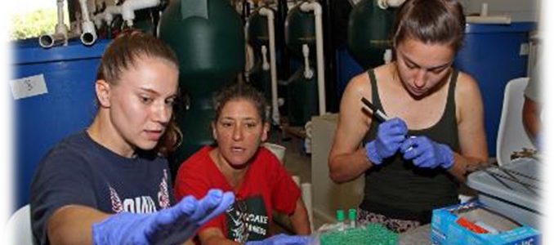
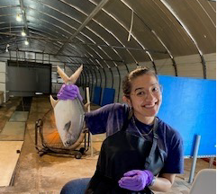
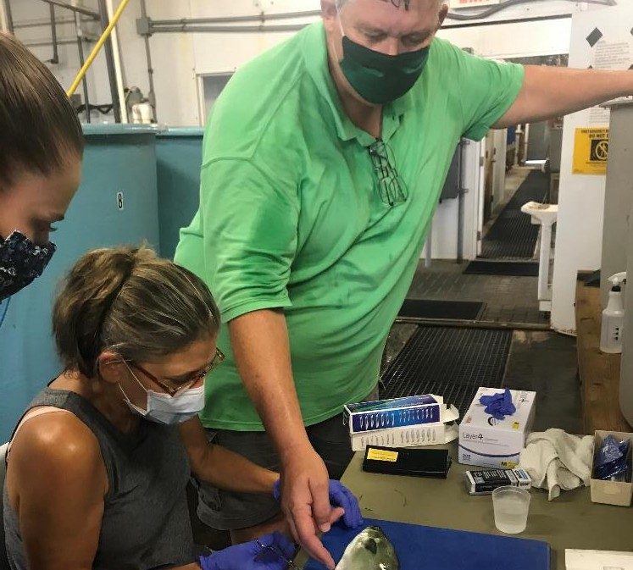
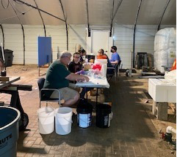
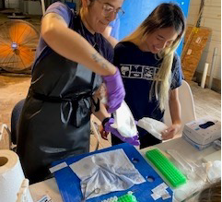
Acknowledgements
Lab Analysis
Caitlyn Courtemanche Cari Sinacore-Migliano Tyler Bianchine Sampling Assistance Erica Albright
Ben Peskin Victoria Uribe Allison Chin
Technical Assistance
Dr. Sahar Metri
Dr. Annie Paige-Karjian

