Slide 1

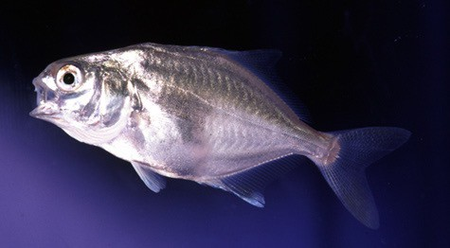
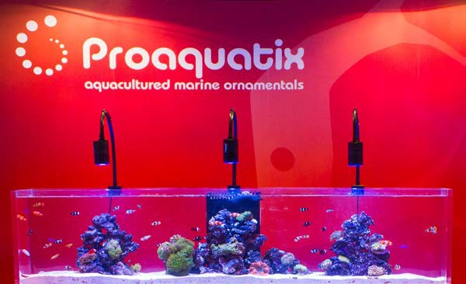
The Commercial Availability of Pompano Juveniles
-Avery Davis Farm Manager

Slide 2
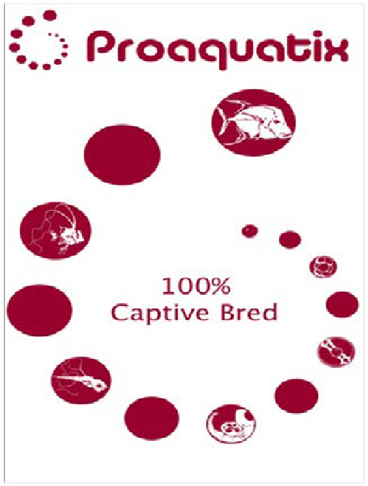

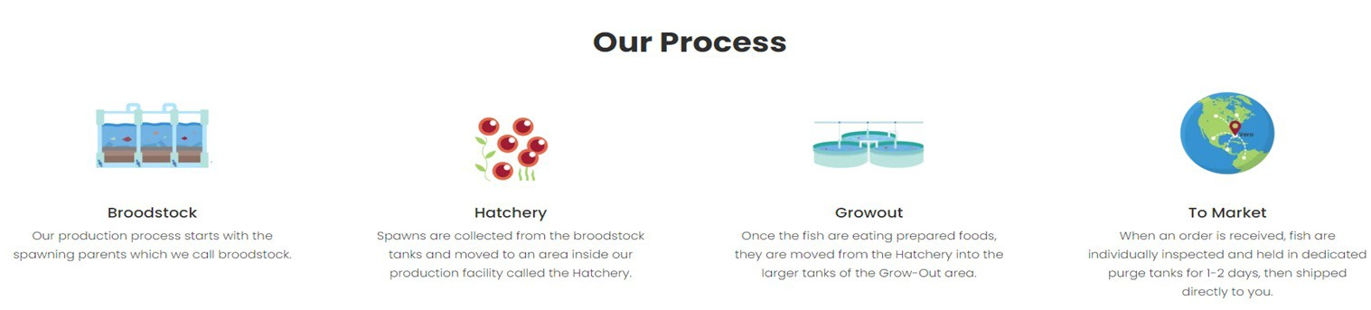
Save The Reefs
Our mission: is to save the reef by providing an alternative to wild-caught fish, we are helping to reduce human impact on ocean reef ecosystems, thus supporting reef conservation and the future of marine aquarium keeping.
Our Promise: All of our captive bred are hand selected and graded to ensure our customers receive the highest quality fish and the best service. We guarantee our fish are healthy and 100% deformity free.

Slide 3


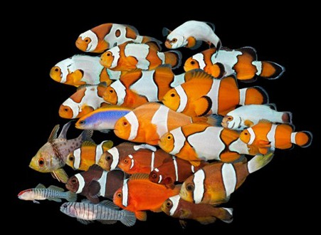
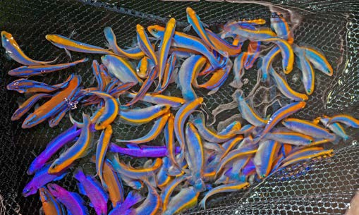
Ornamentals
Food fish is a very small percentage of Proaquatix overall business
The majority of the business is being one of the largest
Marine Ornamental producers in the world, with over 120 SKUs
Clownfish is our top product, 7 different species and 50+ variants
In all we culture 30+ Species of Clownfish, Gobies,
Dottybacks, Dwarf Angelfish, Cardinals, Basslets, Blennies,
Large Display Fish

Slide 4





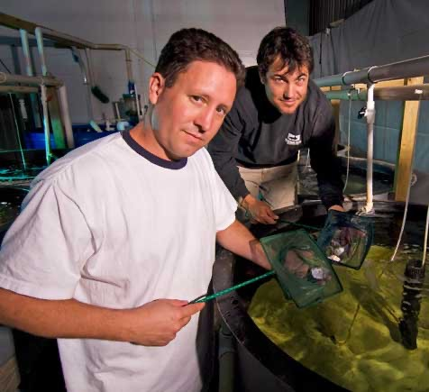
HIstory
Since 1999 as the prior trade names of Maritech and Dyer Aqua LLC, pompano (along with other food fish), and ornamentals have been produced by this company.
In 2009 Proaquatix LLC with parent company Troutlodge Marine took over and shifted focus for the food fish side to just producing pompano (cobia fazed out 2012)
To this day Proaquatix has produced the highest quality pompano eggs and several million fingerlings

Slide 5
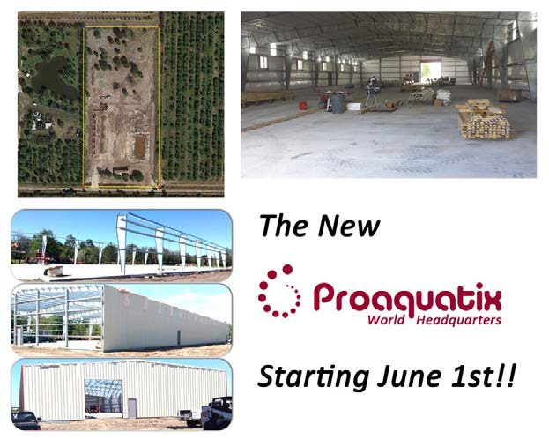



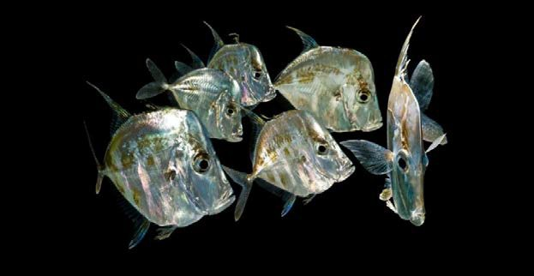
Proaquatix
The fish that really put Proaquatix on the map was culturing Lookdowns
The original locations were a beach site at tracking station on FIT property and a warehouse near US 1
In 2014 a property was purchased and the creation of the Proaquatix world headquarters was made.
Overtime all other locations were closed and all operations were moved into this new 16,000sqft warehouse in 2017.

Slide 6



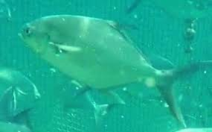
Pompano
Broodstock are sourced locally utilizing Special Activity Licenses issued by the state and/or from a licensed collector
Our broodstock are kept in a 1,600gal tank connected to a RAS system, in a mixed group of males and females
The broodstock are conditioned to optimal parameters of light, temp, and salinity to have ripe eggs and ready for injecting, which is checked by cannulation.
The are feed a mixture of frozen prey as well as a broodstock pellet

Slide 7














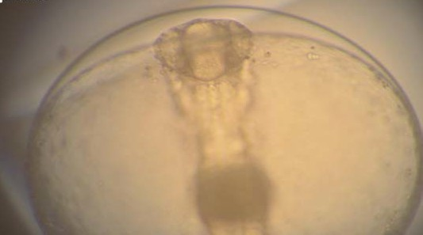
Egg Availability
For Egg➔
Preorder- 1 month in advance Price per egg: $0.075
Minimum size of order-
Domestic (North America): 30k eggs
International: 60k eggs
Timeline-
Broodstock are injected 2 days later spawn Eggs need to be shipped out that morning

Slide 8

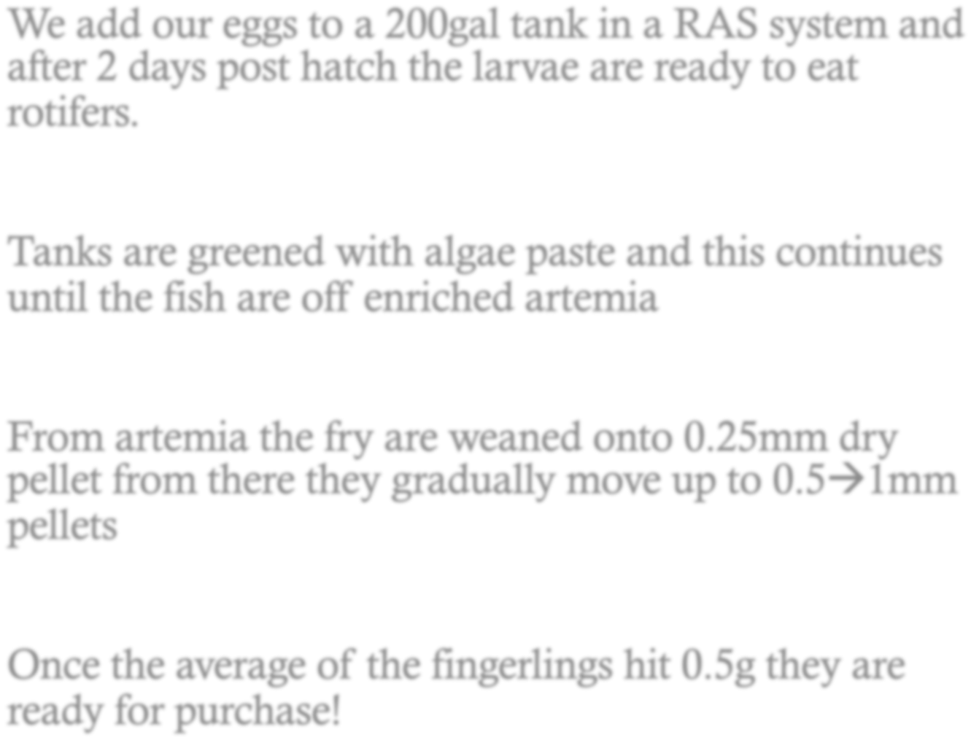
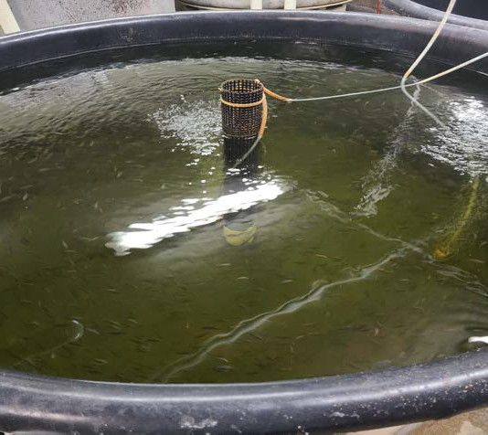


Juvenile Production

Slide 9





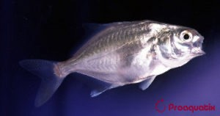
Fingerling
For Fingerlings➔
Preorder- 2 months in advance Price per fingerling: $0.75
Minimum size of order-
Domestic (North America): 3k fingerlings
International: 4k fingerlings (Airports- Miami & Orlando)
Timeline-
Fish take 50-70 days to get to 0.5-1gram

Slide 10


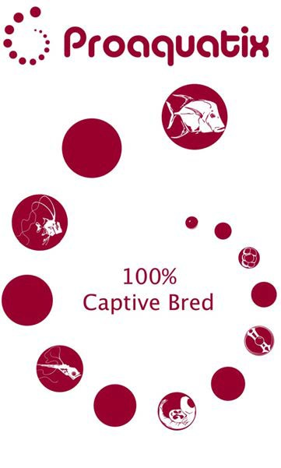
Thank you

