Slide 1


Pompano Culture in Recirculating Aquaculture Systems
Funding Thanks to
Paul S. Wills
CDFA 11.417: Wills - Final Steps Toward Commercialization of Pompano Aquaculture NA18OAR4170345

Slide 2
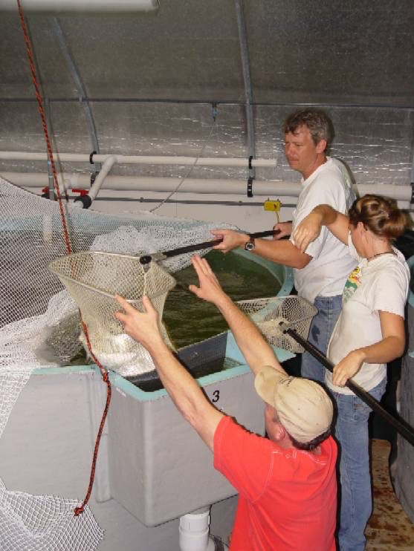
Recirculating Aquaculture Systems (RAS)
Year round growing season
Reduced water consumption
Reduced effluent discharge
Intensive production
Enhanced biosecurity
Increased food safety
Containment of escapees
Environmental Sustainability

Slide 3

Basic RAS Design
Waste Water Makeup Water & Evaporation
Feed
Oxygen
Solid and Dissolved wastes
Nitrate
(very low toxicity)
Solids Filtration
Biofiltration
Ammonia
(Highly Toxic)
Concentrated Waste Sludge

Slide 4
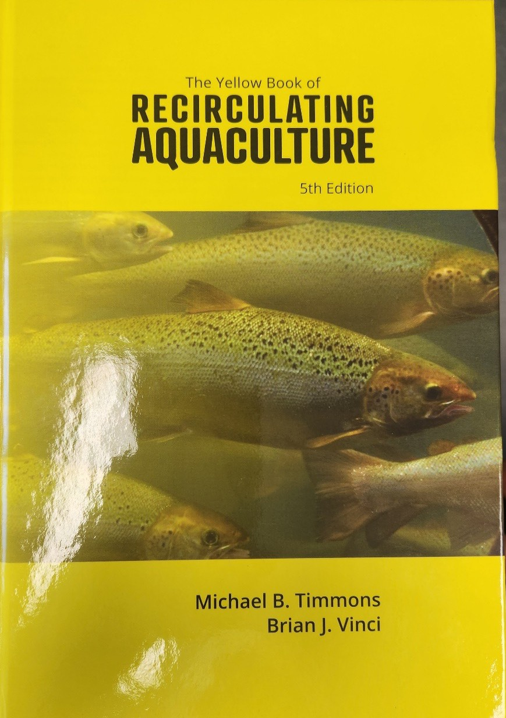
Advanced RAS design and Operation
“The Yellow Book”
New 5th edition
Available on Amazon $99 Search “ISBN 0971264694”

Slide 5
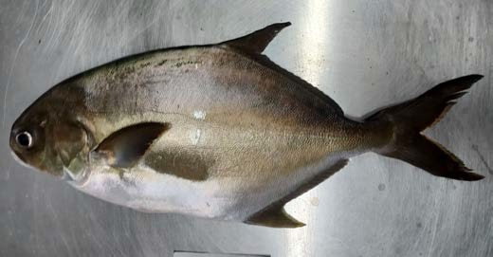
Basis of the Commercial System Design
Scaled up version of tested design developed jointly for USDA-ARS project and FL-FWCC marine hatchery program FMFEI
System Operated so far with:
  Red Drum up to >90 Kg/m³ ➔(~1% BWD feed rate)
  Florida Pompano ~40 Kg/m³
  Cobia ~45 Kg/m³

Slide 6



LOW HEAD GROWOUT SYSTEM
2
3
4
1
7
5
6
1. Long flow pathway moving bed reactor with cross flow oxygenator, float valves, and propeller pump; 2. Incoming salt and freshwater lines with float valves and water meters; 3. UV sterilizer; 4. Torrus filters with 13ft³ of MB3 floating plastic media; 5. Ten-foot diameter tanks w/ center sump and sidebox drain; 6. Diverter box; and 7. 60 micron drum filter.

Slide 7
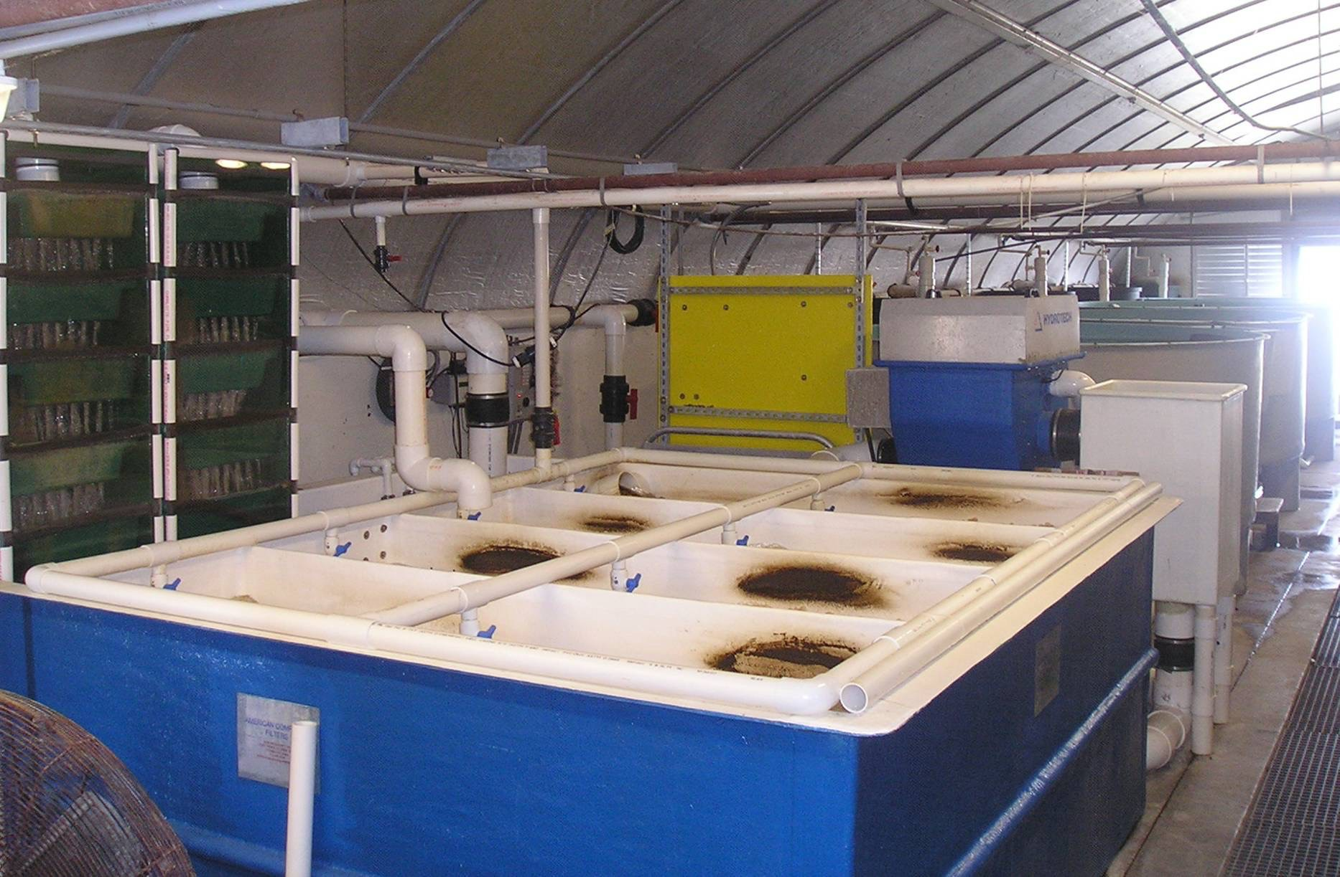
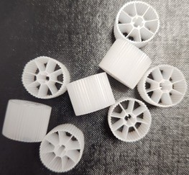
Ocean Science for a Better World

Slide 8
BIOFILTER VOLUMETRIC NITRIFICATION RATES
g TAN/m³ media-day
175.0
Long Flow Pathway Moving Bed Biofilter
150.0
125.0
100.0
75.0
50.0
25.0
0.0
0.00 0.20 0.40 0.60 0.80 1.00
1.20
1.40
1.60
Influent TAN (mg/L)

Slide 9
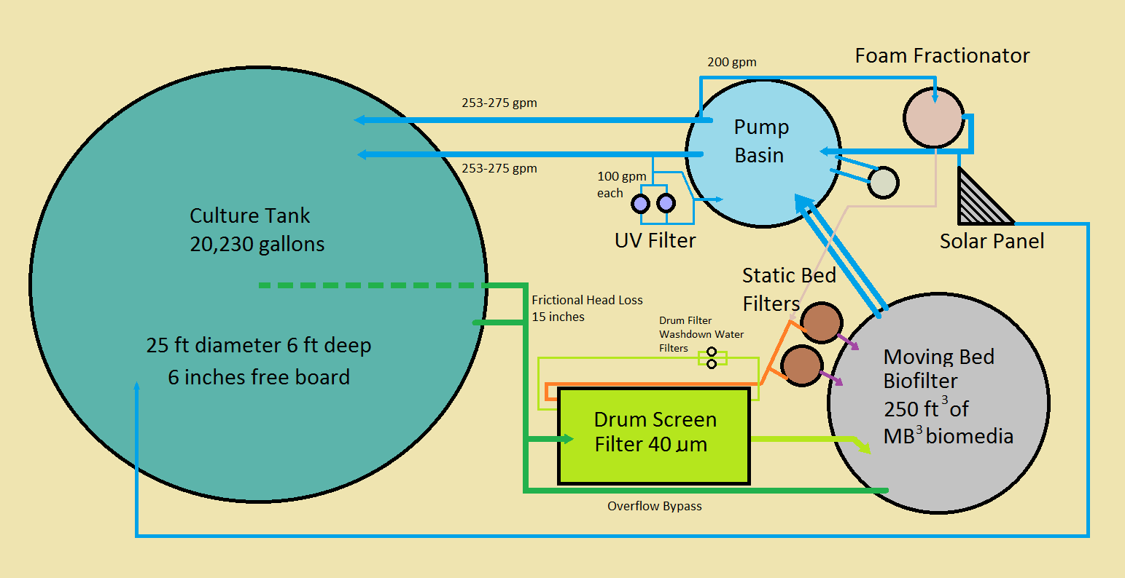
Commercial System Design
*
Not to scale
* Static Bed filters each contain 8 ft³ of MB³ biomedia

Slide 10
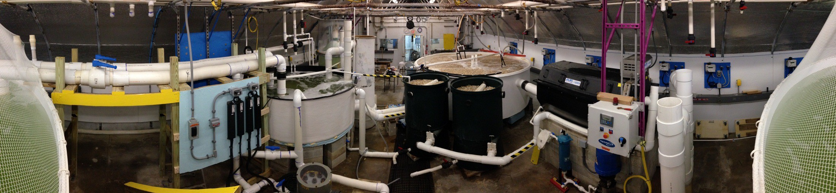
Panorama of Filtration System
Foam Fractionator
Return Water
Biofilter Drum Screen Filter
Main Pumps
Pumping BSatsaitnic Bed Filters Ultraviolet filters

Slide 11
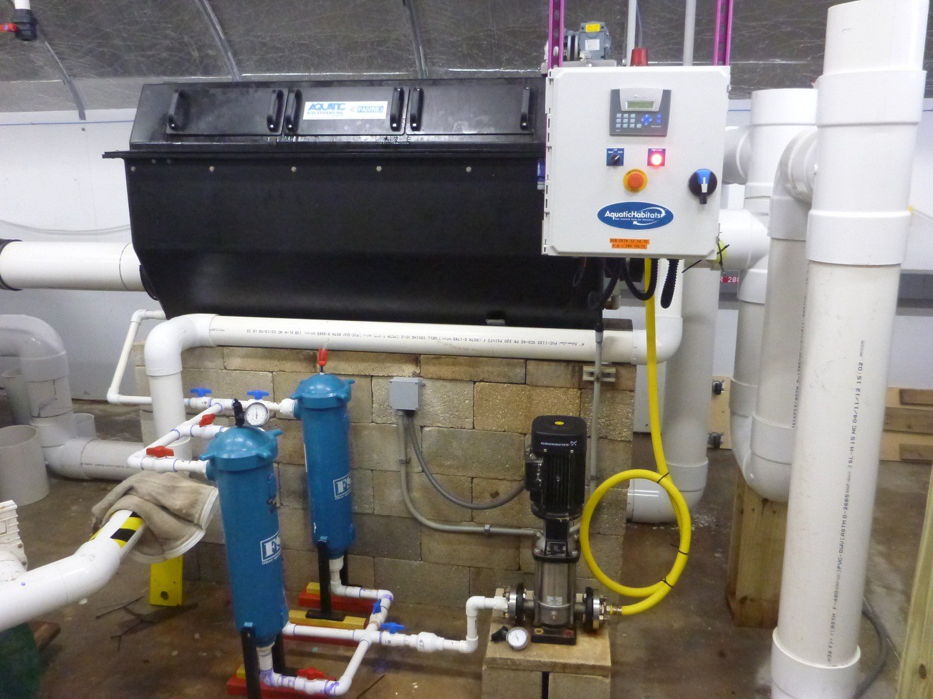
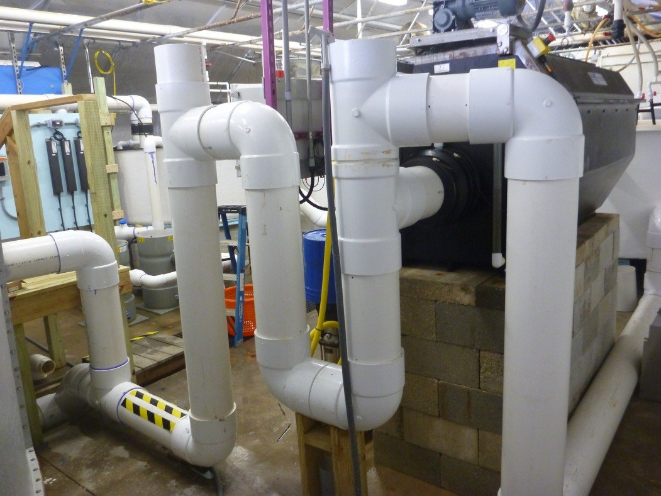
Drum Screen Filter (60um)

Slide 12
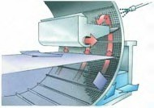
Microscreen Cleaning Process

Slide 13
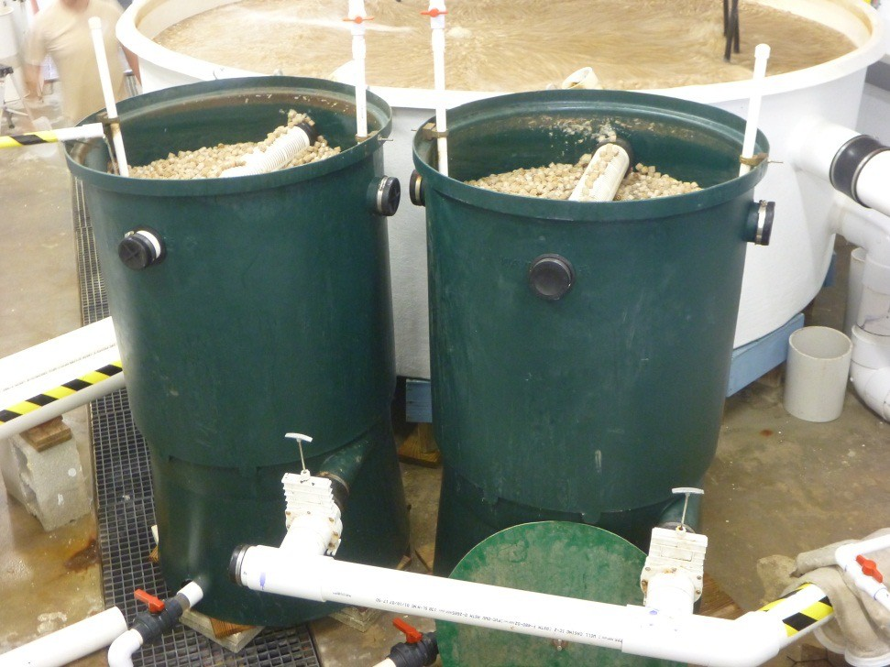

Waste Water Recapture
We used a Static Bed Filter to separate solids from Drum Screen Filter Waste stream
  Concentrates solids prior to discharge
  Recaptures significant component of water used for wash down of drum screen
  Each contains 8 Ft³ MB³ Media

Slide 14
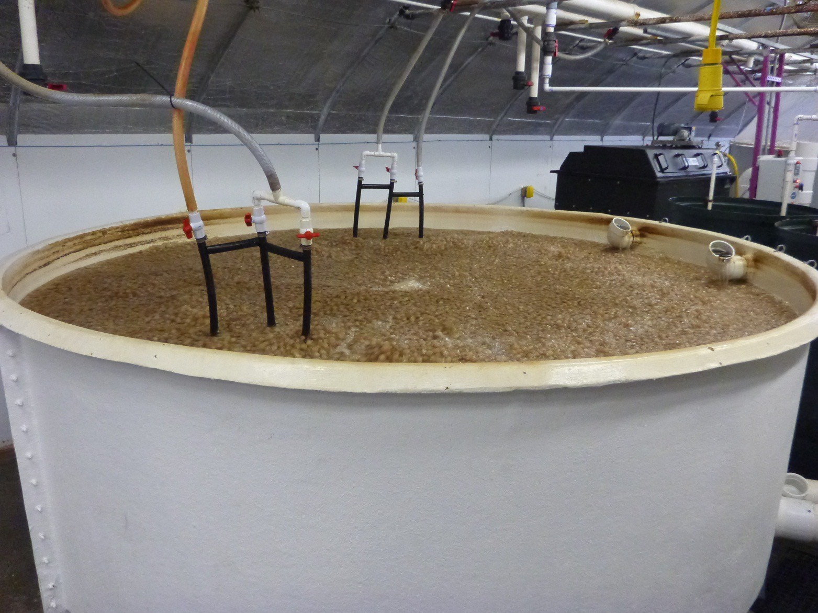
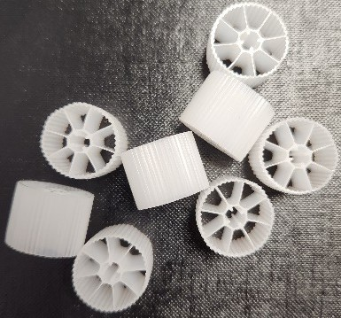
Moving Bed Biofilter
( 450 ft³ MB³ Biomedia)
250
Aeration Keeps Bed Fluidized

Slide 15
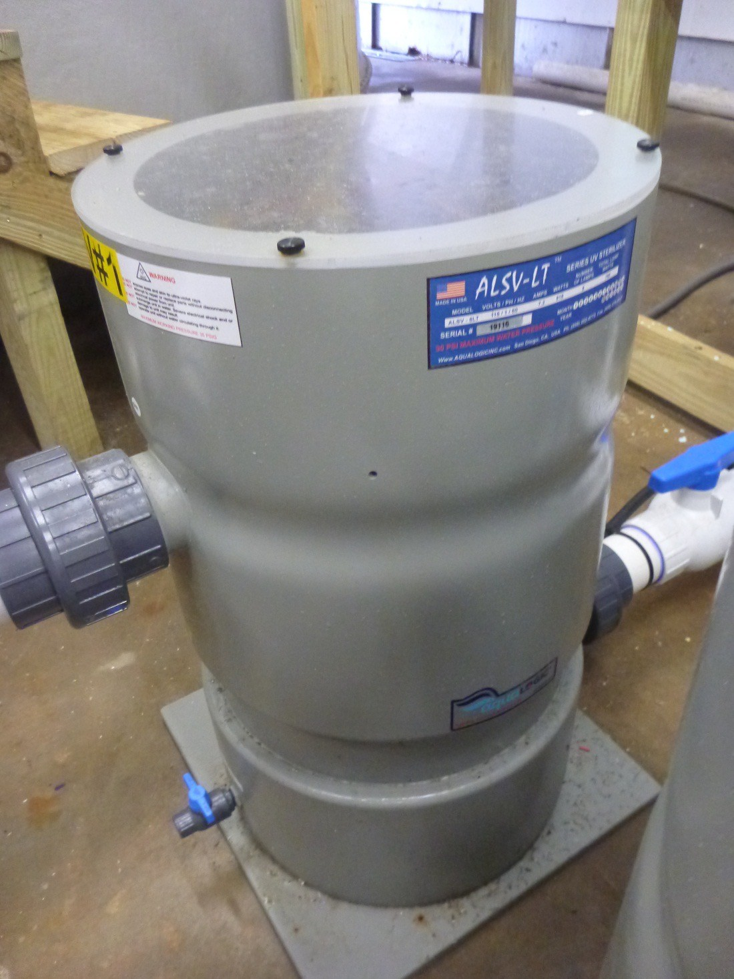
Minimum Dose Desired
Minimum Dose Desired
30,000 uW sec/cm²
The two units delivering
~150,000 uW sec/cm²

Slide 16
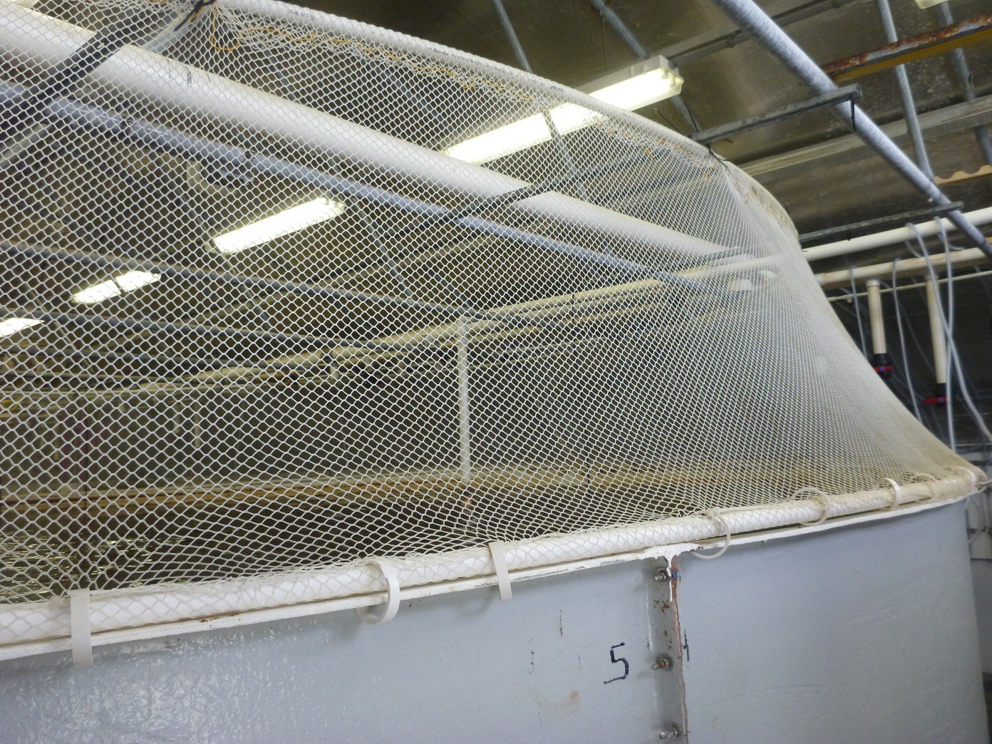
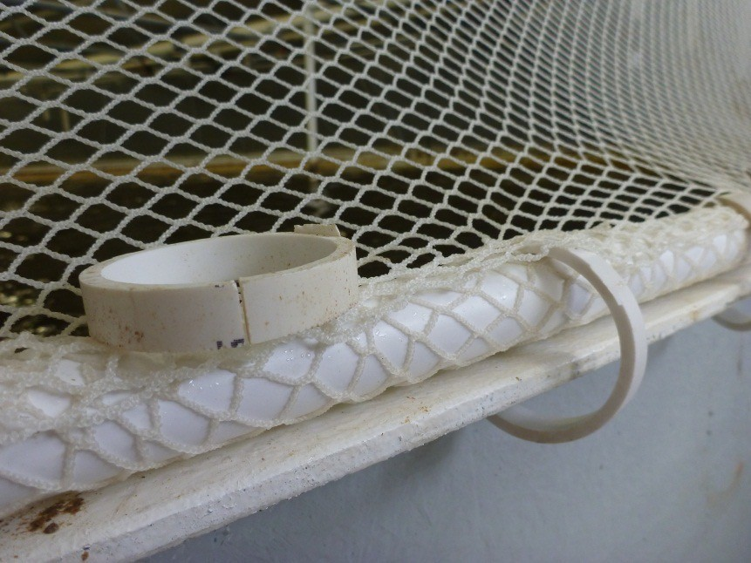
Tank Cover

Slide 17
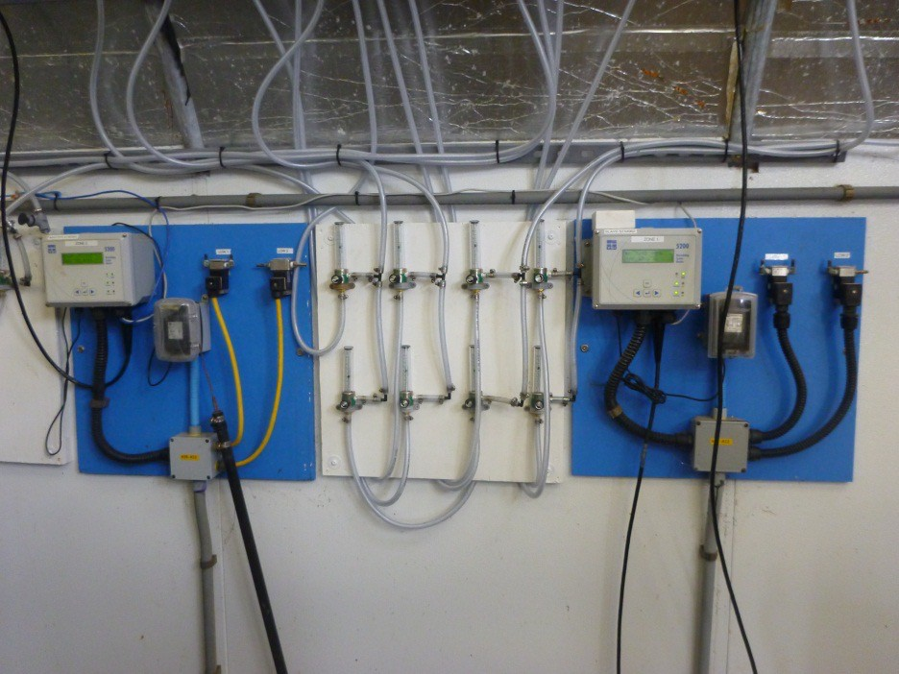
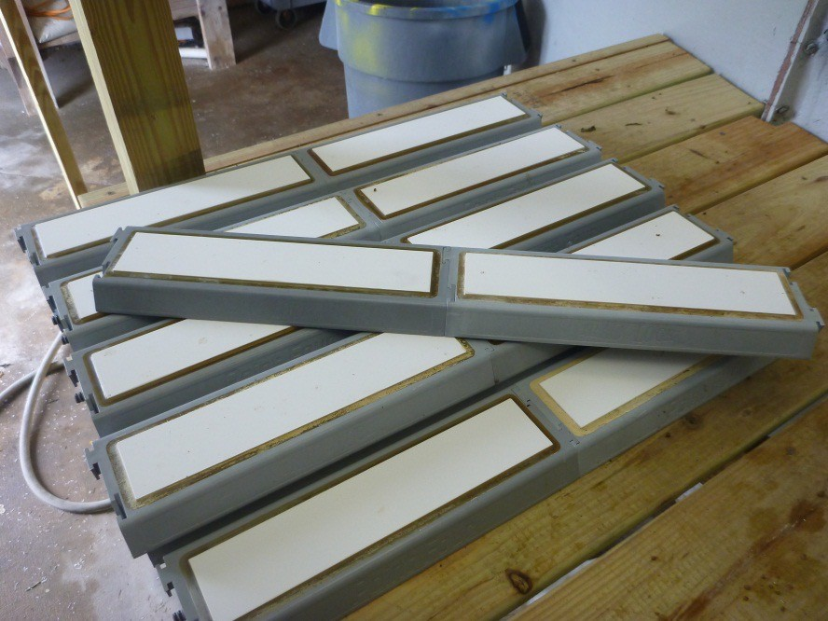
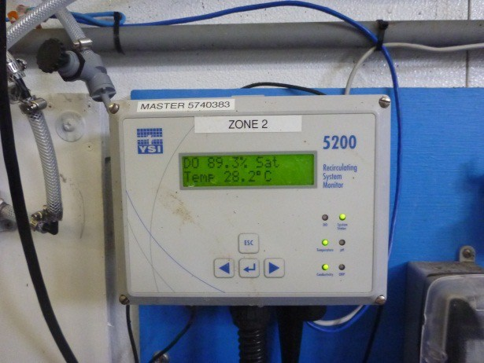
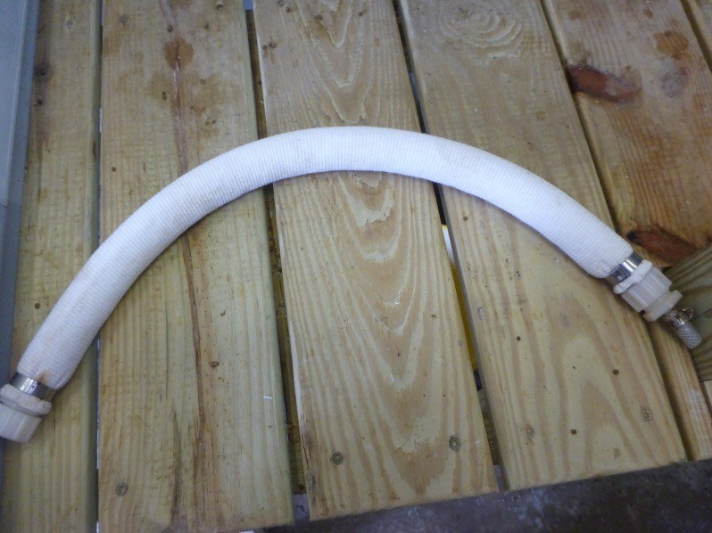
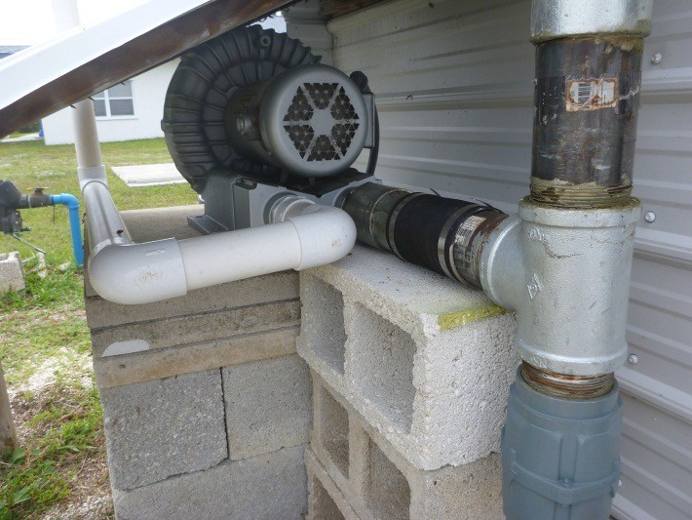
Aeration and Oxygenation

Slide 18
Aeration and Oxygenation 2
Oxygenation Zone 2
25 ft Diameter
O₂
Sensors
Aeration Zone
Oxygenation Zone 1

Slide 19
Backup Systems
Systems designed to combat “Murphys Law”
  “If anything can go wrong it will”
Therefore managers must:
  Anticipate
  Plan
  Train
  Respond
    (an automatic system that “cries wolf” can derail this necessary task)

Slide 20
Backup Systems 2
Generators
Automatic oxygen system
Alarm Systems

Slide 21
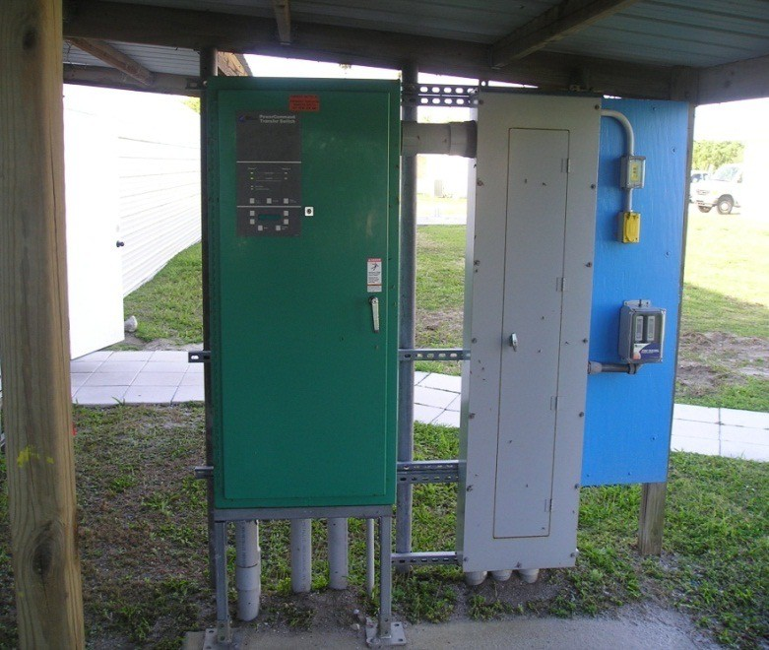
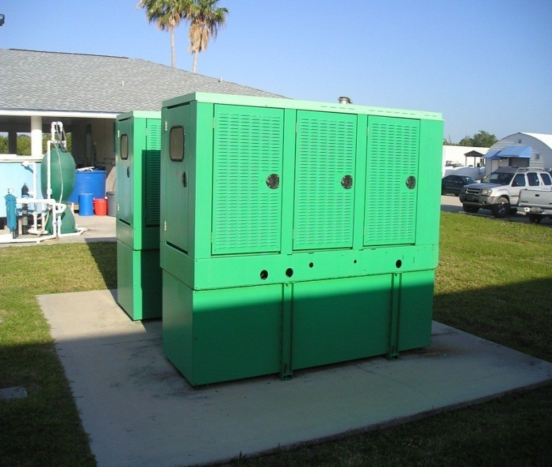
Generators
Must have disconnect switch and meet other local requirements

Slide 22
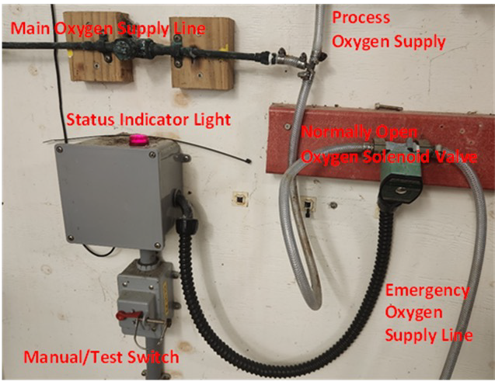
Automatic Oxygen System
Opens oxygen flow to tanks regardless of monitoring systems or other backup systems when power lost
Must use Normally Open Solenoid Valves for failsafe system
– Normally open ➔closed when power on; open when power off

Slide 23
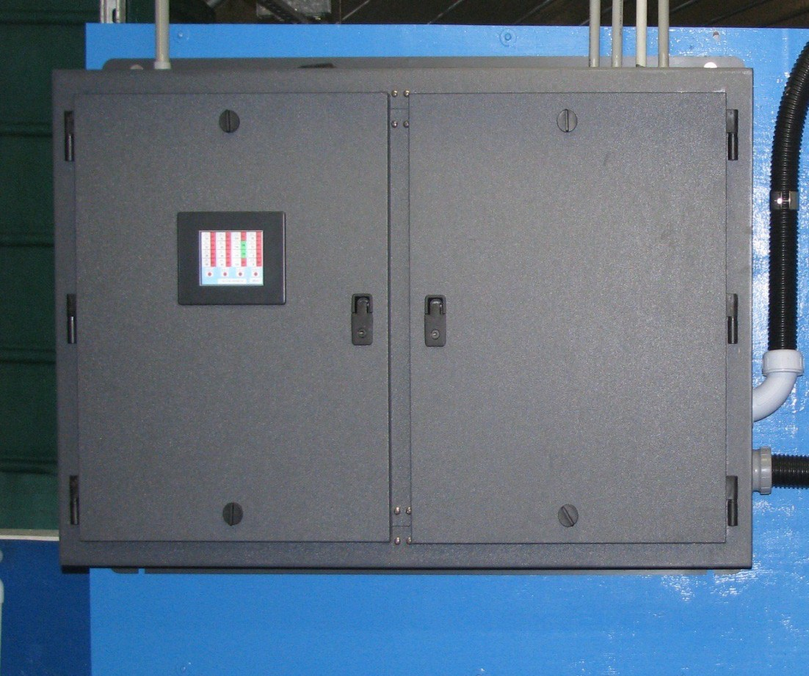
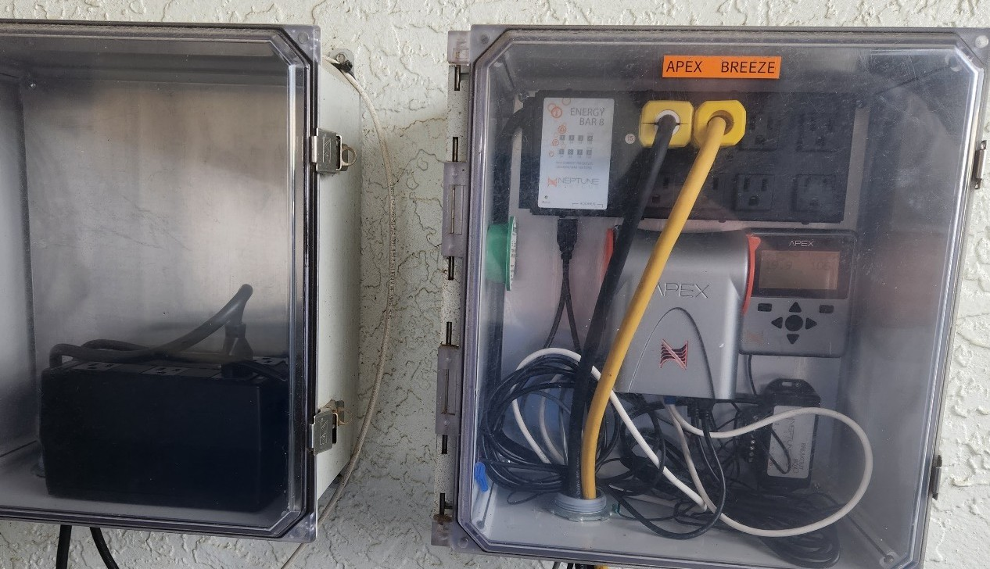
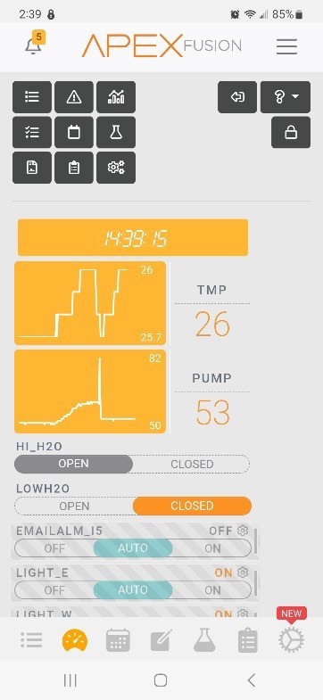
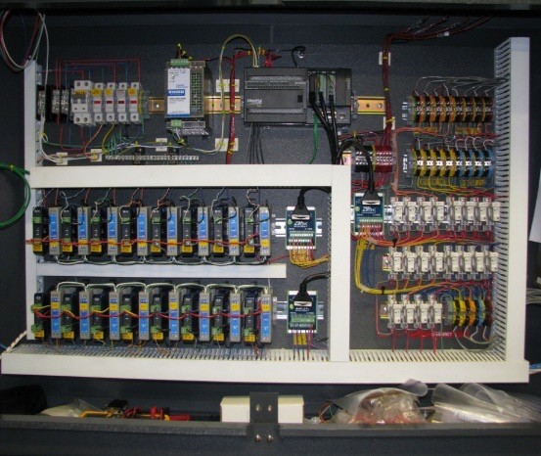
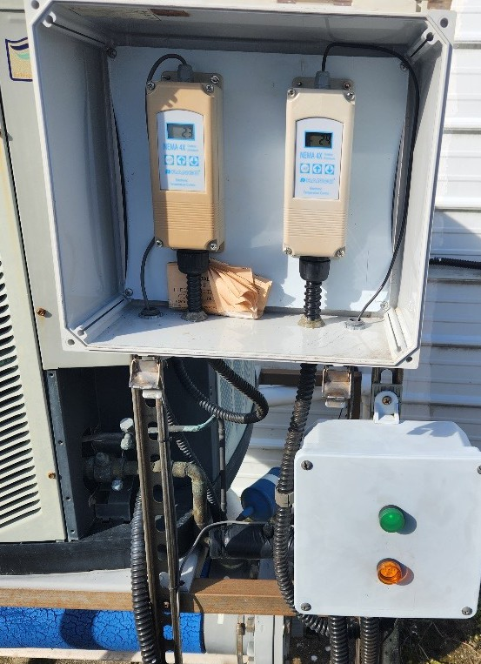
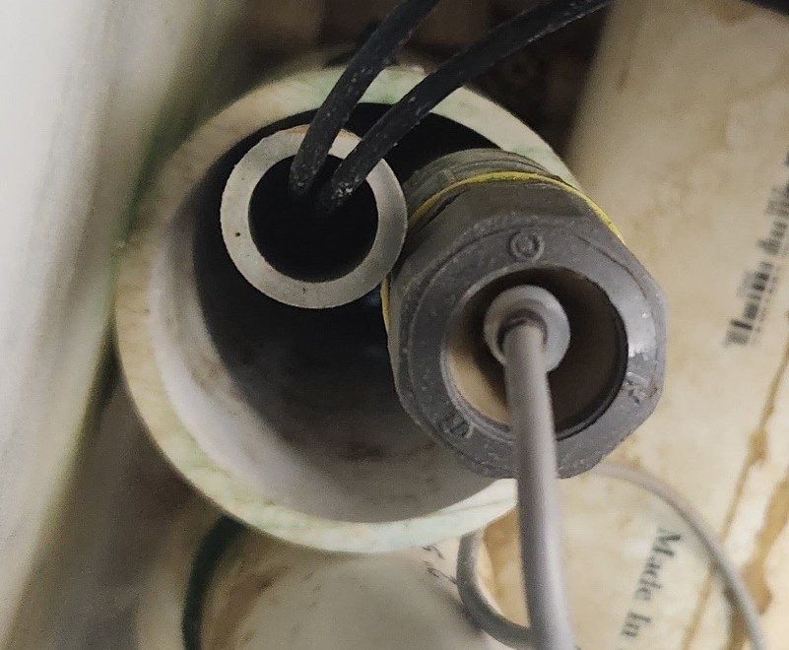
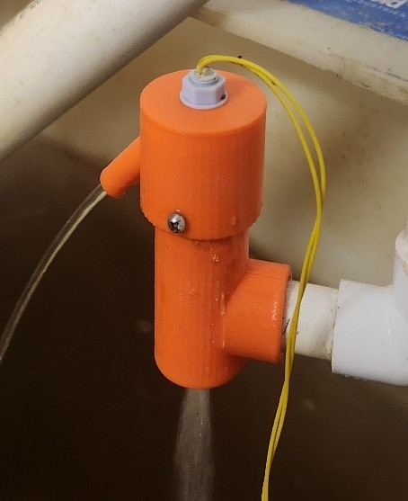
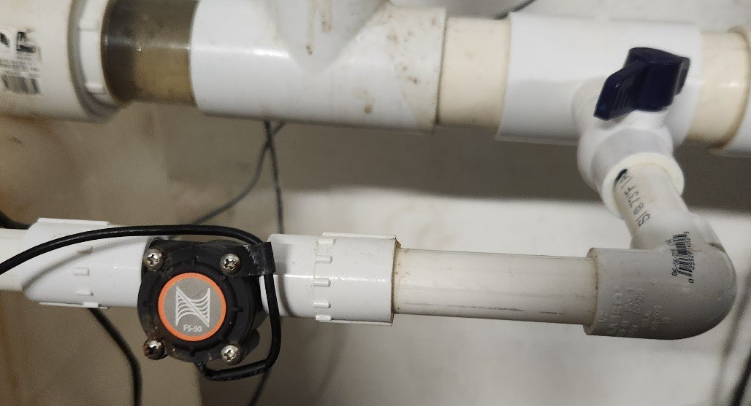
Alarm System

Slide 24
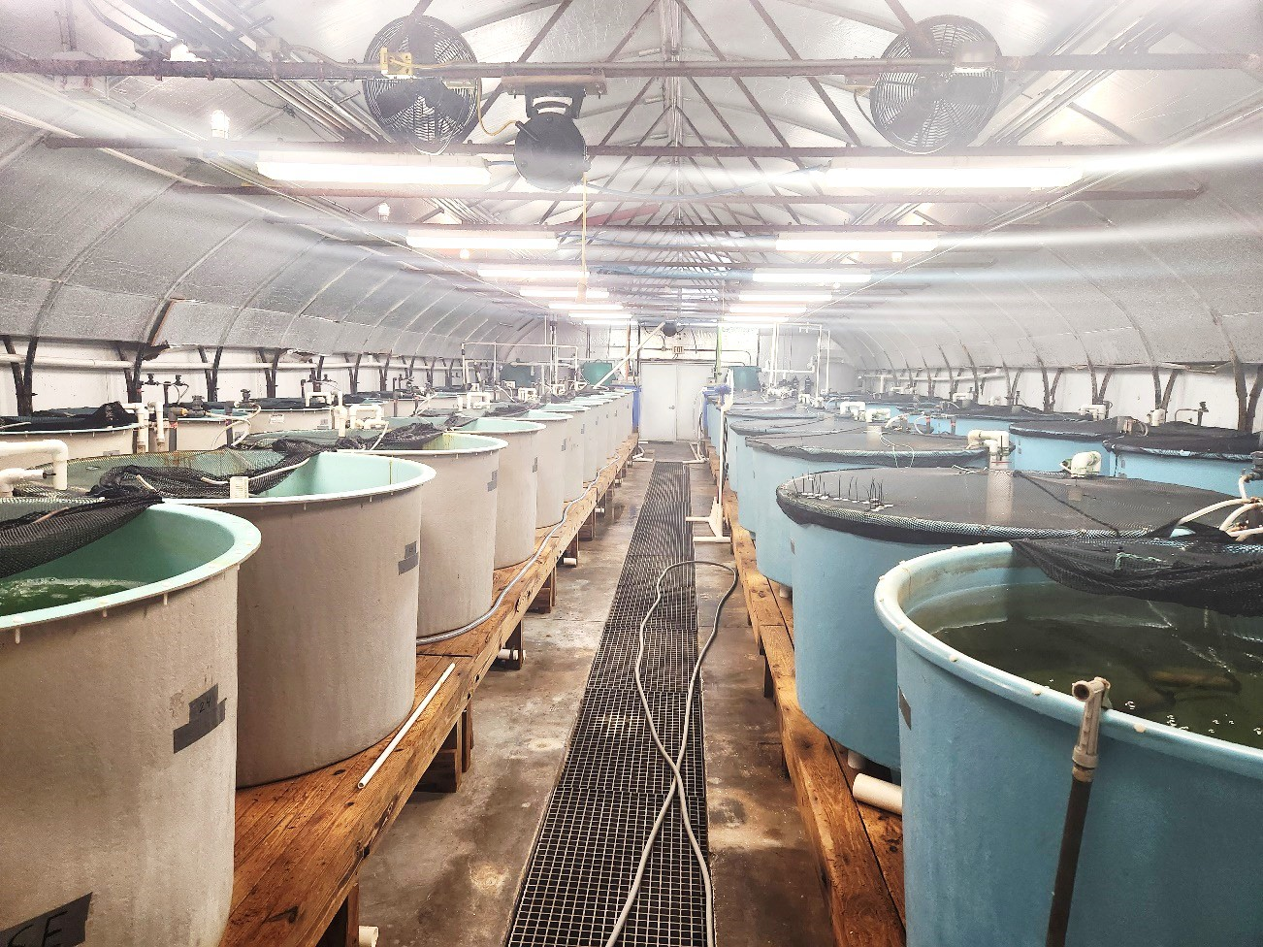
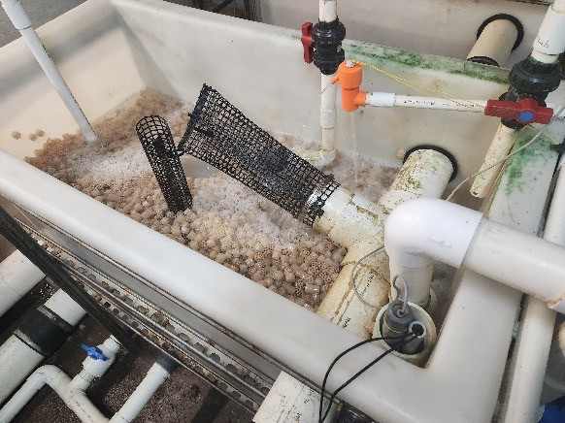
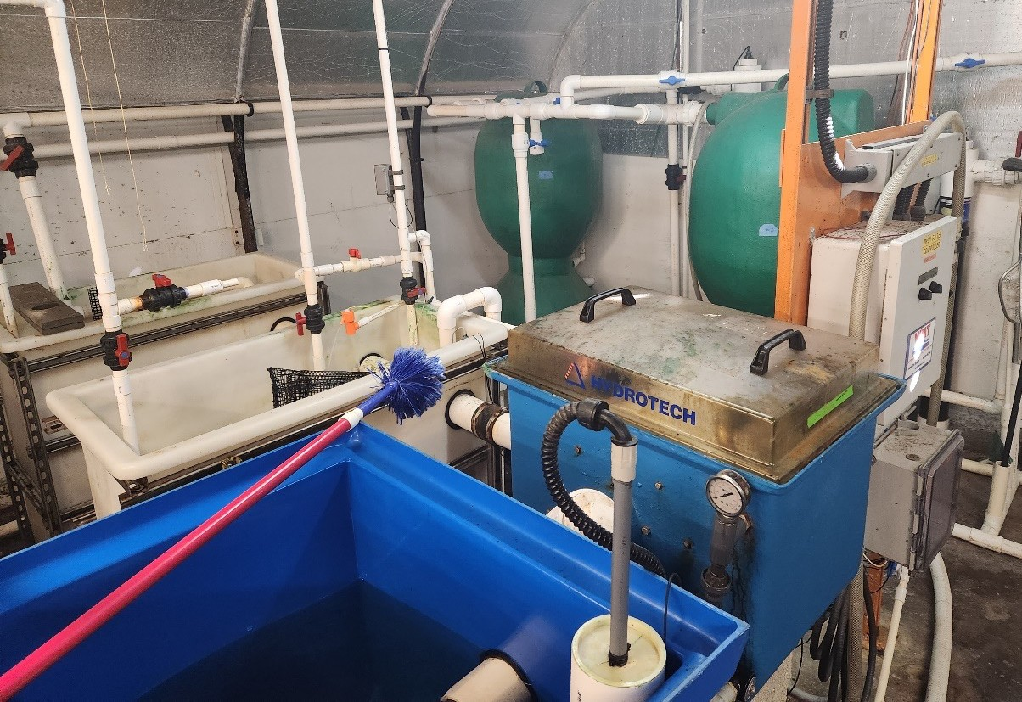
Nursery System

Slide 25
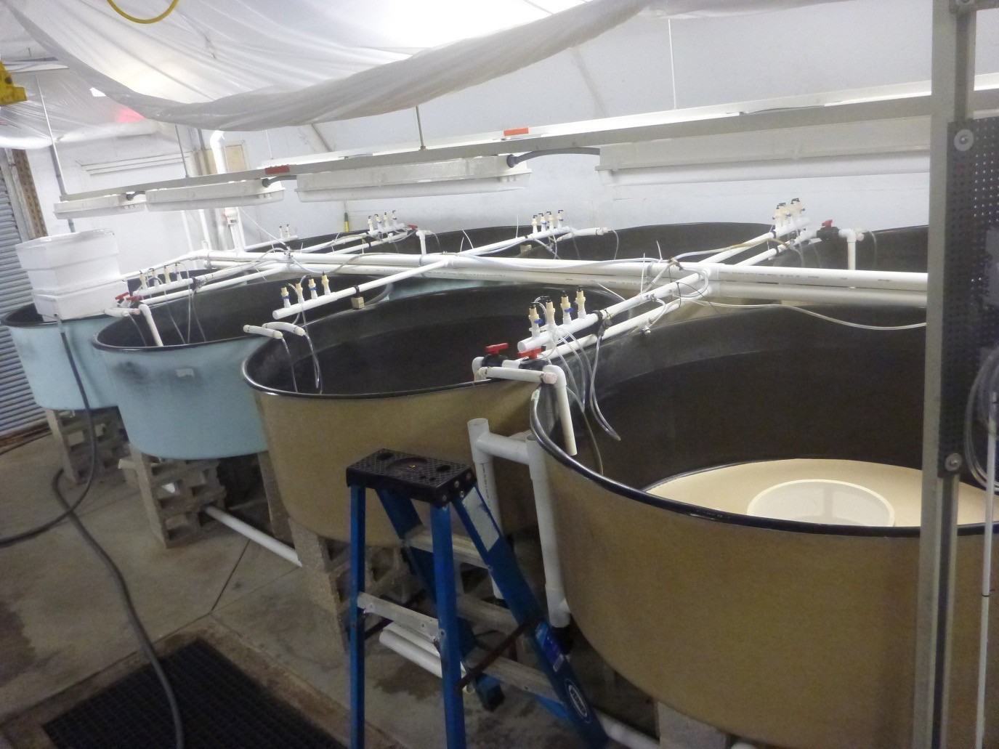
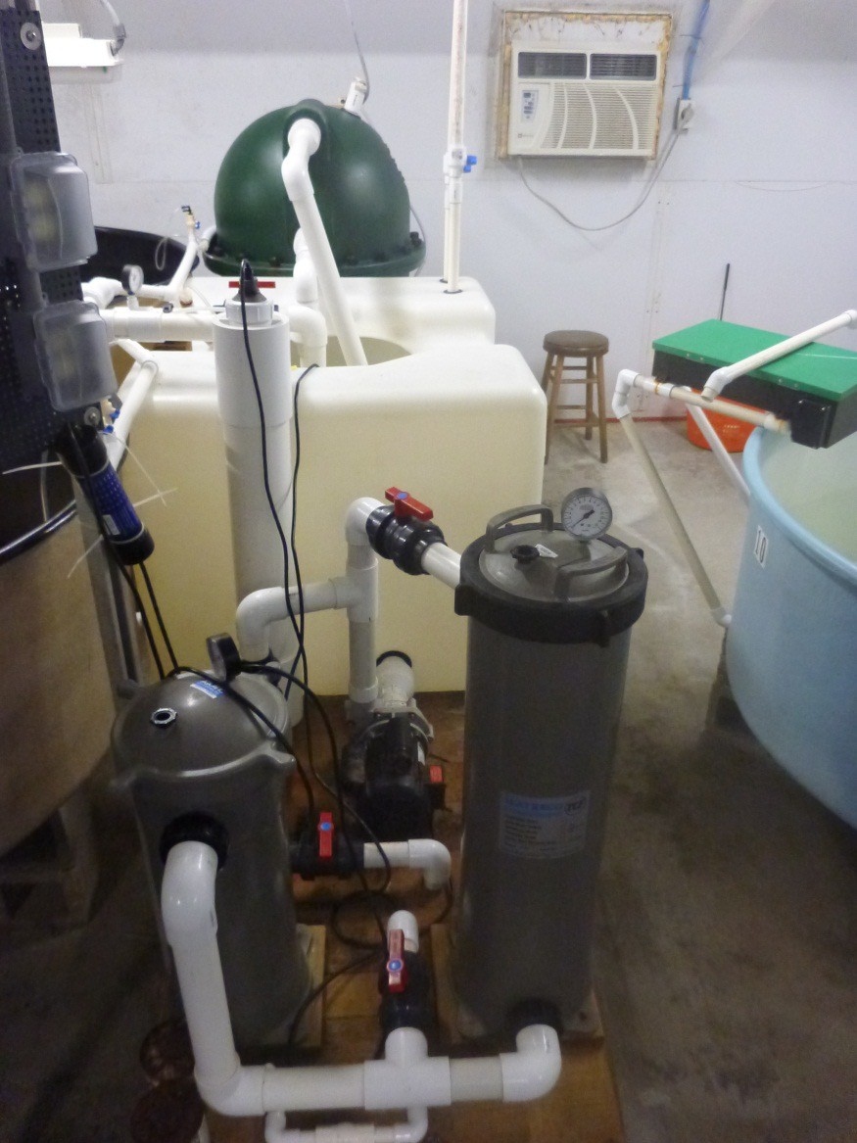
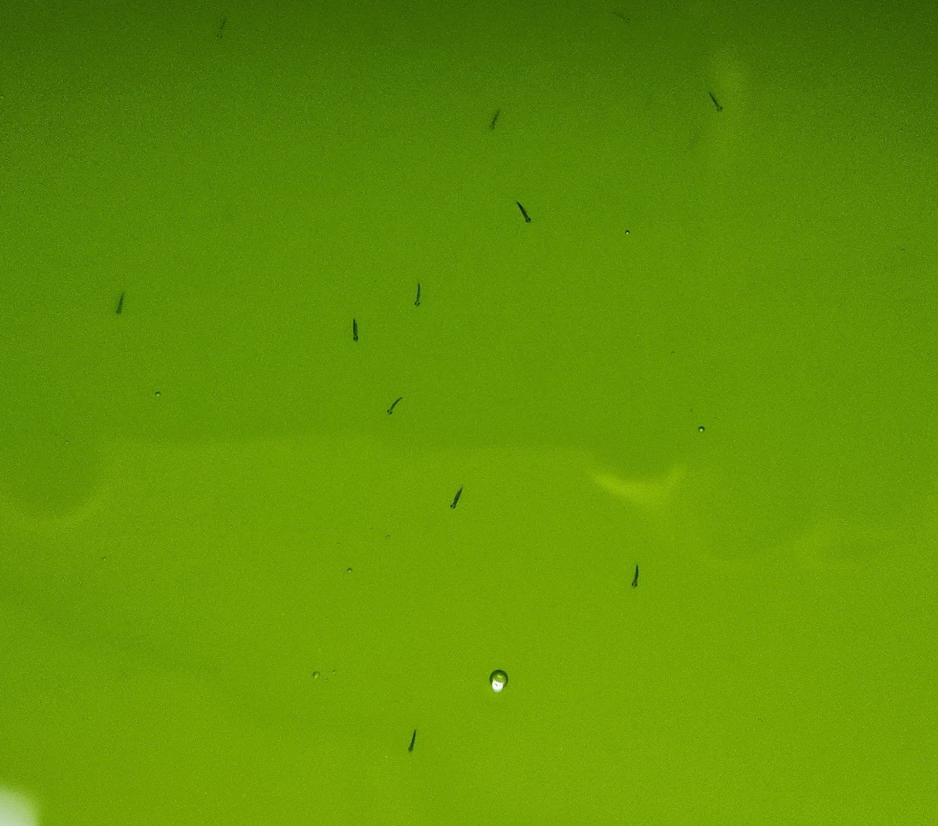
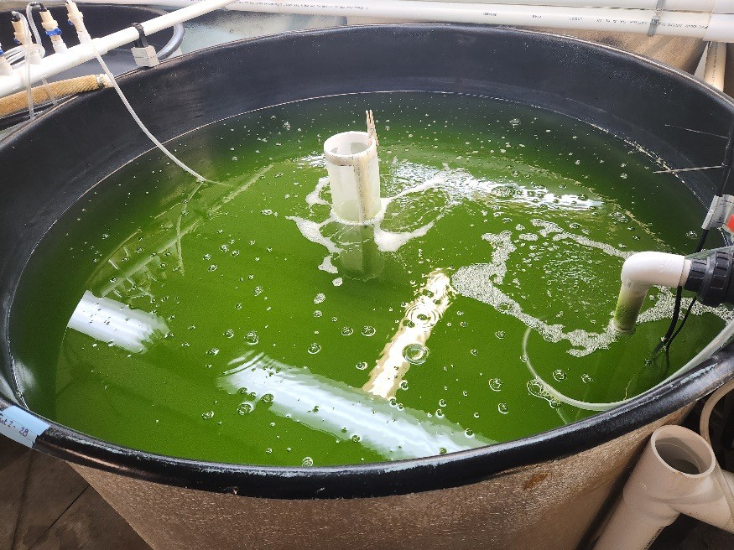
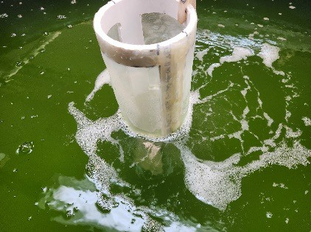
Larviculture System

Slide 26
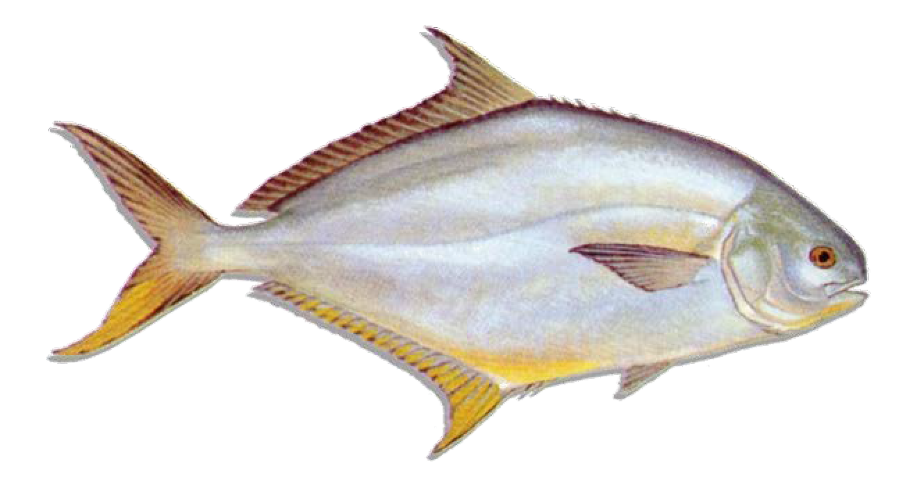


Broodstock Conditioning and Spawning System
USDA-ARS/HBOI-FAU Design

Slide 27





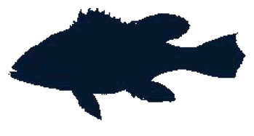
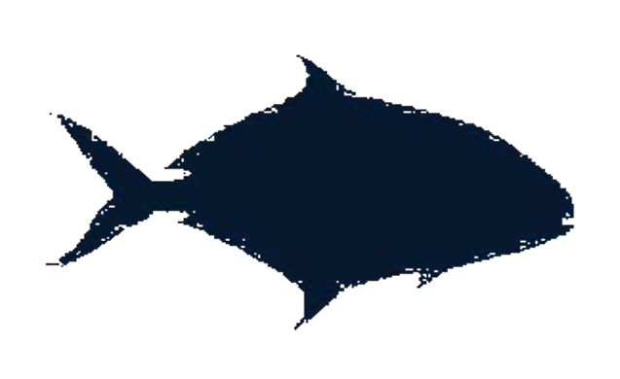



Broodstock Profile
Florida Pompano
Weight: 0.7 – 2.3 kg
Mature age: 1- 3 yrs
Temp: 18 – 30 C
Salinity: 5 – 36 ppt

Slide 28



Water Quality Management Parameters
Parameter Temperature pH
Dissolved oxygen Alkalinity Ammonia
Nitrite
Total dissolved solids
Target Level 16 – 30 C
7.6 – 8.2
≥ 5 mg/L
≥ 200 mg/L
≤ 1 mg/L
≤ 2 mg/L
≤ 5 mg/L

Slide 29






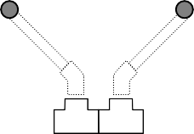




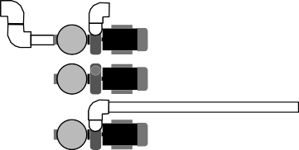










Broodstock Conditioning System
Culture Unit (5.7 m³)
Egg Collectors (0.3 m³)
Waste
Cartridge filters
Pump to chiller
Sump (2.3 m³)
Waste
UV
Waste
Beadfilter (0.1 m³)
Return from chiller

Slide 30
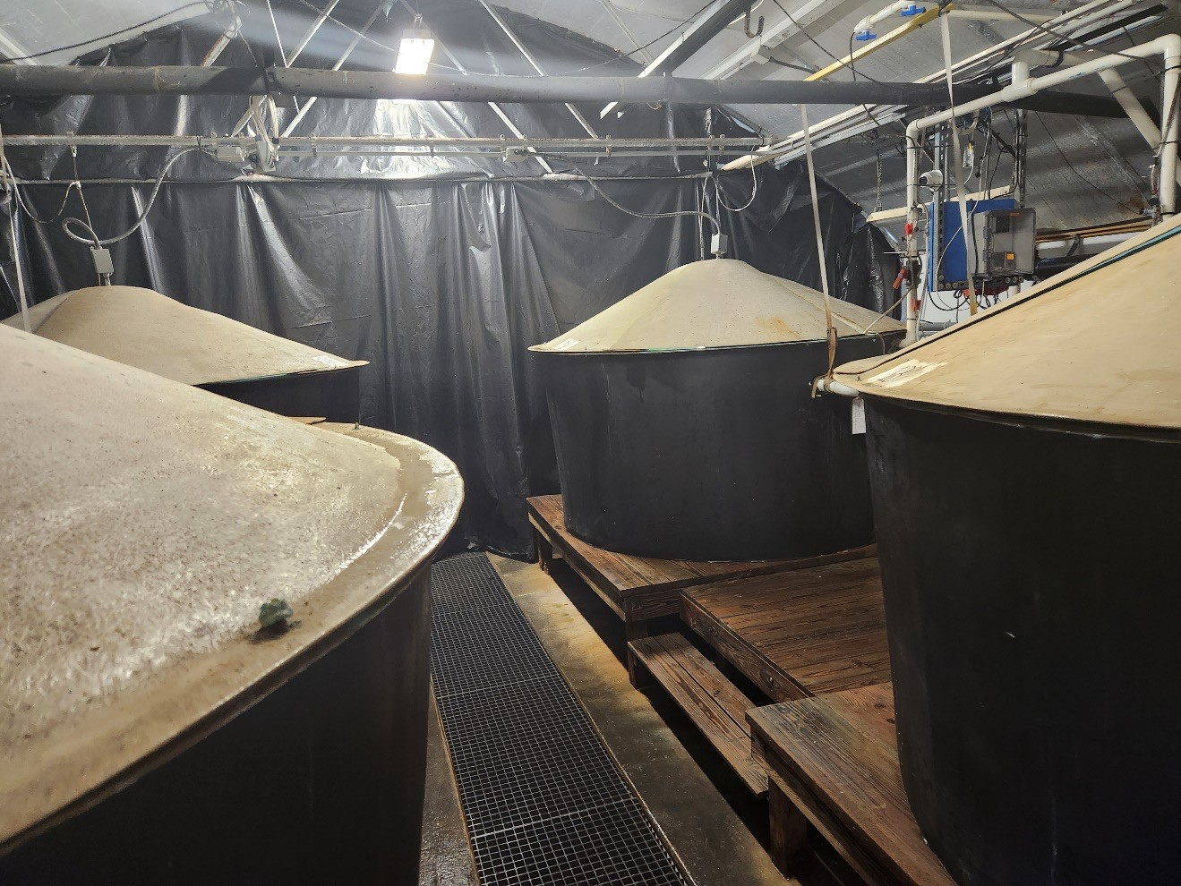
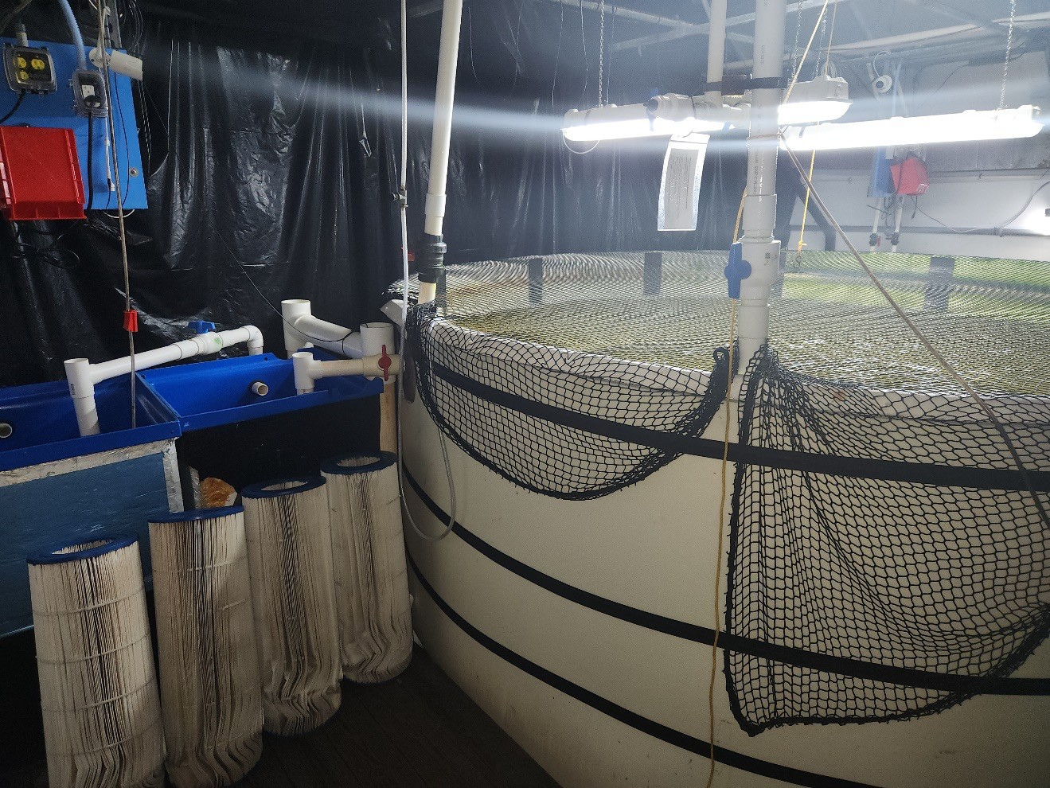
Fishery tanks

Slide 31
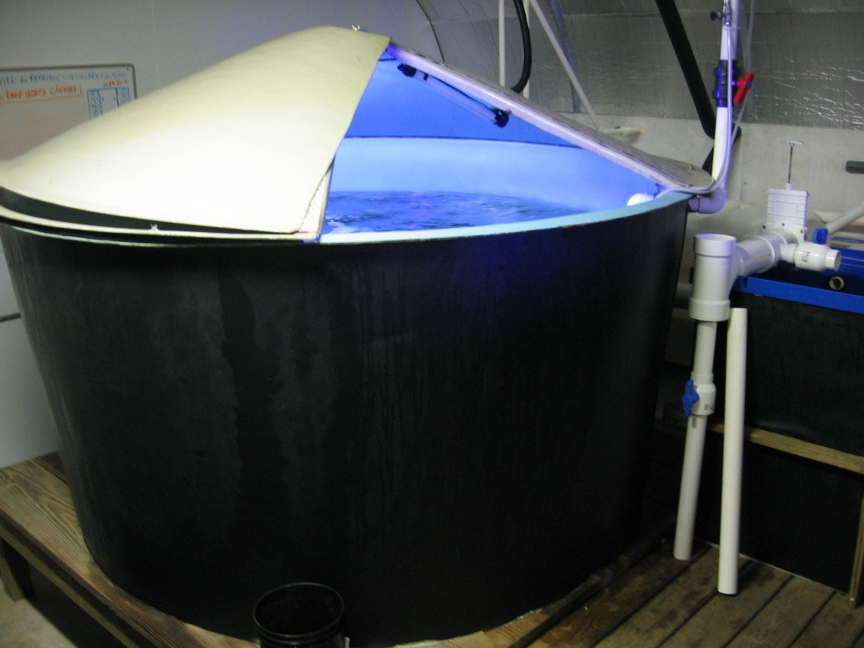
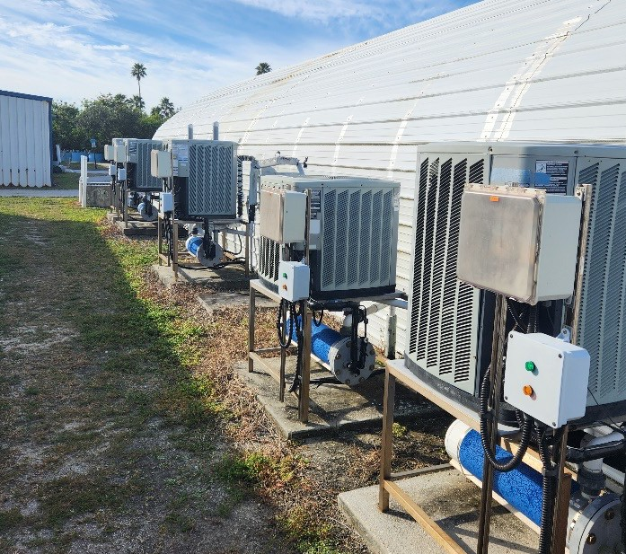
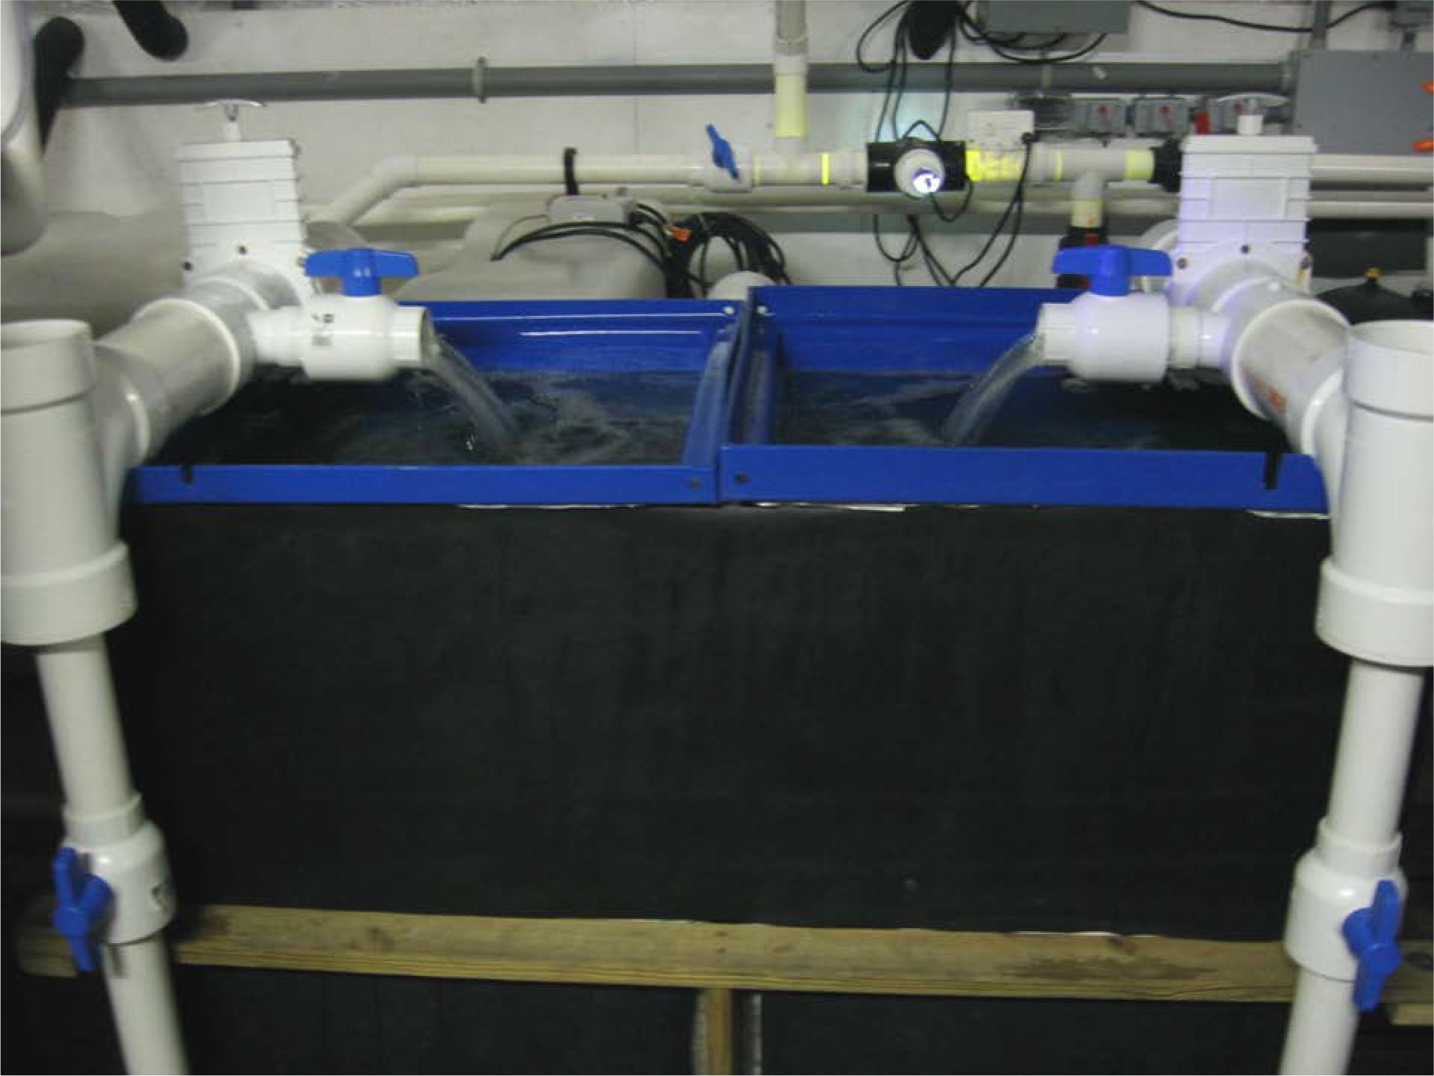

Fishery equipment

Slide 32

Falcon Heavy: USSF-67 Jan 15, 2023
Falcon Heavy: USSF-67 Jan 15, 2023

