Slide 1
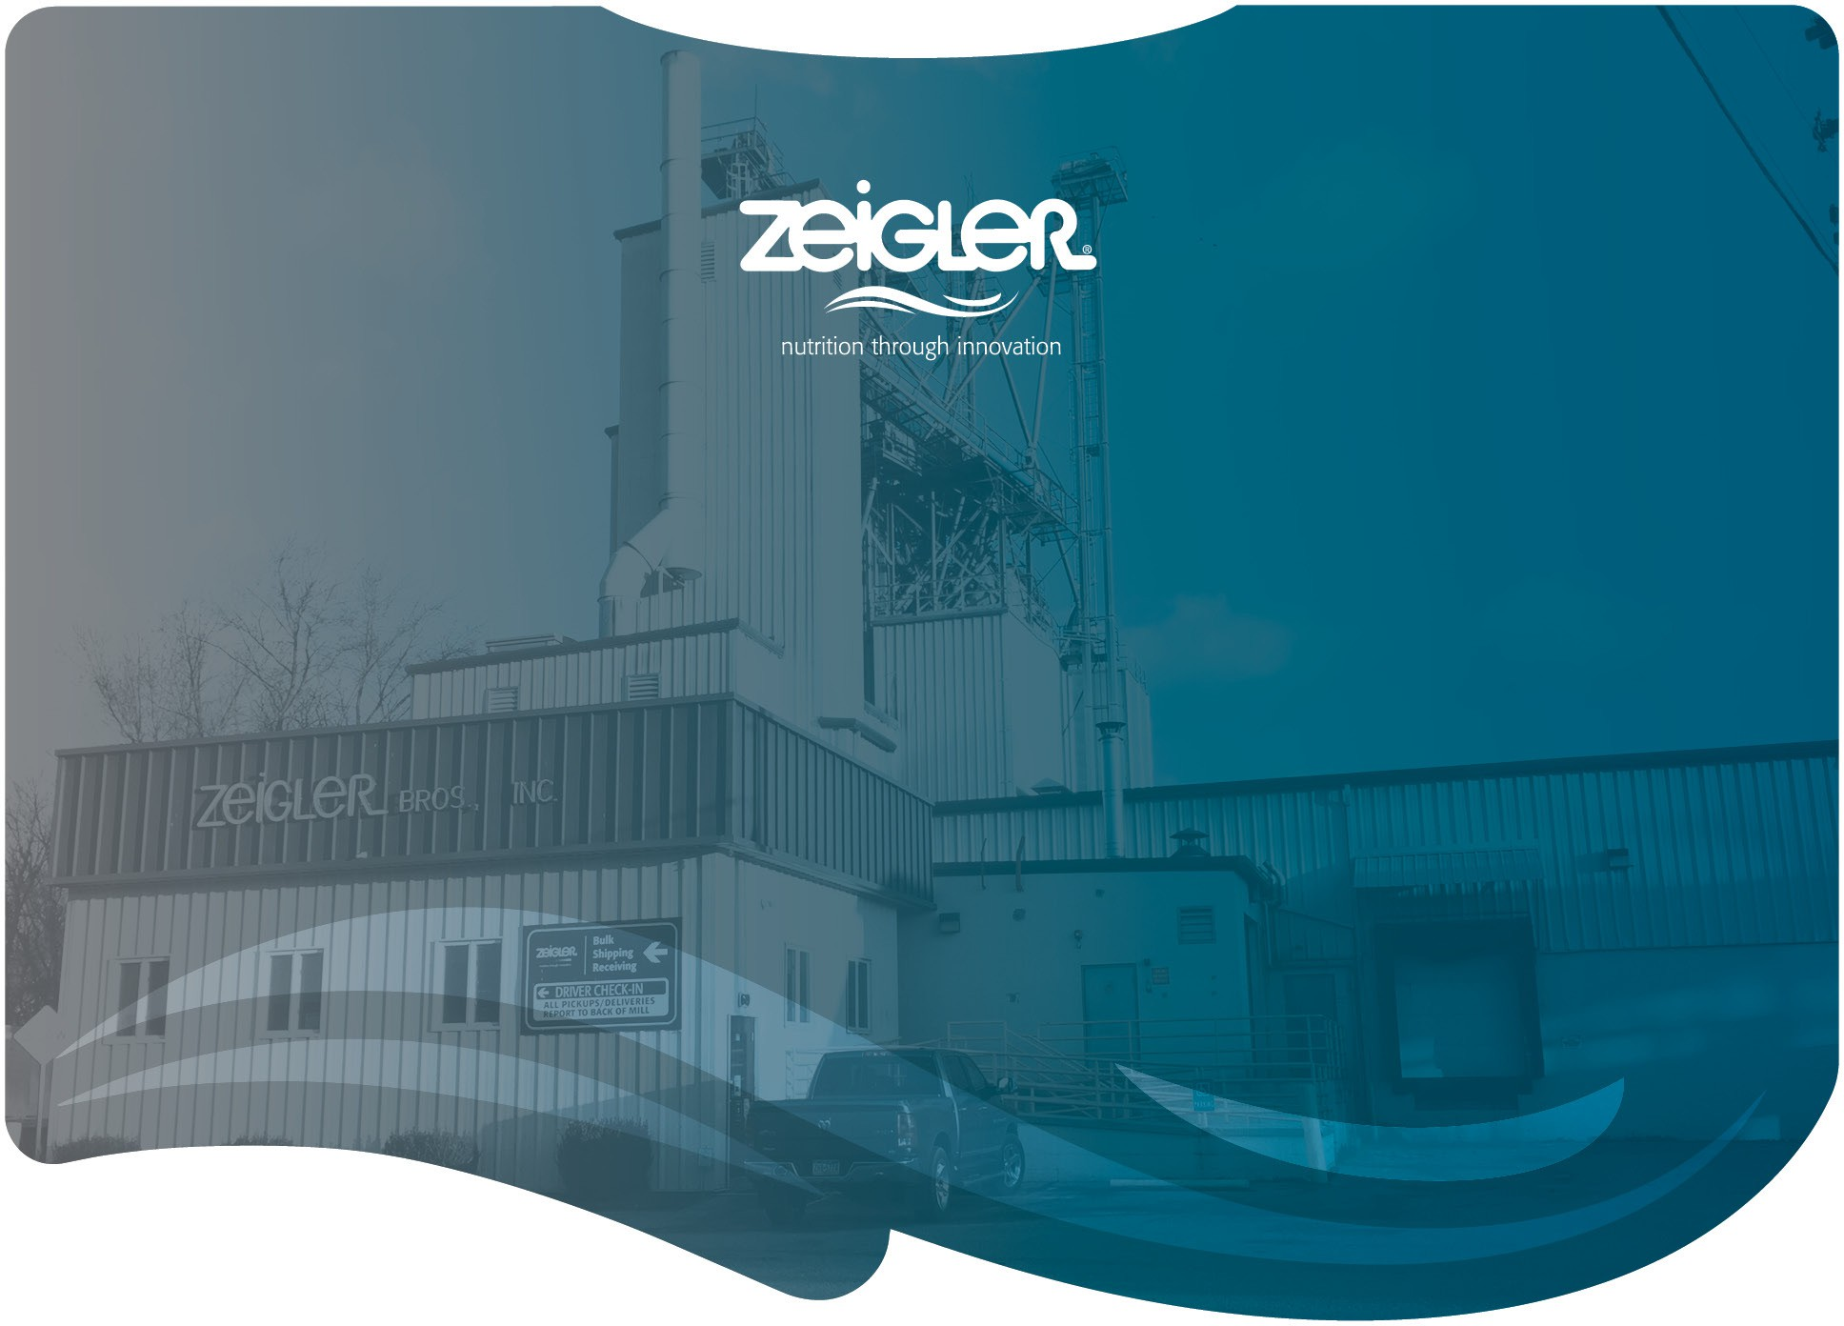
Feeds and Nutrition of Florida Pompano
Scott Snyder and Rick Barrows
Commercialization Status of Florida Pompano Aquaculture Industry Workshop
Harbor Branch Florida Atlantic University
January 19, 2023

Slide 2
Introductions
Who is Zeigler Bros., Inc.?
Review of Florida pompano nutrition.
Overview of feed manufacturing.
Introduction to texturized feed manufacturing.

Slide 3


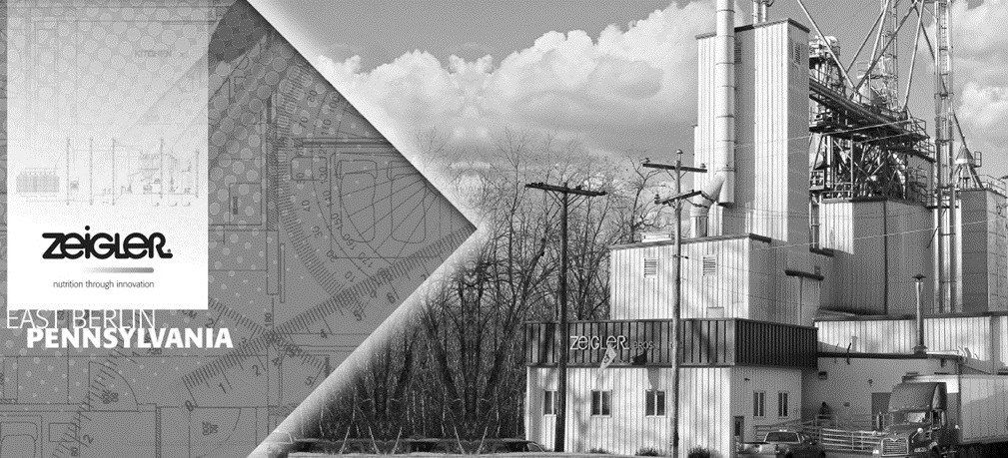
Founded in 1935 …
Founded in 1935 by brothers Ty and LeRoy as a local producer of poultry and livestock feeds.
Dr. Tom Zeigler (son of LeRoy) assumed leadership in 1967 and
changed the strategic direction towards R&D of specialty animal and aquatic feeds.
Today, as Zeigler embarks on its 3rd generation of family leadership the
company continues to develop new and innovative technologies for specialty markets.
With just under 100 employees globally, Zeigler exports hatchery
products to 50 countries and is responsible for about 80,000 MT of aquafeed production in five countries.

Slide 4
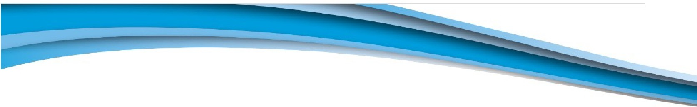
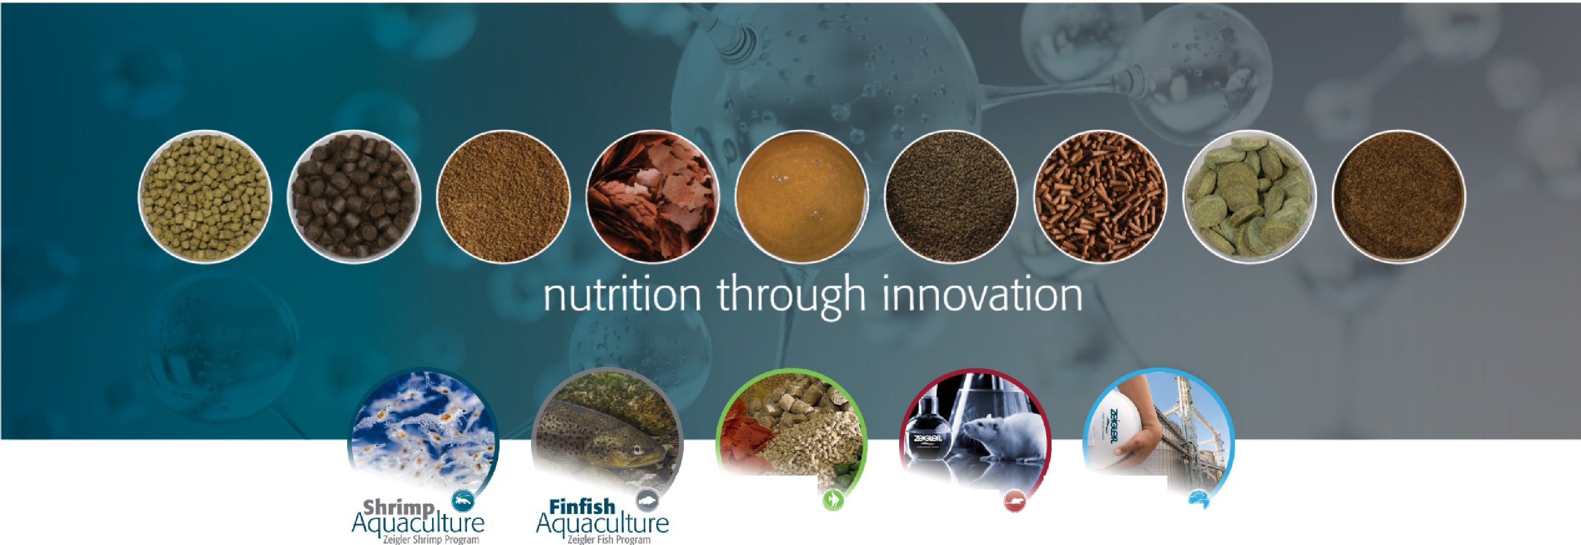
Nutrition through innovation
home I about zeigler I contactus I news & events I products I where to buy
IIDDlmEI
Search
•
2BGlSft
,:;:�-../
nutrition through innovation
Pet&Zoo
NUTRITION
Formulation& Manufacturing
Health &
Feed Mill .
RESEARCH
Technology
TrarlSferProgrnm
Know what's in your dietl
2B.,.G......l._.S...,,R,,
.
nutrition through innovation

Slide 5

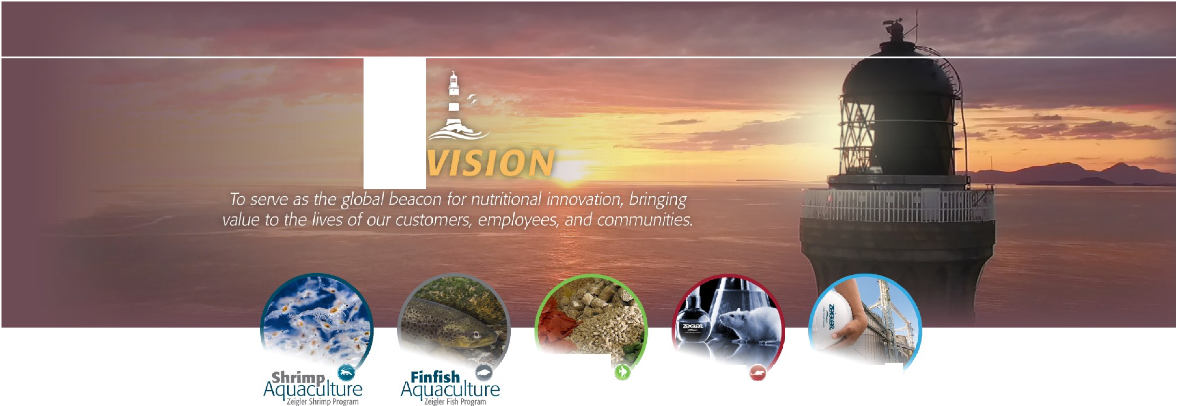
Our Vision
home I about zeigler I contactus I news & events I products I whereto buy
IIDDlmla
Search
•
2BGlSft
c:�-./
nutrition through innovation
Our
Pet&Zoo
NUTRITION
Formulation & Manufacturing
Health &
Feed Mill II·
Technology
TrarlSfer Program
RESEARCH
Know what's in your dietl
2B.,.G......l._.S...,,R,,
.
nutrition through innovation

Slide 6










Company Profile
2013
Matt and Tim Zeigler assume Company Leadership
2015
Dr. Leandro Castro becomes Project Manager at ZBI-RD
2017
New Website
www.zeiglerfeed.com
Focus on Customer
Updated Product Information
2018
R&D / Nutrition Efforts Supported by:
4 Ph.D. Scientists
10 Technicians
2 In-House R&D Facilities
Peter VanWyck becomes the ZARC manager – Full Technical Staff for Conducting Trials
2016
Nutrition Department Expands
Christa Rice – Nutrition Assistant
Dr. Scott Snyder – Nutritional Technology Manager
Dr. Craig Browdy becomes the new Director of Research and Development
2014
2018
Zeigler maintains highly diverse ingredient stocks.
Zeigler manages a sales portfolio of over 300 product SKU’s; 80% of which are aqua products.

Slide 7
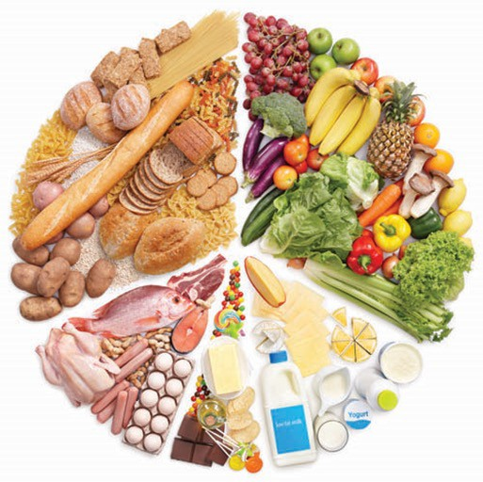
Florida Pompano Nutrition
Protein
Fat
Carbohydrates
Vitamins and Minerals
Specialty Additives

Slide 8
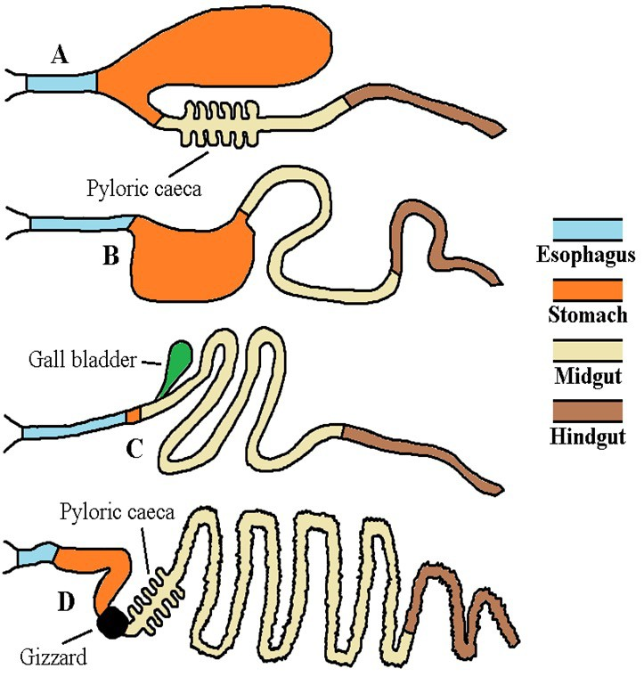
Determining Nutrient Requirements
Comparative gut physiology is
useful in determining basic dietary tolerances.
Digestive System A is
representative of a carnivorous species like salmonids.
System B represents an omnivore
species with carnivore preference like a catfish.
System C represents omnivore
species with herbivore preference like tilapia.
System D represents herbivore species like carp.

Slide 9
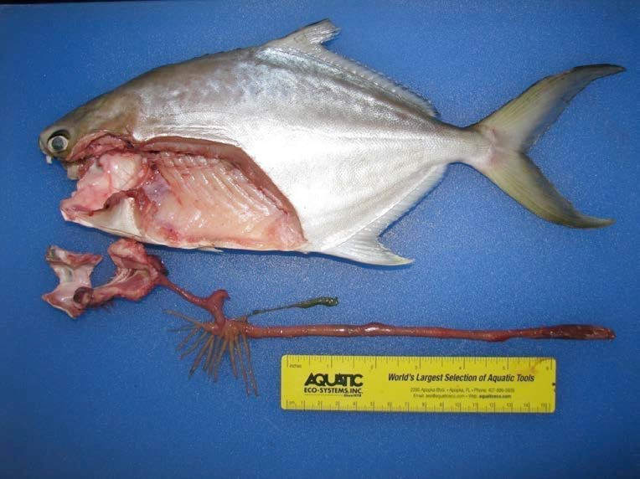
Pompano Digestive System
Pompano have a carnivorous digestive system.
Indicates the need for high protein levels and low tolerance for carbohydrates.
Indicates a preference animal- derived proteins and fats.
Feeds must be composed of highly digestible ingredients.
This basic understanding of the digestive system and early gross protein and energy requirement studies identified that a pompano diet should be relatively high in crude protein (40-50%) and contain moderate levels of fat (10-15%).
Gothreaux, 2008

Slide 10
Protein Requirement
We are referring to amino acid requirements.
Experimental feeds designed to mimic the amino acid profile of the Florida pompano have led to a better understanding of dietary amino acid requirements for this species.
Several labs have made requirement estimates for key amino acids methionine, lysine, arginine and taurine
The use of the ideal protein concept has allowed rapid development of highly digestible feeds.
However, there is much more to determine.

Slide 11
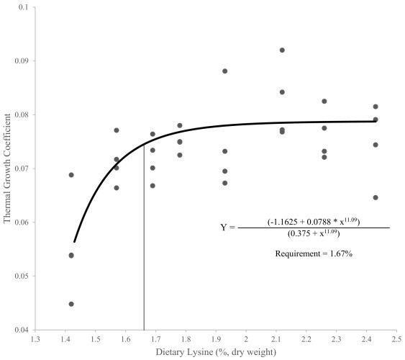
Lysine Requirement
Stites, et al., 2022

Slide 12
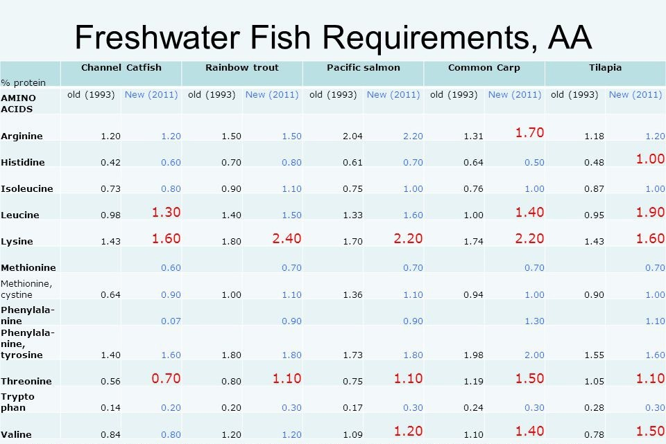
Nutrient Requirements – Amino Acids

Slide 13
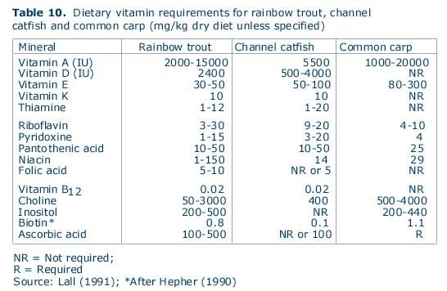
Nutrient Requirements - Vitamins

Slide 14
Commercial Formulation
Identify what is known.
Use the numerous resources to fill in the unknown with data from species as similar as possible.
Strike a balance between manageable requirements and cost.
Formulation is the practice of constructing a finished feed recipe that both nourishes the animal and satisfies the requirements of the farmer in terms of cost, and overall objectives.

Slide 15
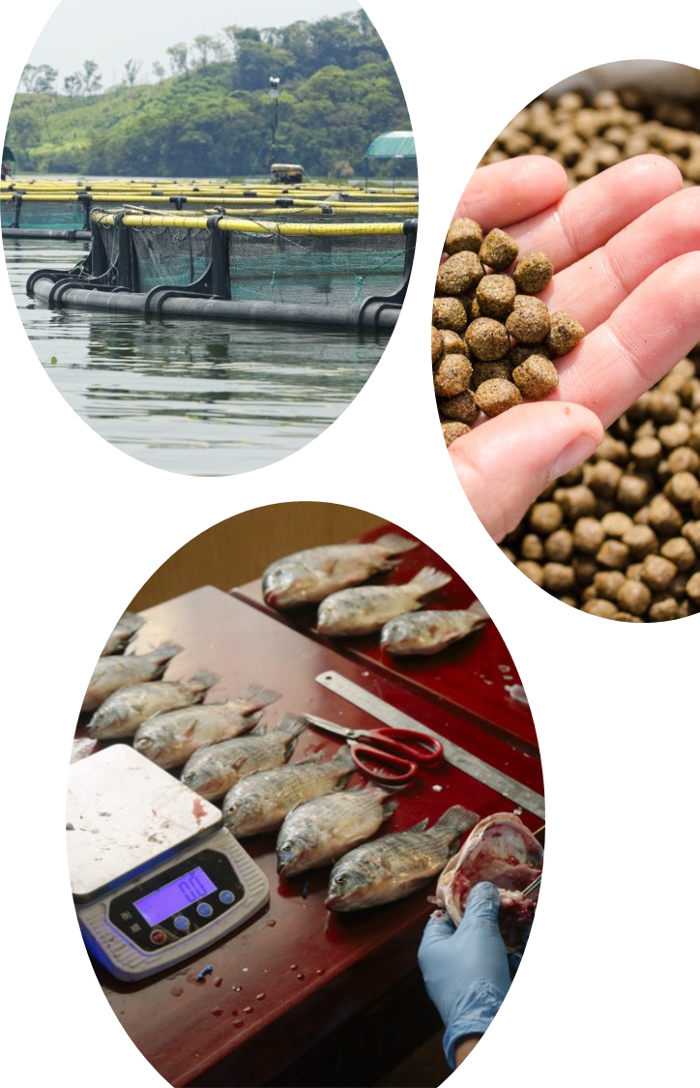
Commercial Formulation 2
Responsibility to customer.
Responsibility to animal.
Limitations of culture system.
Digestibility and waste characteristics.
Overall customer objectives.
Animal performance.
Sustainability.
Certification scheme.

Slide 16
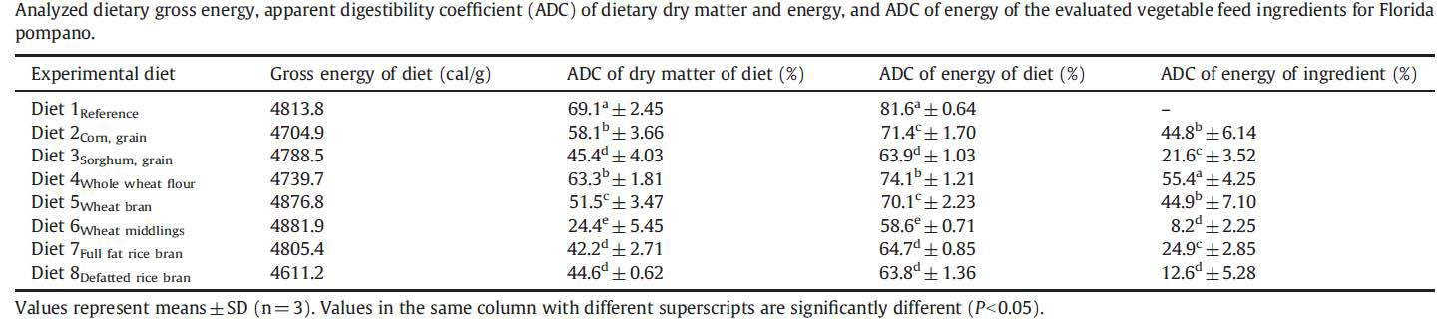
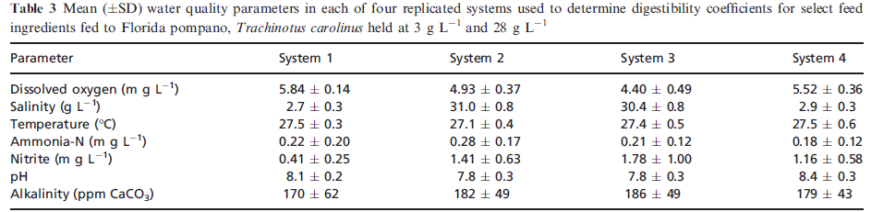
Practical Feedstuffs for Pompano
Gonzalez-Felix et al., 2010
Riche et al., 2017

Slide 17
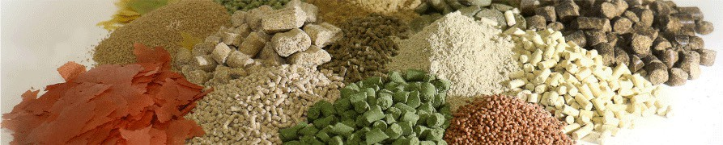
Feed Formulation
Process of selecting and blending ingredients into a product that meets the nutritional requirements of the animal and can be manufactured in a utilizable form cost effectively

Slide 18
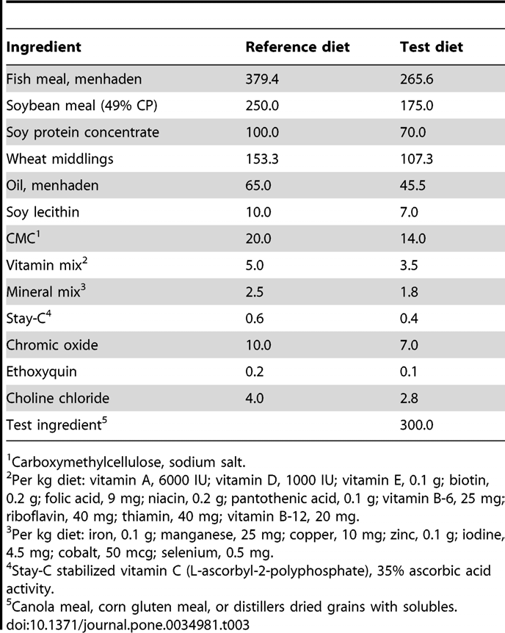
Finished Formula
Lech & Reigh, 2012

Slide 19
Pompano-specific Formulation
Today, there is adequate data available to construct high-quality pompano- specific feeds.
There are still numerous nutrient requirements to determine.
If the formulator considers the rearing environment and the producer’s objectives, superior profitability can be achieved over general marine feeds.

Slide 20

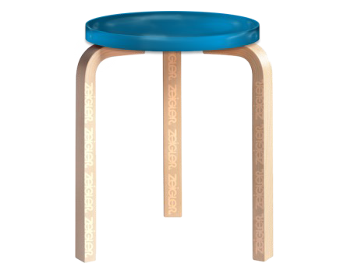
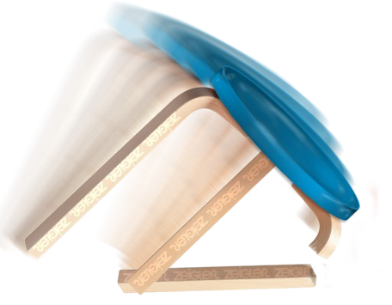
Good Nutrition
Success
Nutrients
Feed
Feeding
Nutrients
Feeds
Feeding Methods

Slide 21

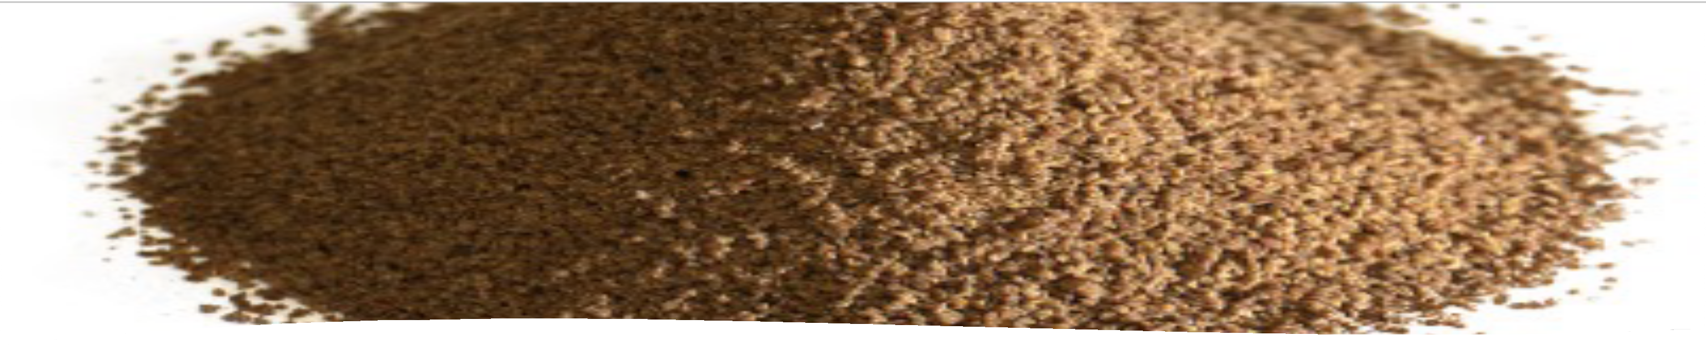
Feed Physical Characteristics
Particle size and uniformity depend on fish size and uniformity
Freshness – check labels for manufacture dates
Packaged to retain quality, shelf life and palatability
Water stability adequate to retain nutrients
Shape and texture as preferred by the animal
Proper storage
Feed Physical Characteristic s

Slide 22
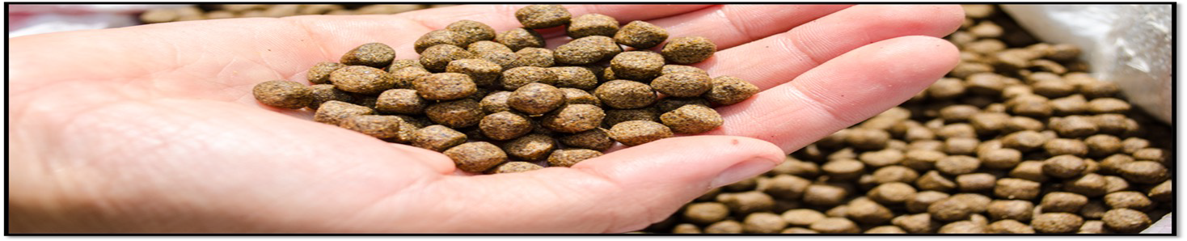
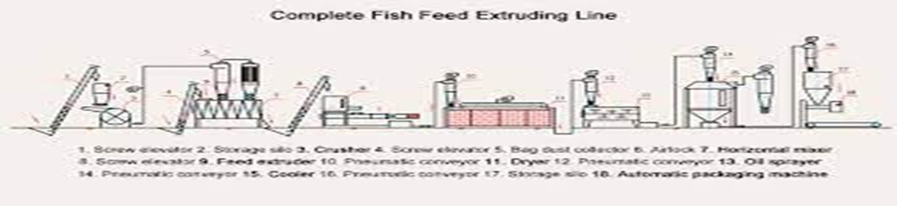
Aquafeed Processing
Traditional dry extrusion review.

Slide 23
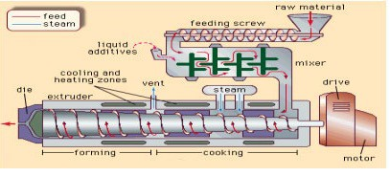
Traditional Extrusion

Slide 24
Traditional Extrusion
Primary Objectives
Starch-based pellet binding.
Aquafeed industry standard.
Process and ingredient combinations are vast.
Efficient and low-cost operations
Consistent final product physical characteristics.
Predictable.

Slide 25
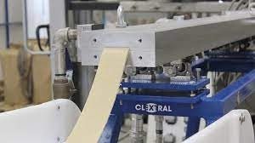
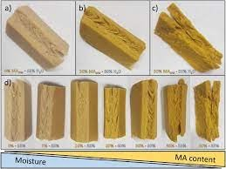
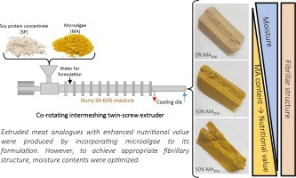
Texturized Extrusion

Slide 26
Texturized Extrusion 2
Primary objectives
Offer a feed with natural mouth-feel.
Offer a feed with incredible water stability.
Increased performance over traditional extrusion.
Increased use of alternative ingredients.

Slide 27
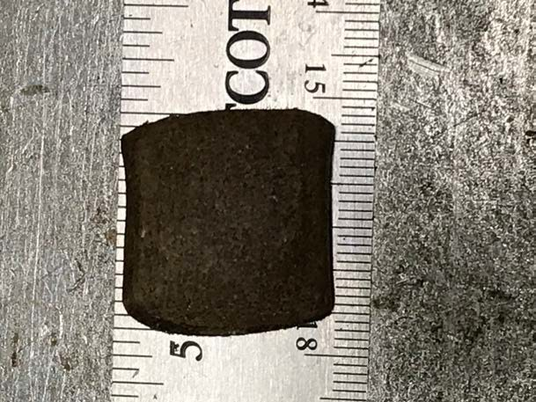
Texturized Extrusion 3

Slide 28
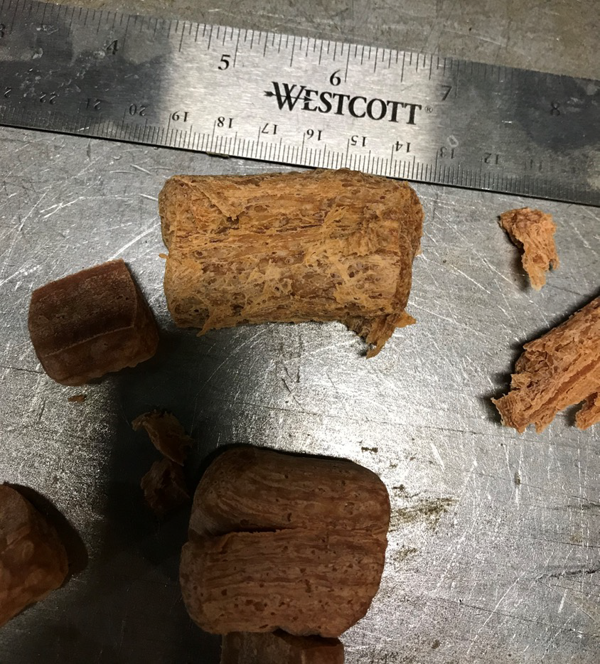
Texturized Extrusion 4

Slide 29
Complete Feed Program
Formulation
Manufacturing
Feeding Methods
Success
Nutrients
Feed
Feeding

Slide 30
Conclusions
Current state is that the texturized extrusion is costly.
Texturized extrusion did not result in improved FCR.
There is much more to learn about this species in terms of nutrition, feeds, and feeding.

Slide 31




Thank you
“The ability to learn faster than your competition may be the only sustainable competitive advantage.”

