Slide 1
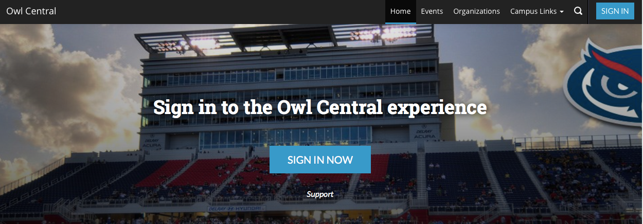
Owl Central
Quick Tutorial & Guide

Slide 2
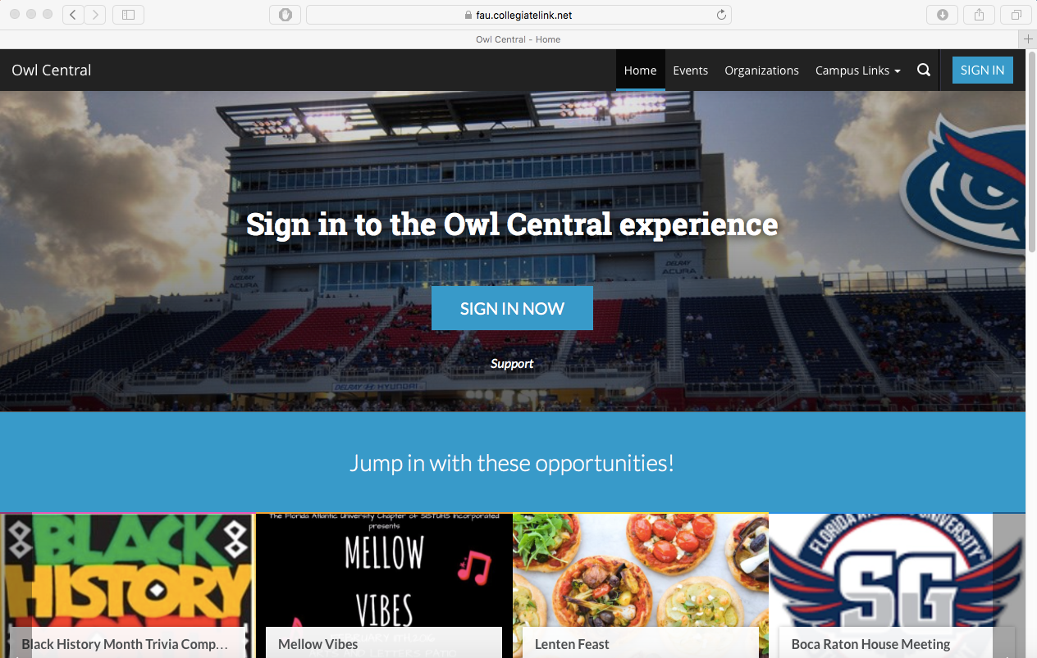
Go to https://fau.collegiatelink.net
Extra URL: www.fau.edu/getinvolved works as well!

Slide 3
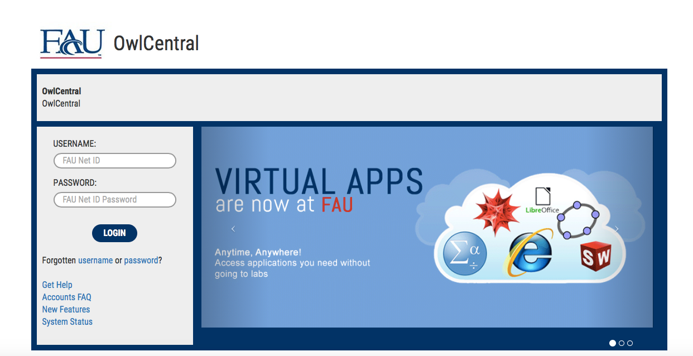
Click on sign-in at top right corner.
TYPE IN USERNAME AND PASSWORD TO SIGN INTO OWLCENTRAL

Slide 4
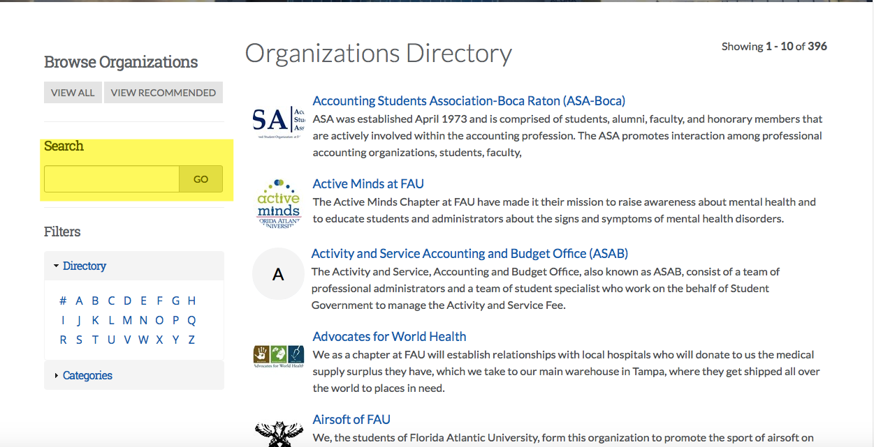
Click on the link at the top right or “Discover a new Organization”.
SEARCH FOR YOUR ORGANIZATION IN THE SEARCH BOX.

Slide 5
Click on “Join Organization” if not already.
*After clicking on join organization, you must wait for the approval to join from someone else in the organization!

Slide 6
CLICK ON ROSTER.
*Not everyone can access or edit the organization’s roster. Only the Primary Contact, President, and Advisor have access to the Roster.

Slide 7
You can invite new members to join the organization by clicking on the blue button “Invite people”. You can manage your members and positions by clicking on “manage roster” or “manage positions”.

Slide 8
Inviting people
*Make sure to only use FAU email addresses when inviting others to join. Use ; separators to invite multiple people at once.
Under “Prospective”, you can see if others have requested to join.
Under “Pending”, you can see who you have invited but not yet actually joined.

Slide 9
Click on manage position and the following screen will come up. Fill in the required information and set management access: No access, all access, or limited access.
-No Access: the member will not be able to edit or change anything for your organization’s page. -All access: the member will be able to have all access to edit or change anything on your organization’s page. -Limited Access: You are able to choose what the member has access to on your organization’s page.
You can add the title of positions in your organization in “Position Name”.

Slide 10
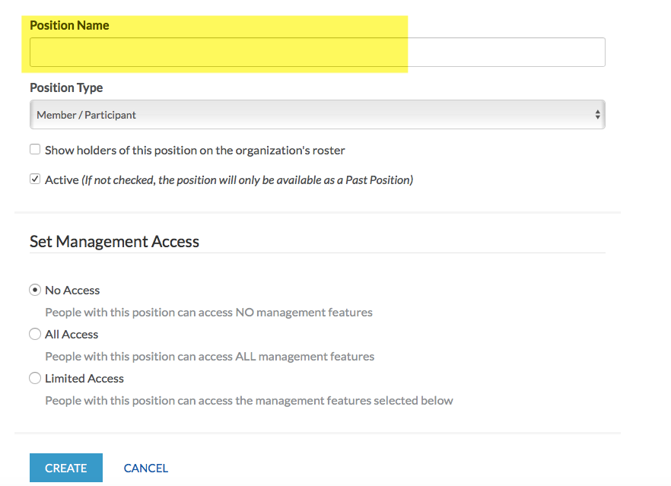
Assigning positions to officers in your organization
If a particular position has not been created yet in your Roster, you can create the position by clicking on “Manage Position”.

Slide 11
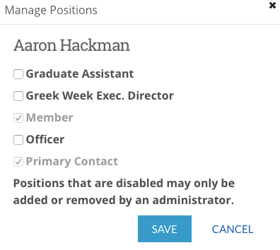
Assigning positions to officers continued…
1) Click on “Manage Roster”. You will then see the following screen.
3) Select the title(s) of position by checking off the boxes for each member.
2) Click on “Edit Positions”. You can add the title of positions to every member in your organization.

Slide 12
Ending membership in the organization

Slide 13
Creating and submitting events / creating and submitting forms
You are able to create and manage events for the organization’s calendar.
Create and manage your forms by clicking on “Forms”.

Slide 14
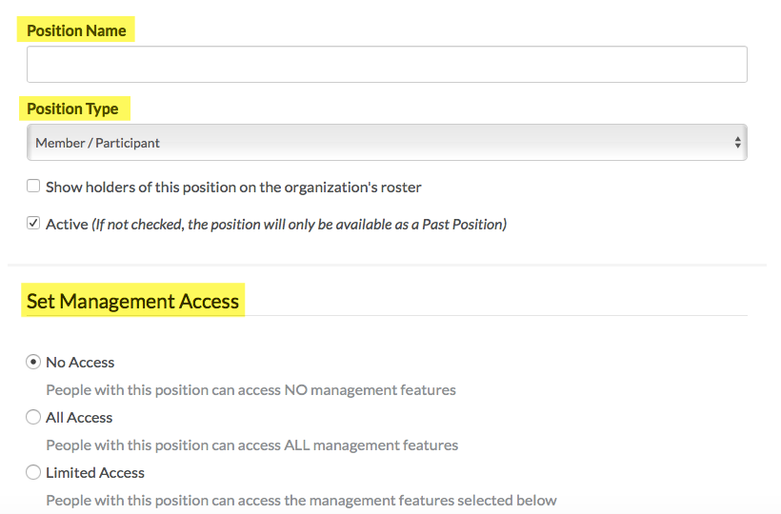
Quick summary

Slide 15
Other features for organizations on owl central
News Articles: Create and write articles about the latest news on your organization.
About: Edit and update your organization’s profile
Gallery: Upload pictures and create albums regarding your organization
Documents: Upload relevant documents for your organization
Forms: Create and manage forms
Elections: You are able to allow your members to vote through Owl Central.
Interests: Rank and manage selected interests in importance of your organization for the search bar.

Slide 16
Need more Help?
COSO: fau.bocacoso@fau.edu
SI: siadmin@fau.edu
FSLife: fslife@fau.edu

