Slide 1

WORK STUDY
SIMPLIFIED
FOR EMPLOYERS AND DEPARTMENTAL SUPERVISORS
Maria Faber, Financial Aid Fiscal Operations Officer
Kelsie Conrad, Need Based Employment Coordinator

Slide 2
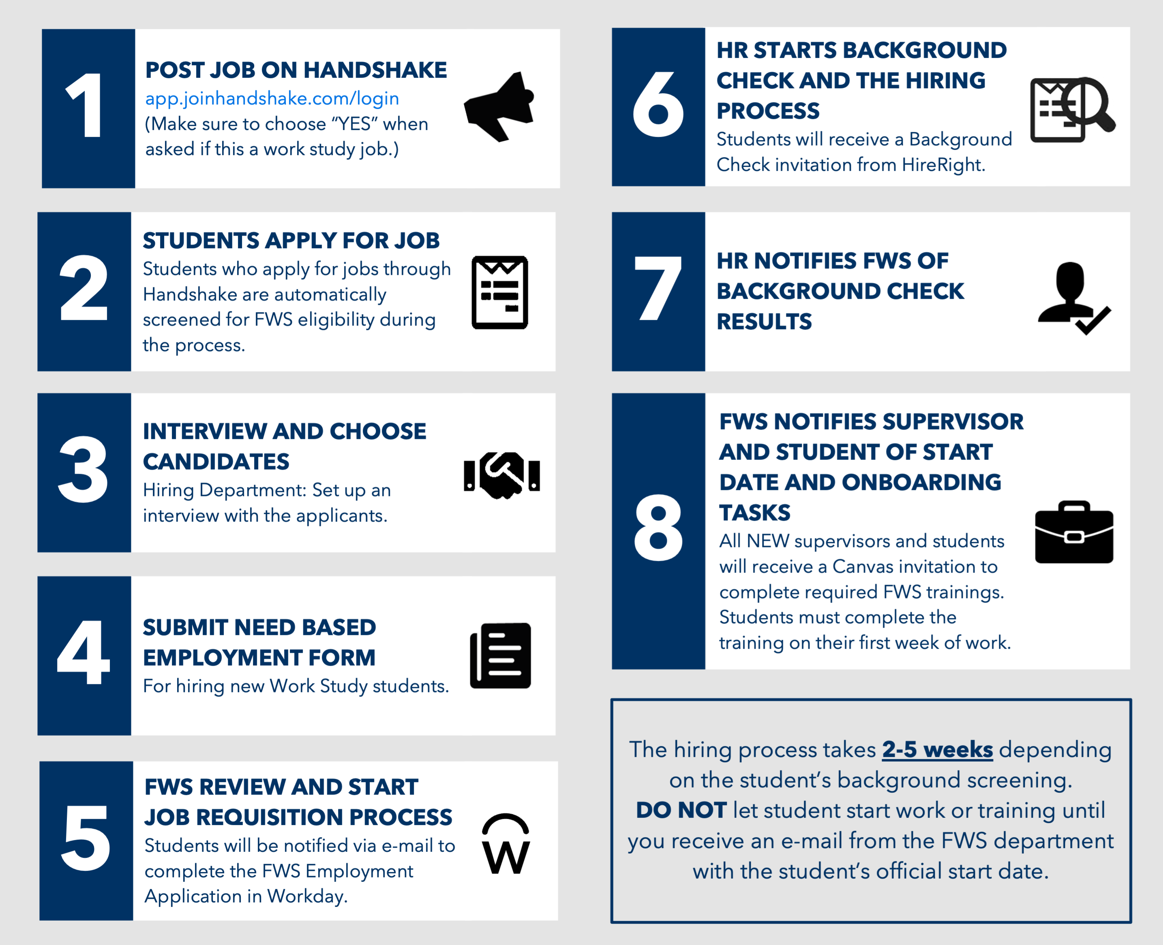
What is the
FWS
Hiring Process?

Slide 3
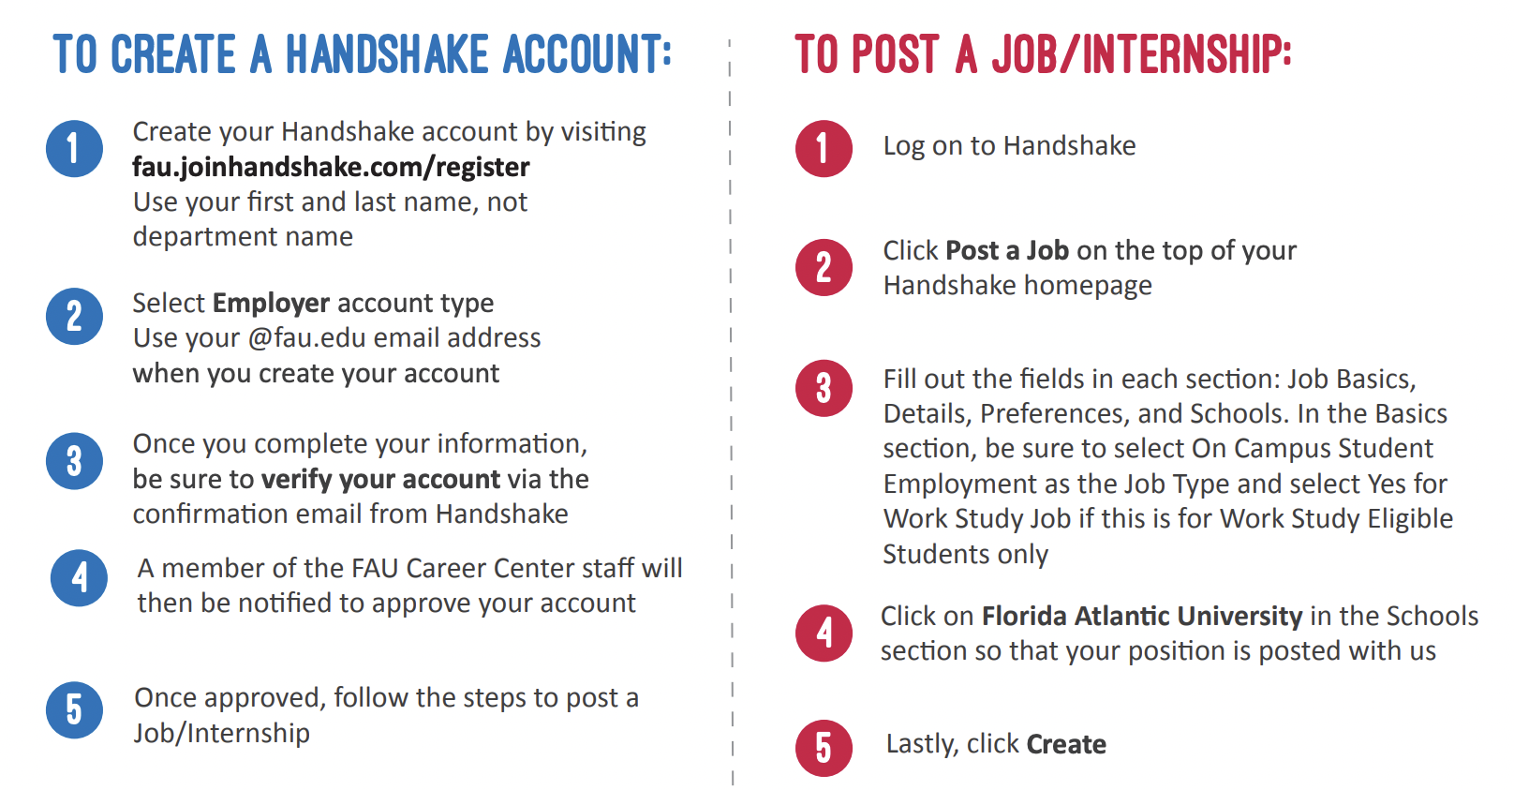
How do I post jobs on Handshake as a supervisor?

Slide 4
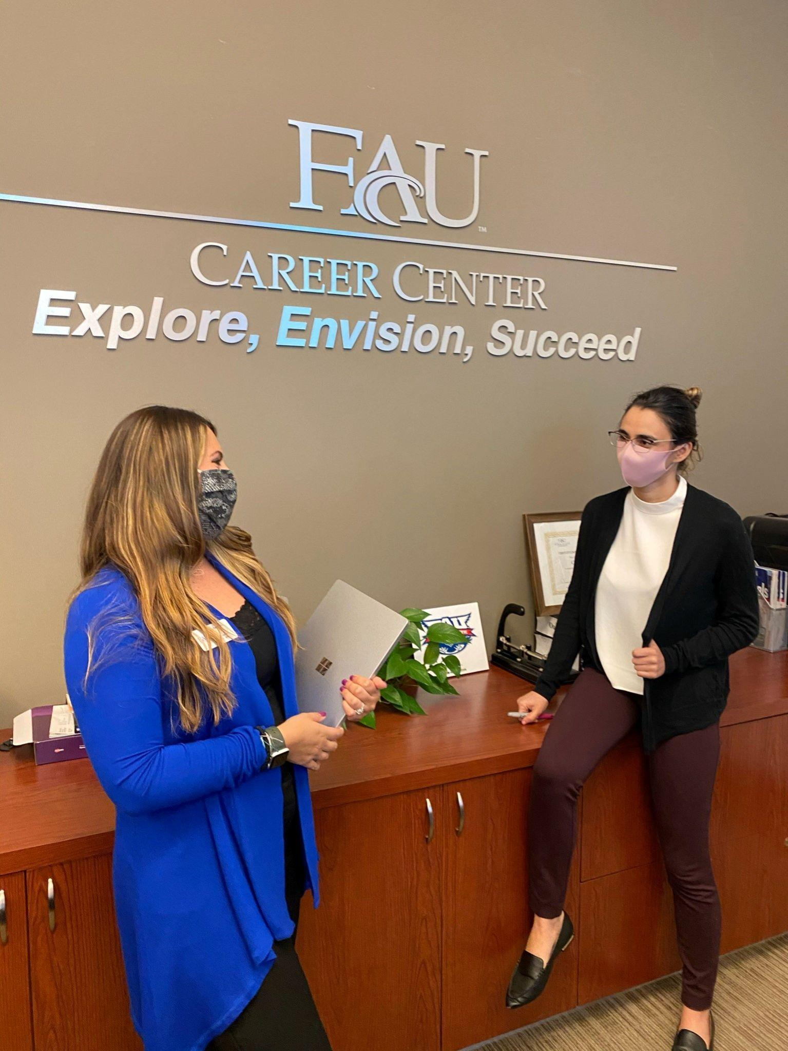
Who can be an FWS/FWEP Supervisor?
Full-Time FAU Employees MUST:
Opt as a Supervisory Organization in Workday
Complete Canvas Training

Slide 5

What are my responsibilities as a supervisor?
Create a learning culture.
Provide flexible schedules that do not interfere with class schedules.
Clarify tasks, goals & expectations.
Communicate effectively.
Treat students as professional team members.
MENTOR students.
Track hours to ensure students are not going over their allotment.
Ensure students completed their Canvas training and Onboarding tasks.

Slide 6
Who qualifies for Work Study?
Students MUST:
Have a current FAFSA on file with FAU
Demonstrate unmet financial need ($2,350+/semester)
Meet satisfactory academic progress (SAP)
Be a degree-seeking student enrolled at FAU
Can a student lose eligibility?
Yes, the FAU Office of Student Financial Aid may adjust or cancel a student's FWS funds, if it is determined that they are no longer eligible. If a student is ineligible, we will notify you that the student can no longer work as a FWS employee.

Slide 7
How many hours can a student work?
Fall/Spring: Up to 20 hours/week
  OR Up to 29 hours/week with a written approval from the student’s academic advisor sent to our department
Summer: Up to 29 hours/week
Per FWS Regulations,
Students are strictly prohibited from working during scheduled class times.
Students MUST submit their time on Workday daily, and it is the supervisor’s duty to check for accuracy and approve time.
Students must be paid monthly.

Slide 8
What is required of me if
I have been chosen to be audited?
The FAU Office of Student Financial Aid will conduct random time entry audits to ensure all departments are in compliance and the time entry for Work Study students is completed in an accurate and timely manner.
If chosen, we will request screenshots of the student’s timesheets in Workday and their class schedule to verify the following:
Students working over 6 hours a day are demonstrating on the timesheet that they took a 30-minute break.
Students are NOT exceeding 20 hours/week, unless given permission from an academic advisor on file with the FWS office.
Students are NOT working during class times, unless there is record of class being cancelled.

Slide 9
PLEASE notify us of the following…
RESIGNATIONS:
Students are required to immediately notify their supervisor as well as the FWS team via email at workstudy@fau.edu.
Supervisors are responsible for ensuring that the FWS team is notified of the student’s last day of work.
TERMINATIONS:
Students who fail to meet job duties can be removed from their position. Documentation of the issue(s) and attempts to correct the issue(s) must occur before termination.
Please contact Human Resources for any issues related to employee relations.
The student’s last day of work must be provided by the FWS team.

Slide 10
How does one access and complete FWS Forms?
To hire a new student, use the Need Based Employment Form.
To track a student’s payroll, use the Allotment Tracking Form.
To renew a student’s employment for the next semester, use the Renewal Form.
To request additional funds for student, use the Request for Additional Funds Form.
  Use if student has around $800 left in their allotment.
  Submit before a student’s funds run out, to avoid liability to your department.
TIPS:
Always include a job description, building number, and room number on the Need Based Employment Form.
Always use the student’s FAU Email Address on ALL forms.
In the unlikely event that you are unsure if your student is directly working with a protected class, please contact empl@fau.edu.

Slide 11
THANK YOU
WORK STUDY: workstudy@fau.edu | 561-297-3533 FAU CAREER CENTER: career@fau.edu | 561-297-3533

