Slide 1

FMRI workshop, March 30, 2021
Gig workers for delivery platforms

Slide 2



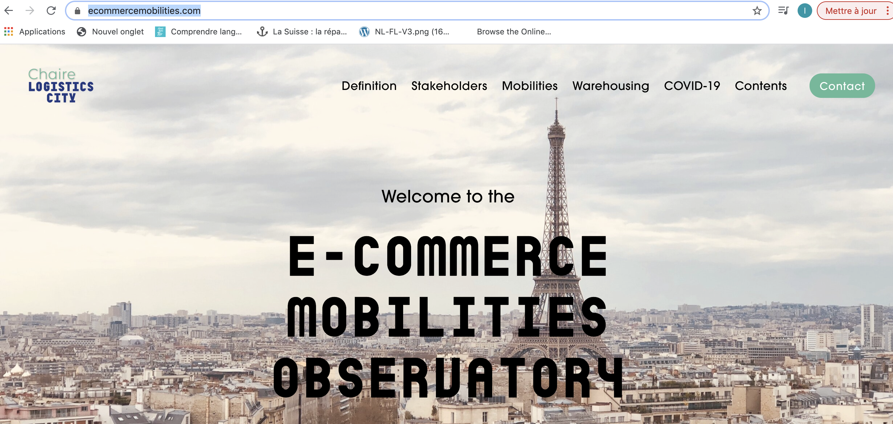
Research oriented Chair
Warehouses, innovations, new trends in consumption and impacts on city logistics
Results available online:
Observatory of ecommerce mobilities (https://www.ecommercemobilities.com/)
Survey reports on gig workers for instant delivery platforms in Paris 2016, 2018, 2020, 2021
Barometer of urban logistics under covid lockdown
Logistics real estate and relationships with urban form in 74 large cities around the world
https://www.lvmt.fr/en/chaires/logistics-city/

Slide 3
Urban freight labor market: new jobs, new issues
City logistics: an easy job market to access, but difficult working conditions and low salaries
500,000 people in warehousing and freight transport in the Paris region
12,000 small freight transport companies in the Paris region, often contractors of the large operators
Gig economy, self-employed couriers: 2,000 new micro-companies created in ‘instant delivery’ every month in the Paris region in 2019 (and 2,000 in rest of France)
The pandemic has further increased the number of gig workers engaged in deliveries (exact data not yet available)

Slide 4
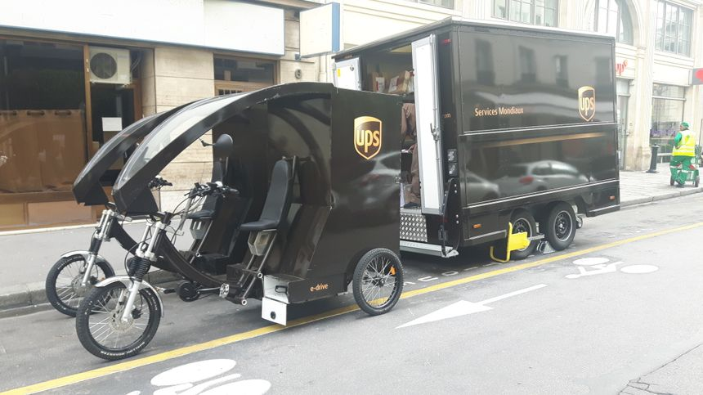
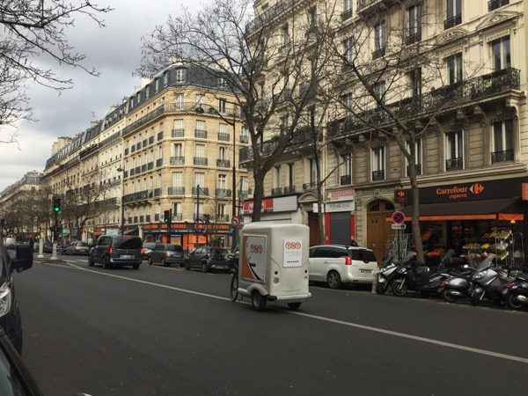
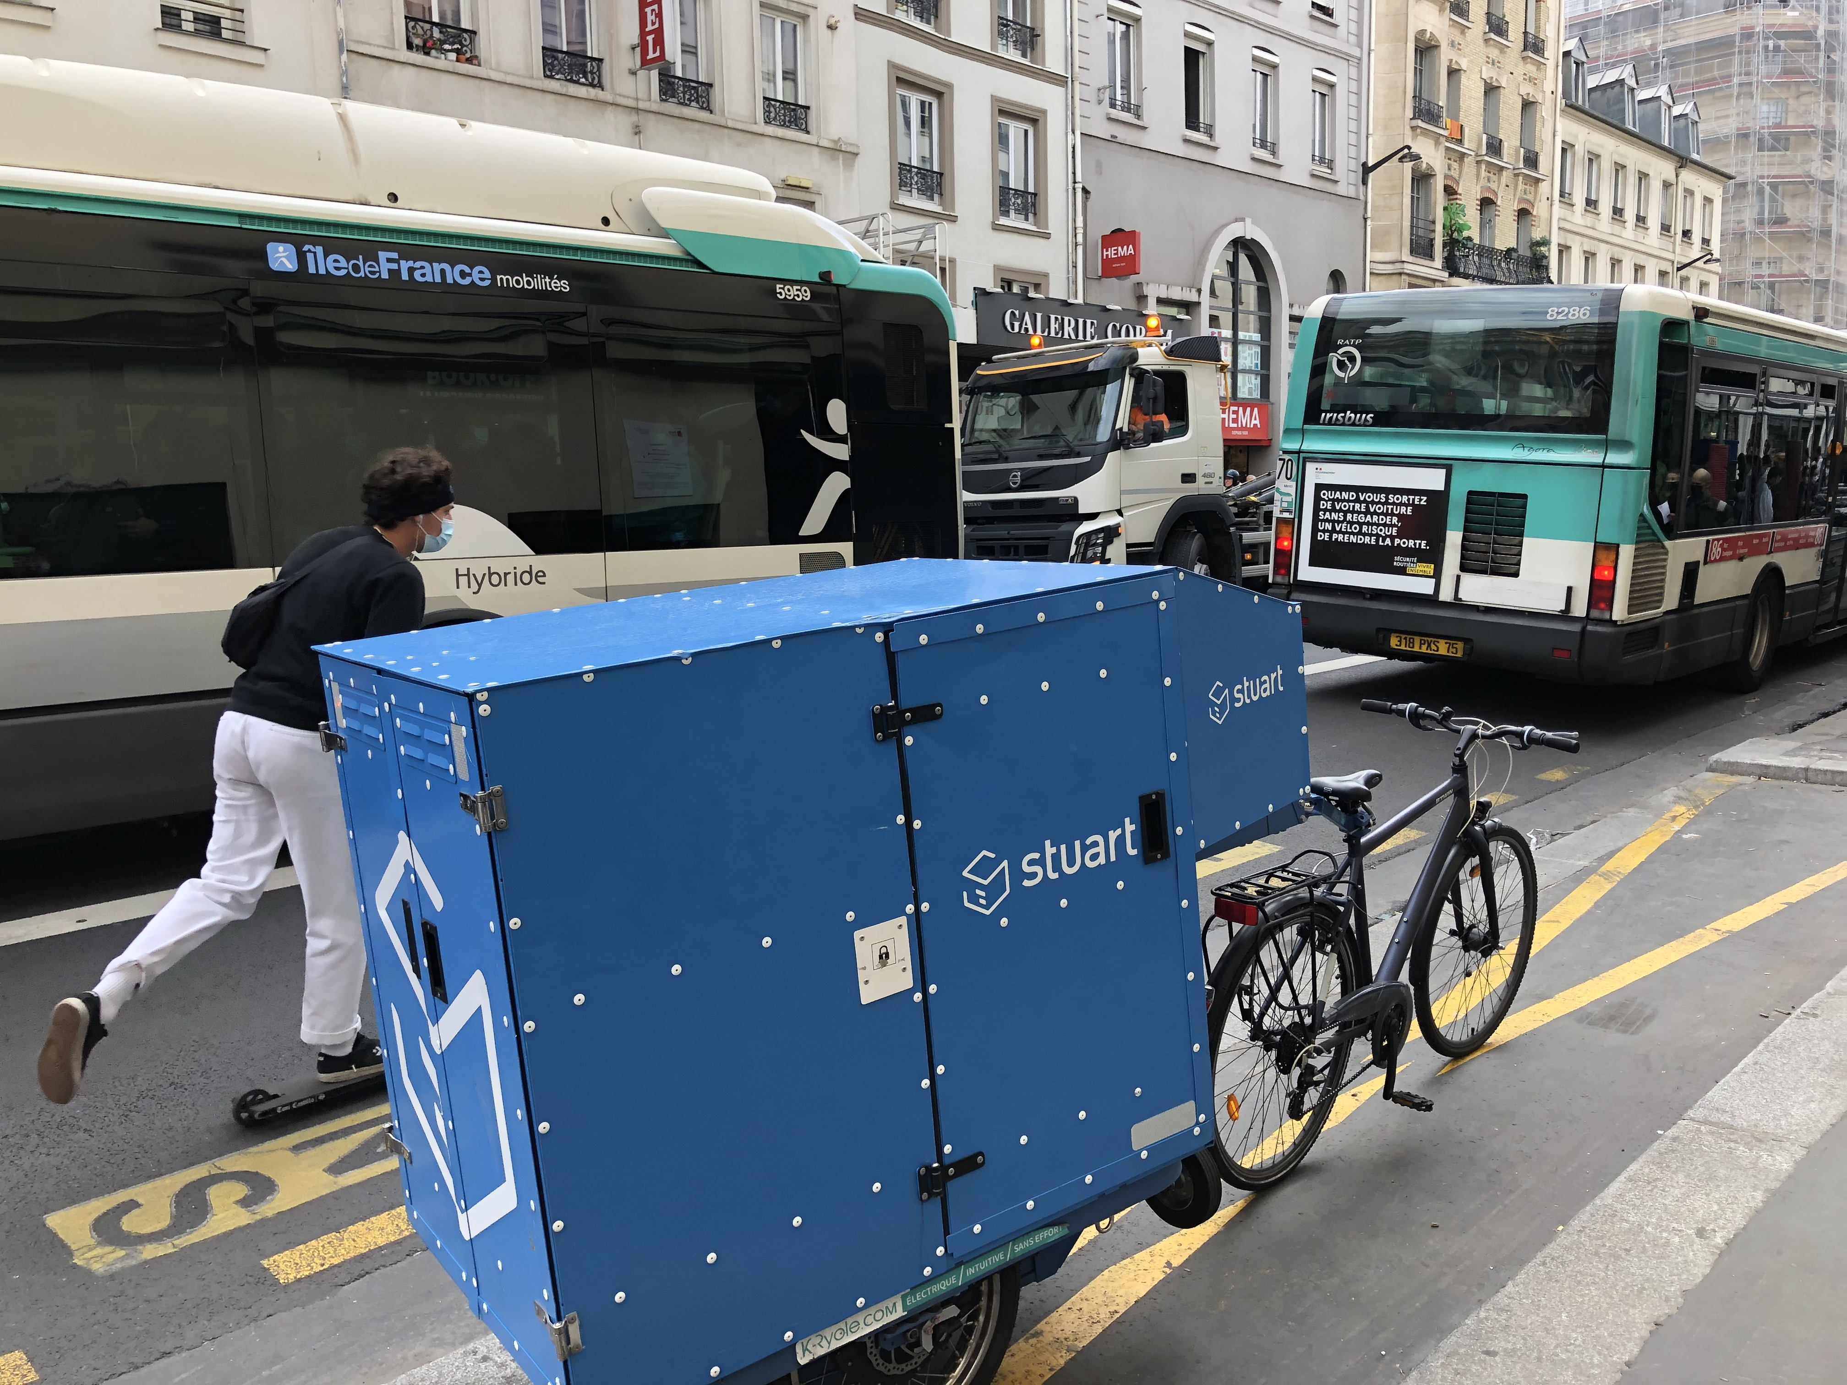

Cyclo-logistics with cargo-cycles: a growing niche
One of the main advantages: access to bike lanes (and ‘corona-lanes’)

Slide 5
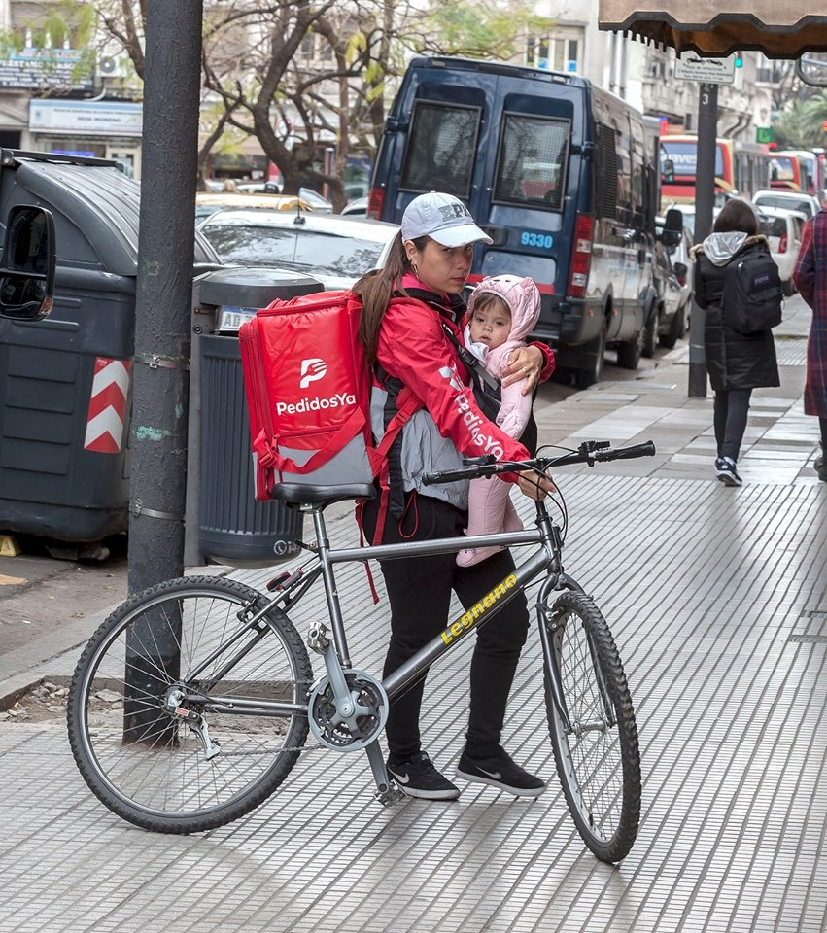
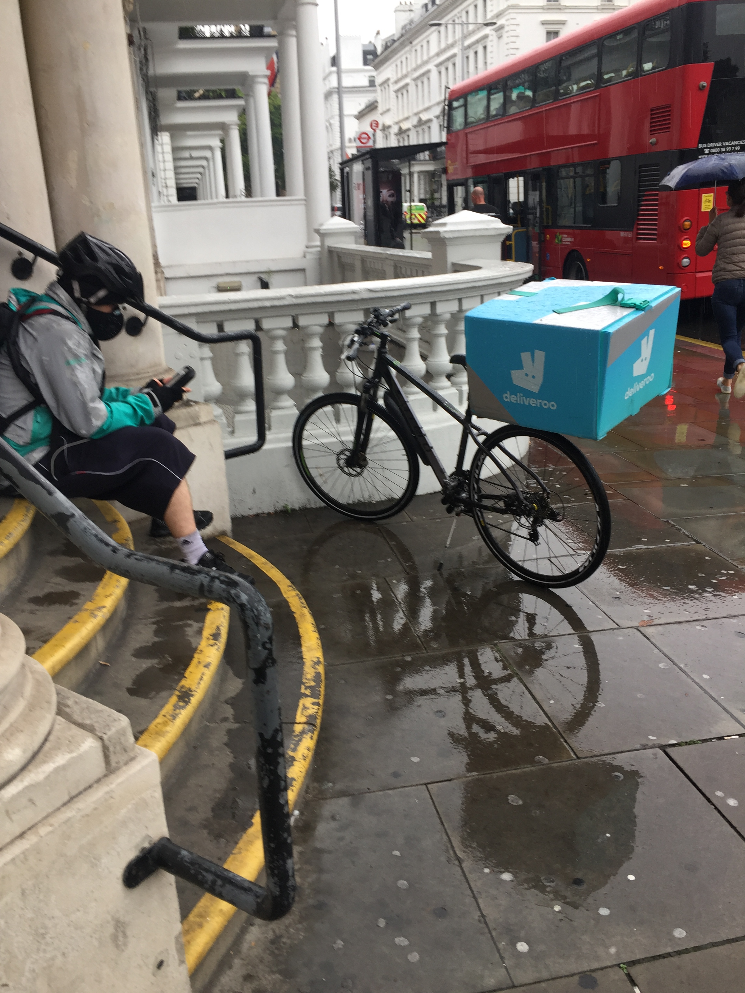
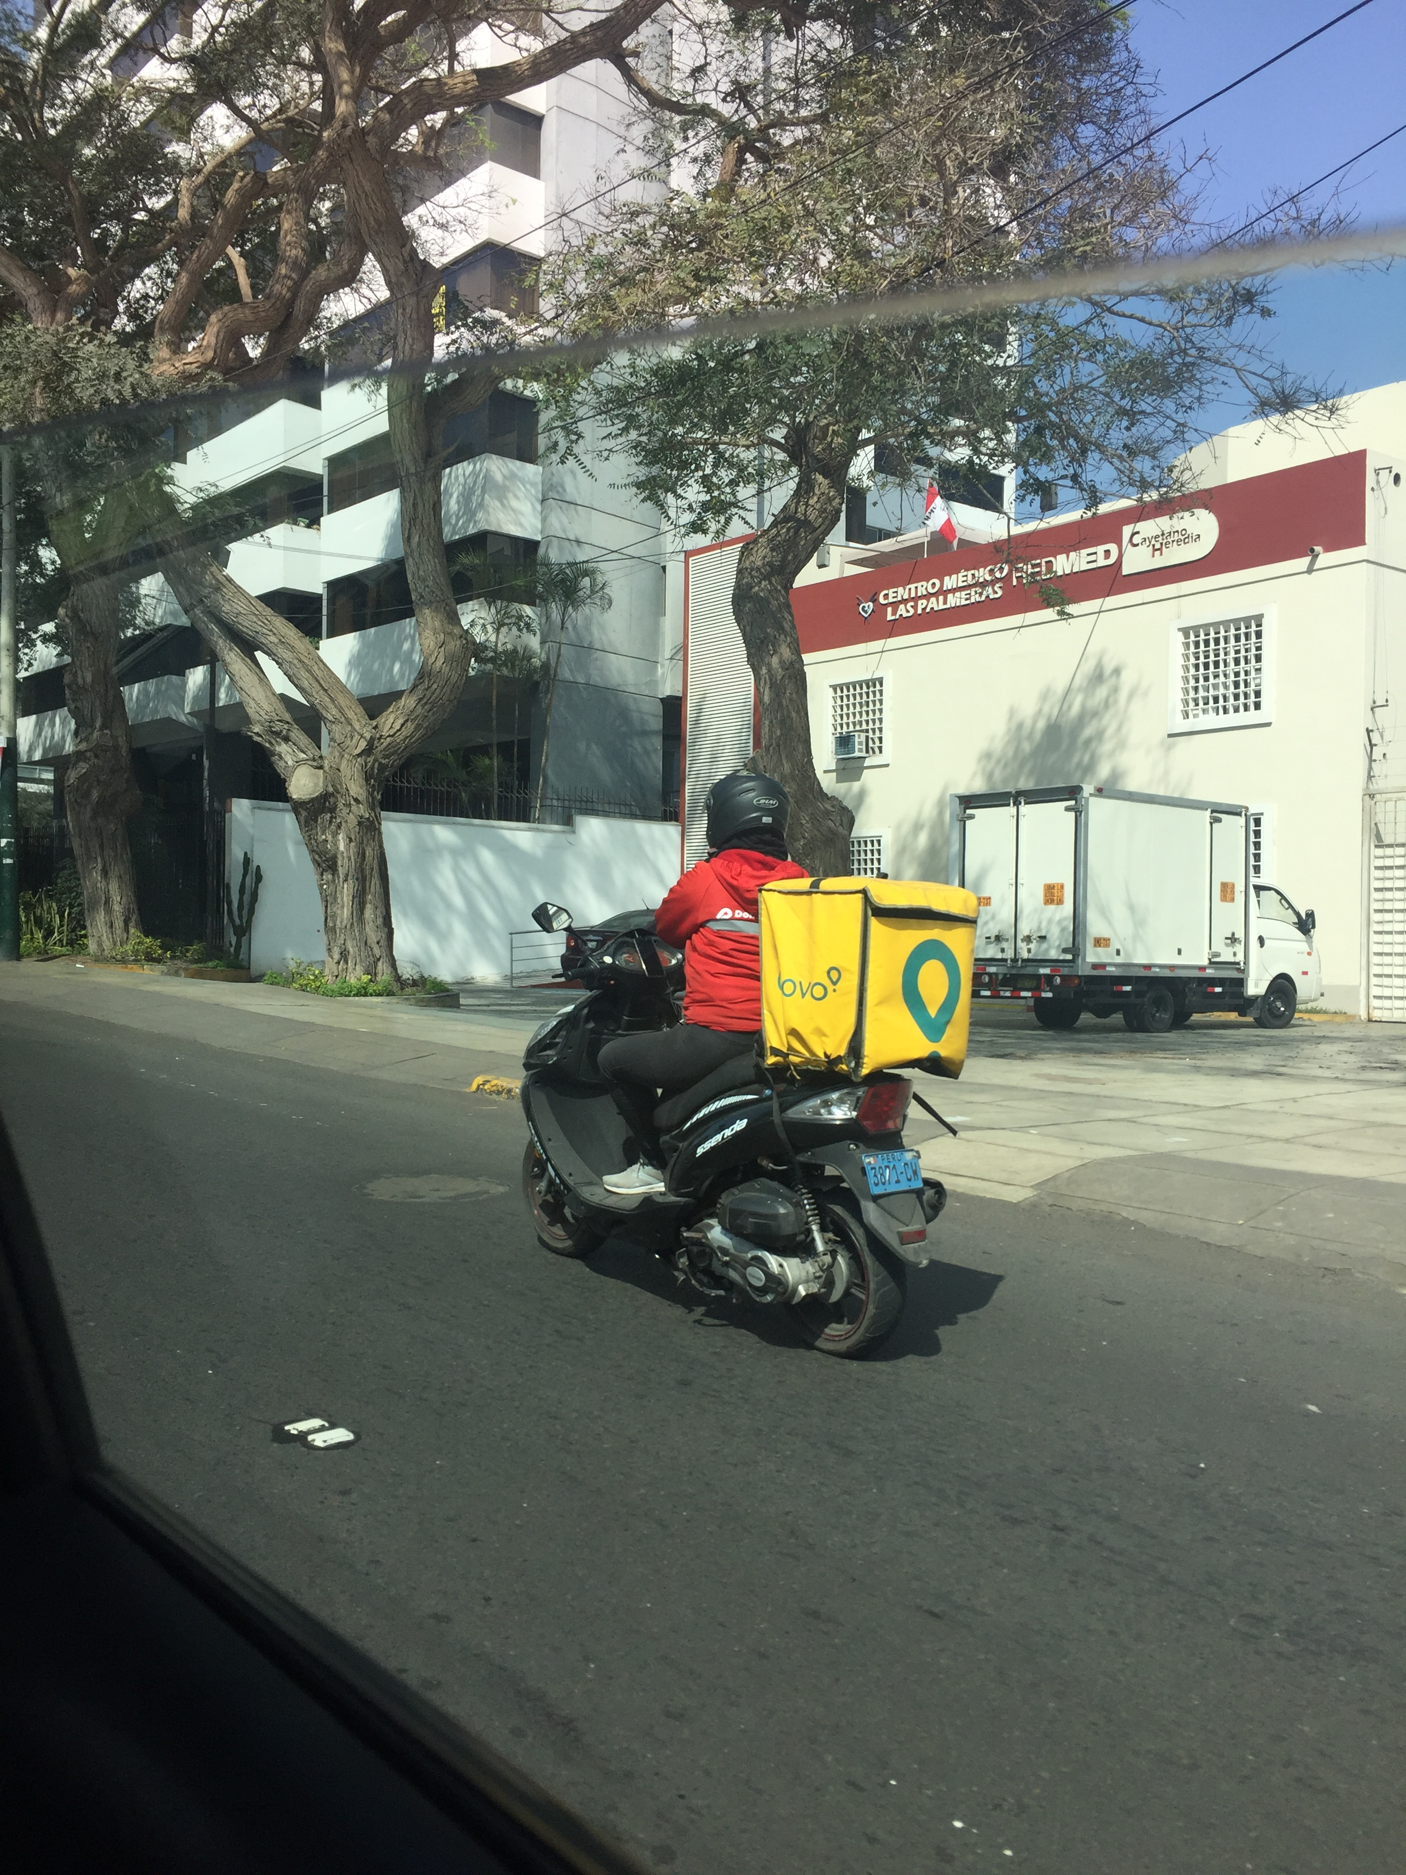
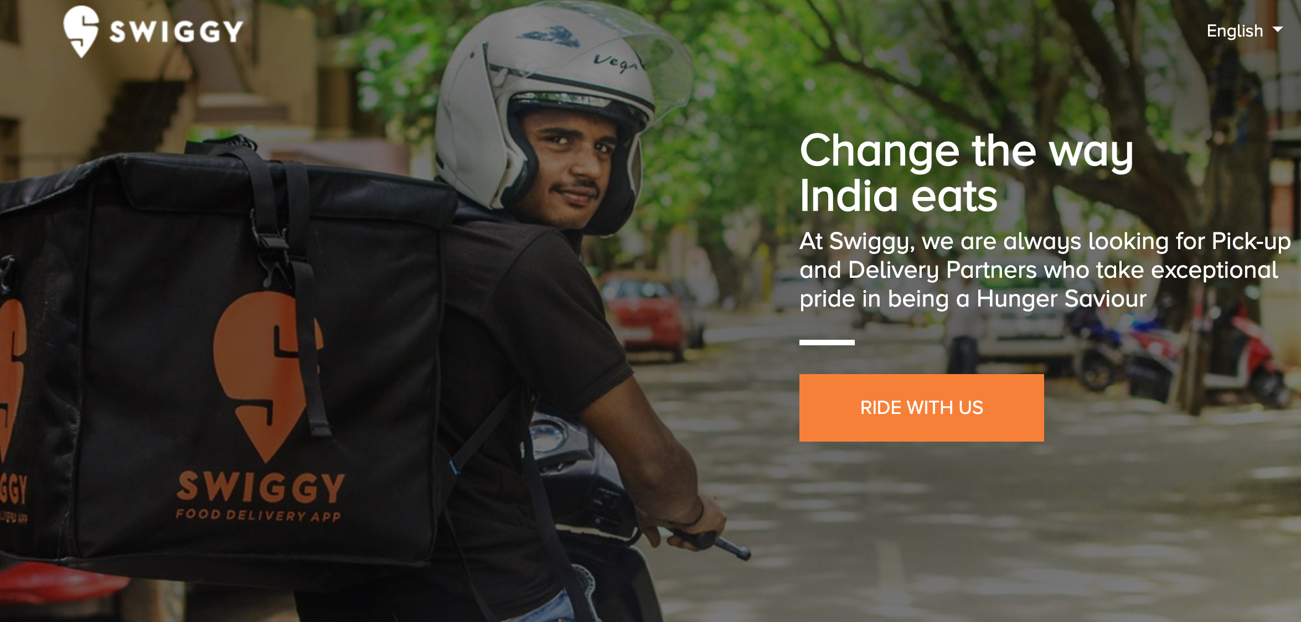
On-demand ‘instant delivery’ services
Deliveries in two hours
Smartphones and digital platforms
Gig workers, self contractors
Buenos Aires
Lima
Mumbay
London

Slide 6

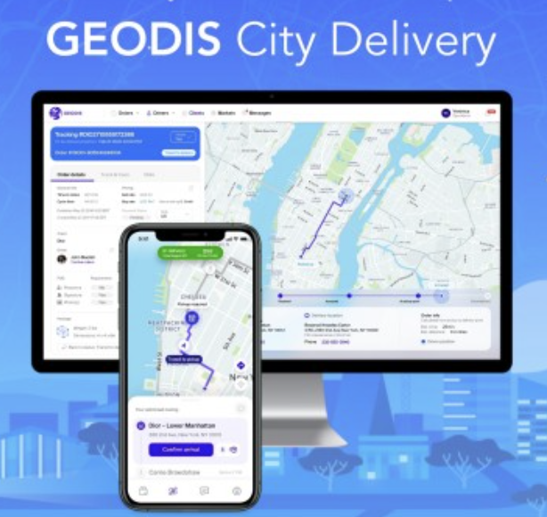
“Pure” crowd sourcing versus regular crowd-sourcing
“Pure” crowd-sourcing: use of private persons’ available transport capacity on the way to work or elsewhere (DHL MyWays, Shopopop, Geodis City Delivery)
‘Regular’ crowd-sourcing: use of private persons who are dedicated to the delivery activity, sometimes as free lance contractors, self-employed couriers

Slide 7


Main instant delivery platforms
World brands: Amazon Prime Now, UberEats
US brands: GrubHub (now JustEat), Postmates (now UberEats), Instacart, DoorDash
Chinese brands: Meituan (linked to Tencent), Ele.me (Alibaba)
Latin American brands: Rappi, IFood
European brands: Delivery Hero (Foodora – bought by Takeaway.com in 2018), Deliveroo, Glovo
Many domestic brands, many start-ups in all regions

Slide 8
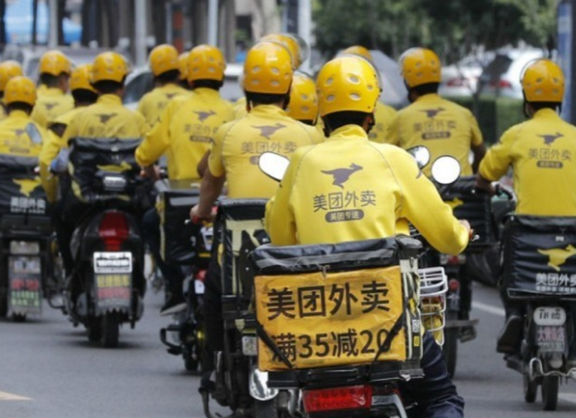
Fun facts from last 12 months
Deliveroo IPO soon on London stock exchange, about £7 bil valuation, some large investors hesitant over workers’ rights and company’s share ownership structure
Meituan valuation: $230 billion
Postmates bought for $2.65 billion in 2020 by Uber
UberEats world gross bookings (2020): +130%
Doordash gross bookings (2020): +198%
Notes:
Doordash became first in the US for on-demand services in 2019. Tipping controversy. Extending to grocery deliveries in 2019 (Mercato stores).

Slide 9

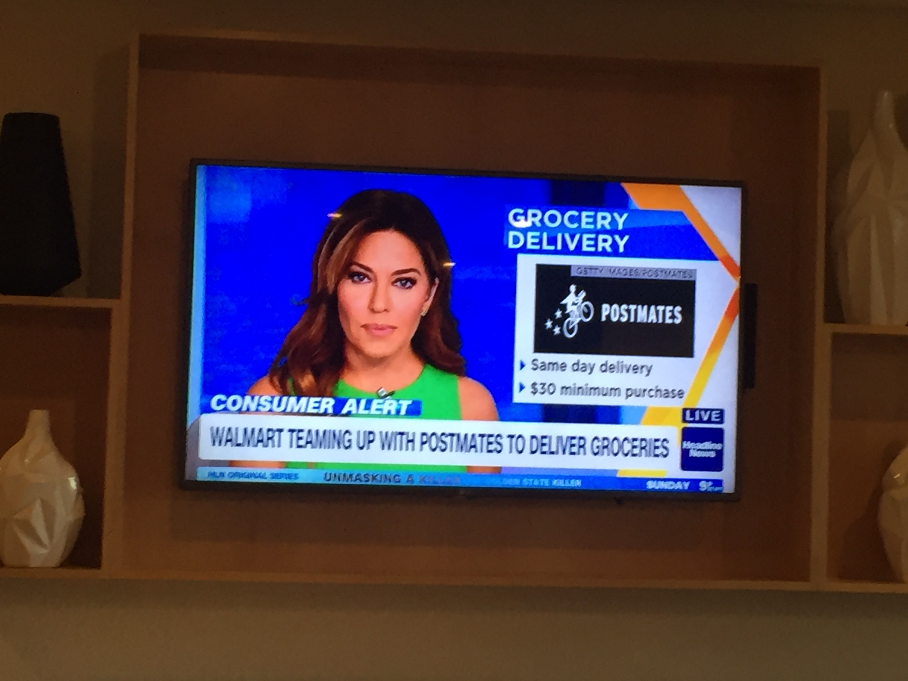
Competition, mergers, partnerships, market sharing
In Europe, Takeaway buys Just Eat In the US, Uber buys Postmates, JustEat Takeways buys Grubhub
In Latin America, Glovo left Chile and Brazil
In Europe, Deliveroo left Germany
Partnerships
  Amazon and Deliveroo
  Walmart and Postmates
  UberEats and Carrefour
  McDonald’s: UberEATS then Doordash
  Alibaba and Ele.me
Notes:
Just Eat by the way owns a little of I Food
Owns a lot of Foodora
Just Eat and Takeaway would represent a market of 360 million orders and $8 bn revenue
800 pence (one penny)

Slide 10
Turns of events on the legal front
Spain, Tribunal Supremo, 25 Sept 2020, a Glovo worker is actually an employee
UK 2021 Uber gives workers’ status to their drivers and delivery partners
California AB5
  2019 State legislation AB5
  Uber and Postmates legal action, proposition 22 successful on Nov 3, 2020
France
  Highest Court, March 4, 2020: Uber (and UberEats) workers are actually employees because of economic dependency to Uber
  400 cases in court at the moment
Notes:
AB5 a des impacts potentiels sur tous les owner operators in the freight industry actually.

Slide 11
‘Alternative’ delivery platforms
Socially and environmentally conscious platforms e.g. Urb-It (London, Paris, Stockholm, Lyon): only by foot, bike or public transport, better pay, 50% women
Alternative social model, cooperatives e.g. Olvo, Applicolis: associated with a cooperative, couriers can become partners by buying social shares
=> Costly niches but growing

Slide 12
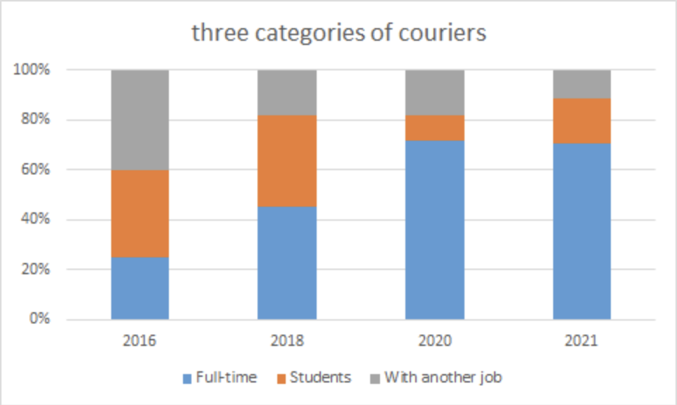
Gig workers’ surveys in Paris (2016, 2018, 2020, 2021)
Methodology of surveys: meetings on the field, random encounters, 500 interviewed
From part time to full time
2021 = impact of covid?
Dablanc et al., 2021
Notes:
Doordash became first in the US for on-demand services in 2019. Tipping controversy. Extending to grocery deliveries in 2019 (Mercato stores).

Slide 13
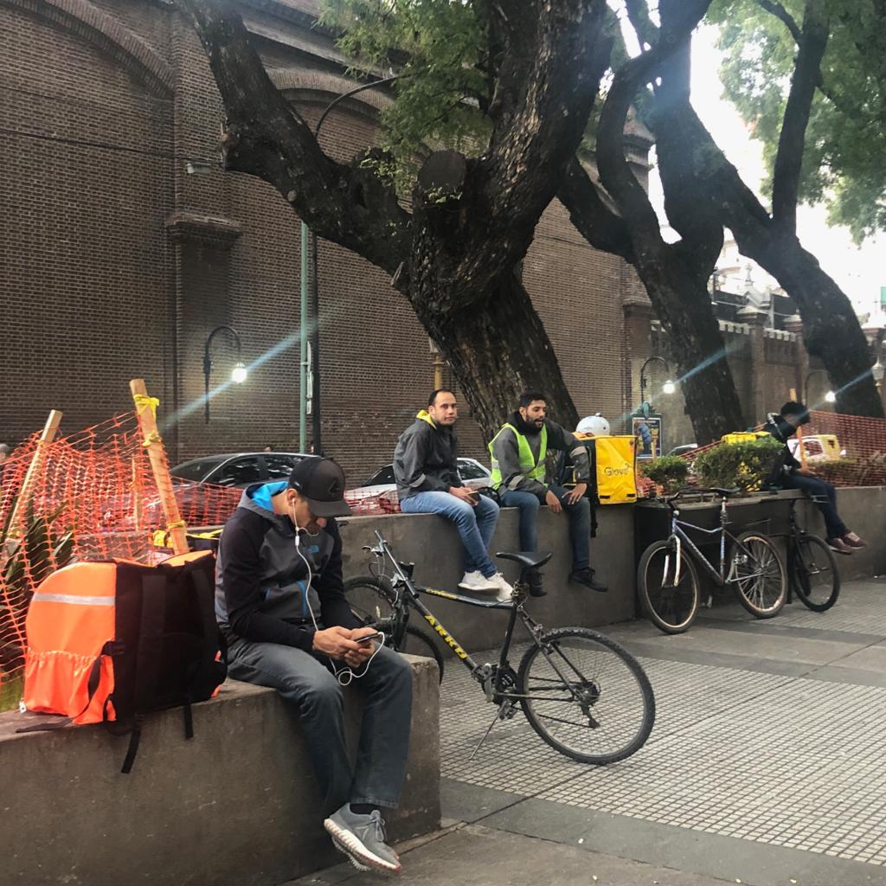
From students to full-timers to migrants
Undocumented migrants in Paris
Venezuelan refugees in Lima
Rural migrants in Chinese cities
Linked to decreasing pay from platforms
Delivery workers waiting for gigs in Lima

Slide 14
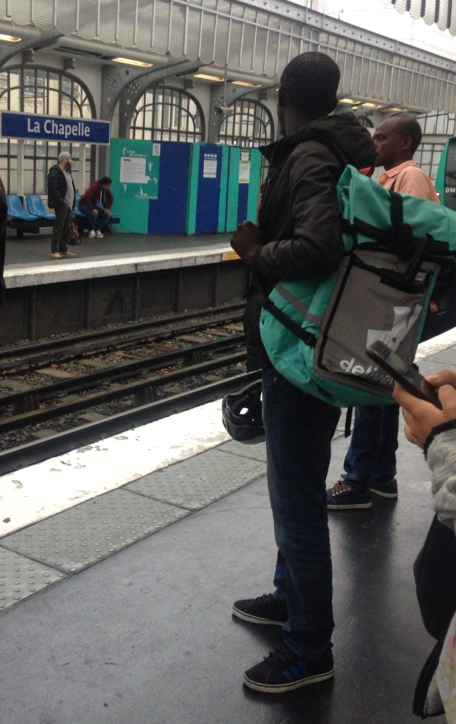
2021 survey
7% are women
10% are French
10% are subcontractors (illegal)
25% have had an accident
29% come to work in public transit, half of whom with bicycles in train
36% use a moped to make deliveries (illegal in France without a professional freight license), 47% use a bicycle (including 15% shared biking), 10% use a scooter
50% see themselves still making deliveries in one year
60% would be interested in being employees (as opposed to free lance)
66% have been on the job less than one year
70% think there is a high road safety risk in the job

Slide 15
For which platform(s) do you work?
Only 11% respondents work for multiple platforms

Slide 16
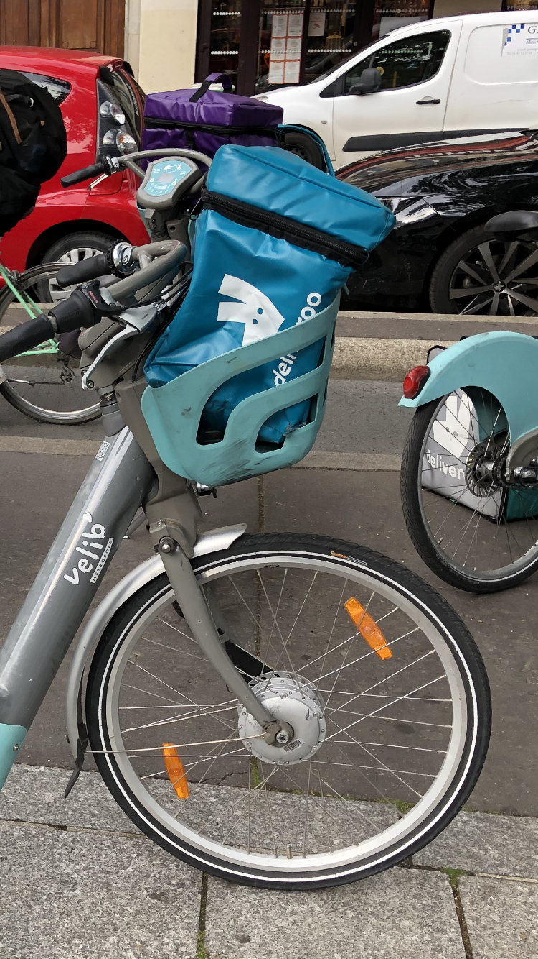

Delivery vehicles
2016
87% bicycle
2018
65% bicycle
2020
60% bicycle
2021
47% bicycle
=> Much higher use of motor vehicles (not allowed)
=> Increase in use of new modes: bike and scooter sharing (not allowed either)

Slide 17
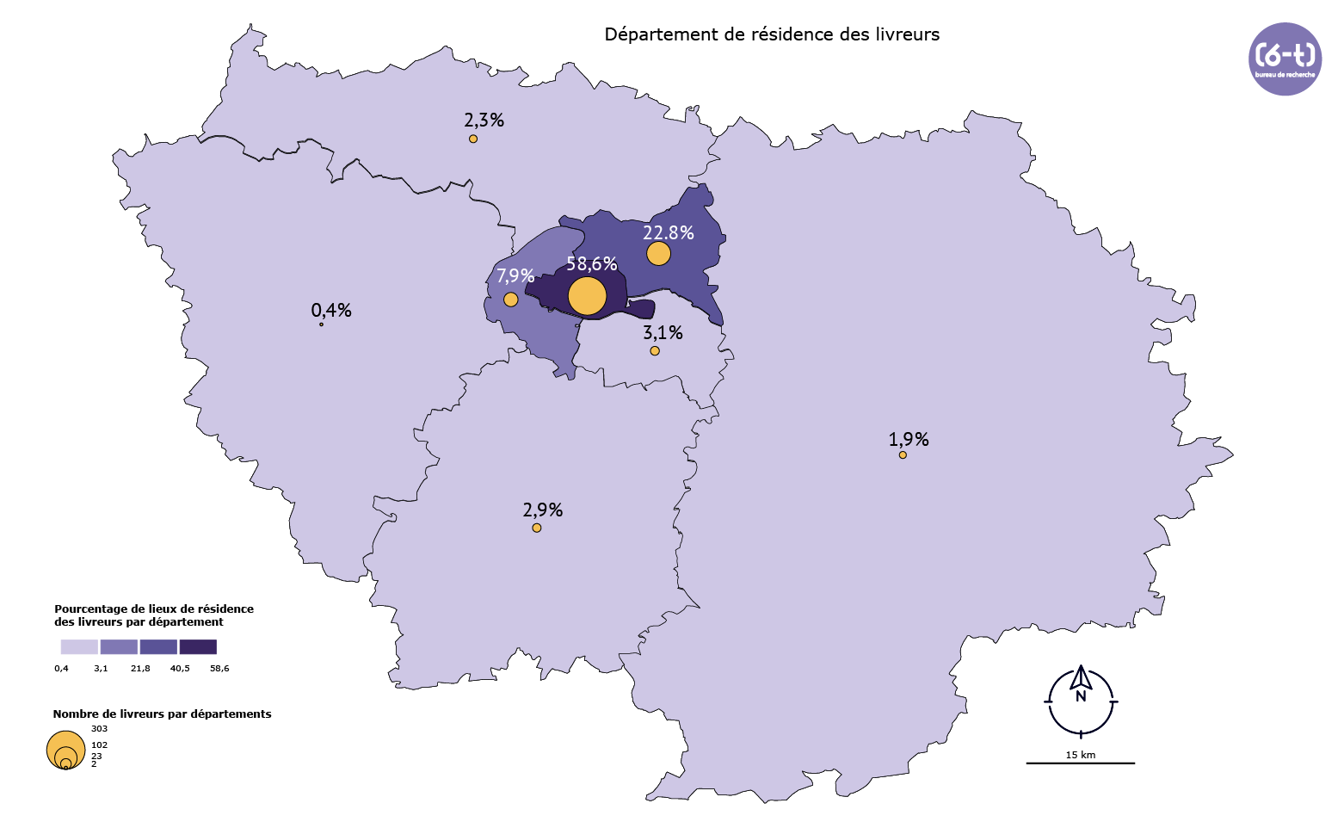
Commuting to the work place (2021)
  62% with vehicle used for deliveries (bike or moped or car)
  16% in public transit, with bike
  13% in public transit
  9% other
N. Saidi

Slide 18
Operational and financial indicators
18 deliveries a day in average and 42 km covered in average
40% work six days a week and 17% work seven days a week
28% work more than eight hours a day
40% are satisfied with their earning, 60% are not
  40% earn less than 1000 euros/month
  40% between 1000 and 1500 euros/month
  12% 1500 to 2000 euros/month
  4% more than 2000 euros/month

Slide 19
Challenges of the job
34% find relationships with clients and restaurants difficult
38% find relationships with platforms difficult
48% find that there are too many gig delivery workers available compared with the number of delivery gigs
70% find that there are high safety risks to their activity and 25% already have had an accident
77% enjoy the independence and working whenever they want
50% imagine themselves still delivery gig workers in one year
35% of respondents were motivated to become delivery worker because of the pandemic

Slide 20
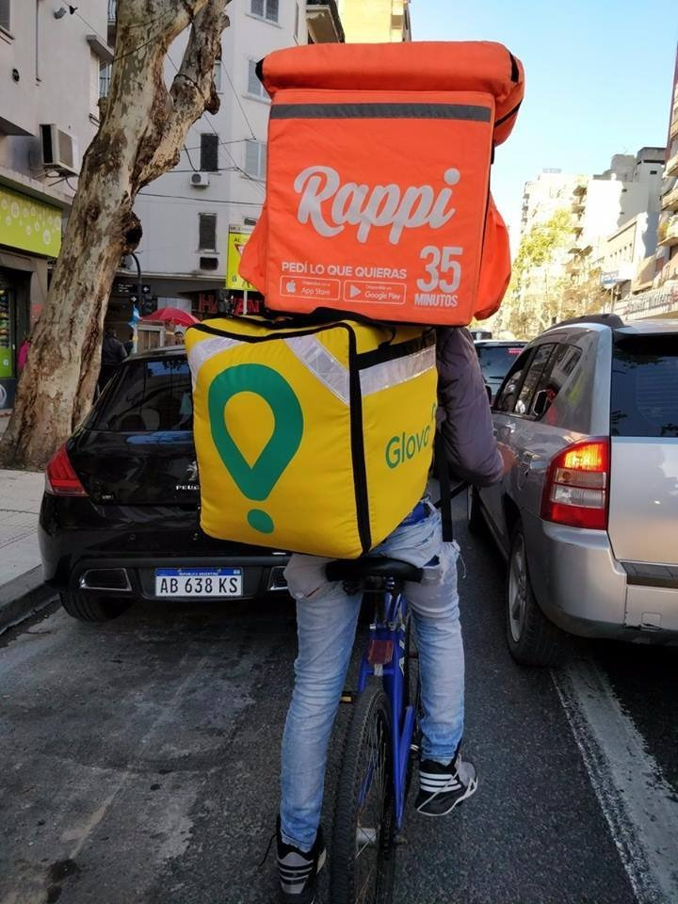
Road safety
A growing concern
Paris major intersection:
  51% passenger cyclists did not stop at red light
  76% delivery cyclists did not stop at red light (Chebance, 2018)

Slide 21
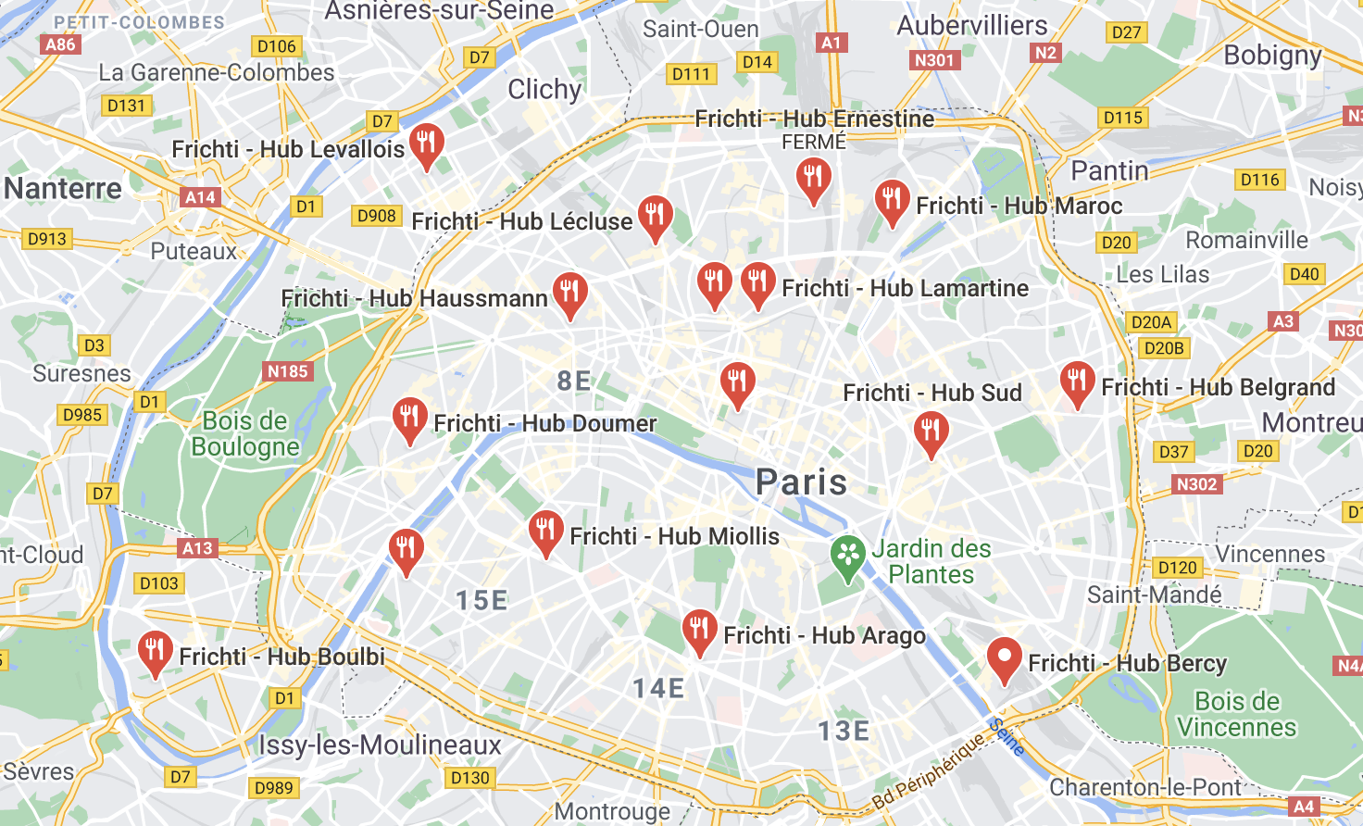
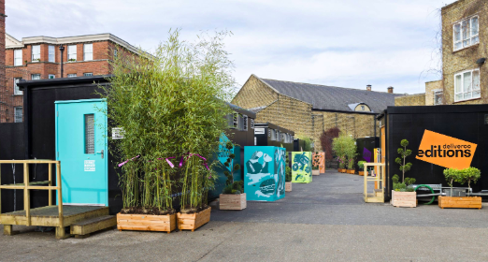
Shared kitchens (‘dark kitchens’) and urban hubs
Meal preparation only, no restaurant
‘Deliveroo Editions’, Keatz, CloudKitchens
Frichti in Paris: kitchens in the suburb and ten ‘hubs’ in Paris for delivery in less than 20 min

Slide 22
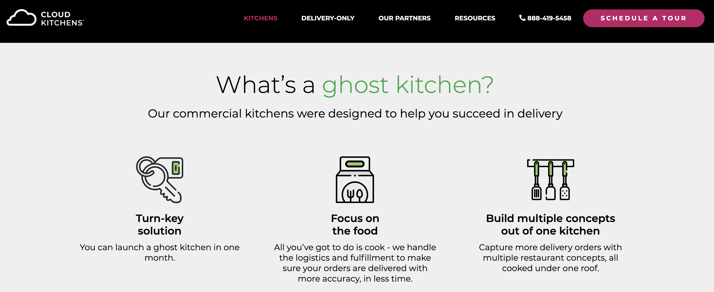

Slide 23
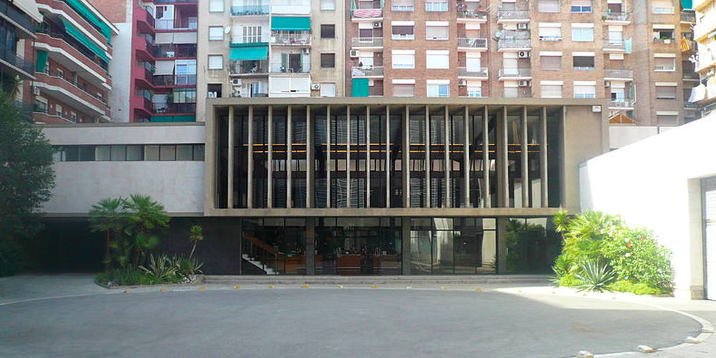
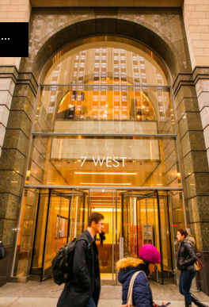
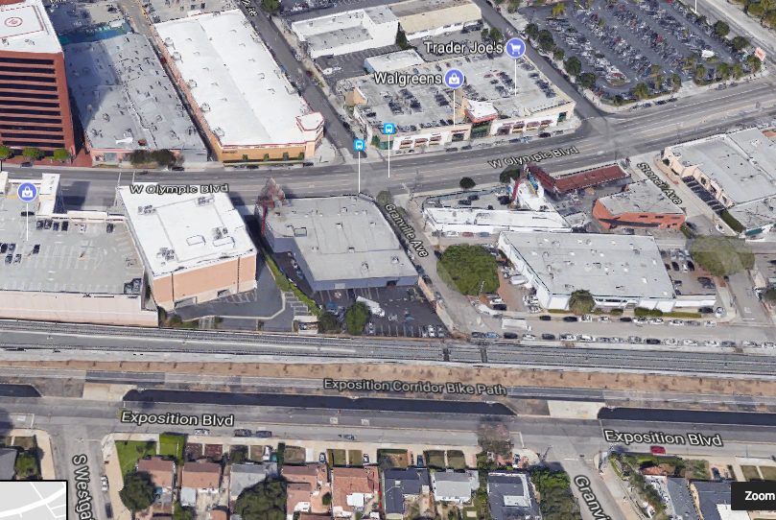
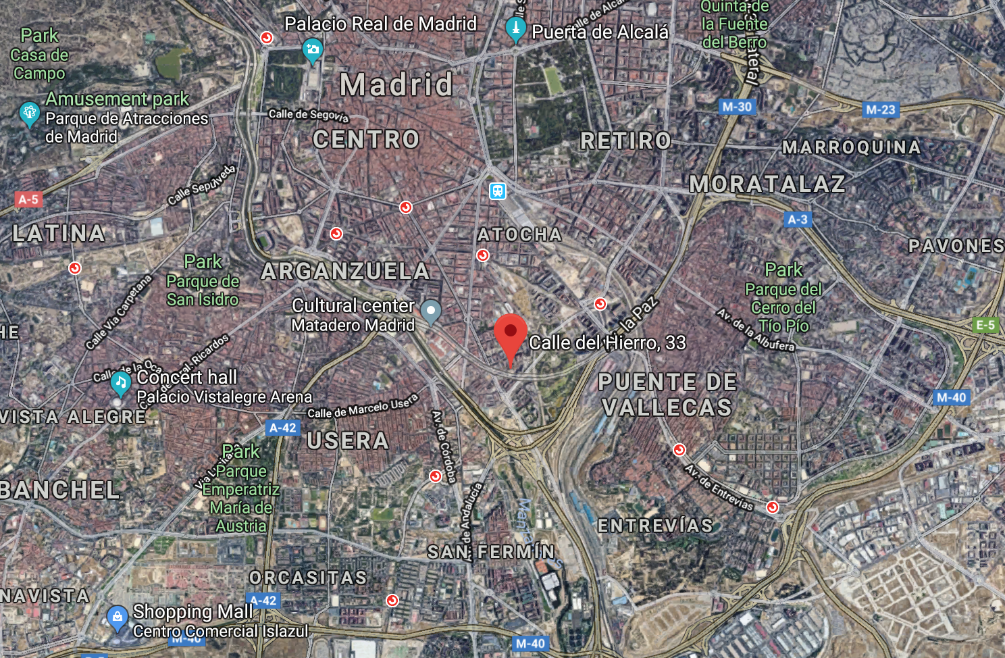
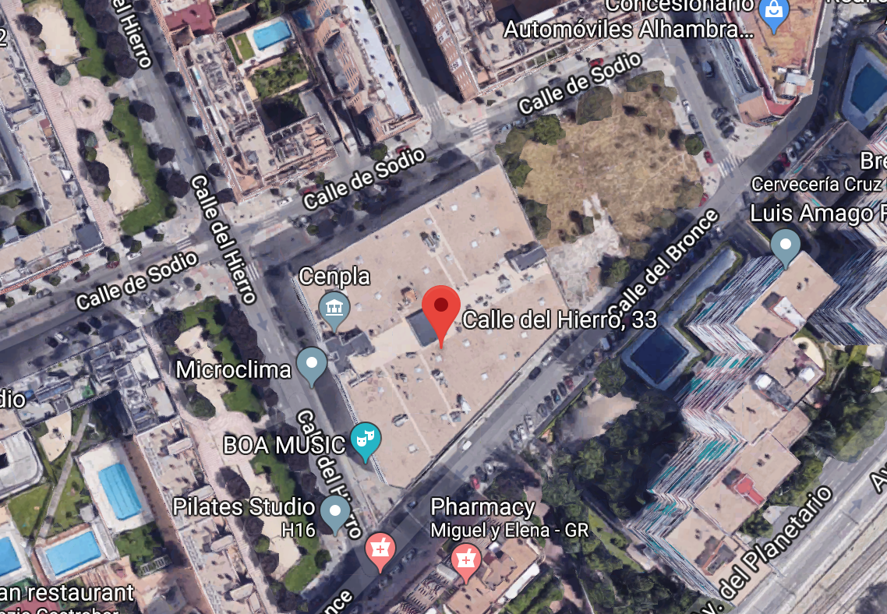
Amazon Prime Now in 100 city centres around the world
⏎
Barcelona
Santa Monica
Manhattan
Paris
Madrid

Slide 24
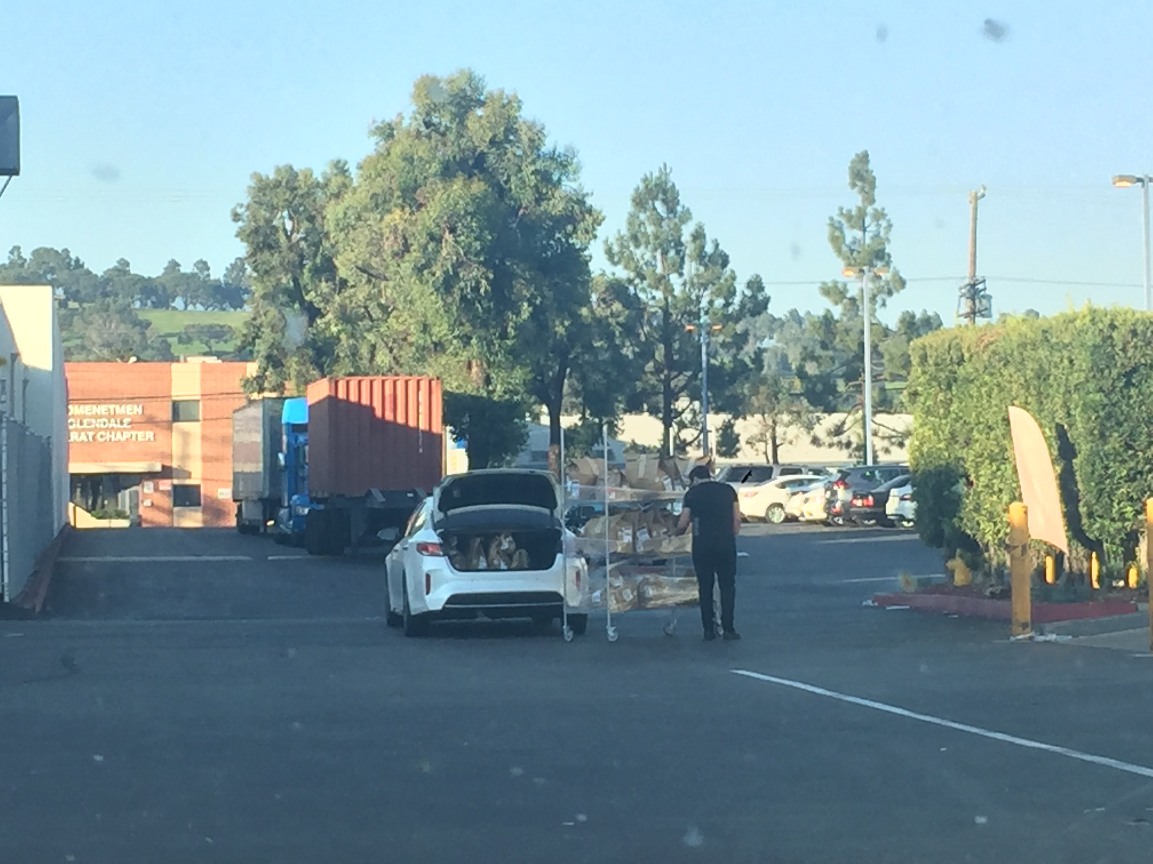
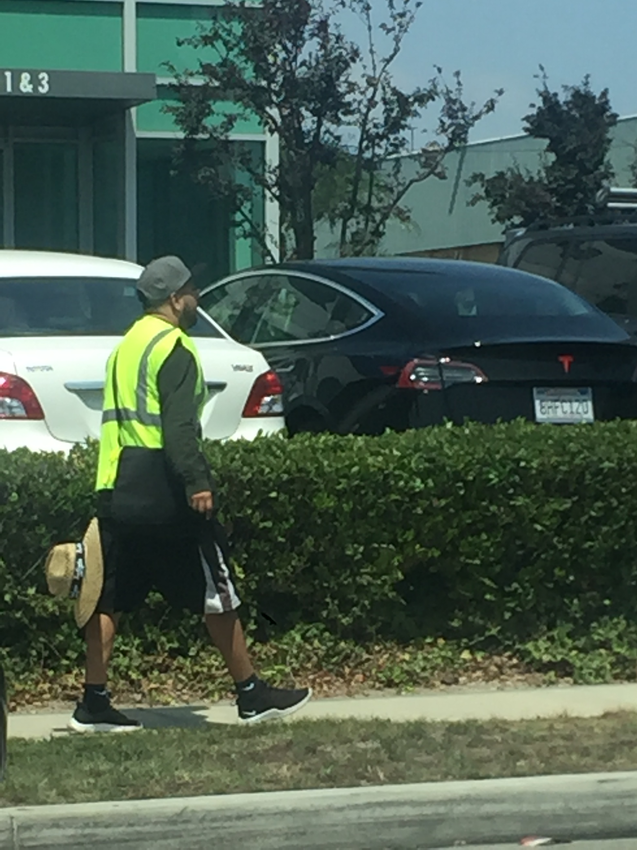
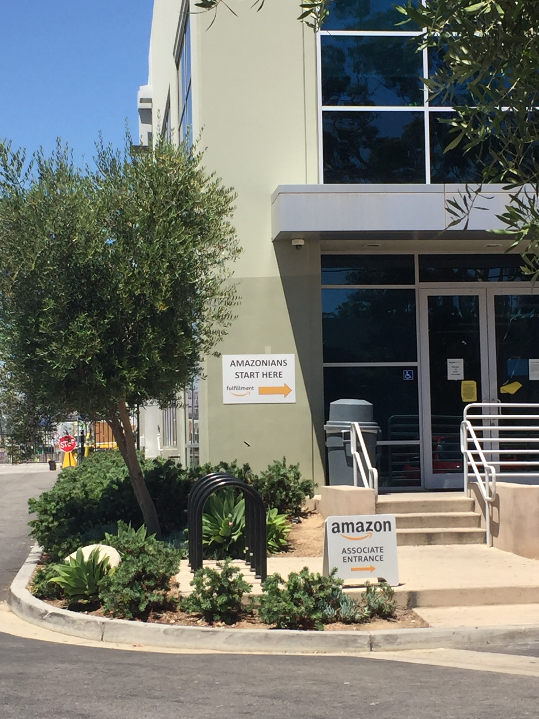
Amazon Flex drivers to Prime Now urban fulfillment centers accross Los Angeles
Median daily number of departures from Amazon hubs in Sacramento (2019, Miguel Jaller UC Davis):
45 lorries
250 delivery vans
800 Flex cars

Slide 25
Conclusion on gig workers and instant deliveries
Huge turnovers of delivery couriers
Business models adapt constantly, partnerships with large shippers, retailers, mergers
Access to investors is key
Emerging issues
  Full-time workforce and legal issues
  Little interest in unions
  Increased illegal work through the use of motorbikes, sharing of licenses and accounts
  But… opportunities for low-skilled jobs in city centers, potential for training, opportunity for use of electric mopeds
  Use of new modes
  More socially responsible platforms

Slide 26


Ressources
T www.metrans.org/metrofreight
CHAIRE LOGISTICS CITY: www.lvmt.fr/en/chaires/logistics-city-sogaris/
METROFREIGHT www.metrans.org/metrofreightw.metrans.org/metrofreight
Dablanc, L., Frémont, A. (Dir) (2015) La métropole logistique, Armand Colin
Heitz, A., Dablanc, L. (2019) Mobilité de la ville durable, les politiques réglementaires de 20 villes françaises passées au crible. Rapport pour la CGI, http://www.cgi-cf.com/images/publications/CGI-RAPPORT-IFSTTAR-2019.pdf
Enquêtes sur les livraisons instantanées à Paris : https://hal.archives-ouvertes.fr/hal-02374915
Browne, M., Behrends, S., Woxenius, J., Giuliano, G., Holguin-Veras, J. Urban logistics. Management, policy and innovation in a rapidly changing environment. Kogan Page, London
Urban Freight Lab: https://depts.washington.edu/sctlctr/urban-freight-lab-0
CITYLAB (2018) Observatory of Strategic Developments impact urban logistics http://www.citylab-project.eu/deliverables/D2_1.pdf
Urban freight platform: https://www.chalmers.se/en/centres/lead/urbanfreightplatform/Pages/default.aspx
World Economic Forum (2020) The future of the last-mile ecosystem

Slide 27
laetitia.dablanc@univ-eiffel.fr

