Slide 1
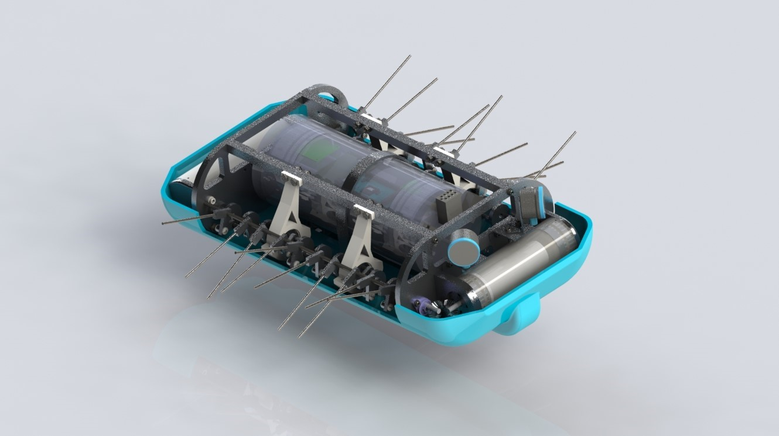


Team 4: Bio-Inspired Autonomous Underwater Vehicle
College of Engineering and Computer Science Department of Ocean and Mechanical Engineering:
Ocean Engineering Systems Design and Control
Final Design Review: 24 April 2020
Remote Recording

Slide 2
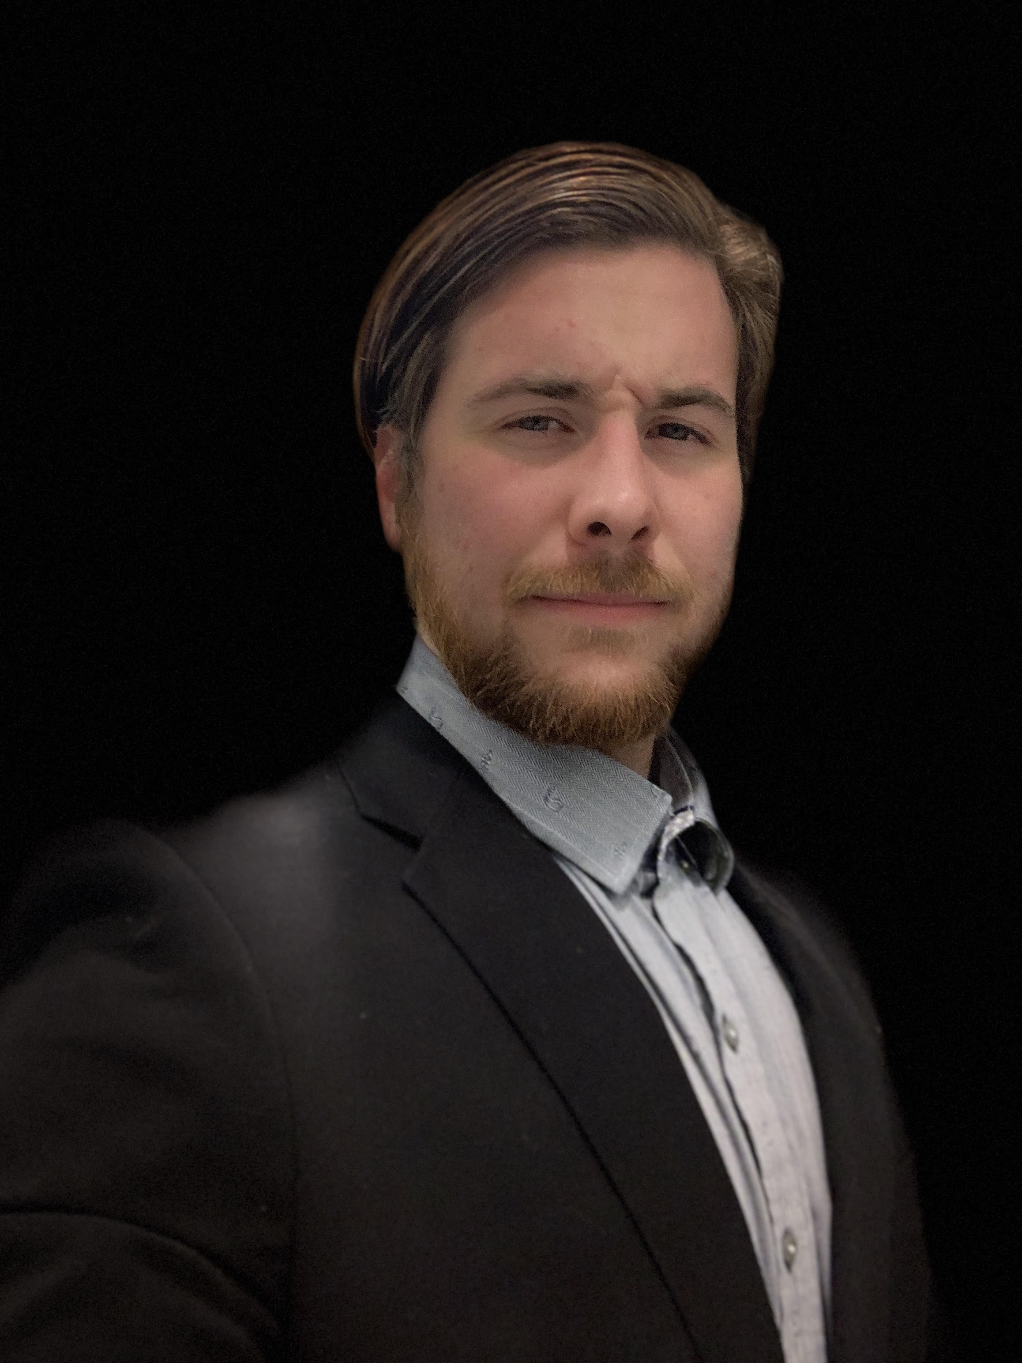
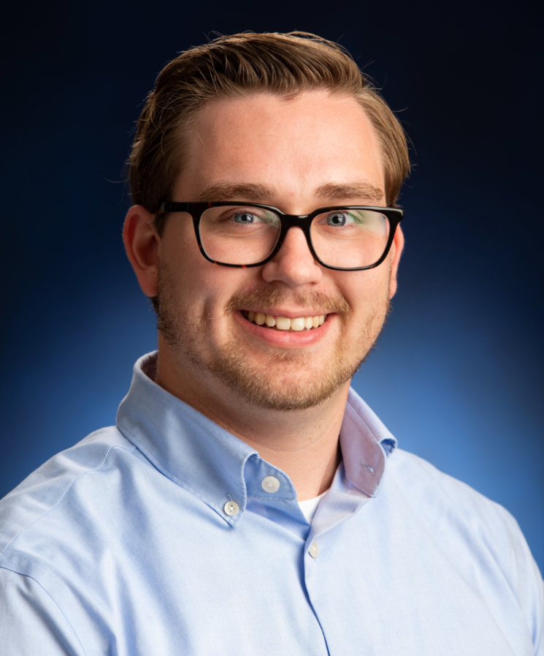
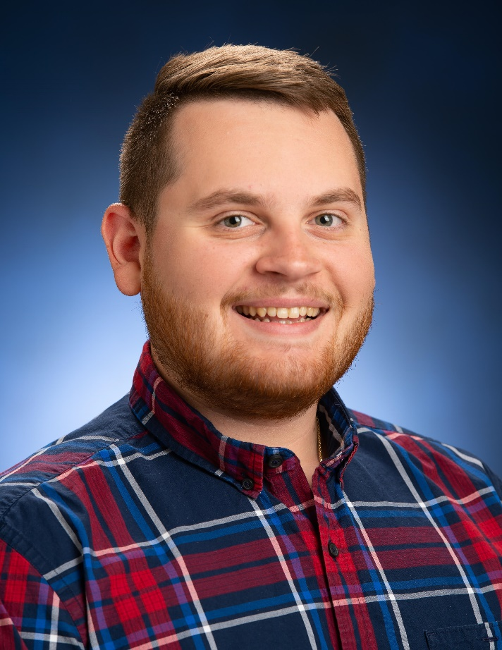
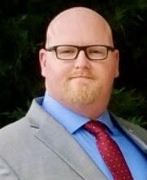
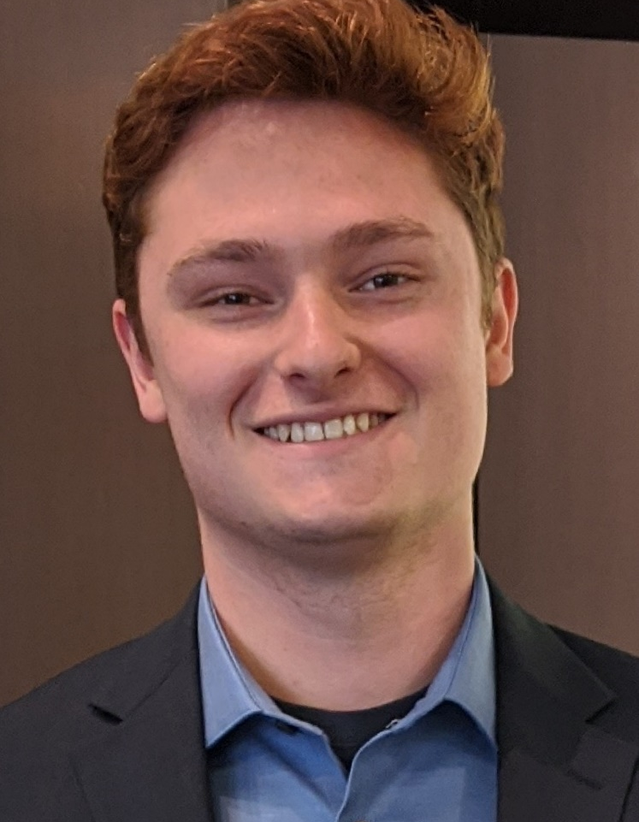
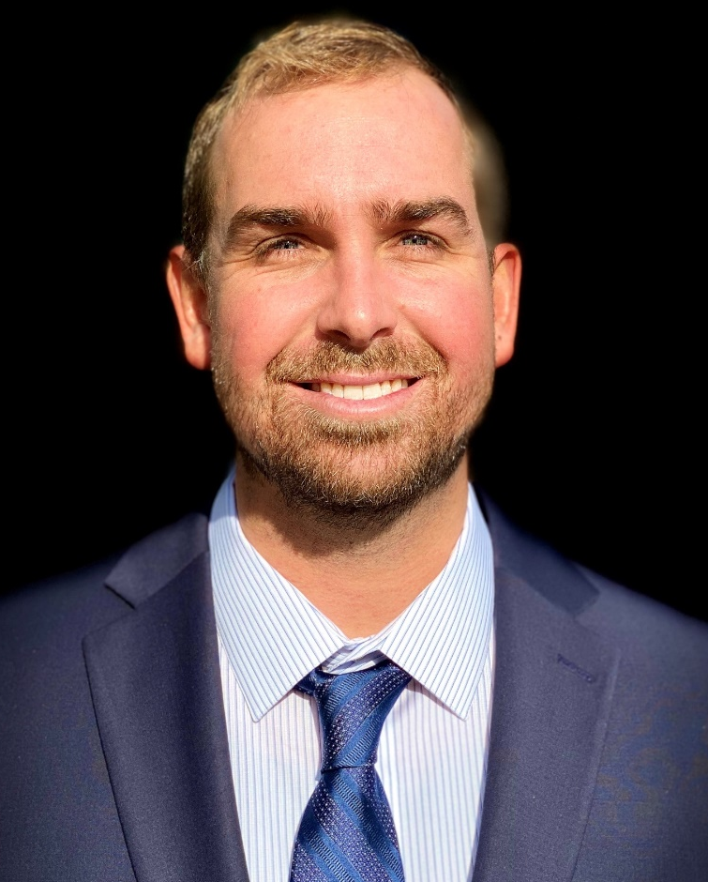
Team Organization
Mechanical
Electrical
Software
David Leon
Machine Shop Coordinator
Jacob Lamoureux
Team Lead
Jesse Schreck
Environmental Health and Safety
Mechanical
Electrical
Software
Steven Roberts
Purchasing/ Budget
William Foster
Electronics Shop Coordinator
Cameron Flynn
Progress Tracking
Notes:
Our team is composed of three different focuses with each team member also being paired with an administrative role. Mechanical: David, Steve, Software: Cameron and Jesse. Electrical Will and Jacob

Slide 3
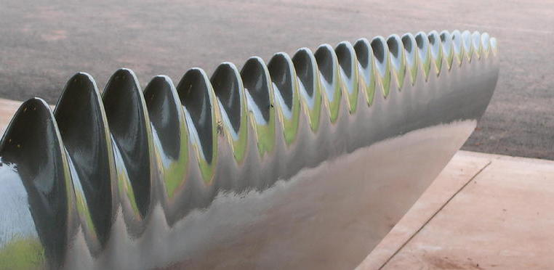
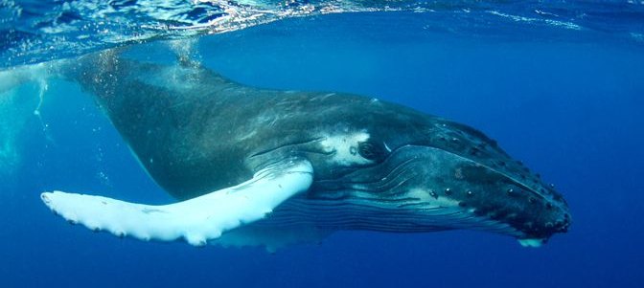
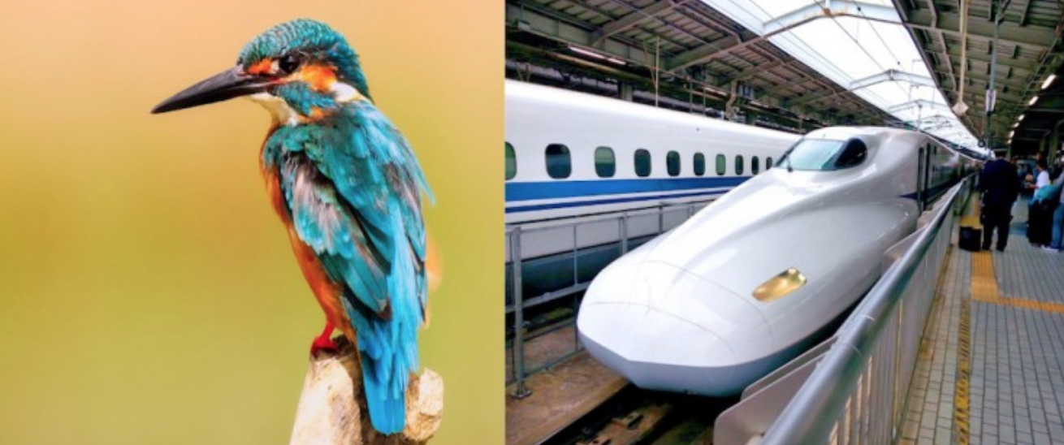
Introduction to Biomimicry
The use of nature to find sustainable solutions through the study of nature's time-tested innovations
Modeling after nature can lead to technological advancements
Notes:
What is biomimicry? Technique of extracting elements from nature to improve technology
Tubercles, small bumps on the leading edge, on whales were found to increase their agility and when used on wind turbines, an increase the efficiency happened.
In the late 90’s Japanese engineers modeled the shape of a bullet train after a kingfisher, which took elements from its large head and long narrow beak.
This resulted in quieter trains and 10% faster train
These are also examples of using engineering to increase efficiency and benefit society

Slide 4
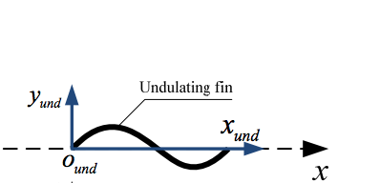
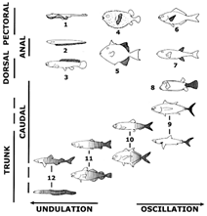
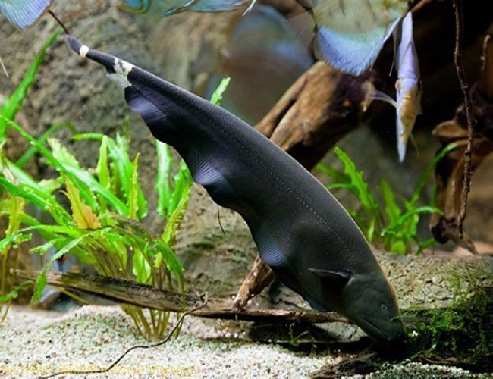
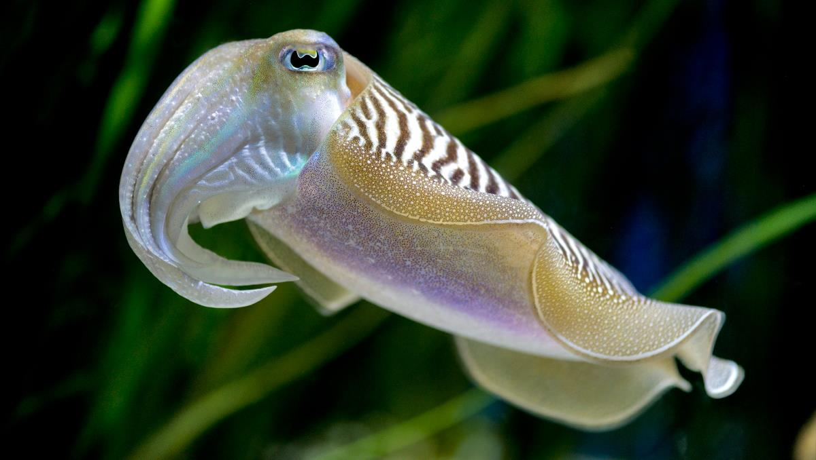
Undulating Fin Explained
Notes:
This project utilizes biomimicry in the form of undulating fins.
Undulation is defined as having more than a single wave present at any time, while oscillation is less than half a wave. An oscillating fin pivots around a single point while an undulating fin produces a wave down the length of the fin.

Slide 5
Project Goals & Objectives
Design, fabricate, and test an autonomous underwater vehicle that utilizes undulation as its primary form of propulsion
The AUV should have basic station keeping and obstacle avoidance capabilities
Learn about the engineering process and follow through with a design
Attempt to fill a gap between typical AUV’s and ROV’s
  Capable of fast speeds in forward and backward direction
  Highly maneuverable
  Could be used for close range inspections

Slide 6
Requirements
Level 1) Vehicle Movement
  The vehicle shall be propelled using an undulating fin.
  The vehicle shall be able to move forward and backwards at a speed of at least ½ the body length per second.
  The vehicle shall be able to operate within 0 - 3 meters of water.
  The vehicle shall be able to maintain depth with an accuracy of ¼ body length.
  The vehicle shall be capable of operating for at least two hours.
Level 2) Obstacle Avoidance
  The vehicle shall be able to detect and avoid collision against a wall.
Level 3) Station Keeping
  The vehicle shall be able to maintain its position in a current between 0 – 20 cm/s.
    The position shall be maintained within a ¼ body length sphere around the center of mass.

Slide 7
Constraints
The vehicle shall be capable of being carried by a single person (< 51lb) as well as being operable while people are in the water as per OSHA guidelines.
The vehicle shall be capable of operating within the wave/towing flume in the hydrodynamics lab at FAU SeaTech.
  Wave tank limiting dimensions: 2.5[ft] x 4[ft] x 60[ft].
The project will be constructed with a budget of $4000 via an NSF grant obtained by Dr. Oscar Curet for use by the design team
Design, construction, and testing of the vehicle shall be completed by May 2020.
The vehicle shall be built at FAU facilities.
Standards: Imperial Units, OSHA, SNAME, ASTM

Slide 8
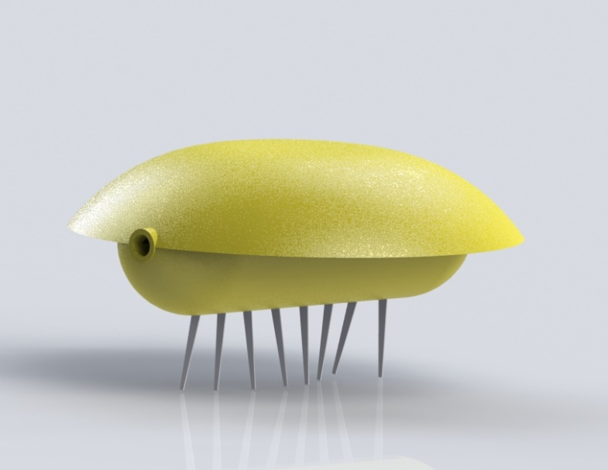
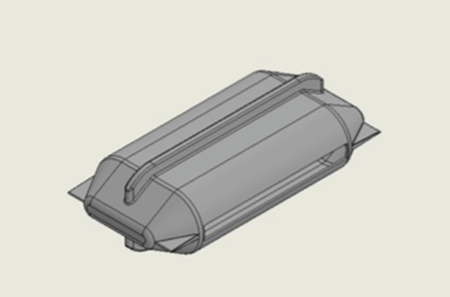
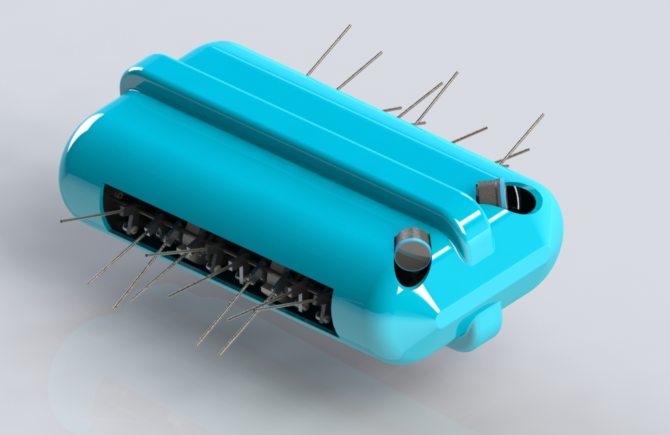
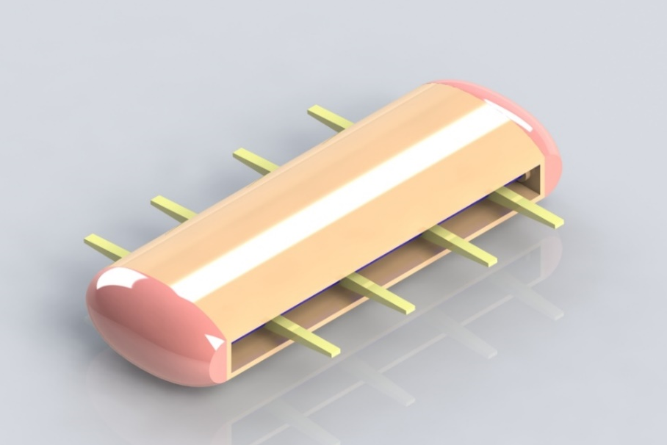
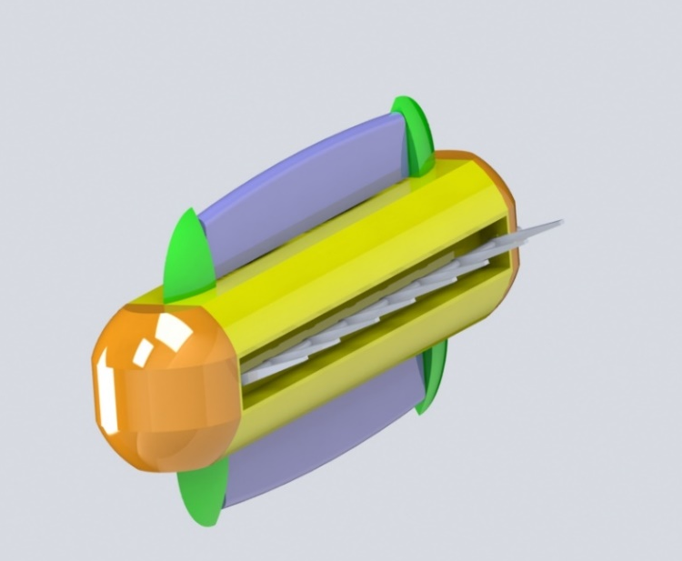
Design Development
Early conceptual designs
Final Design
Preliminary Design
Notes:
The design process carried us though from 3 initial concepts that all used undulation as its forms of propulsion, into the preliminary design of the system and then finally moving into the final design of the AUV

Slide 9
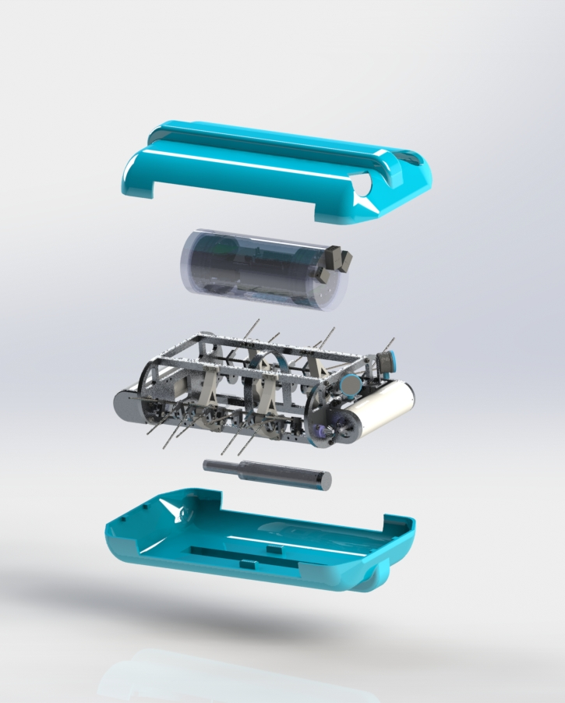
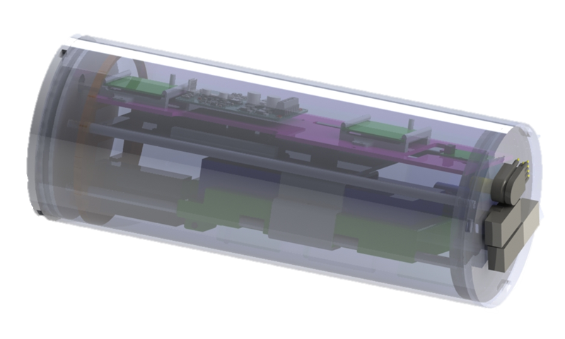
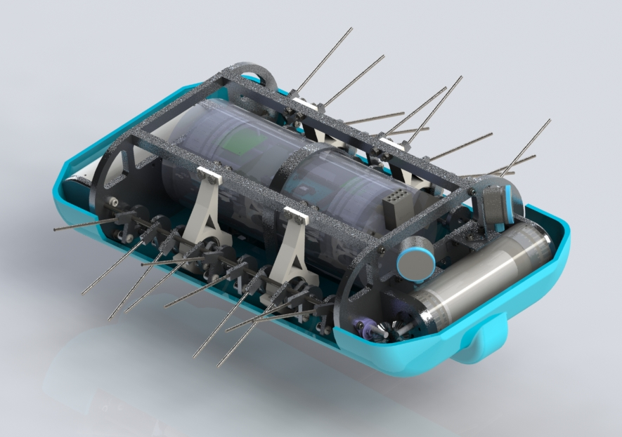
Chosen Design Breakdown
Hull Top
Main Pressure Vessel
SONAR
Frame
Motor Pressure Vessel
Crankshaft
Ballast
Hull Bottom
Notes:
This is the overview of systems within our auv.
Hulls: they were designed to be streamlined and symmetrical to be stable and be able to swim both forward and backwards, it also doesn’t provide any structural support
The main pressure vessel is where we are housing the majority of our components as well as a shifting mass system to control pitch
Sonar: these are mounted on the back of the vehicle and is how we will be able to perform station keeping and obstacle avoidance
Motor pressure vessel: We decided to place both motors into their own separate pressure vessels to individually control each crankshaft independently
The metal frame is what everything attaches to. This is essentially acting as the skeleton of the vehicle.
On the sides are two crankshafts which can be operated independently and are what provide the propulsion using undulation
And The ballast system is used to control the heave motopn

Slide 10
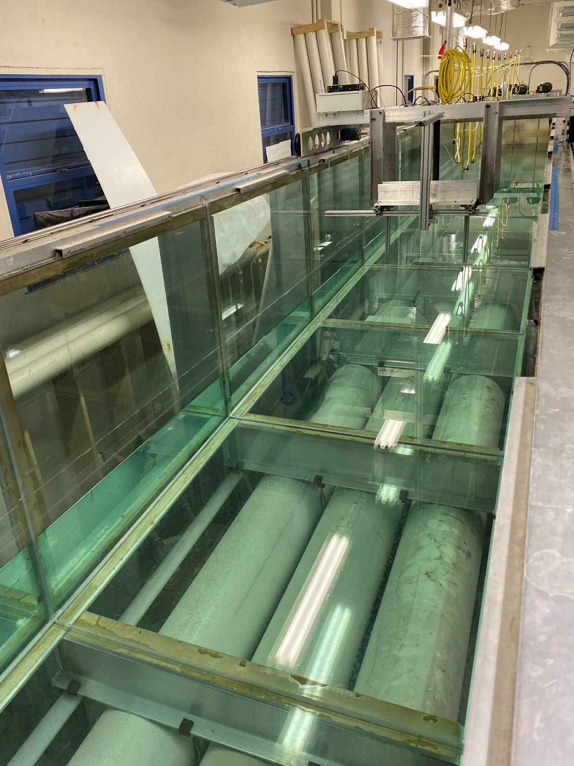
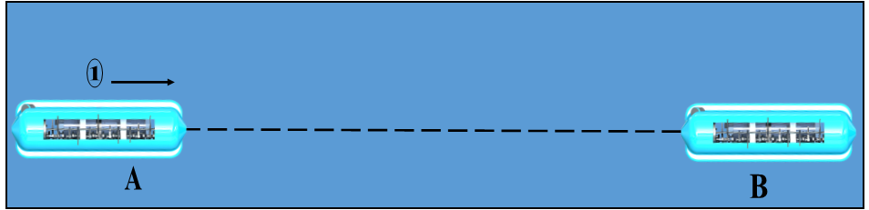
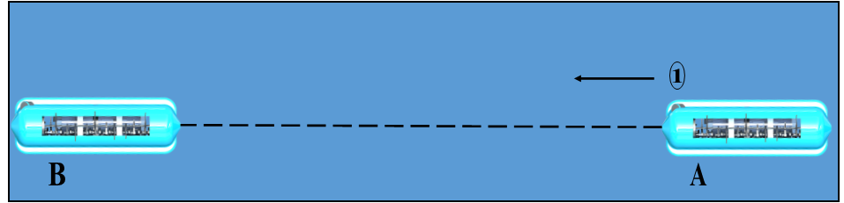
Concept of Operations – Mission 1 & 2
Requirement Level 1: Travel forward and backwards with a speed of ½ body length per second
Mission 1
Mission 2
Location: Wave tank at FAU SeaTech
* Not to scale
Notes:
Missions 1 and 2 were developed in order to assess the vehicles ability to reach its required speed in the forward and backward direction (REQ 1)
Mission 1
The AUV would be placed at roughly its desire operating depth by hand in the SeaTech Wave Tank.
Once the Mission was initiated, the vehicle would orient itself before commencing its trip from position A to position B. (Step 1)
The vehicle speed would then be determined via open loop measurements by the user.
After a predefined amount of time, the mission would end at an arbitrary position B
Mission 2
This would be conducted in the same operational manner as Mission 1
The difference being that position A and B are flipped and the AUV is traveling in the opposite direction from Mission 1

Slide 11
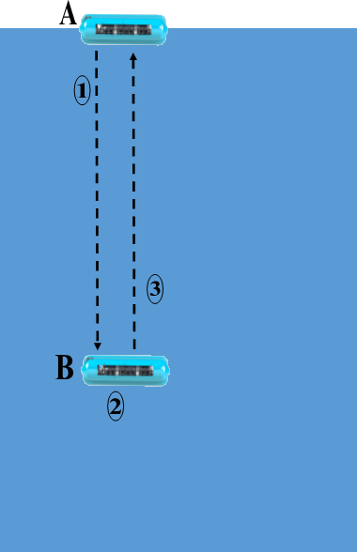
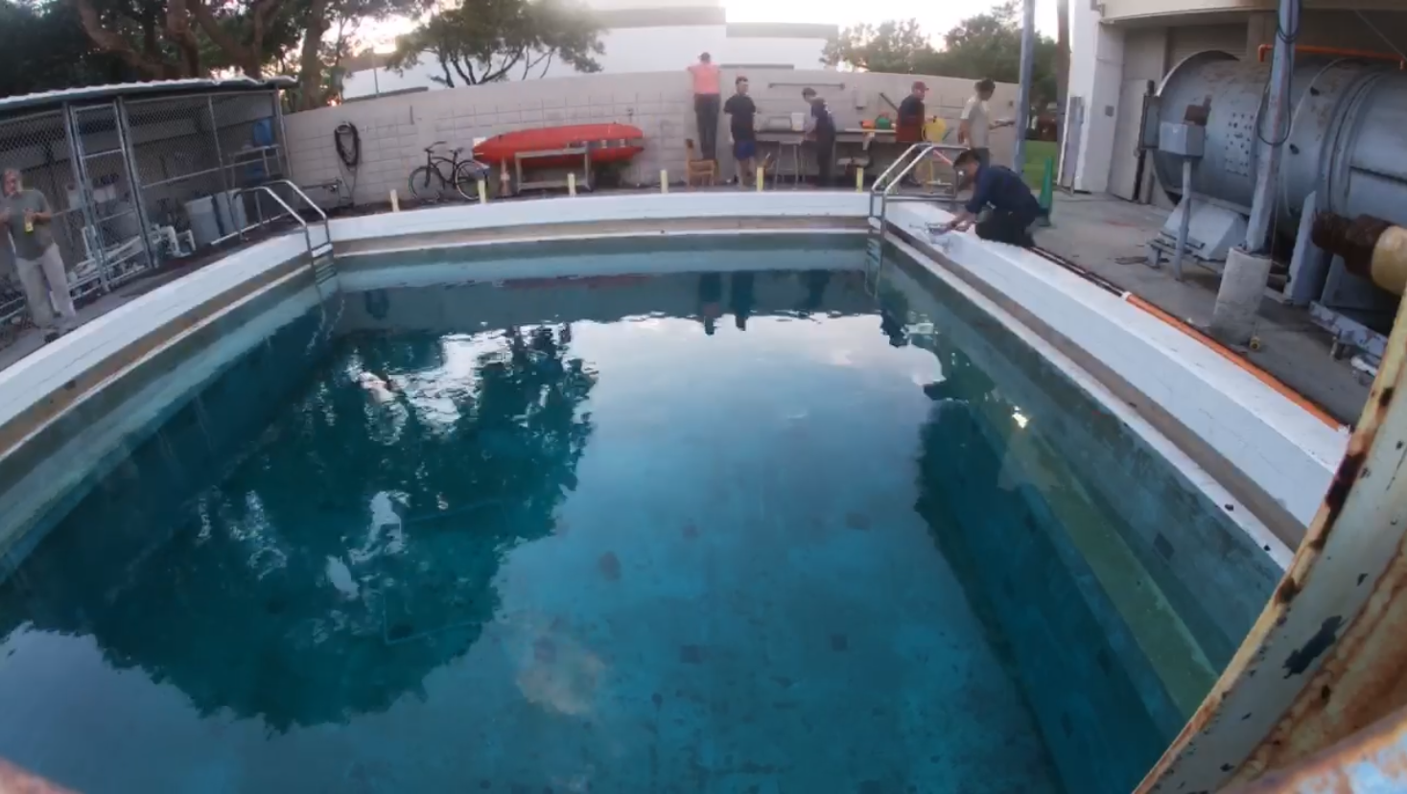
Concept of Operations - Mission 3
Surface -
Requirement Level 1: Must be capable of operating in
0-3 [m] of water
3 [m] -
Location: FAU Boca Engineering West
4 [m] -
Notes:
Still assessing the vehicles ability to meet requirement 1, Mission 2 was developed to test the AUV’s depth capabilities.
The AUV would be placed on the surface of the test pool located at Engineering West on the Boca campus in position A.
The vehicle would descend to a depth of 3m at position B.
For a predefined amount of time, the vehicle was to hold its depth at position B
The vehicle would then ascend back to the surface to position A where the mission would end.

Slide 12
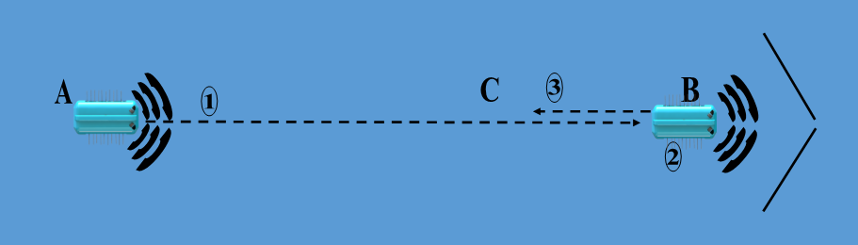
Concept of Operations – Mission 4
Requirement Level 2: Detect and avoid collision against a wall.
Location: FAU SeaTech Wave Tank
Notes:
To meet requirement level 2, Mission 4 was developed to test the AUV’s obstacle detection and avoidance capabilities.
The AUV would initially be placed by hand at its operational depth in the SeaTech Wave Tank
Once the mission was initiated the vehicle would be allowed to orient itself.
The AUV would then begin moving forward from position A while actively scanning for obstacles
Once the obstacle at position B was detected, the movement is stopped in that direction
The AUV then begins moving in the opposite direction before the mission is ended at position C

Slide 13
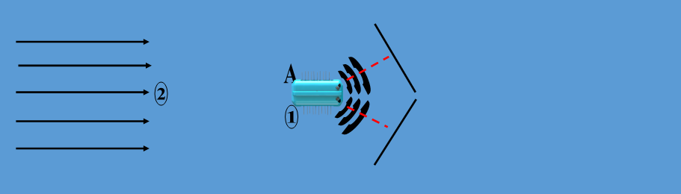
Concept of Operation - Mission 5
Requirement Level 3: Station keeping in a current of 0 to 20 [cm/s]
Location: FAU SeaTech Wave Tank
Notes:
The final mission profile, Mission 5, was developed to test the ability to meet requirement 3 – station keeping in current
The vehicle would be placed in position by hand at the desired depth and distance from the reference targets
Once placed in the water at position A, the AUV would orient itself relative to the reference targets.
After the orientation period, the current at the given velocity would be initiated and the AUV would begin station keeping for the predefined mission time.

Slide 14

Vehicle Design and Construction

Slide 15
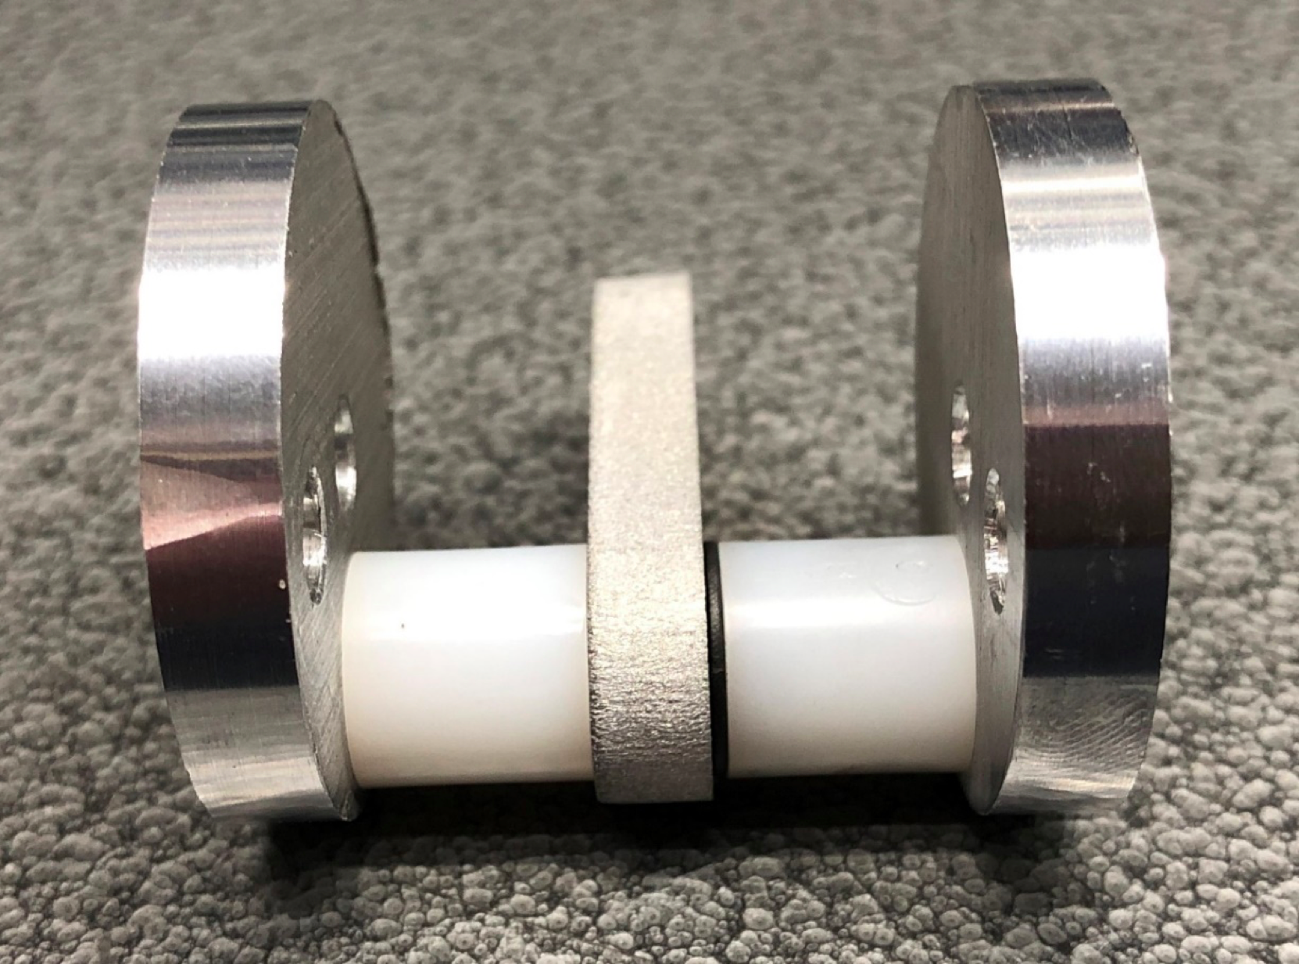
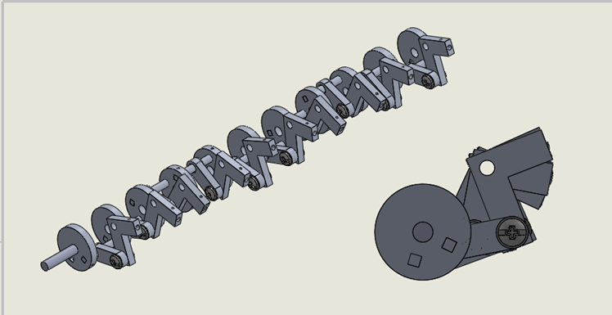
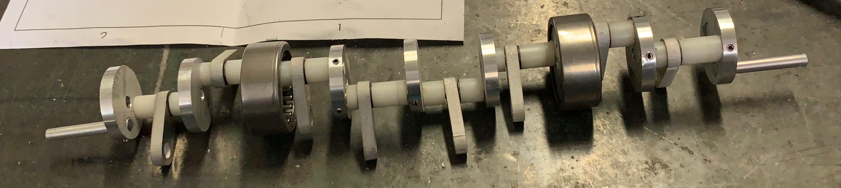
Crankshaft
Parts
  L-links (5000 series aluminum)
  Straight Links (5000 series aluminum)
  Crank Disks (6000 series aluminum)
  Outer/Inner Pegs
  Spacers
  Dry Running Flange Bearings
Materials
  5000 & 6000 series Aluminum
Construction
  Waterjet CNC & Manual Mill
  Hand Assembled
Notes:
-Parts of the crankshaft are composed of The L-links Straight Links, and the Crank Disks.
These components were initially waterjetted from aluminum sheets for the rough shape and holes. Then precisely finished using a lathe and mill
Outer pegs were welded to the out 2 crank disks.
-Cranks disks & Inner pegs were secured together with spring pins.
- To assemble the crankshaft, starting from the inner section, each disk and peg had to be numbered in the correct order, then the ends of the inner
-the order was important for the crankshaft by starting with a disk then spacer, straight link, spacer and then another disk.
-The two discs on the end are the last two to be attached and fastened (along with the corresponding spacers, links, & bearings) because they are the anchors of the crankshaft.

Slide 16

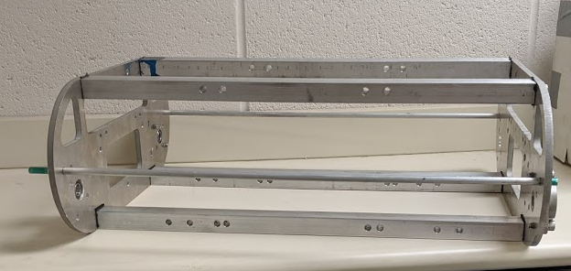
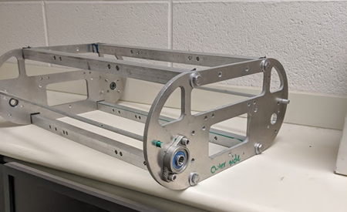
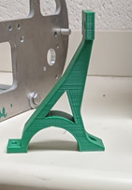
Endo-skeleton
Side Bracket
Parts
  Side Brackets
  Horizontal Beams
  Crankshaft Mounts
  Pressure Vessel Mounts
Materials
  5000 Series Aluminum
  6060 Aluminum
  PLA Plastic
Construction
  Waterjet CNC, Lathe, Manual Mill, & 3D Printer
Horizontal beams
Crankshaft bearing mount
Notes:
The Side Brackets are cut out with the waterjet machine, alongside with the placement of the holes. The holes are drilled to size with the Manual Mill.
The Horizontal Beams are cut to size with the band saw and the side ends are flushed with the manual mill. Then the holes on the beams are measured by hand and drilled with the manual mill.
The Crankshaft bearing Mounts are 3D-printed using the SolidWorks files with PLA Plastic filament.
Assembly
The Side Brackets and Horizontal Beams that make up the Endoskeleton are assembled together with 8, ¼ in Hex Head Screws (4 on each side)
The crankshaft and pressure vessel mounts can be mounted with M5 x 0.8 mm Thread Flange Screws on the side and bottom center of the Endoskeleton.
The flange and the radial bearings are attached to the side brackets.

Slide 17
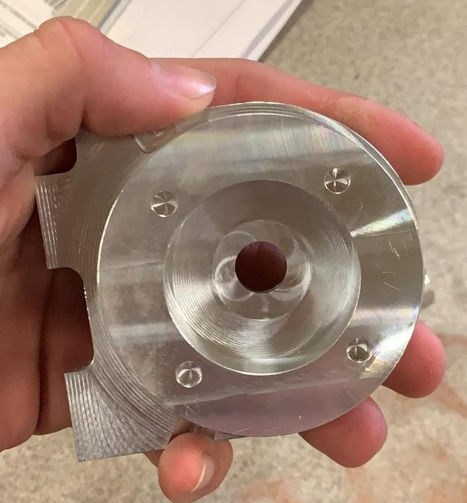
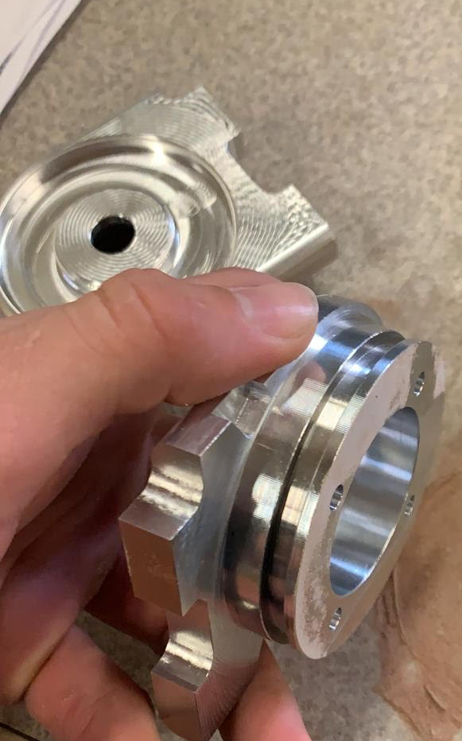
Motor Pressure Vessel
Parts
  End Caps
  Outer Tube
  Internal Motor Mount
Materials
  PVC Plastic
  PLA Plastic
  6060 Aluminum
Construction
  Lathe, CNC Mill< Manual Mill
Notes:
The aluminum end caps were constructed on the CNC Mill from individual 4 in x 4in x 3 in blocks.
Once the end caps were completed, all the screw holes were drilled and tapped with the manual mill.
The Motor Shaft was cut to size with the band saw and the diameter was turned down to size with the Lathe.
. The PVC tube was cut to size using the band saw. Then the inner diameter on the ends of the PVC tube was increased using the Lathe in order to give more clearance for the End Caps and seals.
The holes for the set screws on the PVC tube were drilled with the manual mill.
The motor bracket was cut with the waterjet machine and the holes were drilled with the manual mill.
Assembly
The motor is attached to the motor bracket and fastened with its factory issued screws.
The shaft of the motor is attached to the shaft coupling. The other end of the shaft coupling is attached to the main motor shaft.
The main motor shaft can be slotted through the corresponding end cap and the motor bracket sub assembly can be aligned and fastened to the end cap with M3 screws.
The end cap and the motor assembly can be inserted to the PVC tube alongside with the other end cap housing the connectors ( Fastened with M3 screws).

Slide 18
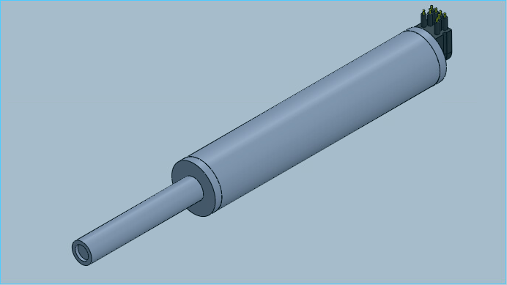
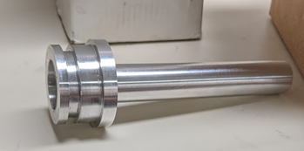
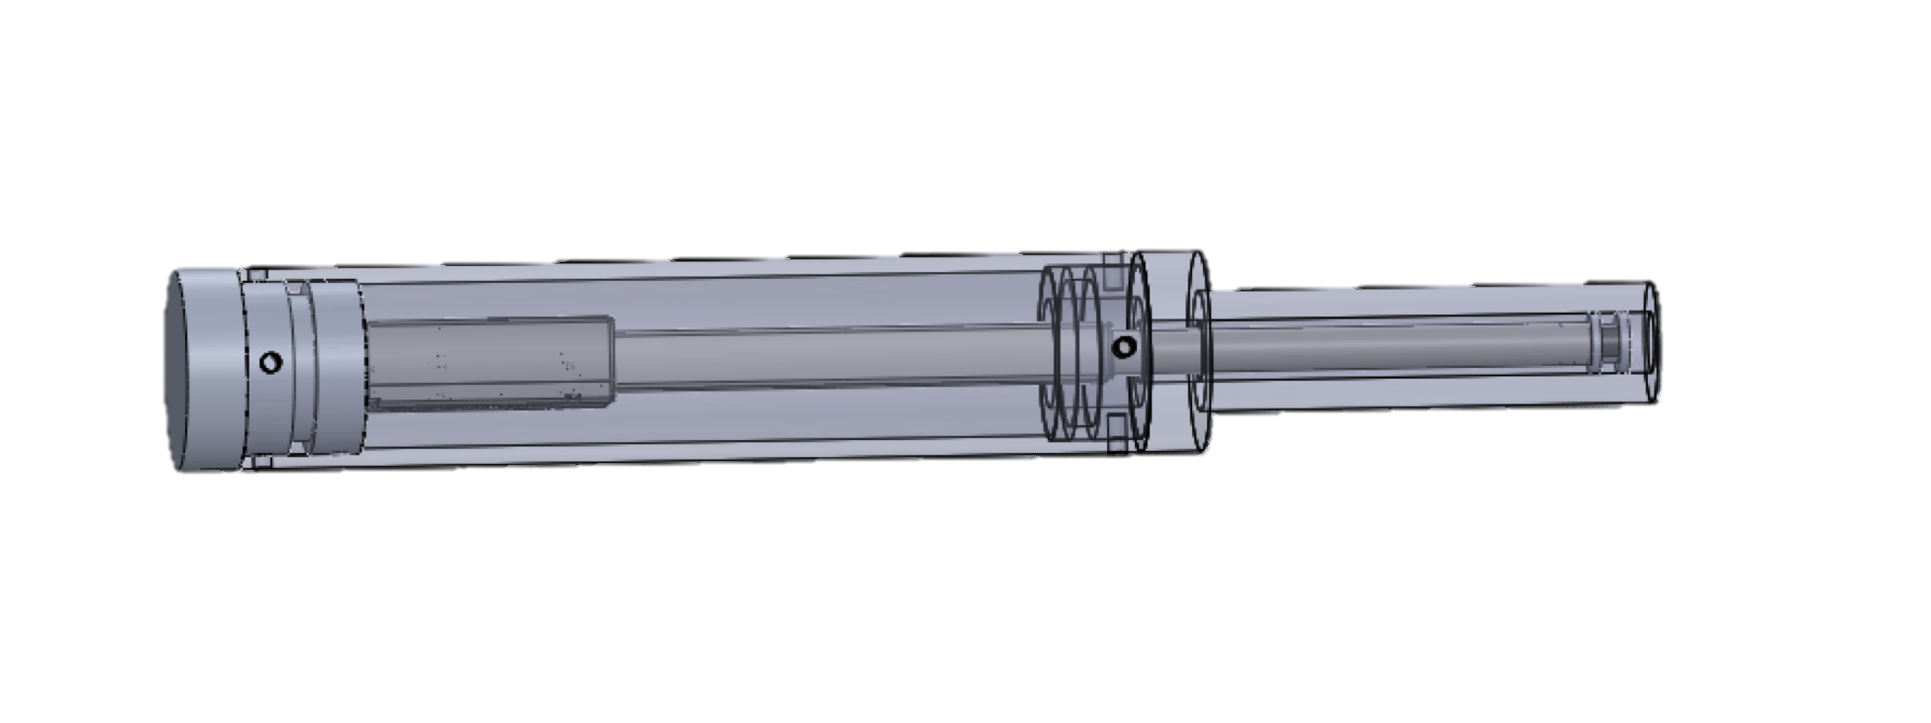
Ballast System
Parts
  End Cap
  Plunger
  PVC tube
  Aluminum Tube End Cap
  Actuator Bracket
Materials
  PVC
  6060 Aluminum
  PLA Plastic
Construction
  CNC Mill, Lathe, & Manual Mill
  Hand Assembled
Notes:
The End Cap is made out of a solid aluminum (6060) tube that is 1.5 in in diameter, which is made on the CNC Mill. Then the grooves for the seals of the End Cap are cut with the Lathe.
The plunger is cut to size with the Band Saw from an 5/16 in aluminum rod and the diameter is turned down using the Lathe. The grooves for the seals are also cut using the Lathe.
The PVC tube is cut down to size using the Band Saw, and the inner diameter of the ends are slightly made larger with the Lathe in order to give the end caps more clearance.
The aluminum Tube End Cap is made from a solid aluminum tube (6060) with a diameter of 1.5 in, which is cut, shaped, hollowed, and turned down with the Lathe.
All of the set screw holes are drilled with the Manual Mill.
- The Actuator Bracket is 3D-printed using the SolidWorks file & PLA plastic.

Slide 19
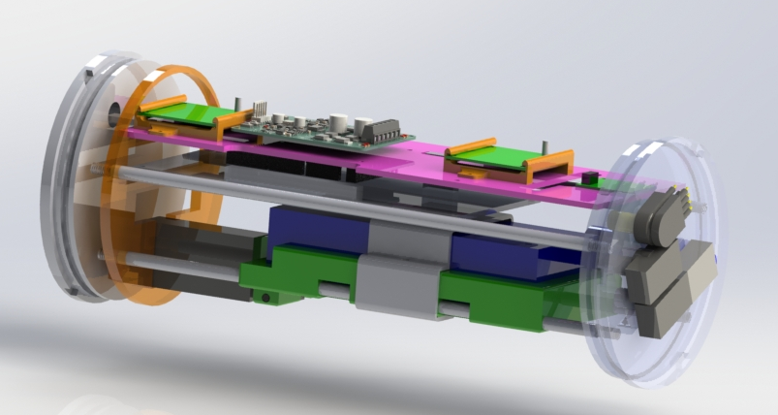
Main Pressure Vessel
Ballast Actuator
Controller
Construction
  Endcaps
  Electronics mounting plate
  Polycarbonate Tube
  3-D Printed Parts
Layout
  Electronics position
  Shifting Mass
  Connectors placement
Shifting Mass Actuator Controller
Dual Motor
Controller
Digital Compass
Electronics Mounting Plate
Subsea Connectors
PCB
Mounting Bracket
Linear Actuator
Battery
Battery Cart
Controller Cart
Support Rods
Notes:
The main pressure vessel was constructed out of the components listed.
Endcaps were constructed out of delryn on the lathe,
Electronics mounting plate was made using the mill
The polycarbonate tube was ordered to the correct diameter and then cut down to size on the bandsaw.
Within the pressure vessel, the electrical components were mounted using standoffs. With the exception of the linear actuator controllers, those needed 3-d printed carts in order to secure them to the plate.
The main pressure vessel is designed to have 4 rods and the electronics mounting plate to be mounted to the endcap with the underwater connectors, and supported on the other end with a bracket. This design allows for the system to be pre assembled outside of the tube, and it slide into the pressure vessel as one complete unit.
Layout how the PCB is mounted underneath the plate to maximize the amount of available space
The shifting mass is positioned towards the bottom of the pressure vessel and aligned using the rods.

Slide 20
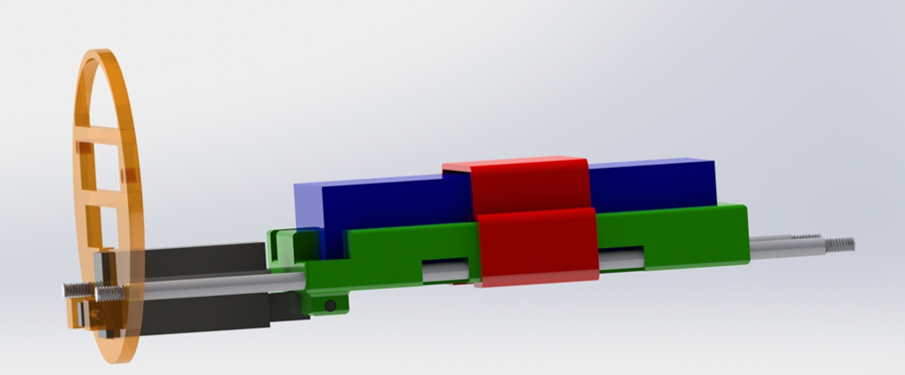
Shifting Mass
End Mounting Bracket
Battery
Aluminum Guide Rods
Linear Actuator
3D Printed Cart
Notes:
Battery used a shifting mass
Linear actuator mounted on rods to serve as track
Actuator attached to 3D printed cart with battery

Slide 21
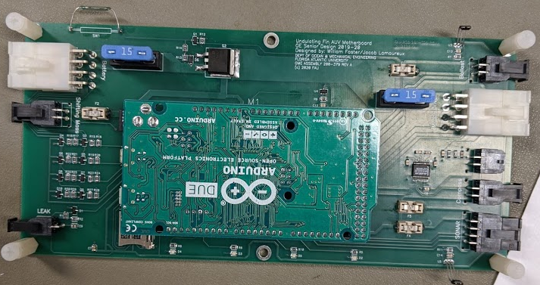
Printed Circuit Board
Reed Switch
Hall Sensors
Fuses
Battery Connector
Ballast Actuator Connector
Motor Driver Connector
Shifting Mass Actuator Connector
Pressure Sensor Connector
Digital Compass
Connector
Leak Sensor Connector
SONAR
Connector
Arduino Due
LEDs
Micro SD Reader
Notes:
Temperature Sensor and Level Translator

Slide 22
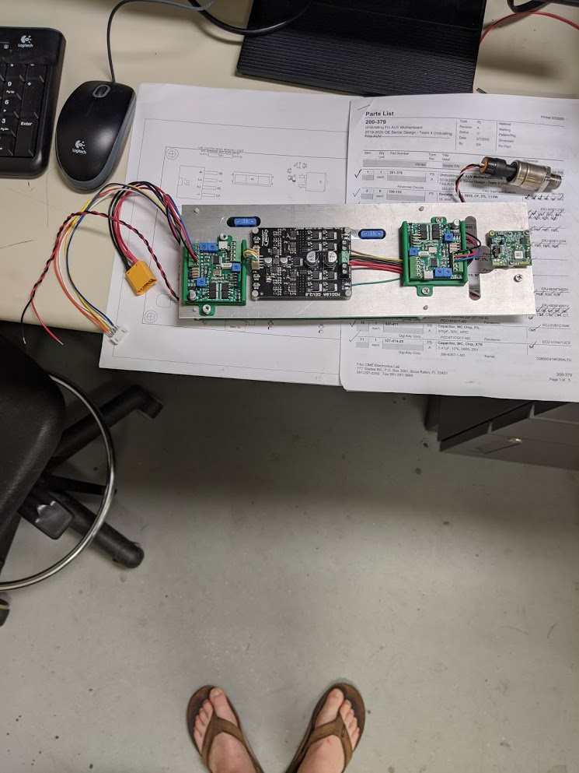
Main Electronic Components Mounting
Main Components
Dual Motor
Controller
Ballast Actuator
Controller
Digital Compass
Shifting Mass Controller
Through Hole for Wiring
Fuses
Notes:
The two linear actuator controllers, the dual motor controller, and the digital compass were all mounted to a 1/8in aluminum plate to allow for both a ridged mounting location, and to facilitate the transfer of heat away from the individual components.
Additionally, the dual motor driver was mounted using 1/4in standoffs and the compass with a small spacer.
A series of three holes were machined into the mounting plate.
The two small oval holes allow for proper fitment of the fuses that are attached to the PCB below, and the larger through hole was placed to allow for the component wiring to pass underneath.

Slide 23
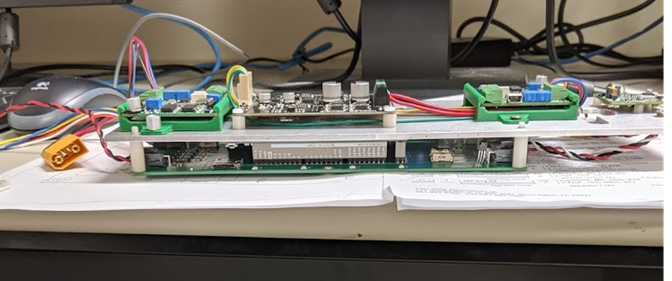
Main Electronic Components Mounting
Full Assembly
Mounted Electronics
Aluminum Mounting Plate
PCB
Notes:
Once the electronics were mounted to the aluminum plate, the PCB was attached underneath with the use of 5/8in standoffs to ensure that the Arduino Due would have proper clearance.
From here the electronics components were assembled and could be mounted within the main pressure vessel.

Slide 24
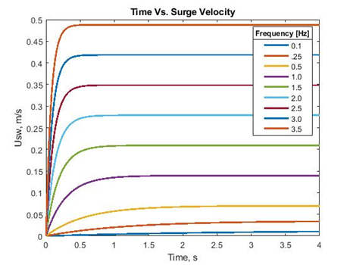
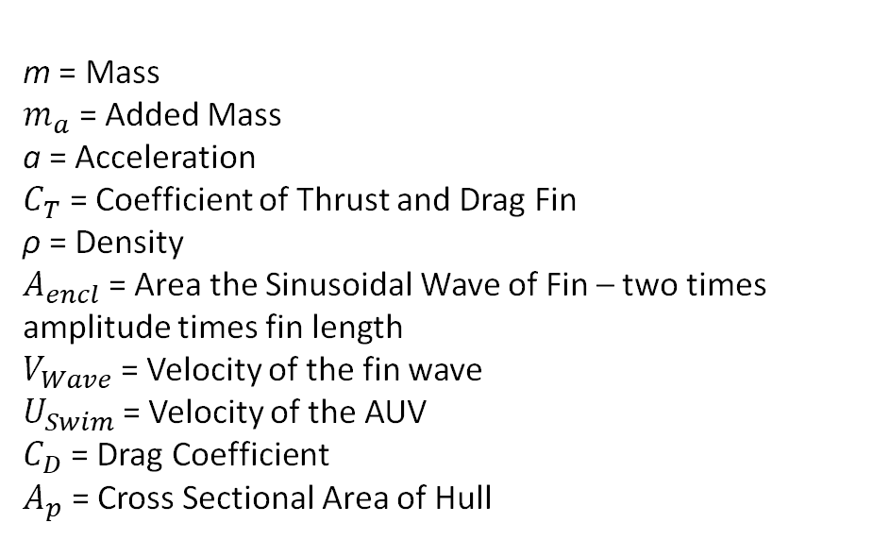
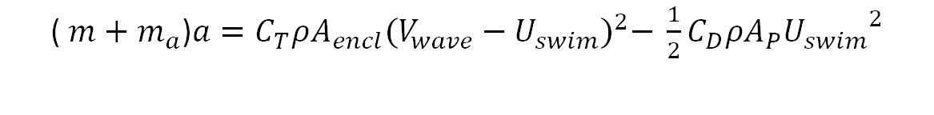
( $m+m_{a}$)$a=C_{T}ρA_{encl}{(V_{wave}−U_{swim})}^{2}− \frac{1}{2}C_{D}ρA_{P}{U_{swim}}^{2}$
Velocity Analysis
m = Mass
$m_{a}$ = Added Mass
a = Acceleration
$C_{T}$ = Coefficient of Thrust and Drag Fin
ρ = Density
$A_{encl}$= Area the Sinusoidal Wave of Fin – two times amplitude times fin length
$V_{Wave}$ = Velocity of the fin wave
$U_{Swim}$ = Velocity of the AUV
$C_{D}$ = Drag Coefficient
$A_{p}$ = Cross Sectional Area of Hull
Notes:
Modeling was of the vehicle at different undulation frequencies was conducted to determine operational velocities
Used the listed equation
Plot shows that we have fine control of velocity at low frequencies
AUV will also meet speed requirements within a realistic frequency range
To determine the frequency of oscillation of the fin, we used our body length of 2/3rds of a meter and our requirement of having to move at a speed of ½ body length per second.
This allowed us to estimate the frequency needed to be 2.5-3 Hz

Slide 25
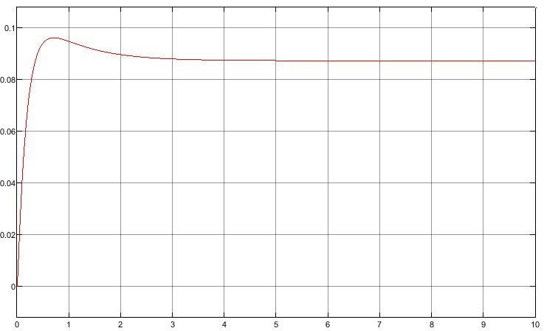
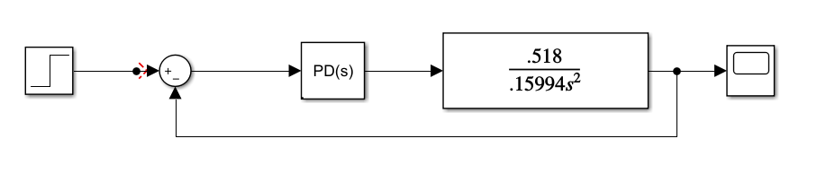
Heading (Yaw) Transient Analysis
Heading Control Response
  Proportional Derivative Controller
    Simulated for a 0.087 rad (5 deg) heading change
    Kp = 2.0
    Kd = 2.0
    Rise Time = 0.275 sec
    Overshoot = 0.087 rad (0.5 deg)
Heading Angle [rad]
Time [s]
Notes:
Yaw is controlled via differential thrust from the two undulating fins and a PD controller and assumed not to be coupled with other degrees of freedom
Transfer function was developed using the small angle assumption which resulted in a negligible drag term
Rise time and overshoot values are manageable for the AUVs use case

Slide 26


Shifting Mass (Pitch) Transient Analysis
Pitch Control Response
  Proportional Derivative Controller
    Simulated for a 0.087 rad (5 deg) pitch change
    Kp = 2.5
    Kd = 4
    Rise Time = 6.23 sec
    Overshoot = 0.016 rad (0.91 deg)
Pitch Angle [rad]
Time [s]
Notes:
Pitch is controlled with the shifting mass system and a PD controller, assumed to be decoupled
Transfer function was developed with small angle assumption as well as estimations for drag
Rise time could be a challenge while translating though the water as it is slow
Full testing was needed to determine if this could be overcome, but could not be conducted

Slide 27


Ballast (Heave) Transient Analysis
Ballast Control Response
  Proportional Controller
    Target depth = 3 m
    Kp = 1.2
    Rise time = 132 sec
    Steady state error = 1.5 cm
Depth [m]
Time [s]
Notes:
Heave motion controlled with the ballast system and a P controller, once again decoupled from the rest of the degrees of freedom
Transfer function again developed with small angle assumption and estimations of drag
For a target depth of 3m, the long rise time of 132s is ok as there is no time/speed for requirement depth testing

Slide 28
Software Design
Mission 1 & Mission 2 Logic
Mission 3 Logic
Descent
Mission 4 Logic
Mission 5 Logic
Notes:
Software was developed for a total of 5 mission sets, as discussed previously, and is shown here in high level logic diagrams
Mission 1 and 2 simply assess the vehicles forward and backward speed capabilities
Mission 3 tests the depth functionality in 3 operational steps
Mission 4 test the ability to detect and obstacle
Mission 5 will handle station keeping operations

Slide 29

Main Loop
Five missions broken into enumerated switch/case form
  Mission is selected from initial case
Multiple “Housekeeping” functions check vehicle health
  checkLeak(), checkTemp(), checkBattery(), logData()
Vehicle position is determined at different update rates
  GetPNIdata(), getSONAR_P(), depth.read_pressure_sensor()
Mission is stopped if any safety function returns a fail
  Vehicle will reset all actuators and return to surface
Mission 1 Control Functions
Notes:
Internal to the code, the 5 missions were used in an enumerated stitch/case form
AUV is initiated into an initial state where the user can select which mission they want to run via the hall effects switch
On each iteration of the main loop, the health of the vehicle is checked and logged
The vehicles heading, pitch, depth, and proximity to target are also checked prior to the case operation
Each mission will run for a predefined amount of time (which is limited by operational area) and will end once the time has elapsed
Mission will also terminate if the “housekeeping” functions return a fail
The figure is a snap shot of how the code moves between cases

Slide 30







Main Loop
Notes:
Visualization of the switch/case functionality
Starts in a selection state with the hall sensor
Mission selection is cycled with one Hall effect sensor, and then activated with the other
Mission 1
Mission 1 has 30 second initial position phase where vehicle orients itself
Motors are then started
Vehicle then alternates DoF control for 0.2 seconds each until the mission ends
Mission 2
Mission 2 happens in the same way as Mission 1, only with opposite direction of travel
Mission 3
Mission 3 will begin with alternating between pitch and depth control for 0.2 sec each
Desired depth is then maintained for a predefined time, again alternating control
AUV will then ascend in the same manner as descent
Mission 4
Mission 4 begins with the 30 sec orientation phase
Moves in the direction the SONARs point until an obstacle is detected
Once the obstacle is detected, the vehicle with reverse motion
Then mission will end after defined amount of time
Mission 5
Mission 5, station keeping beings with orientation phase
Will then actively station keep
AUV will alternate between adjusting position from reference target, pitch, depth, and heading until mission time has elapsed
End States
AUV will enter end mission state after each mission, or a mission failure
All functions were developed and placed until a single program for the AUV, but were not tested as a cohesive unit due to campus closure

Slide 31

Component Tests Completed
Fin Motor – Tested for proper function
Compass Test – Tested for correct reading and for errors in reading in tank
Leak Sensor – Tested for correct operation
Pressure Sensor – Tested for operation and converted to a depth reading
Linear Actuators –Tested for correct operation
SONAR – Tested for accurate distance readings
Ballast System – Linear actuator combined with pressure sensor to test controller operation
Shifting Mass System – Linear actuator combined with the compass pitch reading to test controller operation
Notes:
Due to COVID – 19, we weren’t able to complete full system tests. We were able to complete individual component tests to verify their functionality

Slide 32

Budget
Notes:
We are underbudget for our system by so much because we weren’t able to purchase underwater connectors due to the lead times.

Slide 33
Remaining Work
Mechanical
  The crankshaft needs to be assembled on the frame
  Pressure vessels
    The main pressure vessel needs holes milled out
    The motor and ballast need to be assembled
  The saddle needs to be 3-D printed
  The hulls need to be 3-D printed
Electrical
  The subsea connectors need to be spliced to each of the pressure vessels
Software
  Code needs to be tested and tweaked for full system operation

Slide 34
Self Reflections
David Leon
Jacob Lamoureux
Jesse Schreck
William Foster
Cameron Flynn
Steven Roberts
Notes:
David
During this year long project, the most important skills that I have improved and practiced besides the applied technical skills, have been cooperation and communication. This exercise has emphasized the idea of ”we”, rather than “I”.
This project has also given me a glimpse on the application of systems engineering. It has shown how different engineering practices are able to come together and produce a product. This result has given me the drive to continue learning the needed skills and entering unknown territories.
Steven
Time management across the entire project and balancing classes was the hardest thing for me to over come. It was easy to get wrapped up in the project and neglect other classes.
This project also showed me how much a delay, avoidable or not, can change the project timeline.
Cameron
I have greatly improved my programming and testing skills. I learned how to trouble shoot code and modify to achieve my objectives.
I learned how important teamwork is when working on a project.
Jesse
On a technical and professional level, my skills in programming have greatly increased and given me a real appreciation for the work that goes into not only real-time programming, but the modeling and full systems engineering that goes into the development of autonomous systems.
From the perspective of lifelong learning, I have seen that there truly is always something else to learn when working on a project. Even once the project came to its finish, I had only begun to scratch the surface of what there is to learn in the field and look forward to continuing to learn more.
The best way to ensure ethical completion of any project is to ensure constant communication between everyone working on it.
Will
My fear of being judged for not knowing an answer kept me from asking important questions. This project has given me the confidence to ask a question when I am stuck instead of spending hours or days stuck on the same issue.
I improved my technical skills as well as the ability to communicate within a group. Being on the same page about deadlines and admitting when help is needed were two traits that I enhanced through this project and with my team.
Jacob
I Learned a lot about how important design and communication is for large projects, one detail neglected, or one miscommunication can result in massive amount of time lost and corrections to be made down the line.
In our case our project doesn’t have direct implications for humans or marine life; however, if this project could potentially be used in the ocean where there could be contact with marine life and those interactions should be considered
Even though Covid – 19 cut this project short, it has only instilled my desire to learn more and continue learning as much as I can in the engineering world
Grew together as a team
Improved our design skills through carrying out the design as far as we could

Slide 35

Acknowledgements
Dr. Gonzalo Garreton
Mohammad Uddin
John Kielbasa
Fred Knapp
John Frankenfield
Ed Henderson
Robert Coulson
All previous engineering professors and staff who have helped us along the way
Dr. Oscar Curet
Dr. Pierre-Philippe Beaujean
Dr. Edgar An
Dr. Siddhartha Verma
Dr. Hassan Mafuz
Notes:
Jake

Slide 36
Thank you!
Notes:
Jake

Slide 37











