Slide 1
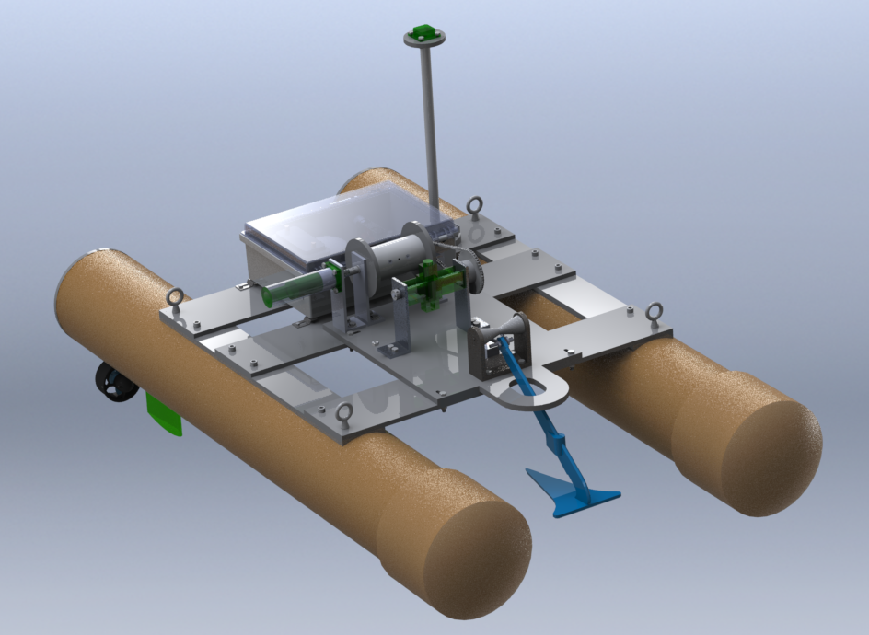

Autonomous Anchoring Surface Vessel
College of Engineering and Computer Science
Department of Ocean and Mechanical Engineering
EOC4804: Ocean Engineering Systems Design and Control
Final Design Review, 23 April 2020
Group 3: Martine Montgomery, Robert James,
Marco Leo, Yun Ni, Eli Shoshan, Joshua Tashbar
Notes:
Hello, we’re Group 3 presenting on the Autonomous Anchoring Surface Vessel.

Slide 2
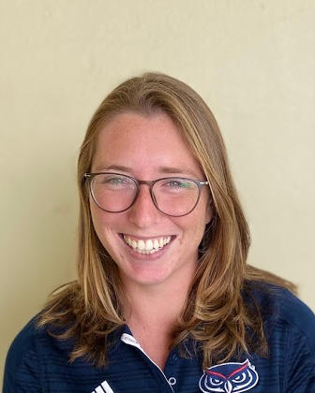
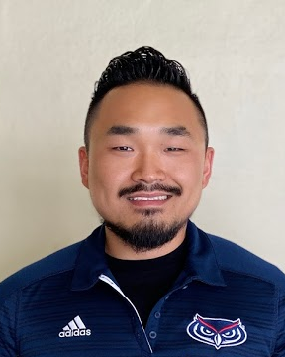
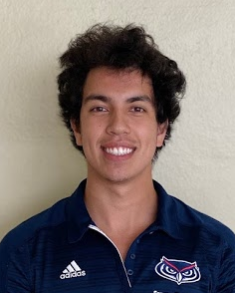
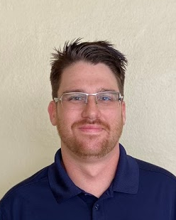

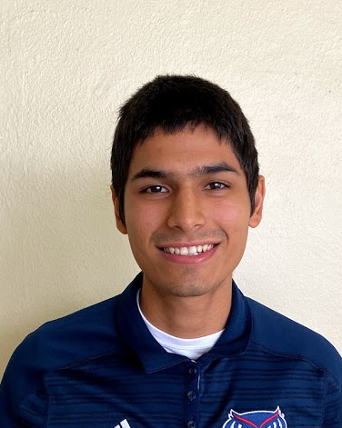
Team Organization
Martine Montgomery
Software
Team Leader
Yun Ni
Mechanical
EH&S
Marco Leo
Electrical
EE Lab Coordinator
Robert James
Software
Budget Manager
Eli Shoshan
Mechanical
ME Shop Coordinator
Joshua Tashbar
Electrical
Progress Tracking
Notes:
Our software team consisted of myself, Martine Montgomery, and Robert James. The Mechanical Team was Yun Ni and Eli Shoshan. The Electrical Team was Marco Leo and Joshua Tashbar. In addition to our technical roles, each team member had an administrative role as well.

Slide 3
Project Goals and Objectives
Design and fabricate an ASV capable of:
    autonomously traveling to GPS coordinates 25m away
    anchoring at depths up to 10 meters
    Hold its anchored position for 15 minutes
    retrieving the anchor after deployment
    returning to the dock.
The goal for this project is to successfully develop a low-energy alternative to station-keeping and help the community enhance future studies and research.
Notes:
Our project objectives are to design and fabricate an ASV capable of autonomously traveling to a GPS coordinate 25 meters away, autonomously anchor at depths of up to 10 meters, hold its anchored position for 15 minutes, retrieve the anchor after deployment, and return to the dock after a successful mission.
The goal for this project is to successfully develop a low-energy alternative to station-keeping and help the community enhance future studies and research.

Slide 4
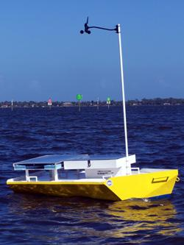
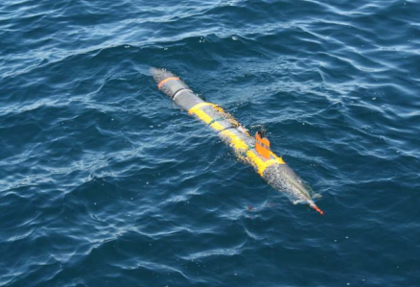
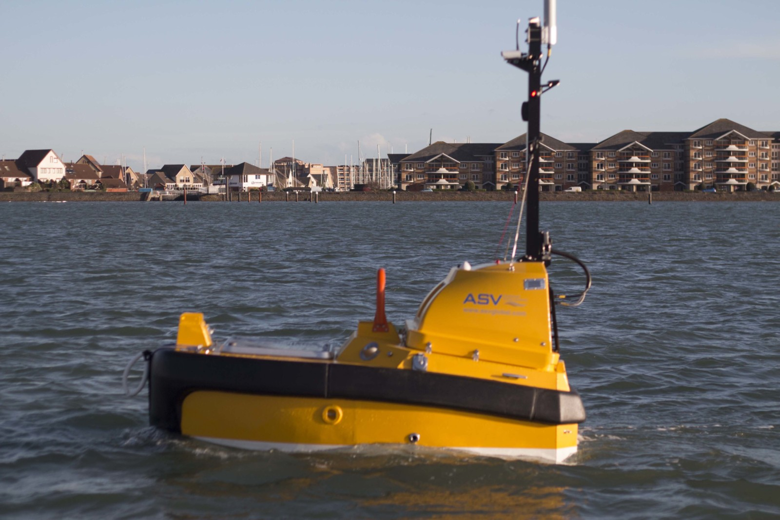
Existing Related Technologies
Scientific Operations
  Oceanographic Data Collection
  Marine Biological Studies
  Environmental Impact Assessment
Defense Industry Operations
  Subsea Asset Positioning
  Surface to Underwater Communications
  Port, Harbor and Ship Security
Current Autonomous Anchoring Surface Vehicles
  FIT’s Autonomous Self-Mooring Vehicle
  VT Self Mooring AUV by AUVAC
  ASV Global – C-stat 2
    Station Keeping Buoy
Notes:
There are several uses for an autonomous anchoring system, such as scientific operations like oceanographic data collection, marine biological studies and conducting environmental impact assessments. Some applications for the defense industry include subsea asset positioning, surface to underwater communications, as well as port, harbor and ship security. Examples of currently existing autonomous anchoring surface vessels include FIT’s autonomous self-mooring vehicle, VT self mooring AUV by AUVAC and the ASV global Cstat 2, a station keeping buoy.

Slide 5
System Requirements
The ASV shall be navigate to target location.
  Set anchor and hold.
  Retrieve anchor.
Requirement 1 + travel to a second point and repeat the operation.
Requirement 2 + the operation must take place at sea.
Notes:
Our ASV shall be capable of traveling the dock in a marina to a location 25m away within a 2m radius, deploying a single anchor in 1 m of water, remaining anchored without dragging the anchor for 15 minutes, retrieving the anchor and returning to the start location within 2m radius. This entire process must be fully automated and be completed without recharging the battery.
The second level requirements includes a repeated mission to a second set of coordinates still on a single battery charge.
To meet the third level requirements the operation must take place at sea, in 10m of water and in sea state 1

Slide 6
Constraints and Assumptions
Assumptions:
Constant Seafloor of Sand or Mud
No Obstacles While Traveling
1 m/s Current, 10m/s Maximum Sustained wind
Constraints:
Budget of $1500 plus donated parts and grants
Deadline of May 2020
Battery Life
Testing Schedule Around R/V Ray McAllister
In-House Fabrication at FAU Boca Raton and SeaTech
Notes:
Throughout this ASV’s design and construction, we assumed a constant sandy seafloor and calm seas.
The constraints for our project remained the same throughout the building process- a fabrication and testing schedule based around the resources at FAU’s Seatech and main campuses, and a budget of 1500 dollars provided by the university along with any grants we could earn.

Slide 7
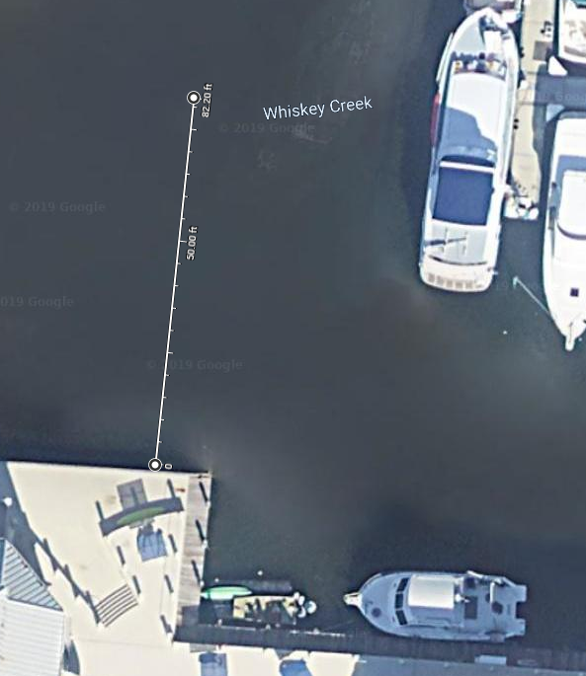
Mission Overview
Pre-Mission
Test subsystem functionality in laboratory
Deploy the system
Test total systems functionality at the dock.
Mission Profile (~20 mins)
Vehicle travels to Anchor Site
Drops anchor and lets out line
Remains anchored for 15 minutes
Retrieves anchor
Vehicle returns to dock.
Repeat Mission
For Requirement
Post-Mission
Shutdown and stowage of vehicle
Anchor Deployment Location
25 m
Dock Location
Notes:
There are 3 stages to the mission process. First during the pre-mission phase, we will verify the functionality of all the subsystems before taking the AASV to the mission area, and doublecheck at the dock or research vessel before actual deployment. The second stage is the mission profile which should take between 20 and 40 minutes. This includes the AASV traveling to the anchor location, dropping the anchor, remaining in location for 15 minutes, retrieving the anchor and returning to dock. During requirement two there is an additional step in the mission profile where the AASV will immediately repeat the mission at another location after retrieving the anchor. The last stage of the mission overview is post-mission, which involves cleaning and stowing the vehicle.

Slide 8
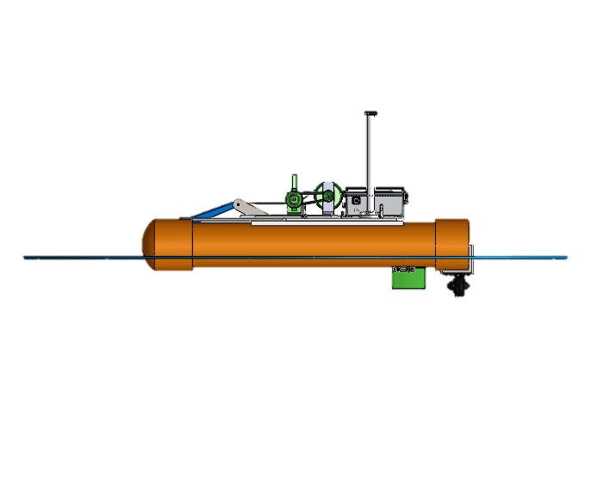
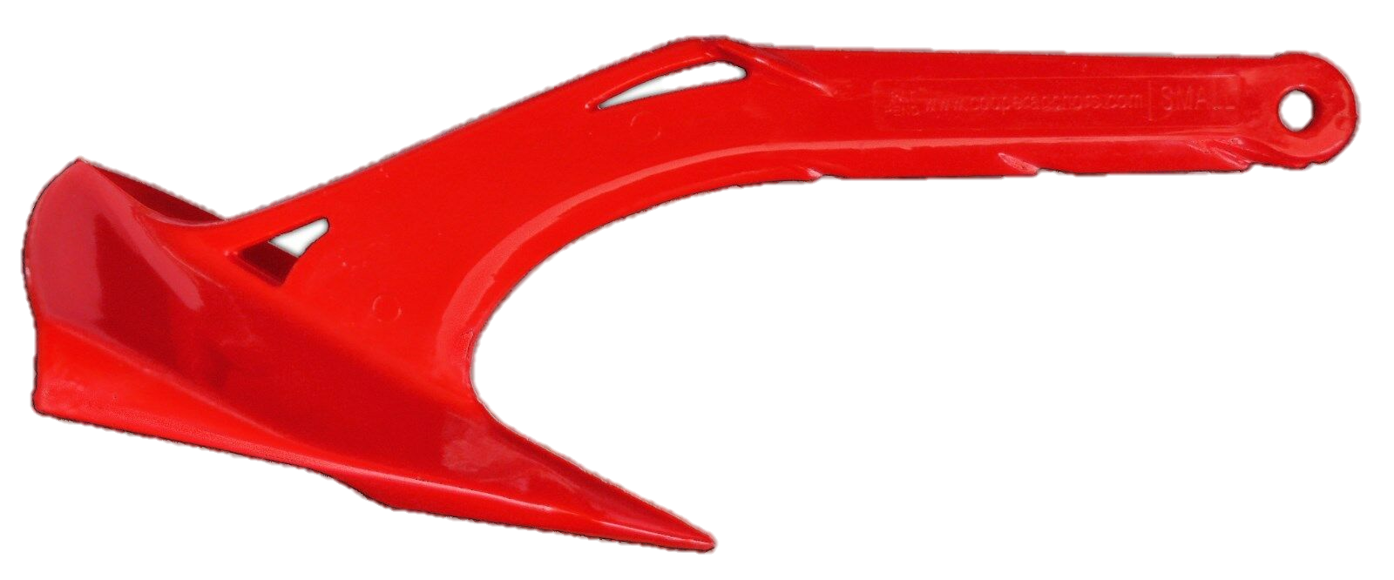
Physical Map
2
1
1
Anchor Drop Location
Anchor Holding Location
2
Notes:
This is a physical map of our ASV’s mission profile. As the ASV approaches the Anchor Drop Location, it will release the anchor and maintain position for a few seconds to allow the anchor to reach the seafloor. Then the ASV will drift back with the prevailing wind or current while unspooling the anchor line. Once an appropriate scope for the anchor line has been let out, the ASV will record its position as the Anchor Holding Location. The ASV’s location will be monitored to ensure the anchor is holding. Once fifteen minutes have passed, the ASV will approach the Anchor Drop Location and unset the anchor from a vertical angle. It will then return to the dock and end its mission.

Slide 9
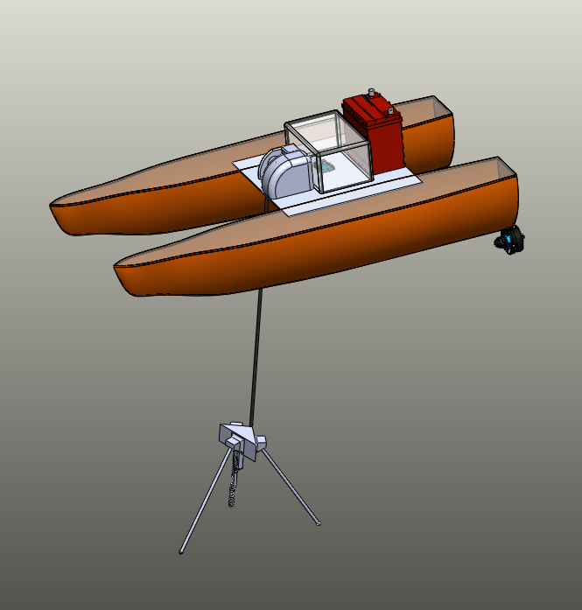
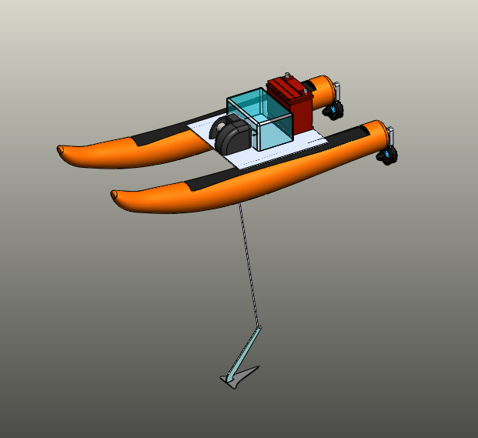
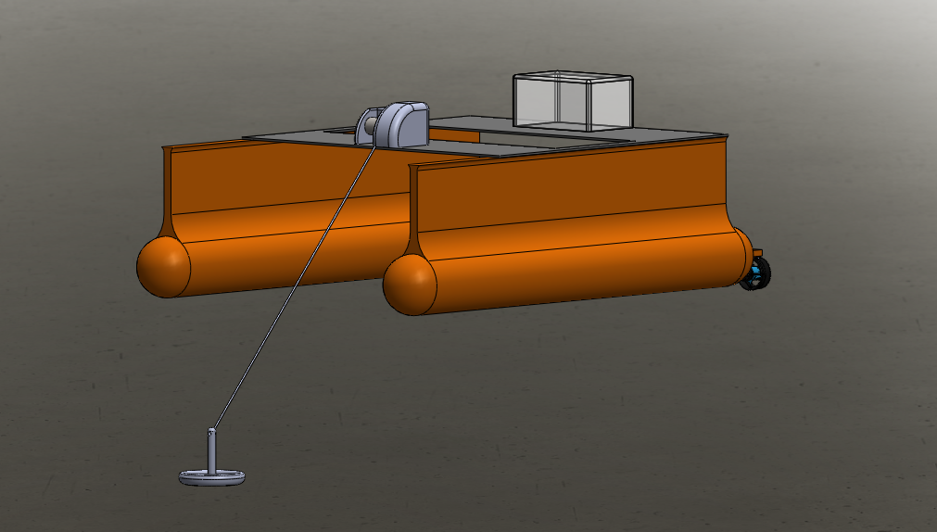
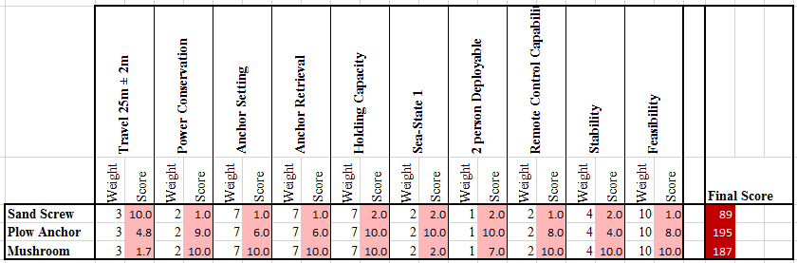
Early Conceptual Designs
Notes:
We used Analytical Hierarchy Processes throughout the design phase last fall to quantitatively rank our competing conceptual ideas as group. Shown here are three early conceptual designs for our anchor. After comparing them using our preliminary design tradeoff requirements we concluded that a plow style anchor would be the most suitable for this project.

Slide 10
Risk Assessment
Probability --> |  |  |  | 1, 2, 3, 4, 5
 |  |  | 6, 7, 8, 9
 | 10
 | Severity -->
Risk Assessment |  | Probability of Occurrance | Impact of Occurrance | Overall Risk | Prepared Risk Mitigation Plan
1 | Electronics Failure | 3 | 4 |  | Yes
2 | Navigation Failure | 2 | 4 |  | Yes
3 | Failure to Deploy Anchor | 3 | 4 |  | Yes
4 | Failure to Retrieve Anchor | 3 | 4 |  | Yes
5 | Anchor Caught on Seafloor/Debris | 2 | 4 |  | Yes
6 | Leaks | 1 | 3 |  | Yes
7 | Poor Test Environment | 1 | 2 |  | Yes
8 | Late Delivery | 1 | 4 |  | Yes
9 | Over Budget | 2 | 2 |  | Yes
10 | Corrosion | 1 | 1 |  | Yes
Notes:
In order to form a Risk Mitigation Plan, ten risks were assessed to determine their probability of occurrence and potential impact on the system. They were ranked on a scale of 1 to 4 and organized into a table to assess their overall risk.
Once their overall risks were determined, they were organized into a Risk Probability and Severity Table.
The risks deemed the highest overall were electronics and navigation failure, failure to deploy and retrieve the anchor, and anchor getting caught on seafloor debris.
A Risk Mitigation plan was prepared for each of these ten risks. Steps were taken to modify the ASV’s design to minimize the probability of the highest rated risks.

Slide 11
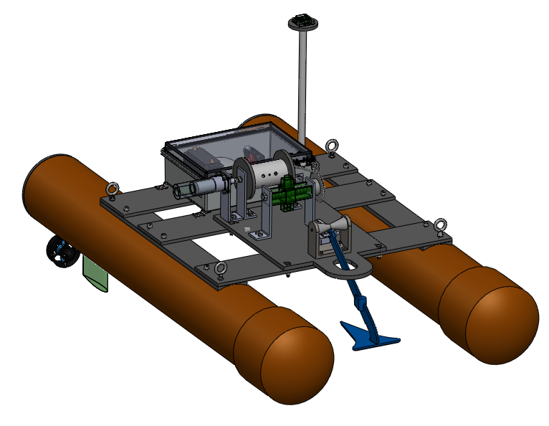
Detailed Design and Analysis - ME
Digital Compass Pole
Electronics box
Winch Assembly
PVC Pontoon Hulls
Bow Roller
T-100 Thrusters
Path Keeping Fins
Cooper Plow Anchor
Notes:
Shown here are the major mechanical components on the AASV. The overall length is one and a half meters, and the two PVC pontoon hulls are 1 meter apart. A path keeping fin is located beneath each hull to minimize drift while traveling. The propulsion is provided by two Blue Robotics T-100 thrusters mounted on the pontoons. All the grey parts connected to the hulls are made of PVC plates including the deck plates and winch assembly plate. Forward on the deck is the Cooper brand’s plow anchor, resting on a steel bow-roller. Located aft on the deck is the electronics box, model WQ-64 from Polycase. Our winch assembly is located between the two.

Slide 12
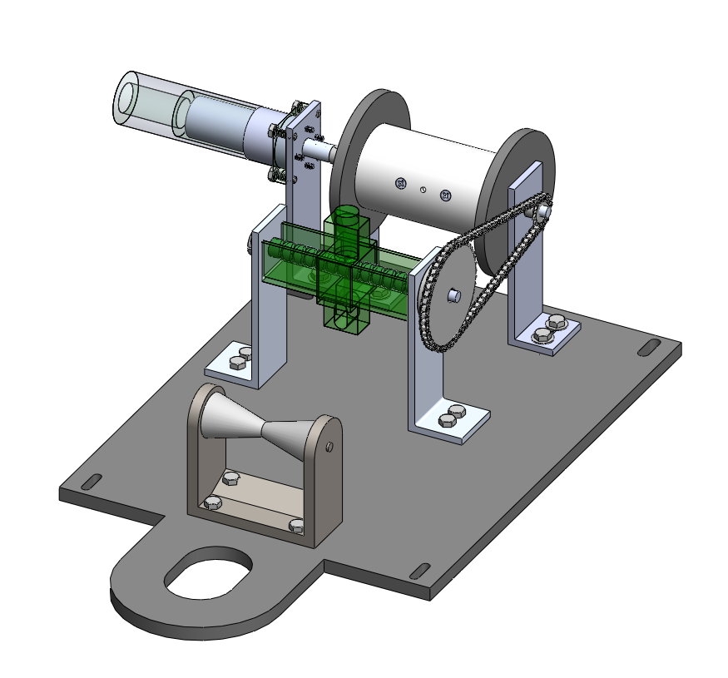
Detailed Design and Analysis - ME
Line Drum
Motor Cover
Sprocket and Chain
Geared Motor
Level Wind Assembly
Bow Roller
Notes:
Here is the detailed layout of the winch assembly. All the parts rest on the winch assembly plate. Starting at the front is a hole which allows the anchor’s attachment point to reach the bow roller, located directly aft of it. The bow roller will take most of the tension force while anchored. Next the level wind assembly will guide the anchor line horizontally back and forth as the anchor line is being retrieved to ensure it is stored without tangling. All the way aft is the line drum, which will rotate with the geared motor.

Slide 13
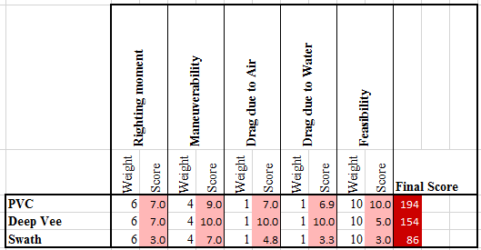
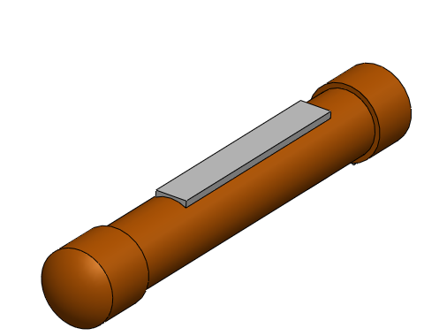
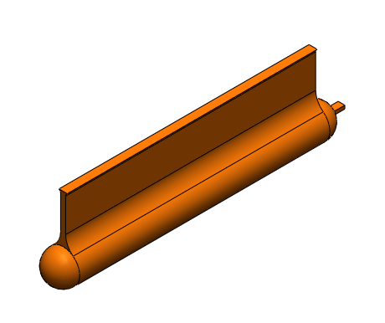
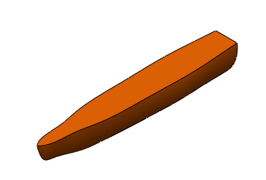
Hull Analytical Hierarchy Process
High righting moment will be necessary during anchor retrieval.
Drag during transit will not be optimized.
Feasibility of manufacturing will be considered.
PVC drastically decrease the complexity of the buoyancy hulls.
SWATH Hull
Deep Vee Hull
PVC Hull
Notes:
Here are our three early conceptual designs for the ASV’s hull. After comparing them to each other with a Analytic Hierarchy Process using our specific design requirements such as necessary righting moment, air drag, and ease of manufacturing, we concluded that a PVC Pontoon hull is the most suitable for this project mainly due to its decreased complexity and low cost.

Slide 14
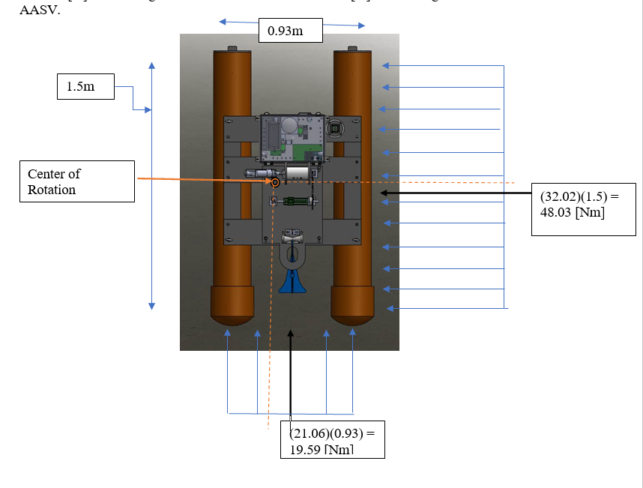
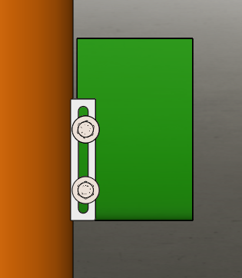
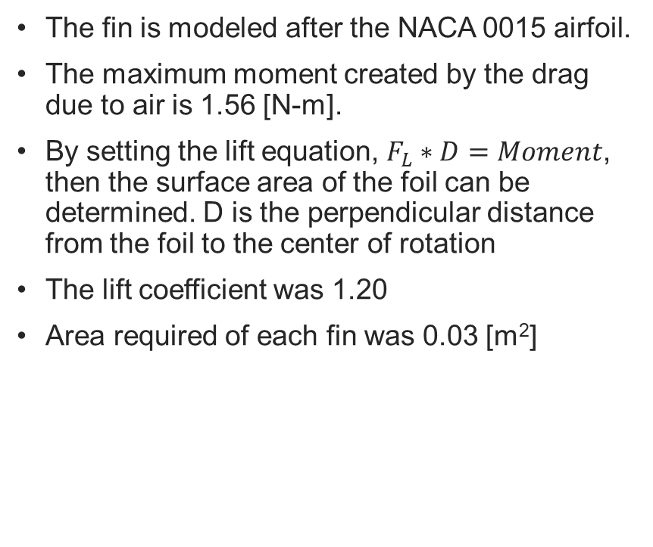
Path Keeping Fin
The fin is modeled after the NACA 0015 airfoil.
The maximum moment created by the drag due to air is 1.56 [N-m].
By setting the lift equation, $F_{L}∗D=Moment$, then the surface area of the foil can be determined. D is the perpendicular distance from the foil to the center of rotation
The lift coefficient was 1.20
Area required of each fin was 0.03 [m²]
Notes:
These path keeping fins were designed to minimize the effect of drag on the AASV due to air flow over the surface of the water. A hypothetical moment was applied to the approximate area of the AASV above the water to help calculate the fin sizes required to keep the vehicle on course as it transits to the mission area.

Slide 15
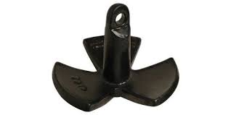
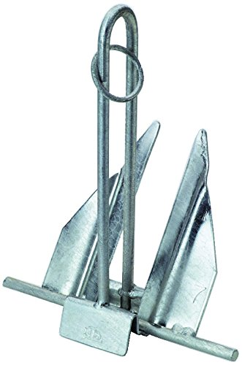
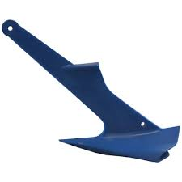
Anchor Choice– Polymer Plow Anchor
Mushroom
Anchor
Three most common anchors for sand seafloors were tested.
Analyzed according to project requirements.
Sets easily from any position
Holding power: 110 [N] at 20°
Force required to set: 60 [N] at 20°
Force required to retrieve: 20 [N] above 45°
Mass: 1 [kg]
Danforth
Anchor
Polymer Plow
Anchor
Notes:
One of the first field tests we performed was to quantify the holding power of various anchors available at the SeaTech campus. We tested these three anchors in a sandy mud seafloor similar to the conditions at the site of our Requirement 1 and 2 testing. This test provided some actual field data for the Analytical hierarchy process shown earlier to help us determine the most suitable anchor for this project.

Slide 16
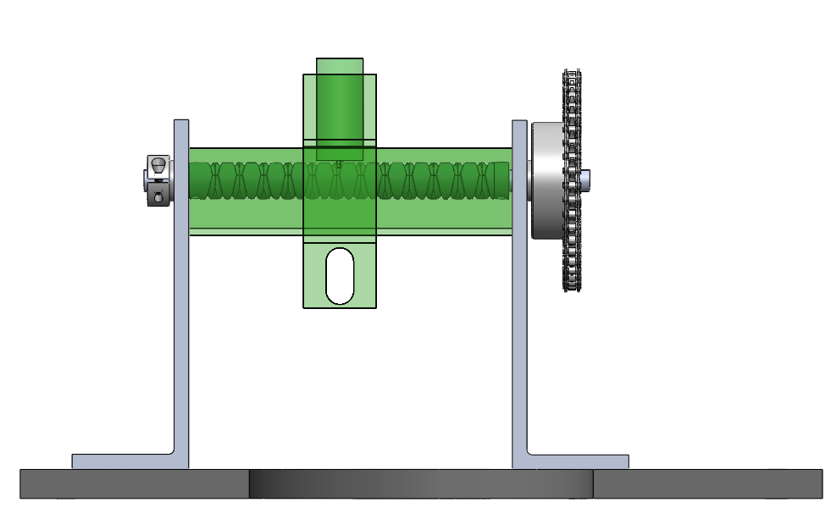
Level Wind
Pawl
Line Guide
Gear ratio of 3:1.
Pawl rides within the double helical screw, pitch of 0.09”.
Requires 12 rotations on the double helical screw.
Double helical screw, pawl, line guide and channel are 3D printed.
Driven Sprocket
3/8’’ Shaft
Double Helical Screw
Brackets
Channel Guide
Notes:
The design of the level wind was intended to have the line traversing laterally on the drum when being spooled/unspooled and the level wind line guide traversing at the same lateral rate. In other words the line guide moves left to right at the same rate as the line moves left to right from the drum. The mechanical solution to that design is to have the pawl tracking along the helices of the double helical screw. Once the pawl reaches the end of the screw on one side it will automatically reverse direction and repeat. When designing the level wind a high gear ratio was desirable in order to minimize the number of revolutions required for the double helical screw. The level wind assembly is held in place through the use of two aluminum brackets that have Delrin bushings that contact the shaft and the brackets.

Slide 17
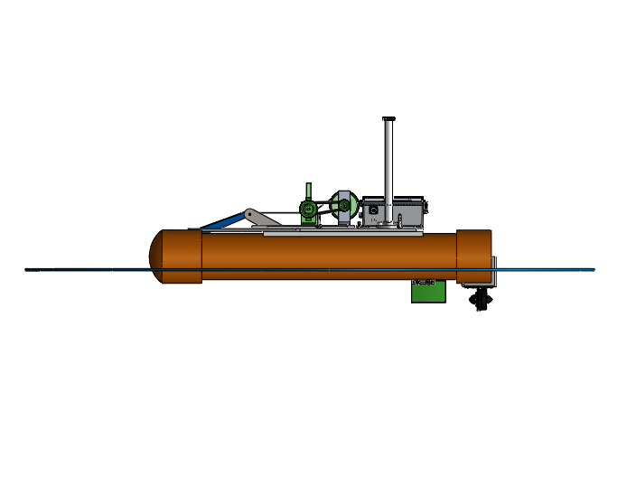
Buoyancy Analysis
F_{W} = 416 [N]
Mass of 42.4 [kg], equates to submerged volume ∀ = 0.041 [m³]
Design draft of 0.06 [m] measured from the base of the motor mount
Component | Mass [kg]
Electronics Box | 4.5
Winch and Anchor | 5.5
PVC Platform | 9.0
PVC Hulls | 23.4
Total | 42.4
F_{b} = 10100∀ [N]
Notes:
A weight analysis of the ASV showed that the heaviest materials by far were the PVC hulls, resulting in an overall weight of 42.4 kg. This is 3 kg below the weight constraint of our requirements. The resulting draft is six cm above the base of the motormount as shown in the figure.

Slide 18
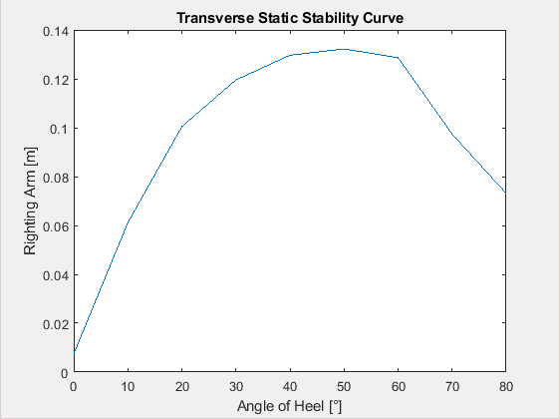
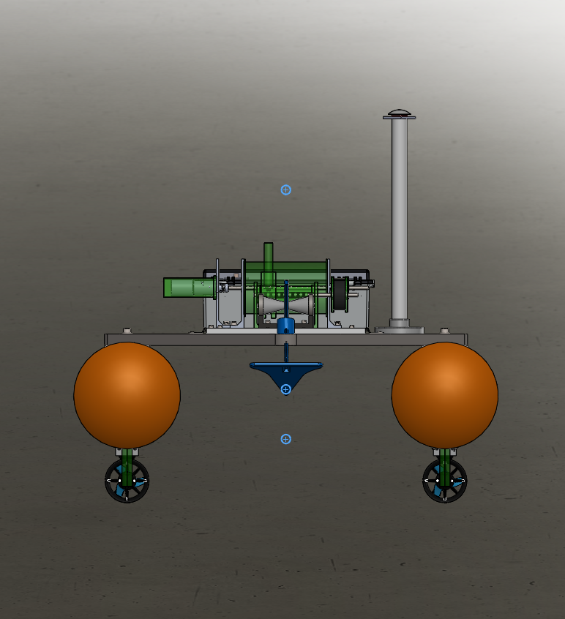
Transverse Stability
Maximum Righting Moment at 45°
Metacenter
Center of Gravity
Center of Buoyancy
Notes:
We calculated some stability statistics for the ASV. Due to the catamaran design it is extremely unlikely to capsize in the sea states in which it will be operating. We also checked that the trim on the ASV will be very small.

Slide 19
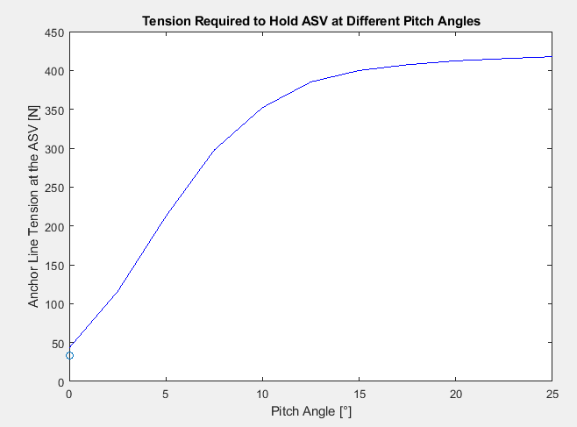
Righting Moment
As the tension in the anchor line increases, the pitch of the vessel will change.
Average force of anchor line at the bow will be 33N
  This will not affect the trim of the vessel.
At a pitch angle of 15°, the waterline reaches the winch
  This would require 400 [N] of anchor line tension.
Notes:
There was some concern during this stability analysis that should the anchor become fixed on the seafloor, the winch could provide enough force to drag the bow of the ASV under the water. Ultimately, the waterline would reach the electronics on the ASV’s deck at a pitch angle of 15 degrees. The additional buoyancy provided by the submerged bow at that angle is around 400N, a force the winch would be unable to overcome.

Slide 20
Drag on the AASV
The drag on the submerged portion of the AASV due to a 1 [m/s] ocean current is 11.17 [N].
The drag applied on the AASV when the air current of 10 [m/s] is applied to the frontal area then the drag is 21.06 [N] and when applied to the side of the AASV the drag due to the air current is 32.02 [N].
Drag due to air
Drag due to water
Notes:
The drag on the submerged portion of the AASV due to a 1 [m/s] ocean current is 11.17 [N].
The drag applied on the AASV when the air current of 10 [m/s] is applied to the frontal area is 21.06 [N] and when applied to the side of the AASV the drag due to the air current is 32.02 [N].

Slide 21
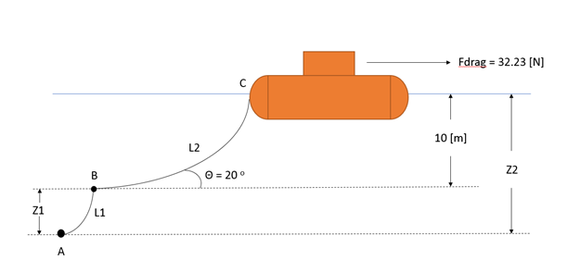
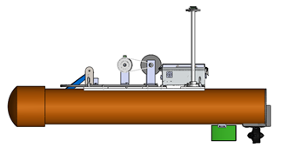
Tension on the AASV due to Catenary of Anchor Line
The anchor line will produce a tension at the AASV of 33.04 [N] when the angle between the anchor and the cable is 20 degrees.
The minimum cable length required to hold the vessel in place is 43.07 [m]. However, common practice is to use a scope of 7:1 and thus the length of line used will be 70 [m].
Notes:
The anchor line will produce a tension on the AASV of 33.04 [N] when the angle between the anchor and the cable is 20 degrees.
The minimum cable length required to hold the vessel in place is 43.07 [m]. However, common practice is to use a scope of 1:7 and thus the length of line used will be 70 [m].

Slide 22
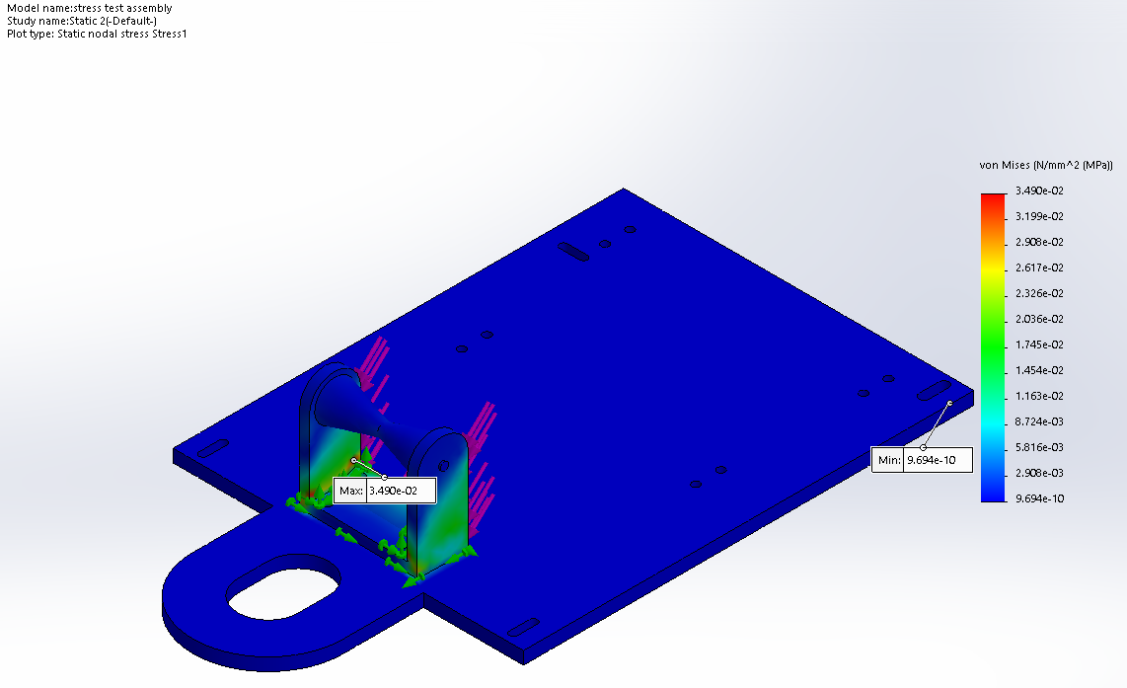
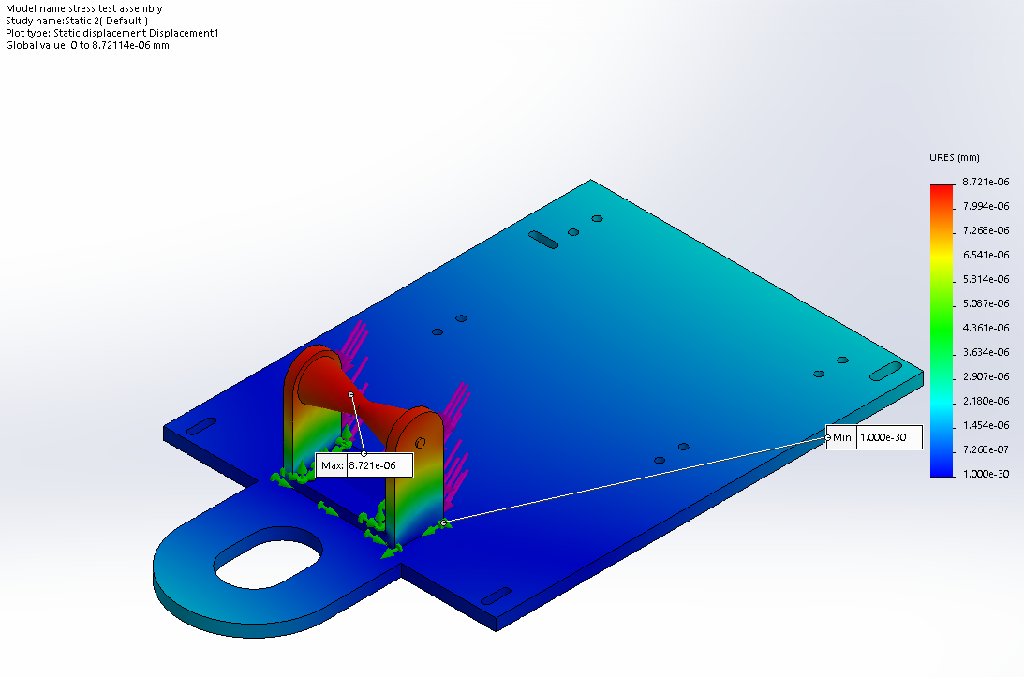
Deck Analysis
The anchor will have a tension of 34 [N] when set and the mass of the components on the deck will produce a force applied will produce a Von Mises stress of 0.0349 [N/mm²]. The displacement developed yields a value of 8.721e-6 [mm].
This stress is less than the maximum compressive strength of 50 [N/mm²].
Notes:
This analysis was completed with solidworks to see the stress and displacement on the roller due to the tension from the anchor line.
When the anchor has been set, a tension of 34 N is anticipated to be applied at the bow roller This will yield a Von Mises stress of 0.0349 N/mm^2 and is modeled on the figure on the left which shows that the maximum stress is at the base of the bow roller. This stress is less than the maximum compressive strength of the PVC plate. The displacement from this tension is inconsequential. The displacement is modeled on the figure on the right and shows that the maximum displacement would occur at the roller section of the bow roller.

Slide 23
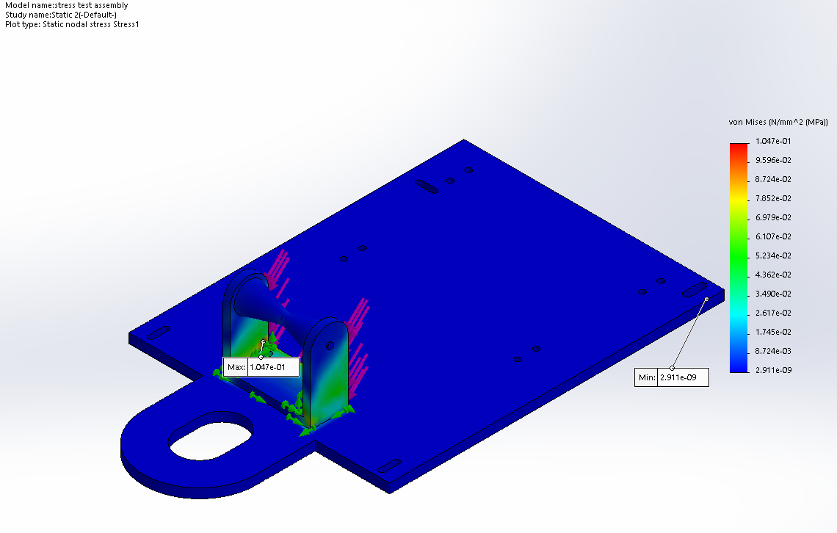
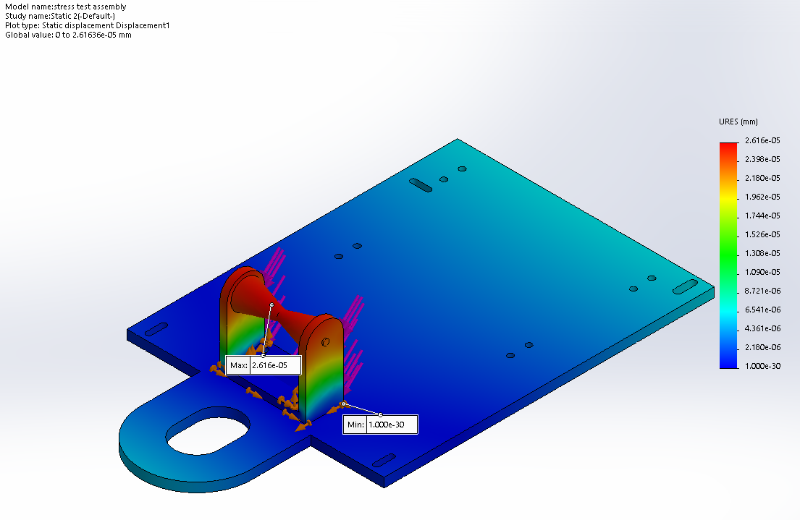
Deck Analysis
When a factor of safety of 3 is added then the Von Mises stress is 0.1047 [N/mm²] which is still below the maximum compressive strength of the PVC material. This also yields a displacement of 2.631e-5 [mm].
Notes:
Next the analysis was repeated with a factor of safety of 3 applied to check how the system would be affected if the anchor became stuck on the seafloor. The result of this analysis was that the Von Mises stress would now be 0.1047 N/mm^2 which is still far below the maximum compressive strength of the PVC sheet. The displacement, which is modeled on the right, would still be inconsequential.

Slide 24
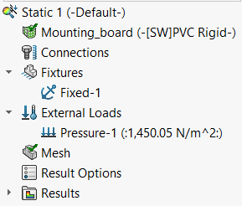
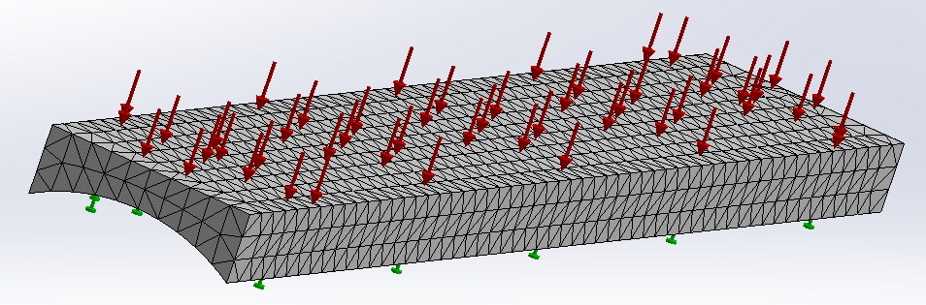
Mounting Board Analysis
Initial Conditions
Fixed
Distributed Load: 0.001450.05 [N-mm²]
The distributed load was determined using the mass of the deck, electronics box, winch system, and bow roller.
Notes:
The mounting boards between the round hulls and the flat deck plates were deemed more than capable of handling the stress from the winch system and electronics box. This analysis was conducted using SolidWorks Simulation. The lower portion of the mount was simulated as a fixed support and a pressure distribution was placed on the upper portion of the structure to take into account the entire weight of the AASV.

Slide 25
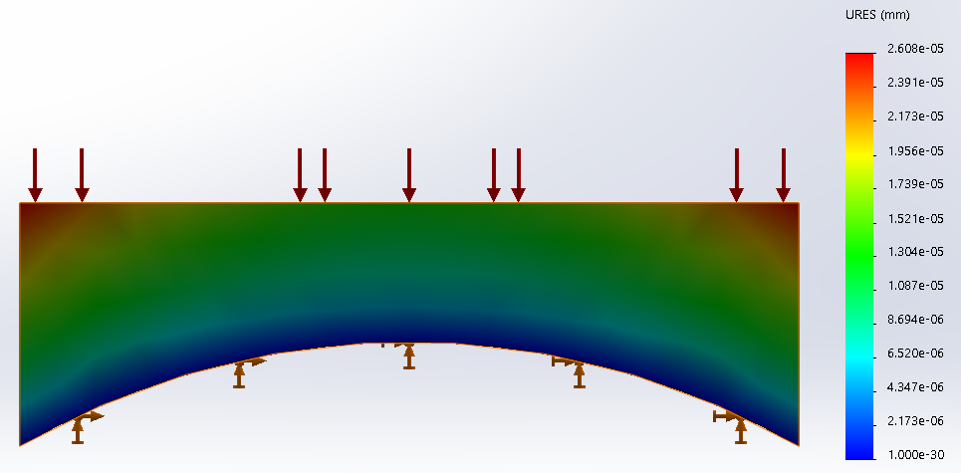
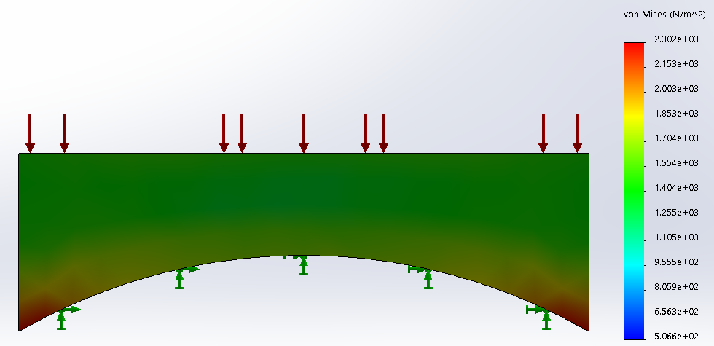
Mounting Board Results
Maximum Displacement: $2.608×{10}^{−5} \text{mm}$
Maximum Stress: $0.0023$N-mm²
Figure 1
Figure 2
Notes:
The left figure shows the displacement of the mounting board due to the pressure distribution applied, and the figure on the right shows the stress in the mounting board due to the pressure field.
The displacement is so small, that it is acceptable due to the flexure inherent in the pvc mounting board anyway.
Time after this slide: 16.5 minutes

Slide 26

Electronics Overview
OS5000 Compass
Electronics Box
Proximity Sensor (Panasonic GX-F12A )
Geared Planetary DC Motor
T100 Thrusters
Notes:
Shown here are the major electrical components on the AASV. The electronics box is located aft on the deck. The Geared Planetary DC Motor powers the anchor’s winch and level wind. There are T100 thrusters beneath each hull. A proximity sensor is located on the bow roller to sense the metallic anchor when it is fully retrieved. And the OS5000 compass is located above the deck to isolate it as much as possible.

Slide 27
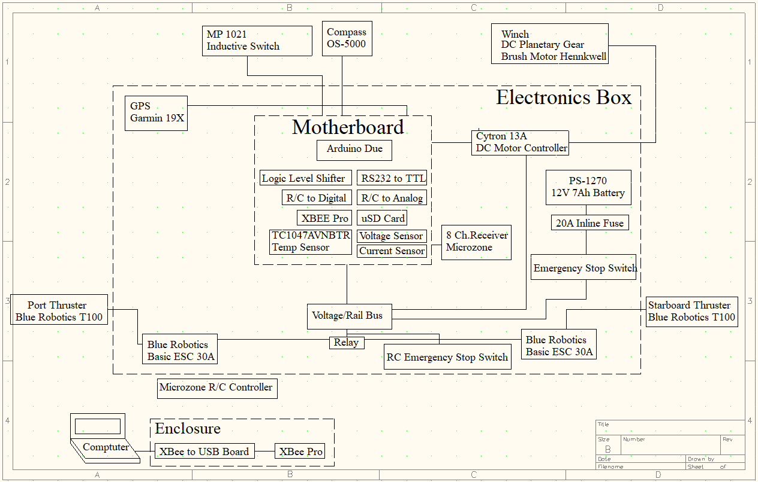
Detailed Design and Analysis-EE
Notes:
This is a High-level diagram of the electronic components of the AASV. It is divided into three main sections and one separate section. In the center of the diagram within the fist red dotted line is the Mother board section. All the components in this section will be located on the Printed Circuit Board for the AASV which serves as the ‘brain’ of the project. This includes the Arduino Due, Xbee Zig, Logic Level Shifter, Micro-SD card, R/C to Analog converter, voltage sensor, current sensor, temperature sensor, PIC controllers and Rs232 to TTL converter. The second red dotted border represents the electronics box and all the components that it will be housing including the motherboard. These components include the Garmin 19X GPS, our power source which is the PS-1270 12V 7Ah Battery, the winch motor controller which is the CYTRON 13A DC motor controller, an inline fuse, the Microzone Receiver, the Blue Robotics ESCs for the thrusters, a cooling fan, voltage / ground rail, and solid state relay. On the very outside are the components that are located outside the electronics box. These include the thrusters, the winch which is the DC planetary Gear Brush Motor, the antenna for the Xbee Zig, the transmitter for the Microzone receiver, emergency stop button, the OS5000 compass, and the proximity sensor. The enclosure section on the bottom left represents the components that will be off the AASV at ‘ground station’ for communication.

Slide 28
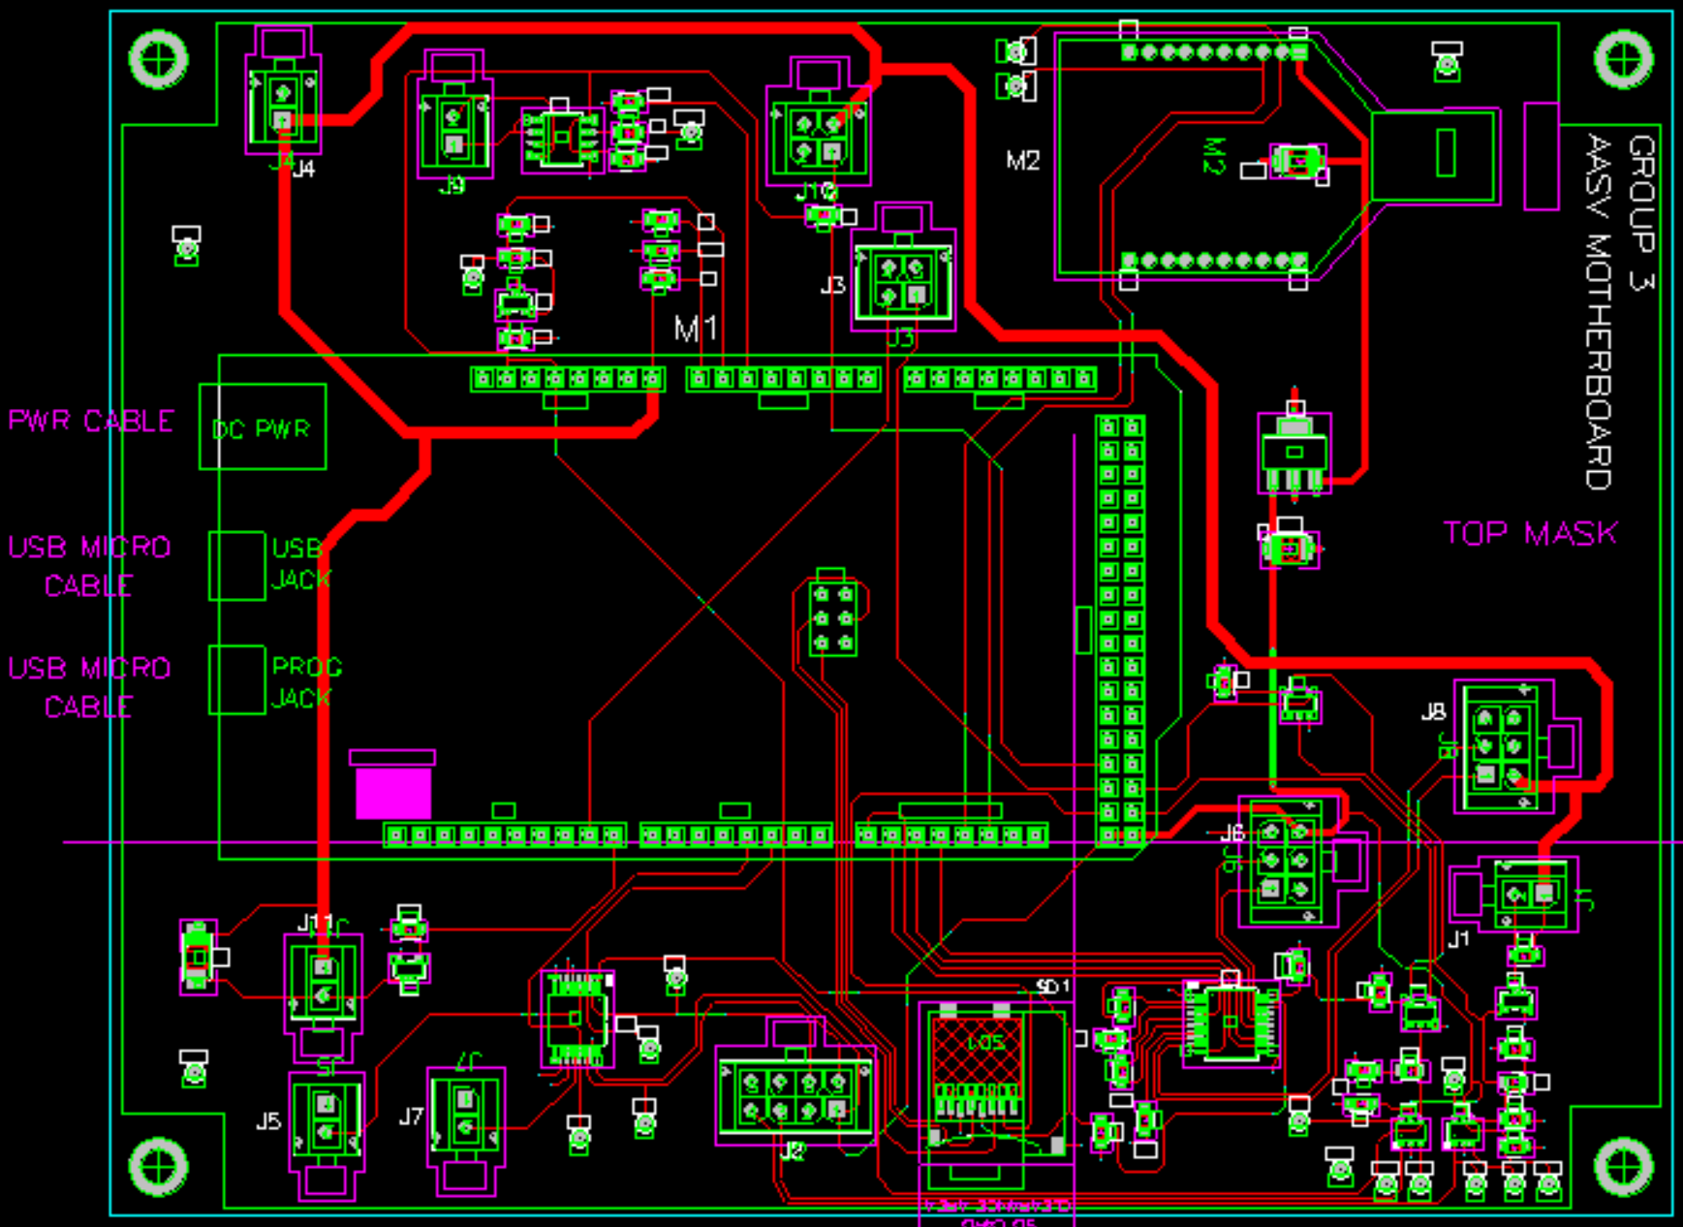
Printed Circuit Board Design
Notes:
The printed circuit board was designed using PCAD 2006 software provided by the FAU Ocean and Systems Engineering Department. The board was designed to properly run all mission levels the AASV needed to accomplish and be compact to take up less space inside the electronics box. Components and connectors were also carefully placed so that accessibility would be easy for the user when testing, troubleshooting, and collecting data.

Slide 29
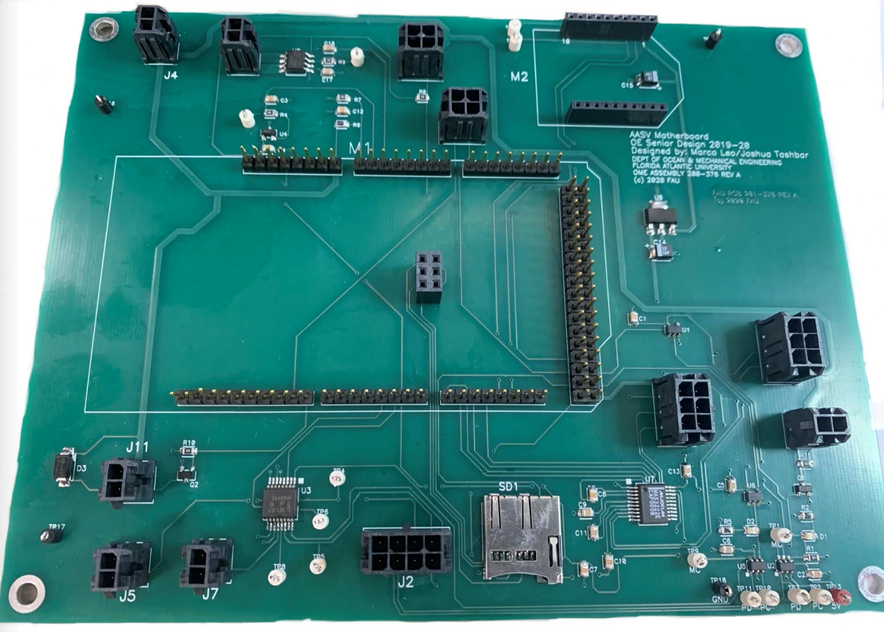
Printed Circuit Board Fabrication
Proximity Sensor Connector
Current Sensor
Motor Driver Connector
Power Supply Connector
Motor Plug Connector
Xbee Radio Communication
Temperature Sensor
Arduino Due Controller
GPS Connector
Compass Connector
Fan Connector
Port ESC Connector
Starboard ESC Connector
TTL – RS232 Converter
R/C Receiver Connector
Micro SD Card
Notes:
Components were then soldered on with the assistance of the FAU electronics shop team. As you can see, the traces, connectors, and components spots directly match the previous slide design image. Test points were included to make sure that each component works properly which greatly simplified troubleshooting when testing began. The four mounting holes on the corners of the PCB were fitted with standoffs to raise the PCB from the mounting plate at the bottom of the electronics box. The same was done with the motor controller for the winch. Holes were drilled into the mounting plate that were a little bit larger than the diameter of the mounting standoffs. Since the mounting plate is raised ½” from the bottom of the electronics box, the larger holes allow for the PCB and motor controller to sink into the mounting plate and not move around. This also allows it to be easily lifted up out of the electronics box if needed. It was deemed unnecessary to bolt down the PCB because the conditions the AASV would be encountering would not unset the securing standoffs. The option of having a modular electronics box and PCB interface was very convenient during all phases of the AASV construction and testing.

Slide 30
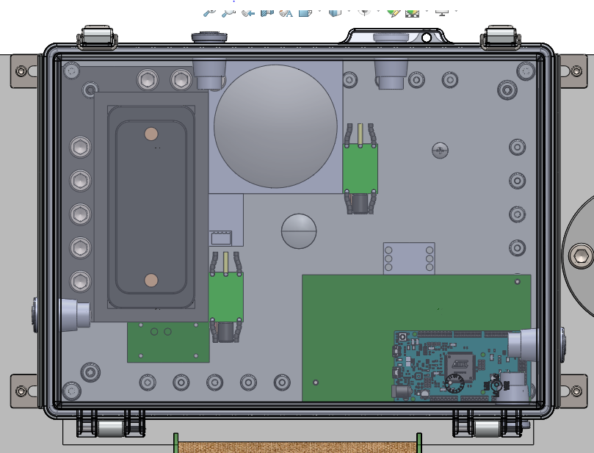
Electronics Box Overview/ Components
Garmin 19X GPS
Blue Robotics T100 Thruster ESC’s
Futaba R2004GF Receiver
Solid State Relay
Cytron 13A DC Motor Driver
PCB Motherboard
Notes:
Here we have the proposed electronics box design layout which includes the major electronics components that will be taking up the majority of the space. The PCB was still in the design phase at the time of this SolidWorks drawing so the dimensions of the board were estimated. This caused to layout to change slightly once the PCB was finished and is shown in the following slide.

Slide 31
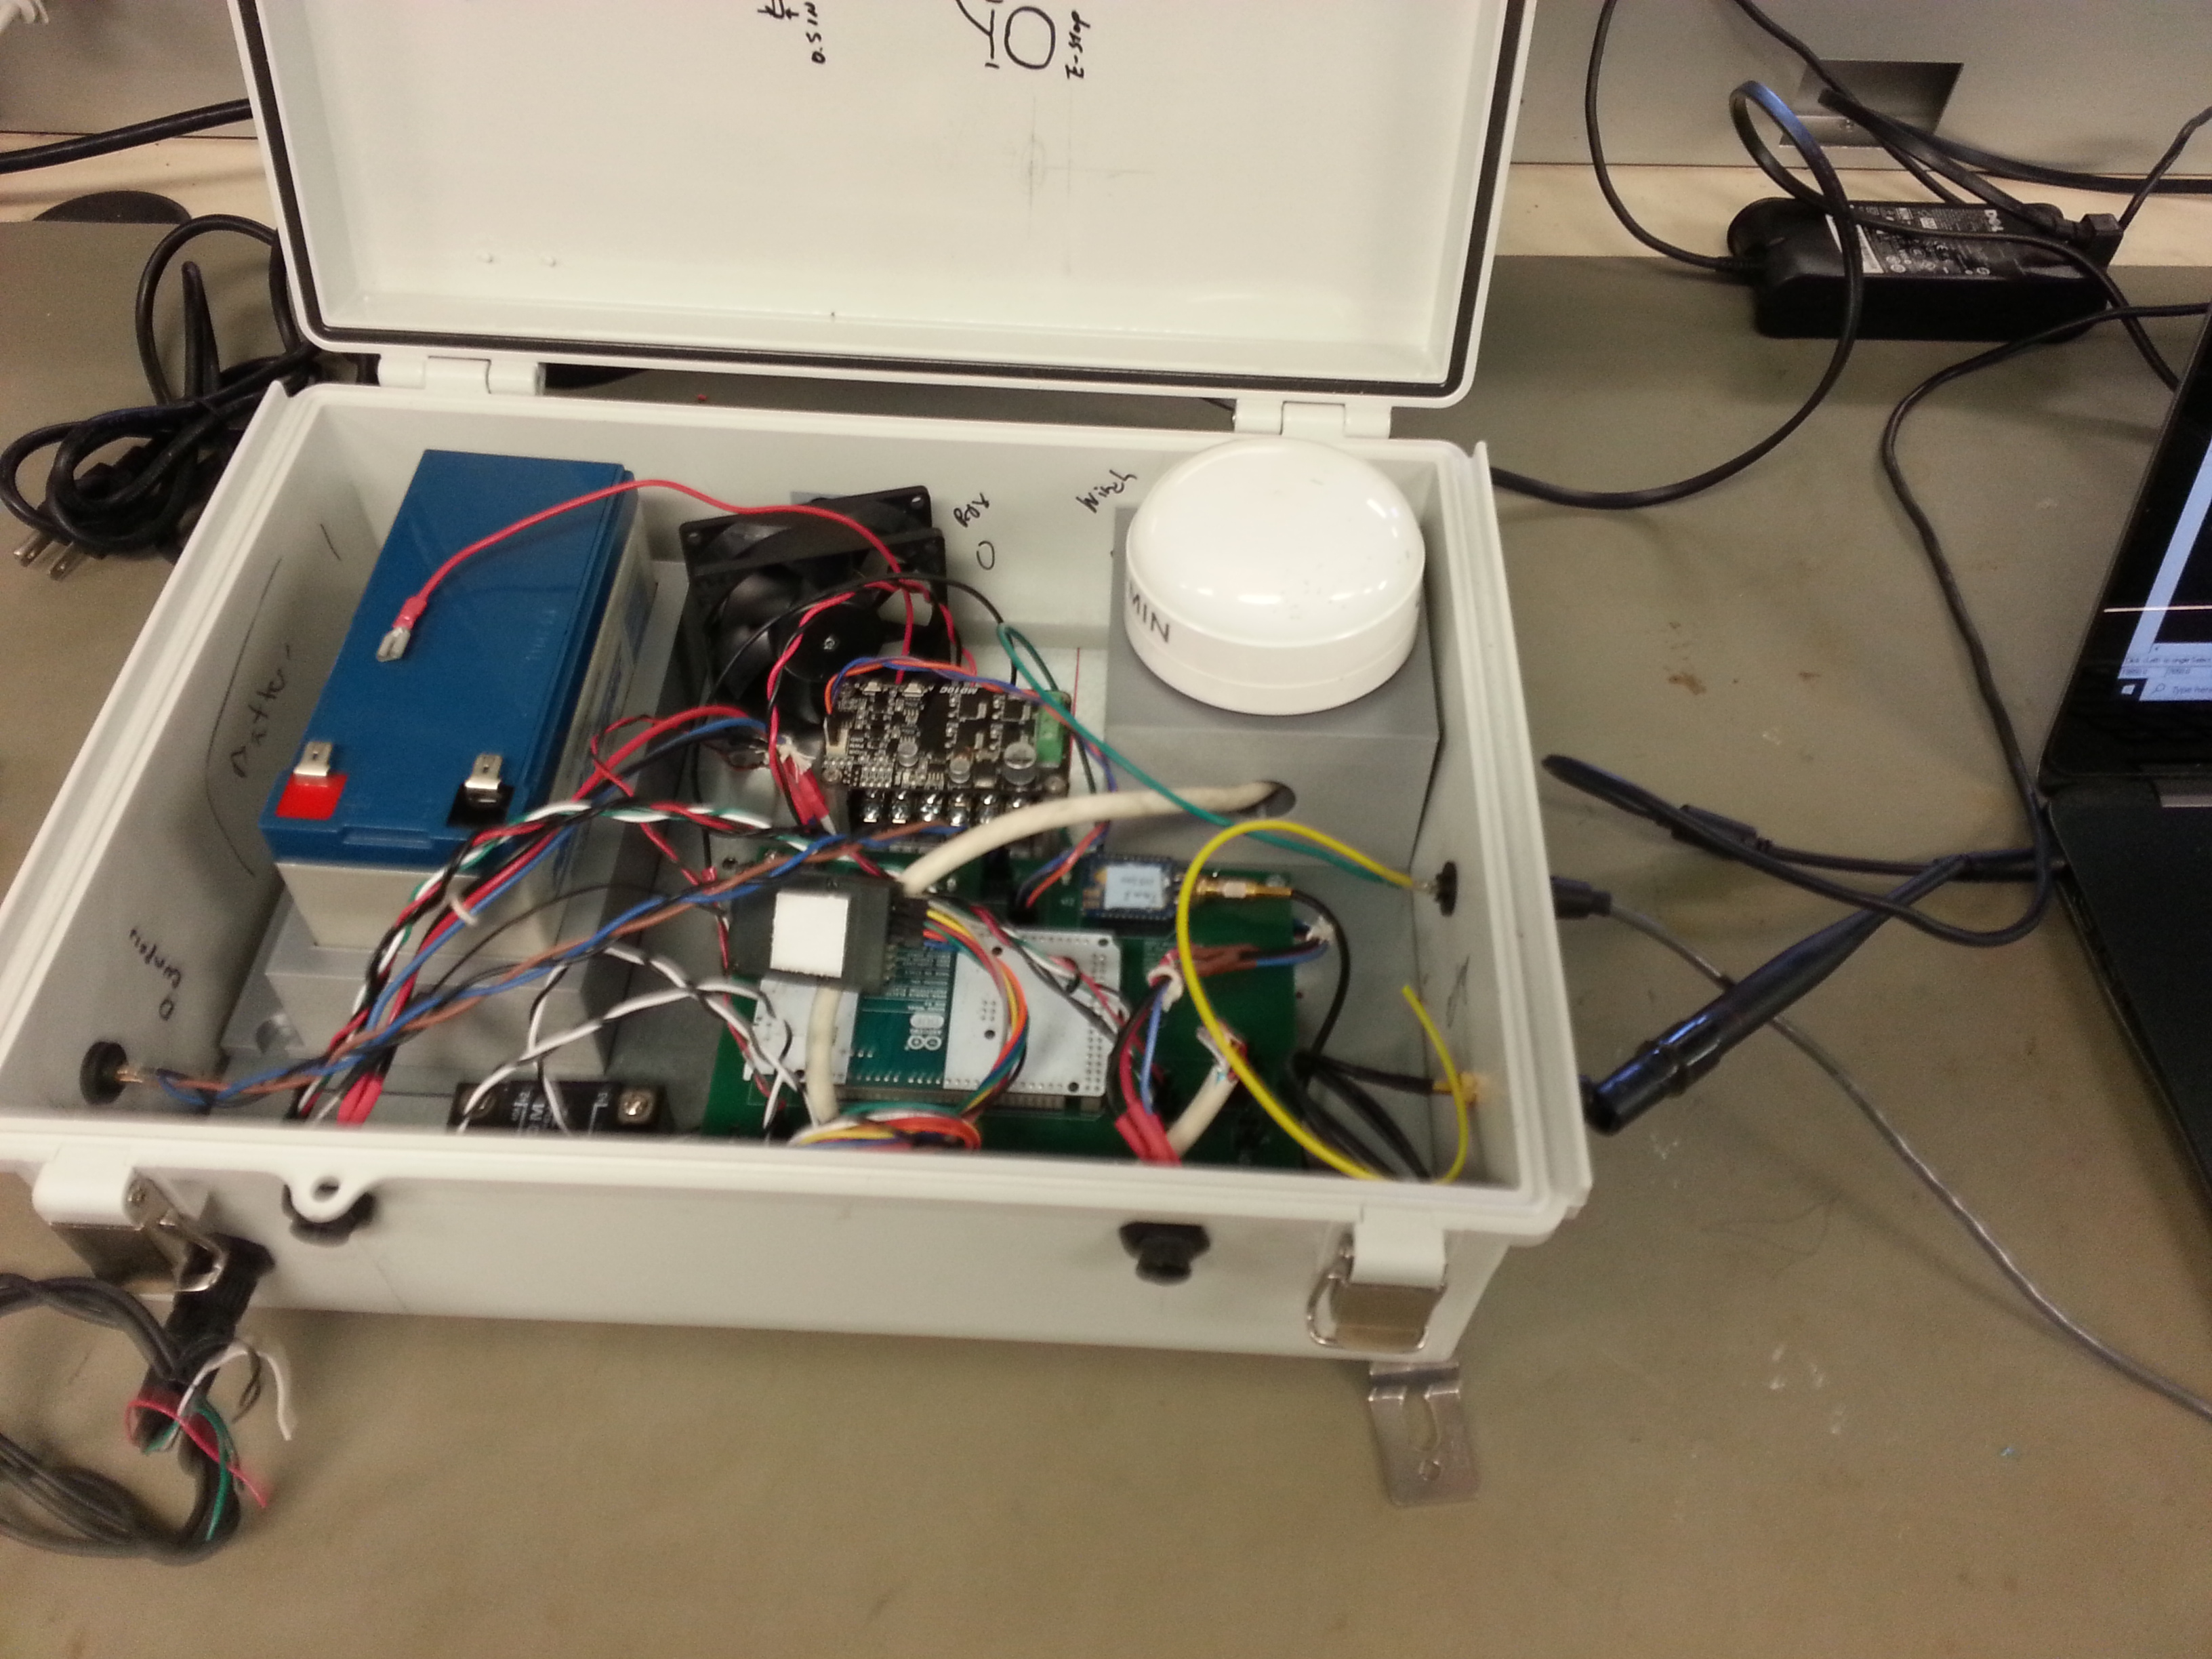
Electronics Box Actual Layout
Notes:
As seen, the layout of the electronics box changed slightly from the original concept proposed. With the addition of the mounting standoffs, space underneath the PCB and motor controller was utilized. The thruster ESCs were placed underneath the PCB and secured with double sided tape. The power rail was moved to underneath the motor controller mount as well to save space.

Slide 32
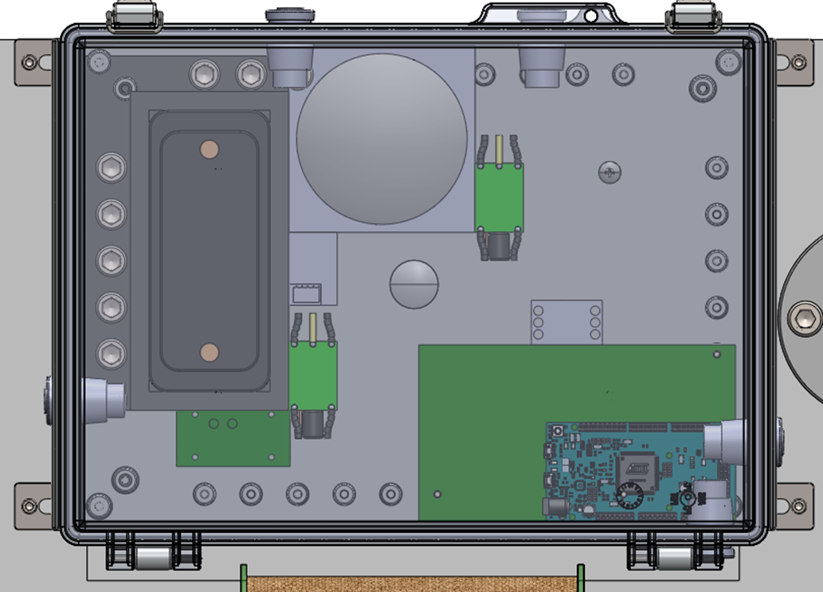
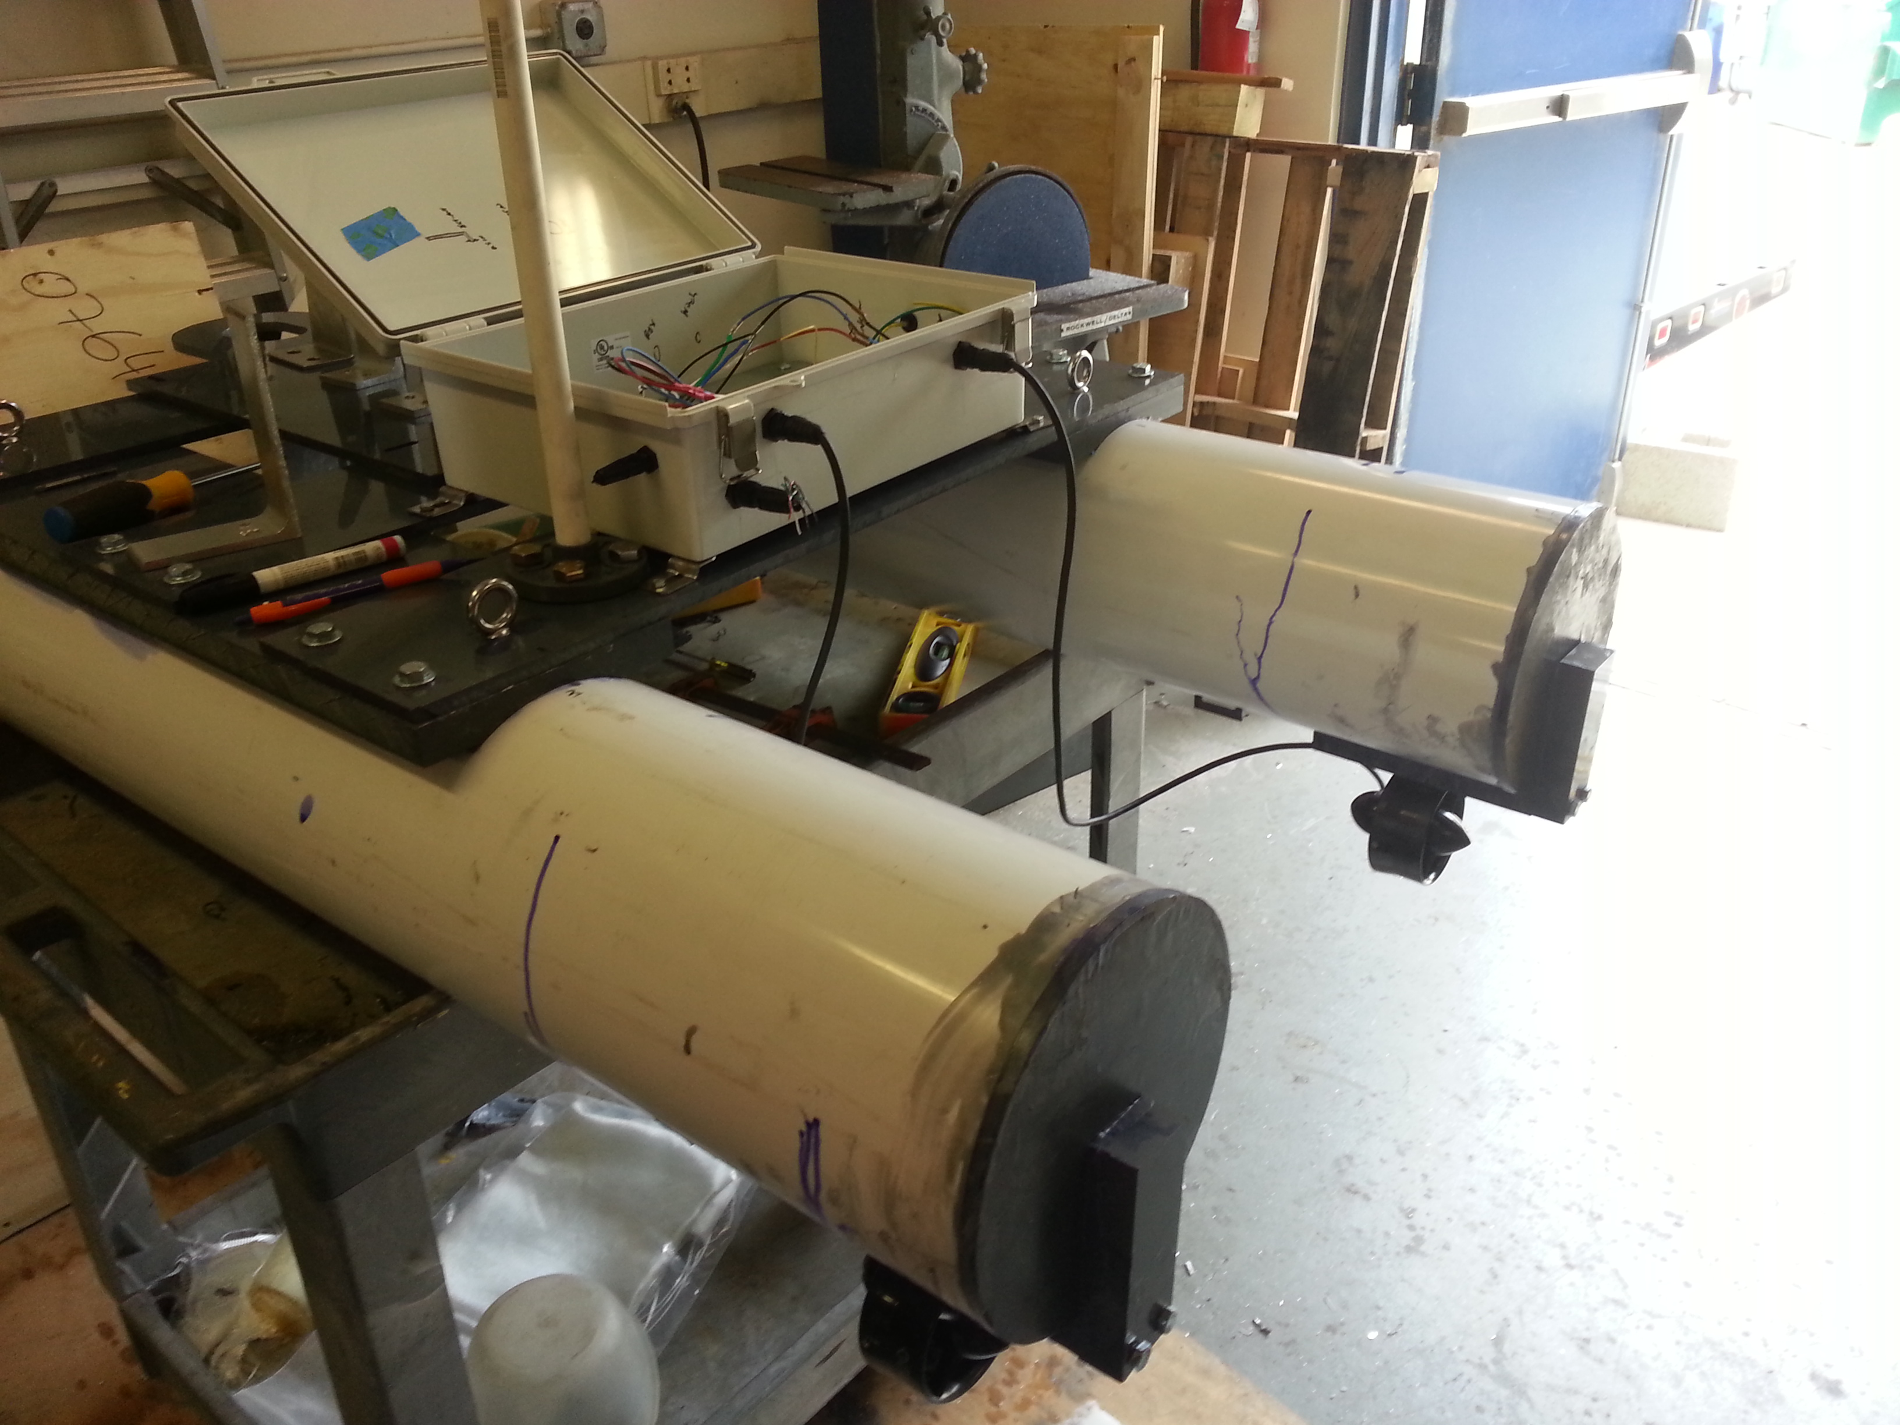

Electronics Box External Connectors
Total of 5 waterproof connectors connecting to external electronics.
Notes:
A total of 5 waterproof connectors connecting to the external electronics were used. In the top portion of the diagram are the two thruster connectors. On the left is the winch motor connector. On the right face is the compass connector and on the bottom face is the proximity sensor connector. The picture on the right shows the electronic box mounted and the connector layout during the fabrication process.

Slide 33

R/C and Wireless Communication
Used a Microzone RC remote and receiver.
Remote control capabilities will include complete thrust control as well as the ability to completely cut power to the thrusters.
Xbee Zigbee will be used to verify new coordinate locations.
Eliminates the need to take the AASV out of the water and remove the electronics box for new mission updates.
Notes:
A microzone controller and receiver were incorporated as a backup feature in the design. They were functioning properly and verified in the electronics shop.
One of the electronics shop staff would do the coding for both 8-bit PIC microcontrollers to control the logic for the remote. We also used an xBee to update mission variables and read the ASV’s health information without needing to open the electronics box.

Slide 34

Health Monitoring
Safety precautions were implemented to the system to prevent damage to individual components and the system as a whole.
Voltage sensor for battery.
Current Sensor for winch.
Temperature sensor.
Emergency stop switch.
Notes:
Having a health monitoring system implemented in the AASV is important because it makes sure critical components of the AASV do not get damaged to the point of needing to be replaced. It makes the AASV as a system safer to use. The voltage sensor will be used to monitor the battery level of the power source. This is done by using a voltage divider to drop the voltage to a range that the microcontroller can read that corresponds to the actual voltage output. If the battery is drained too much, there is a risk of permanently damaging the battery which adds unnecessary costs to the total budget. The current sensor will be used to measure the current drawn by the winch motor. When the winch is reeling up the anchor, there is a relatively constant current being drawn. If the anchor gets caught by a sub sea structure for example, the current would then spike. If the current level exceeds a certain set threshold, the anchor mechanism would shut off to prevent damage to the motor as well as the risk of capsizing the AASV. The temperature sensor could measure the temperature inside the electronics box and shut off the power if the temperature exceeds level that may damage the electrical components. A fan is also implemented to aid in cooling off the components. The emergency stop will kill power to the AASV for all emergencies.

Slide 35

Power Budget
Notes:
This chart shows the typical power and current draw the AASV will consume during a mission.

Slide 36


Power Budget for Mission States
Notes:
The power consumption was then divided into mission phases where phase 1 is the travel to the desired location, phase 2 is the anchor dropping state, phase 3 is the anchor retrieval state, and phase 4 is the return to the original starting position.

Slide 37




Power Budget Continued
Time determined for each state by speed and distance function for both winch and thrusters.
Energy and amp hours were determined for each stage.
Notes:
The total energy required 7.64 watt-hours with 0.64 Amp hours. With this information known, the Power Sonic battery chosen provides sufficient power needed to run successful missions.
Time check after this slide: 24 minutes

Slide 38
Finite State Machine Diagrams – High Level
State | Meaning
1 | Pre-Mission
2 | Mission Navigation
3 | Anchor Deployment
4 | Anchored Position
5 | Anchor Retrieval
6 | End Mission
7 | Remote Override
 | Transition Condition | Meaning
A | Remote Override | 0 = False, 1 = True
B | System Success | 0 = False, 1 = True
C | System Failure | 0 = False, 1 = True
Notes:
Shown here is the software logic for the AASV’s seven main mission states. The finite state machine diagram portrays these main mission states including Pre-Mission, Mission Navigation, Anchor Deployment, Anchored Position, Anchor Retrieval, End Mission, and Remote Override. The transition condition of each state depends on a system success or failure. At any point in the 7 states a remote override is capable of overriding the system and permitting RC control of the entire system.

Slide 39


Transfer Function Derivation
P_{L} = P₀ + p
c_{D} = 0.2
V = 1m/s
Assume:
Small angle approximations
Preliminary Drag Calculations
θ
F_{D}- drag force
Iα = -(0.5b)P_{L} + (0.5b)P_{R} – (0.5b)F_{D}cos(θ)
$$\frac{θ(s)}{p(s)}= \frac{\text{beam}}{\text{I}{\text{s}}^{\text{2}}+\frac{1}{2}ρ{\text{c}}_{\text{D}}{\text{v}}^{\text{2}}\text{Ls}}$$
P_{R}- Stbd propeller’s force
P_{L}- Port propeller’s force
Notes:
While transiting to a waypoint during the mission navigation states, the change in heading must be kept below a 5% error in order to stay within the required error range of 2m over a 25m distance. The free body diagram shown on the left was used to create the equation and controller model describing the moments acting upon the system.

Slide 40

Dynamics Motion Modeling and Simulation
With 90° error input, settling time of 3.7 seconds to a 5% error.
Controller would have been tuned during testing.
Notes:
With an input heading error of 90 degrees, this controller simulation showed a settling time of 3.6 seconds for 5% error using the PD values shown in the graph’s title. This is based on compass and GPS updates at approximately 10 Hz, therefore the sampling time in the above graph is at intervals of 0.1 seconds.
We determined that a PD controller was only necessary while the ASV was traveling the 25m. The system is also designed to slow down proportionately as it approaches the assigned GPS coordinates.

Slide 41

Main Functions
Transitioned through states using a switch-case format.
getGPS()
  Provided instant Latitude and Longitude.
  Calculated a moving average of Latitude and Longitude.
findDistanceHeading()
  Calculated the distance to the mission GPS location.
headingController()
  Updated the heading from the compass data.
  Relayed compass data to thrusters to provide steering.
Notes:
The main code of the AASV transitions through each state using a switch-case format.
The code’s main functions include:
get-GPS, which provided the instant latitude and longitude from the garmin 19x and calculated their moving average.
Find-Distance-heading, which calculated the distance in meters and the heading to the targeted GPS location. This would provide the distance towards the mission GPS location and the Dock GPS location. It would direct the thrusters to slow their thrust when approaching the targeted GPS location when it reached 2 meters from the location.
Heading-Controller received data from the compass to determine the current heading and relayed the appropriate data to the thrusters to control the steering.

Slide 42



Hull Construction Process
The pontoon hull was a 5’ long 8’’ diameter section of schedule 40 PVC pipe that was cut on the bandsaw.
The aft end caps were lathed from a sheet of PVC and cemented onto the hull.
The deck mount is also PVC and was cut using a circular saw with the same radius as the hull and then cemented onto the hull.
PVC End Cap
PVC Pipe Being Cut into Hull Length
Deck Mounts
Notes:
The pontoon hull was a 5’ long 8’’ diameter section of schedule 40 PVC pipe that was cut on the bandsaw.
The aft end caps were lathed from a sheet of PVC. Two 3/8’’ circles which had the same diameter as the inner diameter of the hull were cemented together so that the section of the cap inside the hull being ¾’’ long and the portion of the cap on the outside of the hull being 3/8’’ thick as well as having the same diameter as the outer diameter of the hull and was cemented onto the hull.
The deck mount was cut from a 1’’ thick sheet of PVC using the bandsaw to the required length. Afterwards, the sheet was ran through a circular saw in order to cut a radius on the mount that was the same as the hull radius. This was done to ensure proper fitment once the mount was cemented on the hull. Holes were also milled onto the mount and tapped in order for the eye bolts to be threaded through the mount. This allowed the eye bolts to be used for lifting when transporting the ASV. The eye bolts also serve to help secure the deck slats to the deck mount.

Slide 43




Construction Process
The deck slats were cut from a 3/8’’ thick sheet of PVC using the bandsaw.
The winch plate was also cut from a 3/8’’ thick sheet of PVC using a bandsaw and the mill for to create the bolt holes as well as the hole for the anchor.
Notes:
The deck slats were cut from a 3/8’’ thick sheet of PVC using the bandsaw. Holes were milled on the deck slats for the placement of the eye bolts as well as standard bolts to secure the deck slats to the deck mount.
The winch plate was also cut from a 3/8’’ thick sheet of PVC using a bandsaw and the mill for to create the bolt holes as well as the hole for the anchor. Unfortunately, the plate was not finished due to the campus closure from covid-19 and is lacking the milled holes to allow the winch and level wind brackets to bolt through the plate.

Slide 44

Thruster Mount Construction
The thruster mount consisted of two sections. Both were cut using the bandsaw from a 1’’ thick section of PVC sheet.
This two part assembly was bolted together and cemented onto the hull, with the aft section being cemented onto the end caps.
Notes:
The thruster mount consisted of two sections. Since the design was to have the two part assembly be PVC cemented onto the hull this allowed greater contact area for the cement to bond to and increased the rigidity of the mount. Both sections were cut using the bandsaw from a 1’’ thick section of PVC sheet.
The lower portion was also ran through the circular saw. This was done to allow the mount follow the curvature and be cemented to the hull. There were also two holes tapped on that section in order to allow the mounting of the thruster. The aft section of the mount was tapped to allow bolts to thread into the mount.
The upper section had thru holes milled to allow that section to mate with the lower section.
This two part assembly was bolted together and cemented onto the hull, with the aft section being cemented onto the end caps.

Slide 45






Winch Construction
PVC pipe winch drum.
Aluminum shaft was also cut on the bandsaw and was drilled and tapped for 8-32 screws.
Aluminum brackets secure the winch to the winch plate.
The Delrin bushings were cut on the bandsaw.
Motor bracket holding the line drum
Delrin bushing
Notes:
The winch drum is a 5.25’’ long section of 2.5’’ diameter PVC pipe. It was cut on the bandsaw and had three holes drilled milled through it.
The middle hole milled on the pipe was to secure the anchor line to the drum. The other holes were countersunk to allow a pair of 8-32 screws to secure the pipe to the motor shaft in order for the drum to turn as the shaft turns.
The aluminum shaft was also cut on the bandsaw and was drilled and tapped for 8-32 screws.
The brackets holding the winch are prefabricated aluminum brackets that have been milled to allow a shaft coupled with Delrin bushings to fit inside the bracket. The base of the bracket has holes milled to allow a pair of 5/16’’ bolts to secure the bracket to the winch plate.
The Delrin bushings were cut on the bandsaw for a thickness of ¼’’ to match the thickness of the brackets and these bushings were used to reduce the friction from the bracket on the shaft as it is rotating.

Slide 46


Winch Construction (Continued)
Lathed aluminum shaft adapter.
Set screws secure the adapter to the motor shaft.
Holes were milled onto the aluminum bracket to allow bolts to secure the motor onto the bracket.
Notes:
The DC motor has a shaft that was too short to couple to the shaft for the winch so a shaft adapter was necessary. This was made of aluminum and lathed in order to accept the DC motor shaft on the female end and a shaft coupler on the male end to couple the adapter to the 3/8’’ shaft.
Holes were milled onto the surface of the adapter and tapped to allow set screws to secure the adapter onto the motor shaft.
Thru Holes were milled onto the aluminum bracket to allow bolts to secure the motor onto the bracket.

Slide 47



Level Wind Construction
Aluminum brackets secure the level wind to the winch plate.
The shaft is aluminum that has been cut on the bandsaw to allow the attachment of the double helical screw.
Bracket for Level Wind
Aluminum Shaft
Delrin Bushing
Notes:
Aluminum brackets secure the level wind to the winch plate.
The brackets are the same aluminum brackets used for the winch, there was a hole milled on each bracket for a shaft coupled with the Delrin bushing to fit as well as holes milled on the base for the 5/16’’ bolts to secure the bracket to the winch plate.
The shaft is aluminum that has been cut on the bandsaw to allow the attachment of the double helical screw.

Slide 48


Level Wind Construction (Continued)
Double helical screw and pawl were 3D printed.
The double helical screw has 12 revolutions.
The pawl was designed to have a U shaped tip.
Double helical level wind screw
Pawl
Notes:
Both the double helical screw and pawl were 3D printed using a resin printer to allow a greater level of accuracy as compared to a FDM printer using ABS plastic.
The double helical screw has 12 revolutions and a pitch of 0.09’’. It also has holes at either end of the screw to allow for a set screw to hold it onto the aluminum shaft.
The pawl was designed to have a U shaped tip to match the same pitch as the double helical screw so that the pawl can track along the helices.

Slide 49


Level Wind Construction (Continued)
3D printed ABS channel guide.
3D printed resin line guide.
Line guide
Channel guide
Notes:
The channel was printed using a FDM printer using ABS since the channel was too large a part for the resin printer and the FDM printer allowed the level of accuracy needed for that part.
The line guide was printed on the resin printer in order to have the accuracy needed to traverse along the channel whilst holding the pawl in place.

Slide 50


Electrical Testing Results and Analysis
Winch Motor Controller
T100 Thrusters
Notes:
Unfortunately our campus closed due to the Covid-19 pandemic and we were unable to complete the testing process. We were able to successfully bench test all the electronic components using a setup similar to the one pictured. The PD controller code also passed a brief bench test using the OS5000 compass and T-100 thrusters as shown in the setup on the right.

Slide 51

Software Testing Results and Analysis
GPS
Notes:
Testing with the Garmin 19x GPS was completed to determine that the 19x functions both in collecting the GPS location and relaying that information to an Arduino Due. This test was done on the dock of SeaTech, using the Garmin 19x, an Arduino Due and a laptop. Data was collected at several pylons on the dock to ensure accuracy. The collected data was then uploaded into MATLAB and potted using the Haversine formula to determine the GPS’s accuracy and specifically whether the collected data fell within the 2 meters error radius necessary to fulfill mission requirements. As shown above in the plot the data collected from Pylon 1 all fell within the Circle with a radius of 2 meters. We were also able to test our software’s ability to transition between states based on GPS data.

Slide 52

Mechanical Testing Results and Analysis
Unfortunately our campus was closed due to the Covid-19 pandemic and we were unable to complete our testing process.
Notes:
Shown here is a video of one of the few in-water tests we were able to complete, a stability analysis and check to see how well the ASV maintained direction on its own in the small pool on SeaTech's campus. Although we were unable to test the subsystems of the ASV, we were on track to have a completed prototype on time for requirement level testing before the campus was closed.

Slide 53
Future Improvement
Mechanical:
  Increased communication with machinist during to design phase to avoid any redesigning during construction.
  Thorough testing of the levelwind would be required in any further project development.
Electrical:
  Order parts early to accommodate any unanticipated delays.
  Be sure that all members are on the same page with regards to project design.
  Formalize clear project requirements early on in the design phase.
Software:
  Completion of the anchor deployment and retrieval code.
  Completion of the GPS code to determine if the AASV is dragging the anchor.
Notes:
Further development with this project is difficult to anticipate due to the unfinished testing process. The levelwind would have to be thoroughly tested to ensure that it’s capable of storing the anchor line without tangling it. The gps monitoring code to ensure the ASV is only swinging on its anchor, rather than dragging, could also be further optimized.

Slide 54
Mechanical Budget
Notes:
The Budget of the Mechanical items were $827.00.
This included the PVC Pipe for the hull, the PVC Sheets for the platform, the anchor and line, and mechanical hardware from McMaster-Carr to construct the winch system.

Slide 55
Electrical Budget
Notes:
The total Electrical Budget was 158.41. The most expensive item on this budget was the Polycase enclosure that served as our electronics housing.

Slide 56

Donated Parts
Notes:
The total cost of all of our donated parts was $1,292.02. The majority of these parts were provided by the electrical department from previous Senior Design Projects. The Mechanical hardware was provided by Broward Bolts , a local company in Pompano Beach, Florida.

Slide 57

Budget
Received a $1200 Grant from the Office of Undergraduate Research and Inquiry
Items such as T-100 Thrusters, GPS, OS-5000 Compass, and other electrical components were provided by the department from previous Senior Design Projects.
Mechanical hardware was donated by Broward Bolts of Pompano Beach, Florida.
Notes:
Our total cost for the AASV was $985.50. The Projected Total Cost including the donated parts was $2,277.52.
Our team received a grant from the Office of Undergraduate Research and Inquiry that totaled $1200.
We wanted to stay below that amount for the project and were able to do so due to the donated parts provided.

Slide 58
Achievements
Gained a greater understanding of the importance of details in the design process.
Learned to plan, structure, and develop a relatively involved software program.
Verified RC remote control functioning properly and correctly coding a program for it.
Became more comfortable fabricating parts.
Notes:
This senior capstone project was a thoroughly more involved project than previous course assignments. It was incredibly rewarding to design all the details of the ASV and then follow through with the fabrication.

Slide 59




Flowchart for Spring Semester
Notes:
We were able to complete most of the sub-systems and assembly that we planned for this semester. However, due to the pandemic, plans were cut short.

Slide 60
Acknowledgements
Dr. Beaujean
FAU Office of Undergraduate Research and Inquiry
Dr. Verma
Mr. Henderson
Mr. Kielbasa
Mr. Coulson
Mr. Knapp
Mr. Frankenfield
Dr. Mahfuz
Dr. An
Dr. Glegg
Dr. Sarah Du
Broward Bolts of Pompano Beach
Boca Bearings
Notes:
We would like to thank our senior design professor, Dr. Beaujean, along with all the staff here at FAU’s Seatech campus and the professors who helped us throughout this process.

Slide 61
Self-Reflection
Notes:
During this senior design project, we gained a greater understanding of the design and prototyping process in engineering, specifically the importance of designing all the details early on rather than letting them become a problem during construction. Communication with team members during such an extended project was challenging and we did improve with it.

Slide 62
Thank you
Notes:
Thank you for watching our presentation on the Autonomous Anchoring Surface Vessel. Further details can be found in our Final Design Report.
Total time: 36.5 minutes

