Slide 1
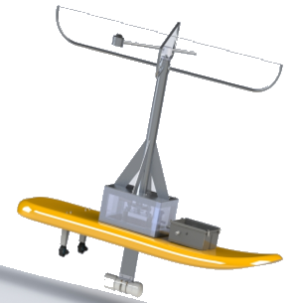


The Wave-Powered Autonomous Surface Vehicle
Ocean Engineering Systems Design and Control Final Design Review
College of Engineering and Computer Science
Department of Ocean and Mechanical Engineering:
FAU SeaTech Campus
Notes:
Hello, this is the senior Design final Review presentation for the wave-Powered Autonomous Surface vehicle

Slide 2
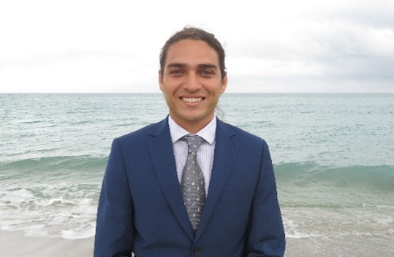
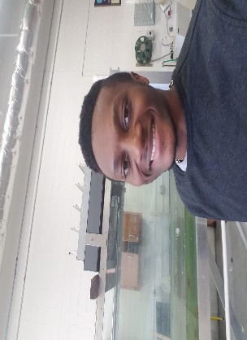




Team Organization
Emmanuel Roig
Project Leader / Software Engineer
Carlton Jones
Progress Tracking / Software Engineer
Derek Hooker
Electrical Shop Coordinator / Electrical Engineer
Luis Julian Velasquez
Environmental Hazard and Safety / Electrical Engineer
Logan Riley
Purchasing& Budgeting / Mechanical Engineer
Tanner Reynolds
Machine Shop Coordinator / Mechanical Engineer
Notes:
My name is Emmanuel Roig and I am the team leader of the group, along with the position of a software engineer. To the right of me is Carlton Jones, another software engineer and the person in charge of progress tracking. Following is Derek Hooker an electrical engineer and the electronic shop coordinator. In the bottom left is Luis Julian Velasques, another electrical engineering and the person in charge of Environmental Hazards and Saftey. Following to the right is Logan Riley a Mechanical engineering and the person incharge of purchasing and budgeting. The last student in the group is Tanner Reynolds he is part of the mechanical engineering team and the persong in charge of coordinating the machine shop.

Slide 3
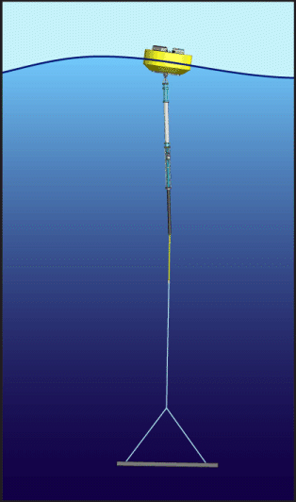
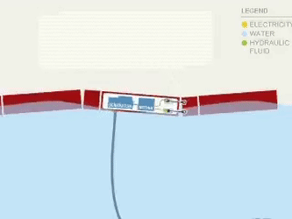
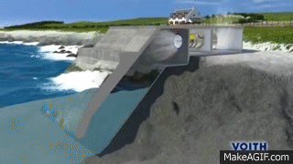
Existing Technologies & Methods
Point Absorber
Attenuator
Oscillating Water Column
Notes:
This slide highlights Existing Technologies and Methods to harness wave energy.
Click Here we have a point absorber. A point absorber is a floating structure which is moored to the seafloor and absorbs energy from all directions through its movements near the water surface. The vertical motion of the buoy is used to activate a power system
Click Here is an attenuator.
An attenuator is a floating device which operates parallel to the wave direction and effectively rides the waves. These devices capture energy from the relative motion of the two arms as the wave passes them.
Click Another existing technology to harness wave enrgy is the Oscillating Water Column:
The Oscillating water columns is a type of Wave Energy Converter that harnesses energy from the oscillation of the seawater inside a chamber caused by the action of waves. As Air is driven in and out of the chamber this will drive a turbine to genergate power.

Slide 4
Objective / Requirement
The vehicle shall be two-man deployable
The vehicle shall harness wave energy in 0.3m-1m waves.
The vehicle shall travel 200 [m] to a waypoint in 600 seconds or less and 200[m] back to its initial position, all within a 5 [m] accuracy.
  The vehicle shall correct its position accordingly while navigating
The vehicle shall harness energy and measure and record the energy being stored.
  The vehicle shall store enough energy to complete the whole mission.
Allow the system to be tunable for trim and increased energy harvesting efficiency.
Have the capability to repeat tests to increase the reliability of the system.
Notes:
Our Objective and Requirmnets are:
The vehicle shall be two-man deployable
The vehicle shall harness wave energy in 0.3m-1m waves.
The vehicle shall travel 200 [m] to a waypoint in 600 seconds or less and 200[m] back to its initial position, all within a 5 [m] accuracy.
The vehicle shall correct its position accordingly while navigating
The vehicle shall harnessing energy and measure and record the energy being stored.
The vehicle shall store enough energy to complete the whole mission.
The vehicle shall be tunable for trim and increased energy harvesting efficiency.
The vehicle shall have the capability to repeat mission to increase the reliability of the system.

Slide 5
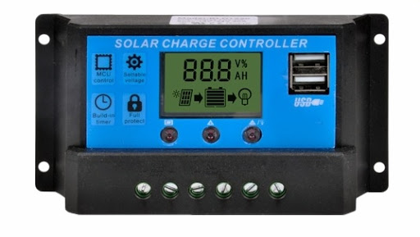
Requirement Adjustment
Storing wave energy would involve in designing a charge controller.
Due to the time frame and complexity of the project, designing a charge controller would exceed the release date of the project.
Therefore the electrical design of the project was done in a mater where inserting a charge controller will theoretically allow energy to be stored.
The wave-Powered ASV will NOT store energy. Instead the energy harnessed will be lost through thermal energy with the use of a resistor.
A current sensor will be used to measure the power produced by the ASV
Charge Controller
Notes:
Reqirment adjustments:
Storing wave energy would involve in designing a charge controller.
Due to the time frame and complexity of the project, designing a charge controller would simply exceed the release date of the project.
Therefore the electrical design of the project was done in a mater where inserting a charge controller will theoretically allow energy to be stored.
The wave-Powered ASV will NOT store energy. Instead the energy harnessed will be lost through thermal energy with the use of a resistor.
A current sensor will be used to measure the power being produced by the ASV

Slide 6
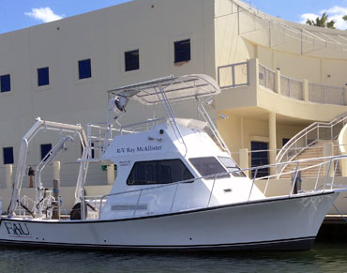
Constraints
The vehicle shall operate in 0.3-1.0 [m] waves
The vehicle shall be two-person deployable from the R/V Ray McCallister
Diver-less operations.
The project shall not exceed a budget of $1500 of initial funding, plus $500 in scholarships.
The vehicle shall be built at FAU Facilities.
The vehicle shall be finished and meet all requirements by May 2020
R/V Ray McCallister Research Vessel
Notes:
The constraints that the wave-powered ASV team Had to deal with are that:
The vehicle shall operate in 0.3-1.0 [m] waves
The vehicle shall be two-person deployable from the R/V Ray McCallister
Diver-less operations.
The project shall not exceed a budget of $1500 of initial funding, plus $500 in scholarships.
The vehicle shall be built at FAU Facilities.
The vehicle shall be finished and meet all requirements by May 2020

Slide 7
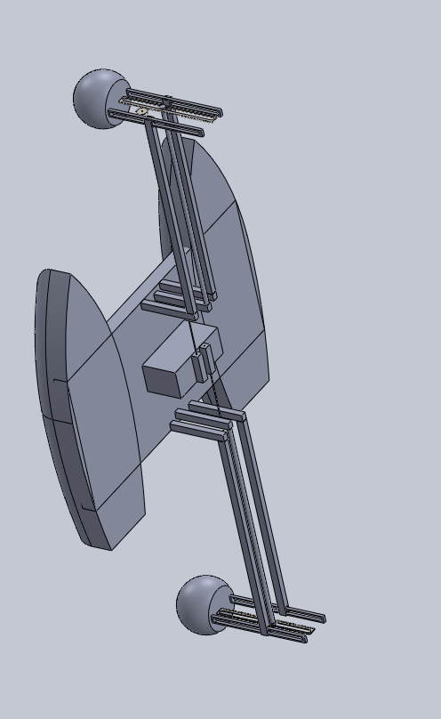
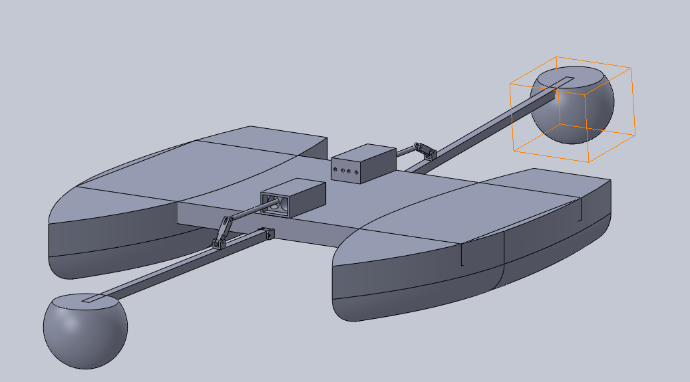
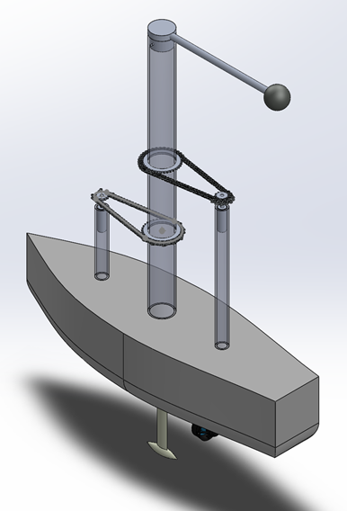
Trade Studies
Air Piston Mechanism
Rack and Pinion Mechanism
Rotating Mass System
Notes:
In the first semester of the project a trade studies was conducted.
Our team came up with 3 conceptual ideas.
The first concept was the Air Piston Mechanism. This system would use two buoys attached to an ocilating shaft that would drive an air pump system.
This system would store mechanical energy in the form of compreesed air, which would then drive a compressed motor to provide thrust to the ASV.
Next we have the Rack and Pinion Mechanism:
This system uses the buoyant force of a bouy along with wave force to drive a rack and pinon up and down to produce electrical energy, which is stored in a battery.
The last concept our group came up with is the rotating mass:
The rotating mass uses the rocking motion of a vessel to spin an ofsetted mass to produced energy. This system takes into account the clockwise and counter clockwise spinning motion of the mass by using one way bearing to power two electric generators.

Slide 8
Trade Studies Cont.
Notes:
A Requirement Prioritization Matrix was done to get a weight of the relative importance of each system requirements.
An Analytical Hierarchy Process was used along with the weight of each requirement to finalize the best conceptual idea.
Our team gathered up and casted votes on how well each conceptual idea would operate with each requirement.
Finalizing all calulation it can be seen in yellow that the rotaing mass had the highest score of 5.8
Therfore our team went with the rotaing mass concept.

Slide 9
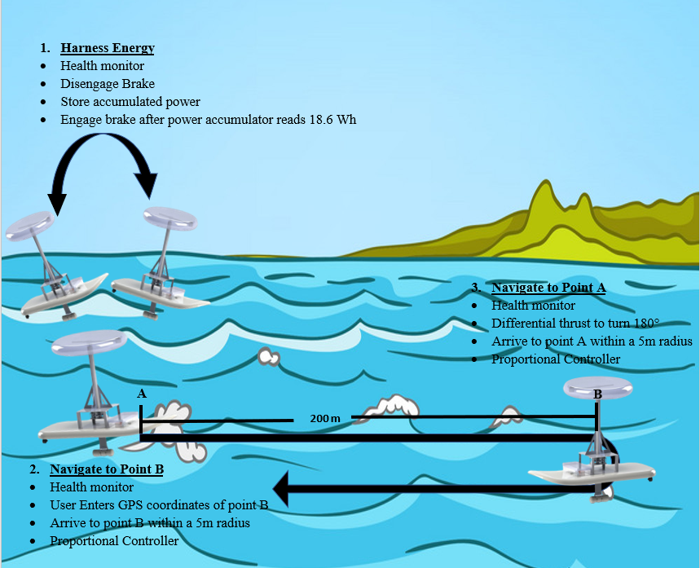
Concept of Operations
Harness Energy
Navigate to waypoint B
Navigate to waypoint A
Notes:
Our concept of operation will first start with Harnessing energy.
In this part the rotaing mass will spin the electric generators which will produce energy.
After suficent energy has been harnessed the ASV will navigate to waypoint B. Here the ASV will conduct a180 degree turn and head back to its initial position

Slide 10
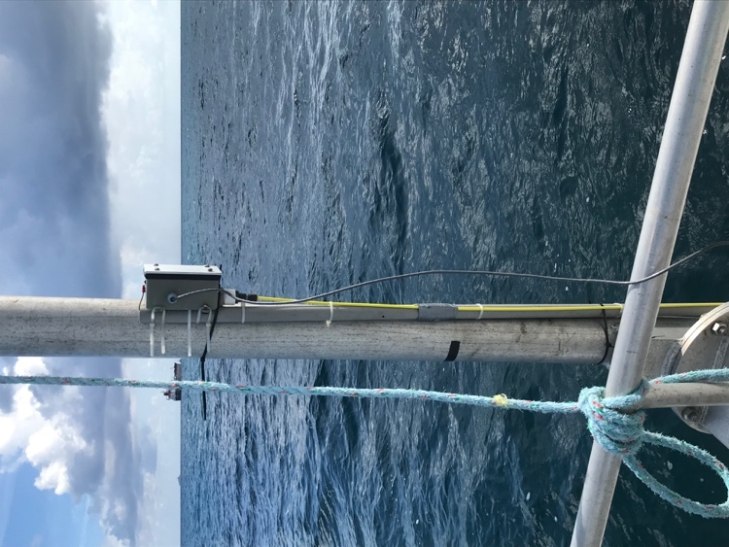
Analysis of Operating Conditions
Average Wave Characteristics for a 1-meter Wave Height Deep water wave. Data Aquired From wave gage experiment conducted in Fall 2019:
Deep water wave
Depth of 14 meters
Period of 3 seconds
Wave height of 1 meter
Wave Gauge
Notes:
Since there is not a wave buoy close to Dania Beach Florida, which is the operating location of the ASV missions. In order to get the most accurate operating conditions for our Simulink simulation, which I will describe in the upcoming slides, our team conducted an at sea experiment on a day where the waves were at an average height of 1m. Our team used a wave gage to measure different Characteristics of the wave. After analyzing the data collected and creating a wave spectrum our team concluded that the ASV will be operating in
Deep water waves
At a Depth of 14 meters
Waves with Period of 3 seconds
And wave height of 1 meter
One thing that I would like to note is that our ASV is designed in a way where we can tune it to operate in various wave heights

Slide 11
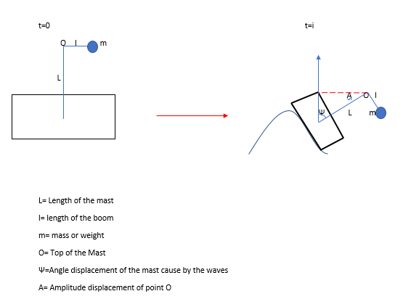
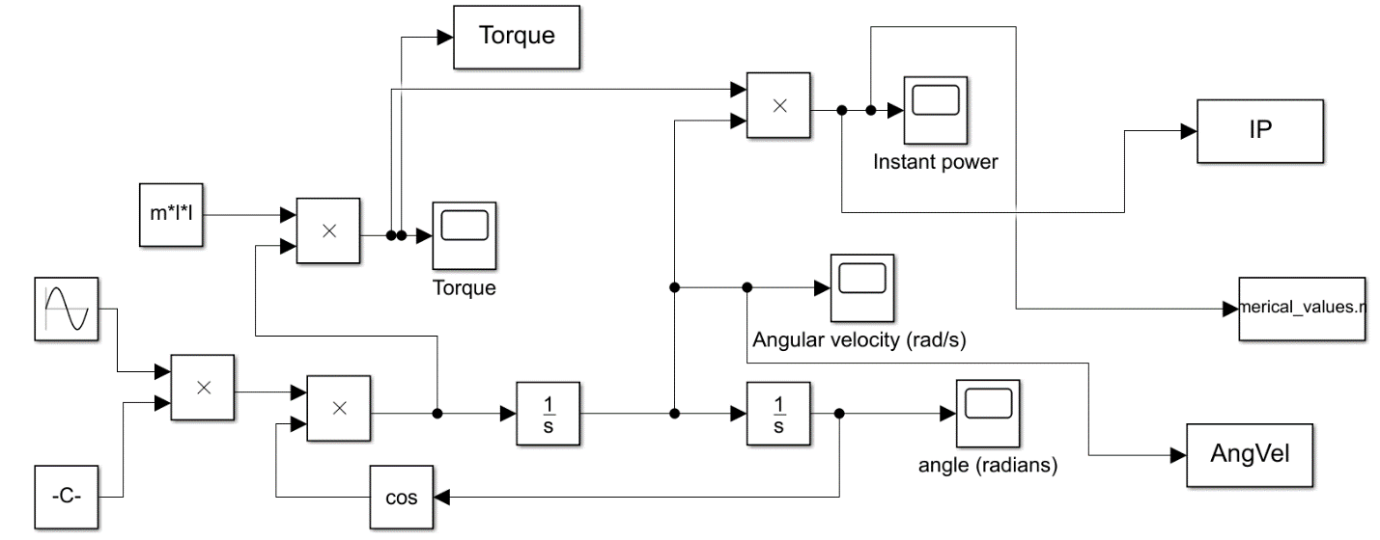
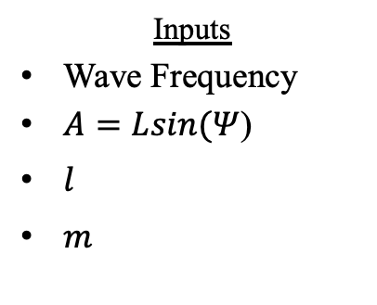

Simulation
Assumptions
The simulated wave is one perfect sinusoidal wave
Two degree of freedom ( Pitch / Rotational )
The ASV will follow the wave (φ = 0°)
2 DOF
Parameters
L=length of mast
$l$= length of boom
Angular Velocity
$m$=mass of ball
O= Top of the mast
$Ψ$=Angle of displacement caused by the wave
A= Amplitude of displacement of point O
Inputs
Wave Frequency
$A=Lsin(Ψ$)
$l$
$m$
Outputs
Power
Torque
Angular Velocity
Notes:
In order to simulate how the ASV will behave in the wave with the characteristics described in the previous slide our team had to make a few assumptions to simplify the equation of motion.
The assumptions made are that the :
The ASV will be exposed to a perfect undistrubed sinusoidal water wave
Only Two degrees of freedom will be considered. Those are the pitching motion of the hull and the rotational motion of the spinning mass
Our last assumption is that the ASV will follow the wave, which means that the ASV and the wave will be inphase
A FBD is shown here to give a visual represenataion of how the ASV will behave:
It can be seen that at time 0 the ASV is still and the mast is point straight upwards towards the sky. And at some time i the ASV is exposed to motion, where now the mast or point O is at an agle Psi
The input parameters to the simulink simulation are the wave frequency.
A= Amplitude of displacement of point O
The length of the Boom
And the mass of the spinning pendulum

Slide 12
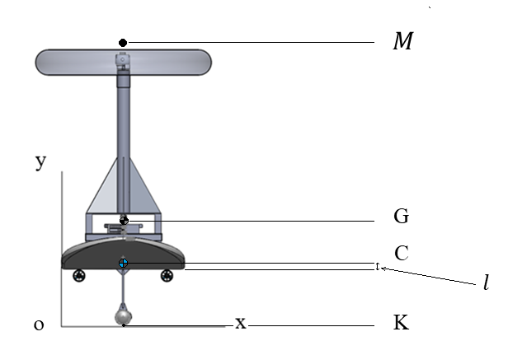

Mechanical Analysis
Static Stability Analysis
Parameters: Reference Frame:
C= Center of buoyancy
G=Center of gravity
$∇$=Volume of displaced water
$l$= Height of the waterline
$I=$Second moment of area
$M$= Metacenter
K= Keel
o= Origin
Notes:
One important analysis that was conducted was stability (static & dynamic) **read the parameters and variables given**

Slide 13

Static Stability Equation & Criteria
GM= Distance between G and M
CM= Distance between C and M
KC= Distance between K and C
KG= Distance between K and G
Stability Equation:
GM=CM+KC-KG
Criteria:
GM>0 Stable
GM<0 Unstable
GM=0 Neutral
Notes:
* Read variables on slides* stability equation >0 = positive <0 = negative etc.

Slide 14
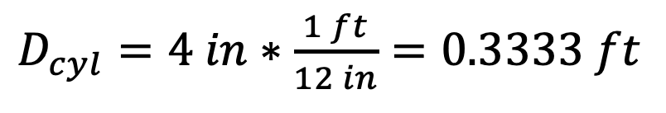
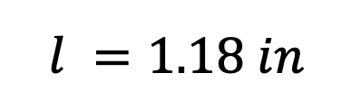
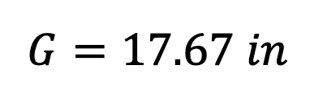
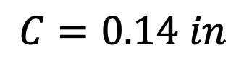
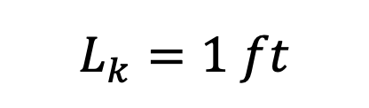
Static Stability Analysis
Measuring from the bottom of the board:
$$C=0.14 in$$
$$G=17.67 in$$
$$l =1.18 in$$
Given System dimensions:
$D_{cyl}=4 in∗\frac{1 ft}{12 in}=0.3333 ft$
$$L_{k}=1 ft$$
Notes:
Read the slide

Slide 15
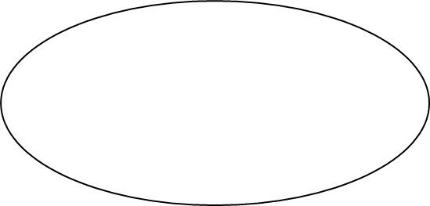


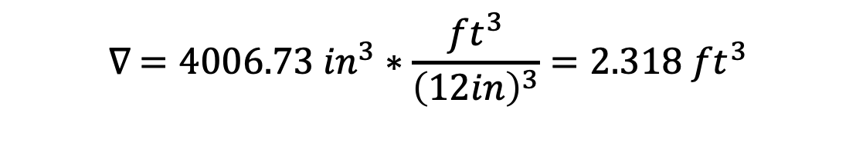
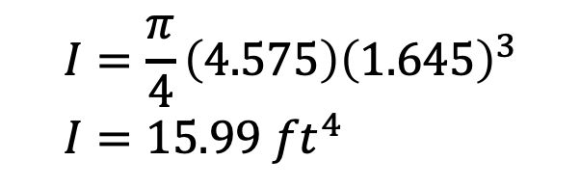
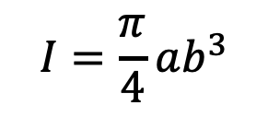

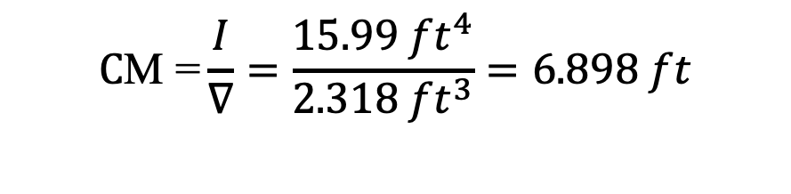
Static Stability Analysis
Assumptions:
Elliptical Shape approximated
CM = $\frac{I}{∇}$ $∇$=4006.73 ${ft}^{3}$
$$I=\frac{π}{4}ab^{3}$$
$$I=\frac{π}{4}\left(4.575\right){\left(1.645\right)}^{3} \\ I=15.99 {ft}^{4}$$
$$C\text{M}\text{ =}\frac{I}{∇}=\frac{15.99 {ft}^{4}}{{2.318 ft}^{3}}=6.898 ft$$
$$∇ =4006.73 {in}^{3}∗\frac{{ft}^{3}}{{\left(12in\right)}^{3}}={2.318 ft}^{3}$$
Notes:
Read the slide from the left to right

Slide 16

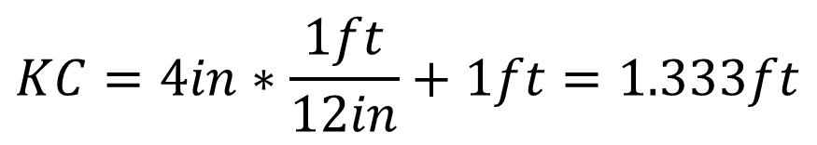
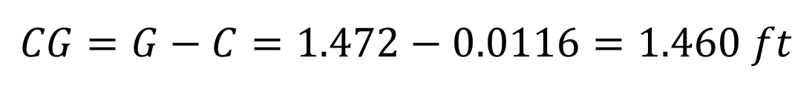
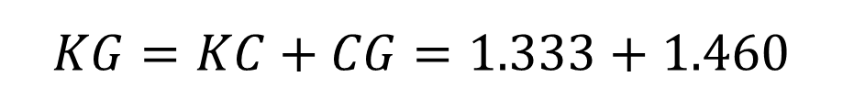
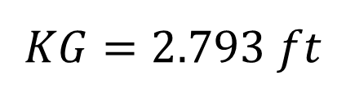
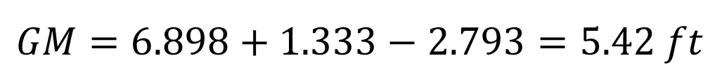
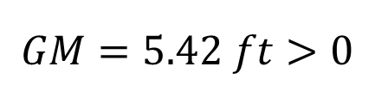
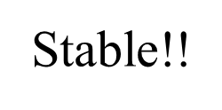

Static Stability Analysis
Notes:
Read the slide and say our ASV is statically stable at the end

Slide 17
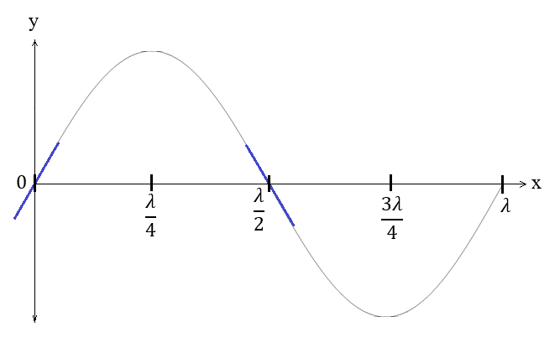
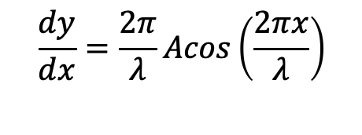
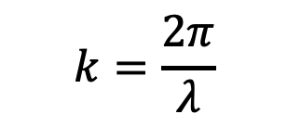
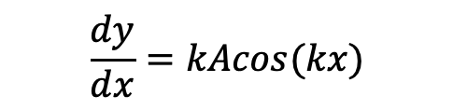
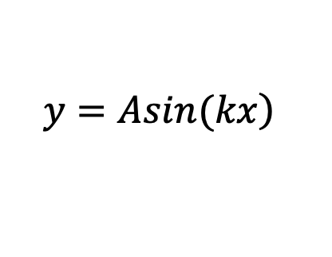
Dynamic Stability Analysis
Equation for a wave:
Wave Parameters:
A= amplitude of the wave
k= wavenumber
$$k=\frac{2π}{λ}$$
$$\left.y=Asin(kx\right)$$
$$\frac{dy}{dx}=kAcos(kx)$$
$$\frac{dy}{dx}=\frac{2π}{λ}Acos\left(\frac{2πx}{λ}\right)$$
Notes:
Read wave parameters then from left to right about how to model the wave etc.

Slide 18
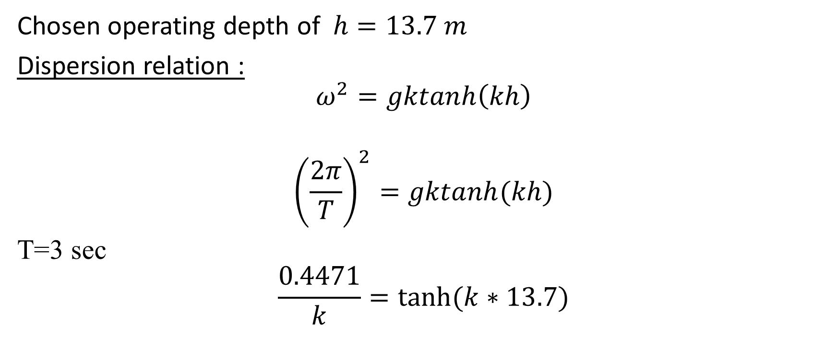

Steepest slope of ASV relative to the wave:
Notes:
Read the slide

Slide 19
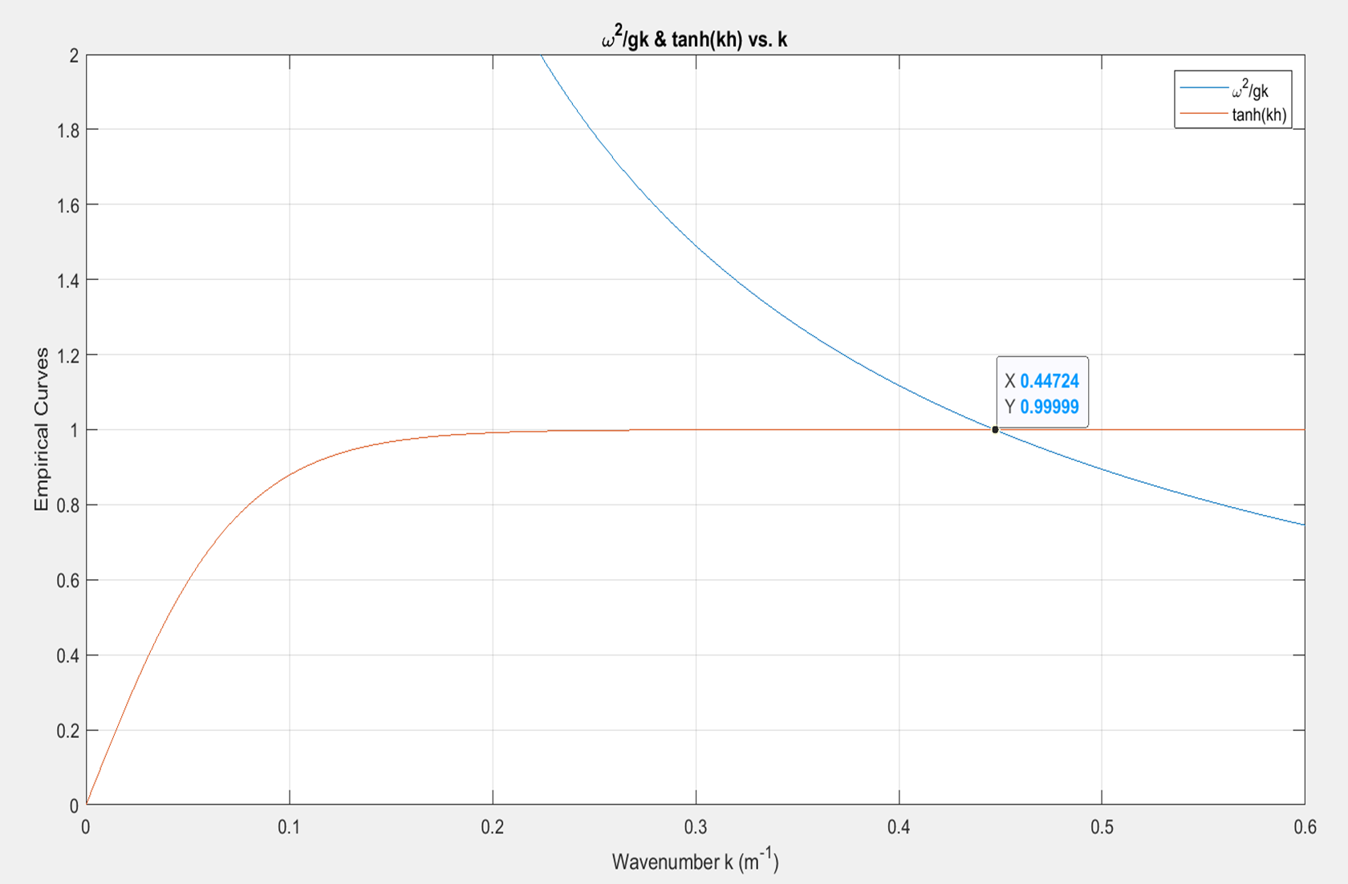
Dispersion Relation Graphical Solution
Notes:
Solution for k (wavenumber) from the dispersion relation

Slide 20

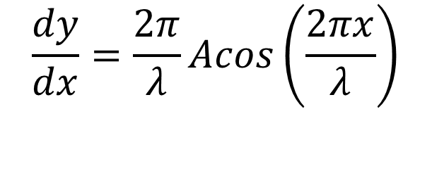
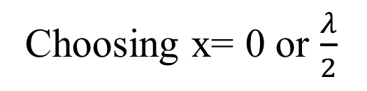
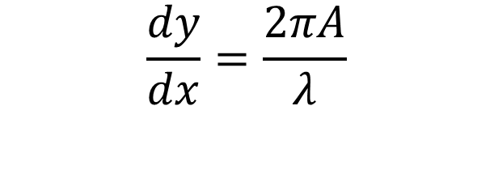

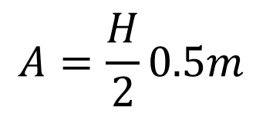


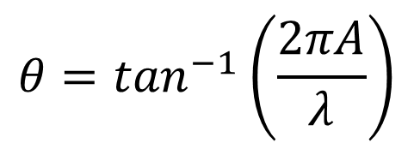
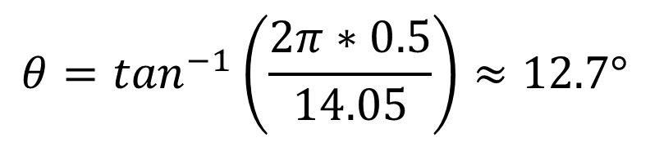


Steepest angle on the wave
$$k=\frac{2π}{λ}$$
$$λ=\frac{2π}{0.4472}=14.05 m$$
Notes:
Read the slide from top to bottom from left to right to find the steepest angle on the wave itself

Slide 21
Angle relative to the wave
Parameter
T= Thickness of the board =0.4375 ft
G = Center of gravity
B= Beam (width of the board)
Notes:
To find the steepest angle relative to the wave the ASV can roll at before capsizing (Read the slide after saying this)

Slide 22

Geometrical Relation
Notes:
Using the Geometry of the ASV based on center of buoyancy Center of gravity, and half of the beam width

Slide 23

Geometrical parameters
Notes:
Given the model the angle alpha can be found base don the parameters

Slide 24


Geometrical angle
Notes:
Angle found was… (read the slide) using trigonometry

Slide 25




Heel angle relative to the wave
Notes:
Given the shifting weight vector pointing downwards as the vessel rolls, Beta is steepest angle relative to the wave when the Asv is at the steepest angle on the wave and theta is steepest angle on the wave. Therefore Beta equals (given in the slide) to find the steepest angle relative to the wave the vessel can roll before capsizing.

Slide 26

Detailed Mechanical Design
Length (in) | 109.14
Beam (in) | 39.30
Height (in) | 89.31
Dry Weight (lbs.) | 169.48
Loaded Weight (lbs.) | 253.19
Notes:
Here are the final dimension of the ASV
9 ft long
3.2 ft wide
Overal height of 7.4ft

Slide 27

Detailed Mechanical Design
Safety Cage
Rotating Mass
Superstructure
Electronics Box
Gear Box
Motor Mounts
Keel that weight can be added
To calibrating the system
Notes:
When the ASV is deployed the rotating mass will spin around clockwise and counterclockwise because of the waves. The rotating mass is connected to a vertical shaft and supported by the aluminum superstructure. The vertical shaft connects to the gear box on the other side which transfers the energy to the motors. The motor mounts are extended so that the thrusters do not come out of the water when transitioning through the waves. The keel has a removable cap to add or remove weight to make sure that the ASV will be stable and calibrated to get the most energy without capsizing. The safety cage was added around the rotating mass to avoid injury when deploying and retrieving the ASV.

Slide 28

Boom arm and Shaft Assembly
Adjustable boom to get desired radius
In different conditions
Rotating Mass with removable cap
To adjust weight if necessary.
Shaft bearing and support
Vertical shaft that connects the
Rotating mass to the gear box
Delrin to keep shaft steady
Shaft bearing and support
Notes:
The rotating mass has a cap so the weight can be adjusted also the length of the boom arm can be changed to find the best combination for the highest average rpms for the conditions. The boom arm is pinned to the vertical shaft which is mounted inside the pipe of the superstructure. The shaft his held sturdy with two mounted ball bearings and a mounted piece of Delrin. The vertical shaft is connected to the gear box with a flexible coupling to allow for slight misalignment.

Slide 29

Gear Box
Gear that mounts
To the main shaft
Spinning with the
Rotating mass
Bearings for
Secondary shafts
Gear on one-way
Bearing that engages
When main shaft
Rotates clockwise.
Gear on one-way
Bearing that engages
When main shaft
Rotates counter clockwise.
Gear that meshes with
DC Generator gear.
Gear that mounts
To DC Generator.
Making the final
Gear ratio 1:10
Main shaft Mounted flange bearing
Notes:
The main gear of the gear box rotates clockwise and counter clockwise with the vertical shaft. There are two gears that mesh to the main gear which are on one-way bearings. This is so that when the main shaft is rotating clockwise it will only engage one of the secondary shafts that go to one motor and vise-versa. so regardless of the rotaing direction of the spinning mass energy will continue to be harnessed. The gear ratio from the main gear to the gear on the DC generators is a 1:10 ratio on both sides of the symmetrical gear box. The shafts are held in place with mounted flange roller bearings. The two gears on the motors are made of nylon, and all the other gears are carbon steel. All the fasteners are stainless steel and the rest of the gearbox components are aluminum. Here are the two DC brushless generators.

Slide 30

Brake System
Linear actuator That
Engages the brake by
Pulling the cable.
Hall sensor used to
Tell when the boom
Arm is aligned with
The keel to signal the
Linear actuator.
Disc brake mounted
Onto the main shaft
And brake caliper.
Notes:
The Linear actuator for the brake system is mounted on the bottom side of the superstructure plate. A brake cable runs from the actuator through mounted cable holders to the caliper for the disc brake. When the system is being deployed the brake will be engaged. Once the ASV is ready to harvest energy the linear actuator will release the tension on the cable allowing the mass to rotate. When the sufficient amount of energy has been harvested the hall sensor will detect the magnet on the main gear and engage the brake when the boom arm is parallel with the keel, so then ASV can transit safely.

Slide 31

Detailed Design: Electrical
Notes:
On this slide we have a picture with our PCB fully populated. These components were carefully soldered and place on the board at the electronics shop on campus. Each component plays an important role for making this system work. On the board we also have connectors which is basically were the electrical wires are connected to and from components. Our PCB board is powered by a 12v SLA battery which is connected to a bus bar which distributes to the components on and off the board.

Slide 32


DC Brushless Generator
Affordable
High Back EMF Voltage constant
Produces high voltage at low RPM
BLWS DC Brushless Generator
Notes:
The two electric motor chosen to produce energy is Anaheim automation

Slide 33

Linear Actuator
2” stroke 25 lb. thrust
Built in Potentiometer to measure its position
2" Stroke Linear Actuator

Slide 34

Current Sensor
This device monitors and reports values for current, voltage, and power. The integrated power accumulator can be used for energy or average power calculations
INA233 Current Sensor

Slide 35


Communication
Ground Station
Communication is achieved using two XBee RF modules
Variables to Vehicle
  Autonomous/Remote Control
  Thruster Control
  Sampling Control
  Controller Gain Values
Variables to Ground Station
  Bearing
  Distance
  Heading
  Mission Status
Electronic Box On the ASV
XBee Pro on the Research Vessel
(Ground Station)
Notes:
Communication between the vehicle and the ground station will be done through the use of two Xbee Pro radio frequency modules to send packets of information.
The ground station will send things like mission parameters to the vehicle, while the vehicle will send its bearing and distance to target to the ground station. In RC mode, joystick inputs will be sent through the Xbees.

Slide 36
High Level Software Block Diagram.

Slide 37

Initialization Software Block Diagram

Slide 38

Energy Collection Software Block Diagram

Slide 39

Transit Software Block Diagram.

Slide 40

Shutdown Software Block Diagram

Slide 41

Autonomous Control
Control System
Distance < 2 meters
Tagt = Sample Site
Target = Home
Notes:
Controller design for the ASV will be a proportional controller to help control the vehicles heading during the transit phase

Slide 42

Complete System Construction
Vehicle System
The board was pressure washed, added fiberglass patches, sanded, and painted for optimal durability and functionality.
Final hull assembly was not completed due to COVID-19.

Slide 43

Superstructure Assembly
The superstructure was made in upper and lower phases, entailing a great deal of cutting, machining , and welding.
Help with superstructure construction came from FAU staff and amongst other senior design groups.
Final assembly of the superstructure was not completed due to COVID-19.

Slide 44

Software construction
Switch/Case statements
getCommand() – function is composed of functions used to receive commands from the ground station to the ASV. These functions in that make up the getCommand() perform tasks, and to switch to the following state
Notes:
The software construction is Composed switch/Case statements. the 3 main states are (0,1,2)
getCommand() – function is composed of functions used to receive commands from the ground station to the ASV. These functions that make up the getCommand() perform tasks, and to switch to the following state

Slide 45

killSytem()
This function puts the system in the idle state
Re-engages the brake if it is disengaged
Turns off the thrusters.
Notes:
Read the slide

Slide 46
energyHarvest()
disengages the brake
starts reading the accumulated power produced by the wave energy convertor
Through I²C communication the wave powered ASV team communicates with the current sensor to store the accumulated power data every second onto the SD card
prints the accumulated power every second to the users laptop.

Slide 47
transitToTarget()
Main state function for ASV to begin the transit state.
Engages the brake to stop harvesting energy.
Receives the target GPS coordinates from ground station.
Reads its current GPS coordinates
Calculates distance and bearing to target
Begins transit and uses proportional controller heading correction
Notes:
Read the slide

Slide 48

Software / Electrical Tests
The GPS outputted the corresponding latitude, and longitude and the measured values were compared with the google maps coordinates.
GPS used to verify outputs of CalcDistance() and CalcBearing() software functions.
SD card was tested to verify data measured from a sensor was stored
Notes:
GPS: GPS was compared with google maps coordinates. Results showed average latitude error of 3.47% and average longitude error of 4.20%. Overall the sensor produces a less than 5% error and is accurate down to the 5th decimal point. This sensor was also used along with verifying the functions such as CalcBearing() and CalcDistance() in the code, which use the GPS measured values and the input target values to calculate its overall trajectory. Once the distance calculated and bearing calculated were identical to the hand calculations performed, the test was concluded to be a success.
SD card: The SD card data storage was tested alongside with the GPS sensor to make sure the data was stored in the desired file format. In this test the GPS coordinates were saved as a .csv file

Slide 49

Linear Actuator / Hall sensor
The linear actuator and hall sensor were successfully tested with software code. When the hall sensor was activated the linear actuator started to extend or engage the brake. The potentiometer from the linear actuator was used to calculate the distance that the linear actuator extended or retracted.
Linear Actuator
Motor Driver
Arduino Board

Slide 50

Current Sensor (INA233)
To verify that the current sensor is properly working 12 Volts was applied from a power source to the sensor. A code was written to measure the voltage input of the INA 233 every second.
INA233 Sensor input voltage readings

Slide 51
Budget
Mechanical Total | $1306.99
Electrical Total | $574.00
Total Budget | $1880.99
Total Budget With 10% Margin | $2069.09
Notes:
Price without donations or pay is: $2429.10
Program liscences:
- Solidwords: $4000 * 5
- Microsoft Office : $50*7
- MATLAB: $5000*7
- ANSYS: $50,000 * 2
Machine Shop:
$50 an Hour
11 Days of work
Electrical Shop
$50 Hour
11 Days

Slide 52
Thank You
Special ThanksTo:
FAU faculty and staff
Department of Mechanical & Ocean Engineering

