Slide 1

Vision 20/20 Pilot of alarms for profound hearing loss
A pilot study showing the effectiveness of tactile waking devices on the hearing impaired
Gerri Penney, Ph.D., EFO
Community Education Coordinator
Valerie Bryan, Ed.D, Professor, FAU
Palm Beach County Fire Rescue
405 Pike Road, West Palm Beach FL 33411
P 561-616-7024; C 561-723-3886;
F 561-616-7084

Slide 2
Introduction
People with Profound Hearing Loss: What do we know? What’s missing?
“During the development of the 2010 edition of NFPA 72, the technical committees incorporated recent research on waking effectiveness for persons with hearing loss …A great deal of discussion…centered on the fact that the new requirements do not address those who are severely hearing impaired or profoundly deaf. The committees would like to have scientific data on methods for awakening, alerting and informing persons with profound or total hearing loss”.
Robert P. Schifiliti, P.E., Chair

Slide 3
People with Profound Hearing Loss:
What is the problem? What is the research question?
What method(s) work best to awaken people who have profound hearing loss in the event of a fire in their home?
We needed to do the research.
Purpose of the Study

Slide 4
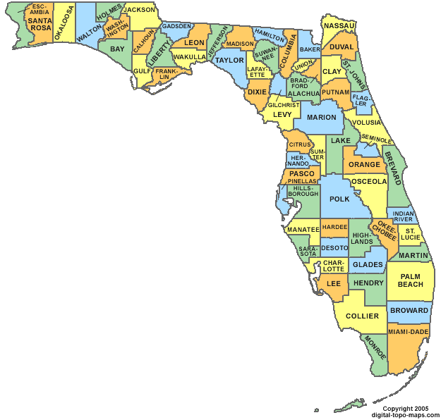
Where was the study? Why there?
1,971 sq. miles
  Larger than Rhode Island & Delaware
1.3⁺ Million population
  363,618 over 60 years
  155,540 seniors with some degree of hearing loss
  16,000 people with PROFOUND HEARING lossR Census Data 201
Palm Beach County, Florida
US Census Data 2010 & Dept. of Elder Affairs

Slide 5
The Partners in the Study
Who did we need to do the study?
Palm Beach County Fire Rescue (Principal Investigator, secured grant and partners)
Area Agency on Aging (Fiscal Agent/ Home Visits)
Deaf Service Center (Measurement-Audiology)
Florida and the Palm Beach County Association of the Deaf (Promoters & recruiters)
Hearing Association of America (Promoters & recruiters)
Delray Medical Center (Sleep Suite/Pilot Demo)
Florida Atlantic University (Research & Report)

Slide 6
What had previous researchers found?
Summary Chart of Literature Review Of Findings Re Successful Devices
STUDY | SUBJECTS | SOUND/ AUDIBLE | STROBE LIGHT | BED SHAKING MOVEMENT | SUMMARY NOTES
Akerstedt (2002) for Combustion Science Engineering (CSE) | Deaf college students |  |  | Vibrating watch, page, pillow, bed shaker 71% REM awake by watch & pager
Ashley (2007) | N=120 (40 deaf, 40 hearing abled,40 hard of hearing) | Standard audible detector only effective in awakening people w/no hearing loss 520Hz square wave auditory signal was most effective-92% awoke participants | Did not sufficiently awaken ANY population 27% awoke participants | Vibratory Tactile Device: most successful wakening for all hearing abilities and age (hearing able, hard of hearing, & deaf) Intermittent shaking devices most effective for deaf 80-84% awoke participants | Tested hearing able, hard of hearing, & deaf Devices used during Stage 2 sleep(Delta & REM) Deaf responded 90% to pillow shaker & 84% to mattress shaker
Chart continues and summary is provided of studies results completed to date

Slide 7
What definitions of terms drove the study?
Profoundly Deaf: “totally deaf; unable to hear anything” Retrieved from http://www.thefreedictionary.com/profoundly+deaf
BAHA: “used to help people with chronic ear infections, congenital external auditory canal atresia and single sided deafness who cannot benefit from conventional hearing aids. The system is surgically implanted and allows sound to be conducted through the bone rather than via the middle ear - a process known as direct bone conduction.” Retrieved from http://www.umm.edu/otolaryngology/baha.htm
Cochlear Implant : “A cochlear implant is a small electronic device that helps people hear. It can be used for people who are deaf or very hard of hearing. ” Retrieved from
http://www.umm.edu/ency/article/007203.htm#ixzz1vnXxhfjC
Hearing Aid: “A small electronic apparatus that amplifies sound and is worn in or behind the ear to compensate for impaired hearing” Retrieved from http://medical-dictionary.thefreedictionary.com/hearing+aid

Slide 8
Definitions cont.
Strobe Light: A strobe light or stroboscopic lamp, commonly called a strobe, is a device used to produce regular flashes of light. Retrieved from http://en.wikipedia.org/wiki/Strobe_light
Intermittent Bed Shaker: “A bed shaker which goes under the mattress and vibrates the bed in an intermittent pattern awakening the sleeper to an emergency” Retrieved from http://www.safeawake.com/Adults%20with%20Varying%20Hearing%20Levels.html
Voice Alarm: “Dedicated manual or automatic equipment for originating and distributing voice instructions, as well as alert and evacuation signals pertaining to a fire emergency, to the occupants of a building.” Retrieved from http://defineterm.com/?s=voice+alarm

Slide 9
Definitions cont.
REM Sleep: “Usually, REM sleep occurs 90 minutes after sleep onset. The first period of REM typically lasts 10 minutes, with each recurring REM stage lengthening, and the final one may last up to an hour. During this stage the eyes move rapidly in different directions. Intense dreaming occurs during REM sleep as a result of heightened brain activity, but paralysis occurs simultaneously in the major voluntary muscle groups. REM is a mixture of encephalic (brain) states of excitement and muscular immobility.” Retrieved from http://www.webmd.com/sleep-disorders/excessive-sleepiness-10/sleep-101
Reaction Time (measured in seconds): “The time elapsing between the beginning of the application of a stimulus and the beginning of an organism's reaction to it.” Retrieved from http://www.merriam-webster.com/medical/reaction%20time
Waking Time: “Marked by full consciousness, awareness, and alertness.” Retrieved from http://www.thefreedictionary.com/waking

Slide 10
How was the study staged & conducted?
Initial Approval of Study
Western Institute Review Board (WIRB) Certificate of Approval for this study
Subjects
50 people, age 50 years or older with profound hearing loss 90 dB + were recruited www.youtube.com/watch?v=bEEhaWyc-aM http://www.youtube.com/watch?v=UxYBAFdxJvg
Screening Process
Application with Palm Beach County Fire Rescue
Verification of Hearing Loss with Deaf Service Center’s audiologist report
Verification of criteria for study with Delray Medical Center
Test Site
Sleep over at Delray Medical Center Sleep Center
Tested with various devices while in REM sleep
Data reviewed & forwarded for analysis
Final Verification of Data
Florida Atlantic University verifies research, conducts literature studies, writes up the report and prepares presentation materials

Slide 11

What processes were used for approval of research? The WIRB process
Verification of certificate of researchers’ knowledge of human subject research
Development of:
  MOU’s between agencies
  Alarm application & qualification form
  Screening procedures for each agency
  Adult consent forms
  Flyers for recruitment
  Podcasts for recruitment
  News releases
Development of:
  Participant questionnaires
  Step-by-step research protocol
  Spreadsheets for coding of clients
  Suggested statistical analysis for data sets

Slide 12
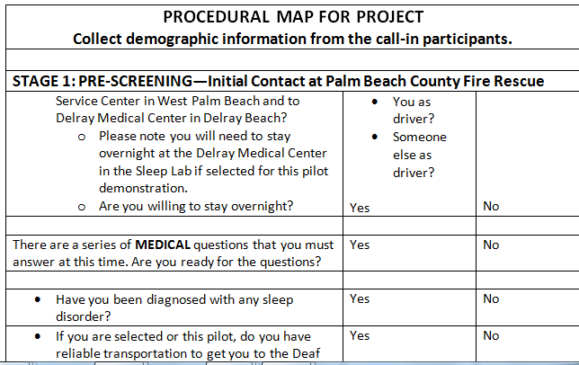
Sample of Procedural Map

Slide 13
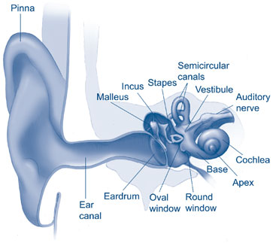
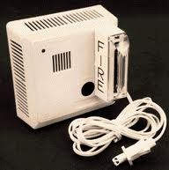
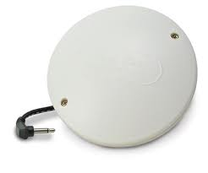
What was tested in the sleep lab?
Is it light?
Is it sound?
T3
Or 520 HZ
Or Voice
Is It movement?
What method(s) work best to awaken people who have profound hearing lost
in the event of a fire in their home?

Slide 14

What devices were used?
All devices were operated remotely from the sleep technician’s lab. Patient was viewed from remote room. Patient had electrodes to measure input.
Photoelectric smoke alarm
ADA compliant 177 cd Strobe- Wall and Ceiling mount in the 7109/7139 Series: 710/713 CS/LS- Gentex corporation
Modified Bedside Fire Alarm and Clock
Lifetone Technology which is a notification appliance that has three modalities:
  Sound-520 Hz tone and voice annunciation in English and Spanish “Fire- Get Out”
  Light- a flashing yellow display screen with FIRE
  in black block letters and
  Movement/motion – an intermittent bed shaker that can be placed under the pillow or mattress

Slide 15
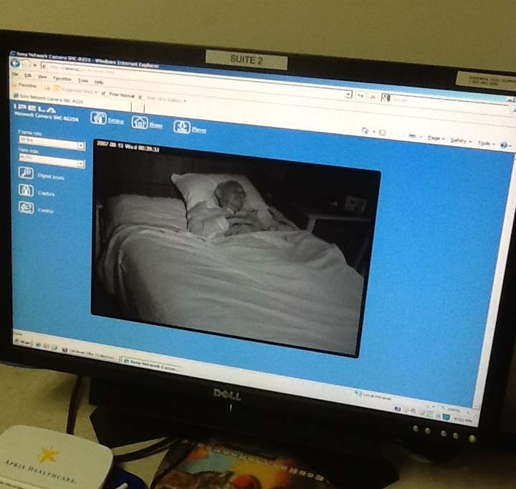
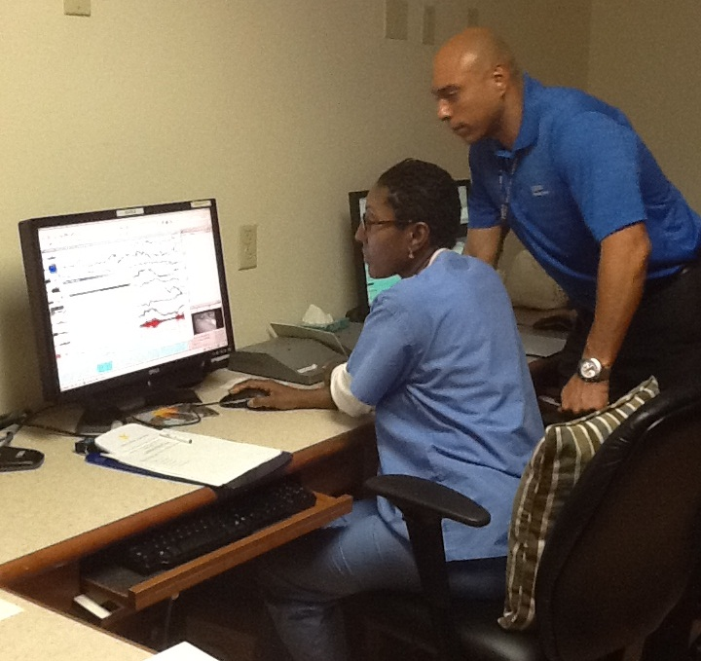
Prana beds & caring technicians
Sleep Lab Photos

Slide 16
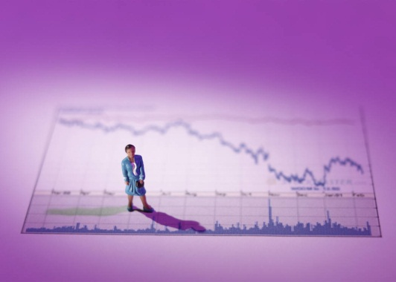

What methodology & statistical analysis will be used to verify results?
The study was a quasi-experimental design
Statistical Applications Used for Independent and Dependent Variables Will Include:
Chi-Square
Factorial ANOVA
Cramer’s V and Phi
Pearson’s Correlation
Multiple Regression
  Using Version 19 of SPSS

Slide 17
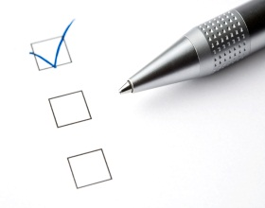
How will the findings be reported?
Any descriptive data on how the intervention was actually delivered in the study
  Extent to which participants completed the sleep lab,
  Gender,
  Age,
  Most effective hearing devices
Indicators of whether the study was successfully carried out
  e.g., amount of sample attrition
Estimates of the intervention’s effect on all outcomes measured
Any estimates of its effect on subgroups within the study sample

Slide 18

How will the recommendations and conclusions be disseminated?
The analyze data will be reported regarding:
  Various intervention’s effectiveness
  Generalizability to others who receive or could receive the intervention
  Study limitations
  Significance to policymakers in fire agencies or communities, community educators, and researchers
How Will the Results Be Shared?
Reports to Vision 20/20
Presentations at national conferences
News and press articles
Communication to the deaf community through their networks and organizations
Articles in national & international publications

