Slide 1
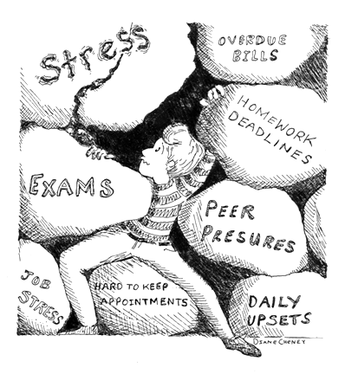

Stress Management
Part 1 – Breathe and Relax
Notes:
Welcome to Stress Management - breathe and relax. This is the first in a series of self-help presentations developed by CAPS to support FAU students in reaching their academic and personal goals. I’m Dr. Nikki Saltzburg, one of the staff psychologists at CAPS, and I’ll leading the presentation today

Slide 2
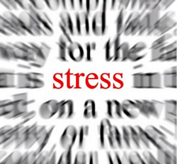
What is Stress?
Physical, Emotional, Psychological
Fight or Flight Response
  Adrenalin & hydrocortisone released
  Long term consequences include suppression of immune system
Some amount of stress is healthy
“Too much” phenomenon
Notes:
Stress is the body’s physical, emotional and psychological response to any demand and is generally perceived as pressure or urgency to respond. When confronted with a threat, the body reacts with fight or flight response.
Adrenalin and Hydrocortisone are released into the body and they shut down some biological mechanisms to conserve energy – muscles tense, heart rate, blood pressure and respiration increases. Once threat has receded the body returns to a more relaxed state. Repeated exposure to Adrenalin and Cortisol can weaken the body’s immune system. Some amount of stress is healthy, and we all experience it – it can motivate us. However, the more stressors we experience in a short period of time, the more severe their effects. When there is not enough time between stressful events we can become overwhelmed and burnt out.

Slide 3
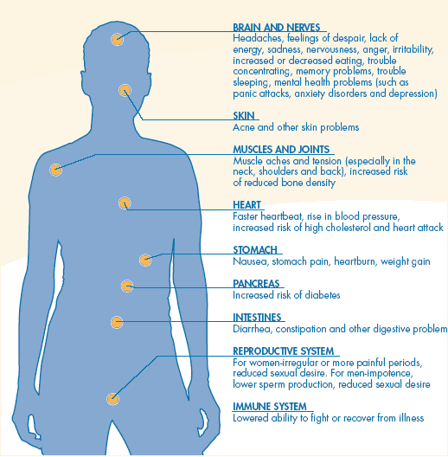
Signs and Symptoms of Stress
Brain and Nerves
Skin
Muscles and Joints
Heart
Stomach
Pancreas
Intestines
Reproductive System
Immune System

Slide 4
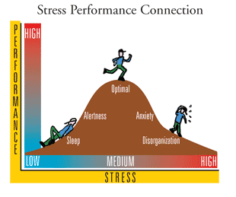
The impact of stress
Most people find that too much or too little stress hinders their performance and sense of well being.
How does stress help?
  Survival
  Performance
How does stress hurt?
  Emotionally
  Cognitively
  Physically
Notes:
Most people find that too much or too little stress hinders their performance and sense of well being.
Too little stress= bored, unmotivated
Too much stress=overwhelmed, fearful
Moderate stress=energized, efficient
How does stress help?
Survival
Alerts you to danger
Performance
Motivates you to action
Moderate amounts improve performance
How does stress hurt?
Emotionally
Feeling anxious, sad, scared, etc.
Cognitively
Difficulty concentrating, racing thoughts, etc.
Physically
Feeling tired, run-down, racing heart, etc.

Slide 5
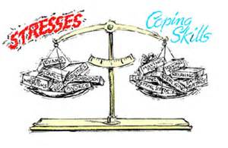
Coping with excessive stress
Emotion focused coping–
  Take responsibility for reactions to a situation, is there a different perspective you can take?
  Build up your emotional bank account through practicing self nurturing behaviors, including relaxation techniques
Problem focused coping –
  Problem solving
  Assertiveness
  Conflict resolution
  Time management
Notes:
An example of perspective taking – imagine you get a lower grade than you wanted on an exam, and your perspective is that you’re a failure. Telling yourself you’re a failure over and over again can increase your anxiety and you might find yourself shutting down and losing motivation. Some other perspectives to consider – just because you performed poorly on a task (in this case an exam) does not mean you are a complete failure in life (consider the successes you’ve had; performing below your standards just means you haven’t mastered the material yet and there is more to learn, trying different methods, getting support, or putting in additional effort may help

Slide 6
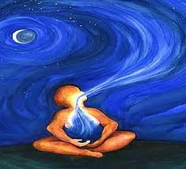
Emotion-focused coping through relaxation techniques
Diaphragmatic Breathing
  Breathe deep, from the stomach, fill the lungs!
Imagery
  Imagine you are on a beach, in a forest, on a mountain top
  What does it smell, taste, look, feel, and sound like?
Visual Perceptual Imagery
  Look around the room, find an object you like
  What does it smell, taste, look, feel, and sound like?
Progressive Muscle Relaxation
  Locate every muscle group you can, slowly, from head to toe
  Tense and release each muscle group two times, hold tension for 5-10 seconds and relax 15-20 seconds
Meditation
  15 minutes of not thinking while sitting or lying in a peaceful, quiet, place
  Try using soft, non-verbal music, incense, and remember to breathe
Increasing Positive Thinking
  Practice positive affirmations daily
  Give yourself credit for your accomplishments, even “the little things”
  Cultivate gratitude
Notes:
Relaxation exercises are a type of emotion-focused coping

Slide 7

Let’s practice… Guided Imagery

Slide 8
Need more help or information?
Check back on our website for more self-help presentations coming soon
Come visit us at CAPS
  Call us at 561-297-3540 or come to our office in SS-8 Rm 229 to schedule an initial appointment with a counselor
  Our services are confidential, and free to enrolled FAU students
  We offer individual, group, and relationship counseling as well as psychiatric consultations

