Slide 1

The Pre-Collegiate and Youth Programs,
University and College level
Spring 2019

Slide 2
The Pre-Collegiate and Youth Programs,
University level
The Pre-Collegiate and Youth Programs office works with FAU departments and external partners to host a variety of educational immersion programs for non-enrolled minors in surrounding communities. The office also supports and oversees every aspect of program planning in order to ensure that Program Standards are met and maintained.
Review the Pre-Collegiate Programs, University Level – 3.1 Policy for general requirements
The Pre-Collegiate and Youth Programs Office assist with:
  Development
  Standards
  Compliance
For more detailed information click here.

Slide 3



Program/Camp Operation Timeline
Summer Workshop for new/current Diirectors
Letter of Intent and On-line Application
Acknowledgement of Understanding Form
Approval Letter
Market Program
Staff Background Checks
Other Business

Slide 4
Other Significant General Requirements
Responsibility of Programs/Camps
FAU Risk Management – Incident/Accident Form and Reporting Incidents
Title IX

Slide 5
Responsibility of Programs/Camps
Follow up with HR to complete background checks
Collect Disclosure Statements (as applicable)
Submit pending Child Abuse and Neglect Prevention Training certificates
Submit final list of program/camp staff
Submit final list of program/camp participants
Obtain and/or document participation insurance (as applicable)

Slide 6
Risk Management: How to document an incident
Write objectively. Describe exactly what you saw.
Incorporate participant and witness accounts of the event into the report. State their comments as direct quotes.
Don’t assign blame. An incident report isn’t an opportunity for you to point out inferior equipment or poor staffing. Just state the facts.
Avoid hearsay and assumptions. It’s up to the person who witnessed the incident to contribute and/or to write the incident report.
Forward the report to the person designate by your facility’s policy. All reports should be forwarded to the Pre-Collegiate and Youth Programs who will then send reports to Risk Management. Ensure that only one copy of the report exists. Initiate a phone call to risk management should the incident involve an injury requiring hospital or emergency room care.
* Click here for an Incident/Accident Form template

Slide 7
Office of Equity, Inclusion and Compliance
Why is Title IX Important?
  Title IX of the Education Amendment act of 1972 protects people from sex discrimination in educational programs and activities that receive federal financial assistance
  FAU is committed to providing an environment free from discrimination on the basis of sex. FAU provides many resources to students, faculty , and staff to address concerns relating to discrimination on the basis of sex, which also includes sexual misconduct

Slide 8
Sexual Discrimination, Sexual Harassment,
And Sexual Violence
Conduct of a Sexual Nature/Sexual Harassment
  Unwelcome sexual advances
  Requests for sexual favors
  Comments about and individuals body, sexual activity or sexual attractiveness
  Sexually suggestive touching, leering gestures, sounds, comments, or displays of sexually suggestive object
Sexual Assault
  Sexual Assault is a physical sexual act perpetrated against a person’s will or where a person is incapable of giving consent (e.g., due to the student’s age or use of drugs or alcohol or because an intellectual or other disability prevents the student from having the capacity to give consent). Acts failing into the category of sexual violence include, but are not limited to, rape, sexual assault, sexual battery, sexual abuse and sexual coercion.

Slide 9
Sexual Discrimination, Sexual Harassment,
And Sexual Violence continuation
Sexual Violence
  Conduct that is also criminal in nature such as:
  Rape
  Sexual Assault
  Sexual Battery
  Sexually motivated stalking (Including Cyber stalking)

Slide 10
Consent is and is Not
Consent
  Consent is an affirmative act or statement by each person that is informed, freely given and mutually understood.
  Consent cannot be obtained by force, threat coercion, manipulation, reasonable fear of injury, intimidation, use of position of influence, or through the use of one’s mental or physical helplessness or incapacity
  Individuals who are under age are unable to consent
  Individuals who are incapacitated, under the influence of any substances or are physically or mentally disabled are ineligible of giving consent
Consent is Not
  Body language
  Power differentials
  Previous sexual activity or prior dating relationship
  Silence
  Being drunk

Slide 11
Notice and Reporting
Notice
  A university has notice if a responsible employee knew, or in the exercise of reasonable care should have known, about the harassment/violence.
  Examples of notice:
    A student/camper complained to authoritative or administrative individual representing FAU
    Parents contact someone in administration
    Administrator or another student witnessed the harassment
Reporting
  All relevant details about the alleged sexual violence that the student/camper or another individual has shared. These facts may include:
  Name(s) of student who experienced the allege sexual violence
  Locations of the alleged sexual assault
  Time and date of the alleged sexual assault

Slide 12
Refer
Title IX Coordinator
Deputy Title Coordinators
Victim Advocate
Counseling
FAUPD
Student Health Services
*Click here to visit the Office of Equity, Inclusion and Compliance web page for more information.

Slide 13
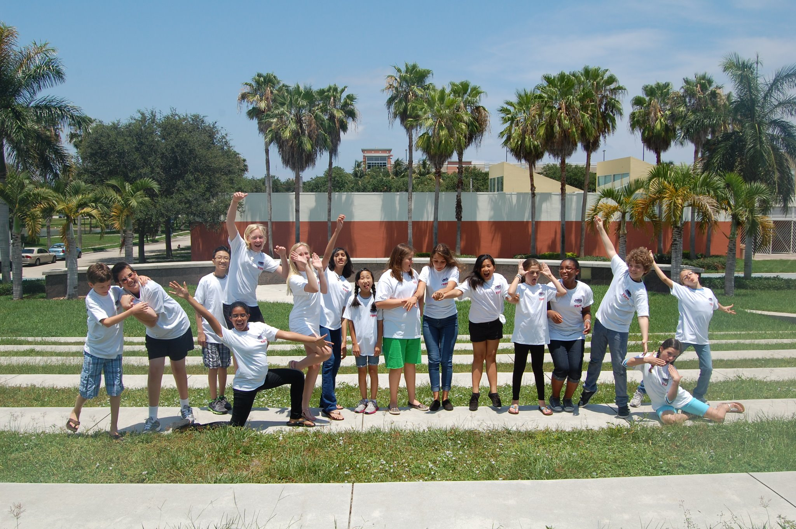
The Pre-Collegiate and Youth Programs,
College level
The Dorothy F. Schmidt College of Arts and Letters Dean's Office works with the University's Pre-Collegiate and Youth Programs Office to host a variety of educational immersion programs for non-enrolled minors in surrounding communities. The Dean's Office also consults, supports and oversees aspects of program planning in order to ensure that university program standards are met and maintained.

Slide 14
What to do at the college level?
Developing your program/camp
Develop a curriculum and budget
Obtain approval from your department chair/unit director and, if needed, dean.
Assist with Pre-Collegiate and Youth Programs requirements
Intent Letter
Program Application
End of program/camp requirements
Final list of staff, and program participants
Keep all camp/program documents in a file in case of an internal audit
Human Resources requirements, if needed

Slide 15
What to do at the college level? - continuation
Click here to download the College’s Pre-collegiate programs/camps checklist with more specific items/steps discussed in previous slide.
If you need further college consultation, please feel free to contact:
Taina Teran-Campbell, MA '11
College Pre-Collegiate Programs Liaison
Office: 561-297-3803
Email: tteran@fau.edu

