Slide 2
Rationale for Teaching about the Holocaust
Why, how, and with which materials should your students learn about the Holocaust & genocide at this time?
How does teaching about rescue support your rationale?
Notes:
Teaching about the Holocaust can be daunting
You do not need to teach everything you know about the Holocaust, and you really should not want to, because it’s a complex history and what you teach should be considered carefully.
Before anything, consider your rationale– are you teaching it because it is mandated?
Are you teaching it for another reason?
Write out your rationale and consider these two questions.
Why teach about rescue? We use the term rescue at the USHMM.

Slide 3
DEFINE THE TERM “HOLOCAUST”
The Holocaust was the systematic, bureaucratic, state-sponsored persecution and murder of approximately six million Jews by the Nazi regime and its collaborators.

Slide 4
During the era of the Holocaust, German authorities also targeted other groups because of their perceived “racial inferiority:”
Roma/Sinti
Mentally and physically disabled persons
Soviet POWs
Poles
Russians
Other groups were persecuted on political, ideological, and behavioral grounds, among them communists, socialists, Jehovah’s Witnesses, and gay people.

Slide 5

Guidelines for Teaching about the Holocaust
Contextualize the history.
Balance the perspective that informs your study of the Holocaust.
Avoid romanticizing history.
Avoid simple answers to complex history.
Notes:
Where does rescue fit in the history? So few people were rescuers– historians note that less than one percent of the European population would be considered rescuers
This is why it’s important to balance whose perspective informs your teaching of the Holocaust– most people were onlookers, and that is another workshop to unpack. We can’t focus solely or mostly on rescuers when they were so few against millions of victims.
We also have to be careful to not romanticize this history. Often, this can be done because we want our students to do the right thing and to emulate behavior that is positive and in service to helping others. But again, in doing so, we forget the sheer number of victims and the reasons why there would be a need for rescue.
That is why we must contextualize the history.
Rescue is complex. We should examine the obstacles and challenges to rescue. We need to highlight the pressures, motivations, fears ordinary people face in making the decision to help.

Slide 6
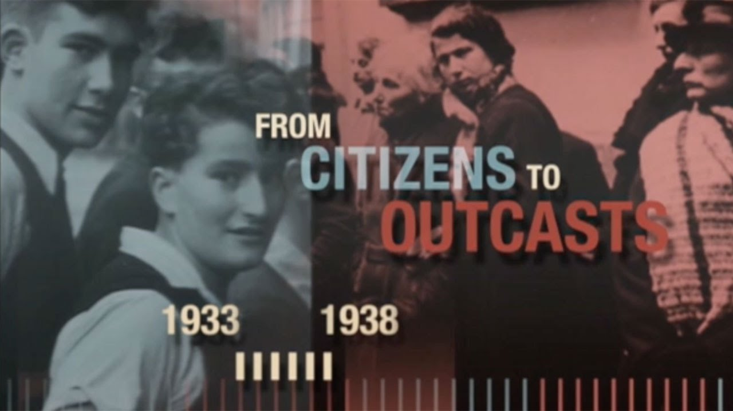
What push factors did Jews in the German Reich experience between 1933 and 1939? What led many to seek refuge in other countries?

Slide 7
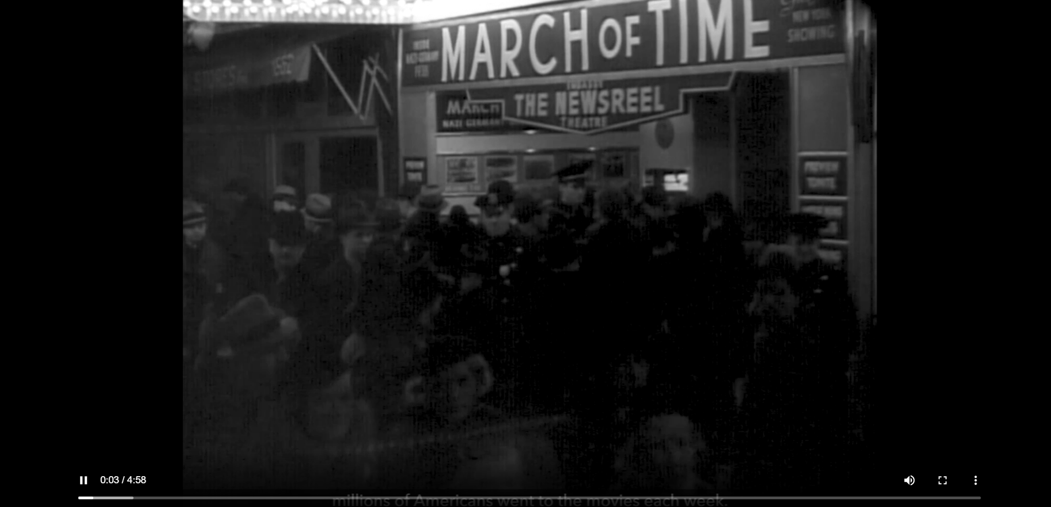
What was happening in the United States in the 1930s that might have made it difficult for European Jews to immigrate to the United States?

Slide 8
Newsreel & Holocaust Encyclopedia Article, “Immigration to the United States, 1933-1941”
How did American racism and antisemitism influence immigration in the 1930s?
How did the Great Depression and economic concerns influence immigration in the 1930s?
How did national security concerns influence immigration in the 1930s?
How did the 1924 immigration law influence immigration in the 1930s?
How did World War II make immigration even more difficult?

Slide 9
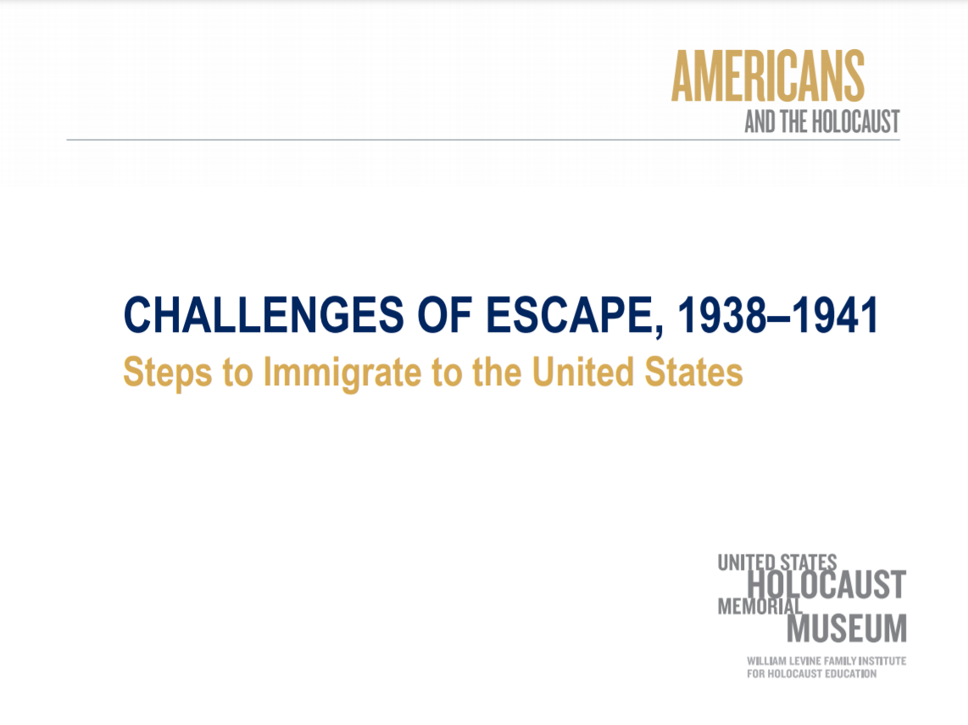
Why do you think each document or step was required for emigration and/or immigration to the United States?

Slide 10
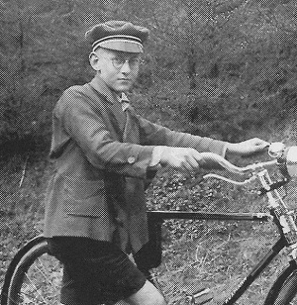
Klaus Langer’s Diary-- 19 December 1938
Summarize the main points of the diary entry.
What does it reveal about the different challenges facing Klaus’s family as they attempted to leave Germany?
What can we learn about the emigration and immigration experience from his diary, and does it differ from what we learned from the historical documents we just examined?

Slide 11
Based on Klaus Langer’s diary, your notes from both of the films, and historical documents in the PDFs, evaluate the challenges faced by Jews attempting to flee the German Reich and immigrate to the United States. Providing evidence from primary sources (government documents and Klaus Langer’s diary) and secondary sources (encyclopdia articles, The Path to Nazi Genocide, and newsreel film), answer the following questions:
How did anti-Jewish policies, laws, and actions influence Jewish emigration from Germany?
How did American domestic concerns influence the ability of Jews to immigrate to the United States?
Consider the impact of government policies, public opinion, and global events in the 1920s and 1930s when formulating your response.

Slide 12

The Diary and Art of Elizabeth Kaufmann

Slide 13
Providing Context
Annexation (Anschluss) of Austria by Germany
History of France (invasion of France by Germany)
Children’s Diaries of the Holocaust
Using Oral Testimonies

Slide 14

Elizabeth Kaufmann

Slide 15

Contact:
Christina E. Chavarría
CChavarria@ushmm.org

