Slide 1
How the Warsaw Zookeepers Risked Their Lives to Shelter Jews

Slide 2


Slide 3
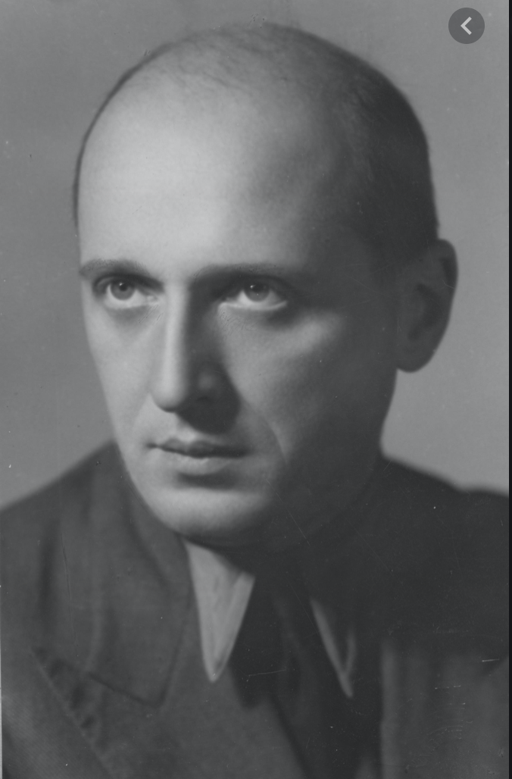
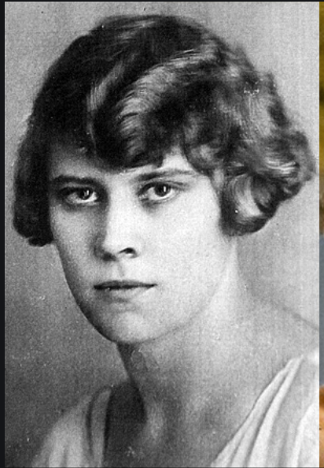
Dr. Jan and Antonia Zabinski

Slide 4
United States Holocaust Memorial Museum
Facebook Live
How the Warsaw Zookeepers Risked Their Lives to Shelter Jews
https://www.facebook.com/34362997676/videos/2660923887475089

Slide 5
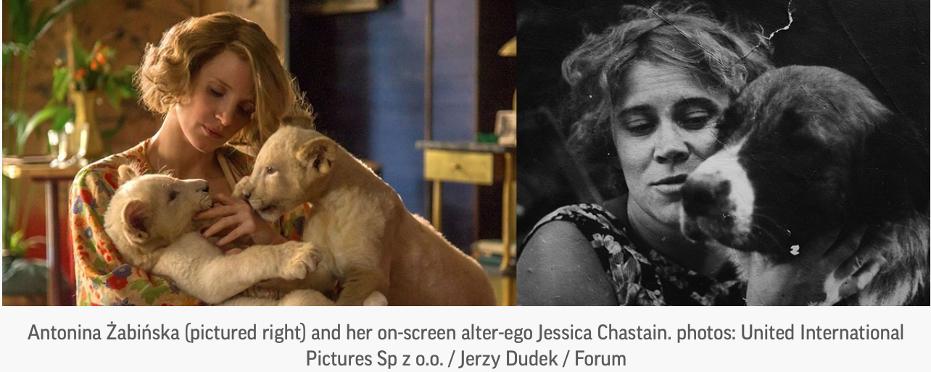
The Zookeeper’s Wife
Based on the true story from the international bestseller
by Diane Ackerman

Slide 6
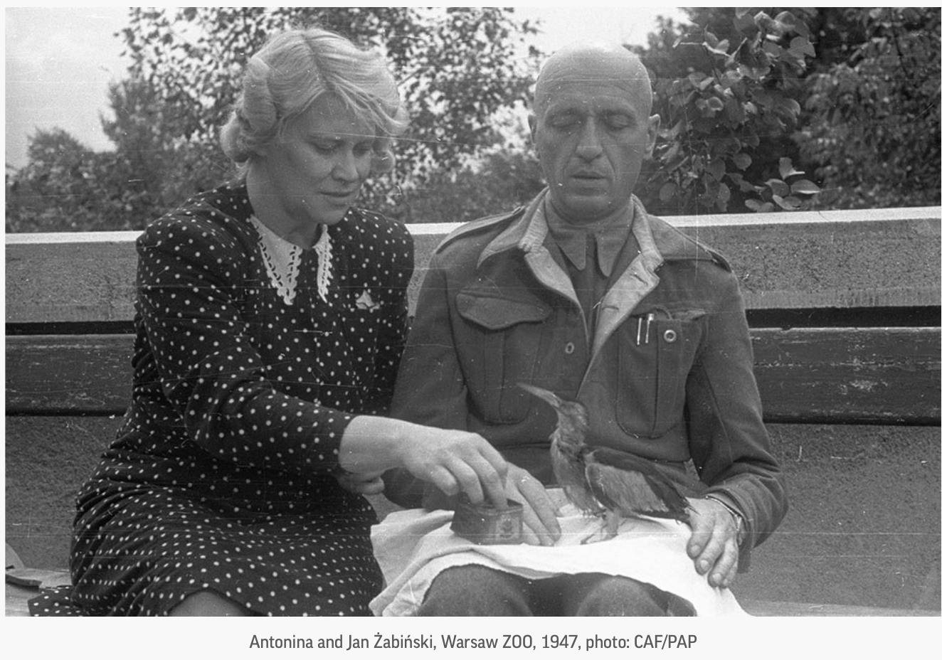
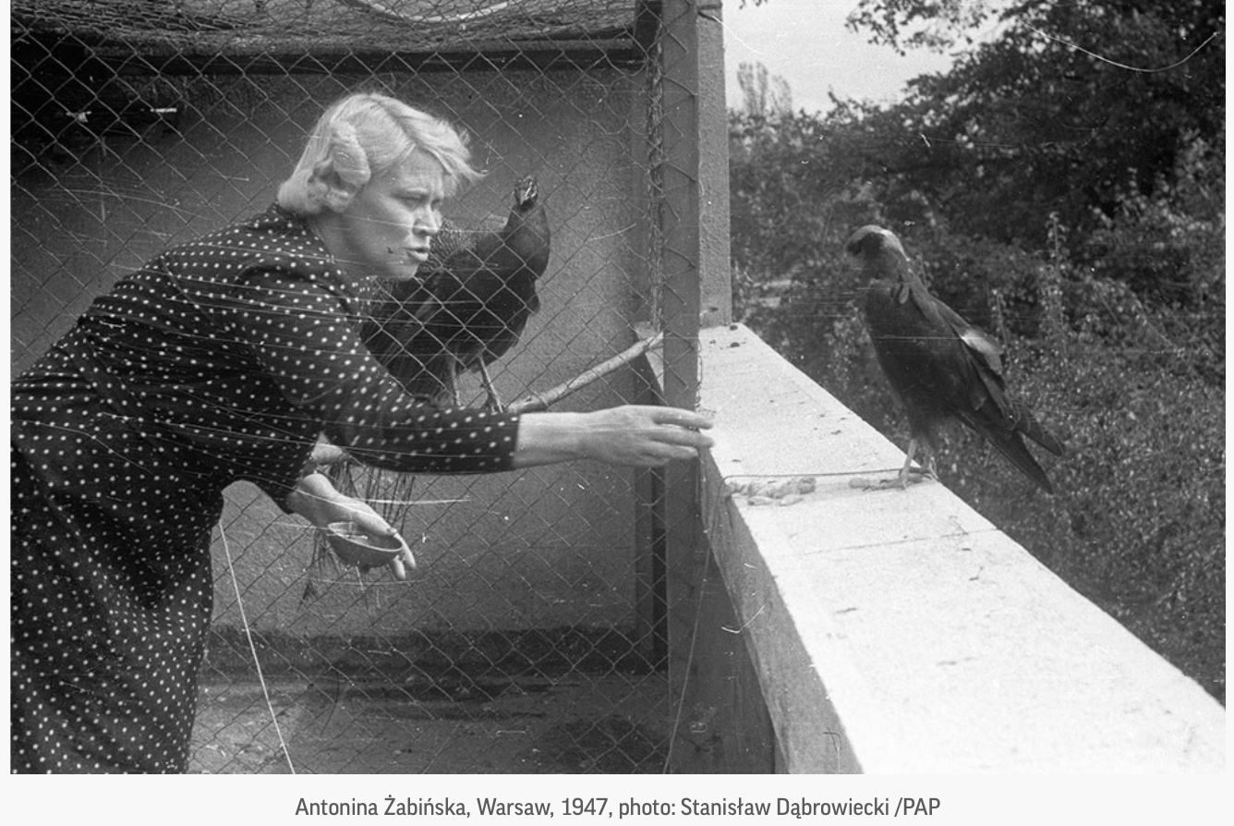
1947

Slide 7
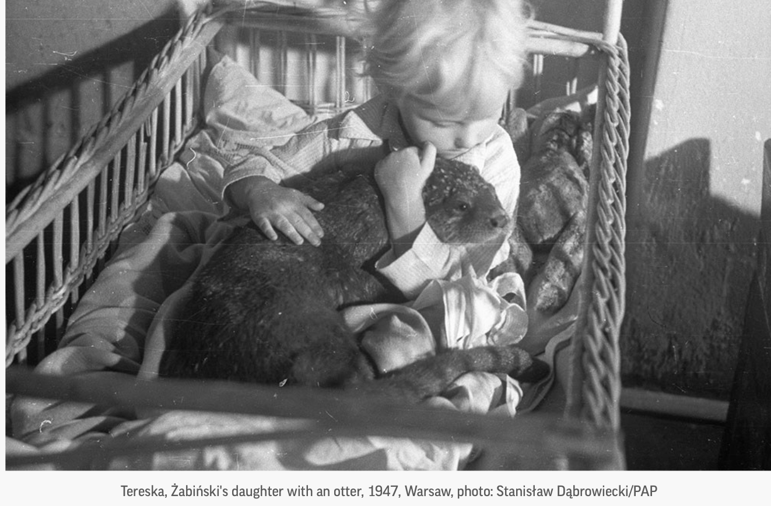
1947

Slide 8
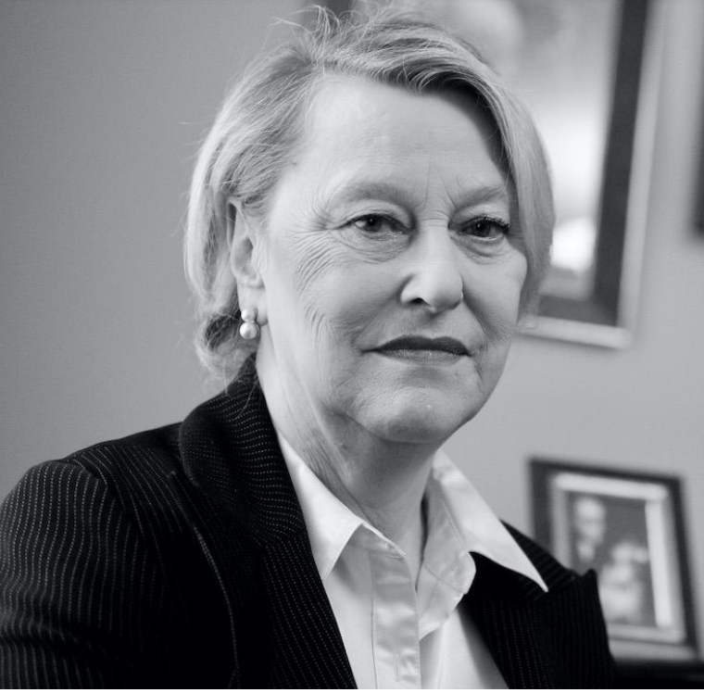
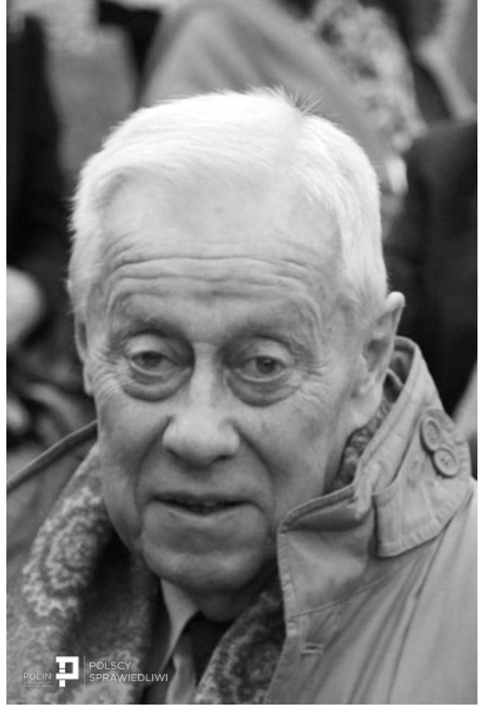
Vale Ryszard Zabinski
(1932 - 2019)
Teresa Zabinska-Zawadzki
(1944 – 2021)

Slide 9
Rescue https://encyclopedia.ushmm.org/content/en/article/rescue
Despite the indifference of most Europeans and the collaboration of others in the murder of Jews during the Holocaust, individuals in every European country and from all religious backgrounds risked their lives to help Jews. Rescue efforts ranged from the isolated actions of individuals to organized networks both small and large.
Rescue took many forms.
Whether they saved a thousand people or a single life, those who rescued Jews during the Holocaust demonstrated the possibility of individual choice even in extreme circumstances. These and other acts of conscience and courage, however, saved only a tiny percentage of those targeted for destruction.

Slide 10
What would you have done?
Can you imagine yourself in the same circumstances as Jan and Antonina?
Could you do what Jan and Antonina and many others did?
Do you question your own courage?

Slide 11
Is rescue a form of resistance?
Non-Violent Resistance
Forms of non-violent resistance included sheltering Jews, listening to forbidden Allied radio broadcasts, and producing clandestine anti-Nazi newspapers.

Slide 12
"And so, we must know these good people who helped Jews during the Holocaust. We must learn from them, and in gratitude and hope, we must remember them."
Elie Wiesel

Slide 13
Rescuers https://www.ushmm.org/collections/bibliography/rescuers
In 1953 the state of Israel established Yad Vashem, the Holocaust Martyrs’ and Heroes’ Remembrance Authority, in order to document and record the history of the Jewish people during the Holocaust as well as to acknowledge the countless non-Jewish individuals who risked their lives to save Jews. Yad Vashem began to award the title Righteous Among the Nations in 1963.
In total, 27,712 (as of 1 January 2020) men and women from 51 countries have been recognized, amounting to more than 10,000 authenticated rescue stories. Yad Vashem's policy is to pursue the program for as long as petitions for this title are received and are supported by evidence that meets the criteria.

Slide 14
Guided by certain criteria, the commission headed by a justice of the Supreme Court of Israel, meticulously studies all documentation including evidence by survivors and other eyewitnesses, evaluates the historical circumstances and the element of risk to the rescuer, and then decides if the case meets the criteria.
Only a Jewish party can put forward a nomination
Helping a family member or helping a Jew who converted to Christianity is not ground for recognition;
Assistance has to be repeated or substantial
Assistance has to be given without any financial gain expected in return (although covering expenses such as food is acceptable)

Slide 15
The Righteous Among the Nations are men and women coming from all walks of life, age groups, religious affiliation (Christian denominations, Muslims, atheists) and professions – university people, teachers, physicians, clergy, diplomats, simple workers, servants, policemen, fishermen, farmers, undertakers, etc. They include highly educated city dwellers and illiterate peasants, officials and people from the margins of society from all the corners of Europe.
The only common denominator is that they believed that the Jews belonged to their universe of obligation and that they were willing to pay a dear price for this commitment.

Slide 16
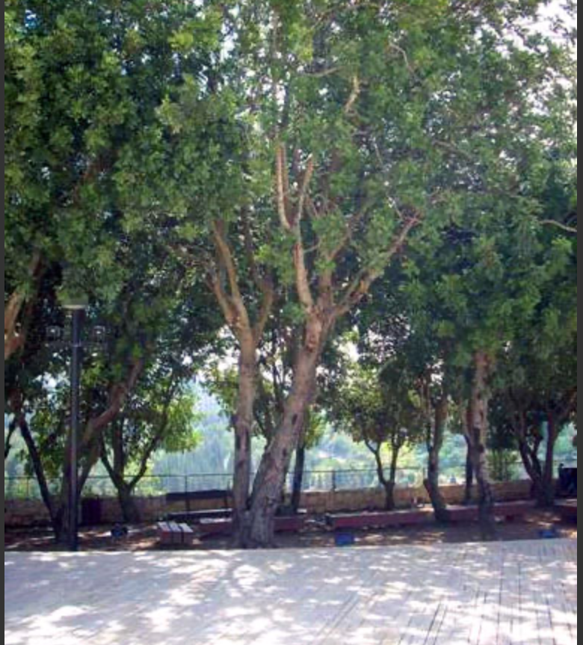

On September 21, 1965,
Yad Vashem recognized Jan Zabinski and his wife, Antonina Zabinski, as Righteous Among the Nations.
On October 30, 1968 Dr. Jan Zabinski planted a tree on the Mount of Remembrance.
The tree planted in honor of the Righteous Among the Nations:
Jan and Antonina Zabinski

Slide 17
Learn more about it …

Slide 18
To learn more about the history and the film, The Zookeeper's Wife, watch a film discussion previously held at the United States Holocaust Memorial Museum. The conversation featured actress Jessica Chastain, director Niki Caro, screenwriter Angela Workman, author Diane Ackerman, and director of the USHMM,
Sara Bloomfield.
https://www.youtube.com/watch?v=TeE7-HkvSk4

Slide 19
Rachel Auerbach and the Oyneg Shabbas Archive
Learn more about Rachel Auerbach and the Oyneg Shabbas Archive.
https://medium.com/.../letter-of-indictment-documenting...
‘Who Will Write Our History’ Review:
A Vital Holocaust Documentary
https://www.nytimes.com/2019/01/17/movies/who-will-write-our-history-review.html?smid=em-share
The film, directed by Roberta Grossman, tells the story of Oyneg Shabbas, a group of Jews imprisoned in the Warsaw Ghetto who worked to document their culture.

Slide 20

When the Nazis Tried to Bring Animals Back From Extinction
https://www.smithsonianmag.com/history/when-nazis-tried-bring-animals-back-extinction-180962739/

Slide 21
A Relic of the Nazi Past Is Grazing at the National Zoo
Learn about the Nazi quest to dictate their environment, even when it came to animals.
https://us-holocaust-museum.medium.com/is-a-relic-of-the-nazi-past-grazing-at-the-national-zoo-b6ea24777c68

Slide 22
Virtual Tour of the Warsaw Zoo
Auschwitz Memorial / Muzeum Auschwitz
Here is a link to the virtual tour of the villa within the grounds of the Warsaw Zoo
http://zoo.waw.pl/willa/wirtualna-wycieczka.html

Slide 23
Linda Medvin, Director
E-mail: lmedvin@fau.edu
chhre@fau.edu
http://www.fau.edu/pjhr/chhre/index.php
Twitter: @fauchhre

