Slide 1
International Laws and Ethics
Cultural Property in Time of War

Slide 2
Cultural Property in War
Generally,
Historic and cultural monuments and museums protected
Unless militarized
Should be marked
There are emblems and symbols for marking them
Depend on the treaty
They should also be listed and noticed appropriately
These days, the belligerents need to have the coordinates to avoid bombs and missile strikes

Slide 3
Treaties
Hague II 1899
Hague VI 1907
Hague IX Bombardment by Naval Forces in Time of War 1907, Chap II Art. 5
Protection of Artistic and Scientific Institutions and Historic Monuments (Roerich Pact) 1935 – Interamerican
Hague UNESCO Convention for the Protection of Cultural Property in the Event of Armed Conflict 1954
Rome Statute of the International Criminal Court

Slide 4
The Hague Conventions of 1899 and 1907
The first was called by the Russian Tzar Nicholas II in 1899
The second was originally suggested by President Theodore Roosevelt
They were the first real and partially successful attempts at establishing international and multilateral laws of war

Slide 5
Laws and Customs of War on Land (Hague II); July 29, 1899 The Convention
SECTION II. -- ON HOSTILITIES
CHAPTER I. -- On means of injuring the Enemy, Sieges, and Bombardments
Article 27
In sieges and bombardments all necessary steps should be taken to spare as far as possible edifices devoted to religion, art, science, and charity, hospitals, and places where the sick and wounded are collected, provided they are not used at the same time for military purposes.
The besieged should indicate these buildings or places by some particular and visible signs, which should previously be notified to the assailants.
SECTION III. -- ON MILITARY AUTHORITY OVER HOSTILE TERRITORY
Article 56
The property of the communes, that of religious, charitable, and educational institutions, and those of arts and science, even when State property, shall be treated as private property.
All seizure of, and destruction, or intentional damage done to such institutions, to historical monuments, works of art or science, is prohibited, and should be made the subject of proceedings.
US signatory

Slide 6
Laws of War 1907
"Laws of War: Laws and Customs of War on Land (Hague IV); October 18, 1907"[1]
Art. 27.:
In sieges and bombardments all necessary steps must be taken to spare, as far as possible, buildings dedicated to religion, art, science, or charitable purposes, historic monuments, hospitals, and places where the sick and wounded are collected, provided they are not being used at the time for military purposes.
It is the duty of the besieged to indicate the presence of such buildings or places by distinctive and visible signs, which shall be notified to the enemy beforehand.
Art. 56.:
The property of municipalities, that of institutions dedicated to religion, charity and education, the arts and sciences, even when State property, shall be treated as private property.
All seizure of, destruction or wilful damage done to institutions of this character, historic monuments, works of art and science, is forbidden, and should be made the subject of legal proceedings.
"Laws of War: Bombardment by Naval Forces in Time of War (Hague IX); October 18, 1907"[2].
CHAPTER II, General Provisions, Art. 5.
In bombardments by naval forces all the necessary measures must be taken by the commander to spare as far as possible sacred edifices, buildings used for artistic, scientific, or charitable purposes, historic monuments, hospitals, and places where the sick or wounded are collected, on the understanding that they are not used at the same time for military purposes.
It is the duty of the inhabitants to indicate such monuments, edifices, or places by visible signs, which shall consist of large, stiff rectangular panels divided diagonally into two coloured triangular portions, the upper portion black, the lower portion white.
US State party

Slide 7
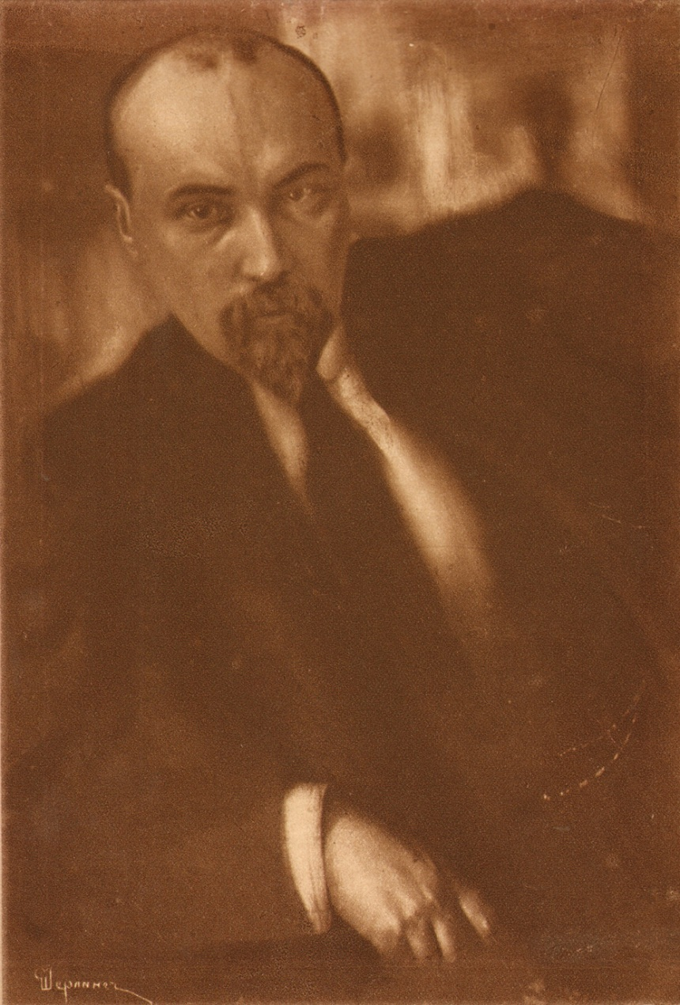
Nicholas Roerich

Slide 8
Roerich Pact
“Protection Of Artistic and Scientific Institutions and Historic Monuments”
Article 1:
“The historic monuments, museums, scientific, artistic, educational and cultural institutions shall be considered as neutral and as such respected and protected by belligerents. The same respect and protection shall be due to the personnel of the institutions mentioned above. The same respect and protection shall be accorded to the historic monuments, museums, scientific, artistic, educational and cultural institutions in time of peace as well as in war.”
1935
Limited to the Americas
U.S. is signatory

Slide 9
Monte Cassino: Eisenhower on Cultural Property during WWII
If we have to choose between destroying a famous building and sacrificing our own men, then our men's lives count infinitely more, and buildings must go. But the choice is not always so clear-cut as that. In many cases, the monuments can be spared without detriment to operational needs. Nothing can stand against the argument of military necessity. That is an accepted principle. But the phrase 'military necessity' is sometimes used where it would be more truthful to speak of military convenience or even of personal convenience. I do not want it to cloak slackness or indifference
Letter, Gen. Dwight D. Eisenhower, Commander-in-Chief, AFH to All Commanders, Subject: Historic Monuments, December 29, 1943, File: CAD 000.4 (3-25-43) (1), Sec. 2, Security Classified General Correspondence, 1943-July 1949, General Records, Civil Affairs Division, Records of the War Department General and Special Staffs, RG 165. From: http://uscbs.org/world-war-ii---monuments-men.html.

Slide 10
The Convention for the Protection of Cultural Property in the Event of Armed Conflict adopted at the Hague (Netherlands) in 1954,
Developed in the wake of massive destruction of the cultural heritage in the Second World War, is the first international agreement accepted world-wide focusing exclusively on the protection of cultural heritage.
Covers immovables and movables, including monuments of architecture, art or history, archaeological sites, works of art, manuscripts, books and other objects of artistic, historical or archaeological interest, as well as scientific collections of all kinds.
The States which are party to the Convention are obliged to lessen the consequences for cultural heritage of an armed conflict and to:
take preventive measures for such protection not only in time of hostility, but also in time of peace;
safeguard and respect cultural property during armed conflict (this obligation also applies in conflicts of a non-international character);
set up mechanisms for protection (nomination of Commissioners-General for Cultural Property and inscription of specially protected sites, monuments or refuges of movable cultural objects in the International Register of Cultural Property under Special Protection);
mark certain important buildings and monuments with a special protective emblem;
create special units within the military forces to be responsible for the protection of cultural heritage.
The Convention was adopted together with a Protocol which prohibits the export of cultural property from occupied territory and requires the return of such property to the State from which it was removed.
The Protocol also forbids the appropriation of cultural property as war reparations. As of 3 January 2002, 102 States are Parties to this Convention, 83 of which are also Parties to the Protocol.
USA finally ratified 3/13/2009 in the wake of Iraq war

Slide 11
The 1999 Protocol
The Protocol, adopted at The Hague in March 1999, reinforces the 1954 Hague Convention and its First Protocol. It reaffirms the “immunity” of cultural property in times of war or occupation and establishes the “individual criminal responsibility” of perpetrators of crimes against culture. It also insists on the need to take preparatory measures in peacetime to protect such property in times of war.

Slide 12
The Blue Shield-Hague Logo

Slide 13
War Crimes

Slide 14
Rome Statute of the International Criminal Court
Article 8, “War Crimes”, Section 2, paragraph b(ix):
“Intentionally directing attacks against buildings dedicated to religion, education, art, science or charitable purposes, historic monuments, hospitals and places where the sick and wounded are collected, provided they are not military objectives;” (emphasis added)
Entered into force 2002.

Slide 15
Bamyan, Afghanistan

Slide 16
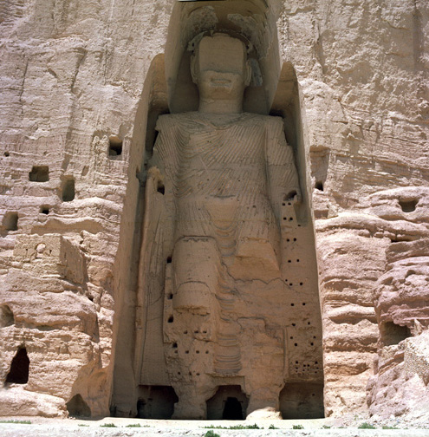
Large Buddha

Slide 17
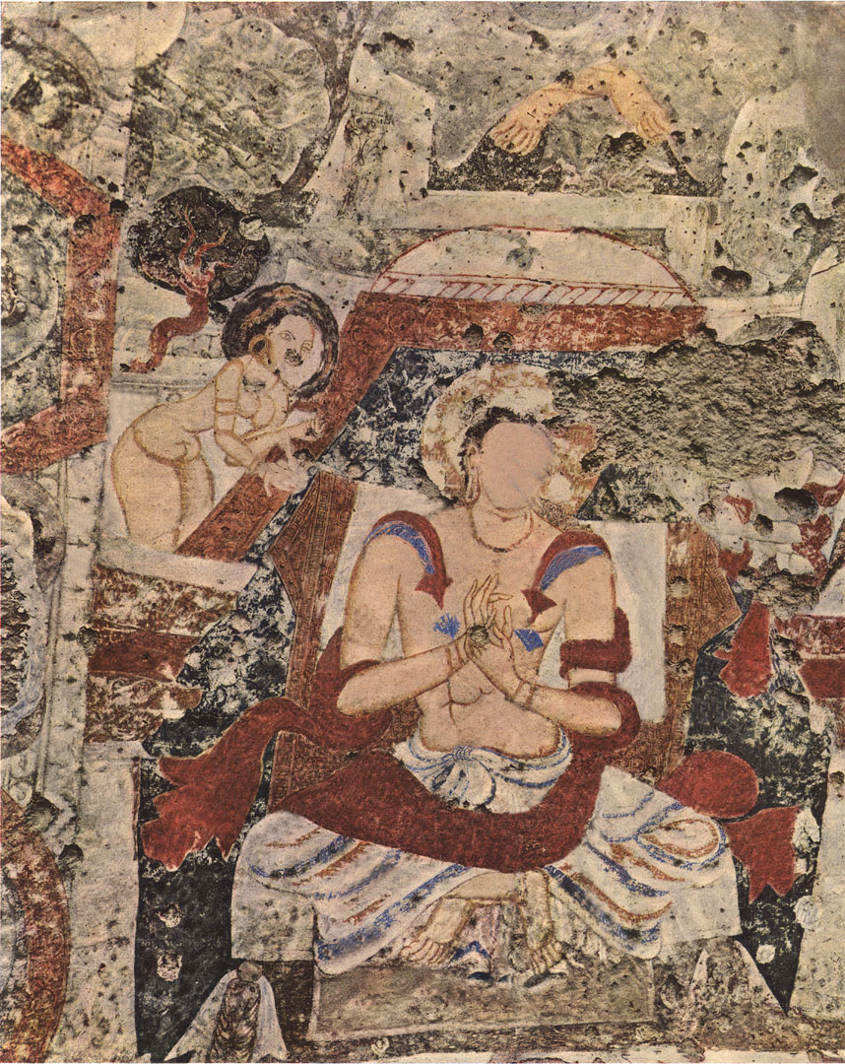
Painting in niche of large statue

Slide 18
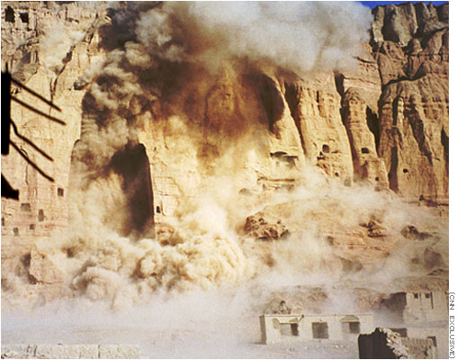

Slide 19
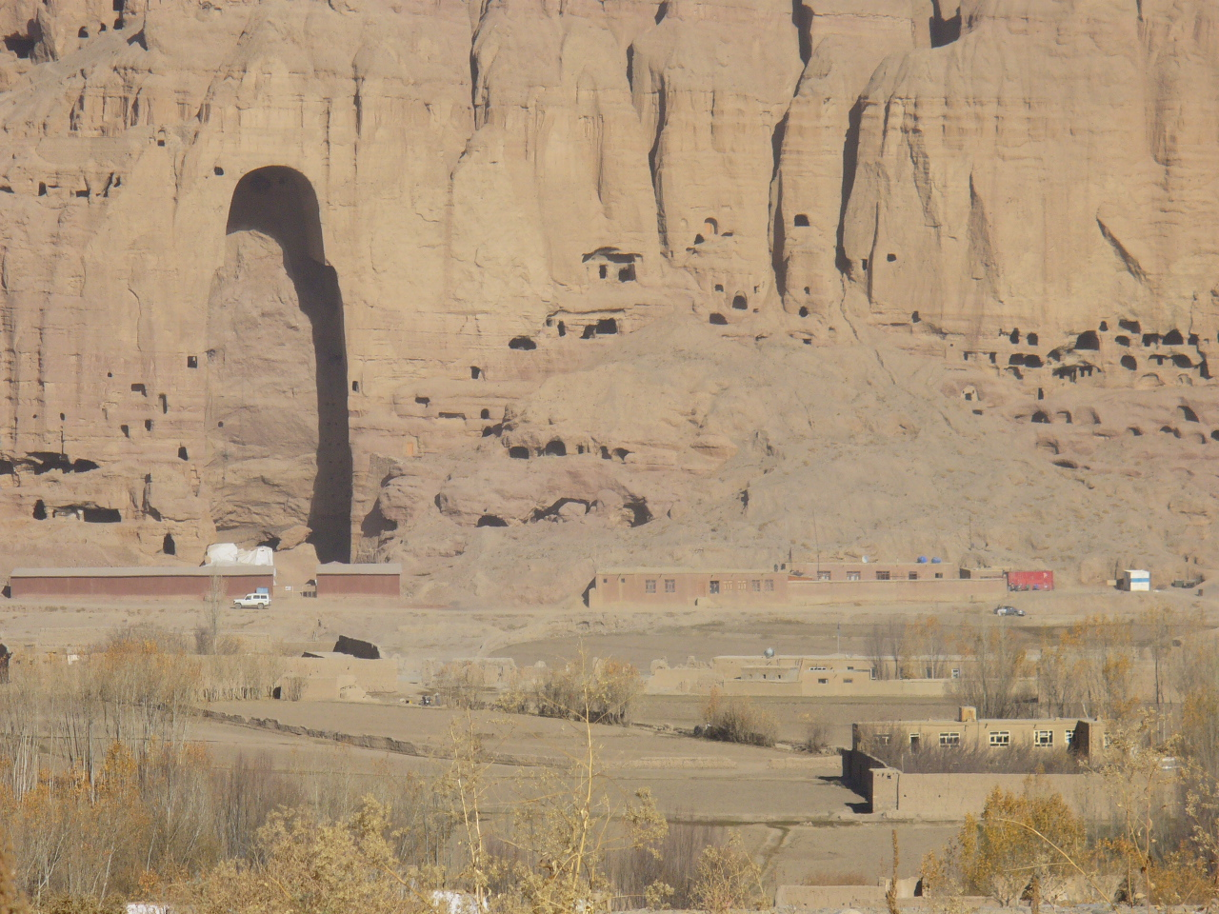

Slide 20
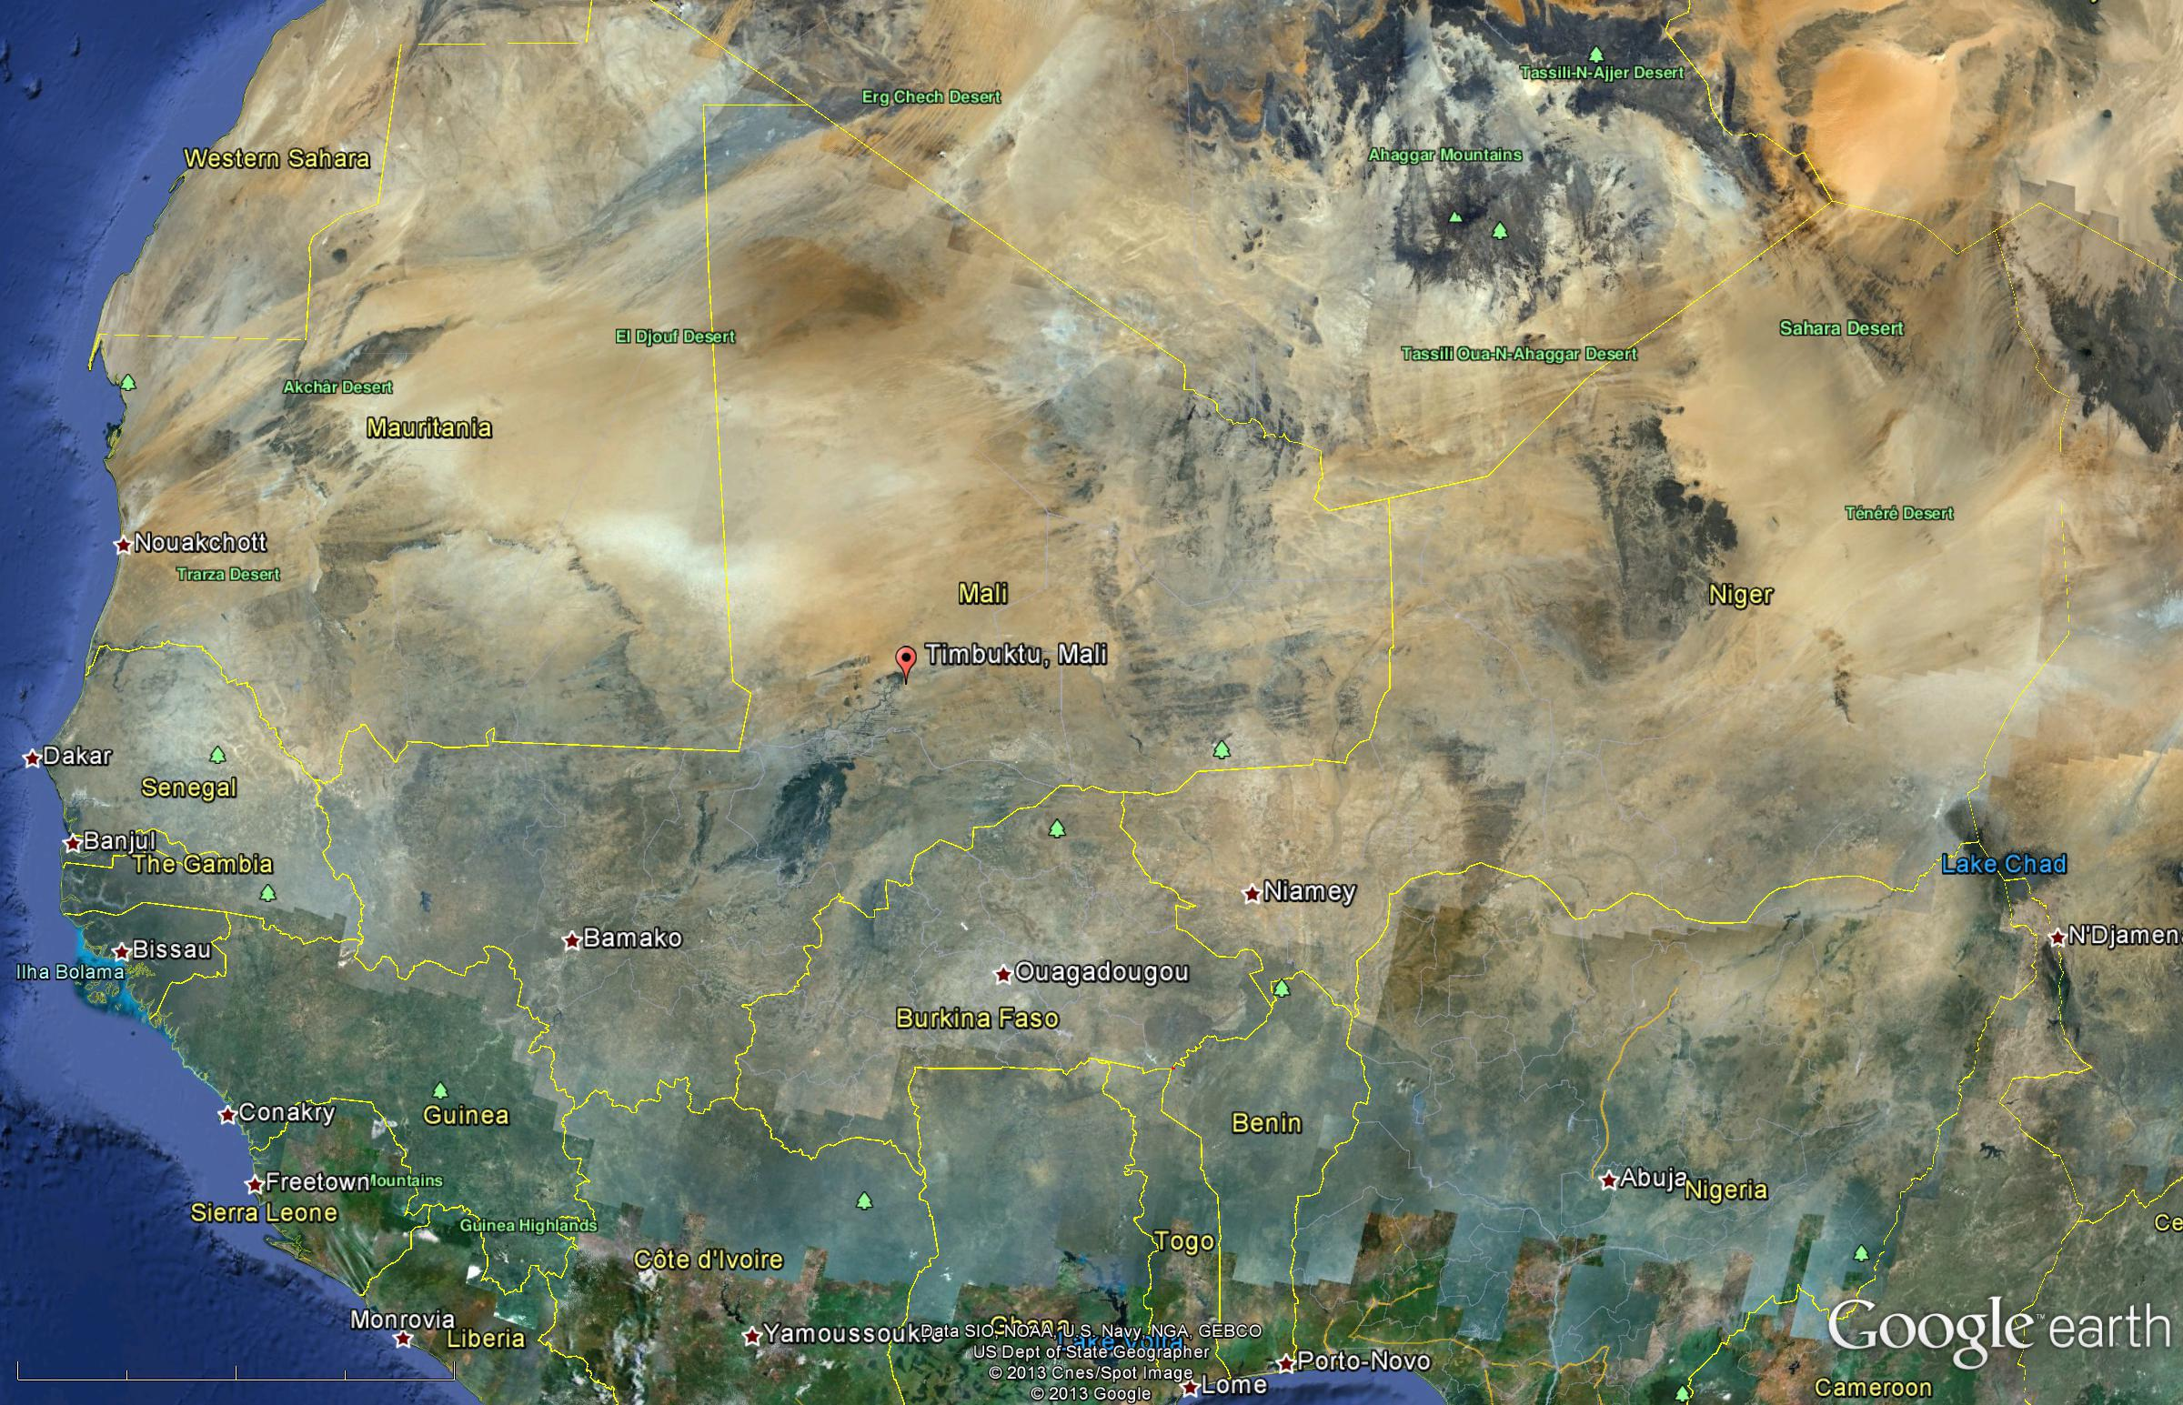
Timbuktu

Slide 21
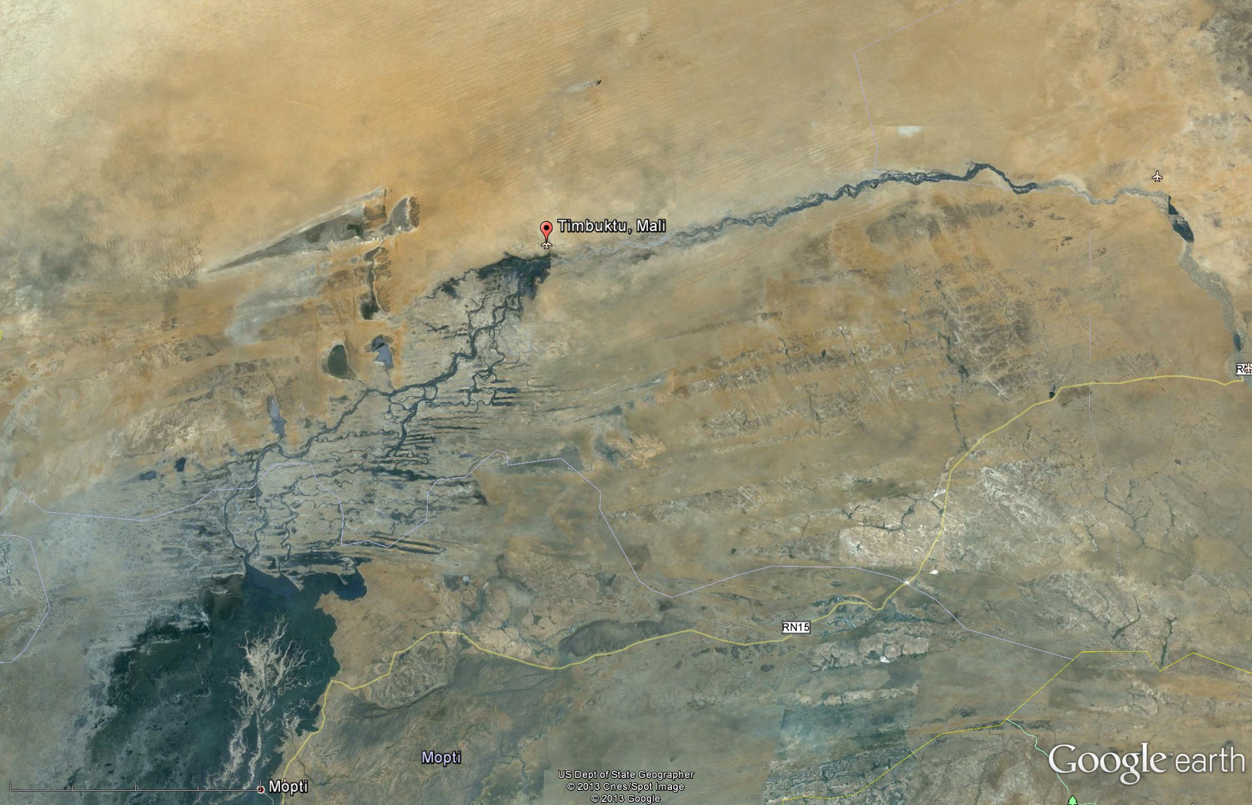

Slide 22
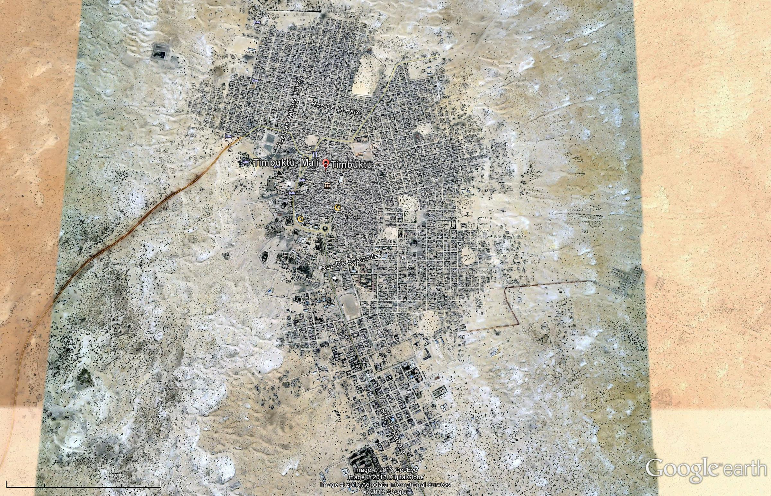

Slide 23
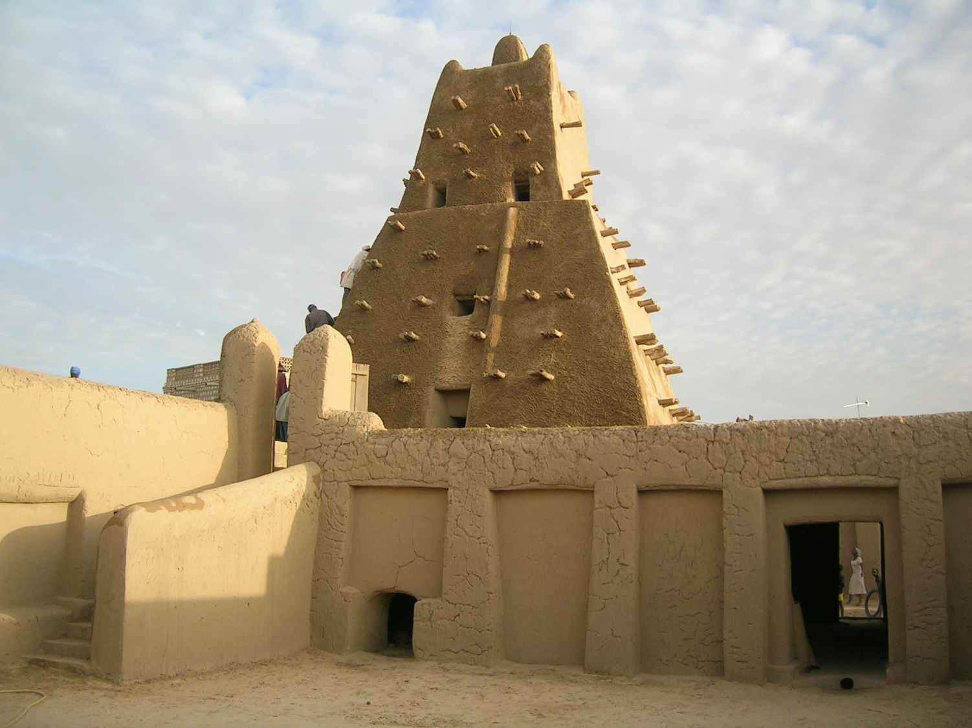
Timbuktu, World Heritage Site

Slide 24
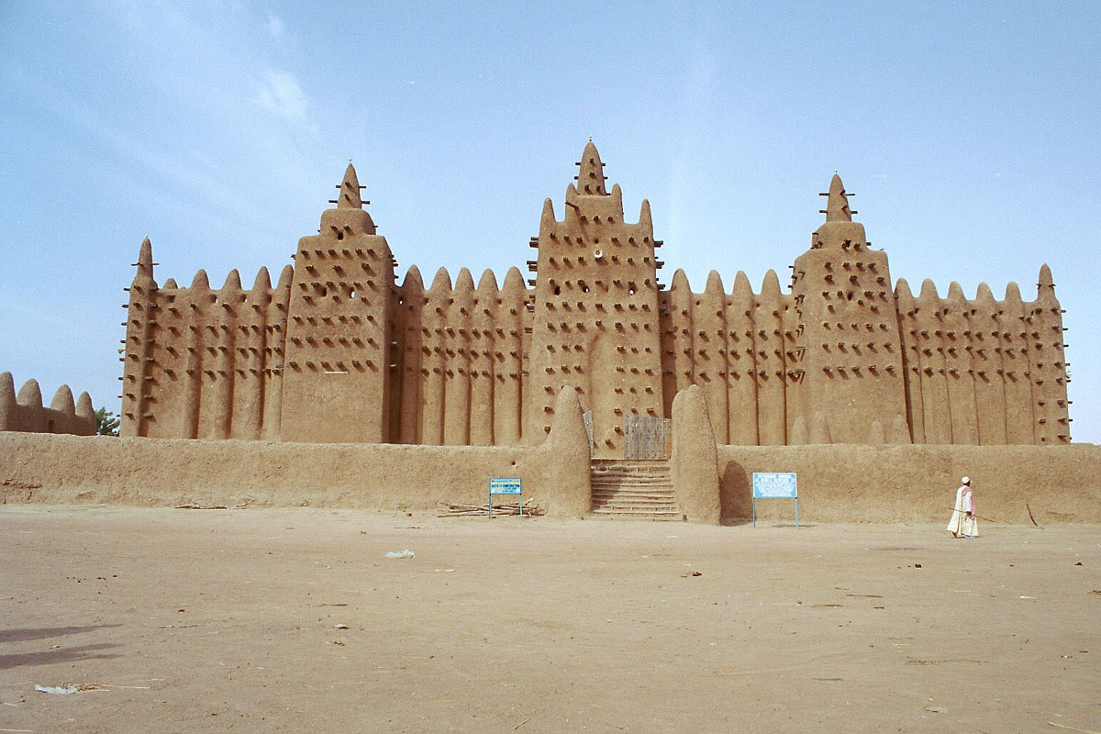
Palace

Slide 25
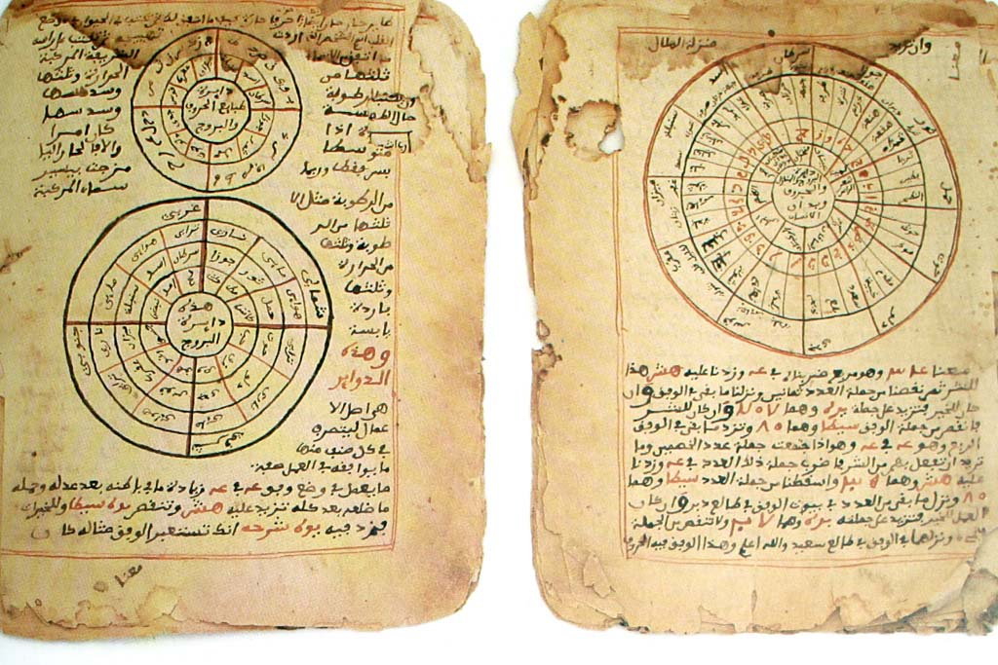
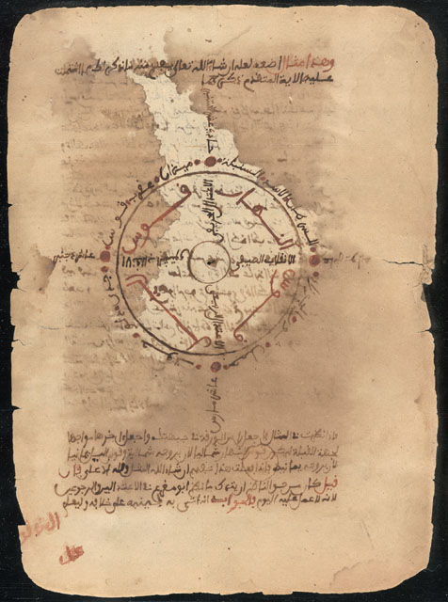
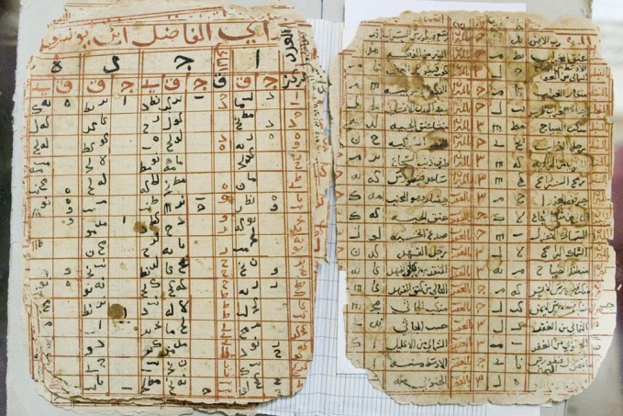
Manuscripts-Astronomy, Math, Korans

Slide 26
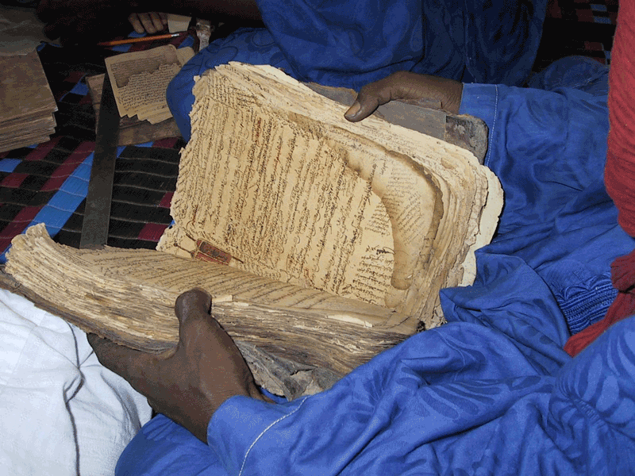
Hundreds of thousands of manuscripts

Slide 27
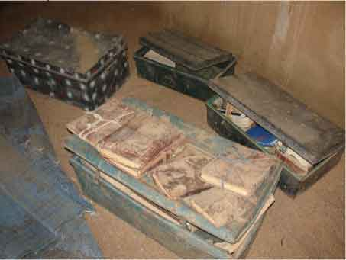
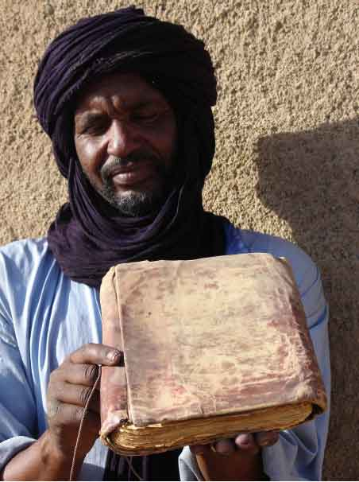
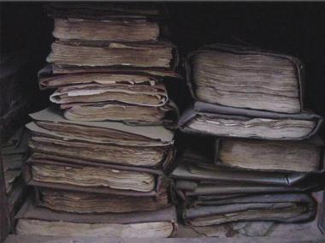
MSs

Slide 28
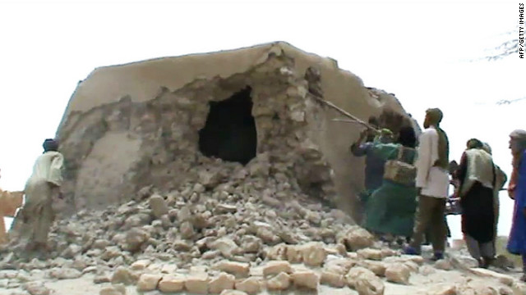
Shrine Destroyed 2013

Slide 29
First prosecution 2015
First individual prosecuted at the International Criminal Court for the destruction of cultural property
Ahmad al-Faqi al-Mahdi
Accused of destruction of nine mausoleums and the Sidi Yahia mosque in Timbuktu,
Which is a UNESCO World Heritage city
Pleaded guilty**
The Guardian, online edition, David Smith “Alleged Militant Appears at The Hague charged with Cultural Destruction in Mali.” Wednesday, September 30, 2015. http://www.theguardian.com/law/2015/sep/30/ahmad-al-faqi-al-mahdi-the-hague-international-criminal-court-mali-timbuktu
**”Jihadist pleads guilty to destroying ancient Timbuktu artifacts” by Tiffany Ap, 8/2/16. http://www.cnn.com/2016/08/22/africa/mali-timbuktu-war-crimes/. Also: https://www.icc-cpi.int/pages/item.aspx?name=pr1236.

