Slide 1
Two Technologies for Improving Interaction and Learning
Presented by
Marcy Krugel
Business Communications
College of Business

Slide 2
Skype for Business
USeeU
Online Presentations, Peer-, and Self- Reviews
FtF Rehearsals and Self-Reviews
Touch-Base Meetings

Slide 3
Session Agenda
What students said about these technologies.
Why I like them.
How they work.
How to get started using them.
What options exist for non-Cengage users.
What other ideas exist.

Slide 4
Student Feedback
One of the most difficult issues with online classes is communicating with teachers or understanding expectations, but using Skype for Business and MindTap’s USeeU really streamlined the process.

Slide 5
Student Feedback
Using Skype for Business for meetings allowed the
teacher to go over our paperwork or coursework.
I enjoyed the two Skype meetings. The meetings gave
me one-on-one attention and helped further my
understanding of the assignments and any feedback
I received from previous assignments.

Slide 6
Student Feedback
USeeU cut down on most of the time spent with the
technical difficulties involved with online presentations.
USeeU was intuitive and made creating presentations with
slides very easy. The USeeU software allowed me to easily upload my pre-
recorded video and to attach the slides. I enjoyed being
able to give real-time feedback on my classmates’
presentations using the program.

Slide 7
Skype for Business Touch-Base Meeting Benefits
Ease of Use
Synchron-ously Working on Papers
Sharing the Desktop
Synchron-ously Reviewing Presenta-tions
Seeing Each Other

Slide 8
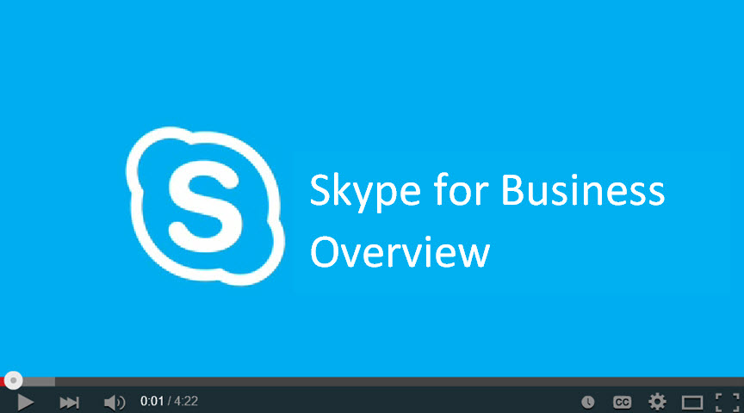
Skype for Business Demonstration
Play me!

Slide 9
Skype for Business Resources
Installation instructions
Lync instructions - for MAC users
SfB instructions developed by FAU’s Center for eLearning
Step-by-Step Skype for Business Video Link
Krugel@fau.edu

Slide 10
MindTap/USeeU Presentation Overview
Play me!

Slide 11
MindTap/USeeU Benefits
Ease of Use
Varied Feedback Modes
Online or Face-to-Face
Presets and Easy Edit Option
Individual or Group Assign-ments
Ability to Upload Student Videos
Response to Student Comments

Slide 12
MindTap/USeeU
Individual Presentation Demonstration
Play me!

Slide 13
MindTap/USeeU Resources
USeeU instructor guide
USeeU student guide
USeeU assignment creation
USeeU group project tutorial
USeeU rubric creation and editing
USeeU assignment grading
Krugel@fau.edu

Slide 14
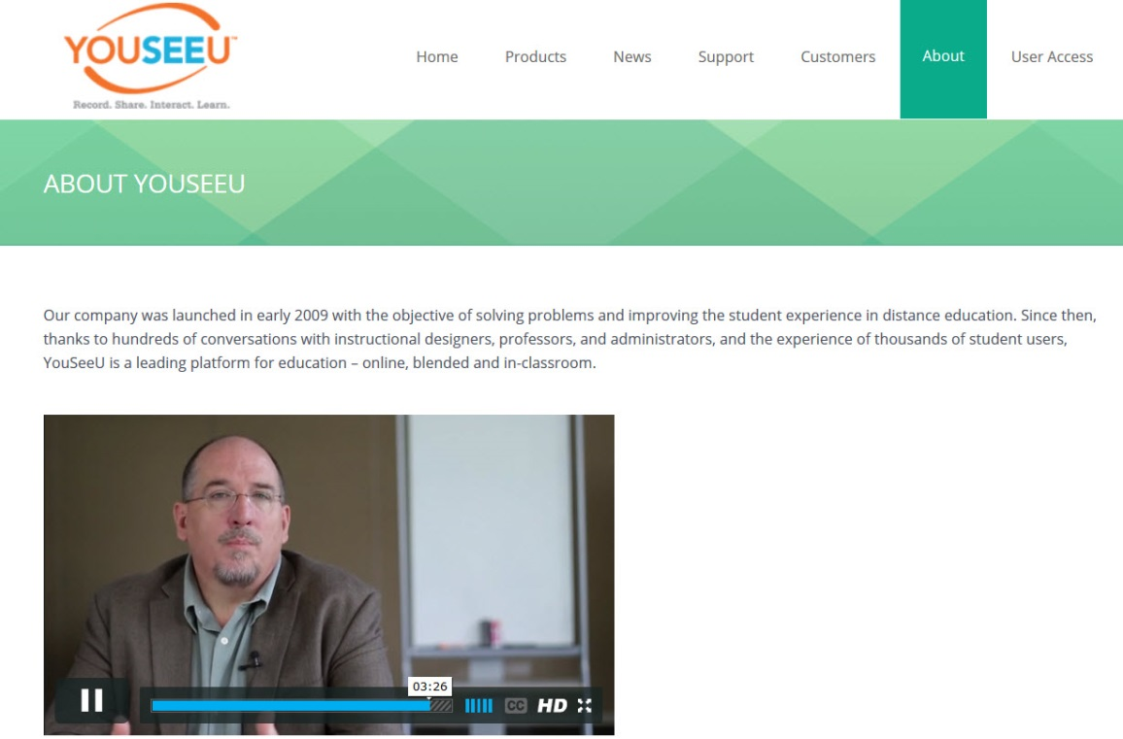
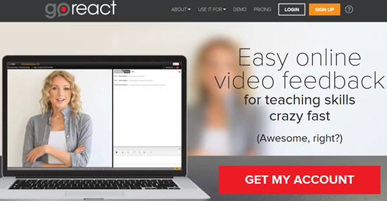
Options for non-Cengage Users
http://www.mheducation.com/highered/platforms/connect.html
http://www.youseeu.com/about/
https://goreact.com/#/

Slide 15
Ideas?
Other

