Slide 1

Workday User Overview
Central Human Resource, Payroll and Financial
Management System
*This overview PowerPoint provides general information regarding Workday. The College of Medicine does not manage nor is responsible for Workday. For more information or question about Workday, please contact the Florida Atlantic University’s Workday webpage or the training webpage for Workday.
Version 1.0 05/31/2022

Slide 2

What is Workday?
What is Workday
Workday is Florida Atlantic University’s (FAU) cloud-based application software that enables human resources, payroll, and financial functions. Workday has a modern interface and delivers service over the internet and stores all information in the cloud, eliminating the need to store and protect the data locally. Workday services provides FAU’s faculty, staff, and students with the tools they need to be successful at FAU.
Key Benefits and Features of Workday
Integrated with FAU’s single sign-on (SSO) which leverages your FAU credentials to access Workday
Personnel profiles are stored in Workday, including hiring information, names, titles, department, etc.
Workday is flexible and is focus on providing functionality specific to higher education
Workday integrates multiple modules beyond just human resource, payroll, and financial functions
The robust features of Workday allows users to access vital information so that they can make strategic decisions and further support the important contributions they make everyday

Slide 3
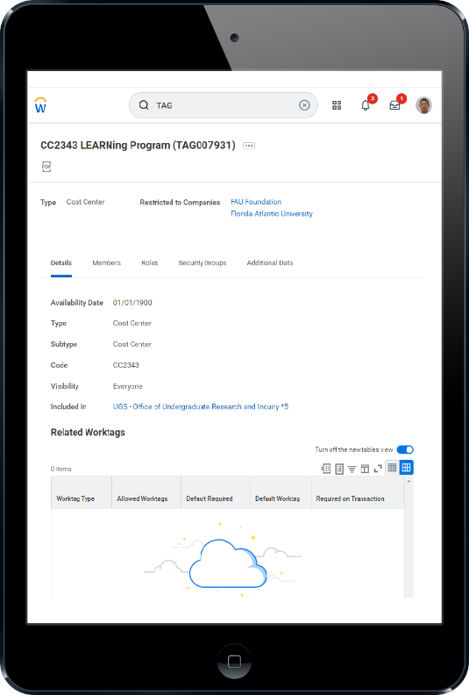
Workday’s Additional Benefits
Additional Benefits
Since Workday is web-based, it can be accessed anywhere there is an internet connection
Intuitive UX which allows the user to utilize and view Workday on various mediums (computer, tablet, and cell phones)
Houses a library of “FAU Job Aids” which provides users with numerous function specific guidelines
Has a robust in-system “notification” and “inbox” indicator that alerts users of specific notifications or tasks assigned to them
Users manage their own profile, including time off requests, benefits, and performance evaluations
Allows users to run specific reports relating to their employment and assigned tasks

Slide 4
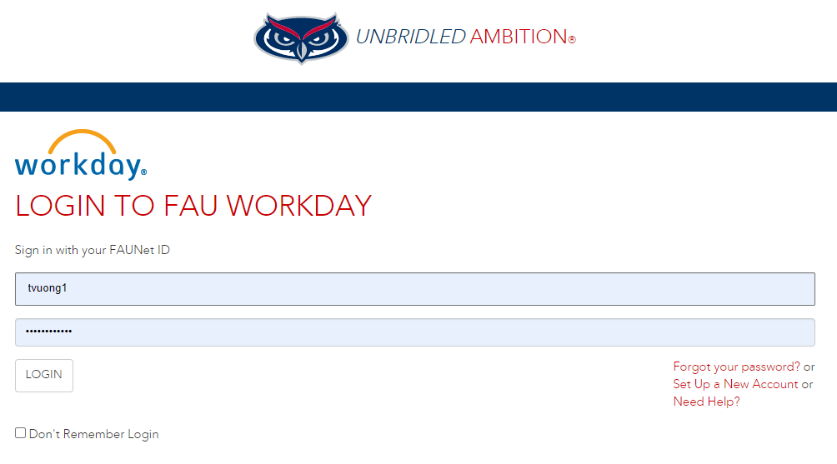

How to Log into Workday
Access Workday at: https://www.fau.edu/workday/
Utilize your FAU’s single sign-on (SSO) credentials (FAUNet ID) to access Workday
Workday requires duo authentication (Duo Mobile App) which users can confirm sign via a landline (office) or mobile device

Slide 5
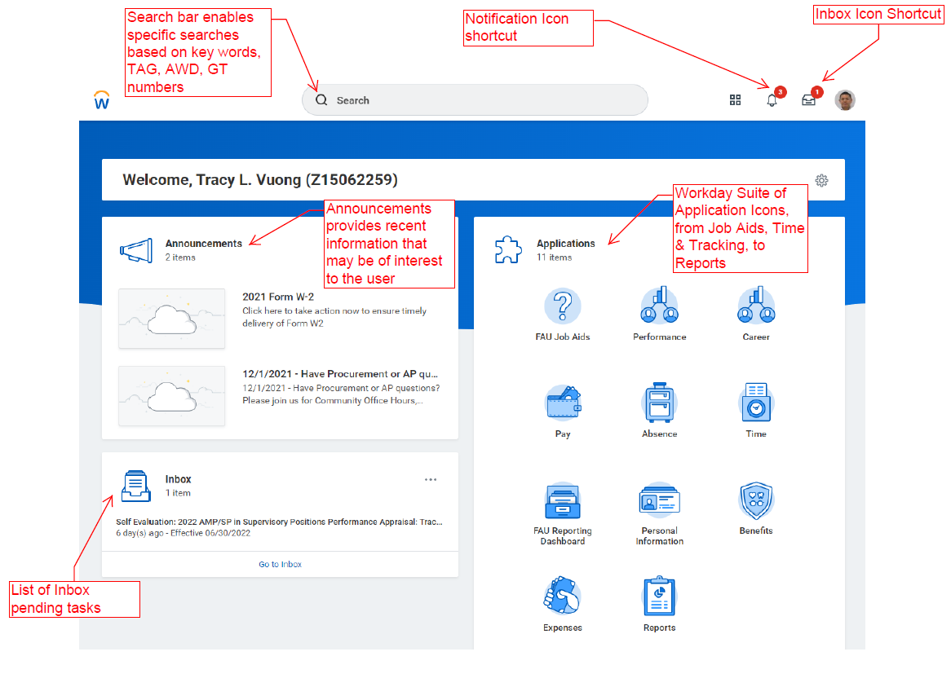
How to Navigate Workday
Navigating the Home Screen
Depending on your access level, the home screen is separated in box form (Announcement, Application, and Inbox)
The top search field allows for quick searches, i.e. AWD, TAG, GT numbers, individuals, etc.
The “Announcement” section provides users with important announcements pertaining to them
The “Inbox” section indicates how many messages/tasks is currently pending for the user

Slide 6
How to Navigate Workday (Cont.)
Navigating the Home Screen (Cont)
The “Application” section contains a suite of icons that are specific to the user
User can access their employment or human resource information, pay, personal information, etc.
Additionally, users can submit time off request (annual/sick/etc.) utilizing the “Time” icon
FAU Workday Job Aids and other useful icons are located in the Application section

Slide 7
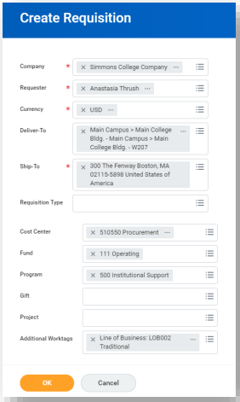
Research Related Purchases & Workday
Making Research Related Purchases
Purchases – Making research-related purchases can occur through multiple methods. Please consult with your COM Department Administrator for additional information prior to making your initial purchase. Common research-related purchasing options include:
  pCard (Purchasing Card)
  Create Requisitions
  Create Requisition Punchout
Contact the COM Department Administrator for more Assistance

Slide 8
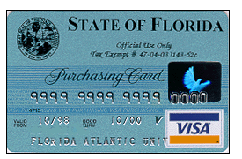
FAU Purchasing Card (pCard)
Purchasing Card (for more information please visit the FAU pCard webpage)
The VISA Purchasing Card (pCard) enables individuals the convenience of purchasing commodities, equipment, supplies, and more without the standard purchase orders, limited purchase orders, or blanket purchase orders. Designed for handle and expedite small orders in an efficient manner and reduce overhead
Cardholders must be approved by their Deans/Directors/Department Heads. Stipulations are in place to control spending limits and commodity codes
Purchases with the pCard are unencumbered transactions until they are paid. For pCard charges to grants, the user must provide justification (how the purchase is related to the specific grant award)
Individuals must attend an online training course, prior to being approved a pCard
Contact the COM Department Administrator for more Assistance

Slide 9
Creating Requisitions for Research-Related
Purchases in Workday
Create Requisition
Workday allows for purchases of research-related items through the “Create Requisitions” process.
In order for a requisition to be created, the vendor in which the item is being purchased from must already be established in Workday. If the vendor is currently not in Workday, the vendor must first be created via “Create Supplier Request” (contact your COM department administrator for assistance)
Once a requisition is completely filled out, the Purchasing Department will review and approve (if there are no issues) of the requisition, thus creating a “Purchase Order”. For complete details please refer to the “Workday Create Requisition” job aid
Create Requisition Punchout
Similar to creating a requisition, this option allows for purchases of items utilizing the “punchout” option, which is a contract that has been integrated in Workday to the supplier’s direct website to procure goods.
Benefits of a punchout is that it is a real time contract which expedites the electronic ordering portal from the supplier to FAU. Available Workday Punchout Contracts includes Office Depot, Fisher Scientific, Staples, etc.
Contact the COM Department Administrator for more Assistance

Slide 10

Creating Expense Reports & Spend Authorizations
Expense Reports & Spend Authorizations
Expense Reports – Purchases made by a pCard show up in Workday as “expense reports” and need to be processed for approval. The Principal Investigator (PI) will need to provide a detailed invoice for each purchase and confirm the Workday SmartTAG associated with that purchase. Workday SmartTAGs are TAG numbers that are established with a specific account (i.e. TAG001234 is linked to NIH award 5R01CA654321-01)
Spend Authorizations – Are prior approval request processed in Workday for future travel or expenses relating to a travel. A spend authorization must be created and completed in advance of traveling and routed for approval (i.e. Cost Center Manager, Research Accounting, etc.). The PI must provide detailed information of the travel, including the purpose, estimated costs (airfare, hotel, transportation, conference fees, etc.), and the SmartTAG to be charged.
Contact the COM Department Administrator for more Assistance

Slide 11
Other Common Research-Related Workday Tasks
Additional Research-Related Workday Tasks
Approvals – As the PI on a project, there are certain research-related tasks (initiated by others) in Workday that will require PI approval before it can be processed. These include:
    Per-diem expenses/bills (Internal Service Delivery)
    Subaward invoices (Supplier Invoice)
    Core Facilities charges (Internal Service Delivery)
Effort Certification – The PI will be required to “certify effort” levels on a particular project in Workday. The Office of Research in the College of Medicine will reach out to the PI and confirm that the effort certification has been pre-reviewed and that it is ready to be approved. For PIs that have not certified effort before, the Office of Research will provide a “cheat-sheet” that will guide the PI on how to approve.
Contact the COM Office of Research for more Assistance

Slide 12
Trainings, Technical Difficulties or Assistance
For training requests or technical difficulties with Workday, please access or contact the FAU Workday webpage or training webpage for assistance. Additionally, you can contact your COM Department Administrator for further guidance:

