Slide 1
Federal Student Loan Repayment and Forgiveness
Ms. Ellen M. Gomes
Director of Medical
Student Financial Aid

Slide 2
Agenda
When Repayment of Federal Student Loans Begins
Different Repayment Plan Types
The MedLOANS Organizer & Calculator
Loan Repayment Examples
Status of Federal Student Debt Relief Plan
Student Loan Repayment and Interest Accrual Pause
Questions

Slide 3
When does Repayment Begin?
Repayment of Federal Student Loans begins after your six month grace period, which begins after you graduate or stop attending school at least half-time.
If you graduate in April, repayment should begin in or near October, and if you graduate in May repayment should begin in or near November

Slide 4
When does Repayment Begin (cont.)?
If you previously entered repayment on any Federal student loan(s), those loans do not have a new six month grace period. They will reenter repayment once you graduate.
If you do not want to make payment on any of your loans until after your new loans’ six month grace period, you will need to request forbearance for the loans without a grace period. This may be done through your loan servicer or at studentaid.gov

Slide 5
Standard 10 Year Plan
(The Default Plan)
The default plan if you do not select an income based plan
Payment is the monthly amount required to repay the loan in full after 10 years

Slide 6
Income Based Repayment Plan (IBR)
A 25 Year Plan
Payment is 10% of Discretionary Income (Your income less 150% of the poverty guideline for a HH your size) for new borrowers as of 7/1/14; or 15% of Discretionary Income for borrowers who had outstanding Federal student loan debt on 7/1/14, up to the payment cap of the 10 year plan payment amount
Any balance due after 25 years of payments is forgiven, and the forgiven amount is taxable income to you in the year it is forgiven
Public Service Loan Forgiveness available for any balance due after you have made 120 on-time payments while employed by a qualifying non-profit employer. The forgiven amount is not treated as taxable income

Slide 7
Pay As You Earn (PAYE)
Repayment Plan
A 20 Year Plan
Payment is 10% of discretionary income (your income less 150% of the poverty guideline for a HH your size), up to the payment cap of the 10 Year plan payment amount
Any balance due after 20 years of payments is forgiven, and the forgiven amount is taxable income to you in the year it is forgiven
Public Service Loan Forgiveness available for any balance due after you have made 120 on-time payments while employed by a qualifying non-profit employer. The forgiven amount is not treated as taxable income

Slide 8
Revised Pay As You Earn (REPAYE)
Repayment Plan
A 25 Year Plan
Payment is 10% of Discretionary Income (Your income less 150% of the poverty guideline for a HH your size (There is no payment cap in this plan)
If your monthly interest accrual is greater than your payment amount, half of the difference between the two is immediately forgiven. This will normally result in a smaller balance due after residency than if you used the IBR or PAYE plan, as not all accrued interest is added to your balance due
Any balance due after 25 years of payments is forgiven, and the forgiven amount is taxable income to you in the year it is forgiven
Public Service Loan Forgiveness available for any balance due after you have made 120 on-time payments while employed by a qualifying non-profit employer. The forgiven amount is not treated as taxable income

Slide 9
MedLoans Organizer and Calculator (MLOC)
The MLOC is found on the AAMC website. You can download your student loan data from studentaid.gov and upload it into the organizer. Once you have done that, you will go to the calculator. First you will estimate the length of residency/fellowship, estimated residency and 1st year in practice salaries, and then you can view estimated payment amounts in the various payment plans

Slide 10
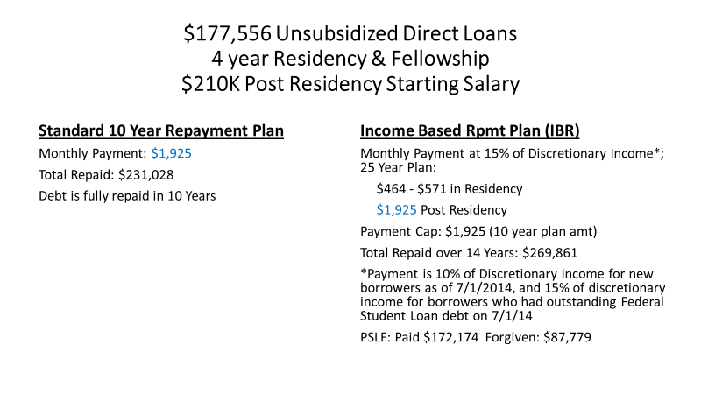

Slide 11
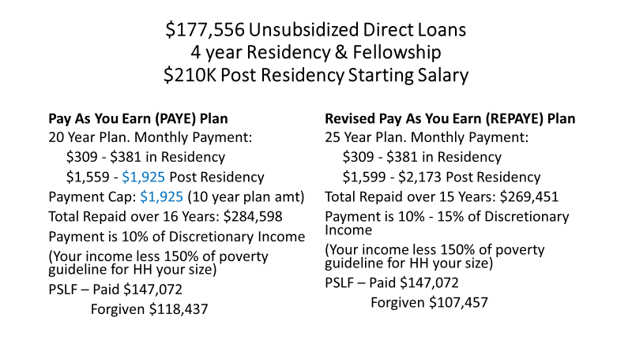

Slide 12
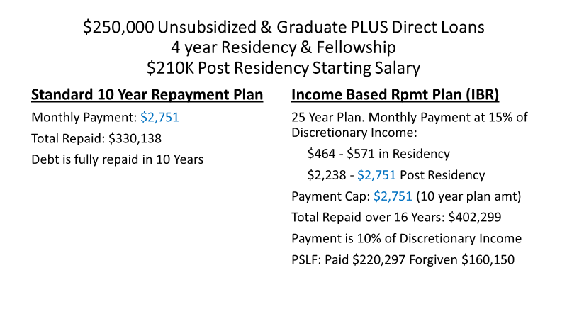

Slide 13
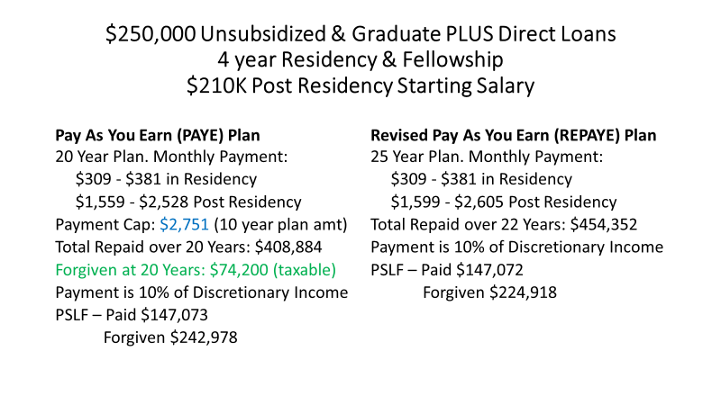

Slide 14
Federal Student Loan Debt Relief Plan
Student Debt Relief is currently blocked
Courts have issued orders blocking the program, and
we are waiting on the Supreme Court to make the final decision.
Eligible Loans:
1. William D. Ford Direct Loans (Direct Loans)
2. Federal Family Education Loans (FFEL Loans) held by the
Department of Education (ED)
3. Federal Perkins Loan held by ED
4. Defaulted Loans held by ED
*Applies only to loan balances you had before June 30, 2022*

Slide 15
Federal Student Loan
Debt Relief (Cont.)
Amount(s) to be Forgiven
1. Up to $20,000 if you received a Federal Pell Grant in College and meet
the income requirements
2. Up to $10,000 If you did not receive a Federal Pell Grant in College and
meet the income requirements
3. Forgiven amounts are not taxed at the Federal level, but some states
have said they will be taxed at the state level.
4. Only outstanding balances due may be forgiven. If you only owe
$5,000, then that is the maximum that can be forgiven.

Slide 16
Federal Student Loan Debt Relief (Cont.)
Refunds for Past Payments
From ED:
If you made voluntary payments during the payment pause and your current loan balance is below the amount of debt relief you’ll receive, after you successfully apply for and receive debt relief under the Administration's debt relief plan, we’ll automatically refund the amount you paid during the payment pause (only up to the remaining amount of your eligible debt relief).

Slide 17
Income Requirements to Qualify for
Federal Student Loan Debt Relief
Tax Filing Status
2020 or 2021 Income (AGI)
Did not file Taxes
Single
Married Filing Separately
Married Filing Jointly
Head of Household
Qualifying Widow(er)
Made less than required to file
Under $125,000
Under $125,000
Under $250,000
Under $250,000
Under $250,000

Slide 18
Federal Student Loan Payment
and Interest Accrual Pause
When Repayment is Scheduled to Restart
The current Payment pause is scheduled to end on June 30, 2023 or when the Supreme Court issues its decision regarding Federal Student Loan Debt Relief, whichever is earlier.
Interest on Federal Student Loans is scheduled to begin/restart accruing on all disbursed funds at the end of the payment pause

Slide 19
To Receive Updates on
Federal Student Loan Debt Relief
From ED:
Subscribe and check back here for updates. The Website is: https://www.ed.gov/subscriptions We will also post information as soon as further updates are available.
Please contact your Financial Aid Office for questions about your individual situations.

Slide 20
Questions?

