Slide 1
Novelution Financial Conflict of Interest Module (FCOI)
Presented by: The Office of Sponsored Programs &
The Office of Research Integrity

Slide 2
Introducing the Novelution FCOI Module
What is the FCOI Module
Novelution’s robust Financial Conflict of Interest (FCOI) module provides seamless electronic disclosure and management for both annual “Significant Financial Interest” (SFI) and “Project-Specific Disclosures”. All disclosures will now be submitted, reviewed, managed, and approved electronically and will be centrally housed within Novelution.
Key Benefits
Seamless disclosures, management, and transparency that reduces investigator burden
Replaces the traditional SFI “paper” or “PDF” disclosure form
Eliminates having to print&scan/email/pass around the SFI disclosure form for signatures
Eliminates the requirement of having to submit a SFI disclosure form for each proposal
SFI disclosures are valid for 12 months with updates/renewal accessible any time

Slide 3
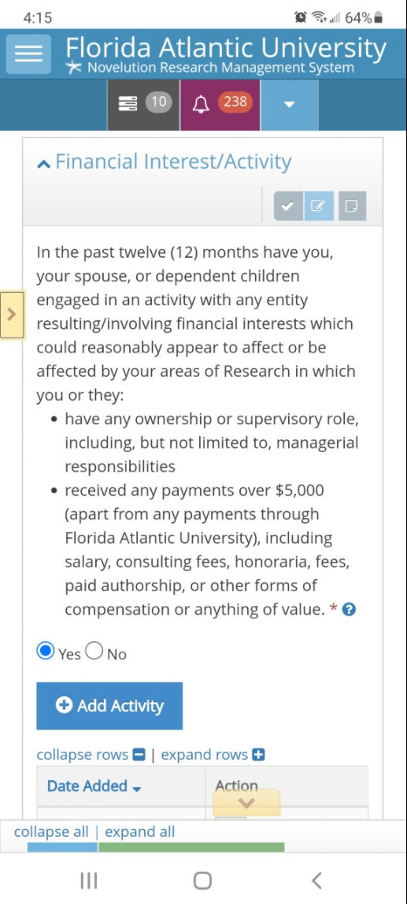
Novelution’s Additional Benefits
Additional Key Benefits
Since Novelution is web-based, it can be accessed anywhere there is an internet connection and users can update their FCOI disclosures utilizing their FAU Single-Sign-On username and password
In-system task reminders when a SFI or Project-Specific Disclosure is required
The FCOI Module works directly with the Sponsored Research Module which makes FCOI routing requirement seamless
Project-Specific Disclosures are only required if the project has been awarded and if there was a SFI disclosed
Each SFI update/renewal automatically extends the disclosure to be active for an additional 12 months

Slide 4
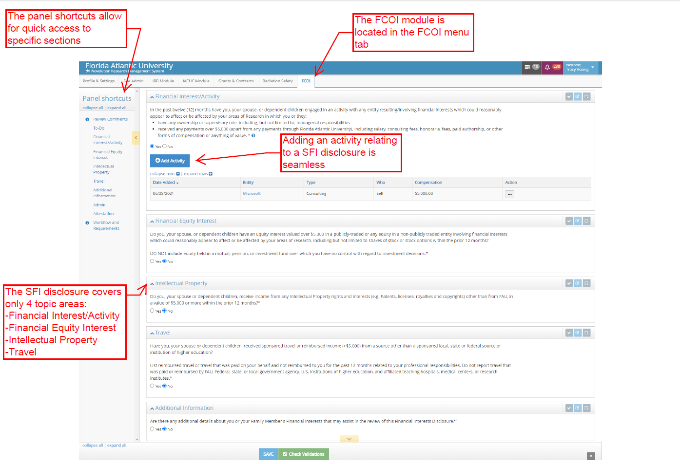
Novelution FCOI Module Interface and How to Navigate

Slide 5
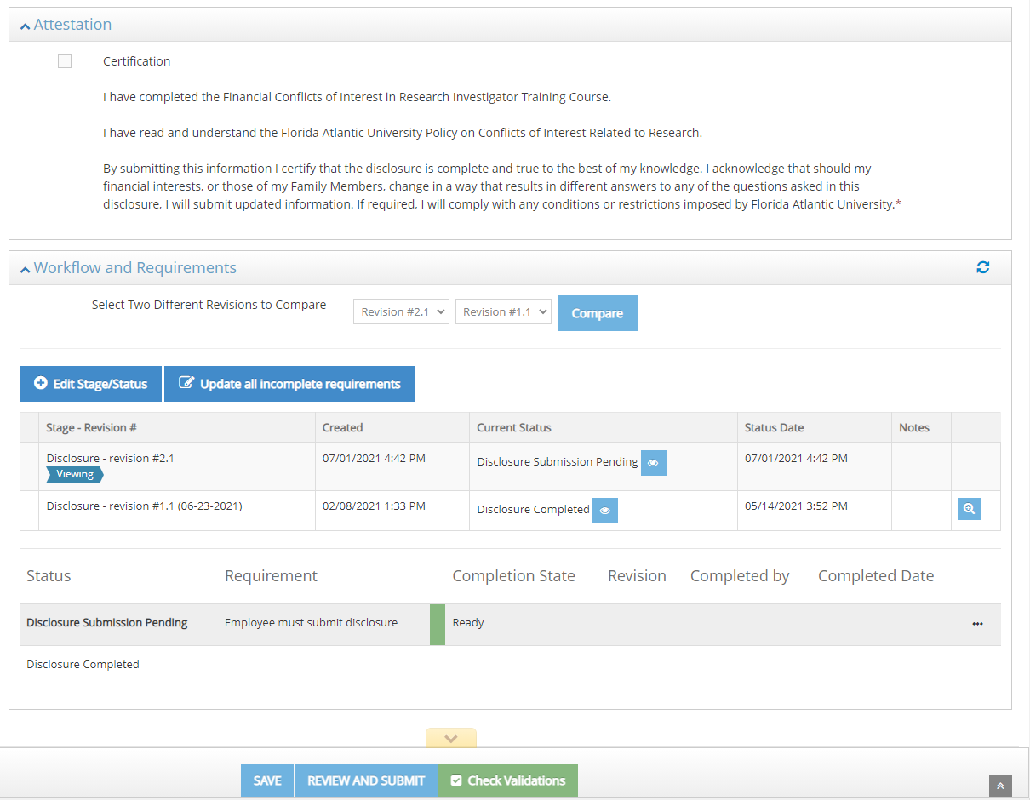
SFI Disclosure Topic Areas and Submission
SFI Four Topic Areas and Submission
The SFI disclosure covers four topic areas, including Financial Interest Activity, Financial Equity Interest, Intellectual Property, and Travel
To complete each topic area, the user will review the topic area question and answer either “Yes” or “No” utilizing the radio buttons
If the answer is “No”, the user can move on to the next question
If the answer is “Yes”, the user will need to further detail the disclosure. The system will populate additional questions when a selection is yes
User can also provide additional information in a separate box to provide further details that may assist reviewers
After attesting, submission is a simple click of a button. No additional approval is required. There will be no additional action needed until either; 12 months have passed, the project is awarded, and/or there has a been a change in the disclosure

Slide 6
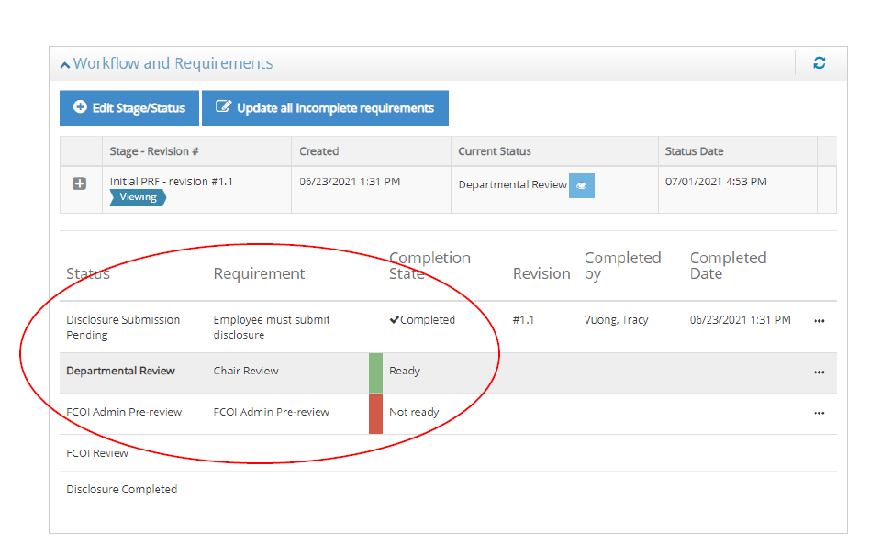
Project-Specific Disclosures
Project-Specific Disclosures
Are only required if, there was a SFI disclosure and the project has been awarded
This section involves describing how the entities the investigators are involved with outside of FAU do or do not relate to their research within FAU
Novelution will auto-generate notification(s) and task(s) for the investigator to complete the project-specific disclosure
Review, management, and approval from the department Chair, FCOI Committee, or others will be seamless and transparent through the workflow history

Slide 7
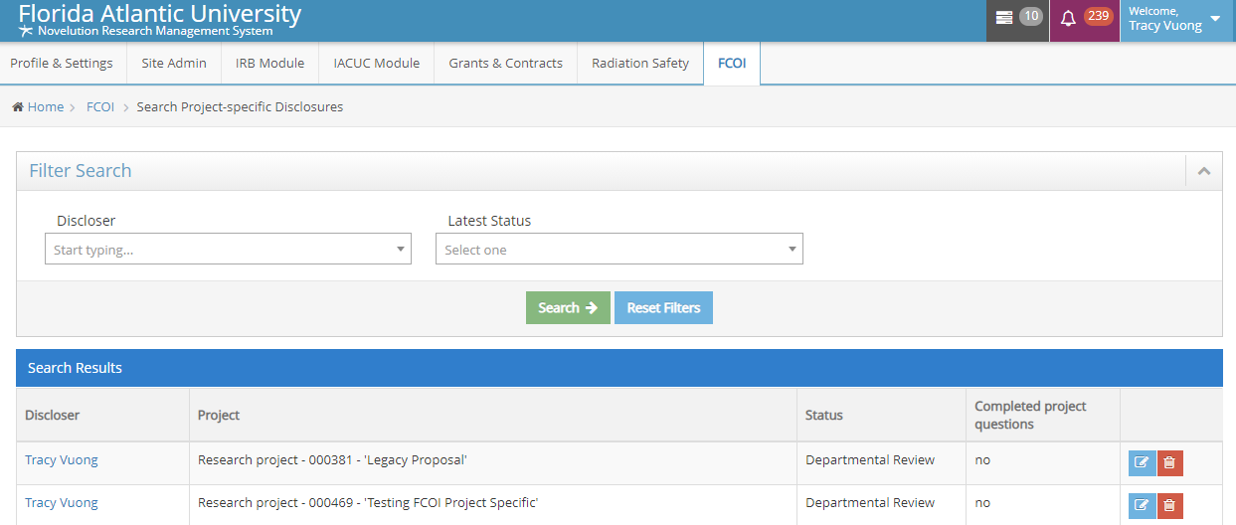
Users are in Control of their own Disclosure
Managing and Tracking Disclosures
Users can manage or review past disclosures
All submitted disclosures remain in the user’s FCOI module profile
Users can search past disclosures including project-specific disclosures
Approval documents or management plans will also be uploaded in the users’ FCOI module profile

Slide 8
Final Thoughts and Questions
Final Thoughts and Questions
The Novelution FCOI module is a robust financial conflict of interest management and tracking tool
The FCOI module leverages the Sponsored Research module which makes the submission and tracking of disclosures seamless within one system
Users can view and update disclosures at anytime which gives them more control over their disclosures
In system notifications makes sure the user is always in compliance and reduces additional burden

